Slide 1
形容词 -Unit 9 What does he look like? Section A 第一课时
华南师范大学外国语言文化学院 许悦彤
广东省河源市紫金县紫城第三中学 杨宇燕

Slide 2
Learning Objectives
学习目标
New words: curly, tall, short, medium, height, thin, heavy, (be)of medium height/build
Key sentences:
- What does he/she look like?
- He/She is tall and has long hair.

Slide 3
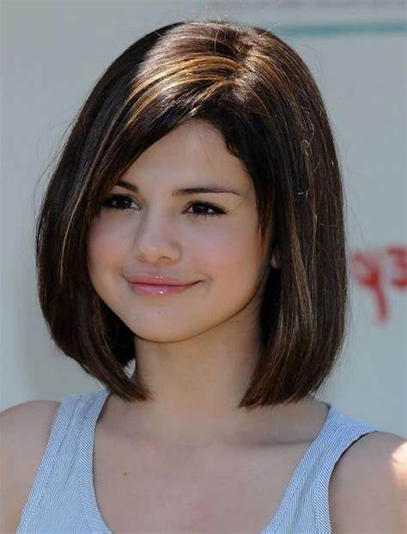
New Words
short hair
straight hair
black hair
long hair
straight hair
black hair
back

Slide 4
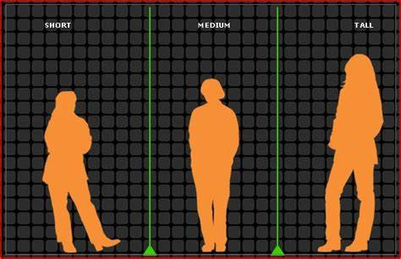
New Words
short
of medium height
high
back

Slide 5
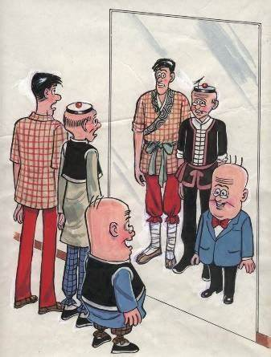
New Words
thin
heavy
of medium build
back

Slide 6
Key sentences: be动词和have/has – 描述人的外貌
I/ You/ He/ She
have/ has
short hair.
straight hair.
am/ are/ is
tall.
long hair.
curly hair.
short.
fat/ heavy.
thin.
back

Slide 7
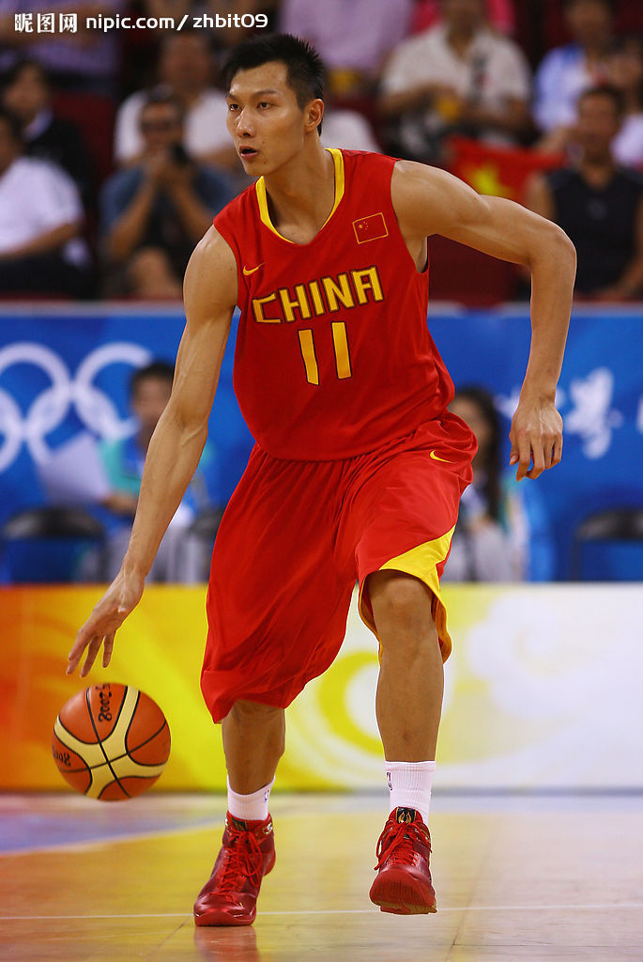
Key sentences: Let’s have a try!
易建联
Yi Jianglian
What does he look like?
He is tall.
back

Slide 8
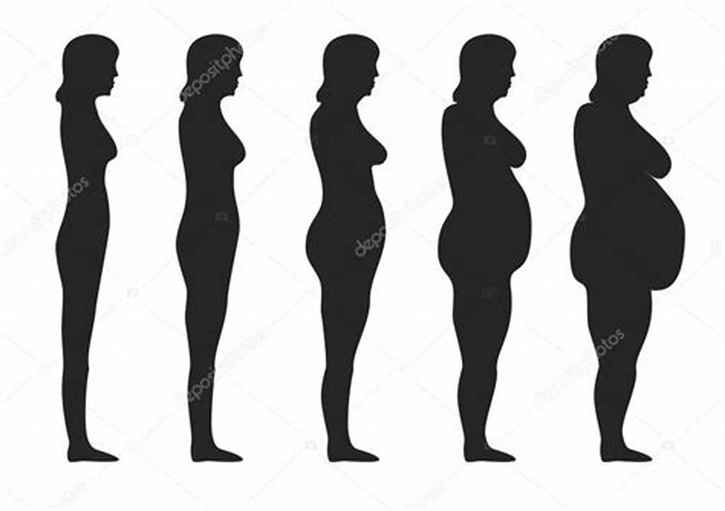
Key sentences
What does she look like?
She is thin.
She is heavy/ fat.
She is of medium build.
back

Slide 9
Key sentences: summary 小结
询问某人特貌特征：
What do/ does +主语+look like?
回答：
主语+be+形容词
主语+have/has +（形容词）+名词
back

Slide 10
Who Says
Let’s enjoy a song!

Slide 11
I wouldn’t want to be anybody else.

Slide 12
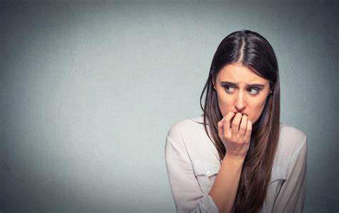
You made me insecure.

Slide 13
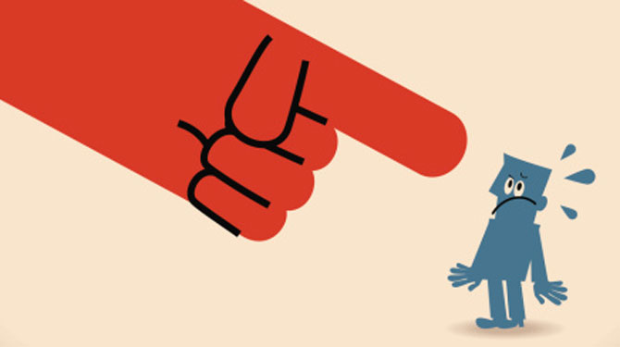
Told me I wasn’t good enough.

Slide 14
But who are you to judge

Slide 15
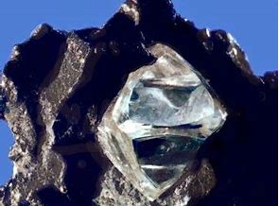
When you re a diamond in the rough?

Slide 16
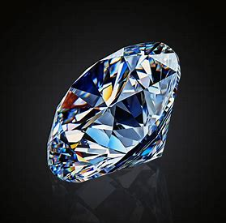
I’m sure you got some things.

Slide 17
You’d like to change about yourself.

Slide 18
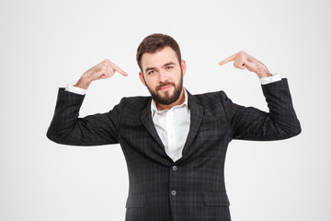
But when it comes to me,

Slide 19
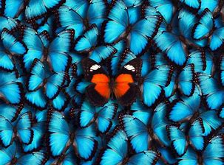
I wouldn’t want to be anybody else.

Slide 20
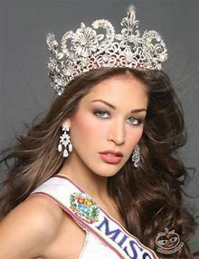
I’m no beauty queen.

Slide 21
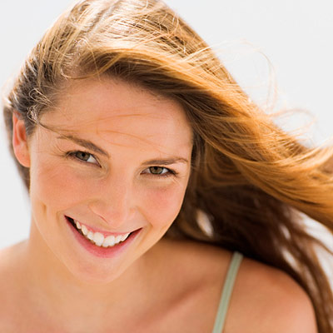
I’m just beautiful me.

Slide 22
You’ve got every right

Slide 23
To a beautiful life.

Slide 24
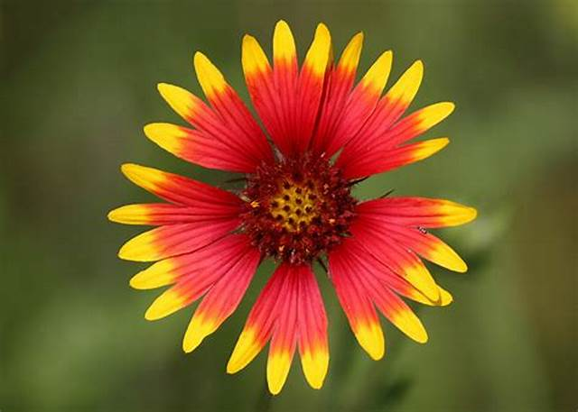
Who says?
Who says you’re not perfect?

Slide 25
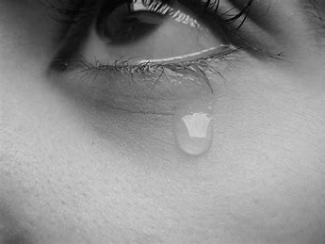
Who says you’re not worth it?

Slide 26
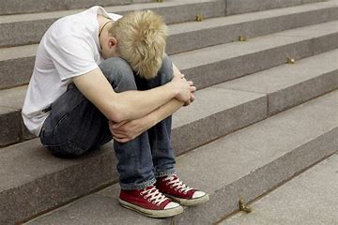
Who says you’re the only one that’s hurting？

Slide 27
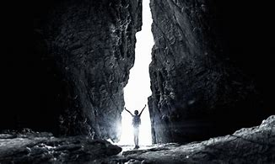
Trust me that’s the price of beauty.

Slide 28
Who says you’re not pretty?
Who says you’re not beautiful?
Who says?

Slide 29
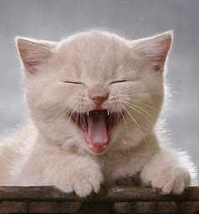
It’s such a funny thing.

Slide 30
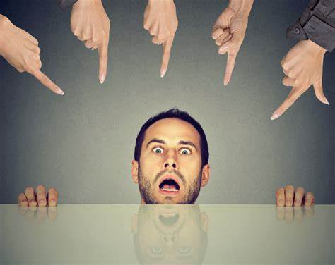
How nothing’s funny when it’s you.

Slide 31
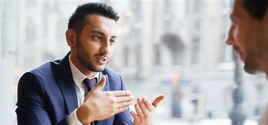
You tell them what you mean.

Slide 32
But they keep whiting out the truth.

Slide 33
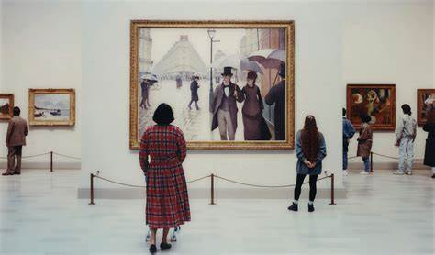
It’s like a work of art

Slide 34
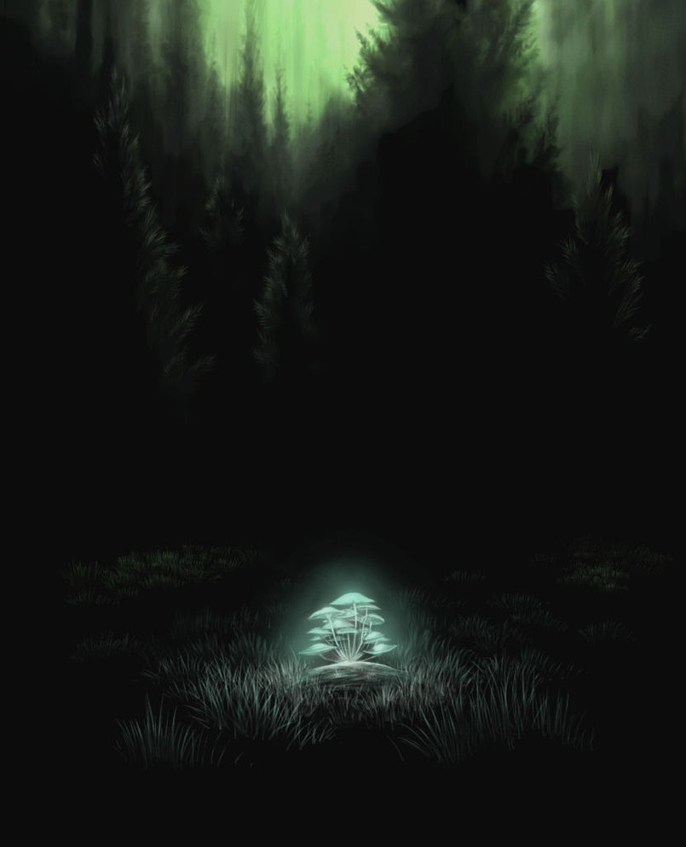
That never gets to see the light.

Slide 35
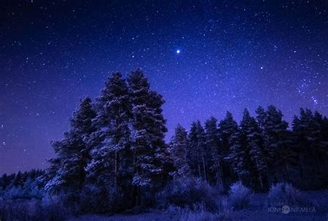
Keep you beneath the stars

Slide 36
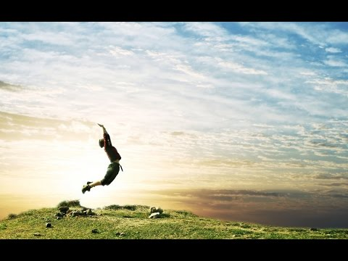
Won’t let you touch the sky.

Slide 37
I’m no beauty queen.

Slide 38
I’m just beautiful me.

Slide 39
You’ve got every right

Slide 40
To a beautiful life.

Slide 41
Who says?
Who says you’re not perfect?

Slide 42
Who says you’re not worth it?

Slide 43
Who says you’re the only one that’s hurting？

Slide 44
Trust me that’s the price of beauty.

Slide 45
Who says you’re not pretty?
Who says you’re not beautiful?
Who says?

Slide 46
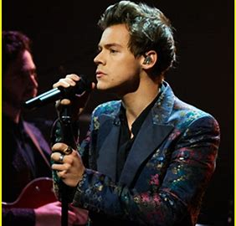
Who says you’re not star potential?

Slide 47
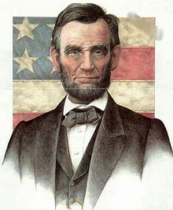
Who says you’re not presidential?

Slide 48
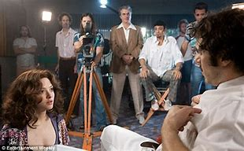
Who says you can’t be in movies?

Slide 49
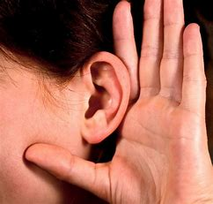
Listen to me, listen to me.

Slide 50
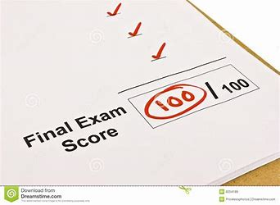
Who says you don’t pass the test?

Slide 51
Who says you can’t be the best?
Who said? Who said?
Won’t you tell me who said that?

Slide 52
Who says?
Who says you’re not perfect?

Slide 53
Who says you’re not worth it?

Slide 54
Who says you’re the only one that’s hurting？

Slide 55
Trust me that’s the price of beauty.

Slide 56
Who says you’re not pretty?
Who says you’re not beautiful?
Who says?

Slide 57
Who says?
Who says you’re not perfect?

Slide 58
Who says you’re not worth it?

Slide 59
Who says you’re the only one that’s hurting？

Slide 60
Trust me that’s the price of beauty.

Slide 61
Who says you’re not pretty?
Who says you’re not beautiful?
Who says?

Slide 62
Thanks for listening!
华南师范大学外国语言文化学院 许悦彤
广东省河源市紫金县紫城第三中学 杨宇燕

