Slide 1
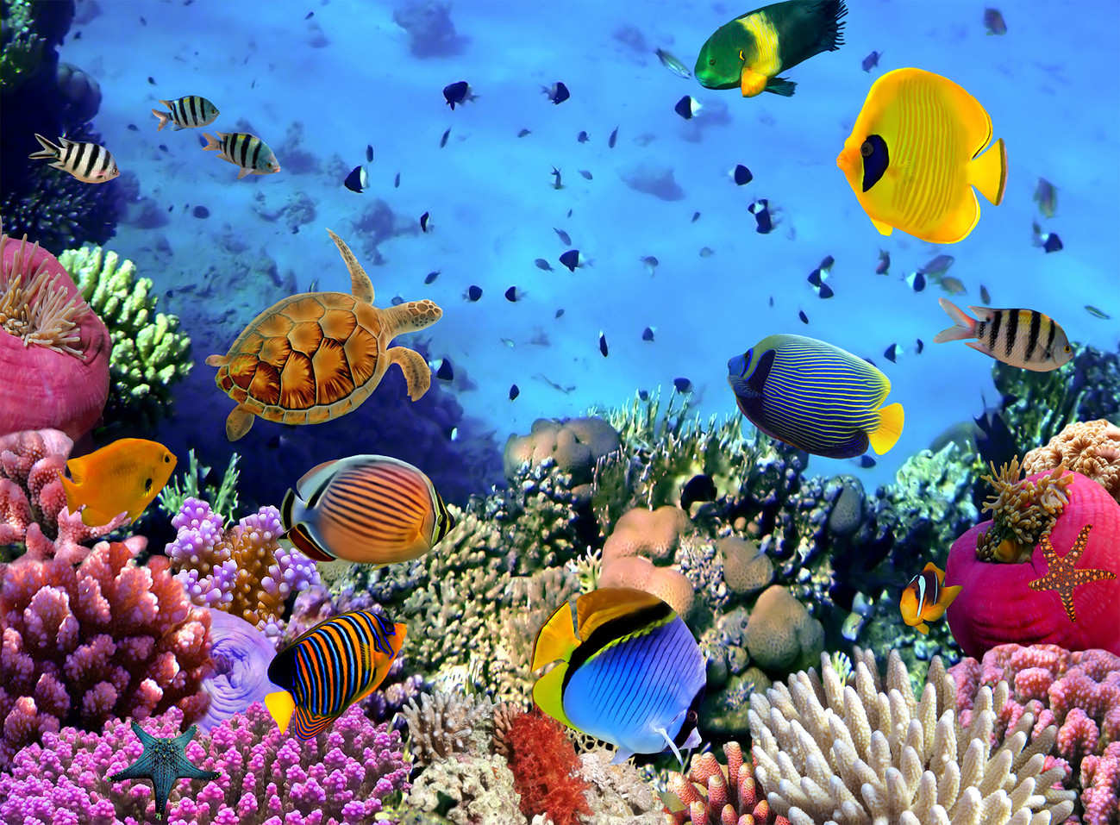
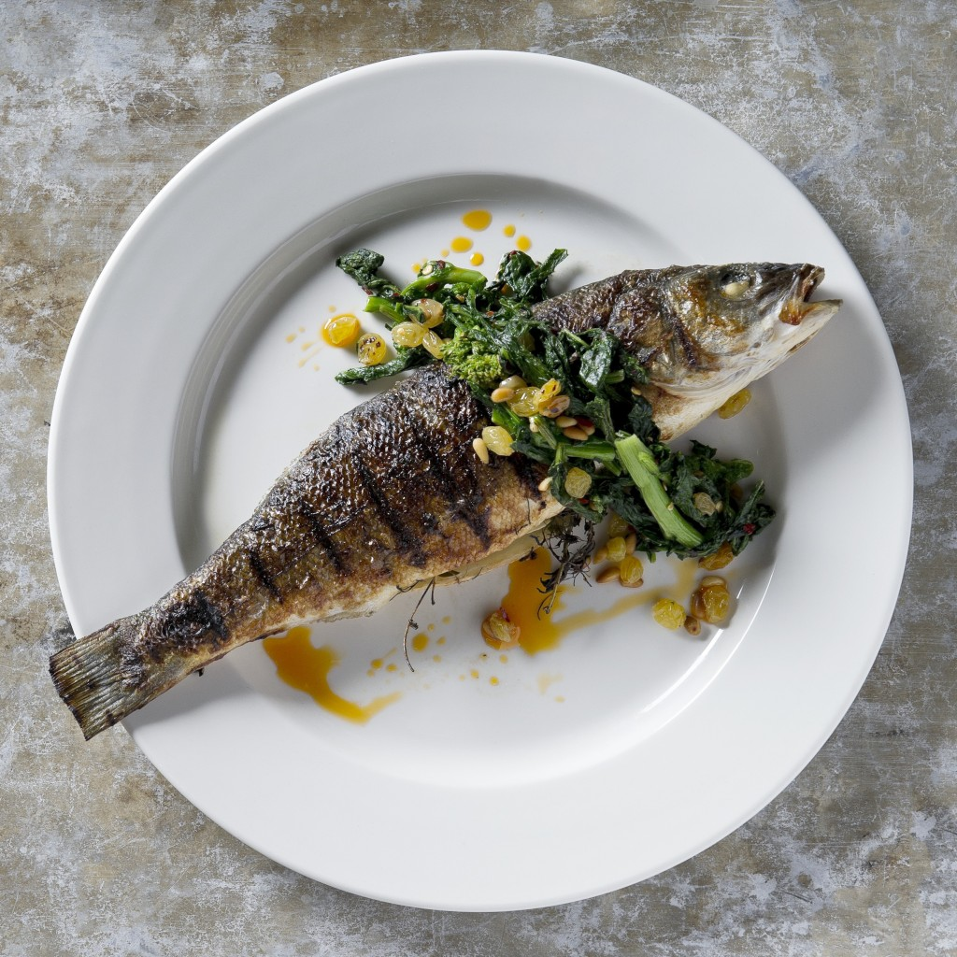
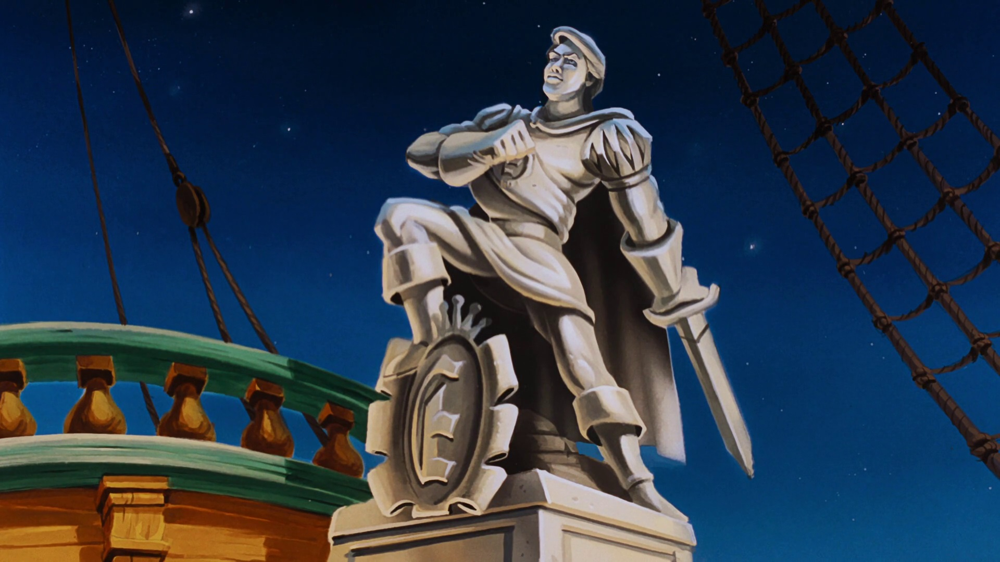
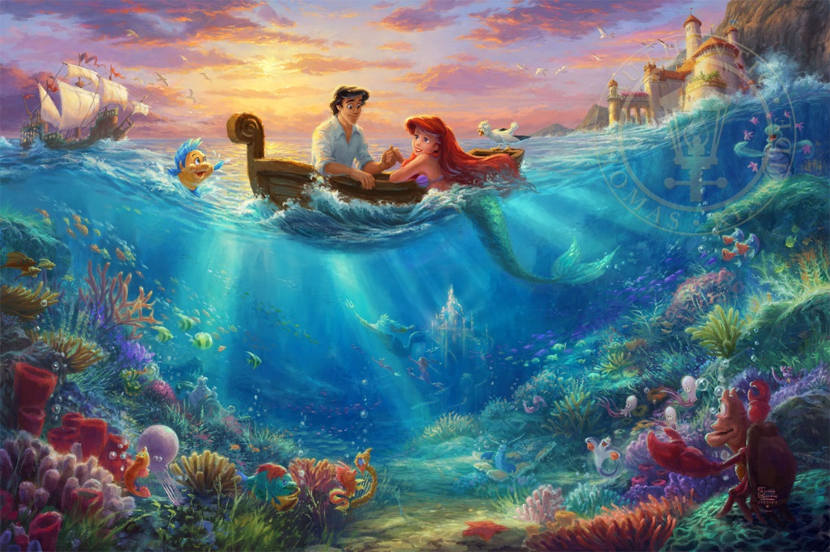
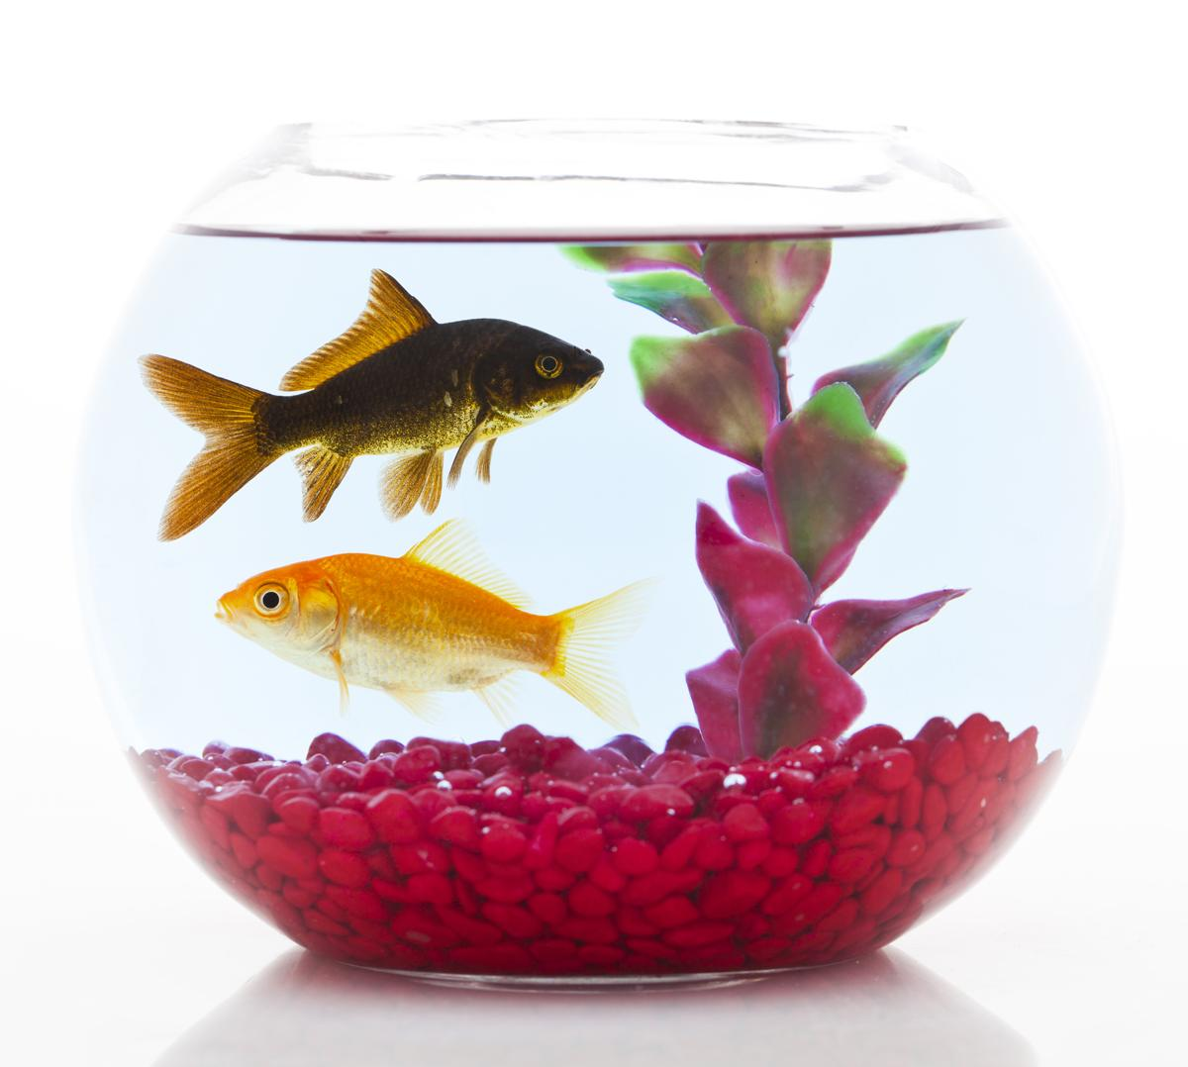
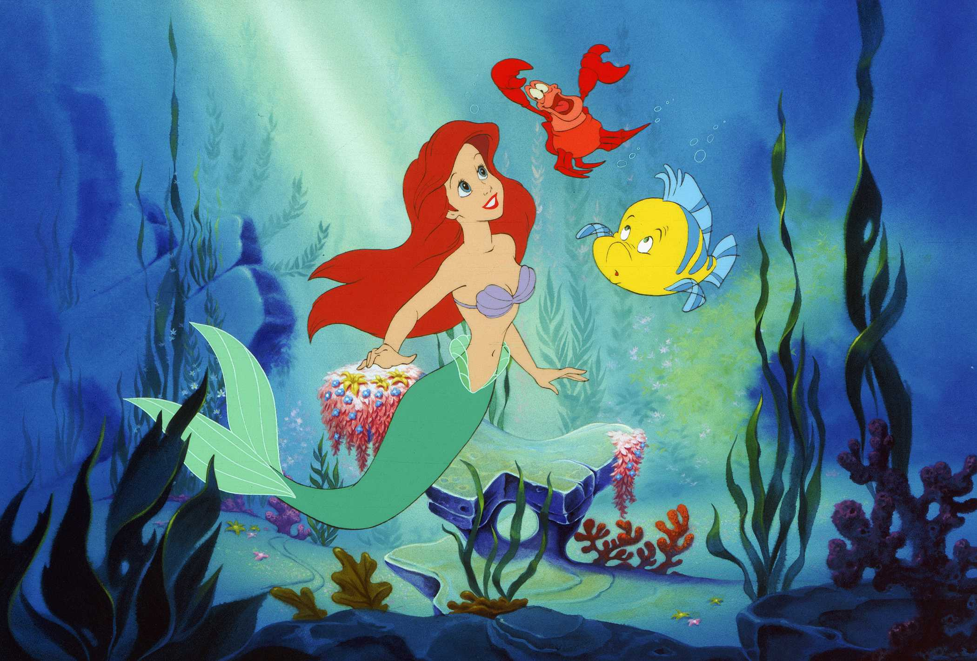
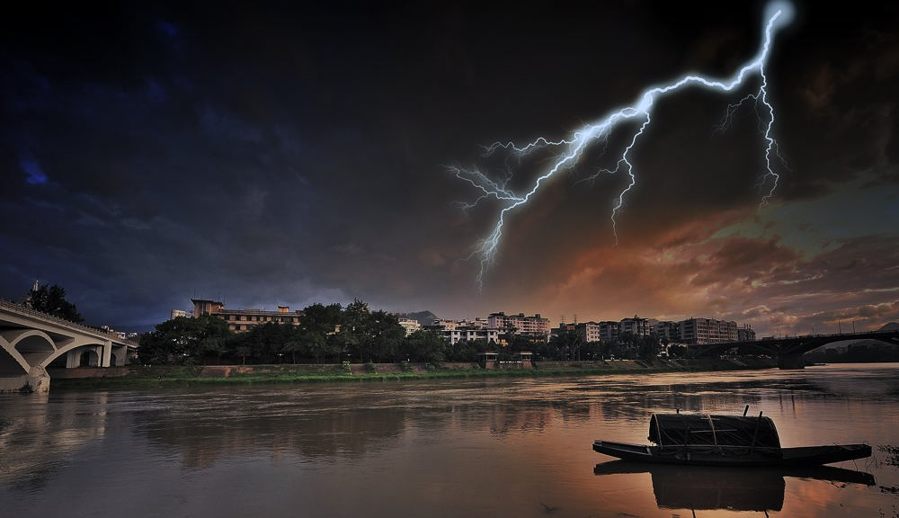
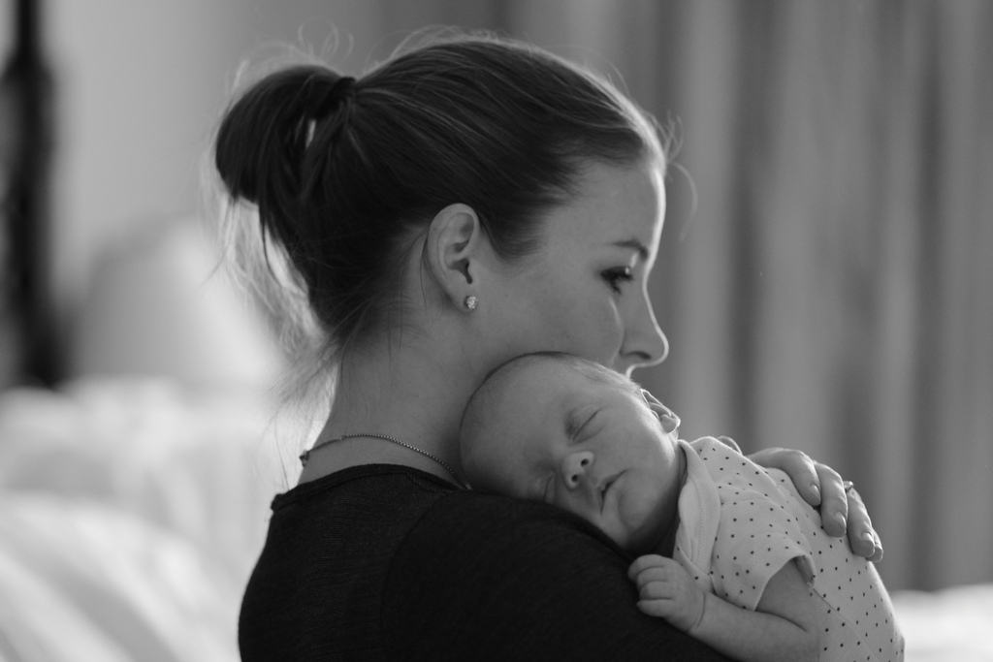
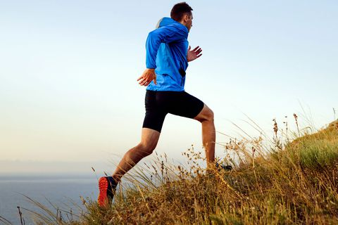
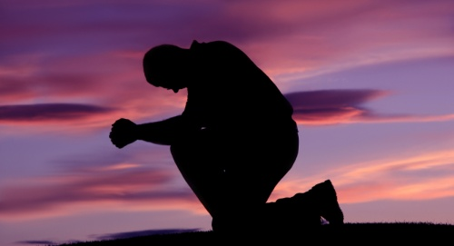
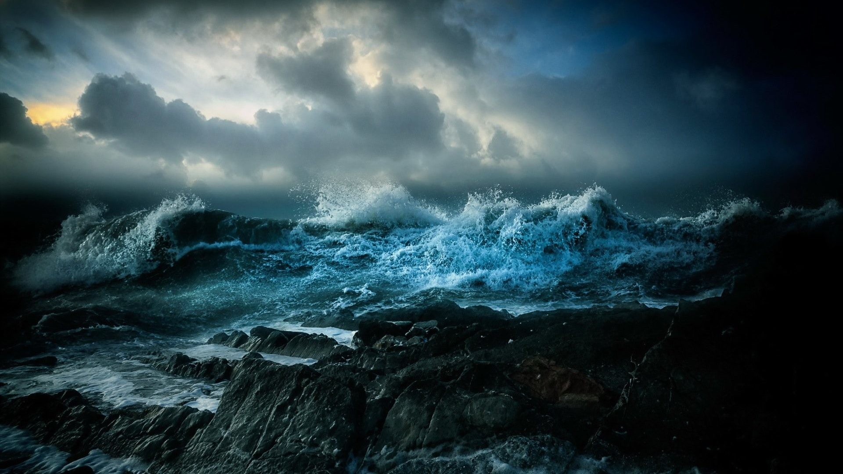
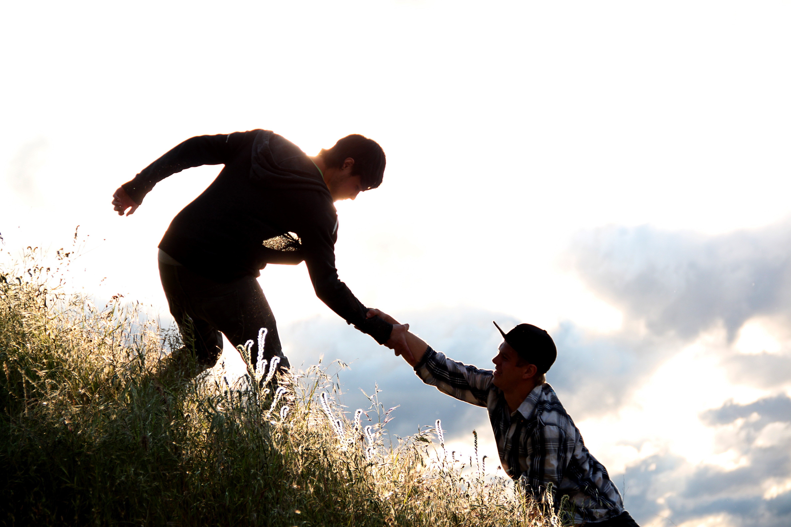
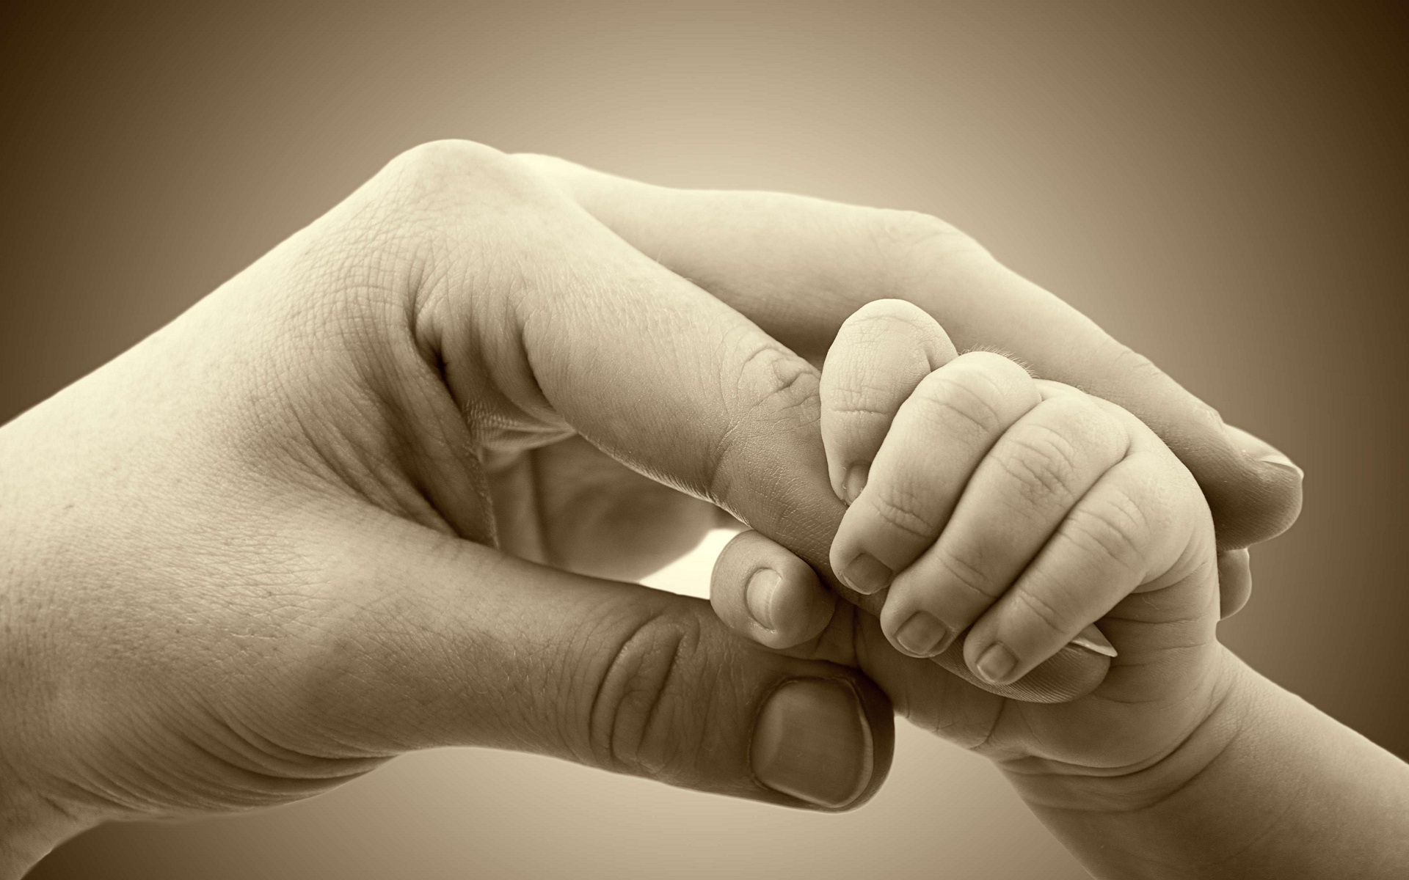
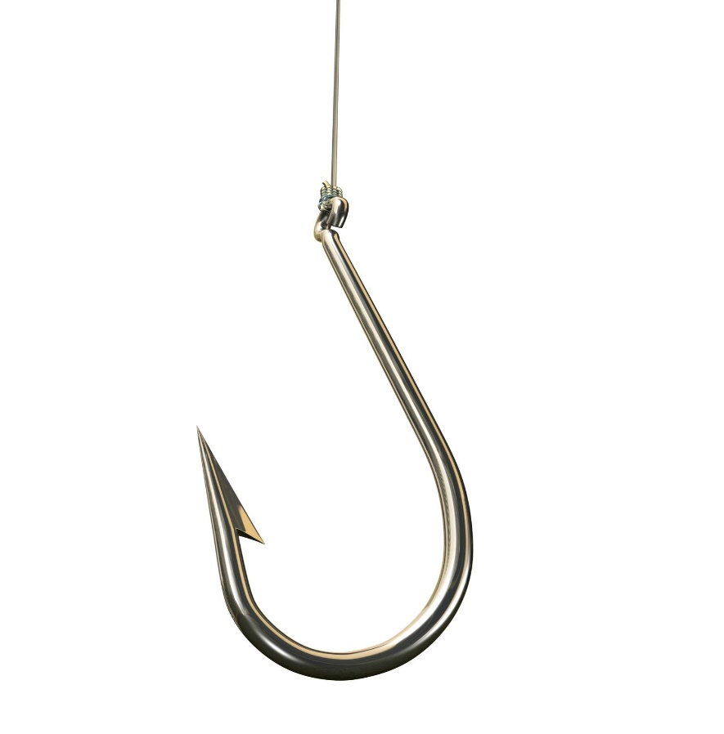
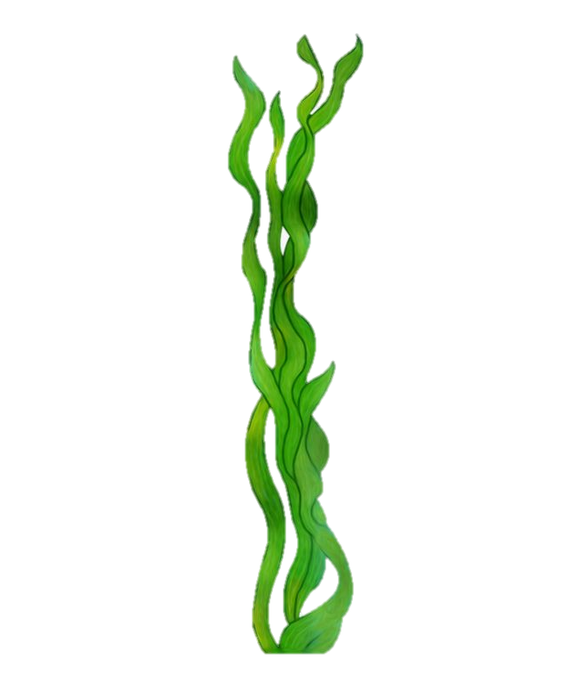
You Raise Me Up &Under the Sea
under
under
in
under
Thank you!
on
in
介词(on, in, under)
under
on
on
on
on
on
on
on
You Raise Me Up & Under the Sea
作者：
华南师范大学外国语言文化学院 陈祖因
广东省河源市紫金县青溪中学 钟怡
When I am down and oh my soul, so weary
Until you come and sit awhile with me
When troubles come and my heart burdened be
You raise me up, to walk on stormy seas
You raise me up, so I can stand on mountains
Then, I am still and wait here in the silence
I am strong, when I am on your shoulders
But fish in the bowl is lucky. They in for a worser fate
You raise me up: To more than I can be
Such wonderful things surround you, what more is you looking for?
Just look at the world around you right here on the ocean floor
You dream about going up there, but that is a big mistake
One day when the boss get hungry, guess who's gonna be on the plate
Darling it's better, down where it's wetter, take it from me
The seaweed is always greener, in somebody else' s lake
The fish on the land ain‘t happy. They sad cause they in their bowl
Up on the shore they work all day, out in the sun they slave away
Down here all the fish is happy as off through the waves they roll
You raise me up, so I can stand on mountains
We what the land folks loves to cook. Under the sea we off the hook
You raise me up, to walk on stormy seas
You raise me up: To more than I can be
Under the sea come with me
Under the sea, under the sea
While we devoting full time to floating under the sea
Nobody beat us, fry us and eat us in fricassee
I am strong, when I am on your shoulders
Under the sea, under the sea
We got no troubles, life is the bubbles under the sea
Under the Sea by Raven-Symoné
You Raise Me Up by Westlife

