Slide 1
We are the brave
—— 代词
华南师范大学外国语言文化学院 曾宇铃
广东省河源市紫金县紫金中学实验学校 赖晓娜

Slide 2
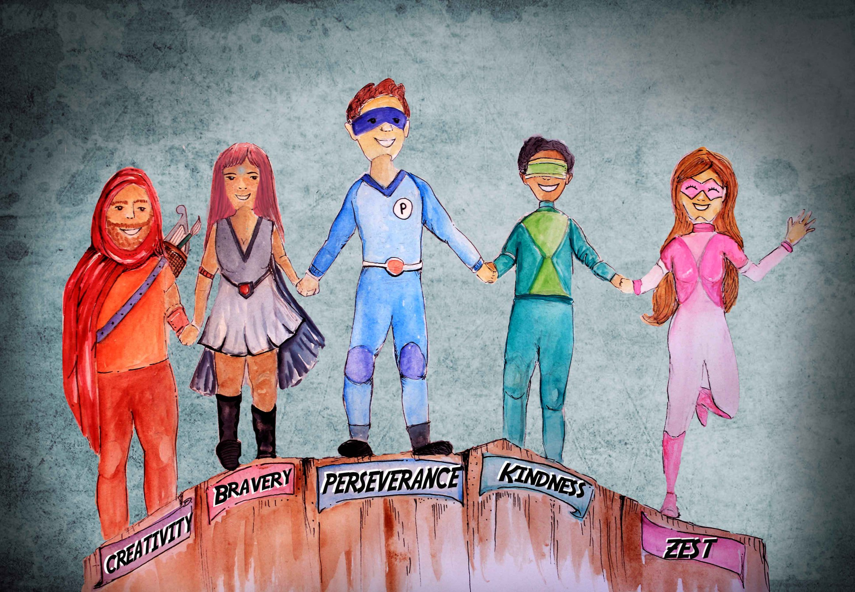
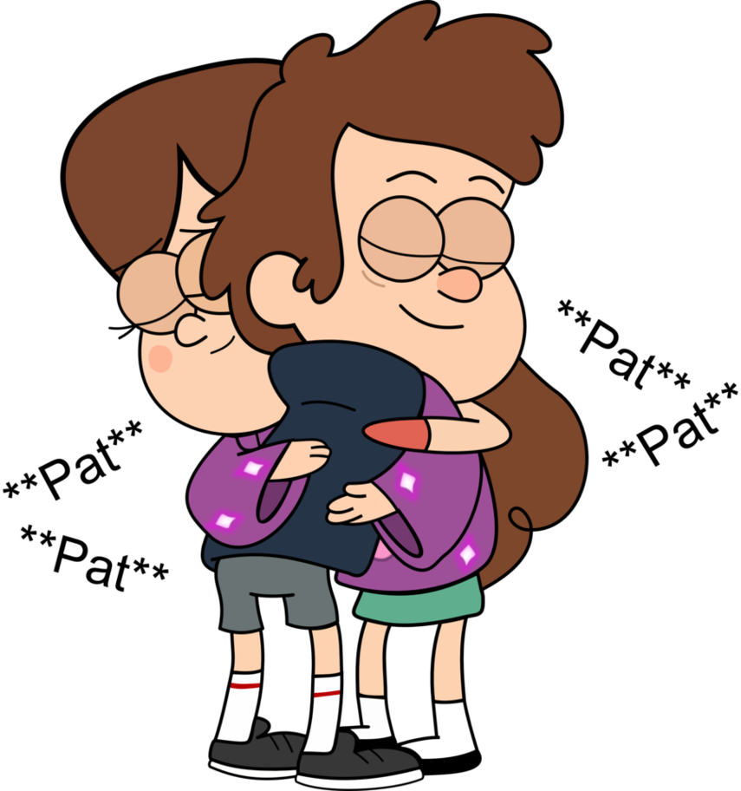
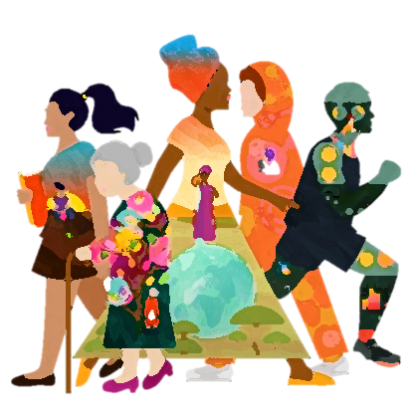
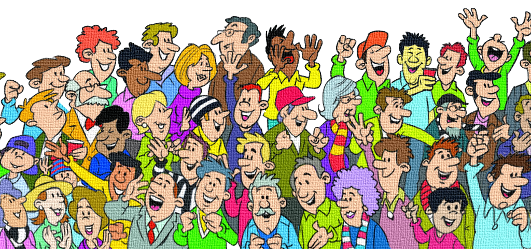
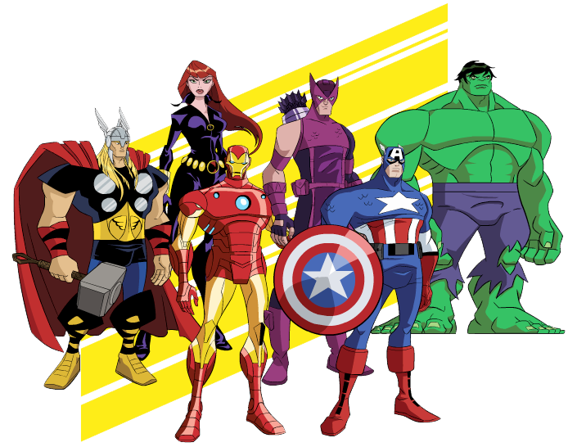
And all our dreams light up the way
So light up the power in you
So light up the power in you
So light up the power in you
So light up the power in you
We are the brave
We are the brave
You and me
We are the free
You and me
We are the brave
So hold on don’t stop
This is our time
We are the brave
We are the brave
We are the brave
So stand up don’t stop
And go for the best in you
We have the power to be stronger if we want it
We can have everything
We have the power to be stronger if we want it
We can be anything
And go for the best in you
We can do anything
There’s so much in you
This is our day
And go for the best in you
Cause I see a light shine through
And go for the best in you
Cause I see a light shine through
We are the light
We are the free
everything
We are the brave
anything
anything
We can do everything
The best is in you
We light the dark
Cause I see a light shine through
Cause I see a light shine through
everything
anything
anything
We are the bold
everything
everything
We are the brave

