Slide 1
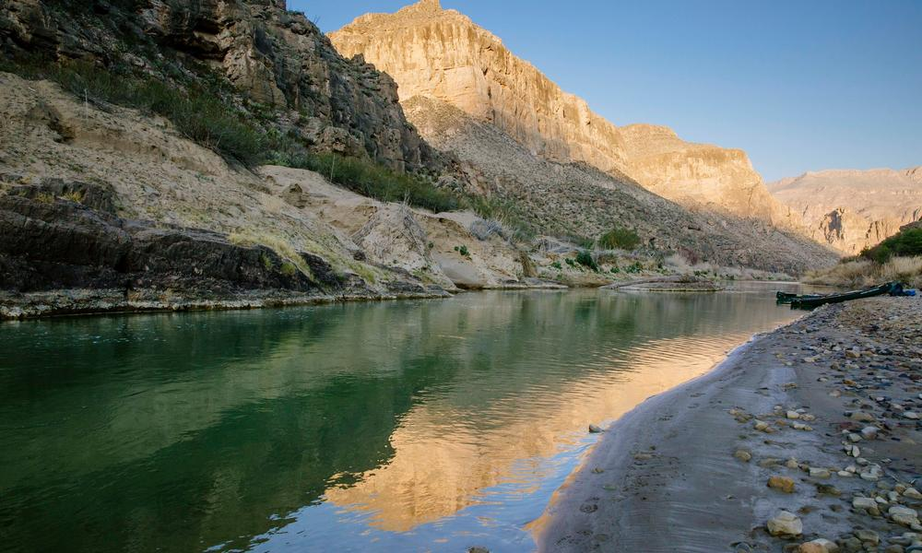
冠词
I'm an old cowhand
华南师范大学外国语言文化学院 曾嘉慧
广东省河源市龙川第一实验学校 刘碧娟

Slide 2
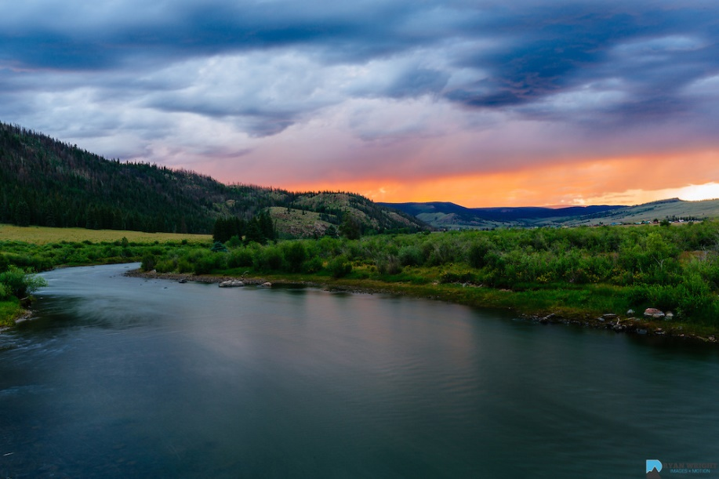

Slide 3
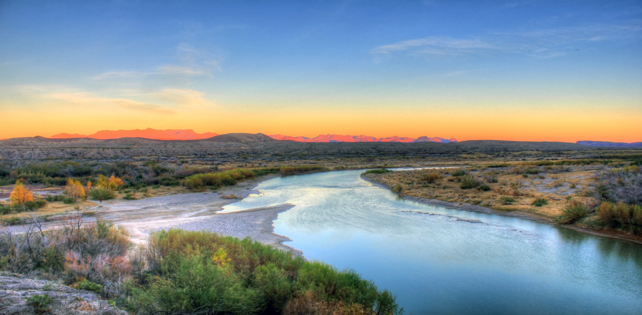

Slide 4
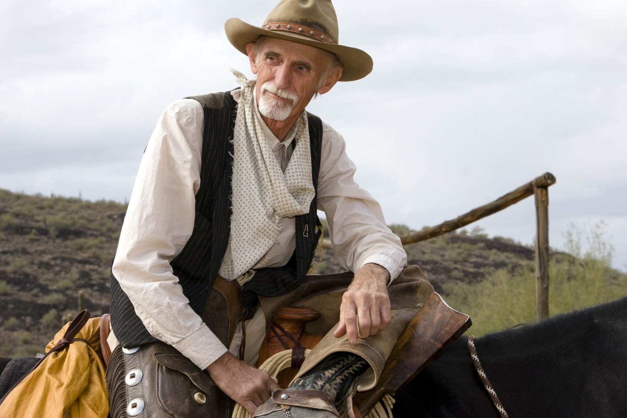
I'm an old cowhand from the Rio Grande
我是个老牛仔，来自Rio Grande

Slide 5
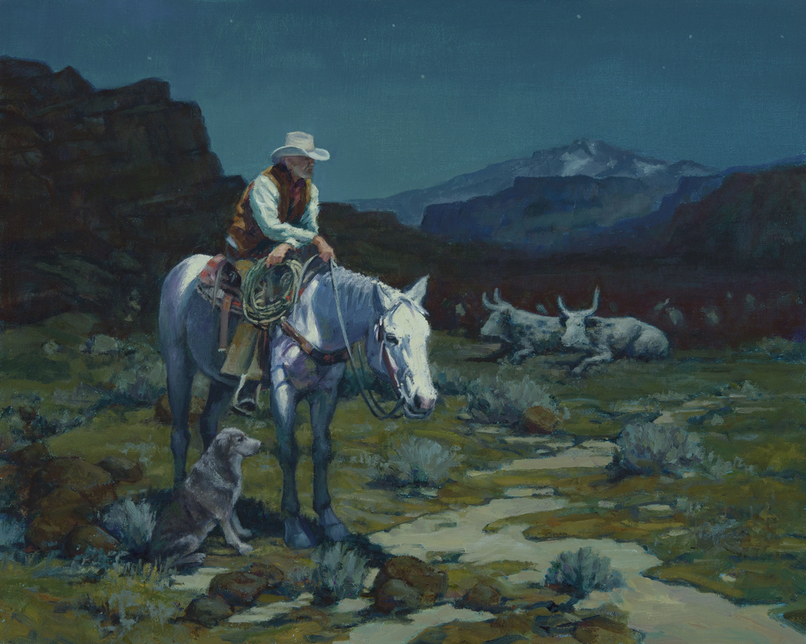
And my cheeks ain't tanned
也没有晒黑
But my legs ain't bowed
但我也没有O型腿

Slide 6
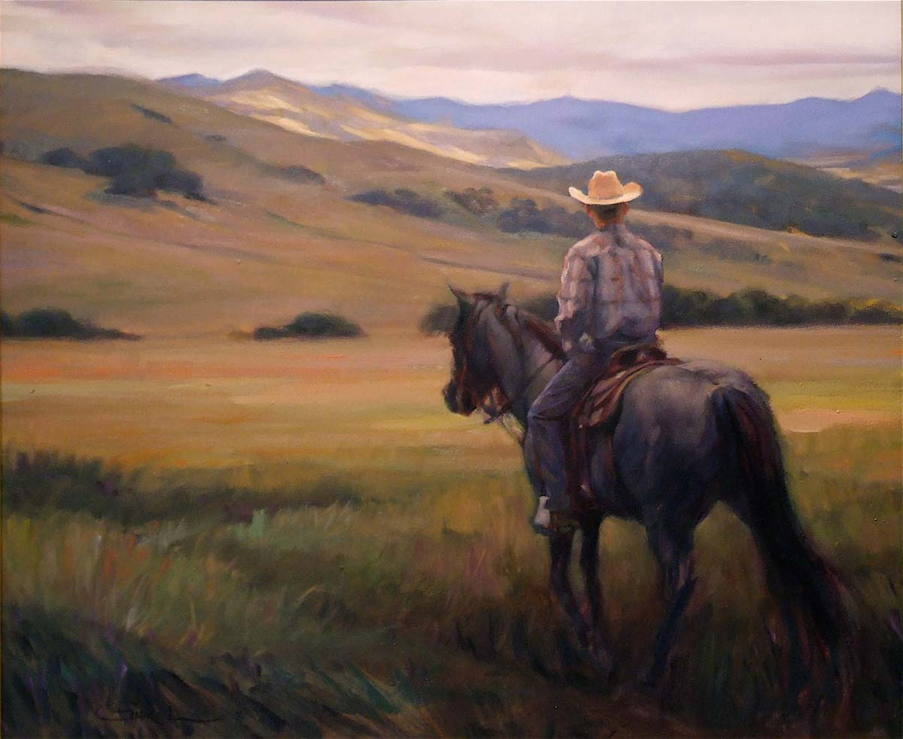
I'm a cowboy who never saw a cow
甚至没有看过牛

Slide 7
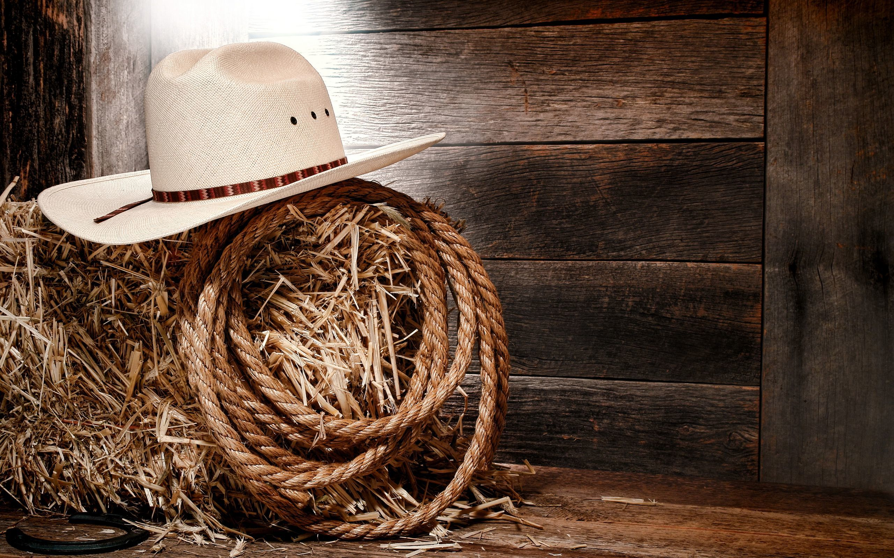
Never roped a steer cause I don't know how
连缰绳的投法都不会
And I sure ain't fixing to start in now
现在也不会特别想学

Slide 8
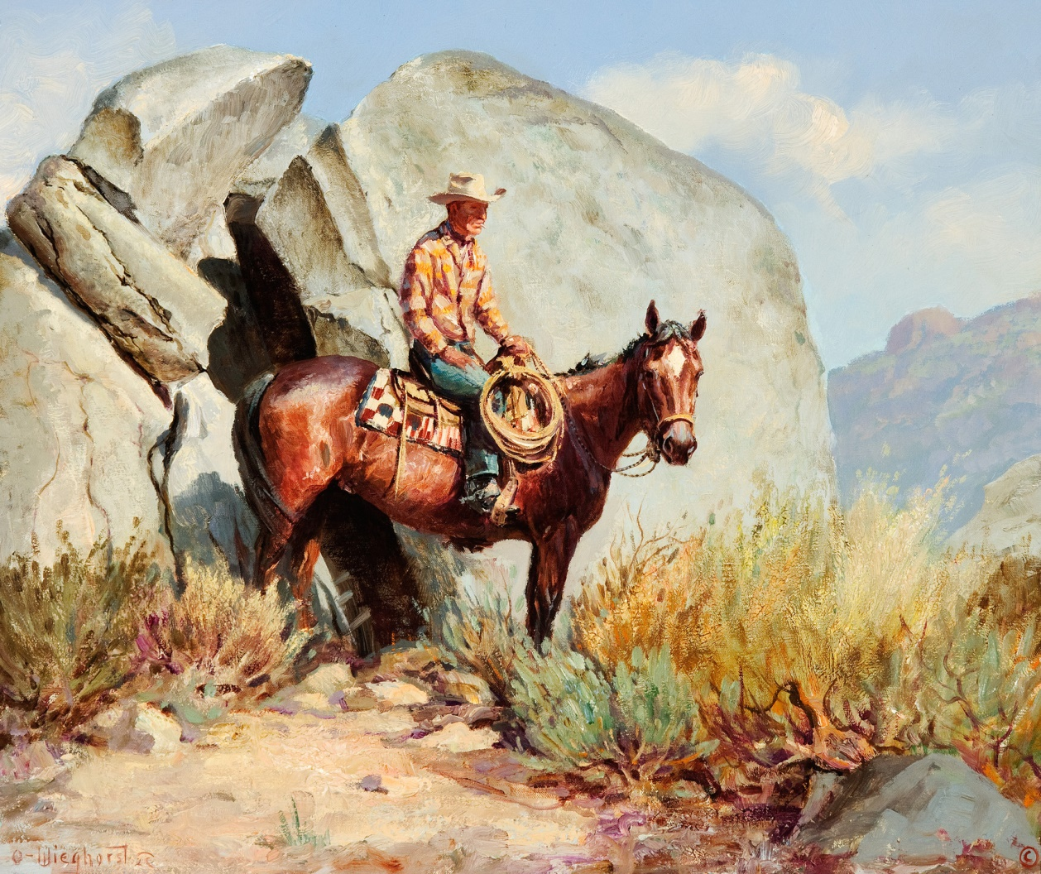
Yippie-yi-yo-ki-yay
呀喝！呀喝！
Yippie-yi-yo-ki-yay
呀喝！呀喝！

Slide 9
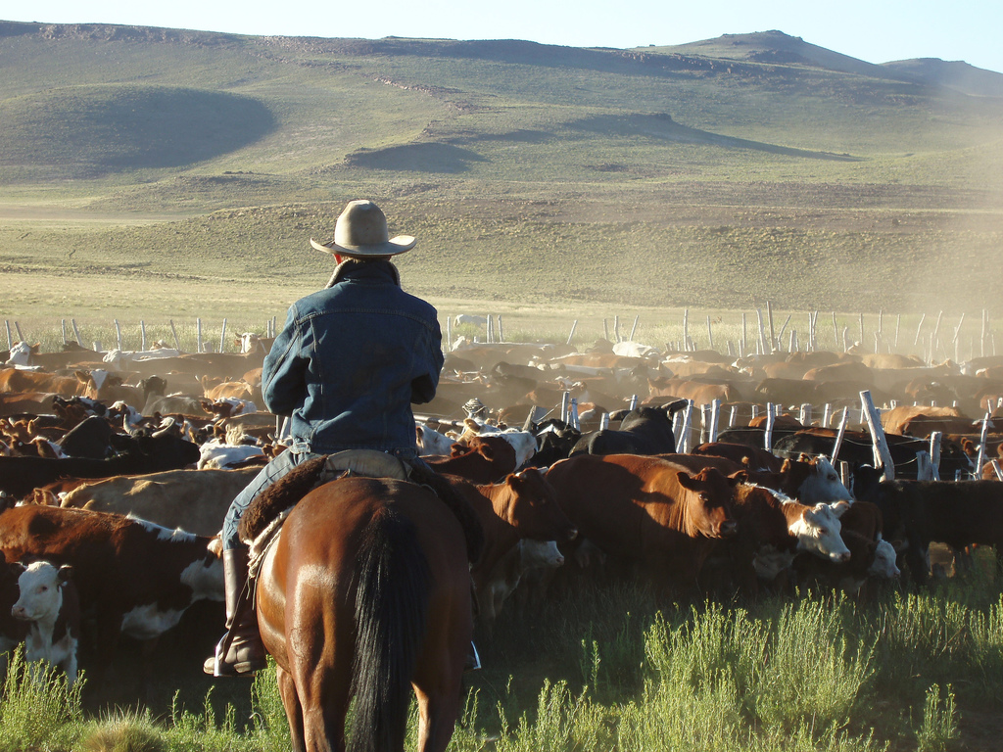

Slide 10
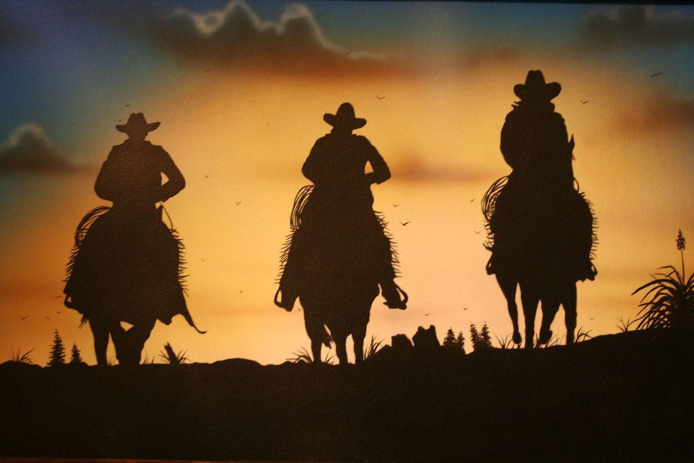

Slide 11
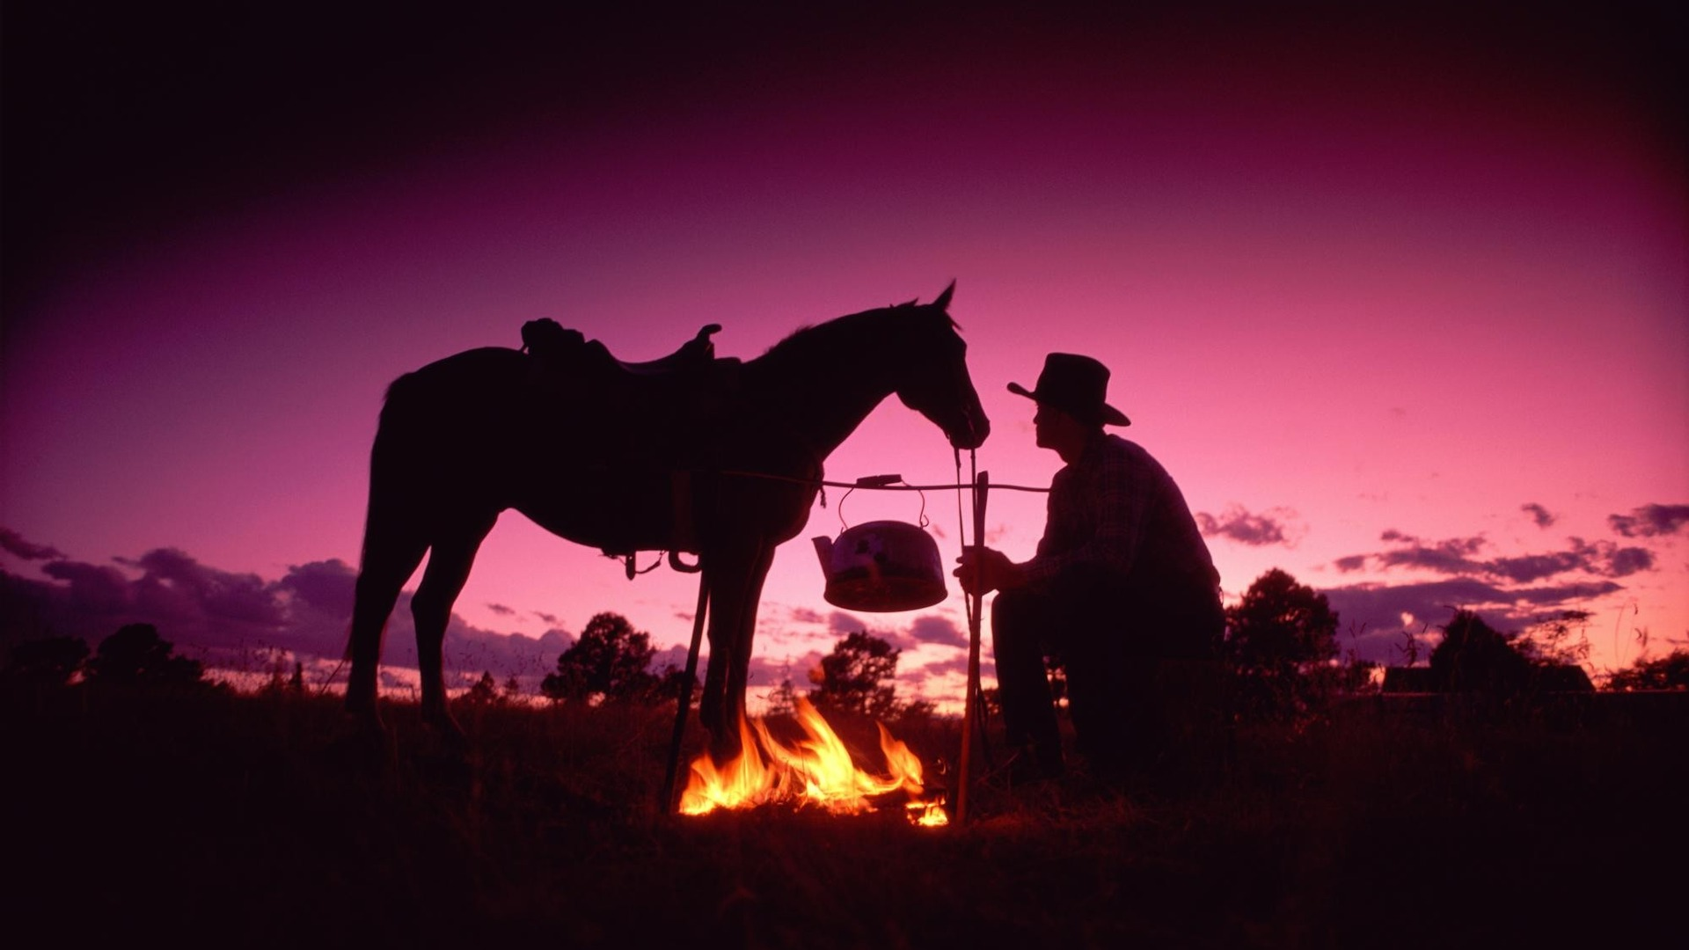

Slide 12
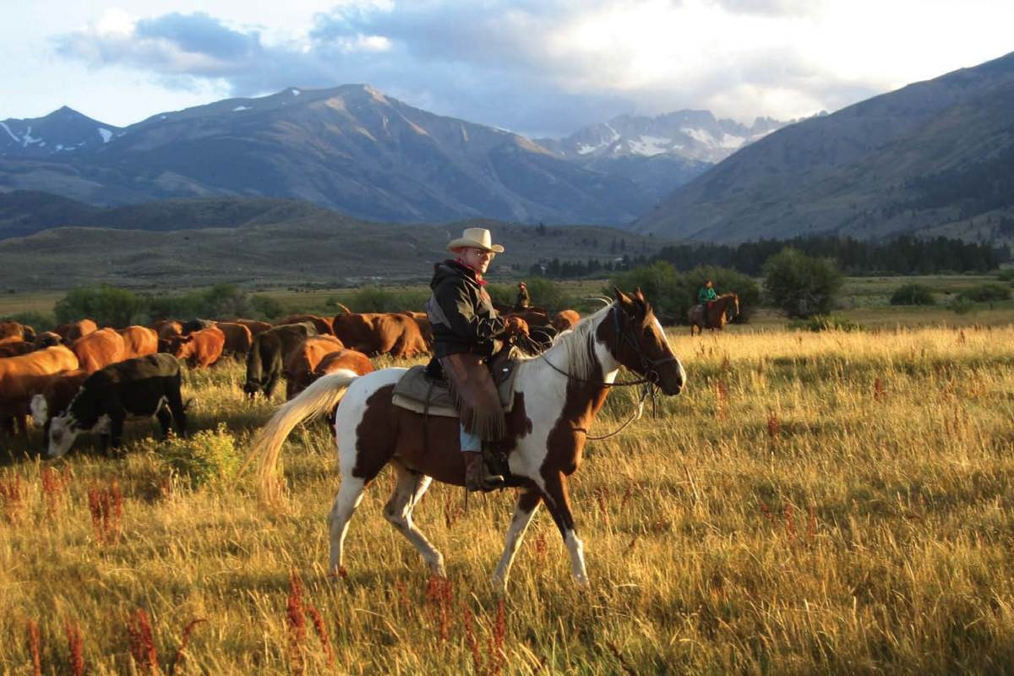
I'm an old cowhand from the Rio Grande
我是个老牛仔，来自Rio Grande

Slide 13
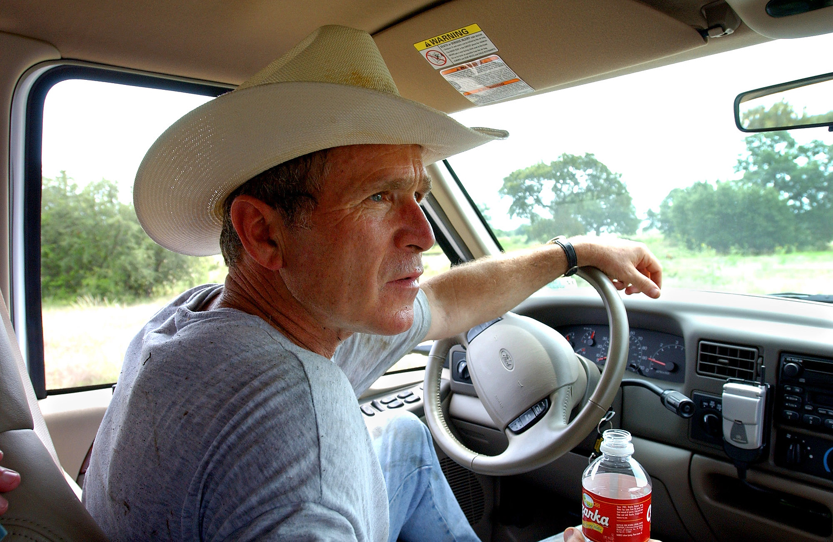
And I learned to ride For I learned to stand
在学会走路前便学会开车

Slide 14
I know every trail in the Lone Star state
德州的每条危险道我都知道
I'm a riding fool who is up to date
就是现代爱车族

Slide 15
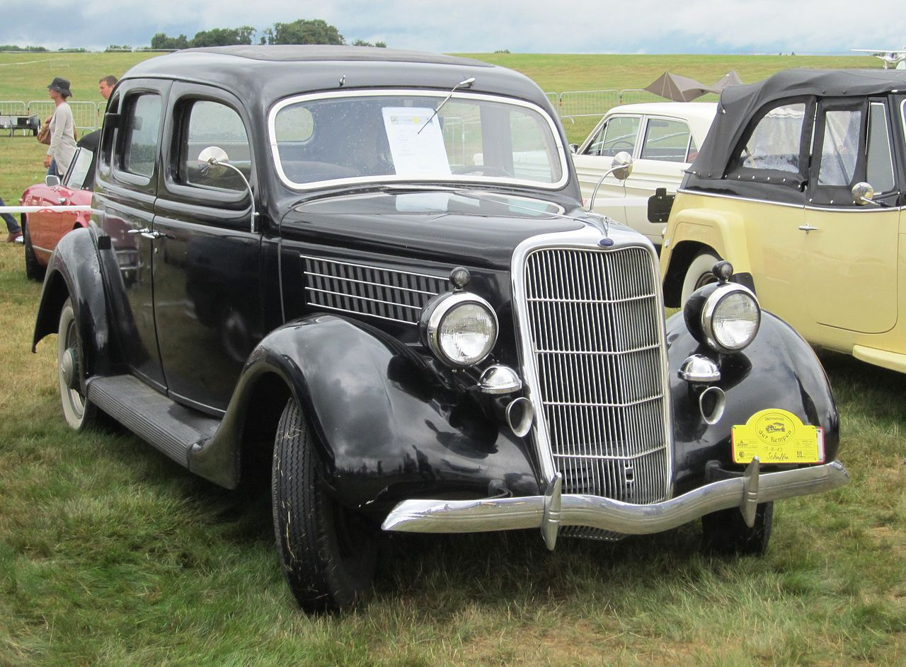
Cause I ride the range in a Ford V8
因为我总是开着福斯汽车在农场奔驰啊

Slide 16
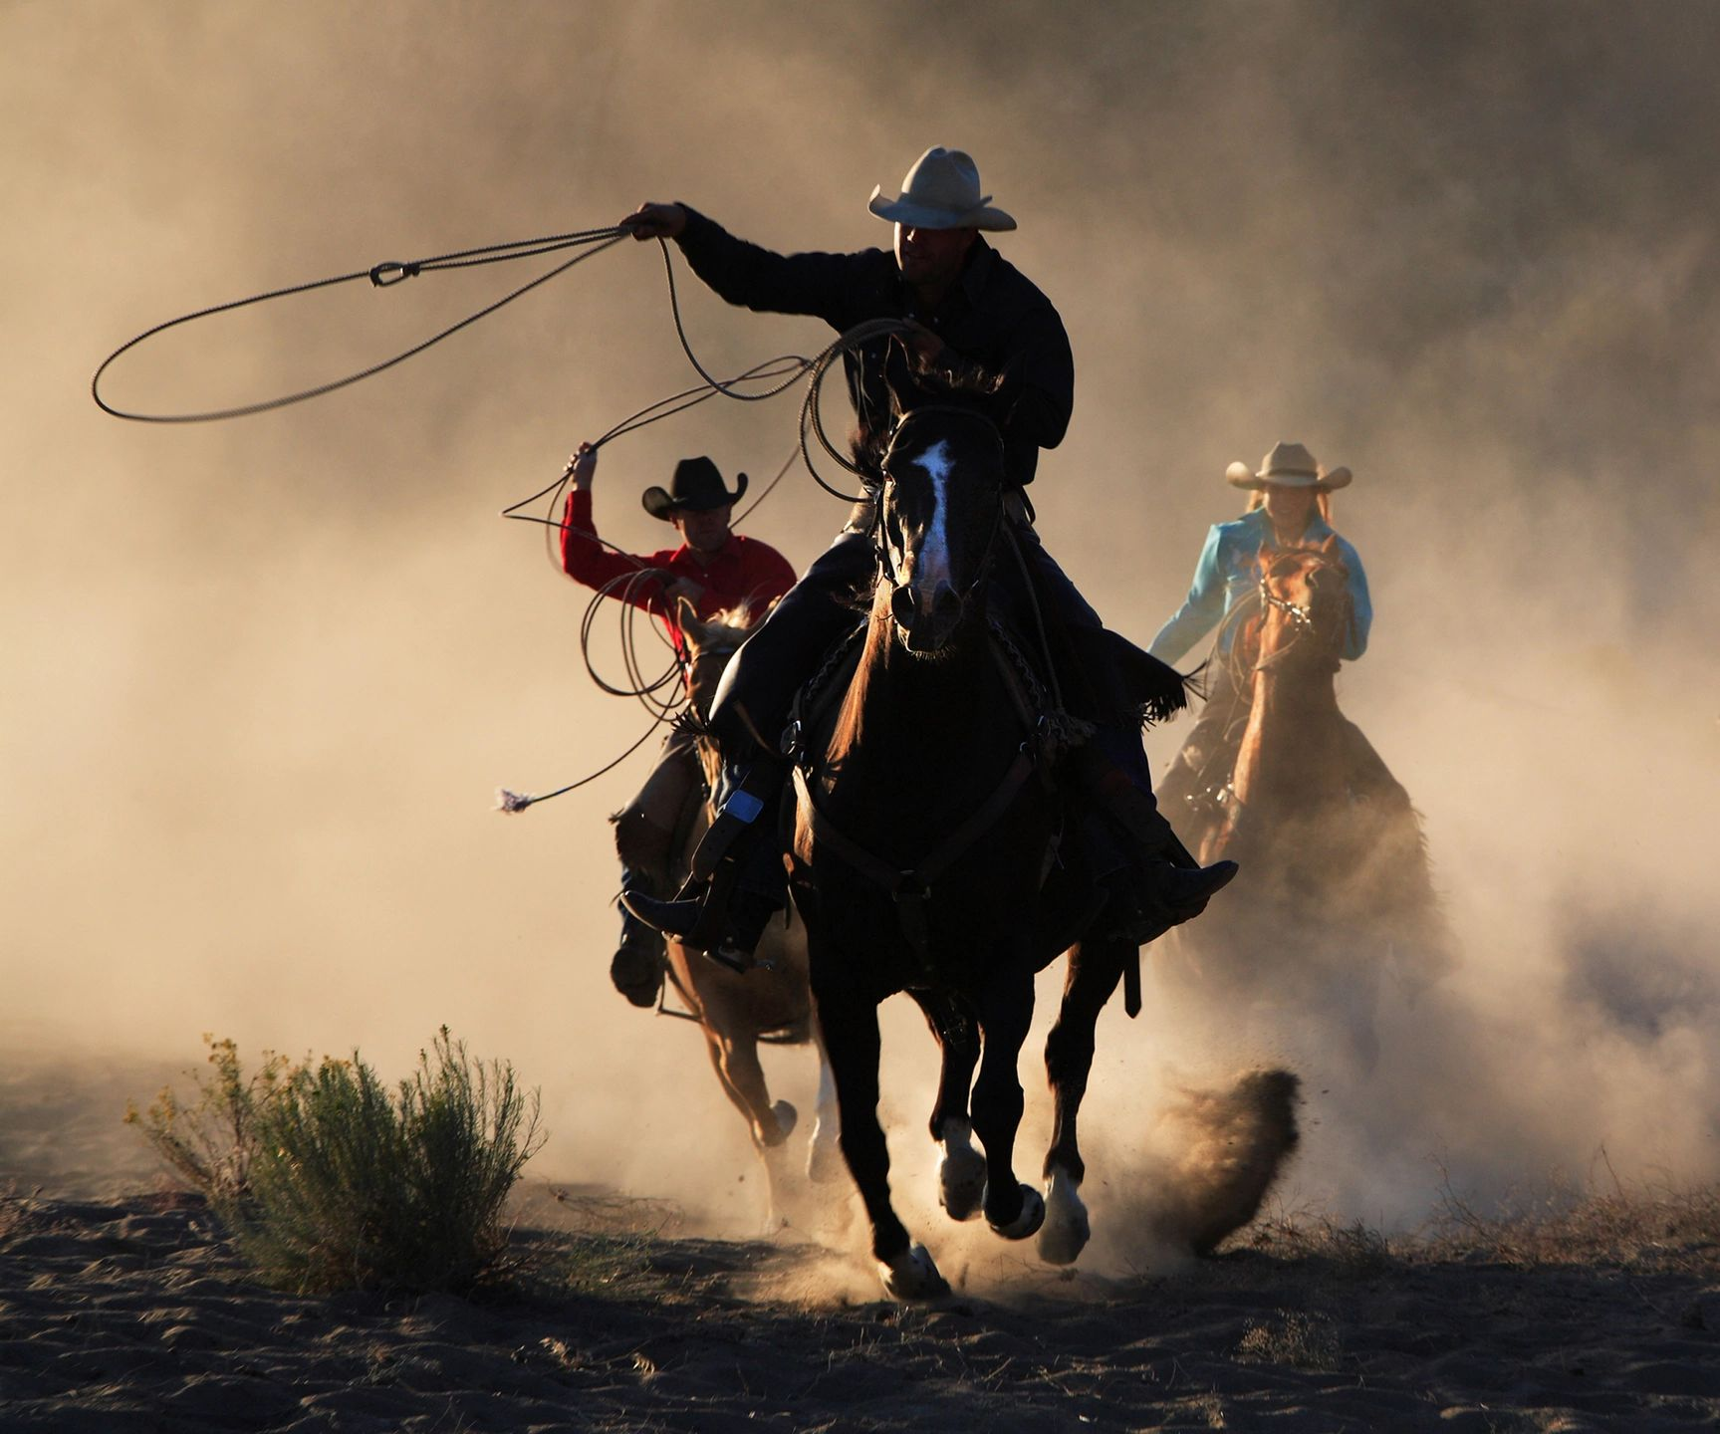
Yippie-yi-yo-ki-yay
呀喝！呀喝！
Yippie-yi-yo-ki-yay
呀喝！呀喝！

Slide 17
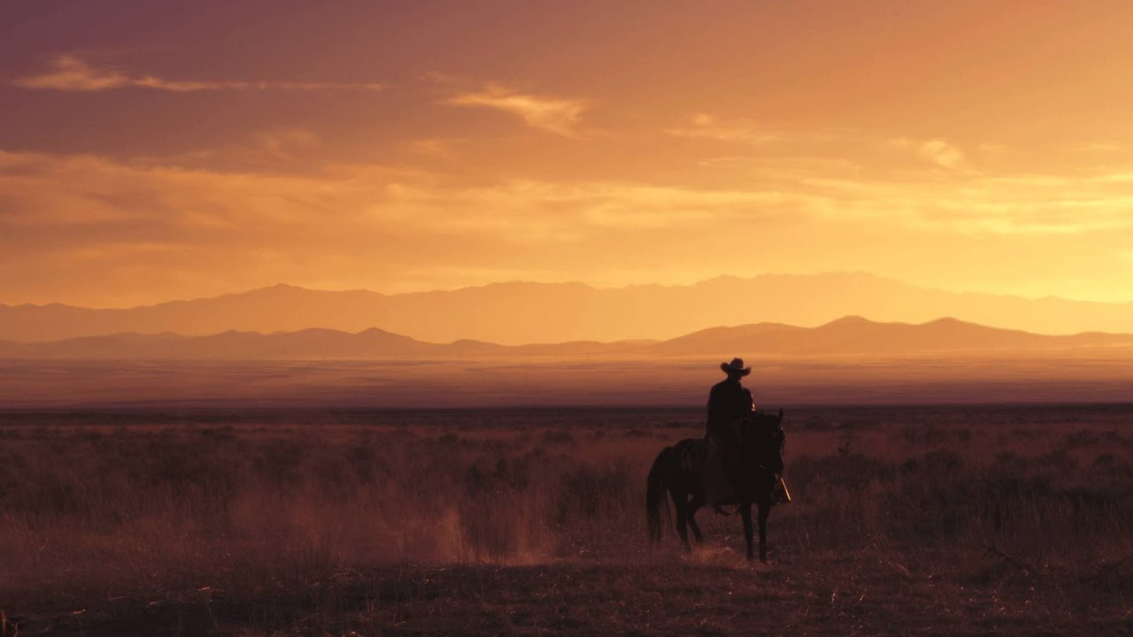

Slide 18
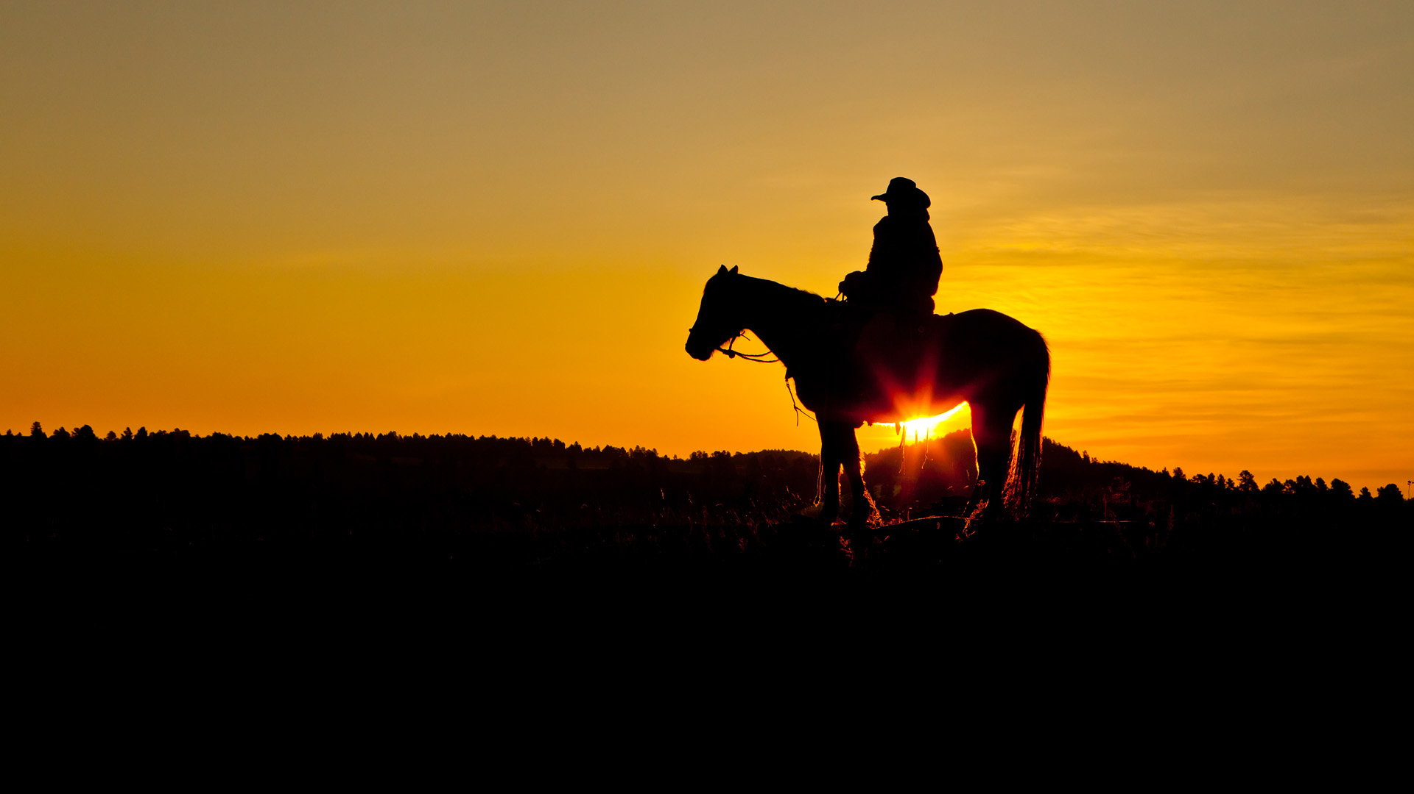

Slide 19
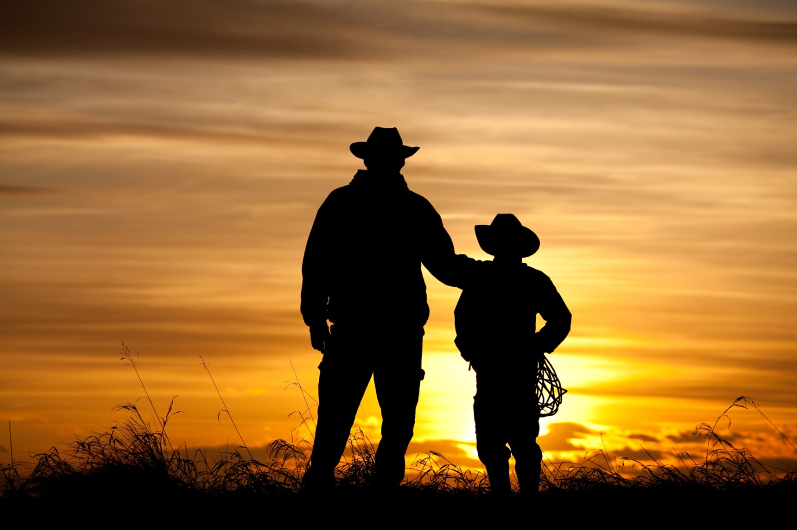

Slide 20
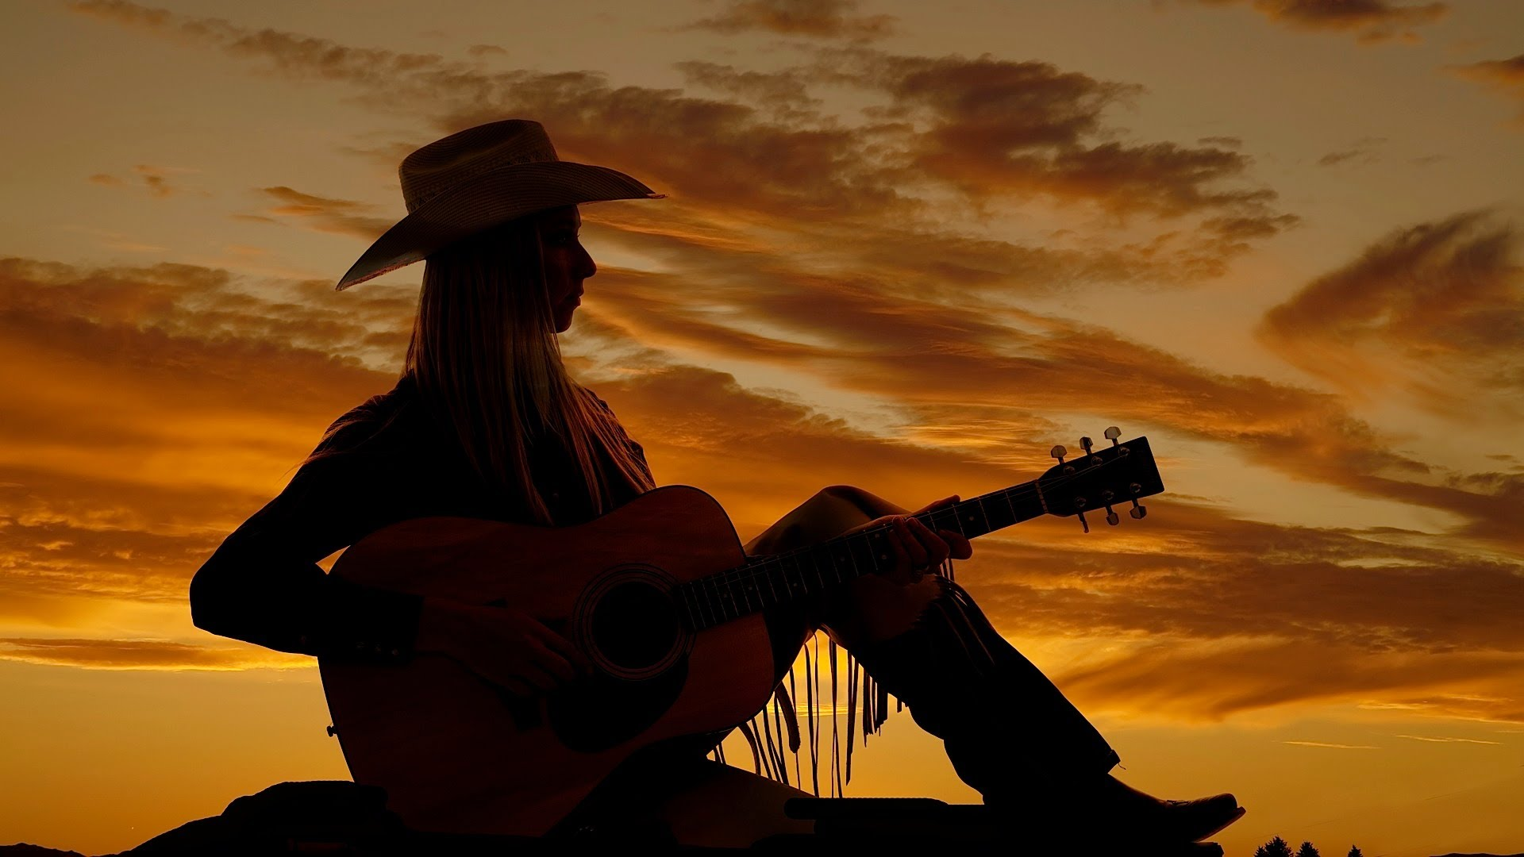

Slide 21
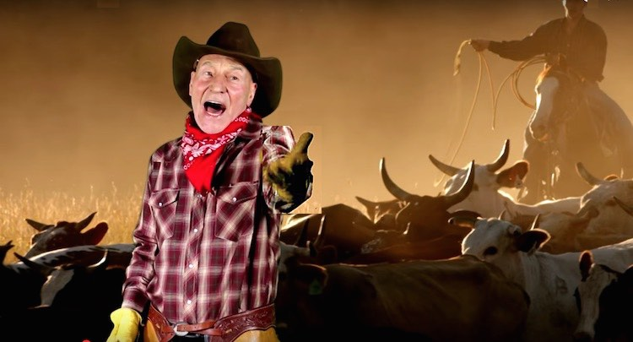
I know all the songs that the cowboys know
我熟知所有牛仔之歌

Slide 22
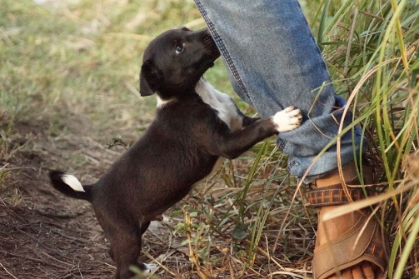
About the big corral where the dogies go
连狗狗都会靠过来的家畜栅栏之歌

Slide 23
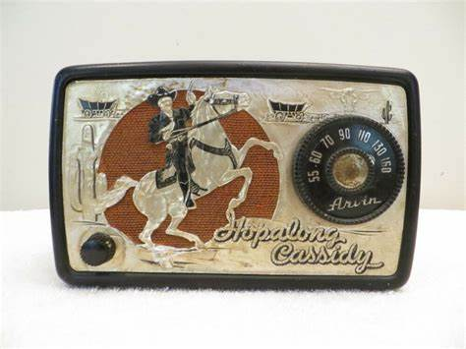
Cause I learned them all on the radio
因为我都从车上的收音机学会唱的
Yippie-yi-yo-ki-yay
呀喝！呀喝！
Yippie-yi-yo-ki-yay
呀喝！呀喝！

Slide 24
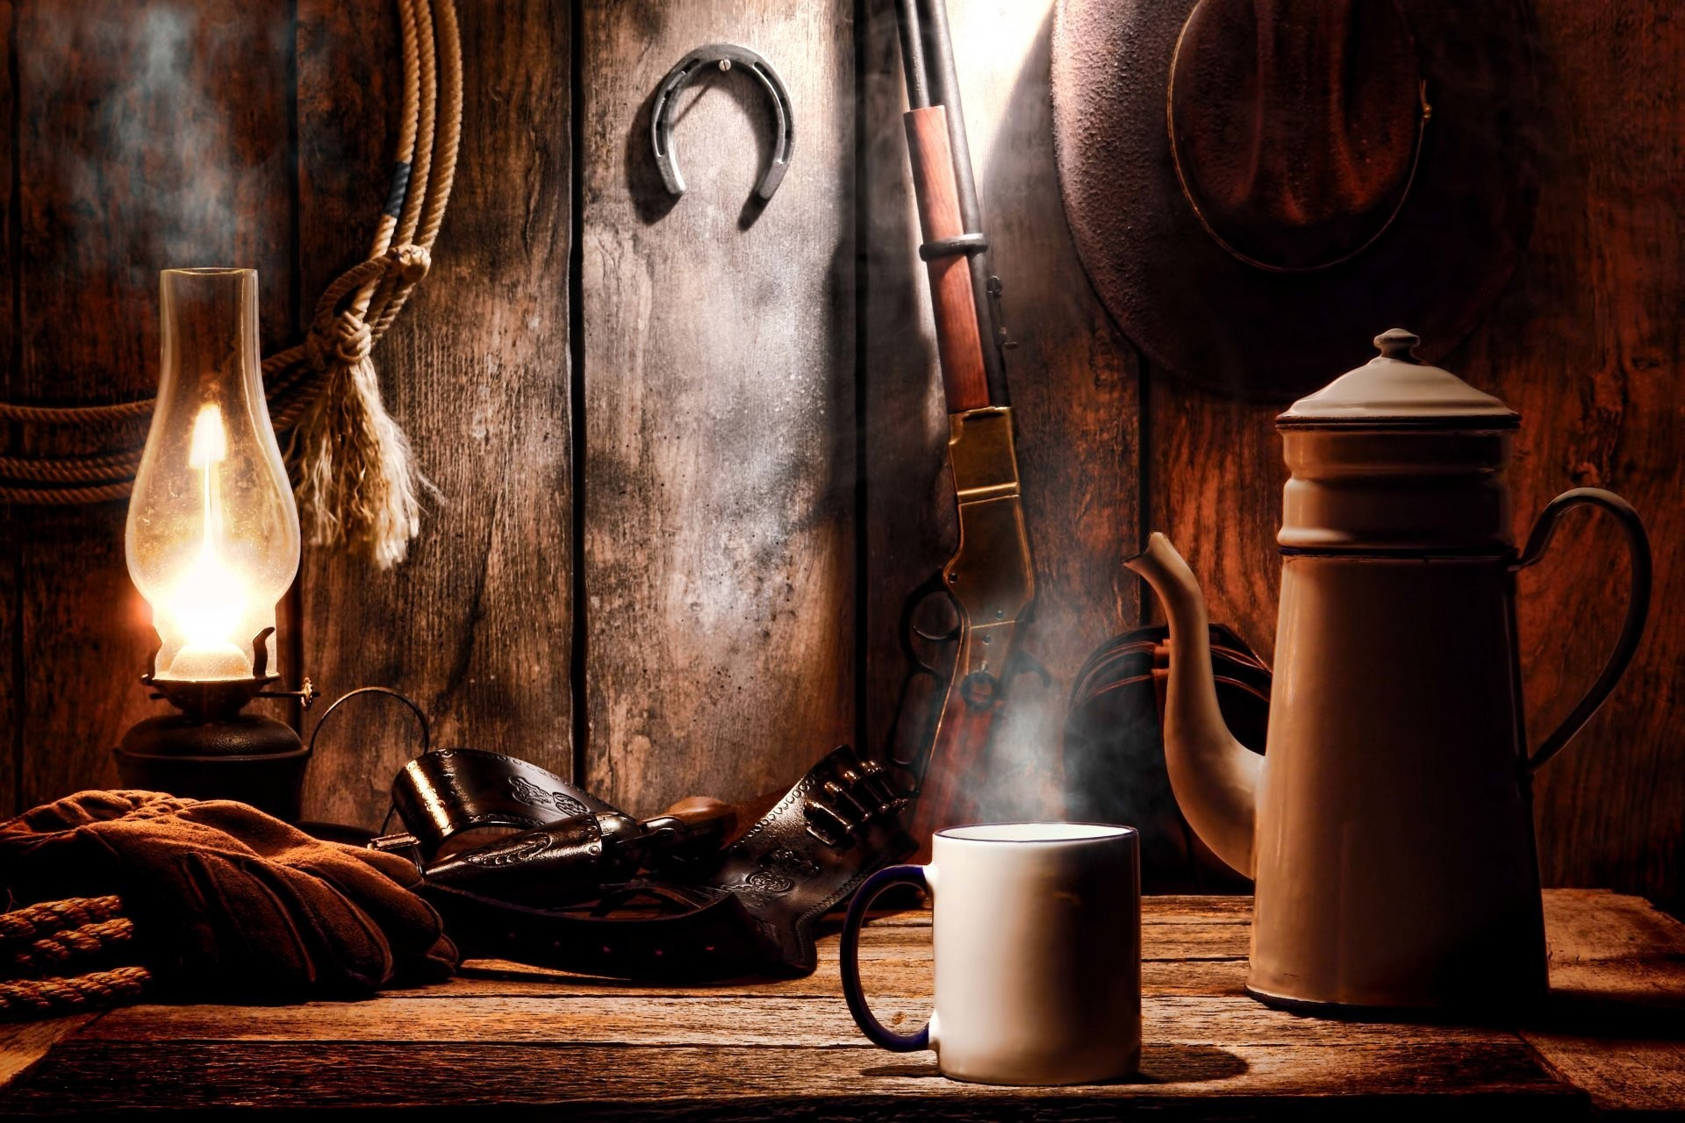
Yippie-yi-yo-ki-yay
呀喝！呀喝！
Yippie-yi-yo-ki-yay
呀喝！呀喝！

Slide 25
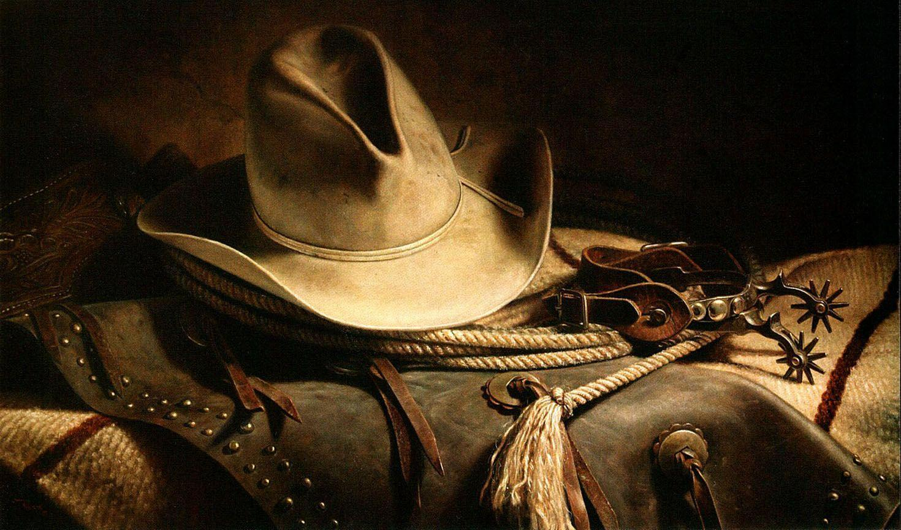
Thank you
Yippie-yi-yo-ki-yay
呀喝！呀喝！
Yippie-yi-yo-ki-yay
呀喝！呀喝！

