Slide 1
Friday I'm in love
——名词
设计制作：华南师范大学 李实洁
龙川县上坪中学 刘菊芬

Slide 5
I don't care if Monday's blue

Slide 6
Tuesday's grey and Wednesday too

Slide 7
Thursday I don't care about you

Slide 8
It's Friday I'm in love

Slide 9
Monday you can fall apart
Tuesday Wednesday break my heart

Slide 10
Oh Thursday doesn't even start

Slide 11
It's Friday I'm in love

Slide 12
Saturday wait
And Sunday always comes too late
But Friday never hesitate

Slide 13
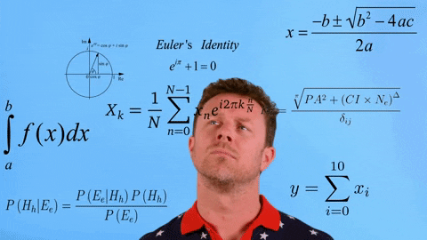
I don't care if Monday's black

Slide 14
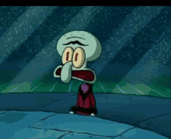
Tuesday Wednesday heart attack

Slide 15
It's Friday I'm in love
Thursday never looking back

Slide 17
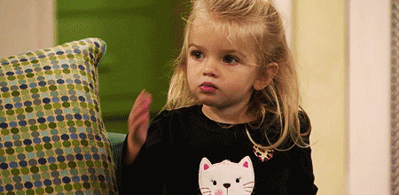
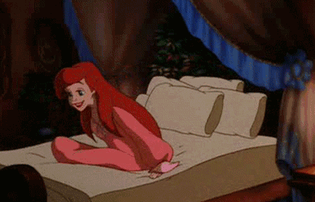
Tuesday Wednesday stay in bed
Monday you can hold your head

Slide 18
It's Friday I'm in love
Or Thursday watch the walls instead

Slide 19
Saturday wait
And Sunday always comes too late
But Friday never hesitate

Slide 20
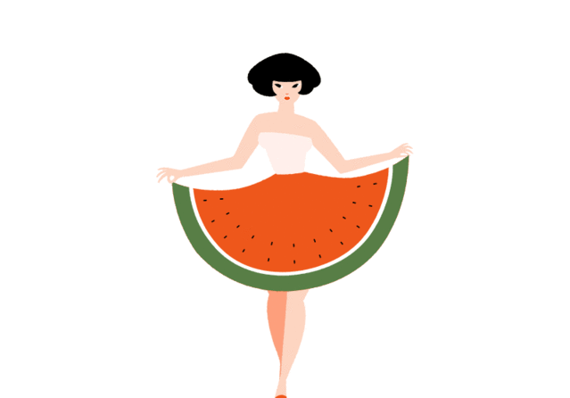
It's a wonderful surprise
Dressed up to the eyes

Slide 21
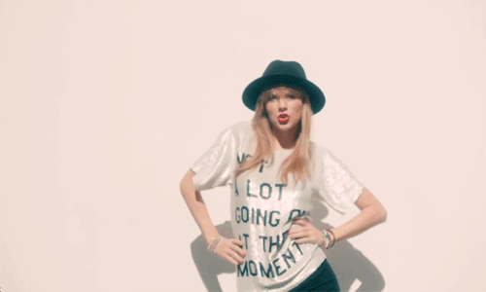
To see your shoes and your spirits rise

Slide 22
Throwing out your frown
And just smiling at the sound

Slide 23
Spinning round and round
And as sleek as a shriek

Slide 24
It's such a gorgeous sight
Always take a big bite

Slide 25
To see you eat in the middle of the night

Slide 26
It's Friday I'm in love
You can never get enough enough of this stuff

Slide 27
Tuesday's grey and Wednesday too
I don't care if Monday's blue

Slide 28
Thursday I don't care about you
It's Friday I'm in love

Slide 29
Tuesday Wednesday break my heart
Monday you can fall apart

Slide 30
It's Friday I'm in love
Thursday doesn't even start

