Slide 1
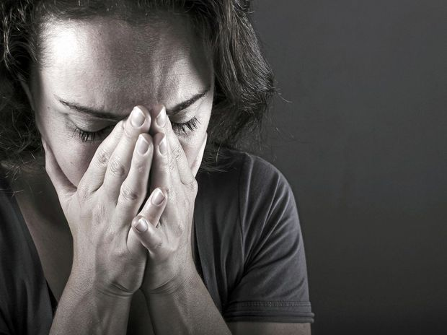
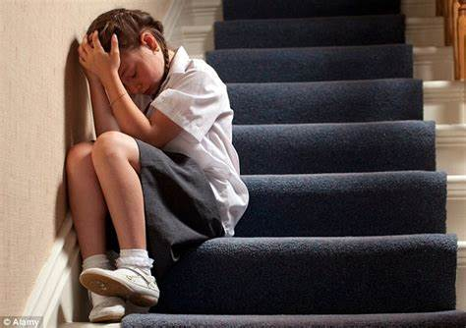
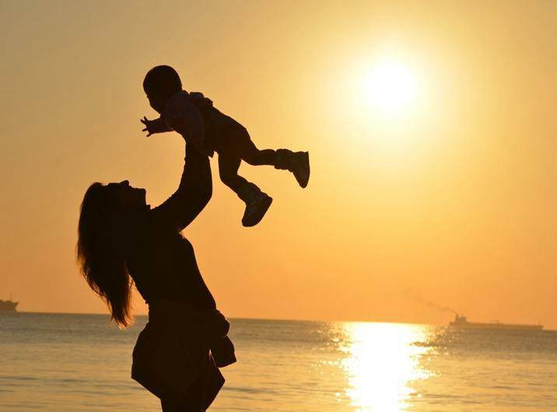
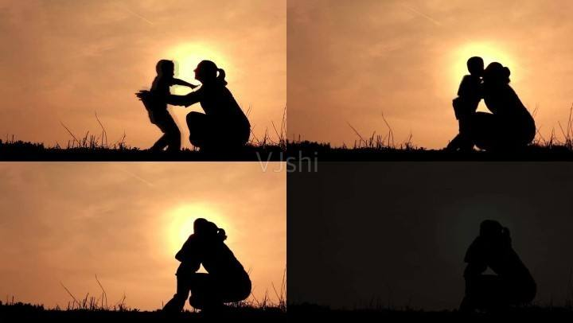
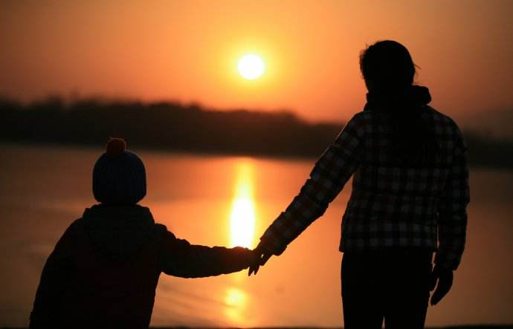
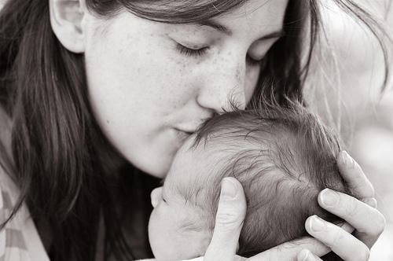
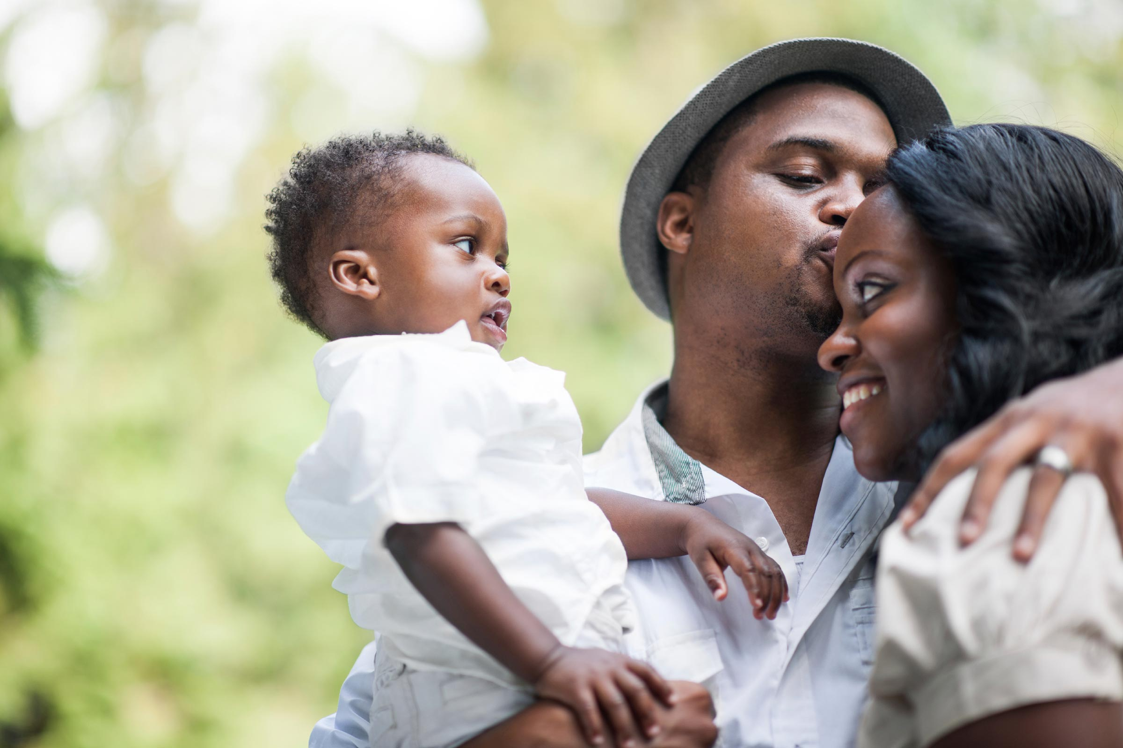
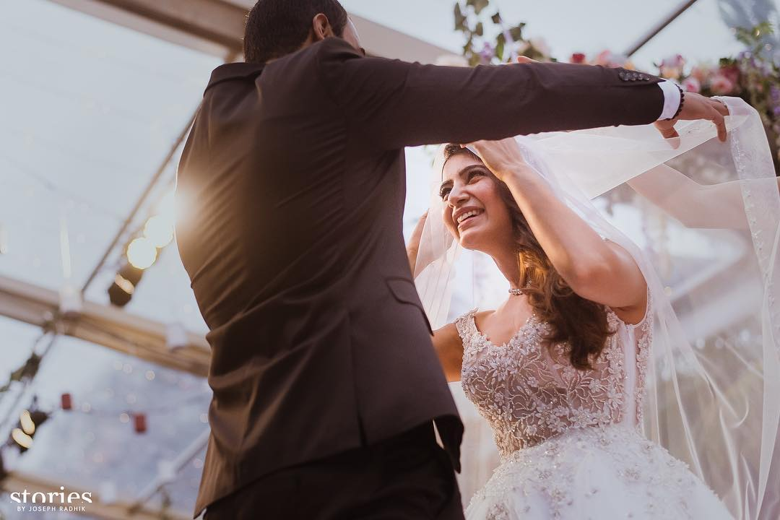
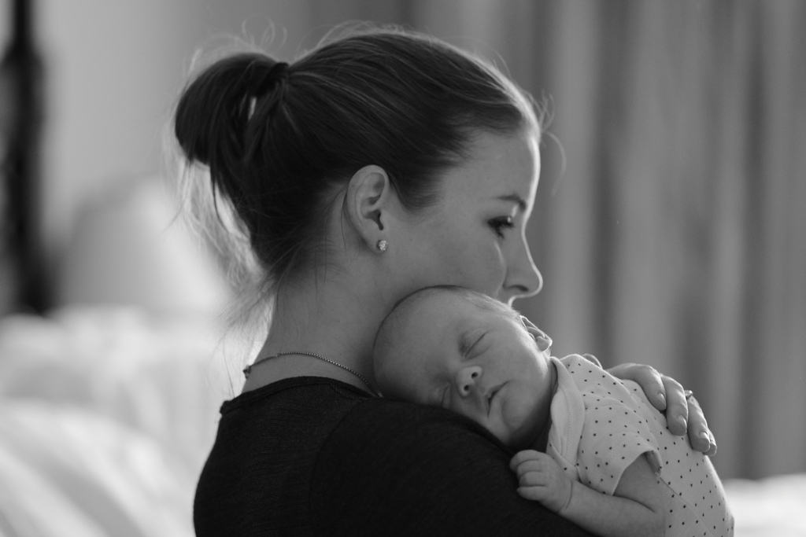
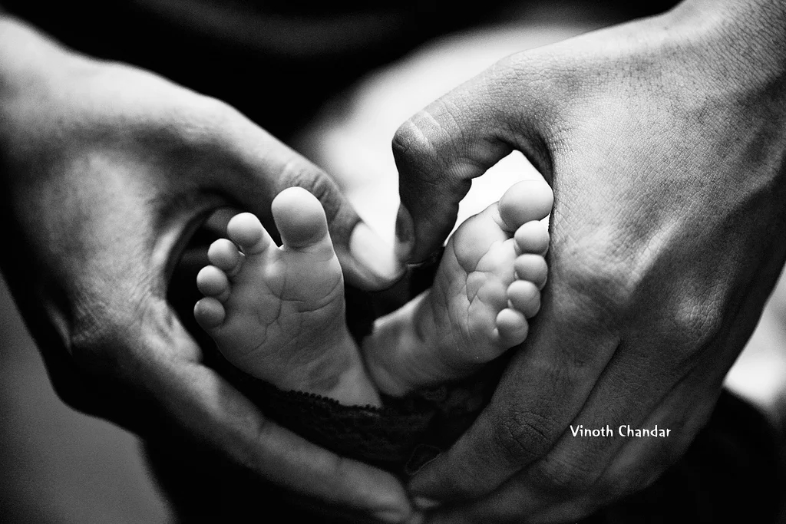
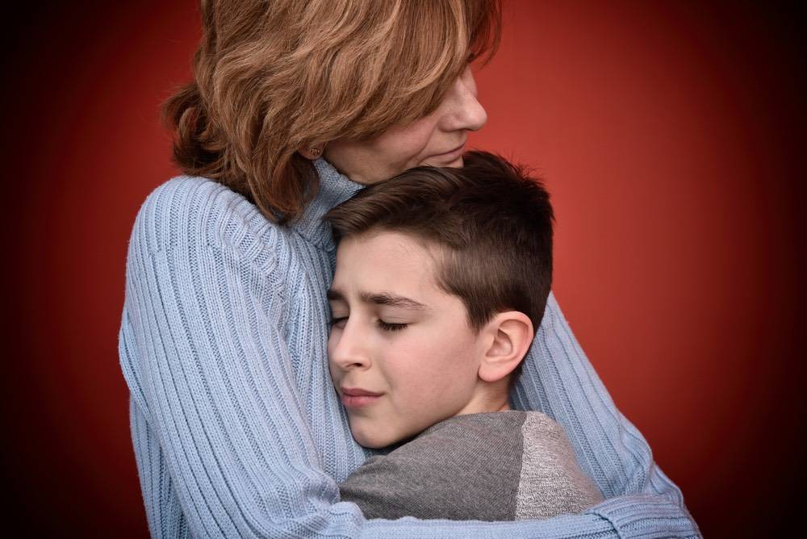
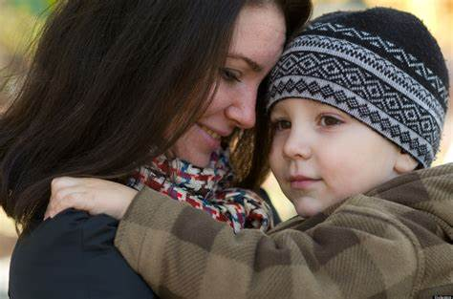
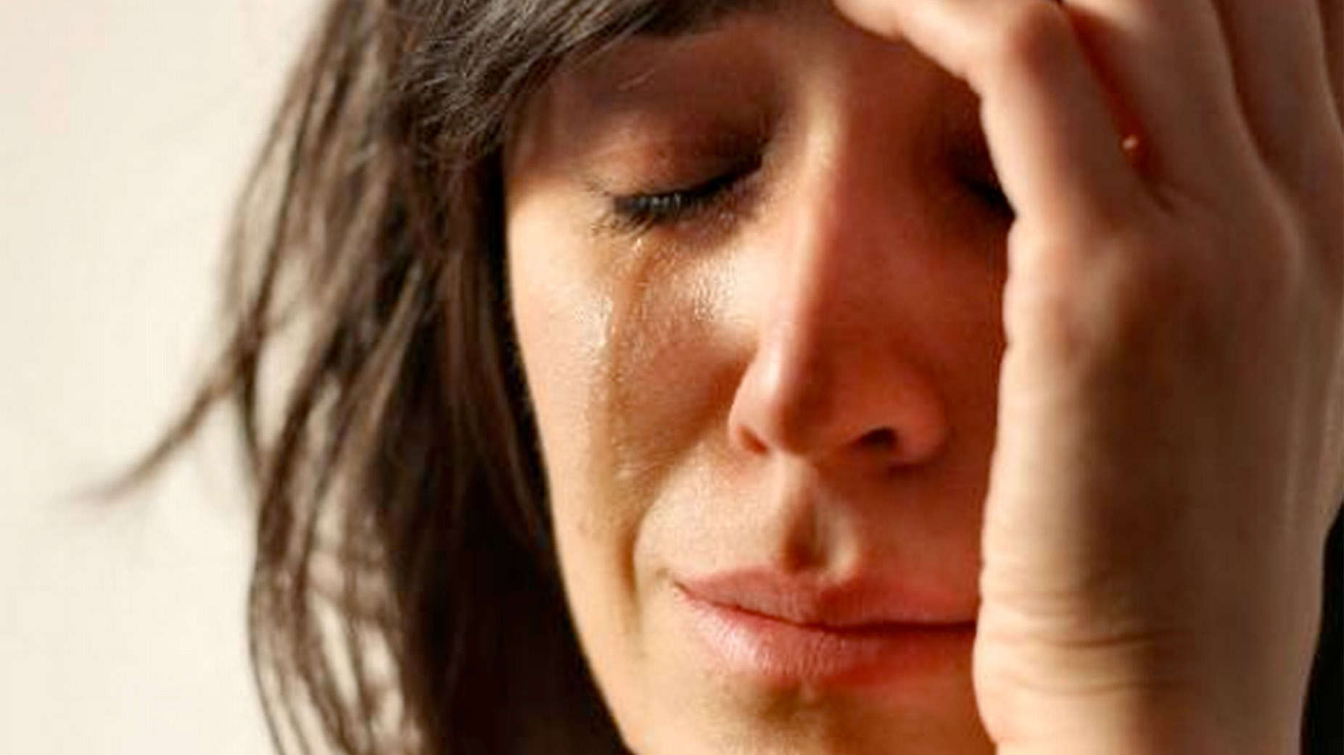
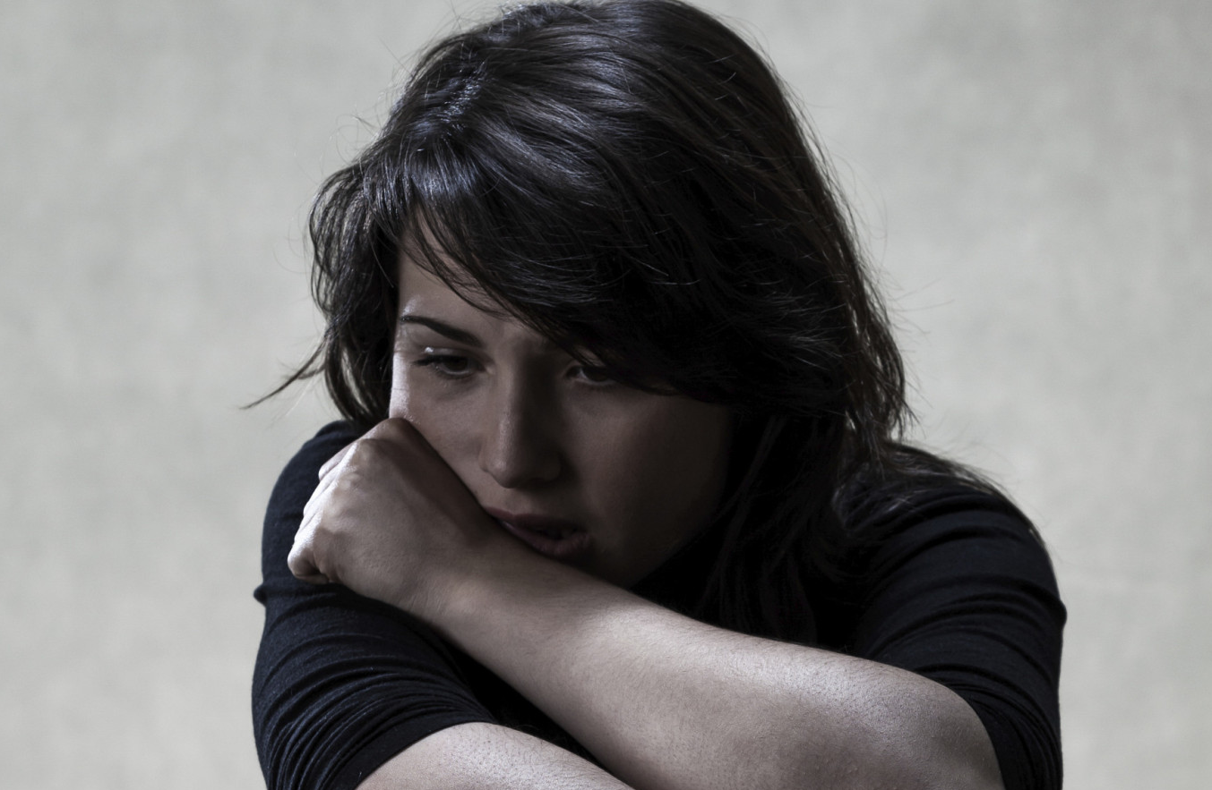
You had to be a woman
There was nothing that would stop or get in our way
Let my love take you higher
When you're broken in two
Who I am today
It was '94
So when you're lost
and you're tired
You worked two jobs
I don't know what I'd do if you left me
You were so brave
Cause I...
I admire you
TURN TO YOU
—— phrase “turn to sb.”
制作者：华南师范大学外国语言文化学院 陈梁静
广东省河源市龙川县谷前中学 邹文芳
And I know you will
always be there for me
for the strength you've instilled in me
And you could not ignore
You were so young
No you never gave up
Cause I...
I still turn to you
Cause I...
Cause I...
You were forced to
change your ways
And I wanted more of your heart
You were just my age when you had me mom
So when you're lost
and you're tired
So when you're lost and you're tired
Then you found the lord
You gave your life to him
The year that everything started to change from before
I still turn to you
The love he had for you
I still turn to you
I turn to you
I still turn to you
To change your ways
I still turn to you
I still turn to you
When you're broken in two
I still turn to you
Let my love take you higher
Let my love take you higher
You chose a life for me
So please don't go away
Everything that you are is who I am
When you're broken in two
To keep a roof above our heads

