Slide 1
Keep your head up
与Keep有关的短语
华南师范大学外国语言文化学院 肖心怡
广东省河源市龙川县紫市中学 罗秀霞

Slide 2
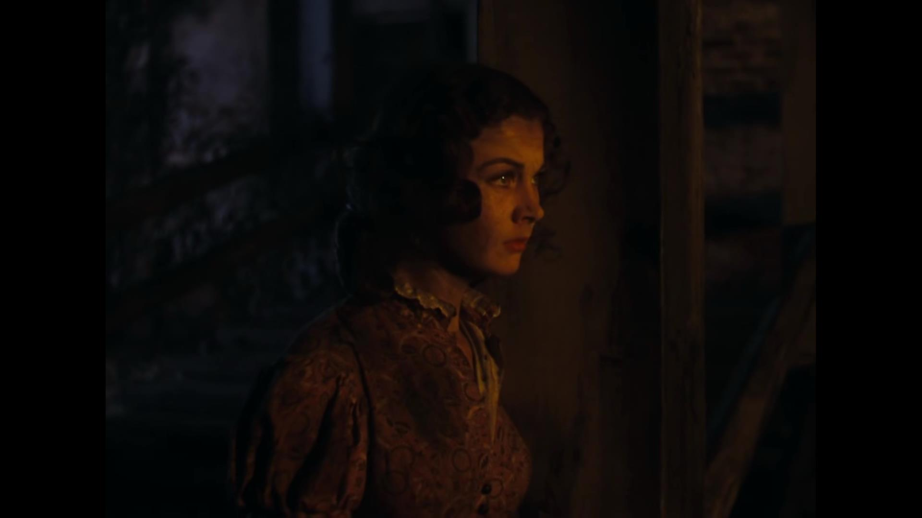
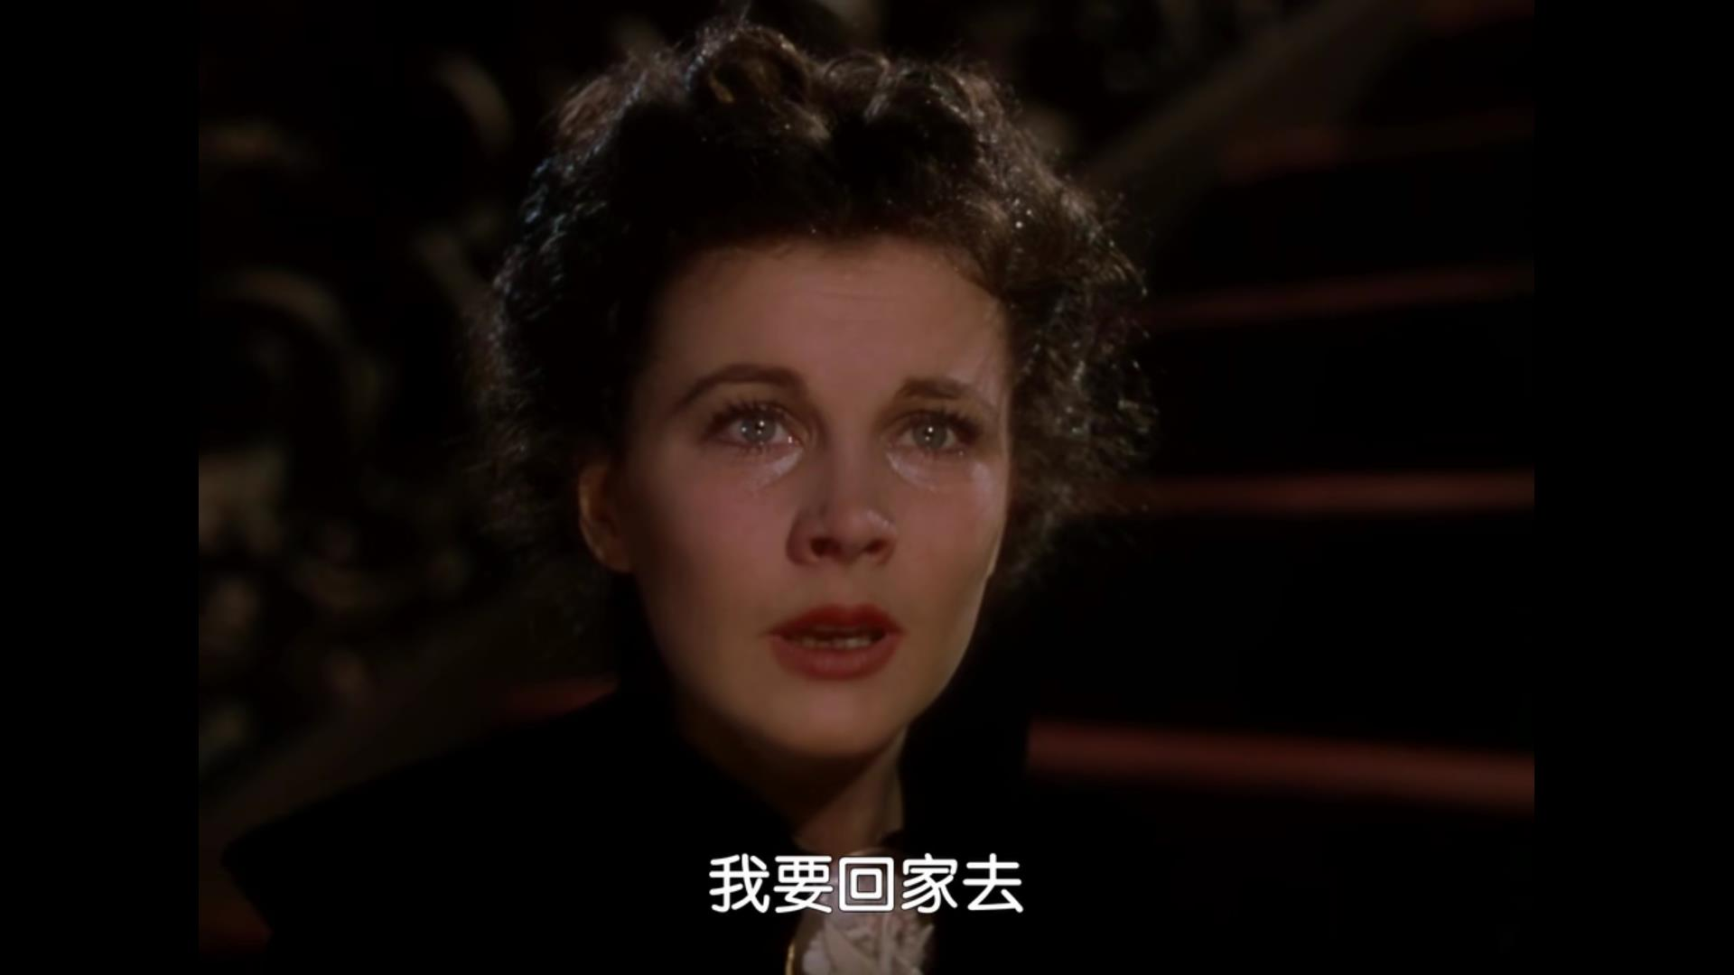
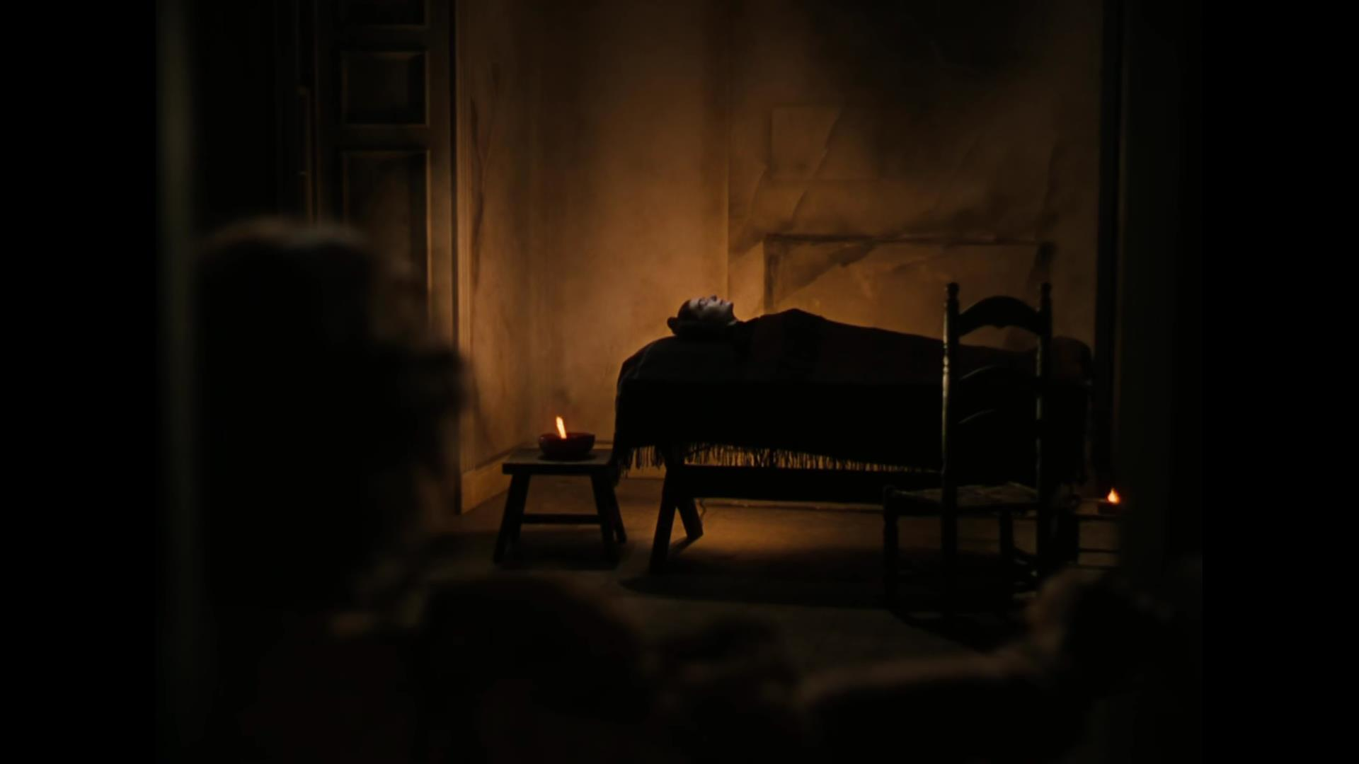
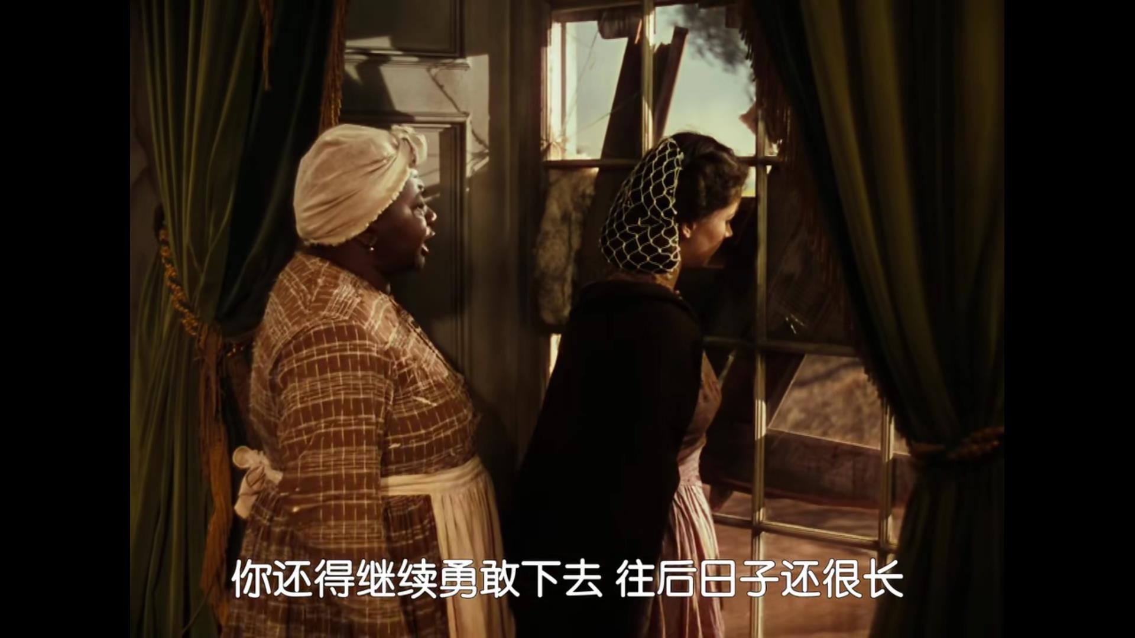
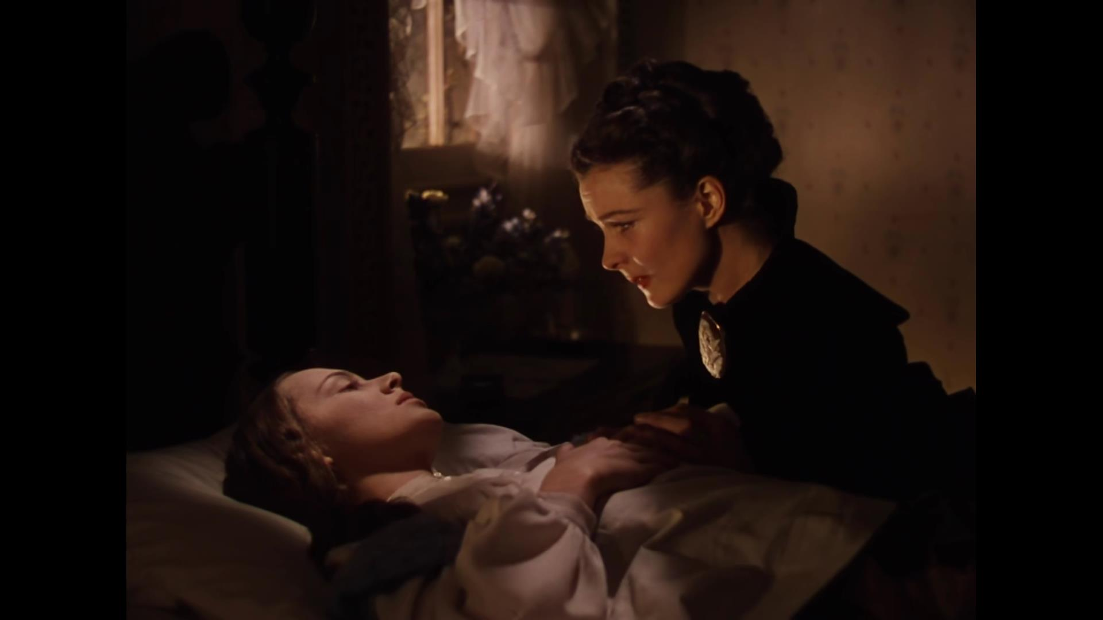
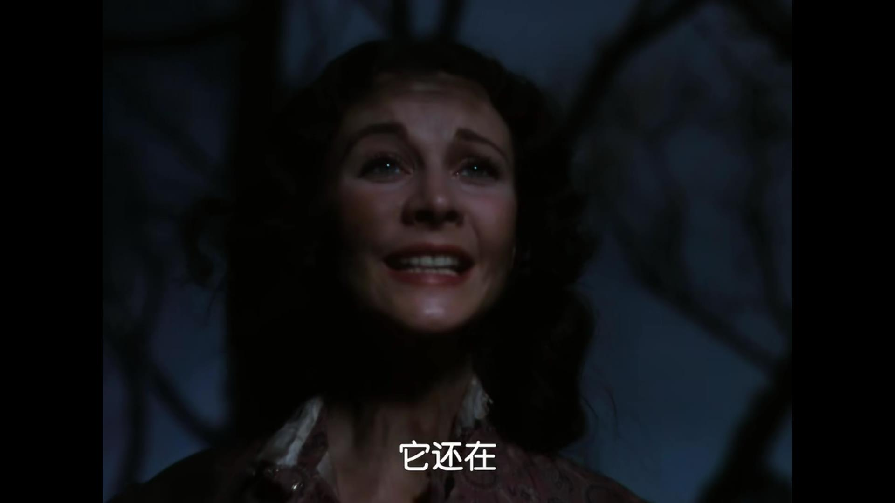
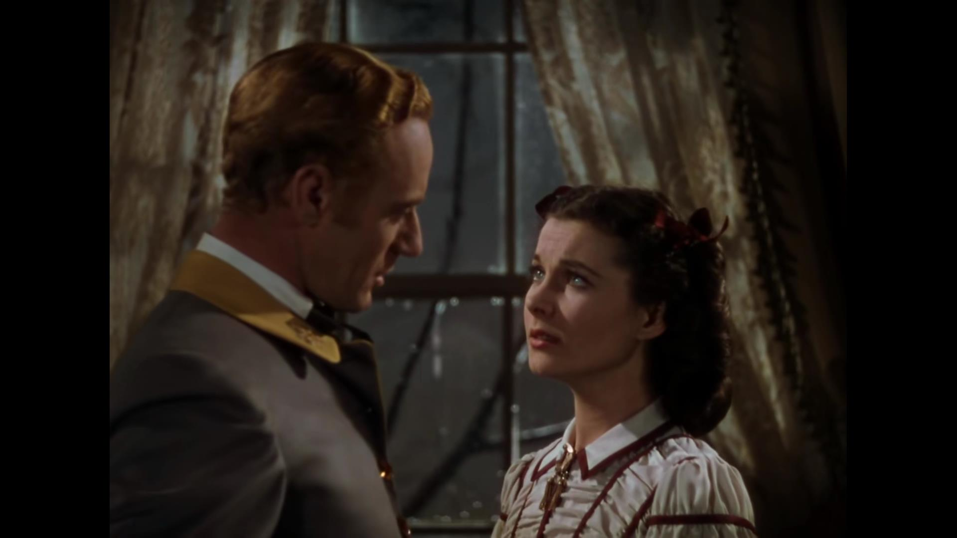
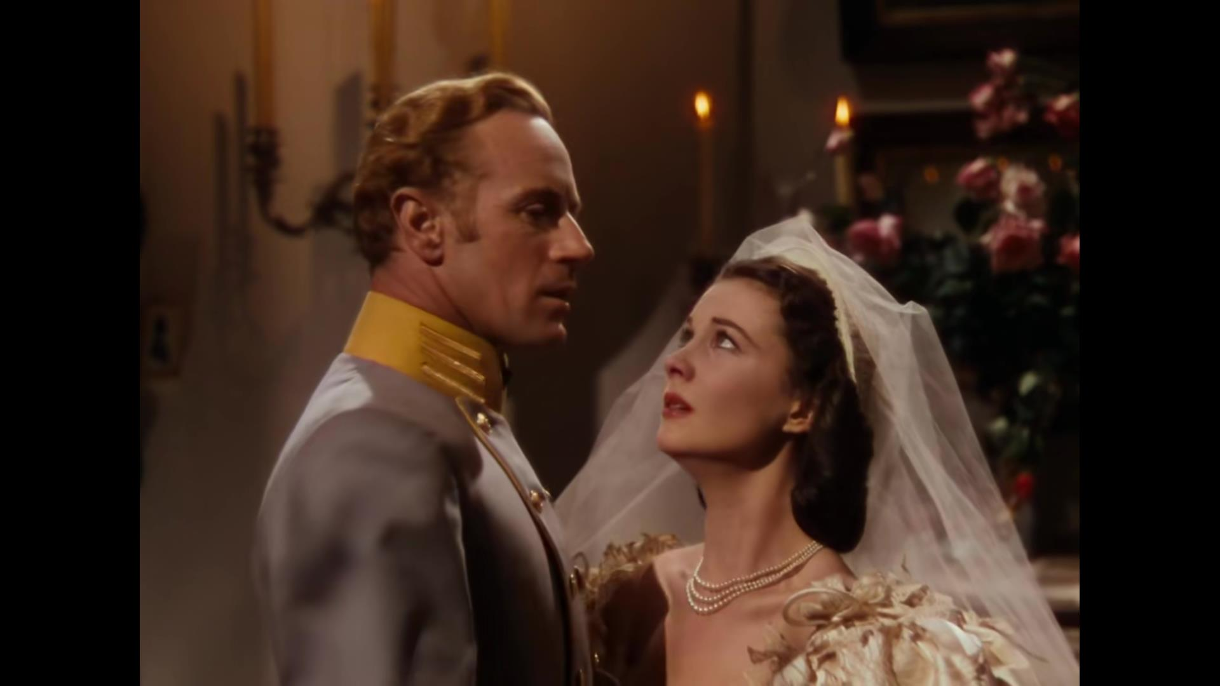
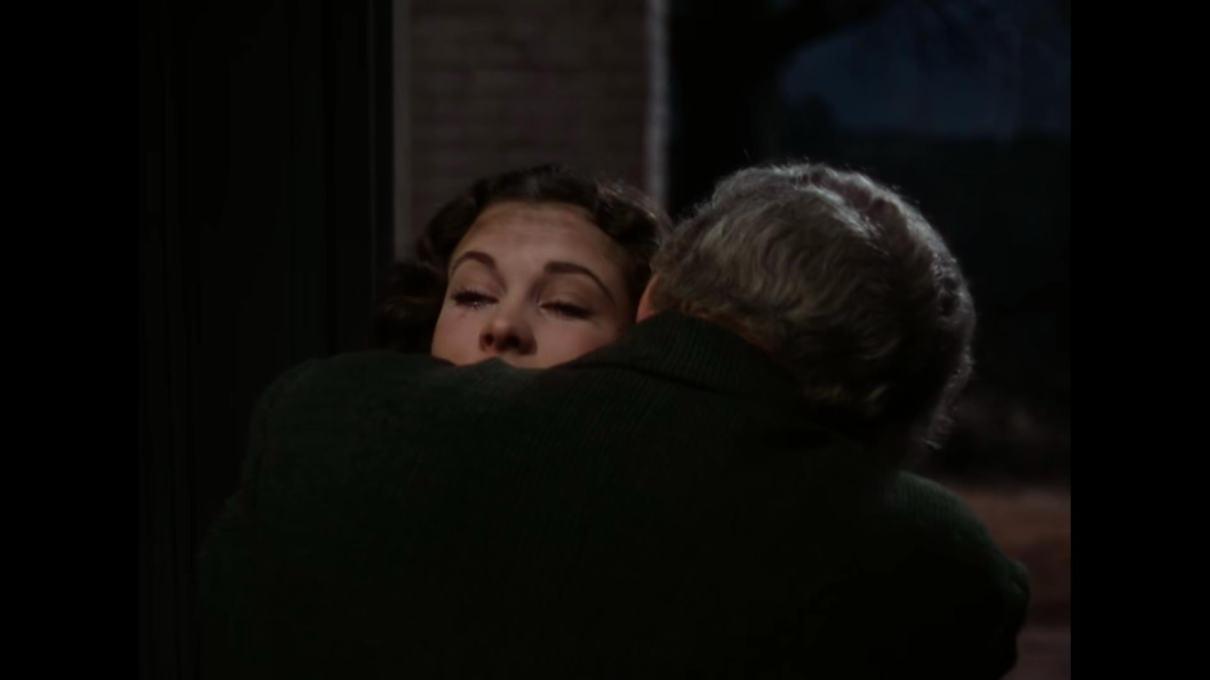
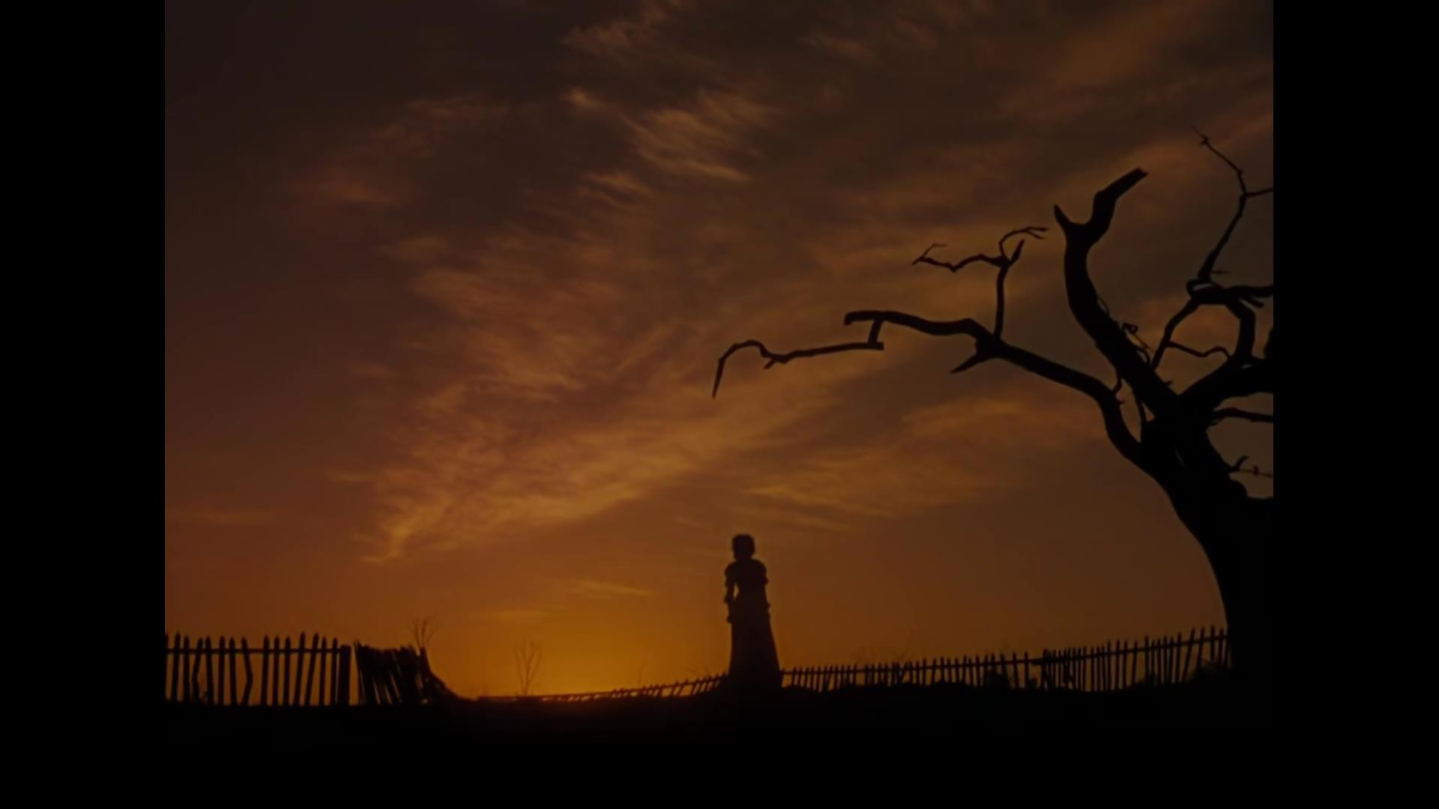
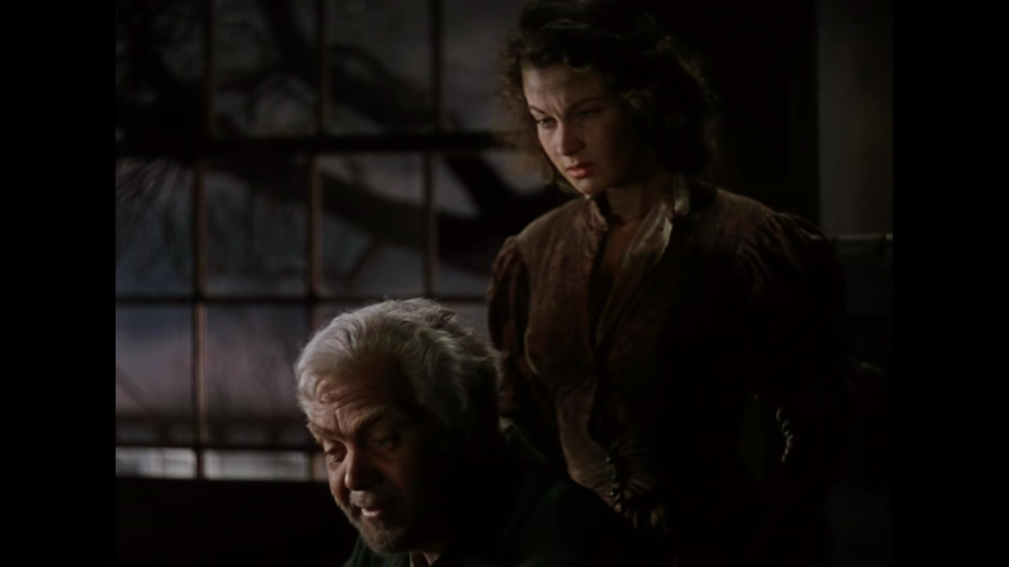
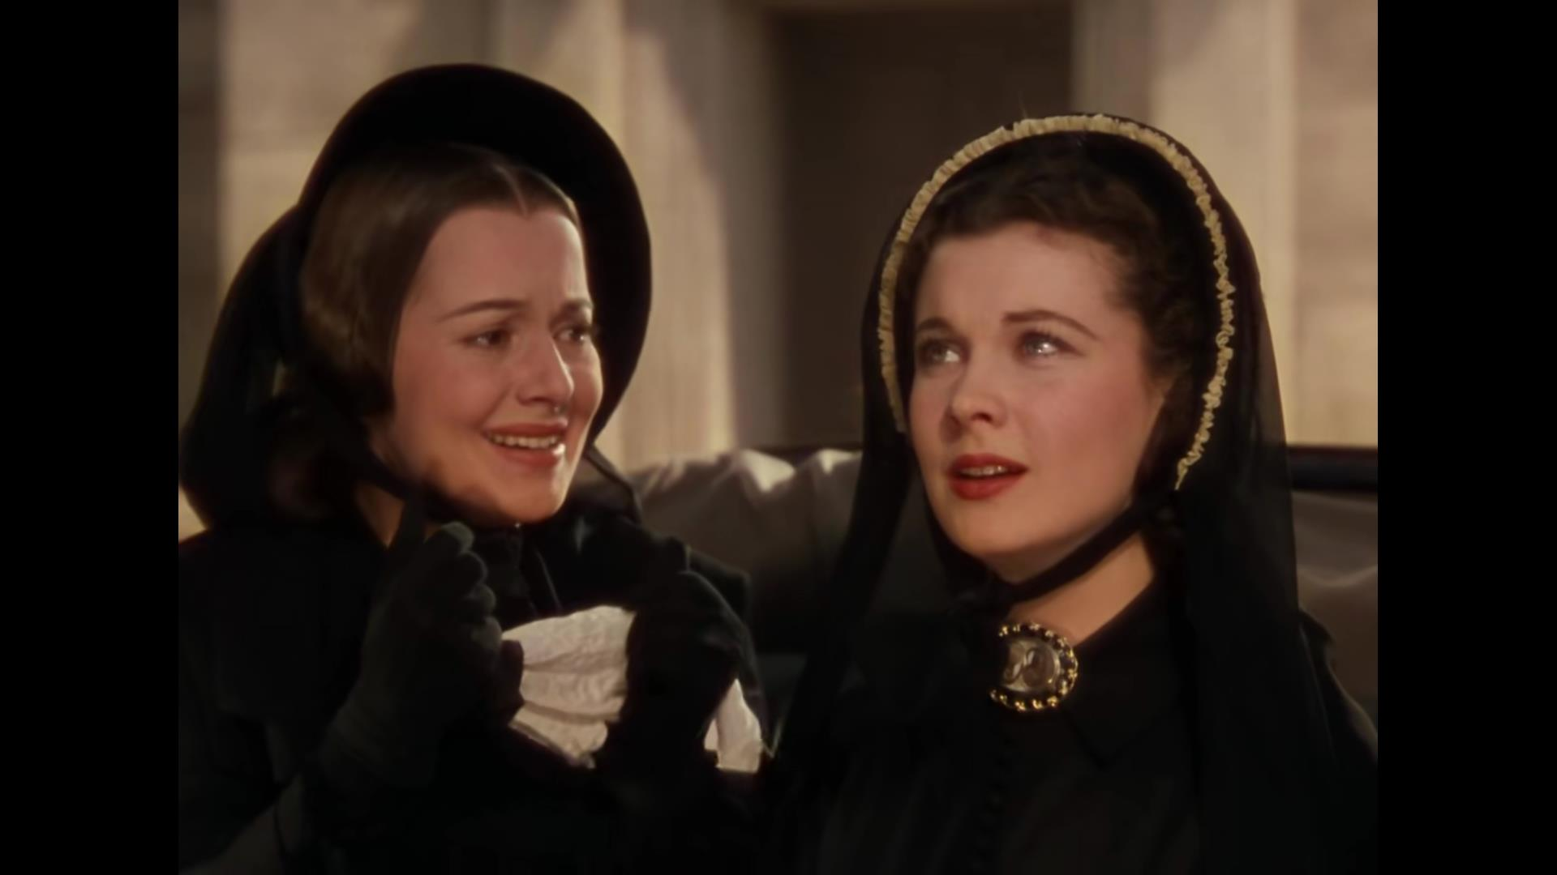
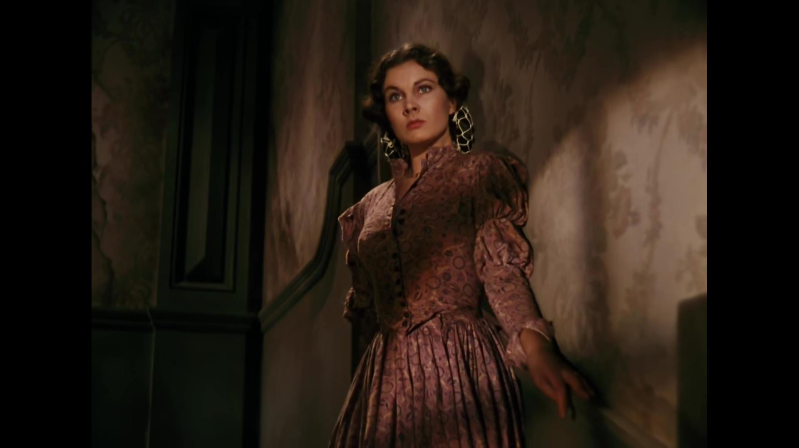
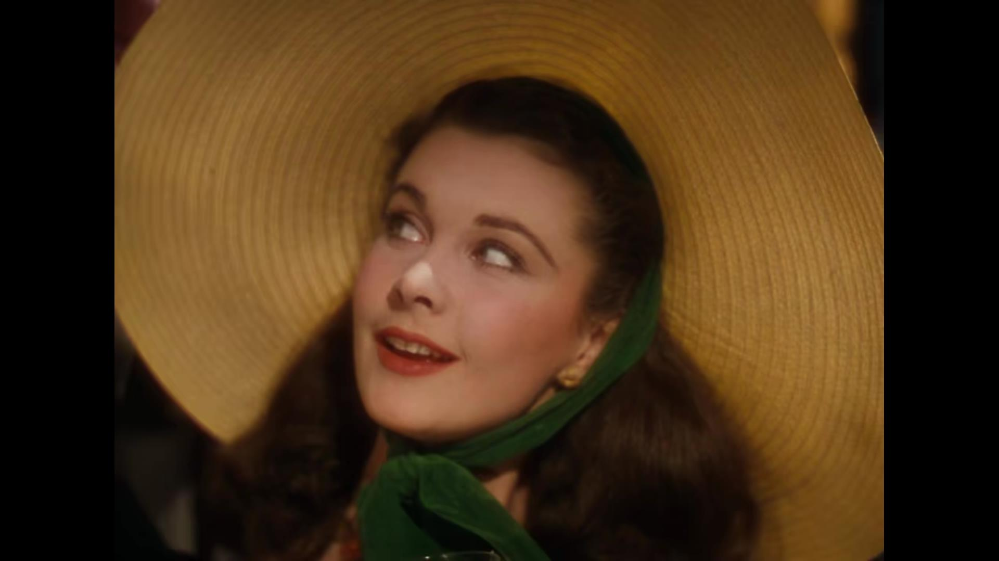
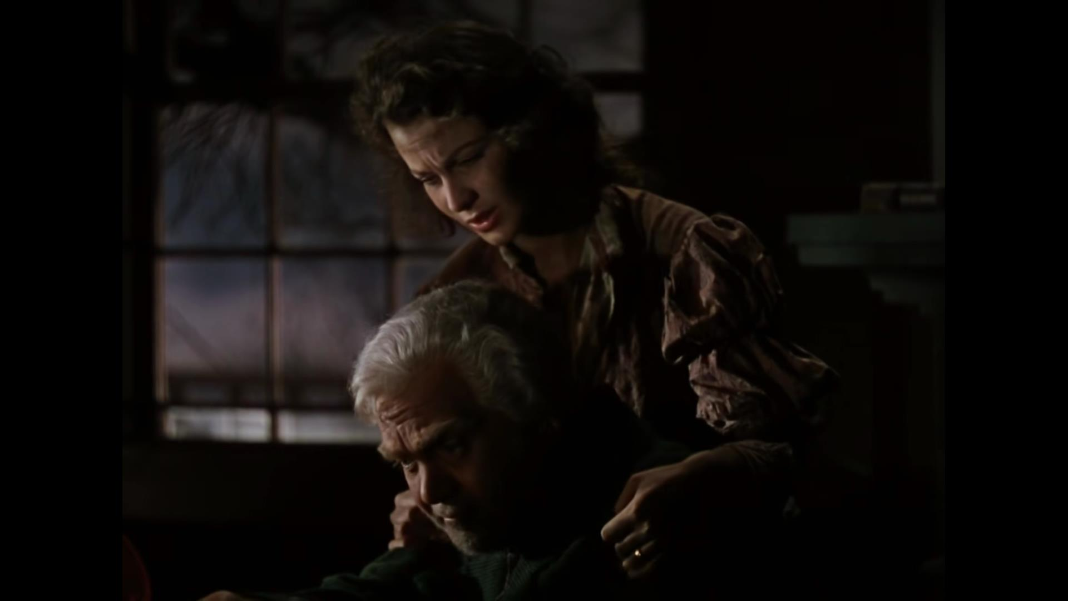
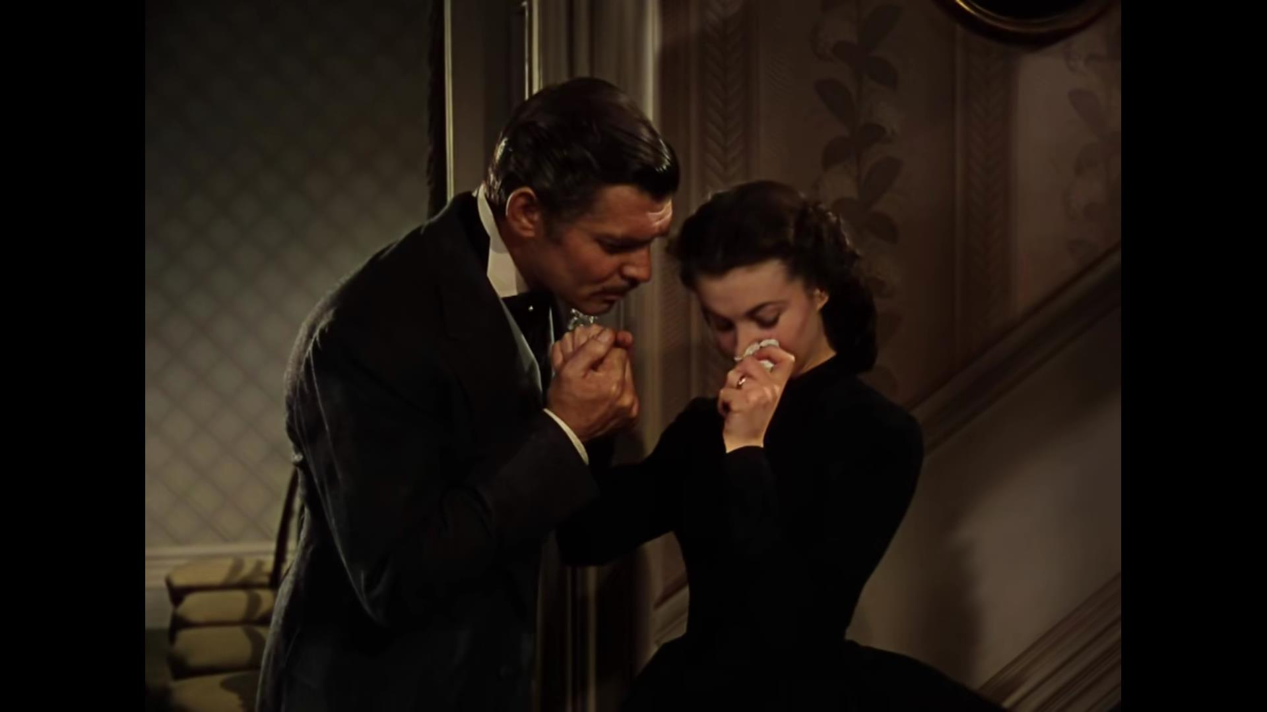
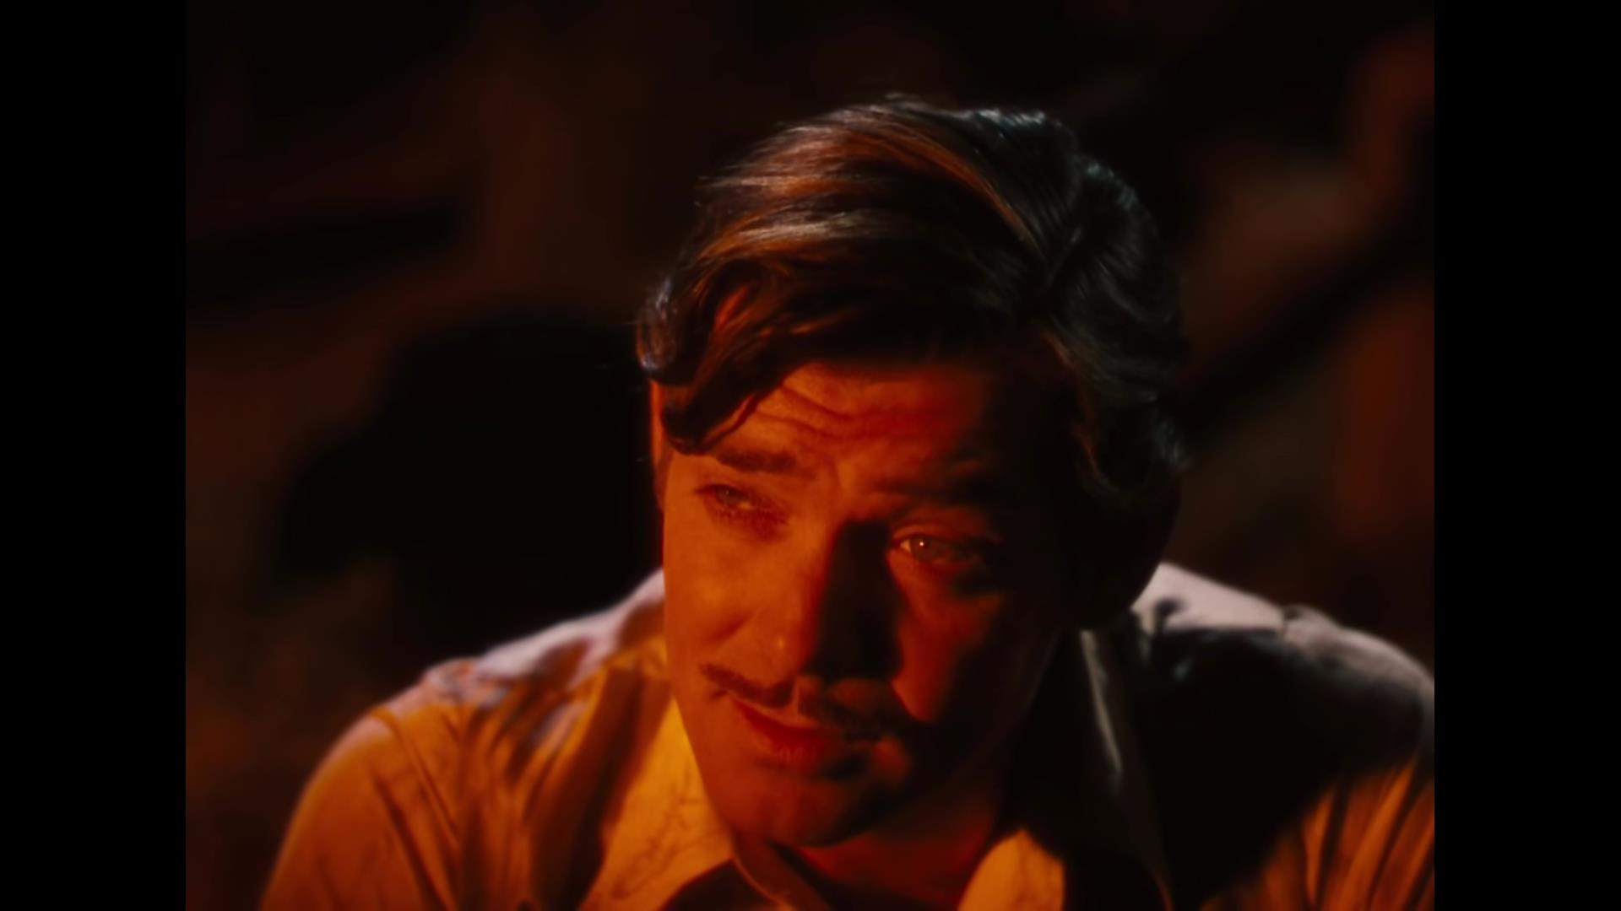
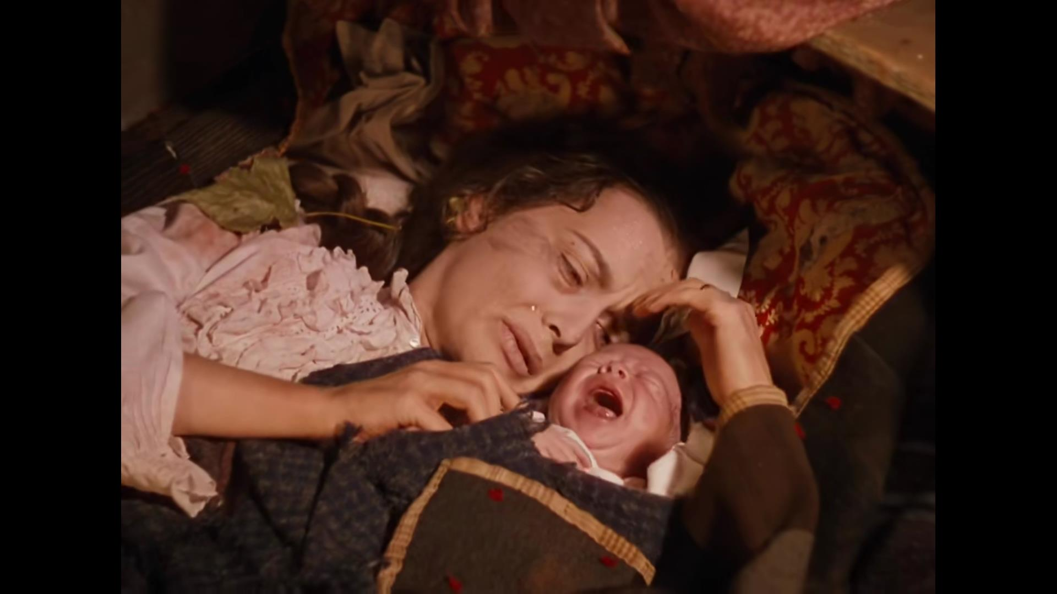
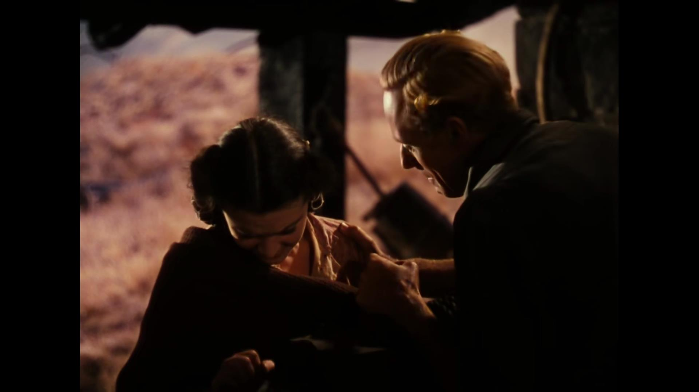
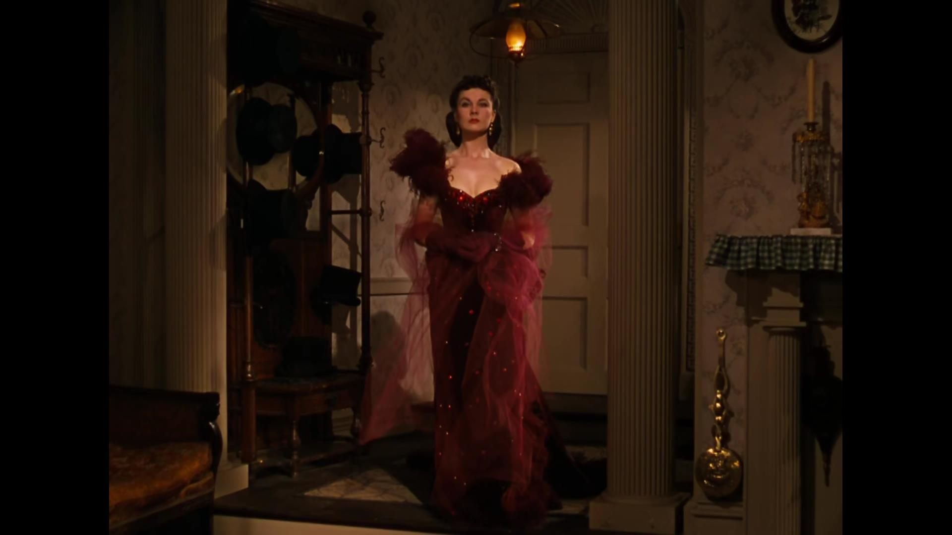
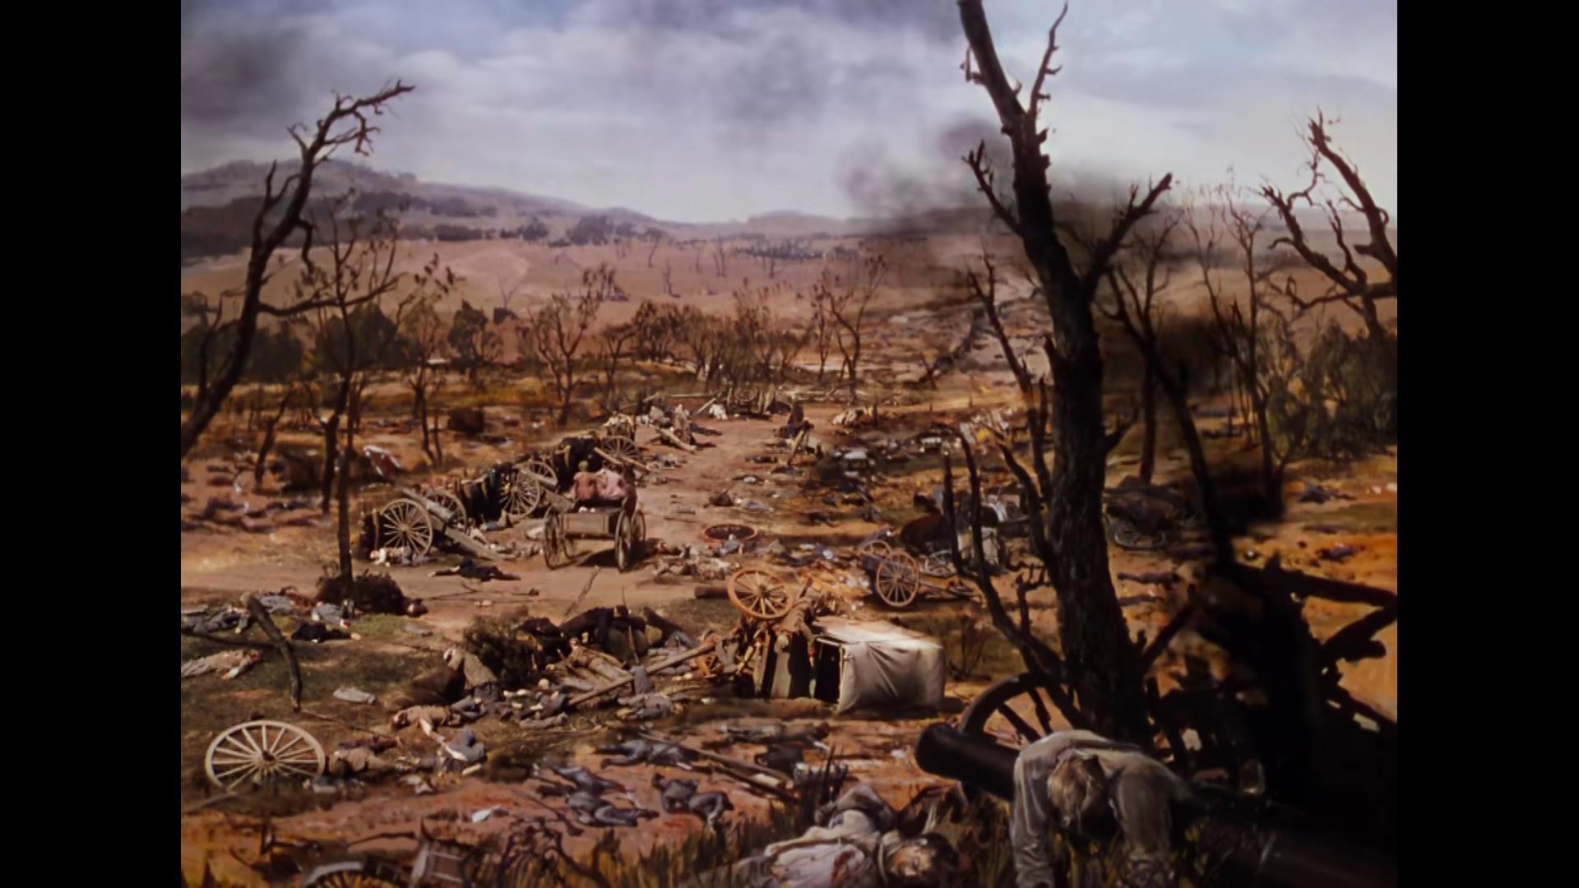
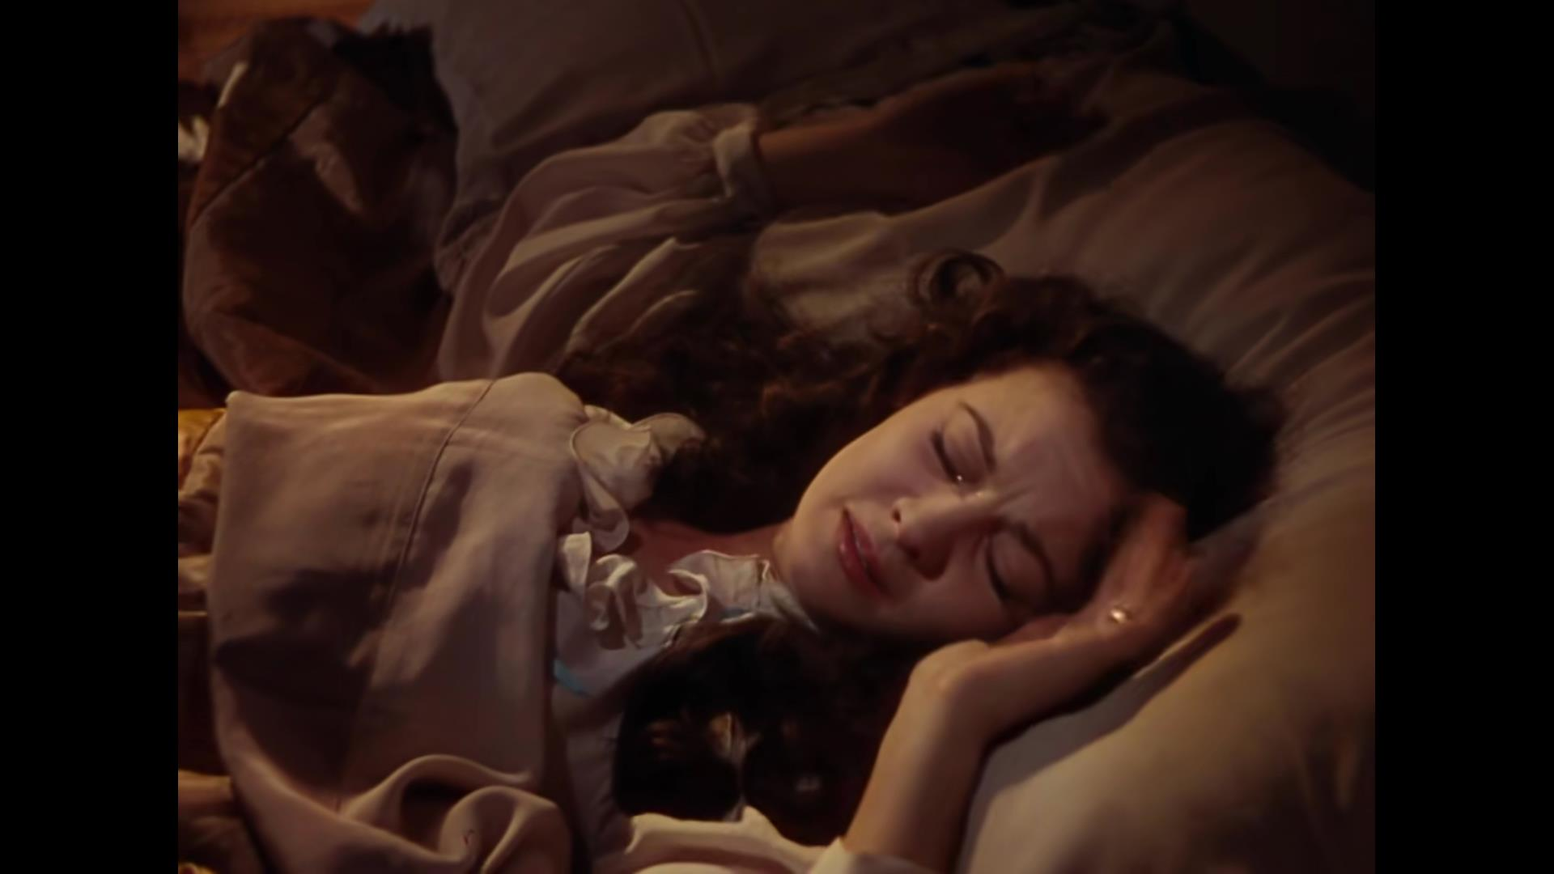
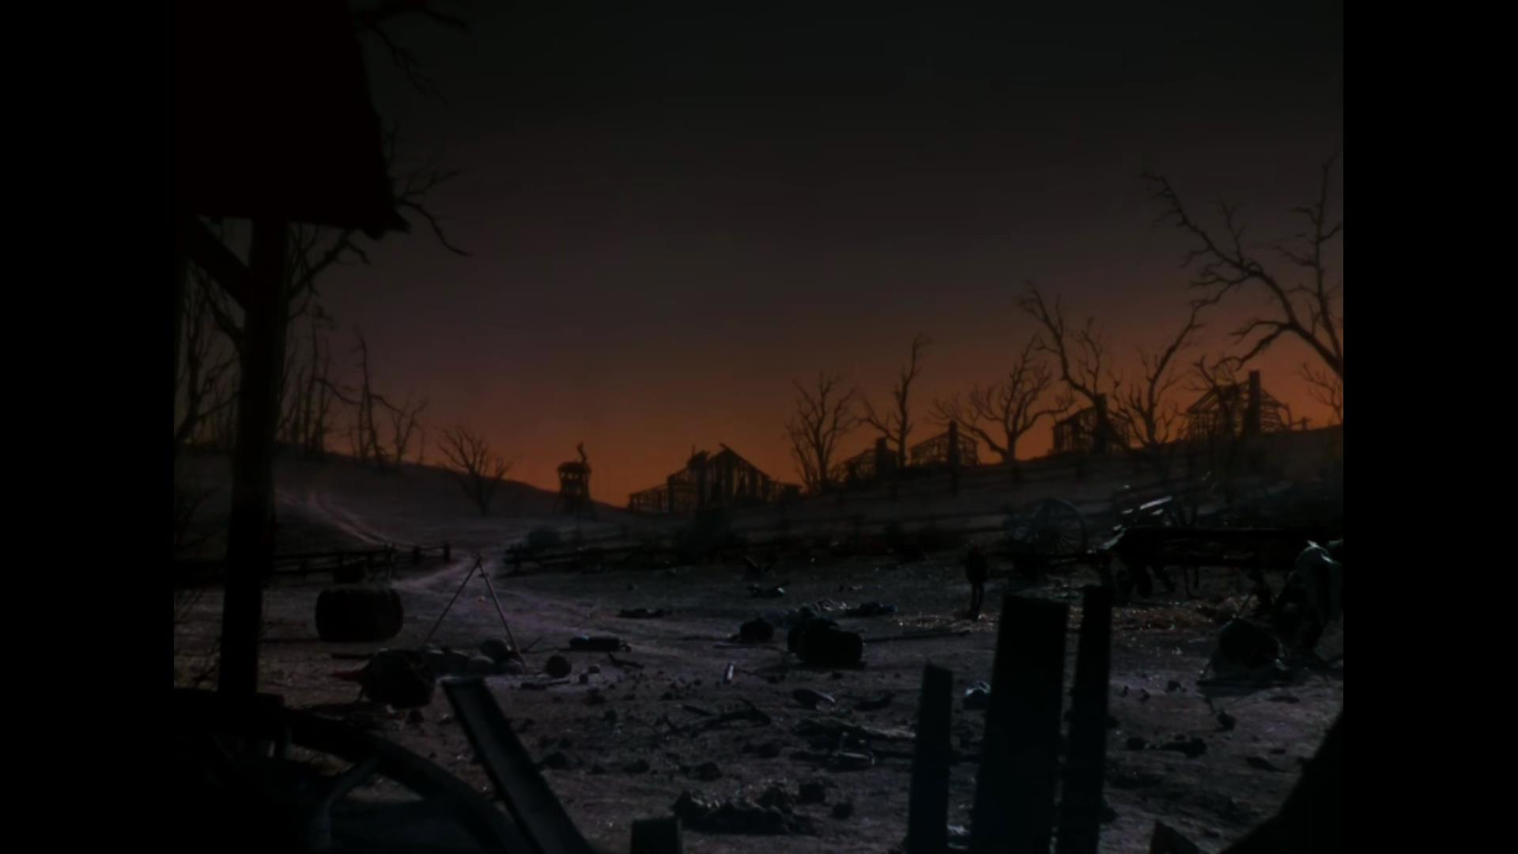
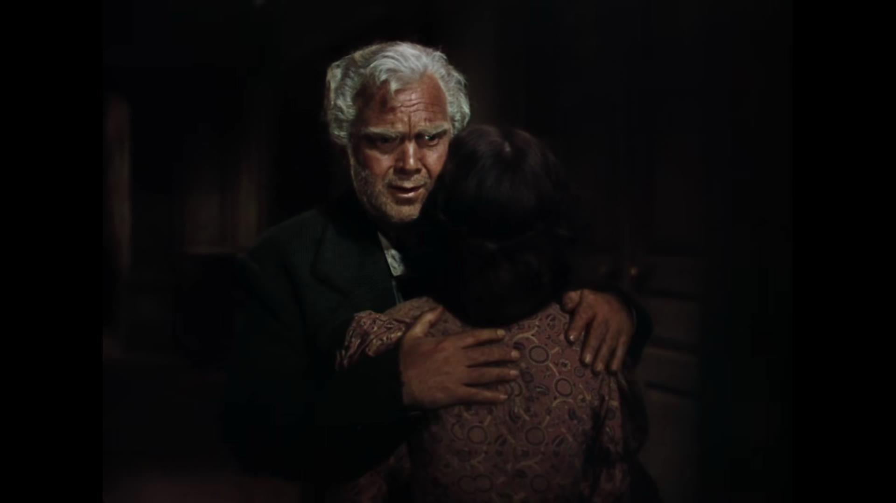
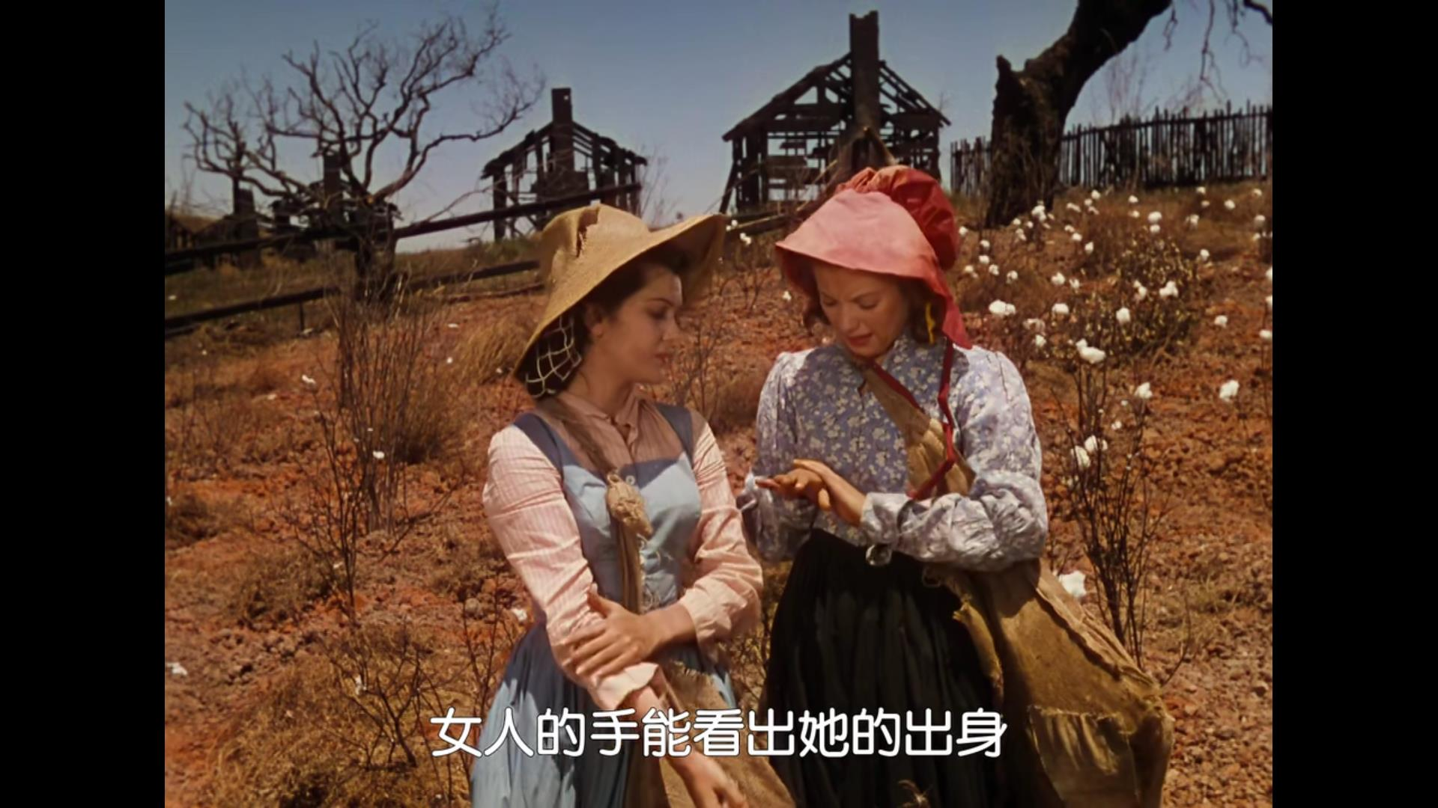
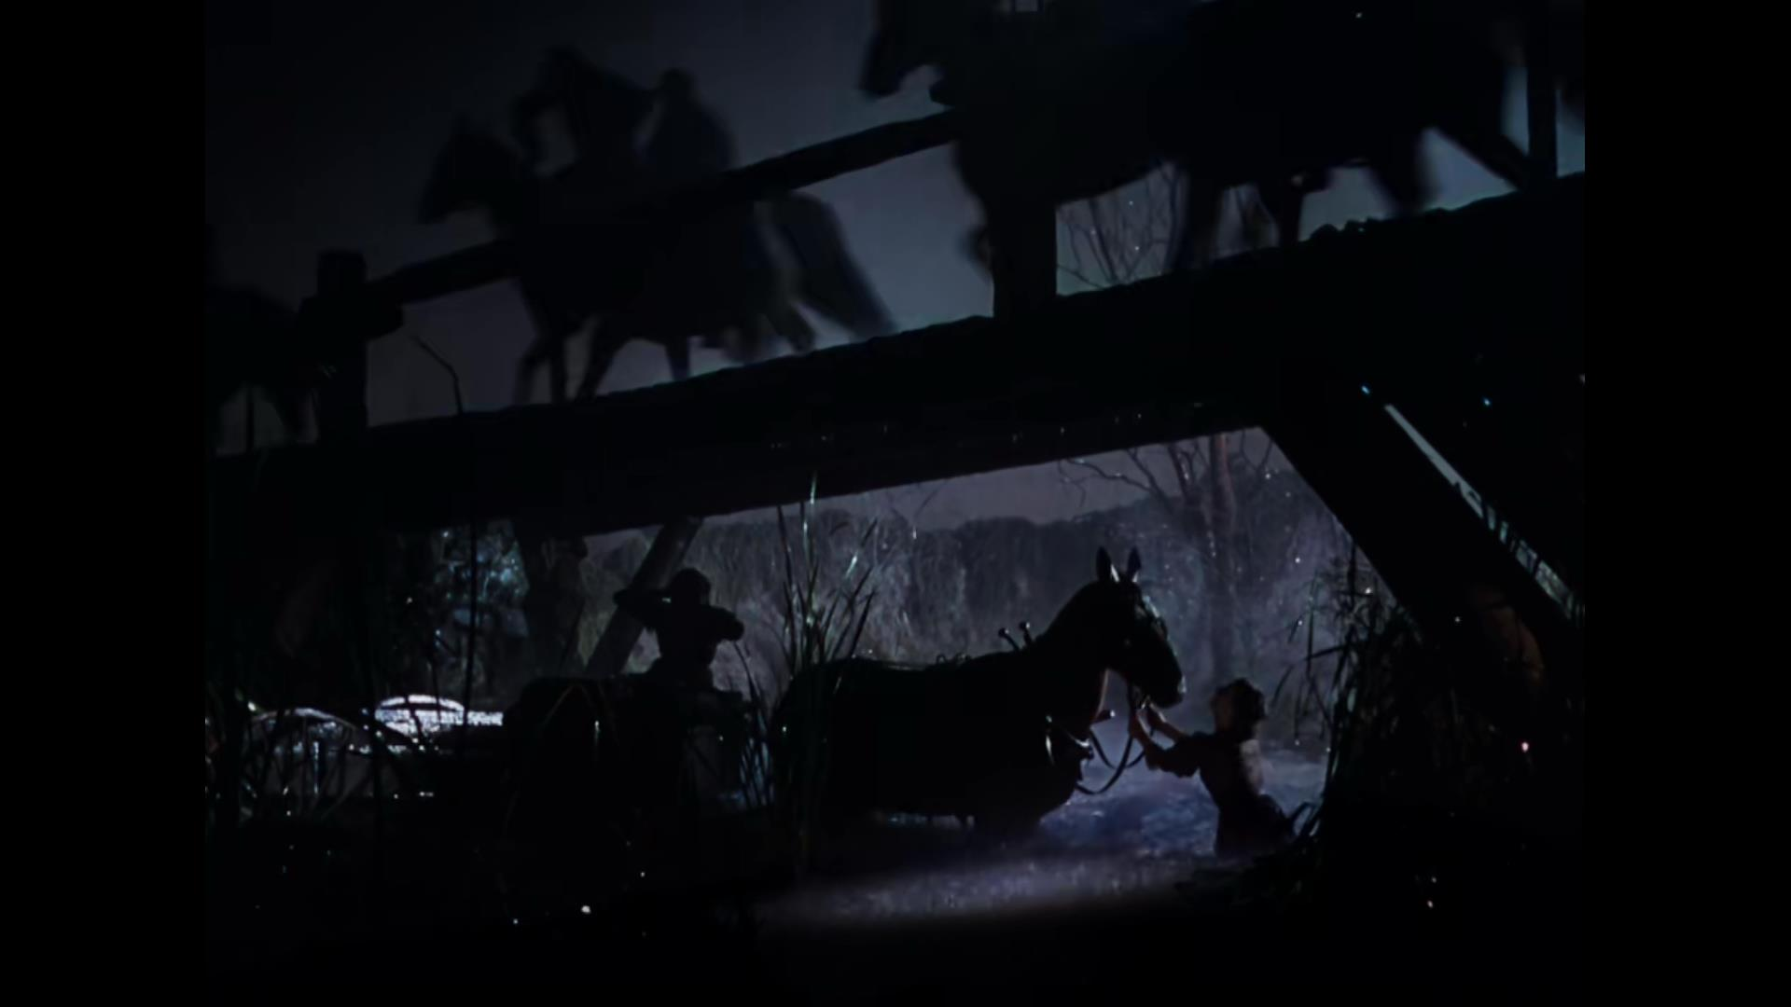
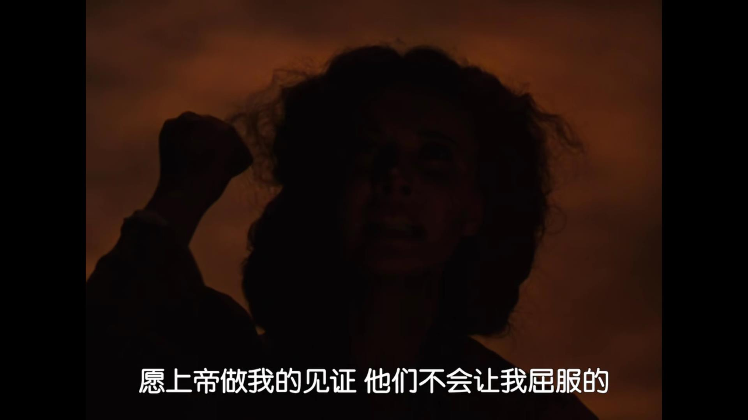
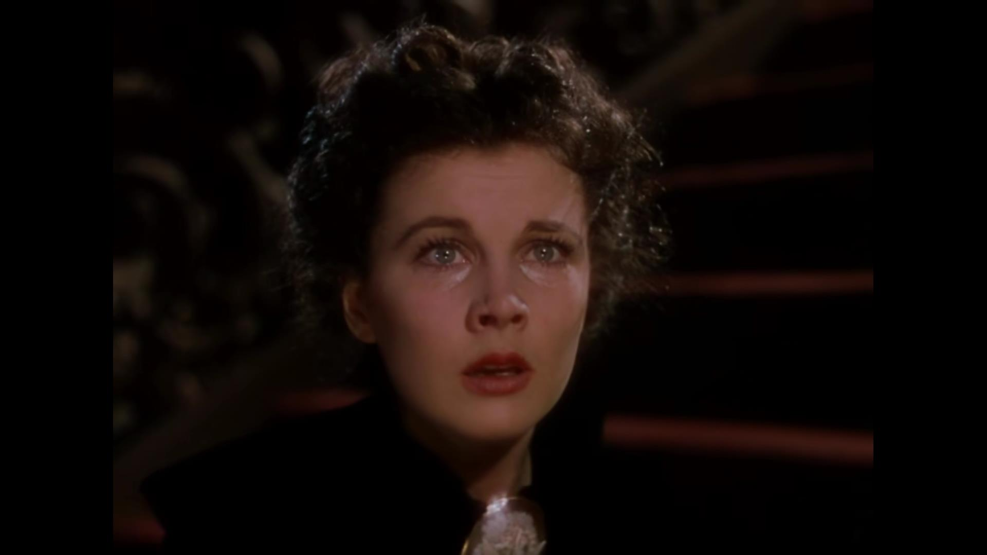
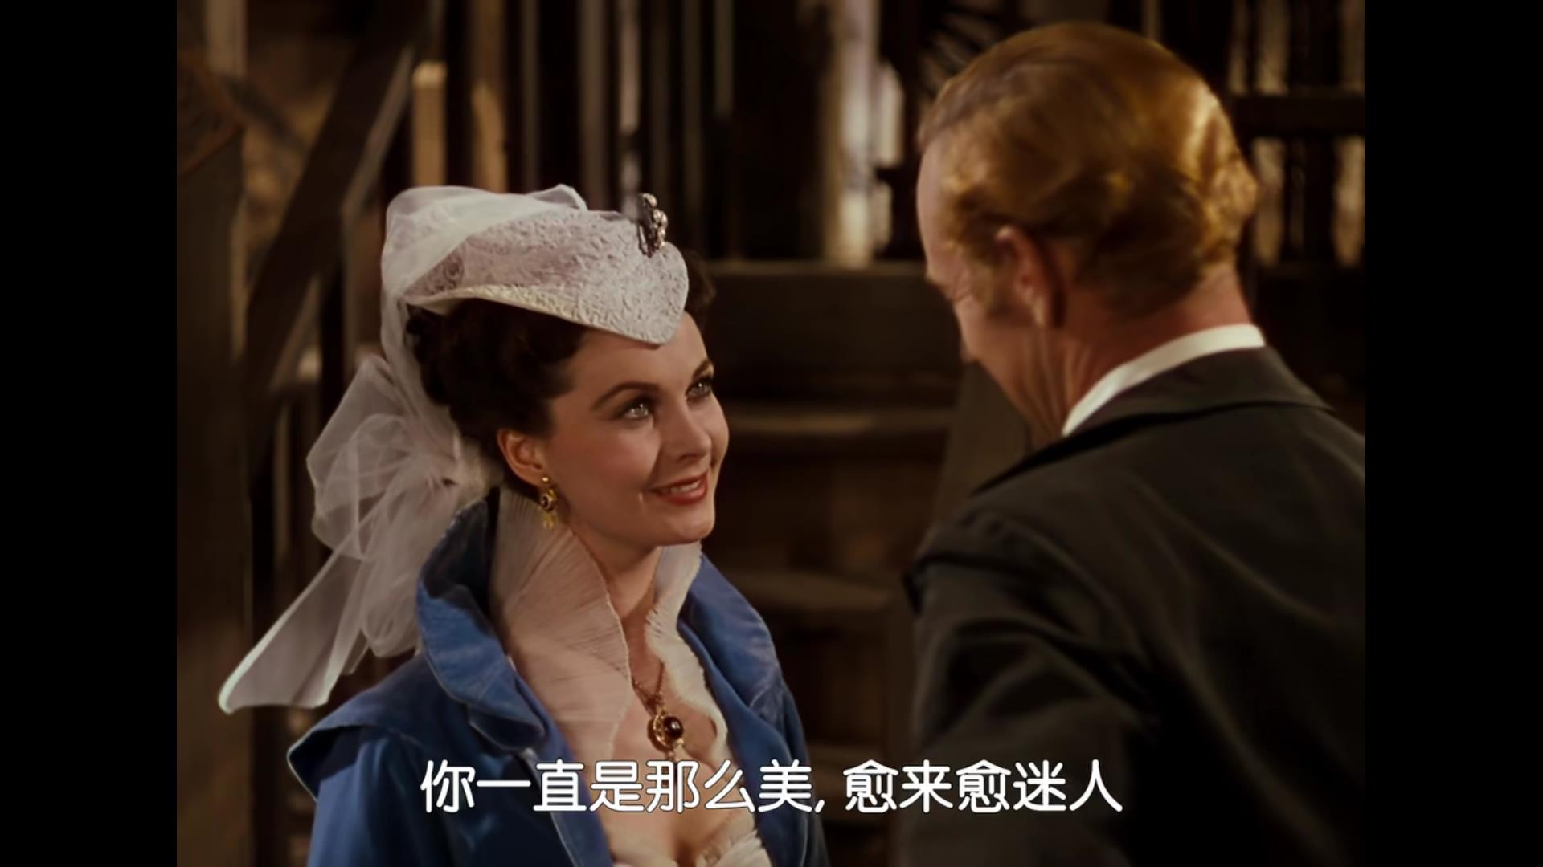
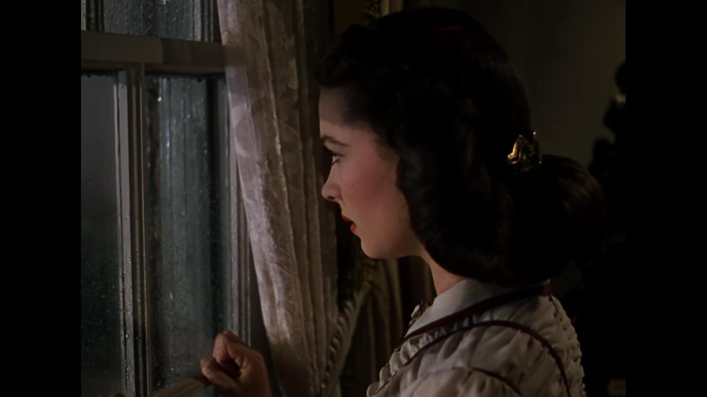
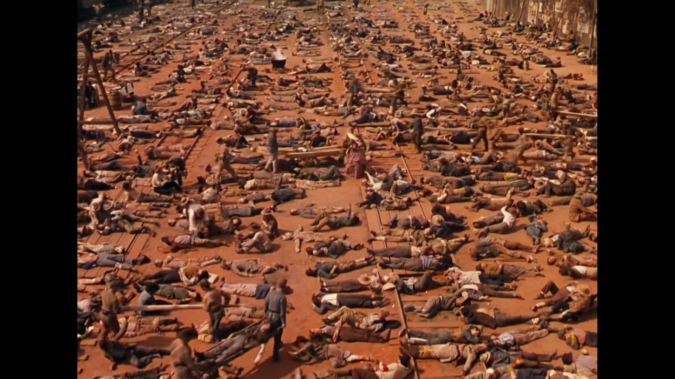
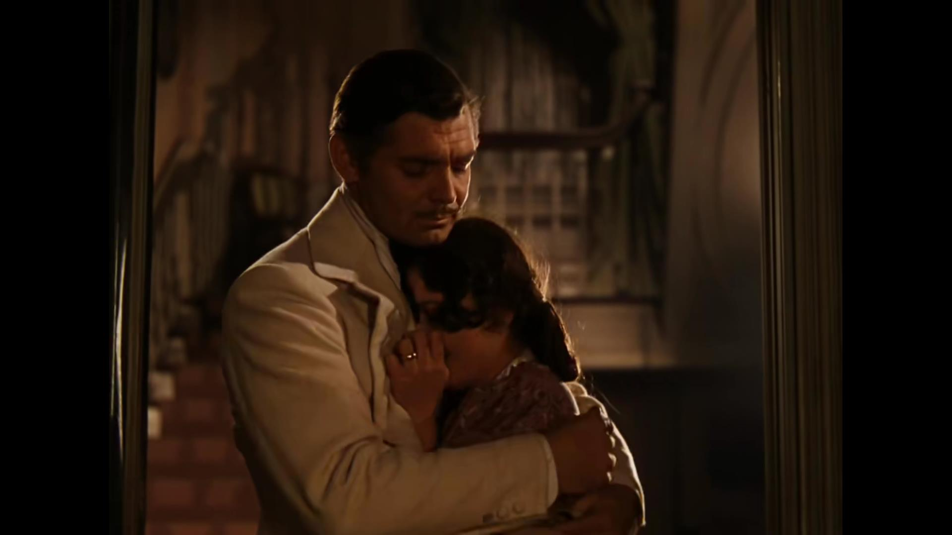
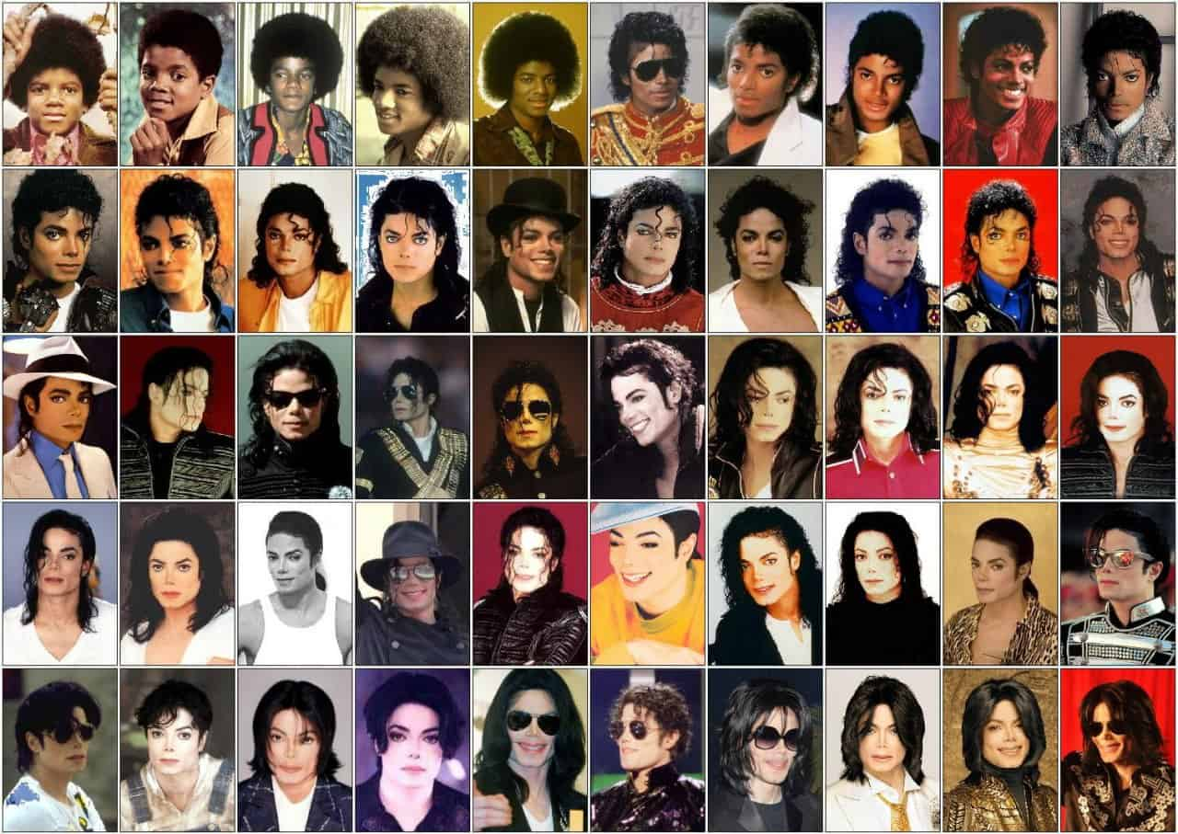
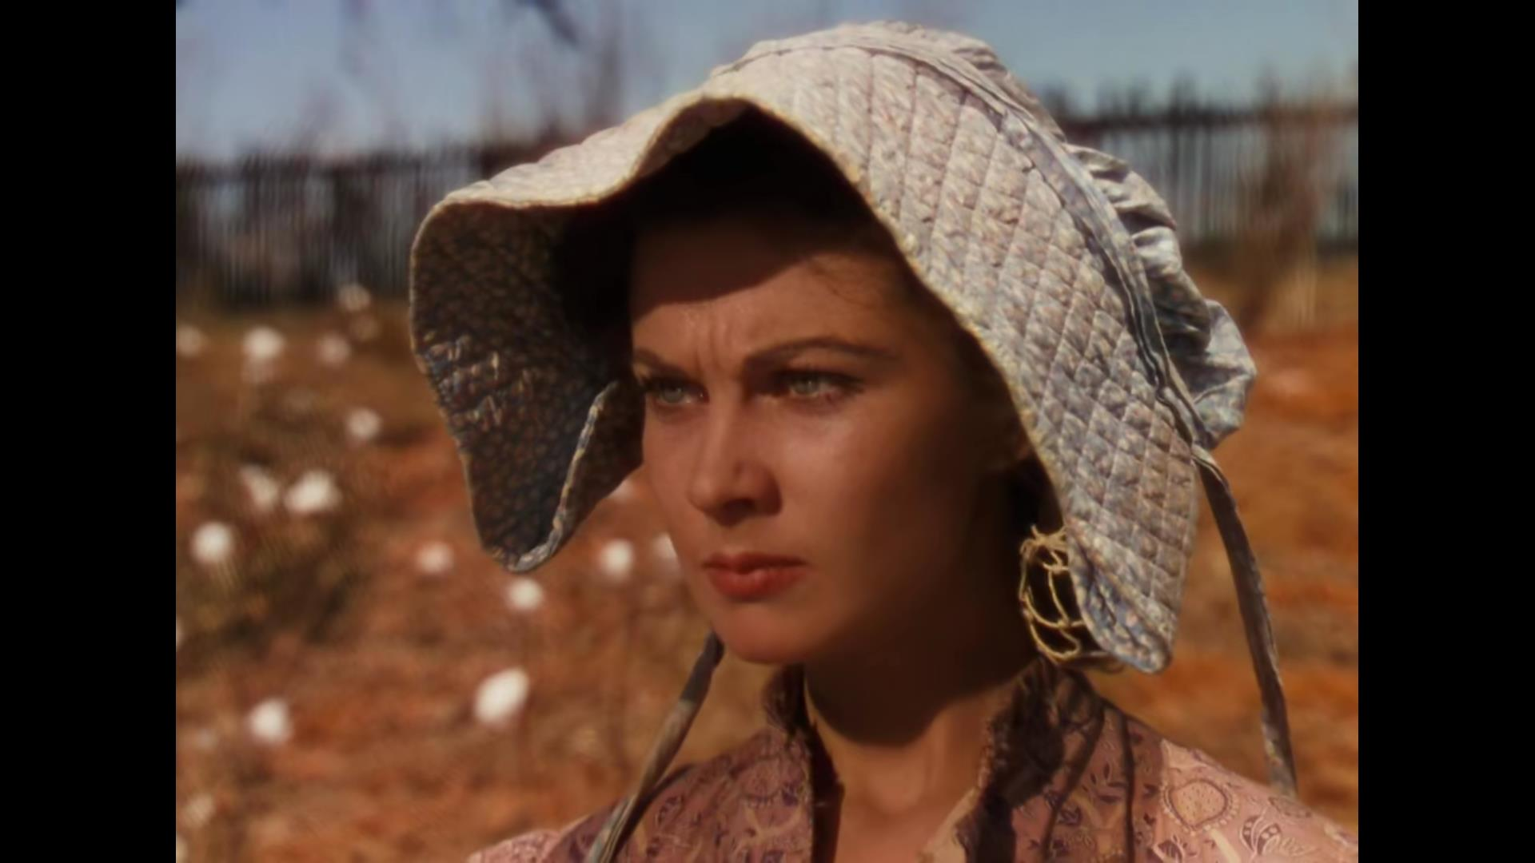
Keep your head up
Are we could just rise up, tell me now?
Give me your wings so we can fly!
Keeping your mind stay alive
Killing up the life in the birds and the trees
Are we could just rise up, tell me now
Give me your wings so we can fly!
Keeping your head up to the sky
Keep your head up, tonight
And sucking up the air in the earth from under me
Keeping your wings so we can fly
Are we could just rise up, tell me now?
She's working two jobs, keeping alive
She works in a restaurant night and day
Keeping your wings so we can fly
Keeping your head up to the sky!
Keeping your mind stay alive
I can't even breathe!
And she is dying inside, everytime her baby cries
She cries inside everytime she feels this way
Keeping your head up to the sky!
She's looking for a job and a finer place to stay,
She waits her life away
She wipes her tears away
She's looking for the hope and the empty promises
And all you need is just a moment wanting to
Keep your head up, don't give up, today!
I wish that love would come today!
Keeping your wings so we can fly
Tell you I always come and...
Keeping your mind stay alive
How long can we wait?
All you need is love
I can't even see!
Keeping your head up to the sky
Everybody say that time is borrowed
Keeping your wings so we can fly
Give me your wings so we can fly!
Keeping your head up to the sky!
Keeping your mind stay alive
Keeping your head up to the sky
Just give yourself a chance
Keep your head up, tonight!
Fight the circumstance
And hanging down your head is no good
Are we could just rise up, tell me now?
And if your day arrives...tomorrow
Keeping your head up to the sky!
Keeping your head up to the sky
Keep your head up, tonight!
Keep your head up, tonight!
Rising too, again!
Give me your wings so we can fly!

