Slide 1
Today Will Be Better, I Swear!
——Take 词组：take in
设计制作：华南师范大学外国语言文化学院 陈丽林
河源市龙川县培英学校 江满
指导教师：江满、刘晓斌

Slide 2
When you can't get up to the cold morning light

Slide 3
But you don't get to sleep in, still dreaming

Slide 4
And everybody only wants to fight

Slide 5
You're up against never being right
When the worries of the world hold your feet
When the worries of the world hold your feet

Slide 6
And there's little left to believe in

Slide 7
Today, today, it's gonna be a better one

Slide 8
There's nothing more to take in going wrong
There's nothing more to take in going wrong

Slide 9
Today, today, it's gonna be a better one

Slide 10
There's nothing more to take in going wrong
There's nothing more to take in going wrong

Slide 11
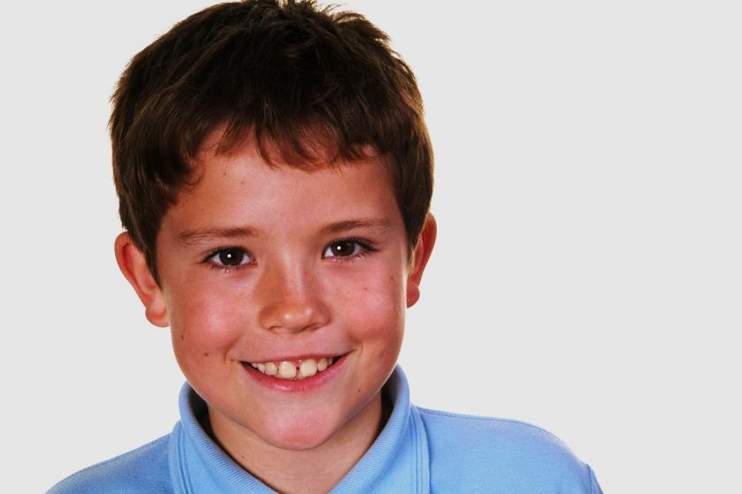

Slide 12
Old, pale memories of someone you knew

Slide 13
Keep crawling through the back of your mind, stealing time

Slide 14
And in the daylight you're crossing all your wires

Slide 15
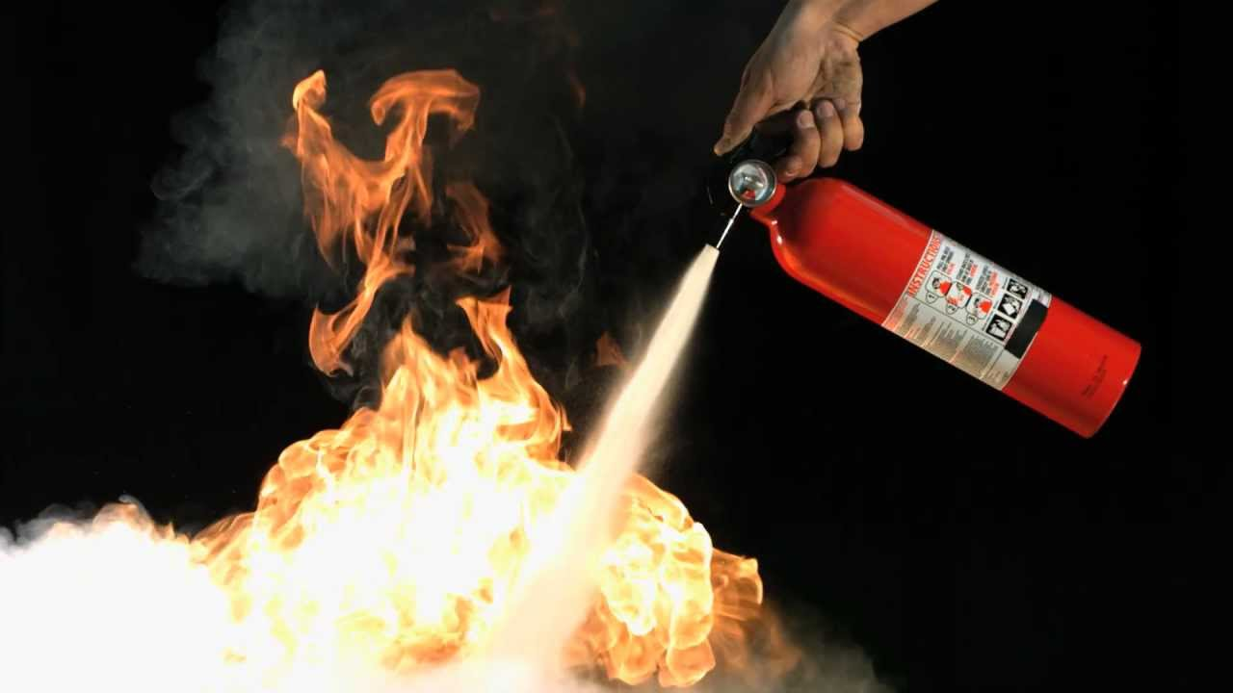
You never knew just how to put out a fire

Slide 16
And the closet's been shaken with bones
Little reminders that you're out on your own

Slide 17
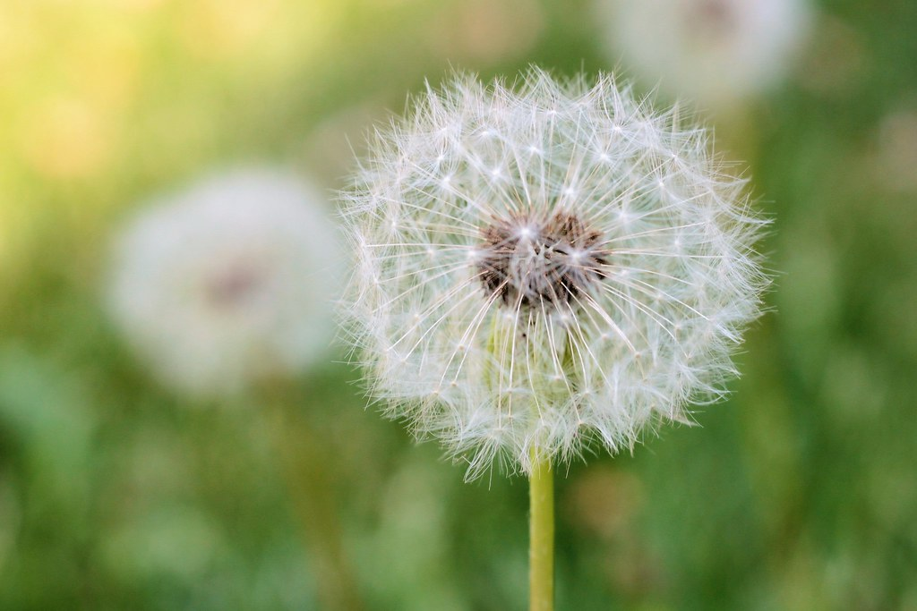
Today, today, it's gonna be a better one

Slide 18
There's nothing more to take in going wrong

Slide 19
Today, today, it's gonna be a better one

Slide 20
There's nothing more to take in going wrong

Slide 21
Today, today, keep your head and drive again

Slide 22
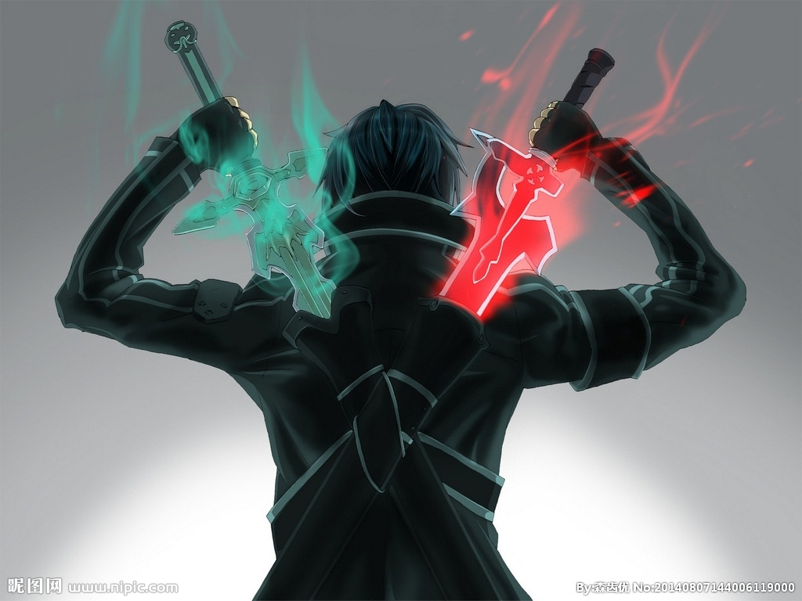
There's nothing more to battle when you go

Slide 23
Today, today, it's gonna be a better one

Slide 24
There's nothing more to take in going wrong

