Slide 1
Make you feel my love
——与make 有关的短语
课件设计：华南师范大学外文化学院 温海清
河源市永和学校 邓奕妍
指导老师：邓奕妍、刘晓斌

Slide 2
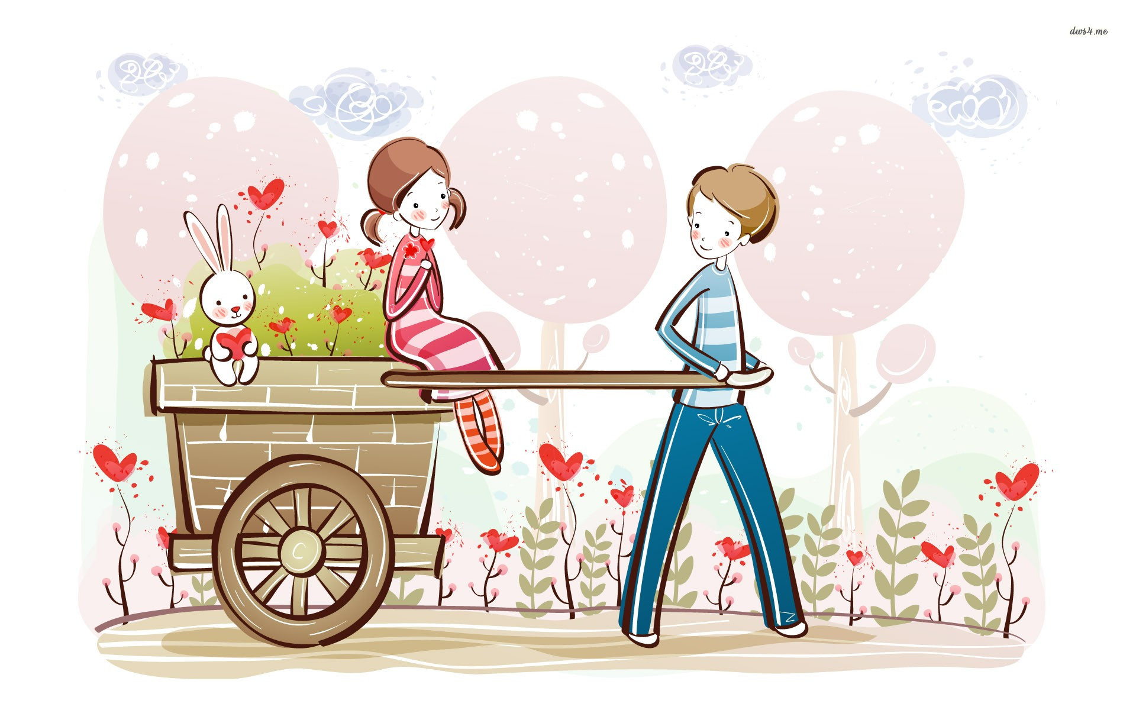
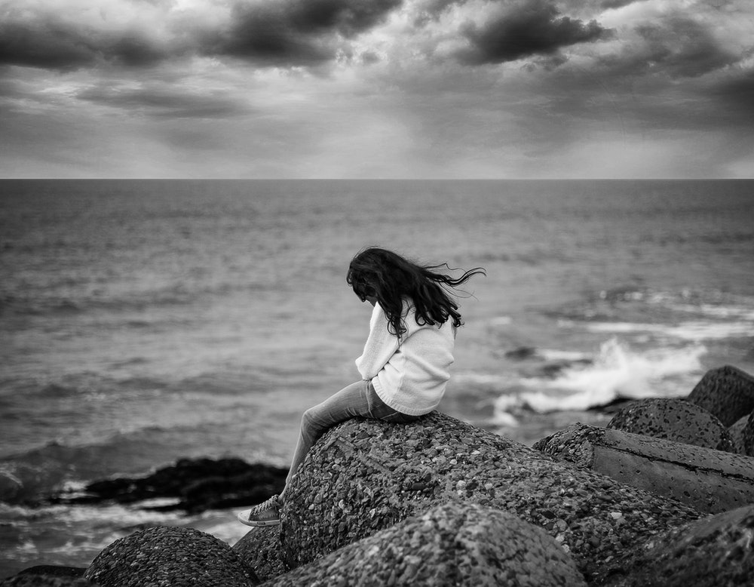
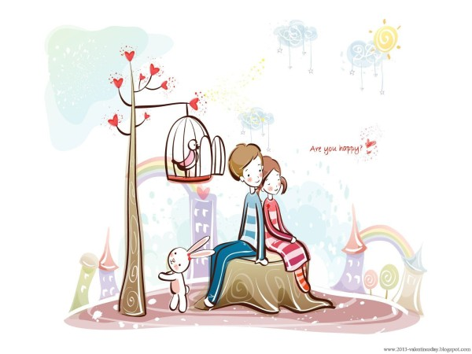
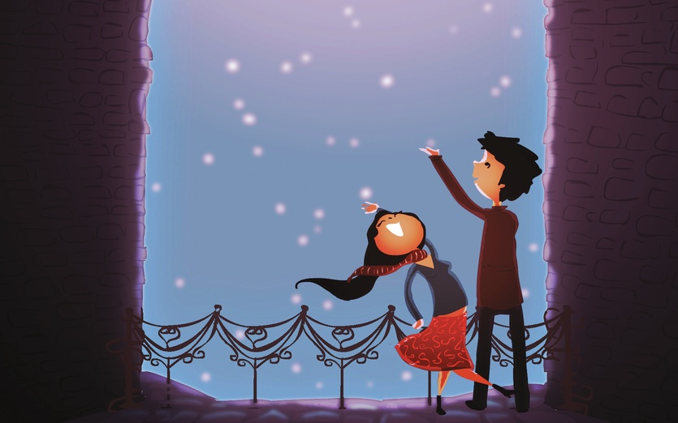
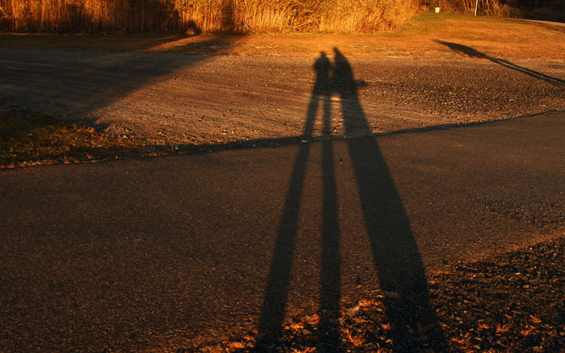
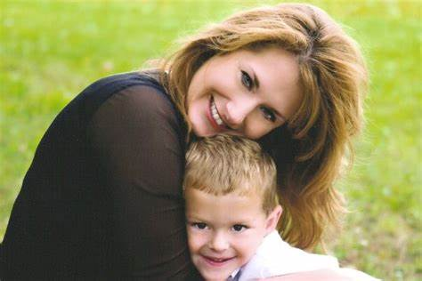
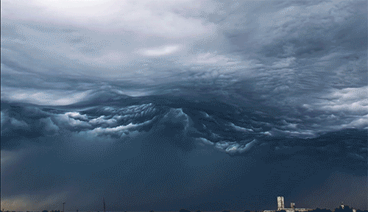
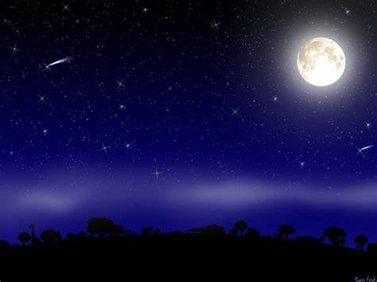
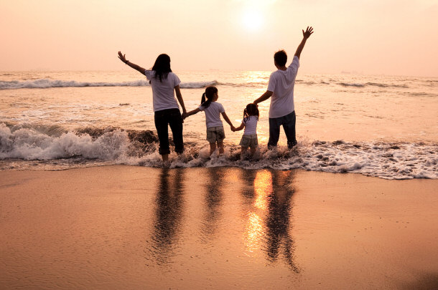
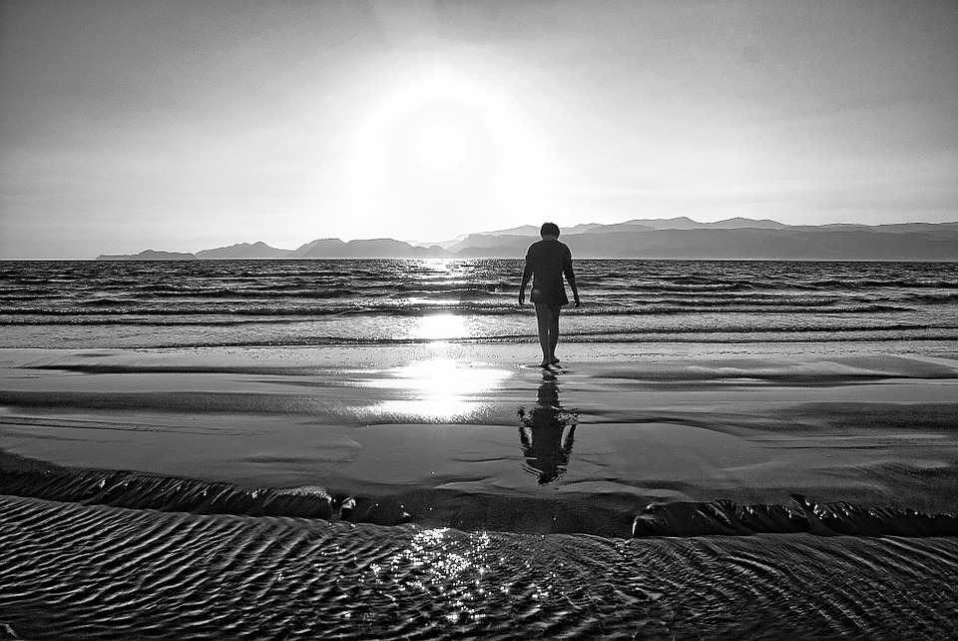
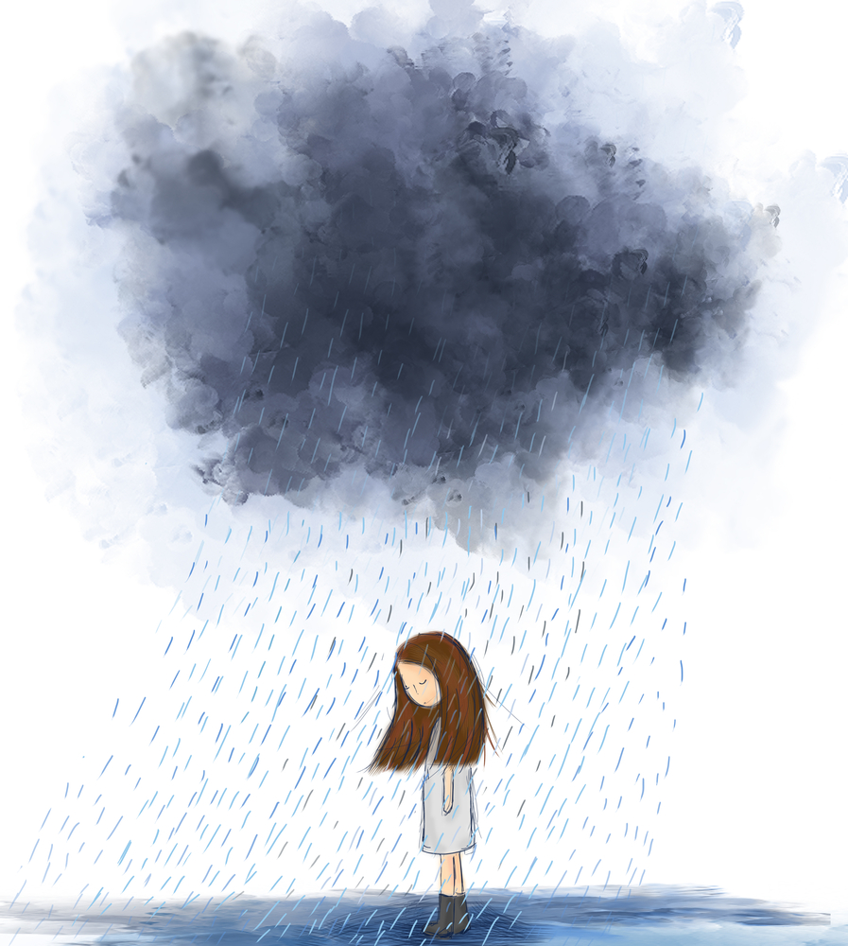
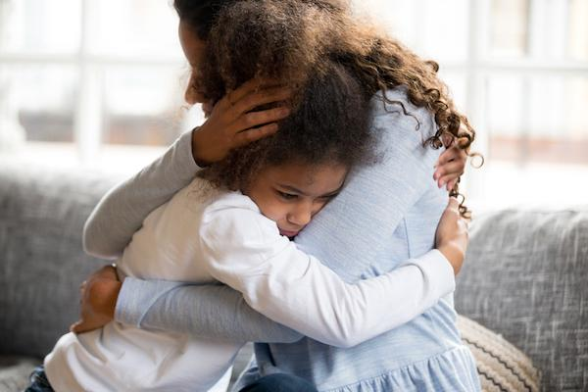
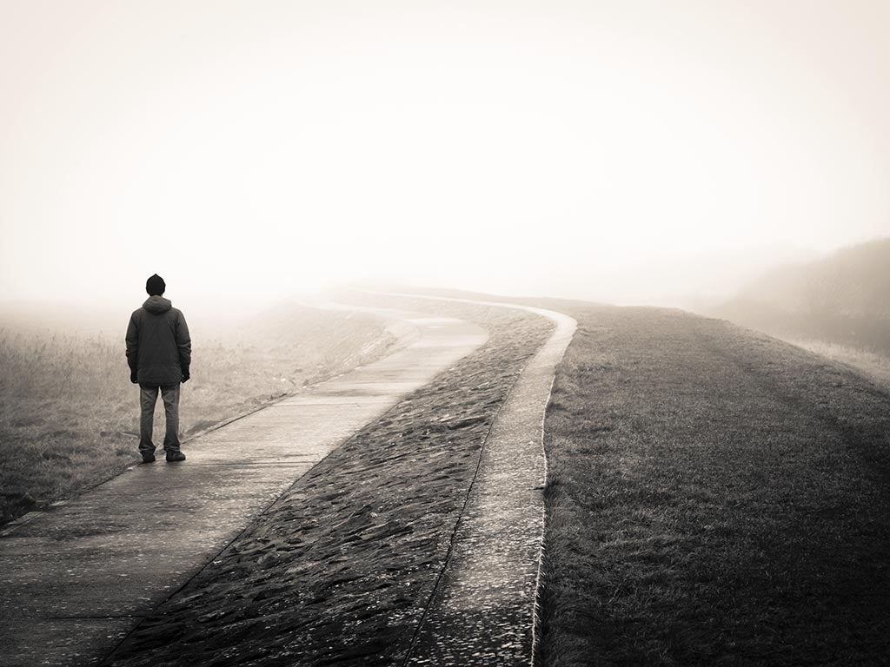
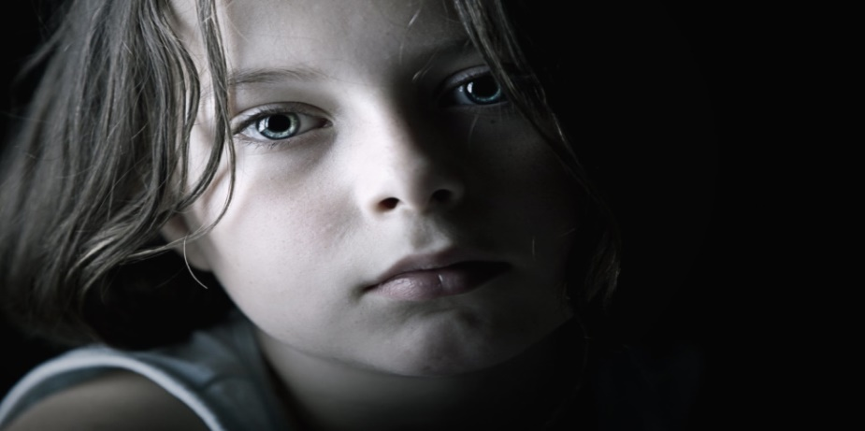
you ain’ t seen nothing like me yet
Nothing that
I wouldn't do
I'd go crawling down the avenue
The storms
are raging on
the rolling sea
And the whole world is on your case
When the rain is blowing in your face
When the
evening shadows
and the stars appear
I could hold you
for a million years
Go to the ends of
the Earth for you
I know you haven't
made your mind up yet
but I would
never do you
wrong
And there is
no one there
to dry your tears
I could make you happy make your dreams come true
And on the
highway of regret
to make you
feel my love
I've known it from
the moment that we met
The winds of change are throwing wild and free
no doubt in my mind
where you belong
No, there's nothing that I wouldn't do
I could offer you a warm embrace
To make you feel my love
To make you feel my love
I'd go hungry; I'd go black and blue
To make you feel my love

