Slide 1
Put on a happy face
——put短语
设计制作：华南师范大学外文学院 黄倩宇
指导教师：刘晓斌

Slide 2
Gray skies are gonna clear up, yeah

Slide 3
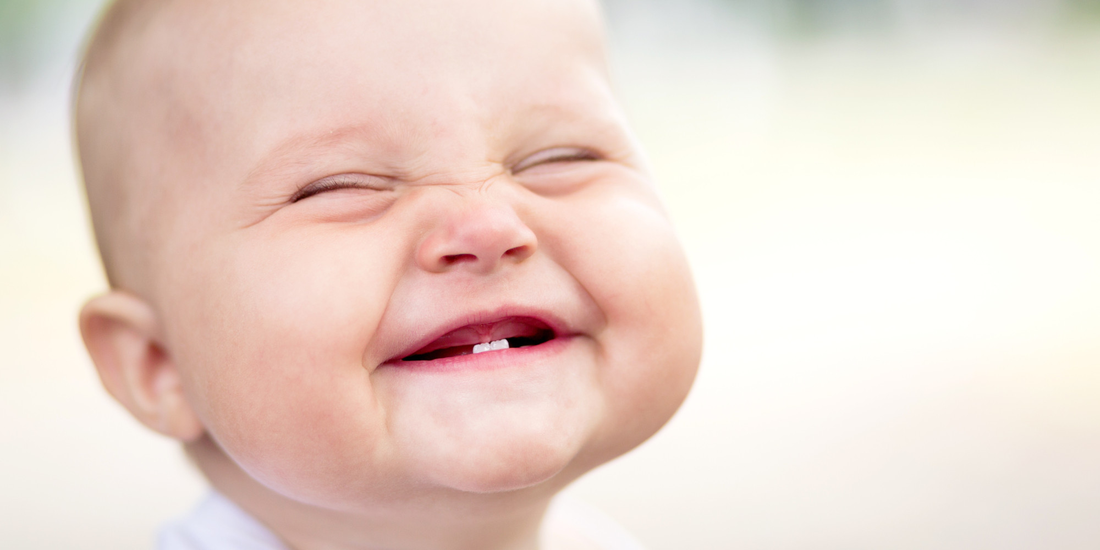
Put on a happy face

Slide 4
Brush off the clouds and cheer up

Slide 5
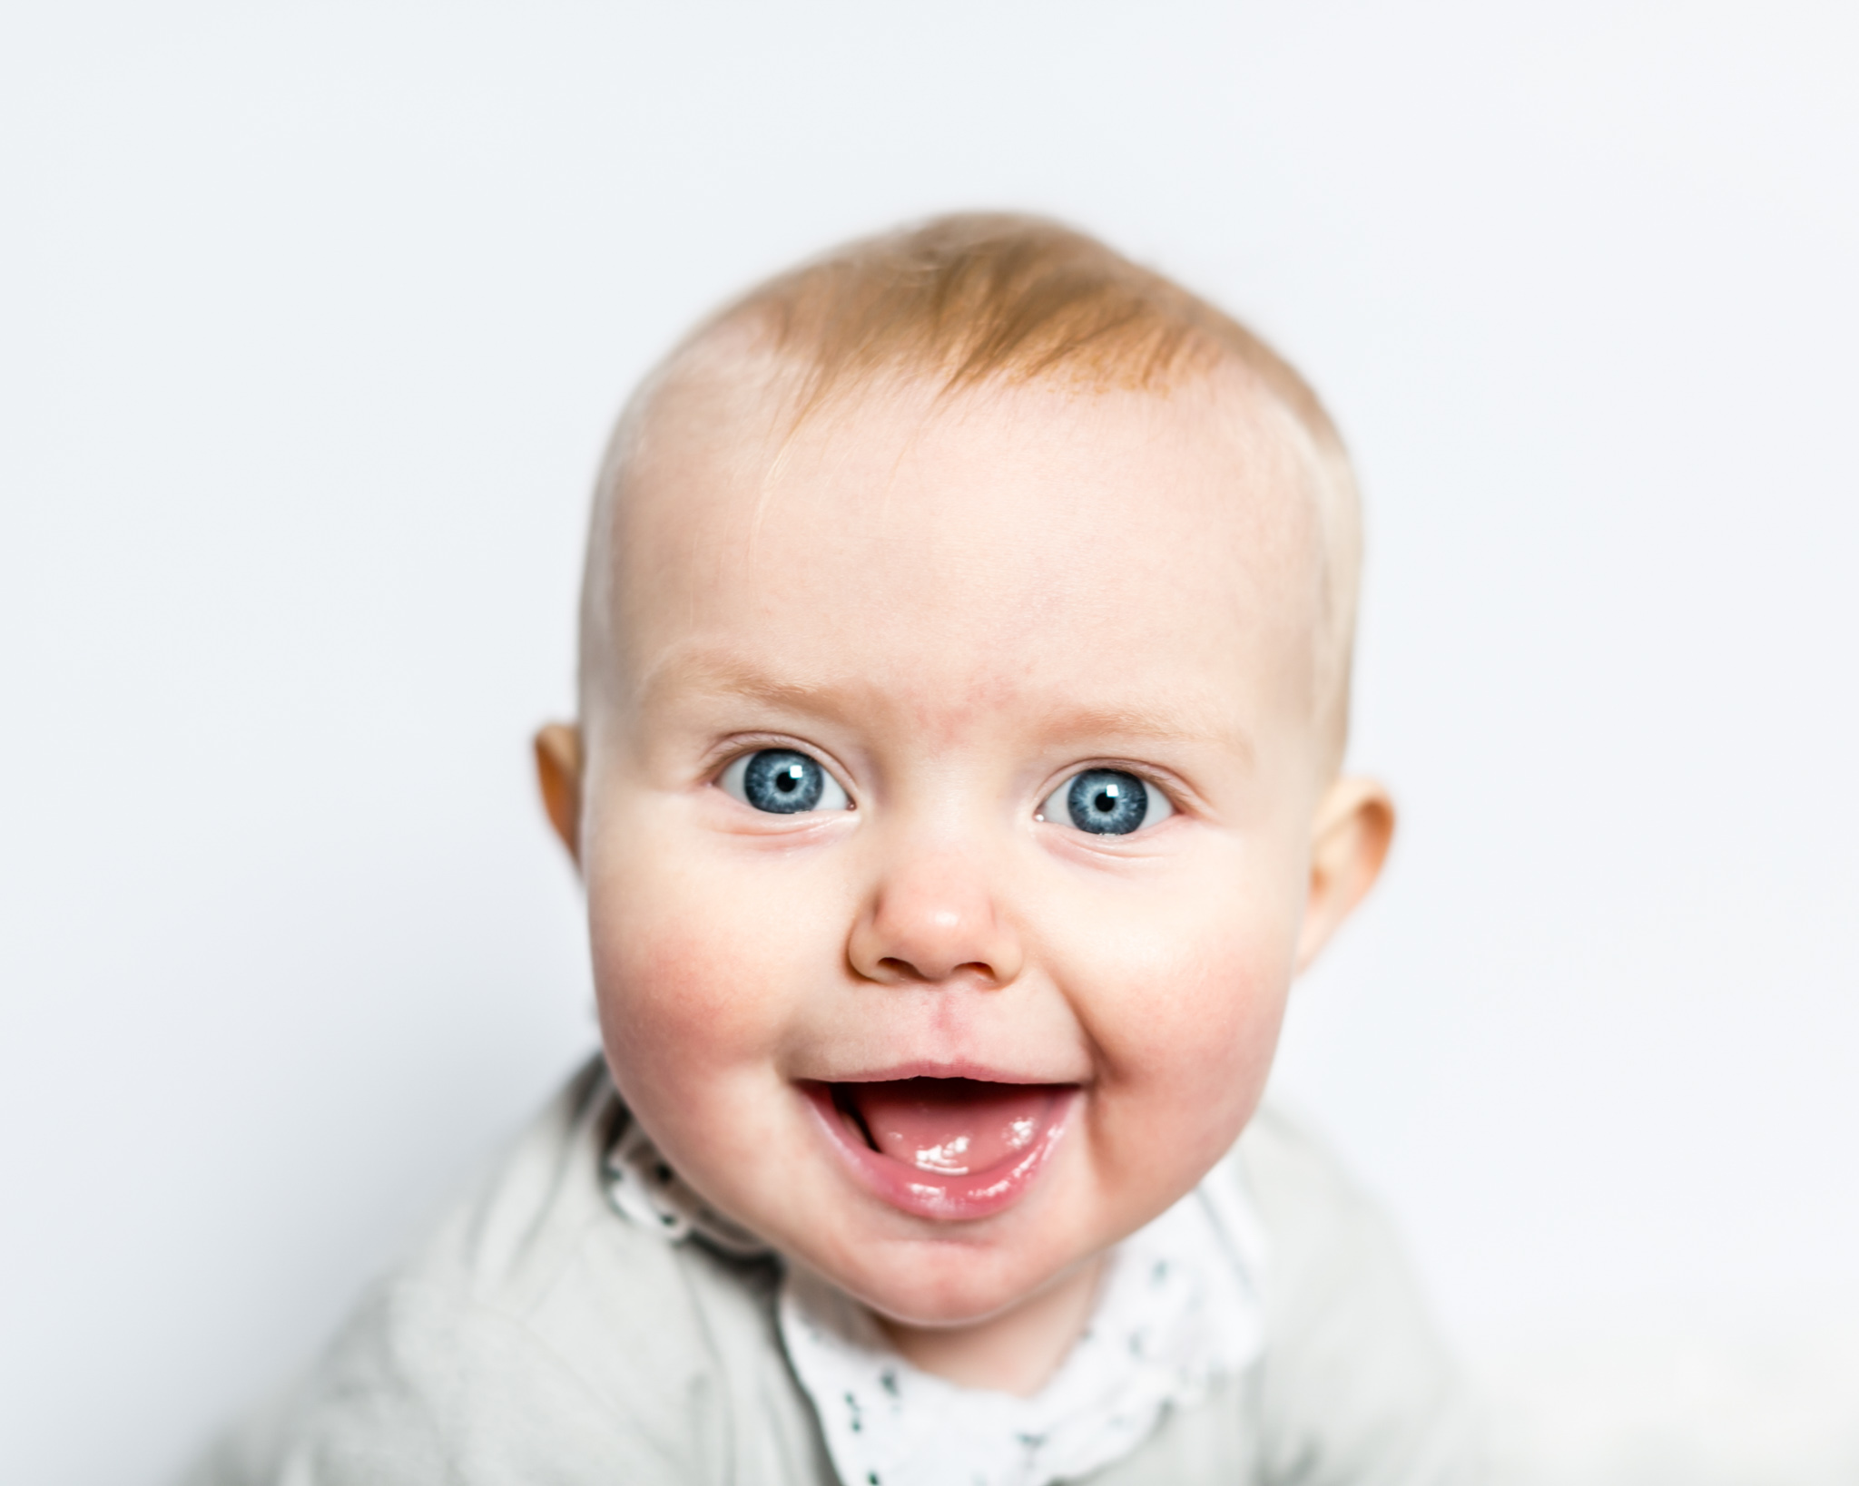
Put on a happy face

Slide 6
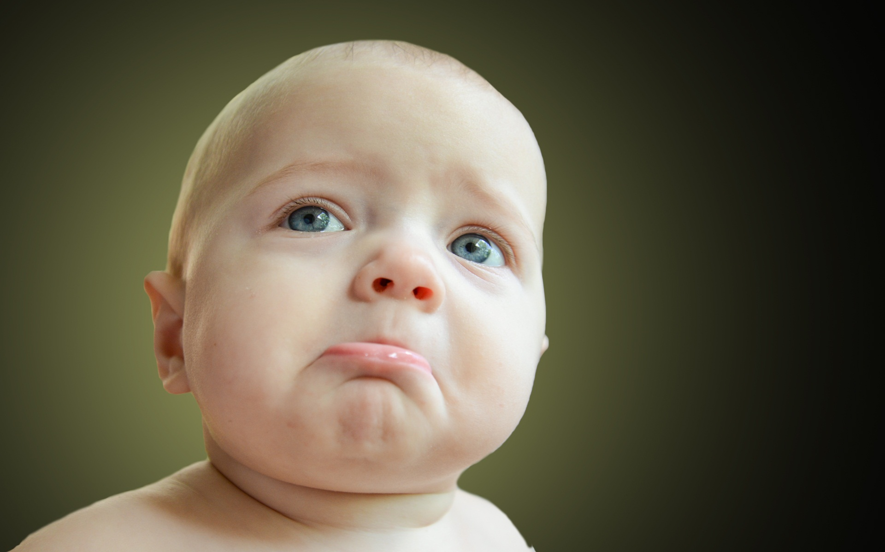
Take off that gloomy mask of tragedy

Slide 7
It's not your style

Slide 8
You'll look so good that you'll be glad that you

Slide 9
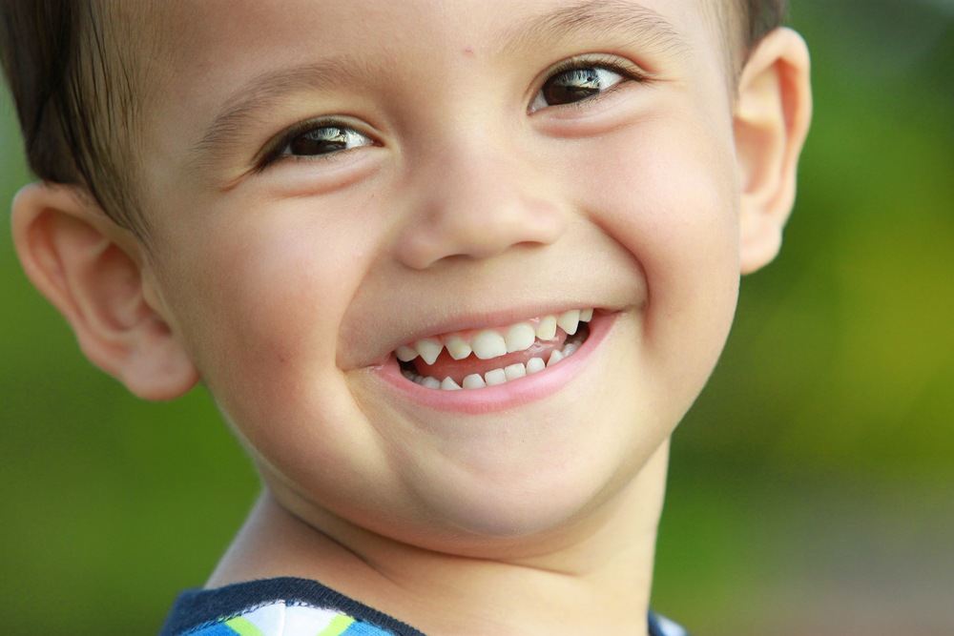
Decided to smile

Slide 10
Pick out a pleasant outlook

Slide 11
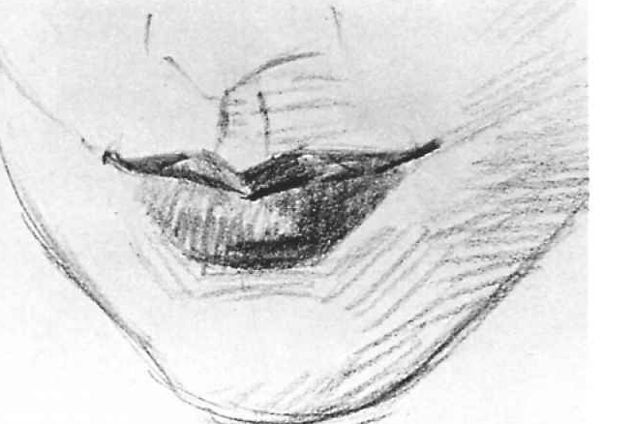
Stick out that noble chin

Slide 12
Wipe off that "full of doubt" look

Slide 13
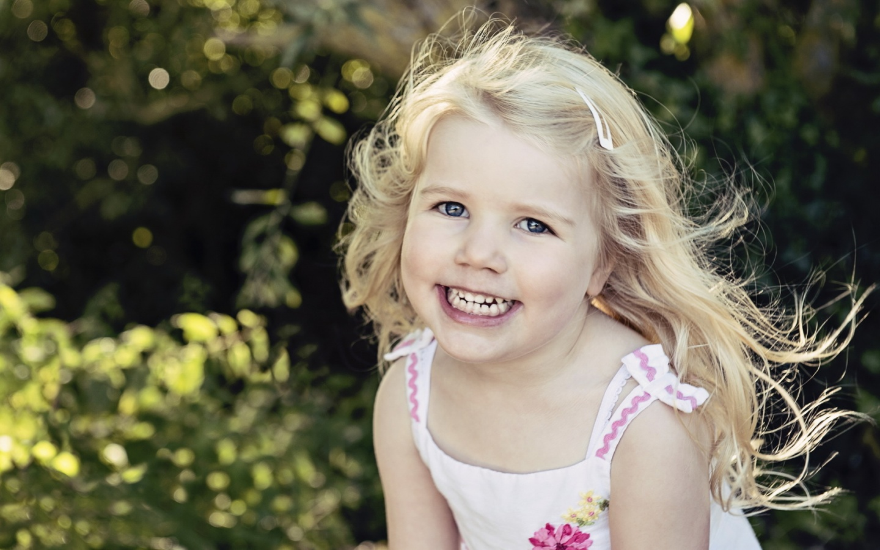
Put on a happy grin

Slide 14
And spread sunshine all over the place

Slide 15
Just put on a happy face

Slide 16
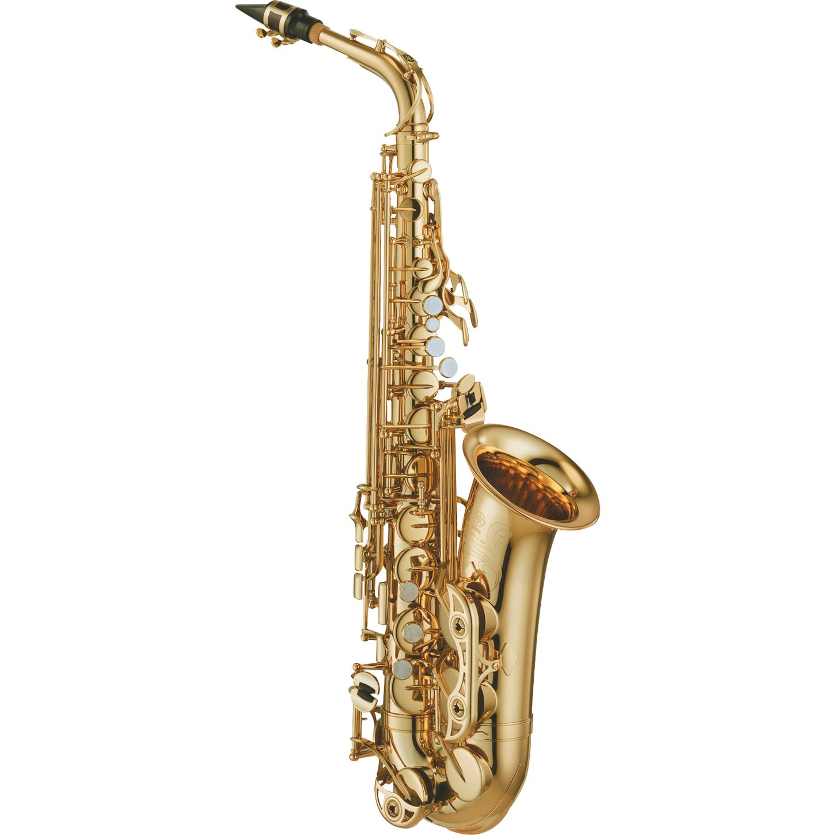

Slide 17
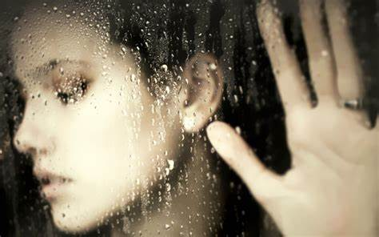
Take off that gloomy mask of tragedy

Slide 18
It's not your style

Slide 19
You'll look so good that you'll be glad that you

Slide 20
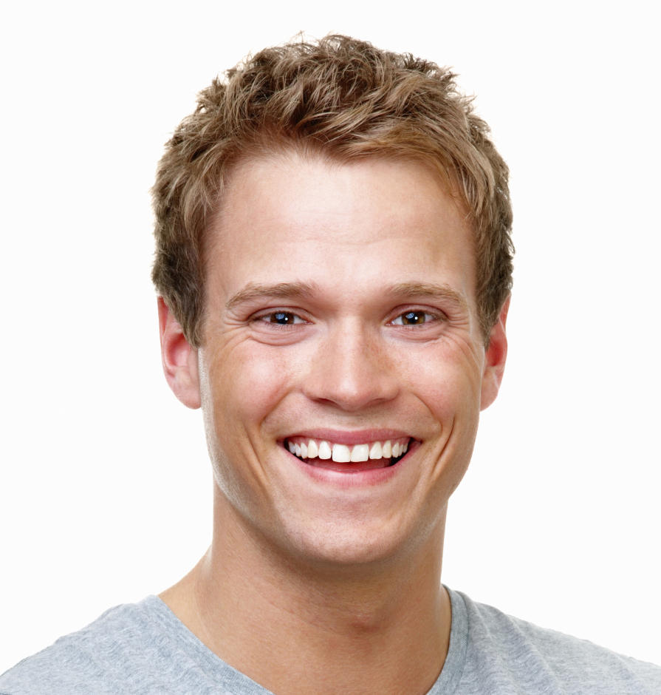
Decided to smile

Slide 21
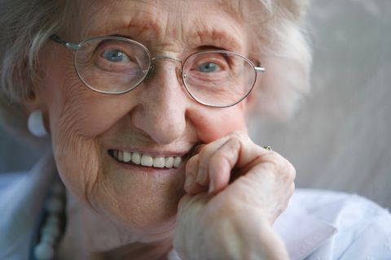
Pick out a pleasant outlook

Slide 22
Stick out that noble chin

Slide 23
Wipe off that "full of doubt" look

Slide 24
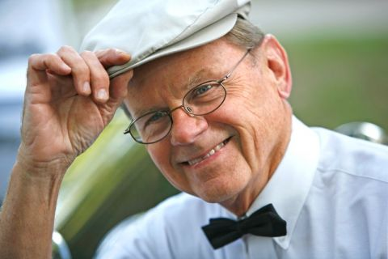
Put on a happy grin

Slide 25
And spread sunshine all over the place

Slide 26
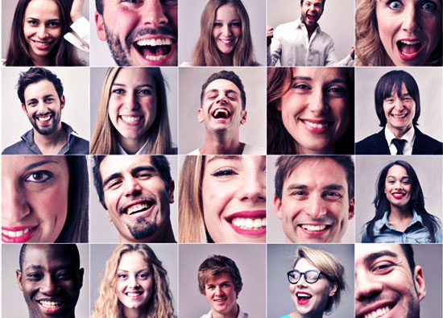
Just put on a happy face

Slide 27
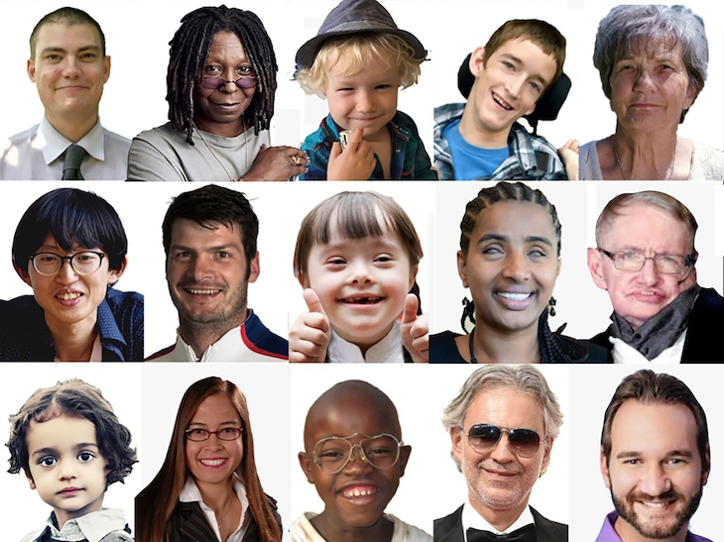
Just put on a happy face

