Slide 1
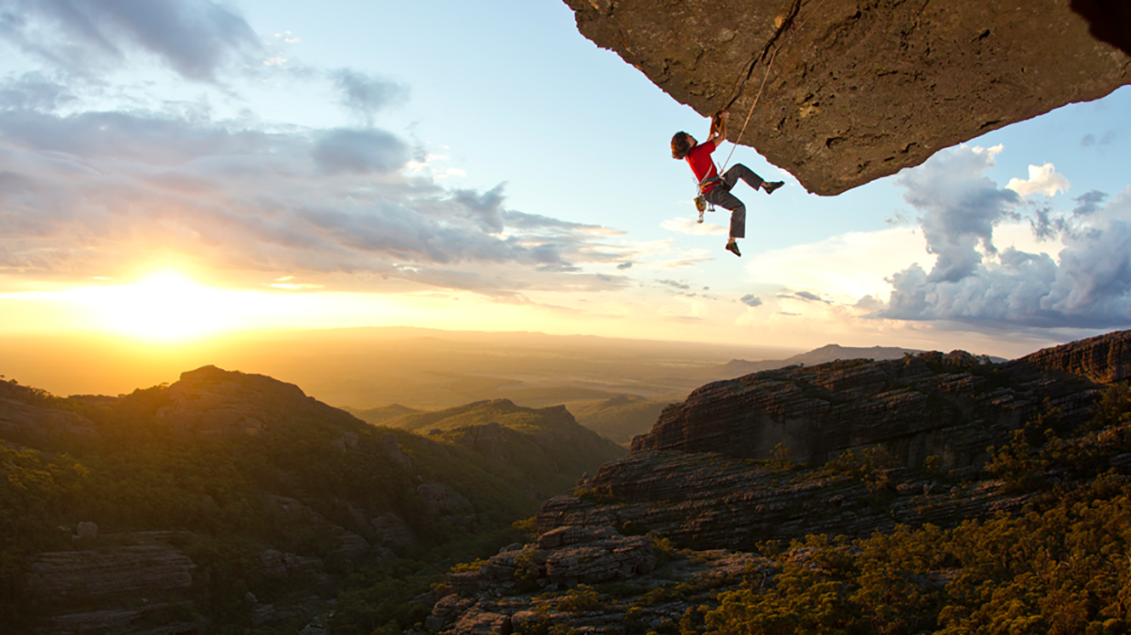
I Won't Give Up 有关give的短语(give up) 华南师范大学外国语言文化学院 陈婉娴 河源市龙川县贝岭中学 刘水连

Slide 2
When I look into your eyes 当我凝望你的双眸

Slide 3
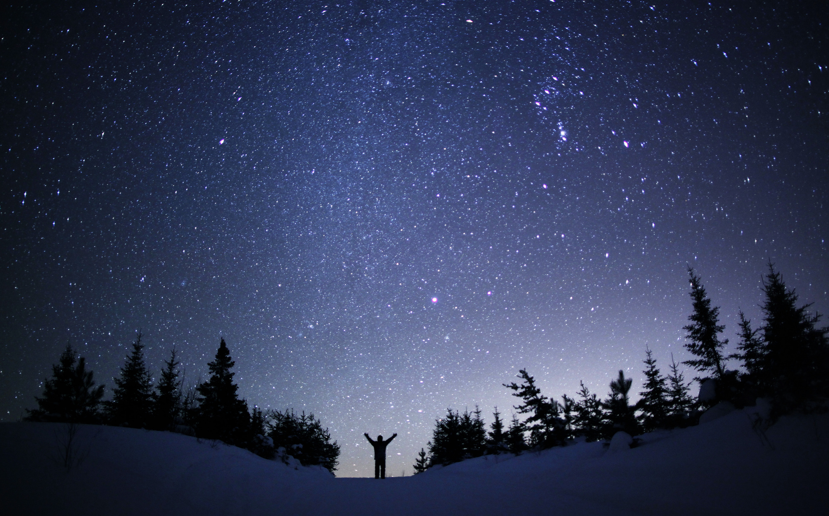
It's like watching the night sky 就像望着绚烂夜空

Slide 4
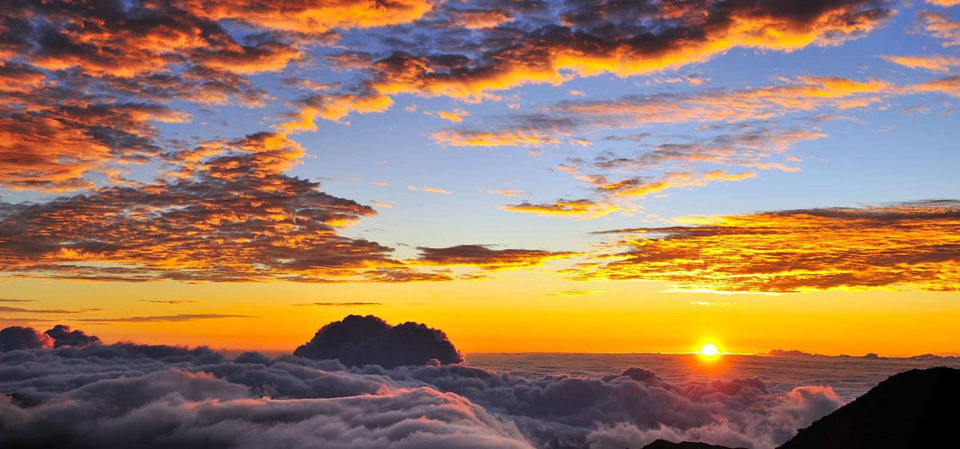
Or a beautiful sunrise 就像看着美丽日出

Slide 5
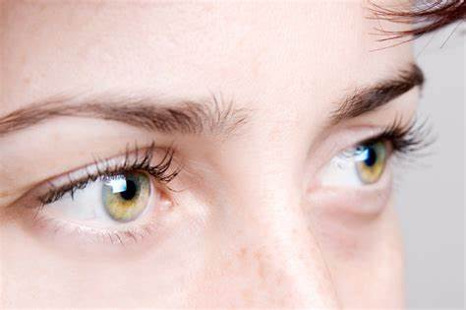
There's so much they hold 他们都是如此深邃

Slide 6
And just like them old stars 仿似那些古老繁星

Slide 7
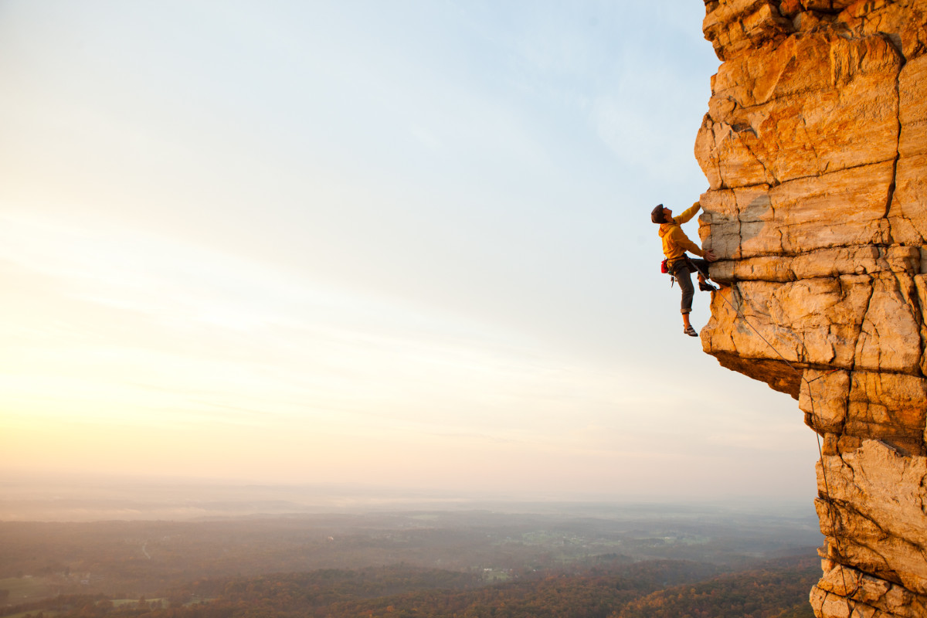
I see that you've come so far 我明白你经历许多

Slide 8
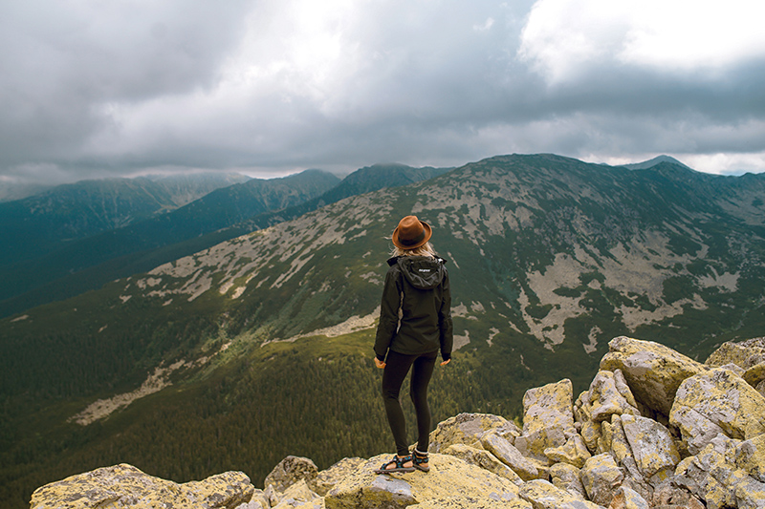
To be right where you are 才走到今天这地步

Slide 9
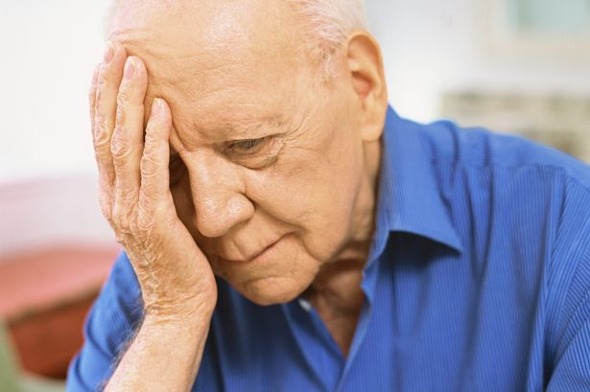
How old is your soul? 灵魂是否已经饱经沧桑

Slide 10
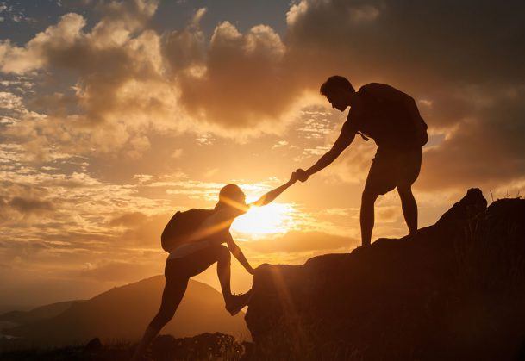
I won't give up on us 我不会放弃我们的

Slide 11
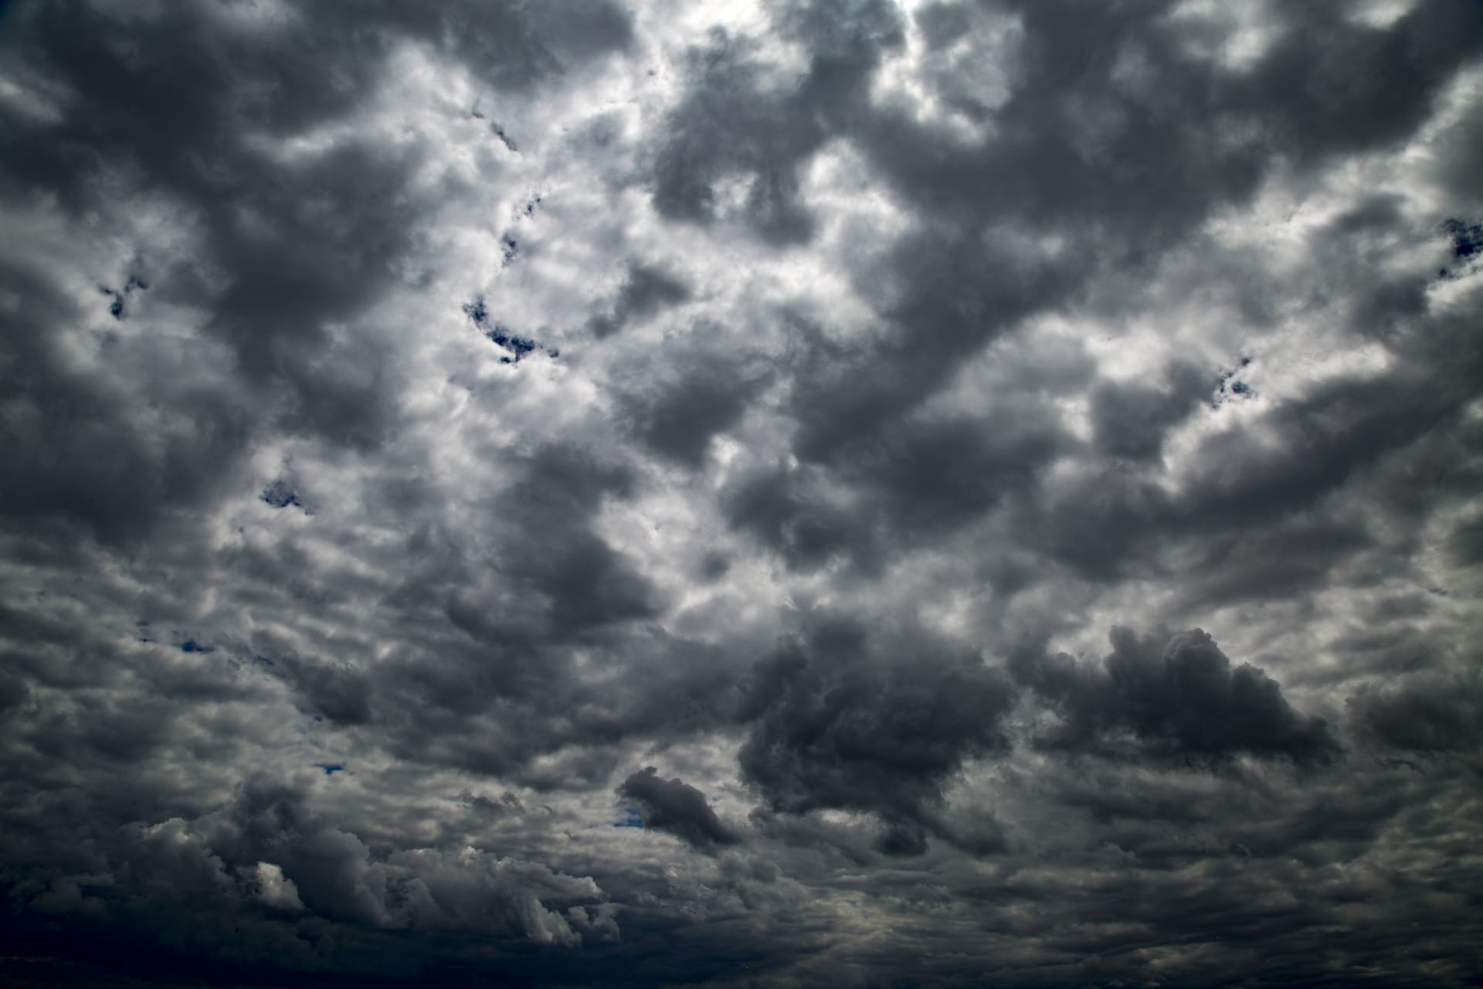
Even if the skies get rough 即使天空美丽不再

Slide 12
I'm giving you all my love 我会给你所有的爱

Slide 13
I'm still looking up 依然乐观充满期待

Slide 14
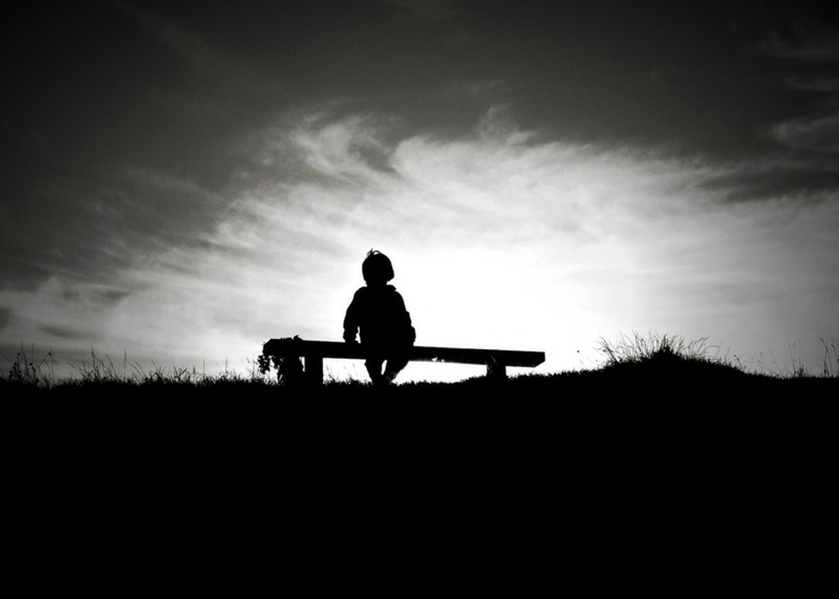
And when you're needing your space 当你需要自由空间

Slide 15
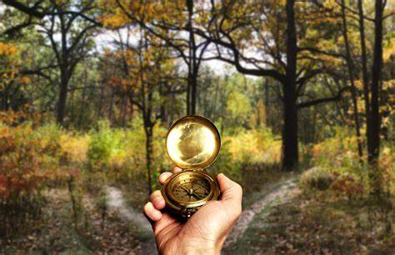
To do some navigating 去寻找自己的世界

Slide 16
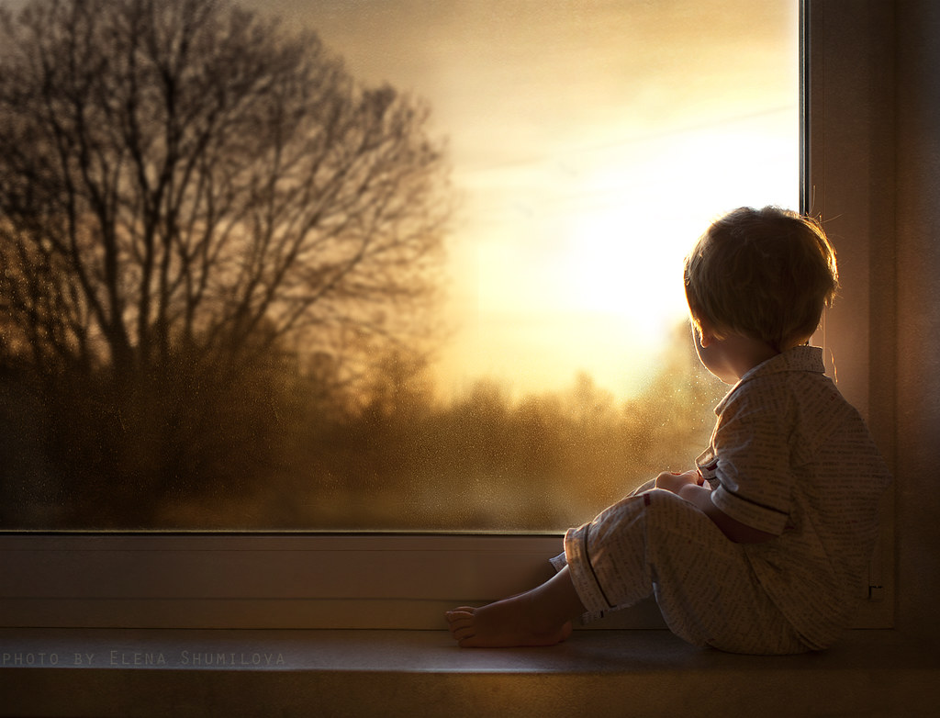
I'll be here patiently waiting 我会在这耐心守候

Slide 17
To see what you find 见证你发现的一切

Slide 18
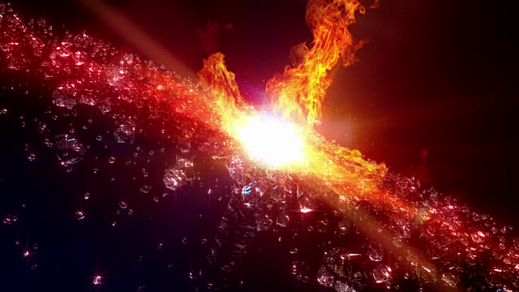
'Cause even the stars they burn 就算繁星燃烧殆尽

Slide 19
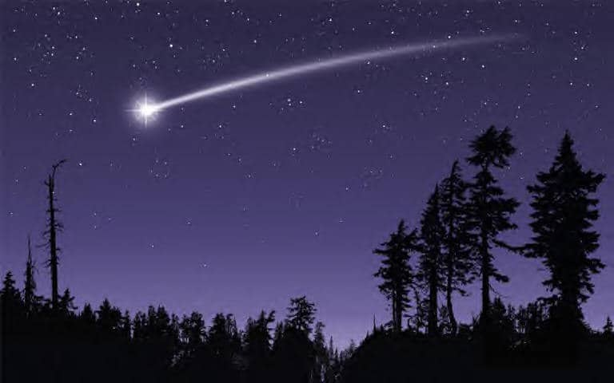
Some even fall to the earth 甚至有些坠落凡尘

Slide 20
We've got a lot to learn 我们还有很多要学

Slide 21
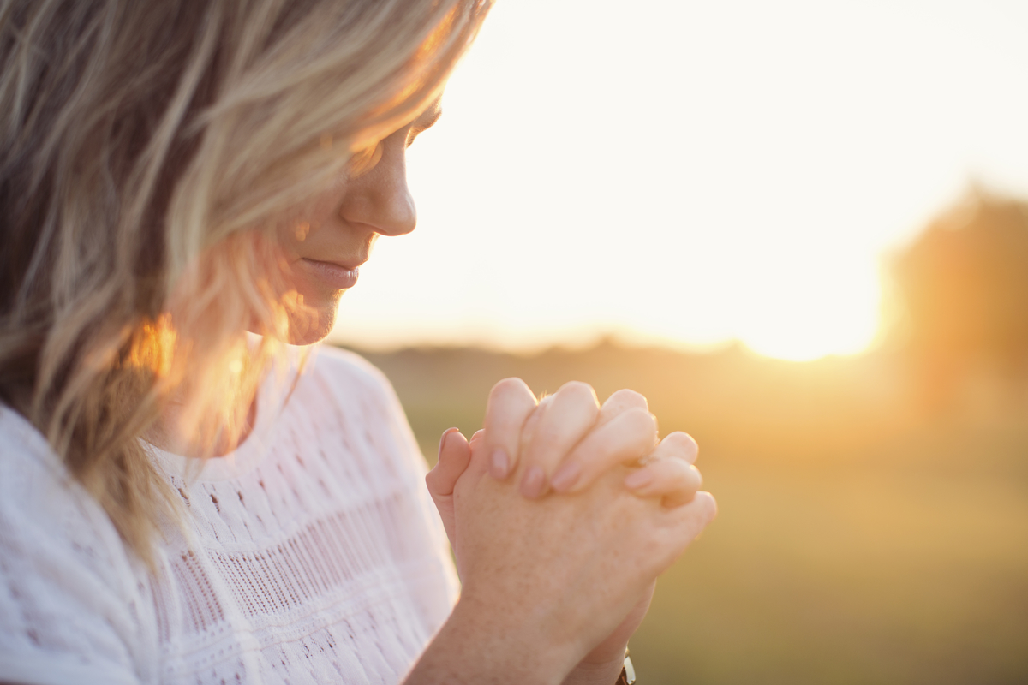
God knows we're worth it 上天知道我们值得

Slide 22
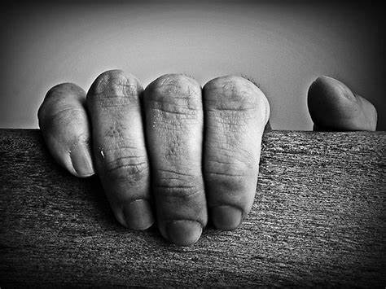
No, I won't give up 不，我不会放弃的

Slide 23
I don't wanna be someone who walks away so easily 我不愿做你的过客

Slide 24
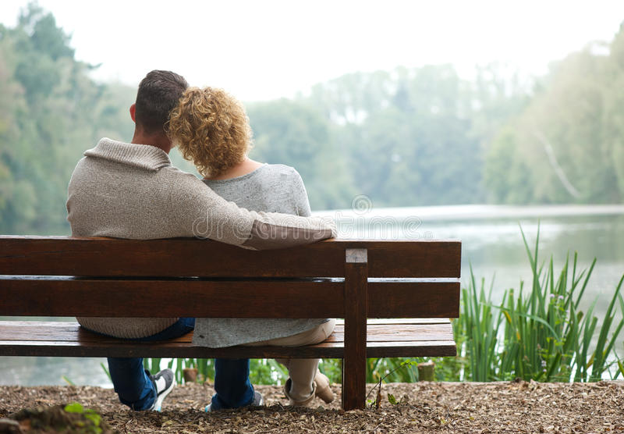
I'm here to stay and make the difference that I can make 我会留下尽力改变

Slide 25
Our differences they do a lot to teach us how to use 我们的不同教会了我们

Slide 26
The tools and gifts we got yeah, we got a lot at stake 紧要关头使用各自天赋

Slide 27
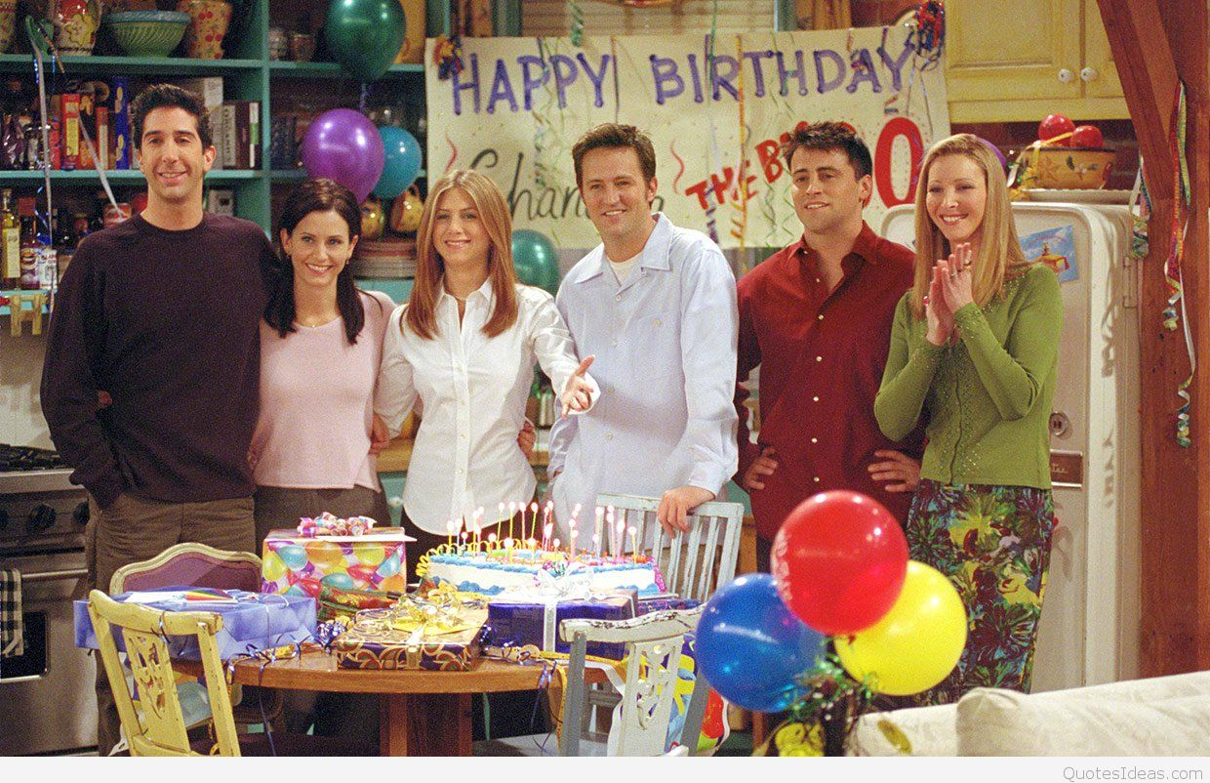
And in the end you're still my friend, at least we did intend 到最后你仍是我的朋友，我们还在为彼此付出

Slide 28
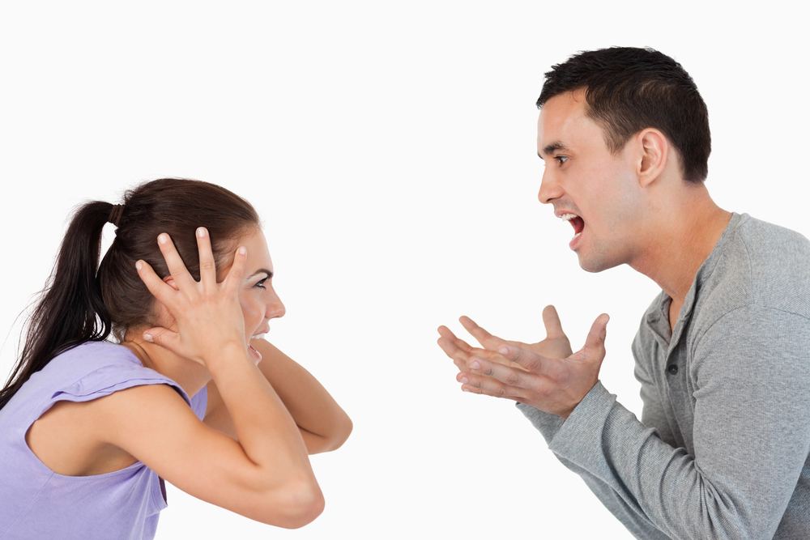
For us to work we didn't break, we didn't burn 我们没有决裂，也没有争吵

Slide 29
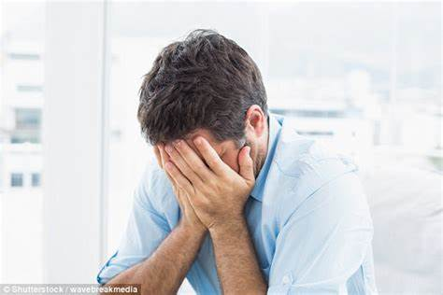
We had to learn how to bend without the world caving in 在世界崩塌之前我们得学会弯腰

Slide 30
I had to learn what I've got, and what I'm not 我必须弄清楚我拥有什么，没有什么

Slide 31
And who I am 还有我是谁

Slide 32
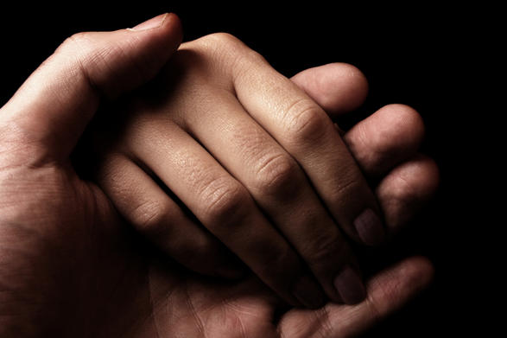
I won't give up on us 我不会放弃我们的

Slide 33
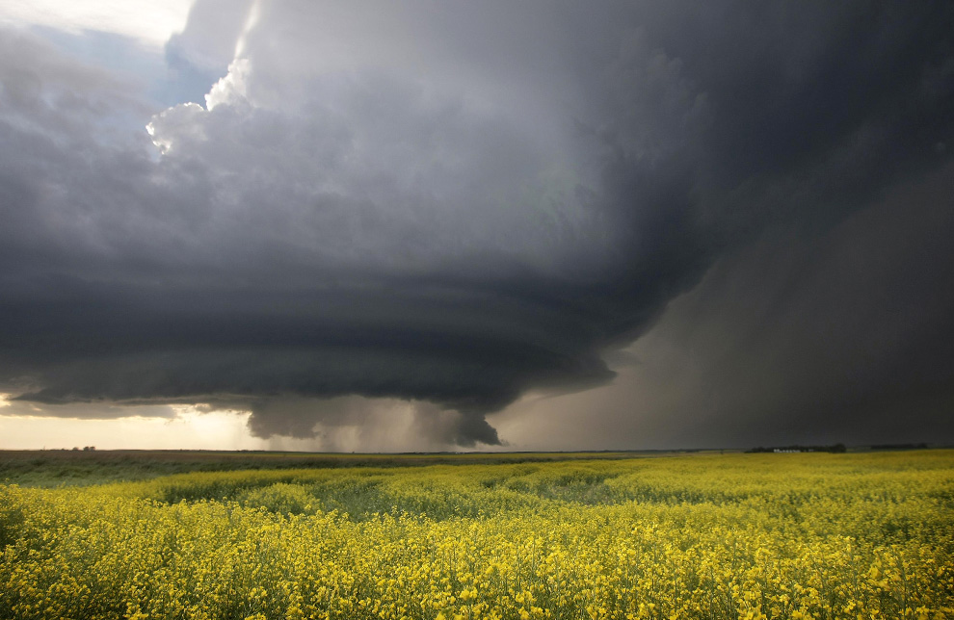
Even if the skies get rough 即使天空美丽不再

Slide 34
I'm giving you all my love 我会给你所有的爱

Slide 35
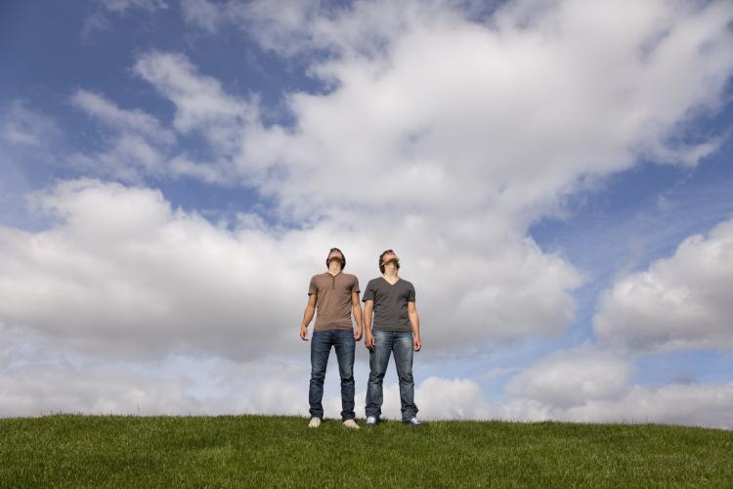
I'm still looking up 依然乐观充满期待

Slide 36
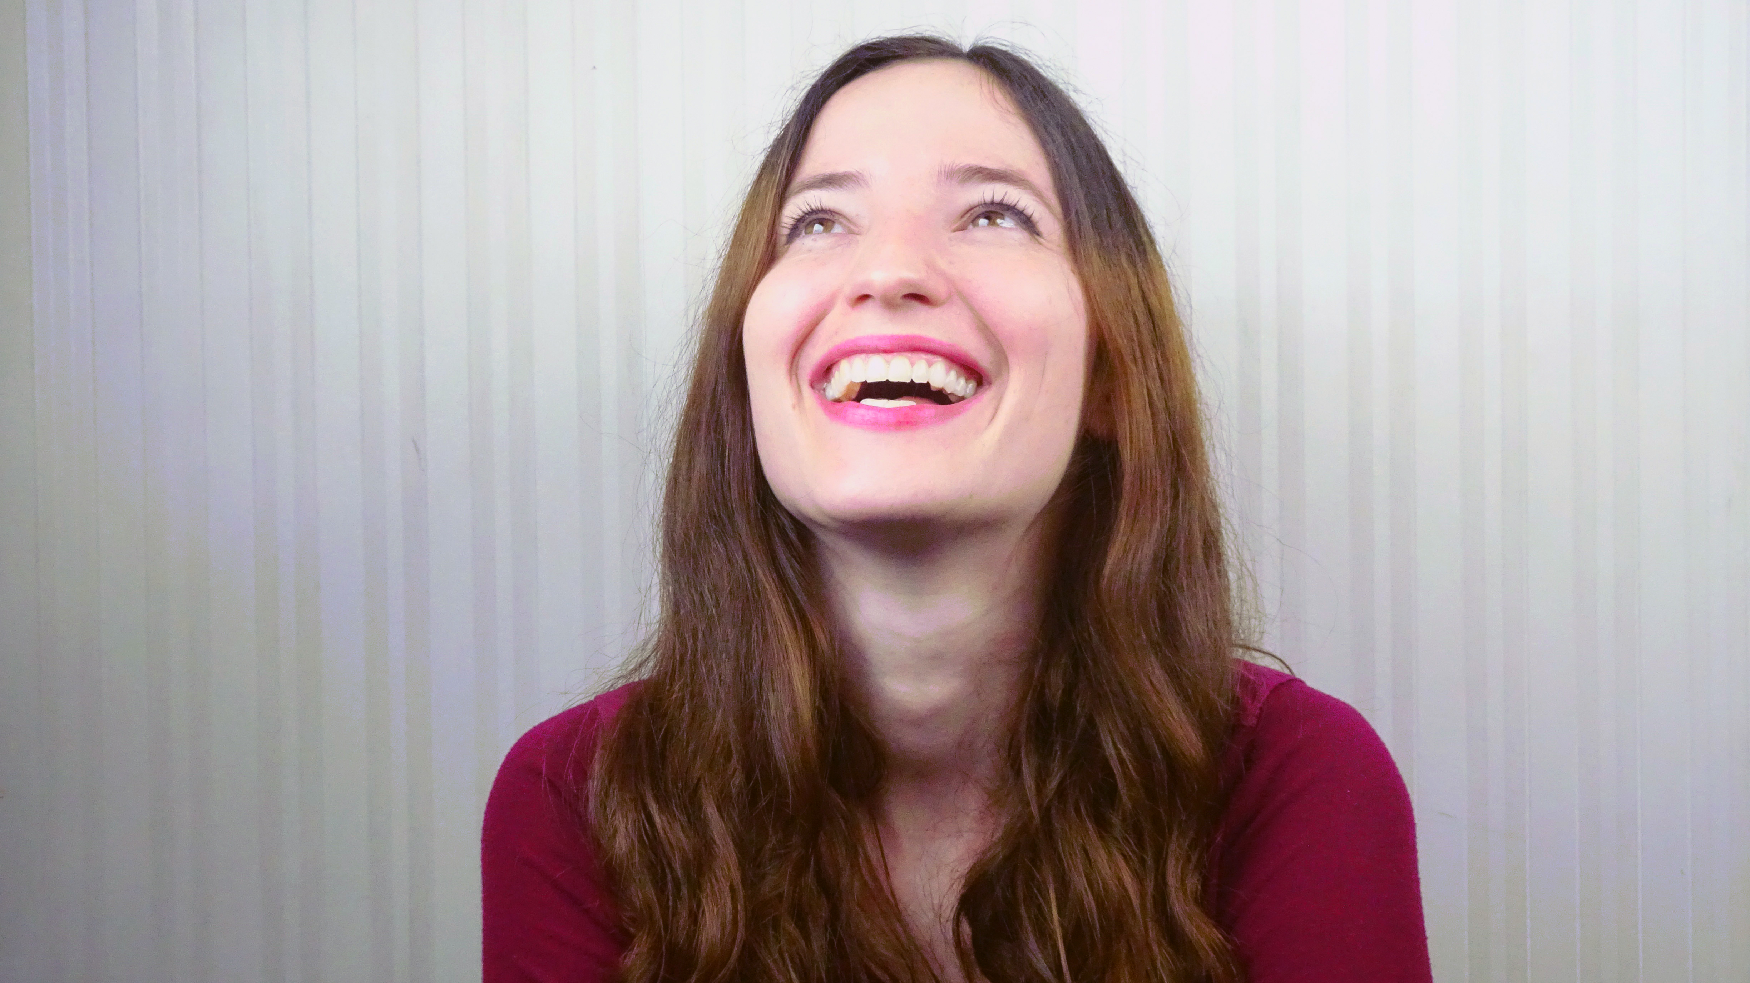
Still looking up 充满期待

Slide 37
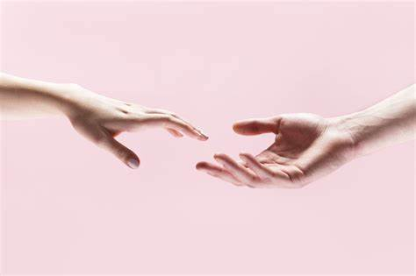
I won't give up on us 我不会放弃我们的

Slide 38
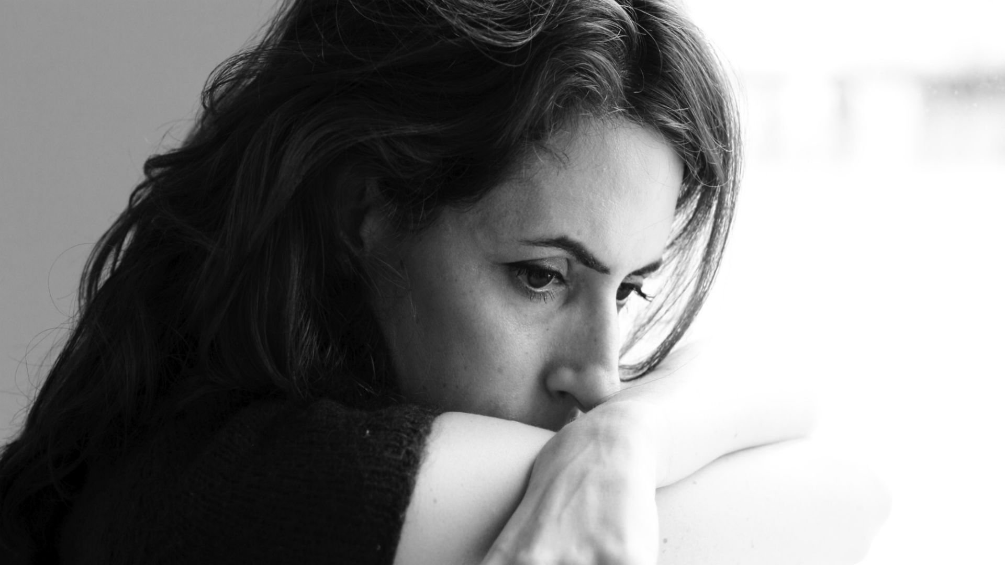
God knows I'm tough, He knows 上天知道我足够坚强

Slide 39
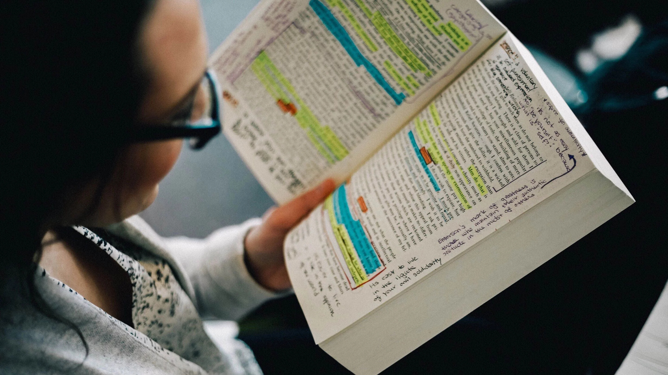
We've got a lot to learn 我们还有很多要学

Slide 40
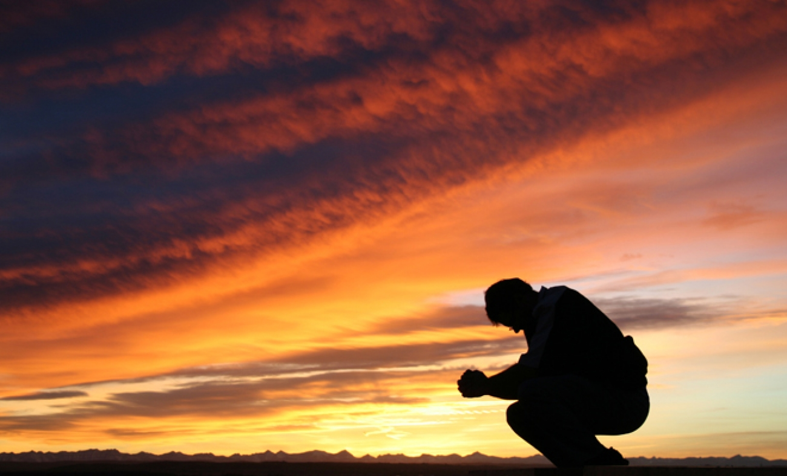
God knows we're worth it 上天知道我们值得这些

Slide 41
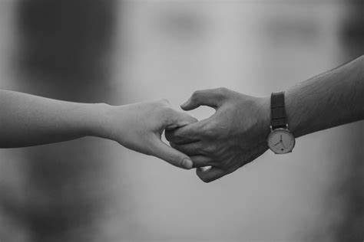
I won't give up on us 我不会放弃我们的

Slide 42
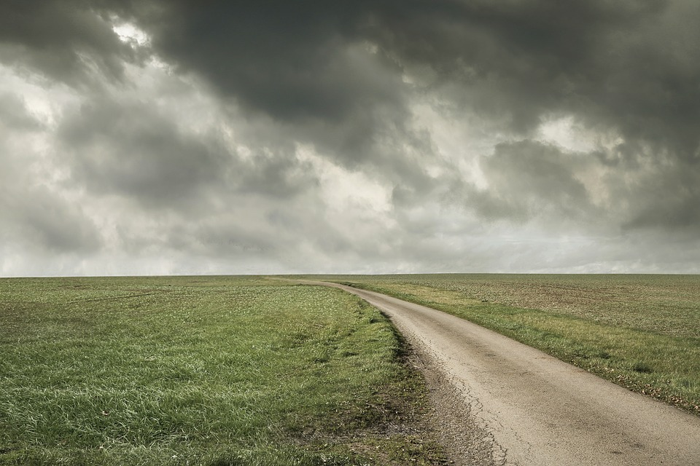
Even if the skies get rough 即使天空美丽不再

Slide 43
I'm giving you all my love 我会给你所有的爱

Slide 44
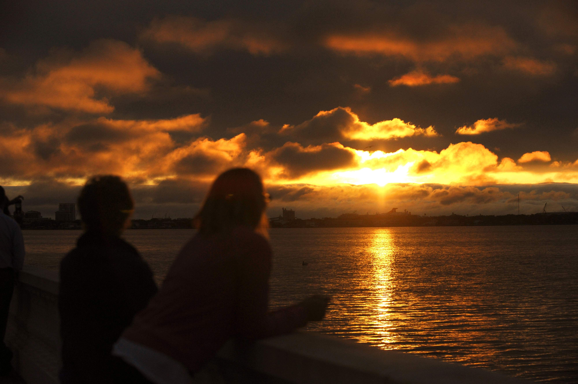
I'm still looking up 我依然乐观充满期待

