Slide 1


Get ready for it
——关于get的动词短语
Editors：
华南师范大学外国语言文化学院 邓颖
广东省河源市龙川县第一中学初中部 柳惠青

Slide 2



Get ready for it
Get ready for it
Loading…

Slide 3



You Said
whatever you put out there
Whatever you put out there

Slide 4

Is gonna come back…

Slide 5




You said
whenever you're ready
Whenever you are ready

Slide 6

Just let it all out

Slide 7


I know
cause the enemy inside me
cause the enemy inside me
Is holding me back…

Slide 8

But we know THAT
something in the silence
Something in the silence

Slide 9



Get ready for it
Get ready for it

Slide 10


You said
there's only one place left to find

Slide 11



Together
we can
save the world tonight
Get ready for it

Slide 12

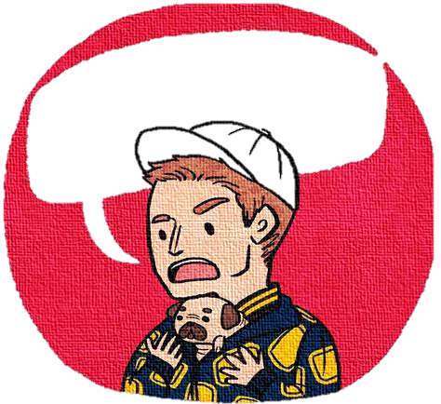

You are
A FOOL OR a king's man
You said
“ every life is a lesson ”
Cause only you know

Slide 13


Hold on
cause the volume is rising
Yeah the volume is rising
So you better hold on

Slide 14


The night is young
Until it's over
Until it's over

Slide 15

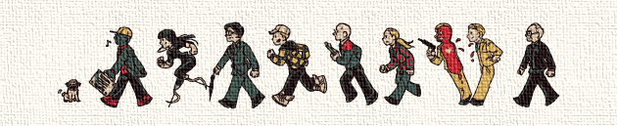
The night is young
The night is ours
Until tomorrow，Until tomorrow

Slide 16

Get ready for it
Get ready for it

Slide 17

You said there's only
one place left to find
Together we can
save the world tonight

Slide 18

Get ready for it
Get ready for it
Get ready for it
Get ready for it

Slide 19

The night is young
Until it's over
Until it's over

Slide 20

The night is young
The night is ours
Until tomorrow
Until tomorrow

Slide 21
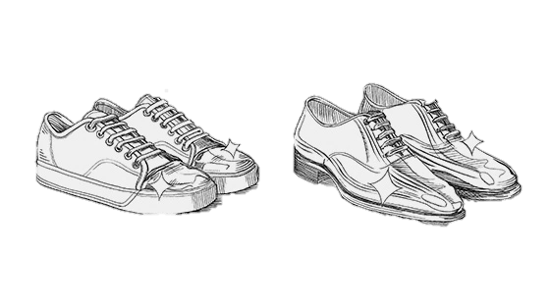
Get ready for it…

Slide 22


I'll hold your hand
With guard intentions
With guard intentions
I'll hold your hand

Slide 23

The night is ours
Until tomorrow，Until tomorrow

Slide 24

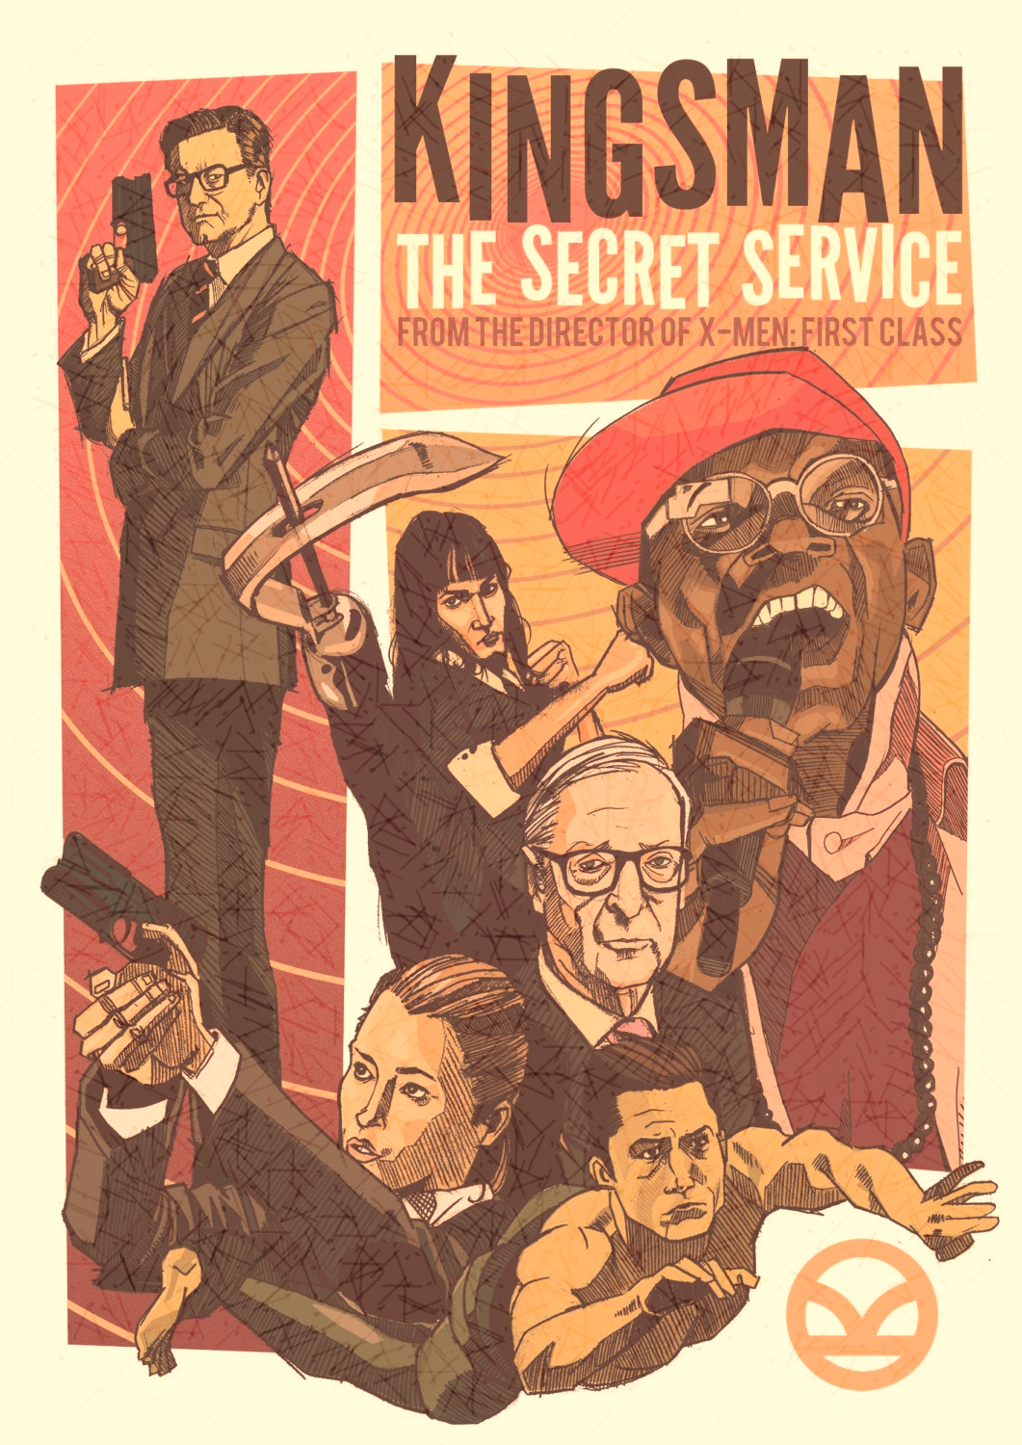
You said
Together we can
“there's only one place left to find”
save the world tonight

Slide 25


Get ready for it
Get ready for it
Get ready for it
Get ready for it
Get ready for it
Get ready for it

