Slide 1
歌曲：Fall Asleep
知识点：短语fall asleep
作者：华南师范大学外国语言文化学院 林洁蓉
河源市龙川县第一中学初中部 朱惠梅

Slide 2
I’m always worrying through out the day
一整天，我都心神不宁

Slide 3
These trouble and problem never go away
烦恼挥之不去

Slide 4
And at the end of the day I just want to lay my head
深夜时分，我只想静静躺下

Slide 5
On the pillow next to yours inside our bed
躺在你的枕边

Slide 6
I just want to fall asleep
我只想安然入睡

Slide 7
I just want to fall asleep
我只想安然入睡

Slide 8
I just want to fall asleep
我只想安然入睡

Slide 9
Inside your arms
在你的臂弯里

Slide 10
I just want to fall asleep
我只想安然入睡

Slide 11
I just want to fall asleep
我只想安然入睡

Slide 12
I just want to fall asleep
我只想安然入睡

Slide 13
Inside your arms
在你的臂弯里

Slide 14
I’m always worrying when I’m awake
醒来时，我总是无比担心

Slide 15
Life is kinda hard with all this give and take
付出与收获让生活变得如此艰难

Slide 16
When it’s too much to bare and I’m all-alone
当我无法承受又倍感孤独的时候

Slide 17
I think about lying next to you when I get home
当我回到家，我只想躺在你身旁

Slide 18
I just want to fall asleep
我只想安然入睡

Slide 19
I just want to fall asleep
我只想安然入睡

Slide 20
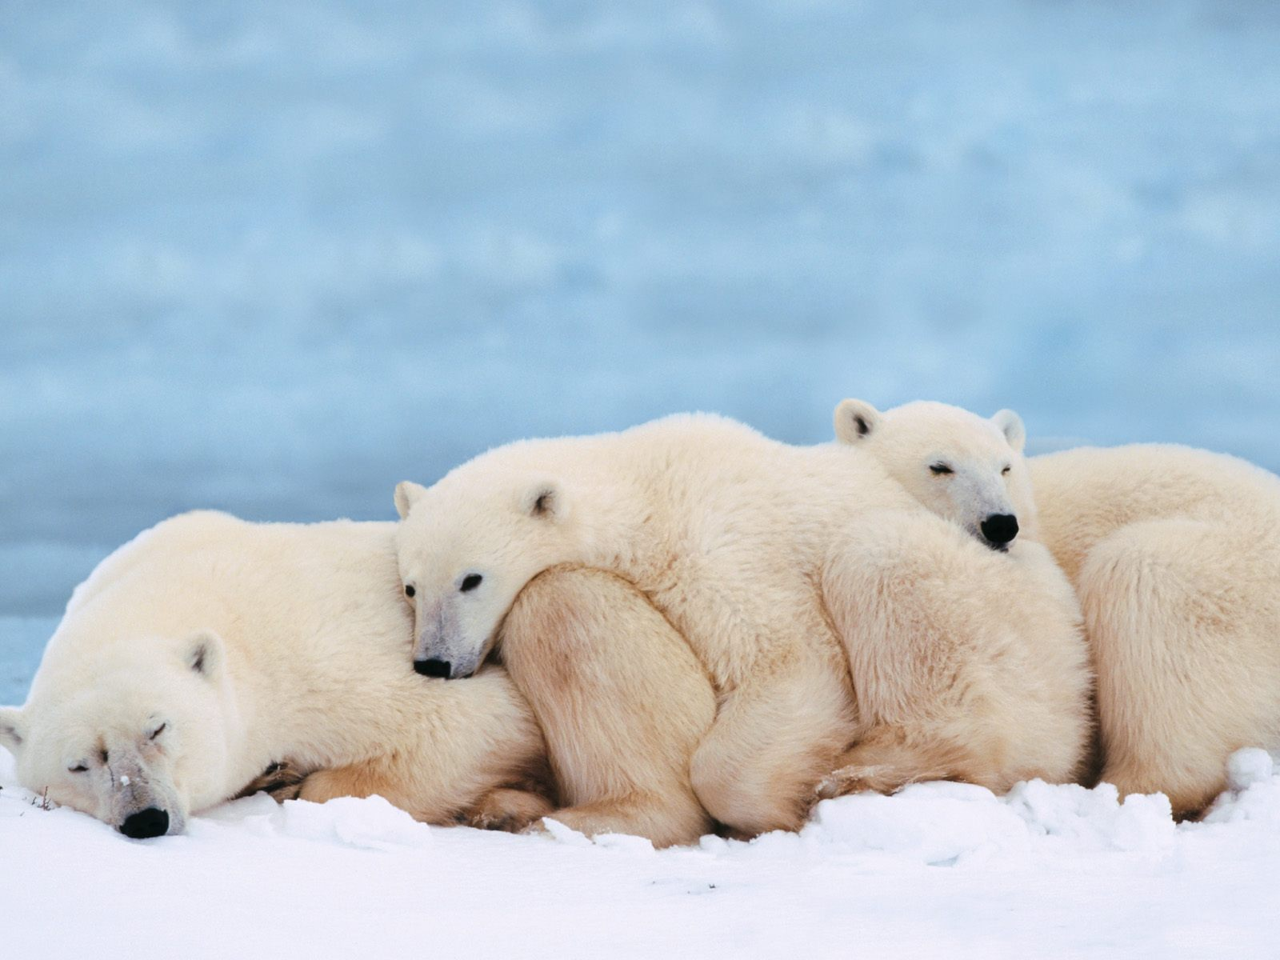
I just want to fall asleep
我只想安然入睡

Slide 21
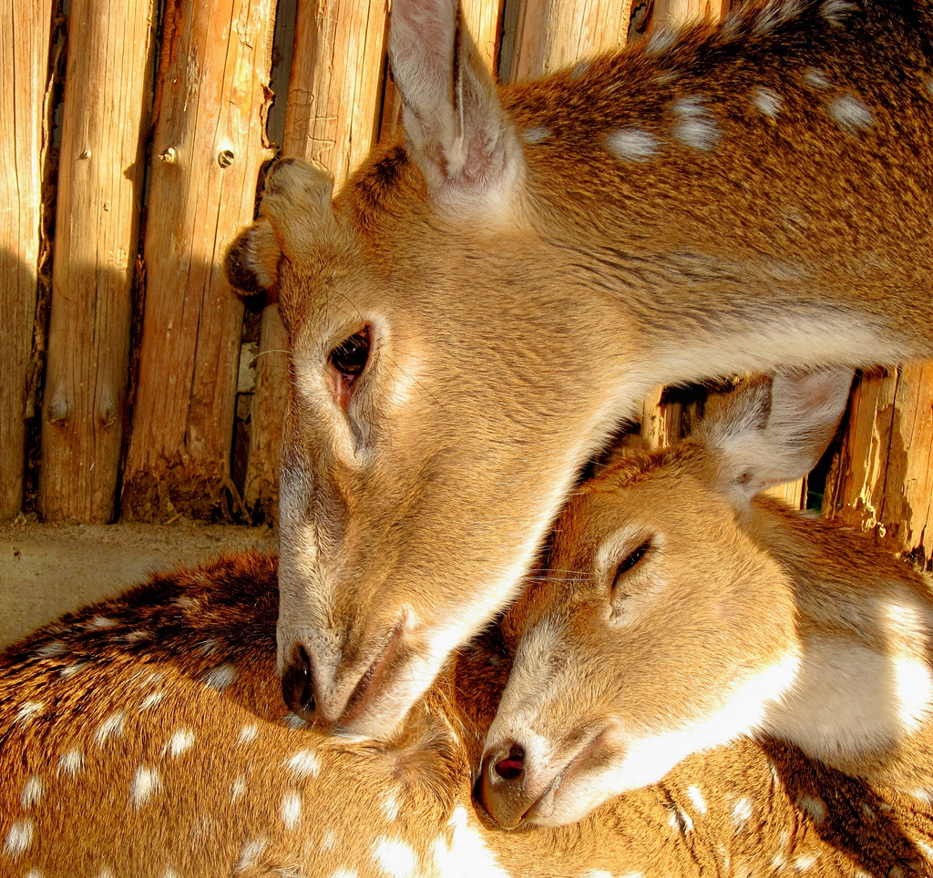
Inside your arms
在你的臂弯里

Slide 22
I just want to fall asleep
我只想安然入睡

Slide 23
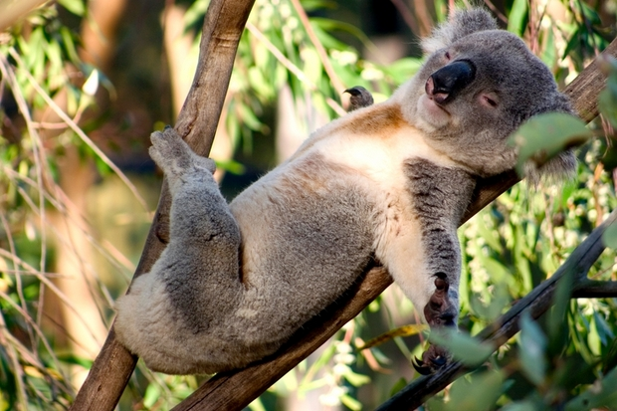
I just want to fall asleep
我只想安然入睡

Slide 24
I just want to fall asleep
我只想安然入睡

Slide 25
Inside your arms
在你的臂弯里

Slide 26
We’re just lovers we’re just lovers
我们只是两个相爱的人

Slide 27
Under the covers under the covers
除去所有的牵绊

Slide 28
We got each other each other now
此刻，我们已经拥有了彼此

Slide 29
We’re just lovers we’re just lovers
我们只是两个相爱的人

Slide 30
Under the covers under the covers
除去所有的牵绊

Slide 31
We got each other each other now
此刻，我们已经拥有了彼此

Slide 32
Woah yeah woah oh yeah

Slide 33
Woah yeah woah oh yeah

Slide 34
I just want to fall asleep
我只想安然入睡

Slide 35
I just want to fall asleep
我只想安然入睡

Slide 36
I just want to fall asleep
我只想安然入睡

Slide 37
Inside your arms
在你的臂弯里

Slide 38
Inside your arms
在你的臂弯里

Slide 39
Inside your arms
在你的臂弯里

Slide 40
Inside your arms
在你的臂弯里

