Slide 1
My Hands
—与agree有关的短语
设计制作：华南师范大学外文学院 范祖贤
广东省河源市黄石职业中学 骆茵
指导教师：叶玉芳、刘晓斌

Slide 2
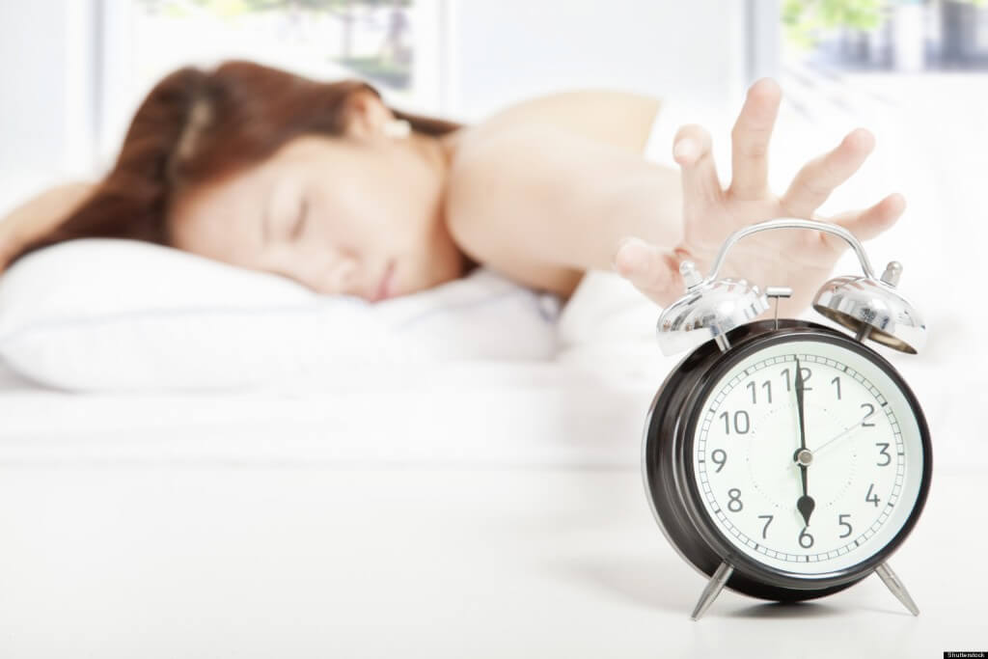
I wake in the morning

Slide 3
tired of sleeping

Slide 4
get in the shower

Slide 5
and make my bed alone

Slide 6
I put on my make up

Slide 7
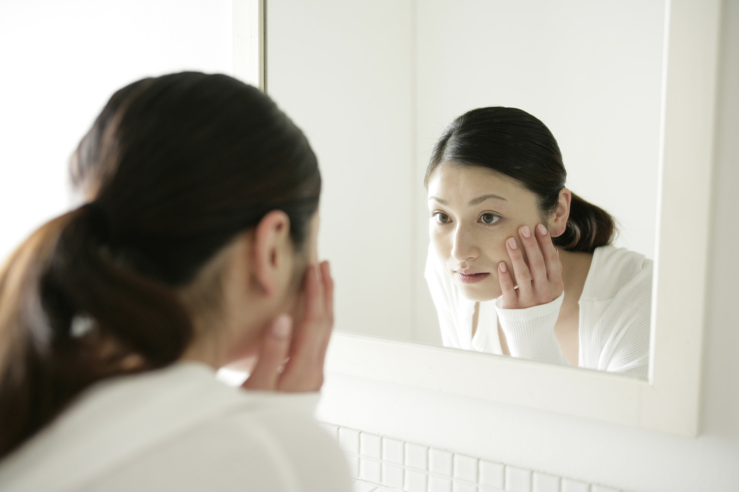
talk into the mirror

Slide 8
ready for a new day without you

Slide 9
and I walk steady on my feet

Slide 10
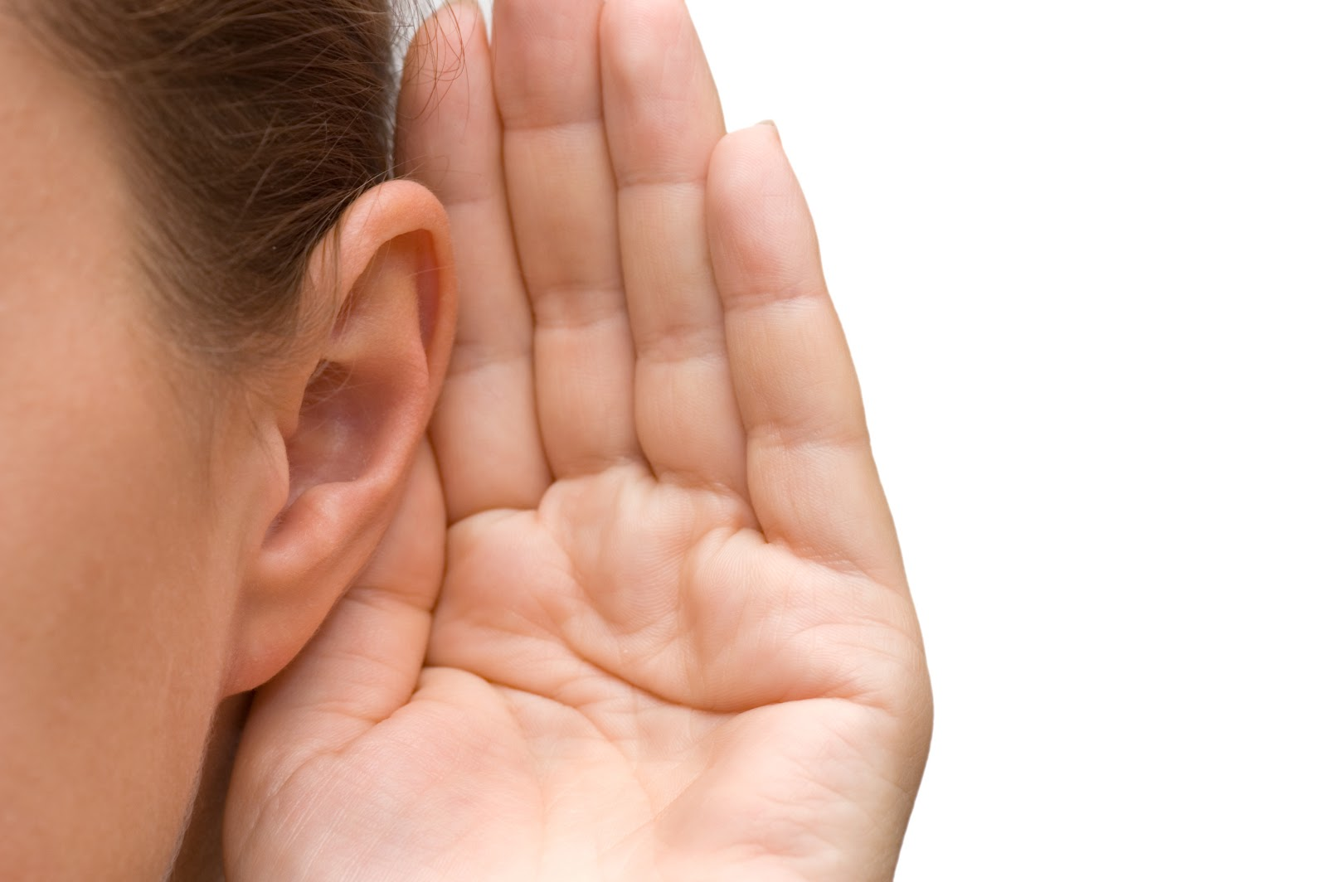
I talk my voice obeys me

Slide 11
I go out at night

Slide 12
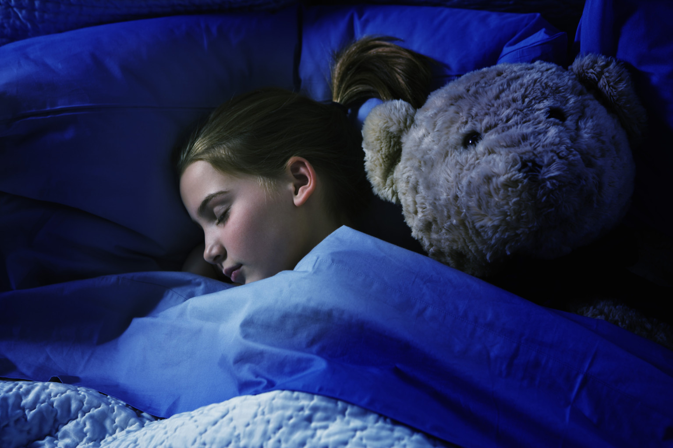
sleep without the lights

Slide 13
and I do all of the things I have to

Slide 14
keeping you on my mind

Slide 15
but when I think I’ll be alright

Slide 16
I am always wrong cause

Slide 17
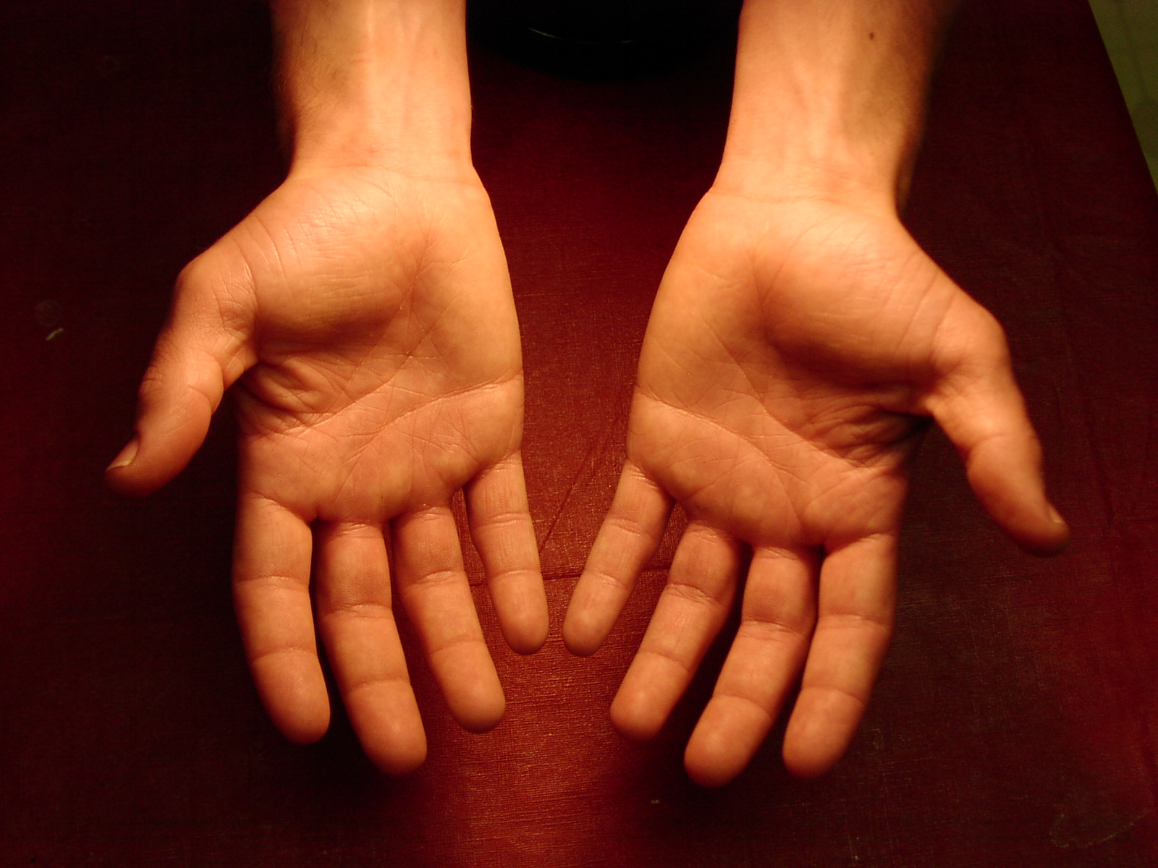
my hands
don’t wanna start again

Slide 18
my hands
no they don’t wanna understand

Slide 19
my hands
they just shake it
try to break whatever piece I may find

Slide 20
my hands
they only agree to hold
your hands

Slide 21
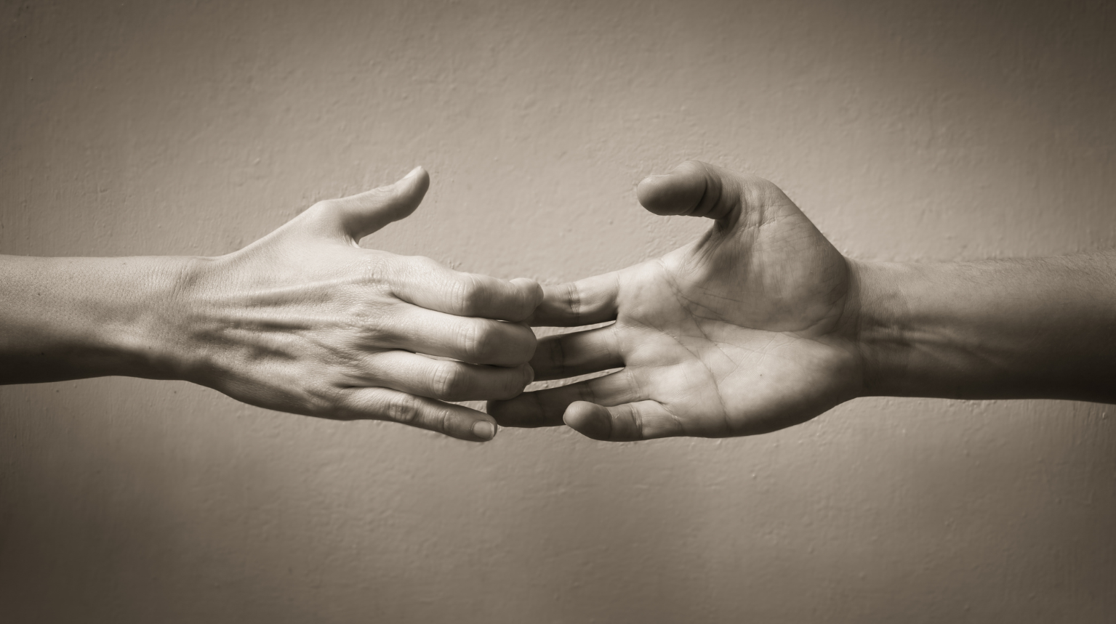
and they don’t wanna be without
your hands

Slide 22
and they will not let me go
no they will not let me go

Slide 23
I talk about you now

Slide 24
and I do without crying

Slide 25
I go out with my friends now

Slide 26
I stay home all alone

Slide 27
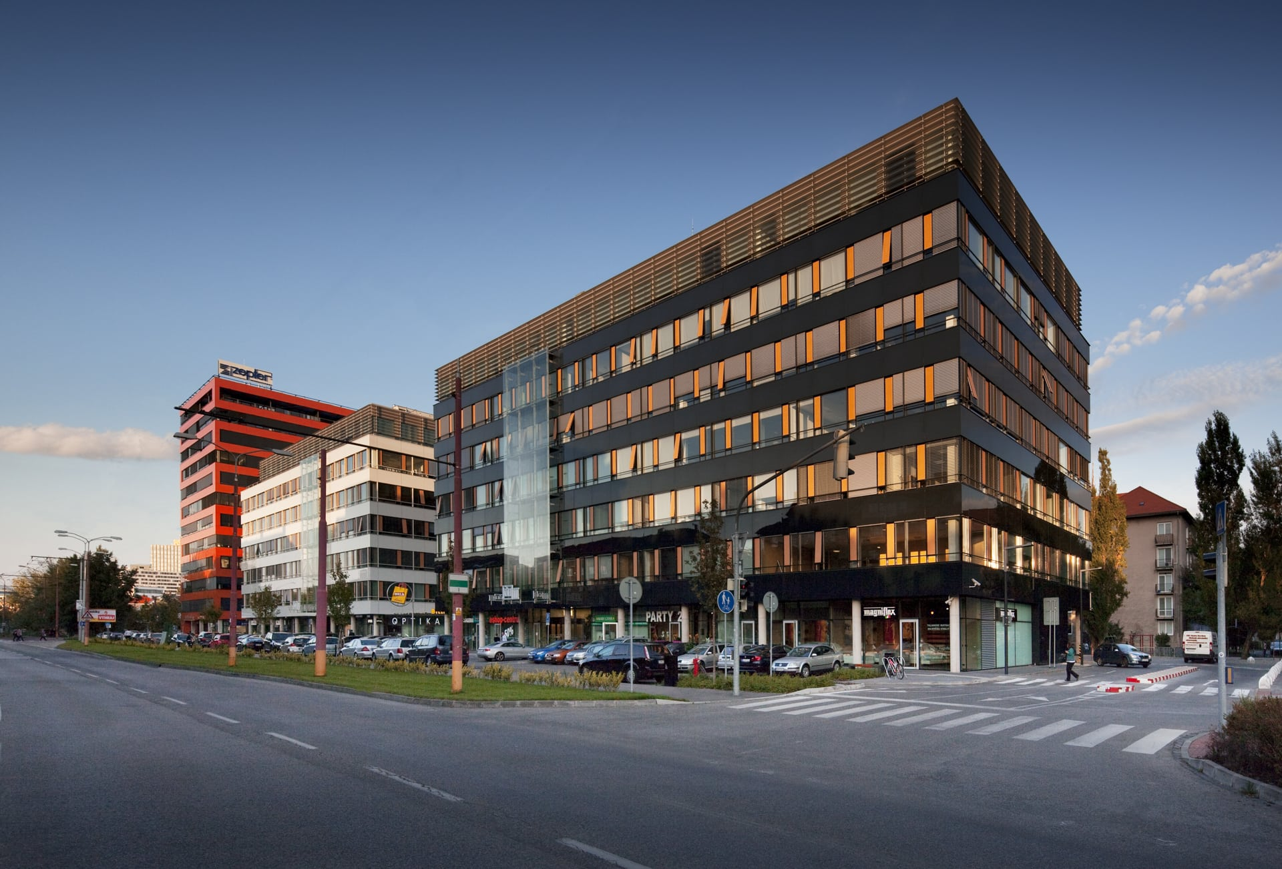
and I don’t see you everywhere

Slide 28
and I can say your name easily

Slide 29
I laugh bit louder

Slide 30
without you

Slide 31
and I see different shades now

Slide 32
and I’m almost never afraid now

Slide 33
but when I think I’ll be ok

Slide 34
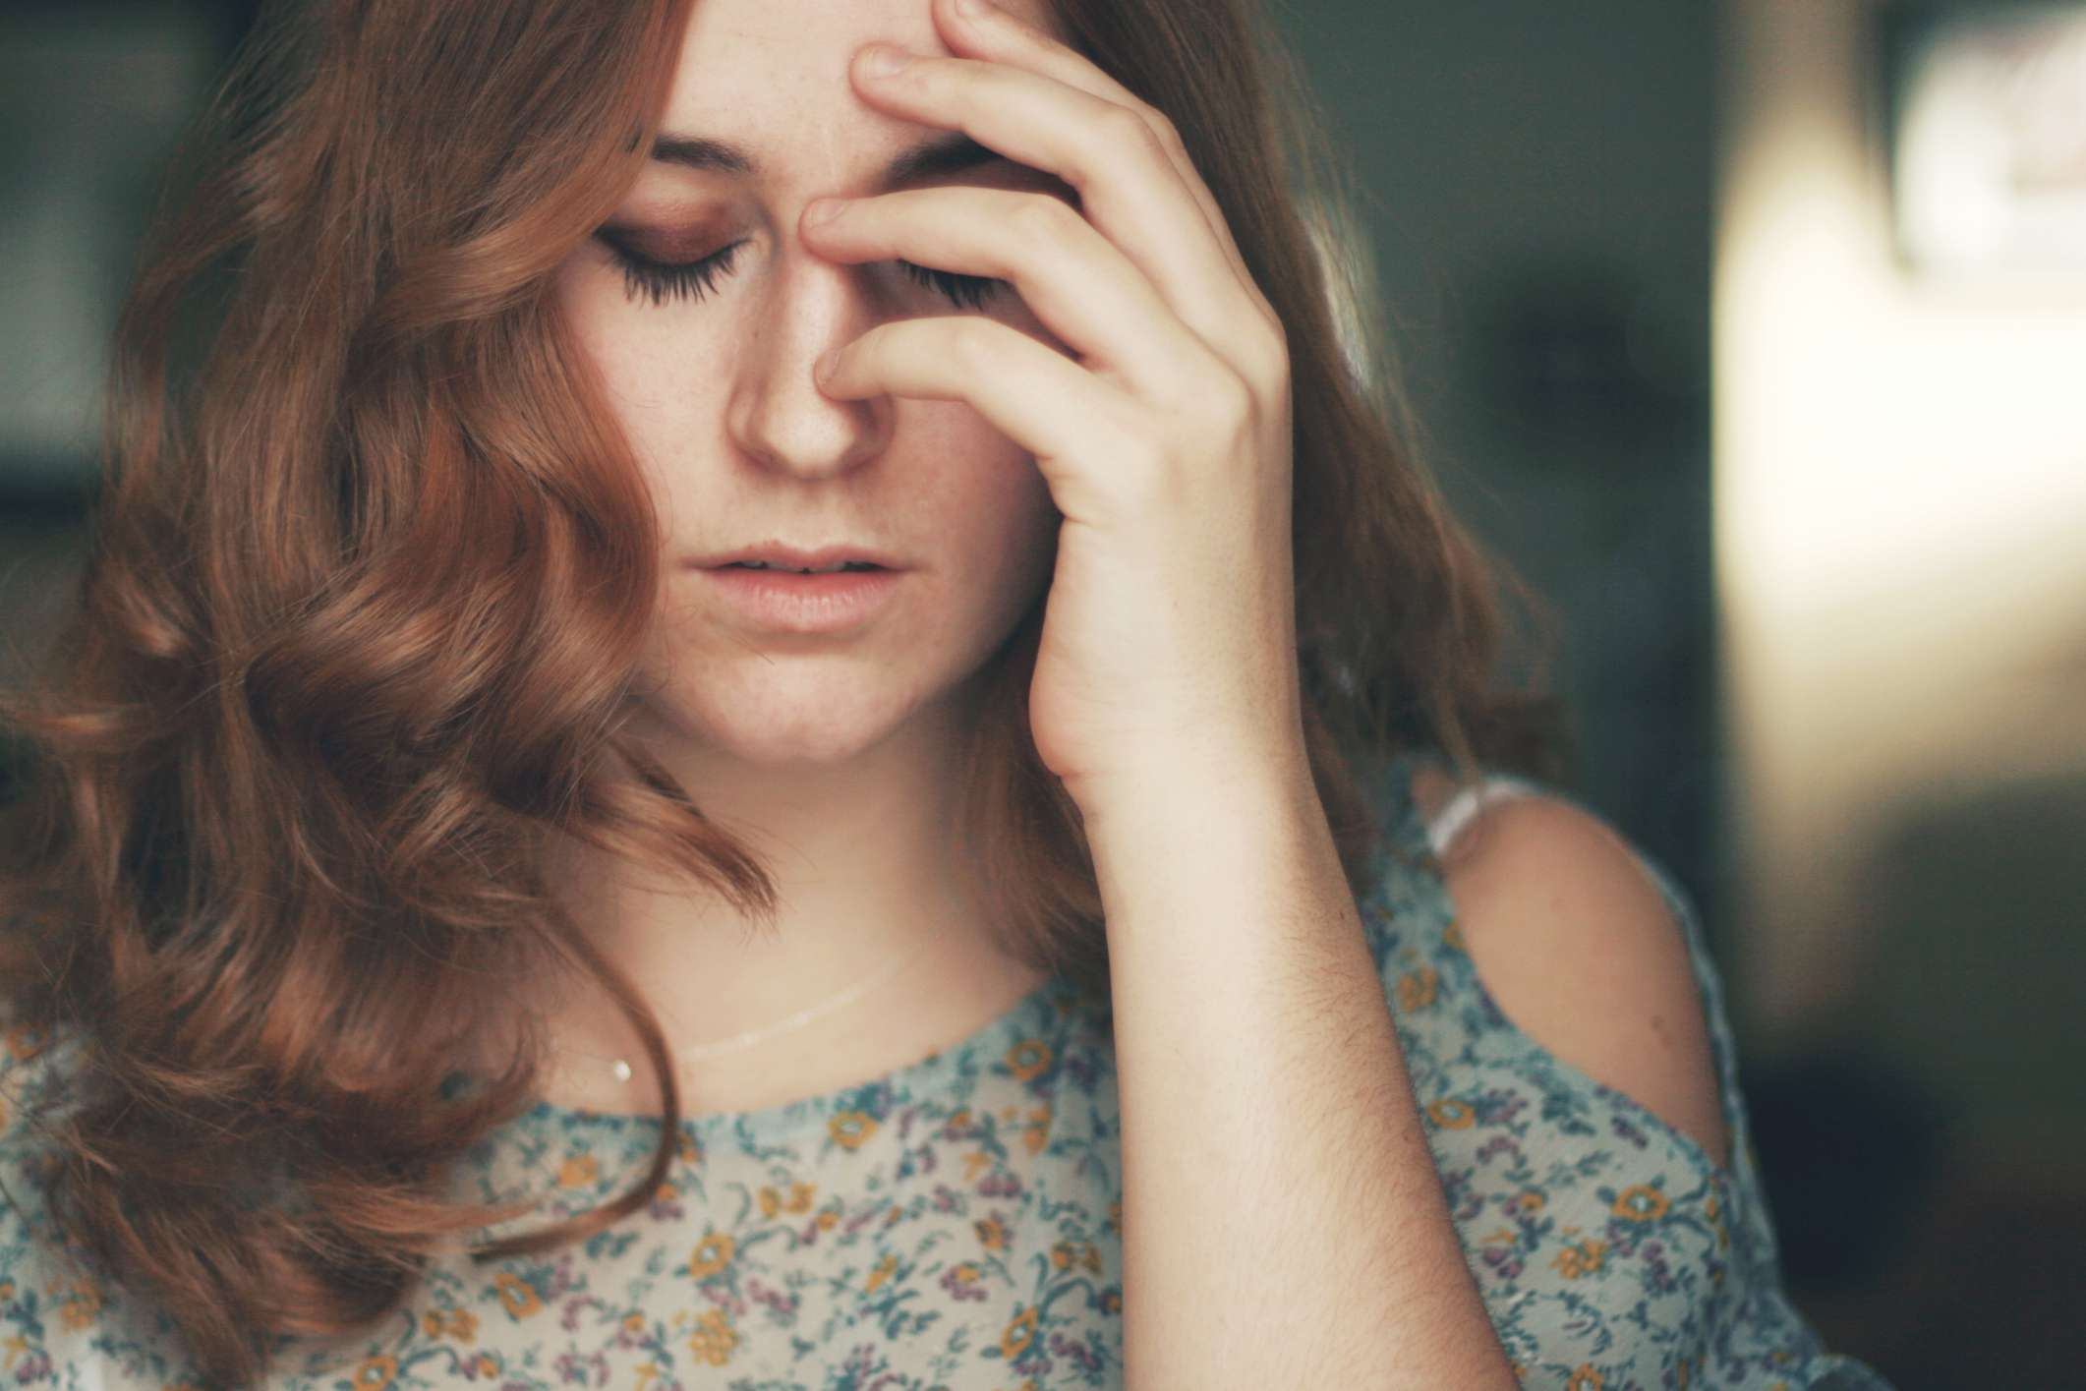
I am always wrong cause

Slide 35
my hands
don’t wanna start again

Slide 36
my hands
no they don’t wanna understand

Slide 37
my hands
they just shake it
try to break whatever piece I may find

Slide 38
my hands
they only agree to hold
your hands

Slide 39
and they don’t wanna be without
your hands

Slide 40
and they will not let me go
no they will not let me go

Slide 41
sometimes I wait

Slide 42
I see them reaching out for you

Slide 43
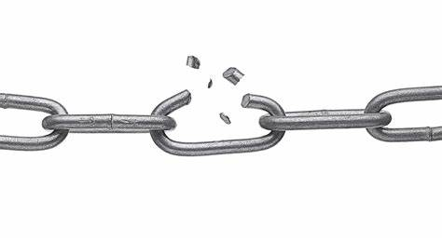
quickly break

Slide 44
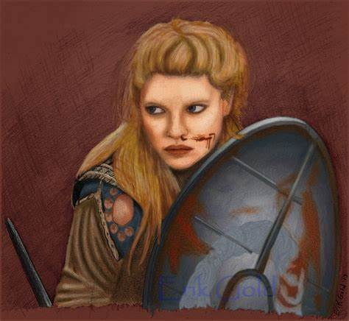
whatever shields I spent so long building up

Slide 45
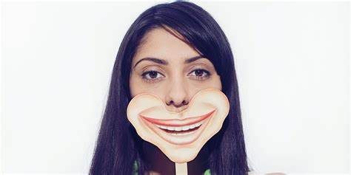
I cannot fake

Slide 46
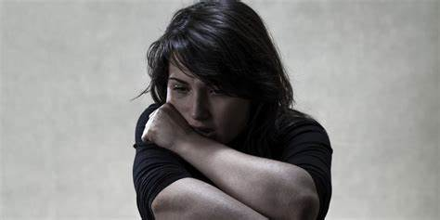
cause when they cry I’m almost broken

Slide 47
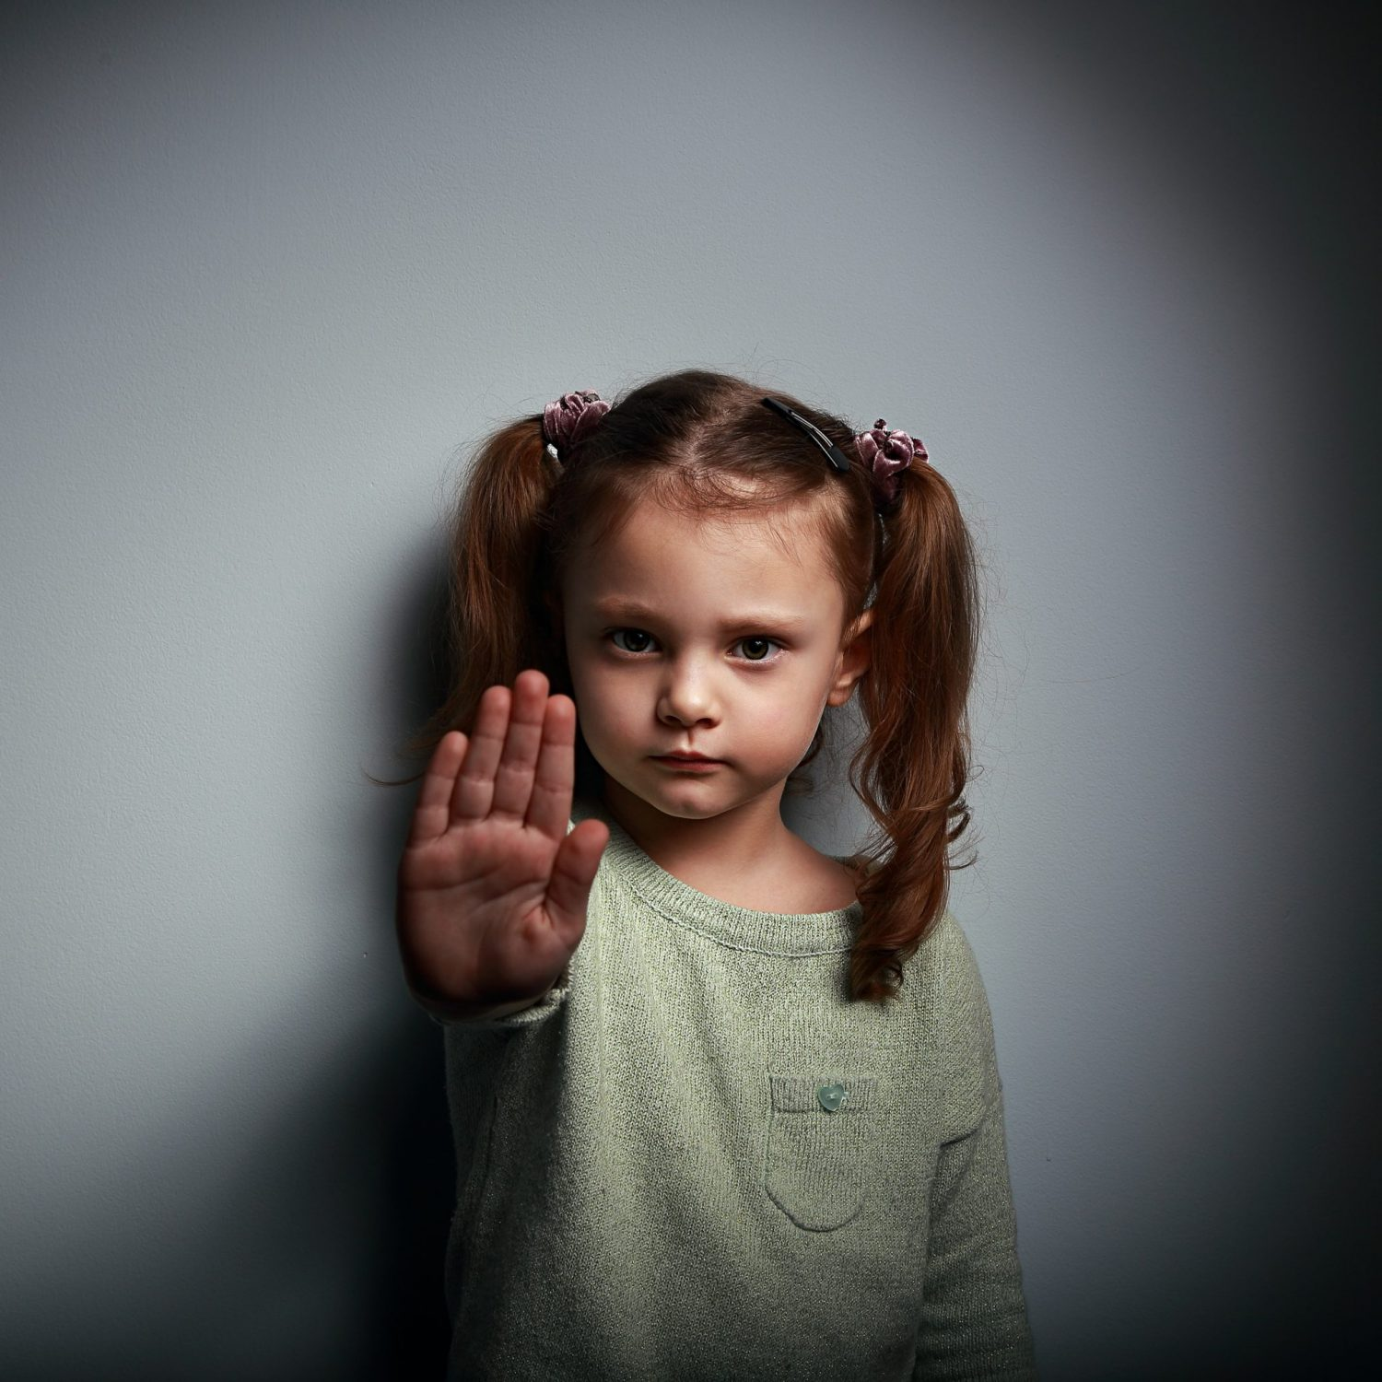
they miss holding my baby

Slide 48
my hands
no they don’t wanna understand

Slide 49
they just shake it
try to break whatever piece I may find

Slide 50
my hands

Slide 51
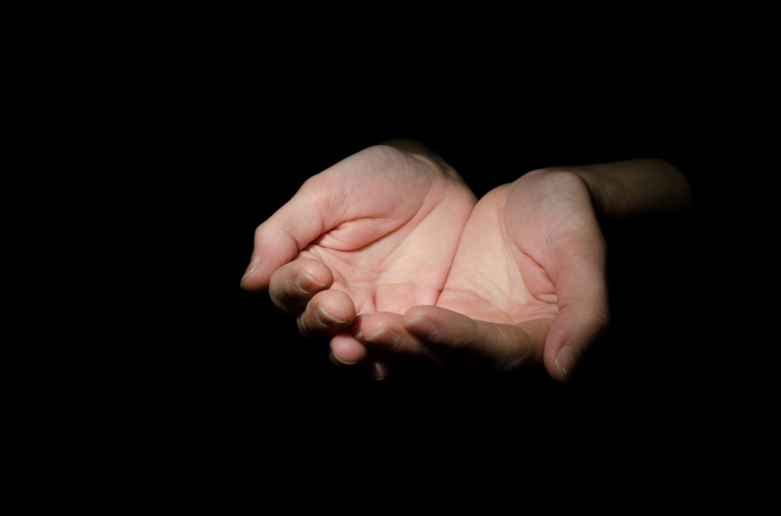
your hands

Slide 52
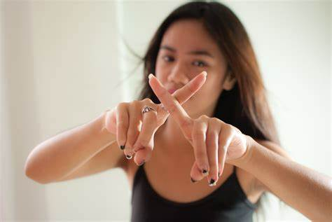
they don’t wanna be with us

Slide 53
and they will not let me go
no they will not let me go

Slide 54
my hands
don’t wanna start again

Slide 55
my hands
no they don’t wanna understand

Slide 56
my hands
they just shake it
try to break whatever piece I may find

Slide 57
my hands
they only agree to hold
your hands

Slide 58
and they will not let me go
no they will not let me go

Slide 59
Thank you!

