Slide 1
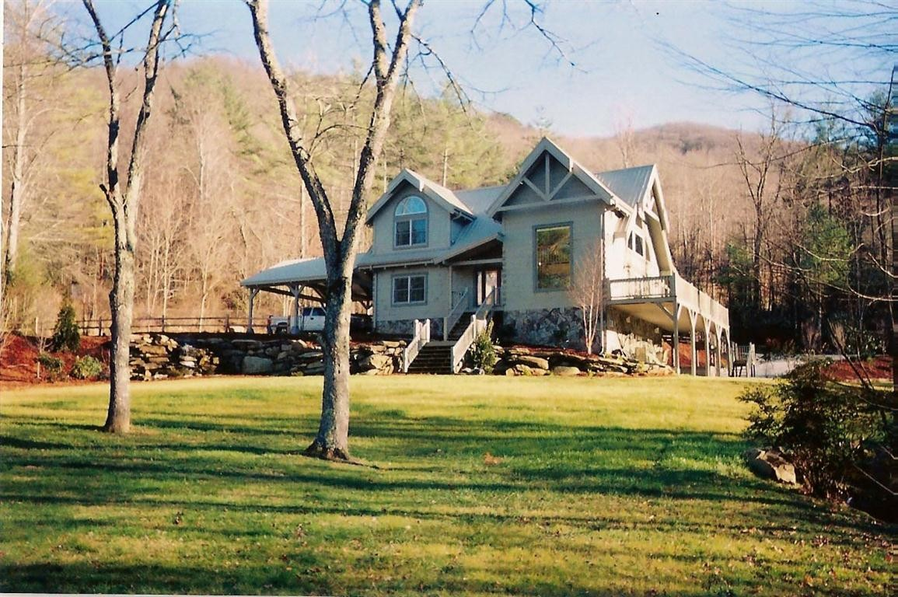
相册
由 admin 创建
语法点：与down有关的固定搭配
设计制作：华南师范大学 叶映利
河源市和平县阳明镇新社学校 黄素琼
指导老师：刘晓斌 黄素琼
HOME

Slide 2
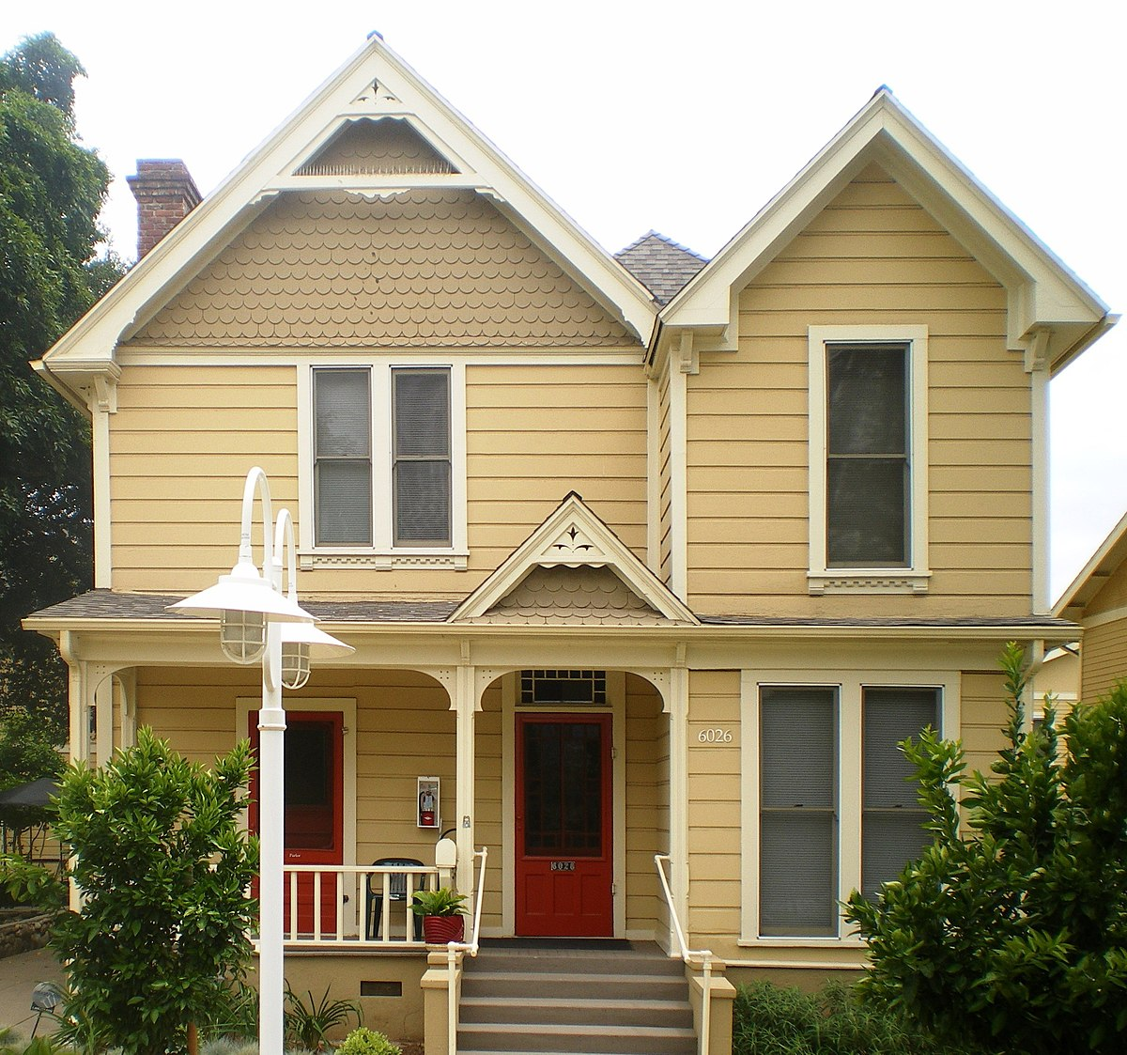
Looking for a place I can call my home, my home, wow~

Slide 3
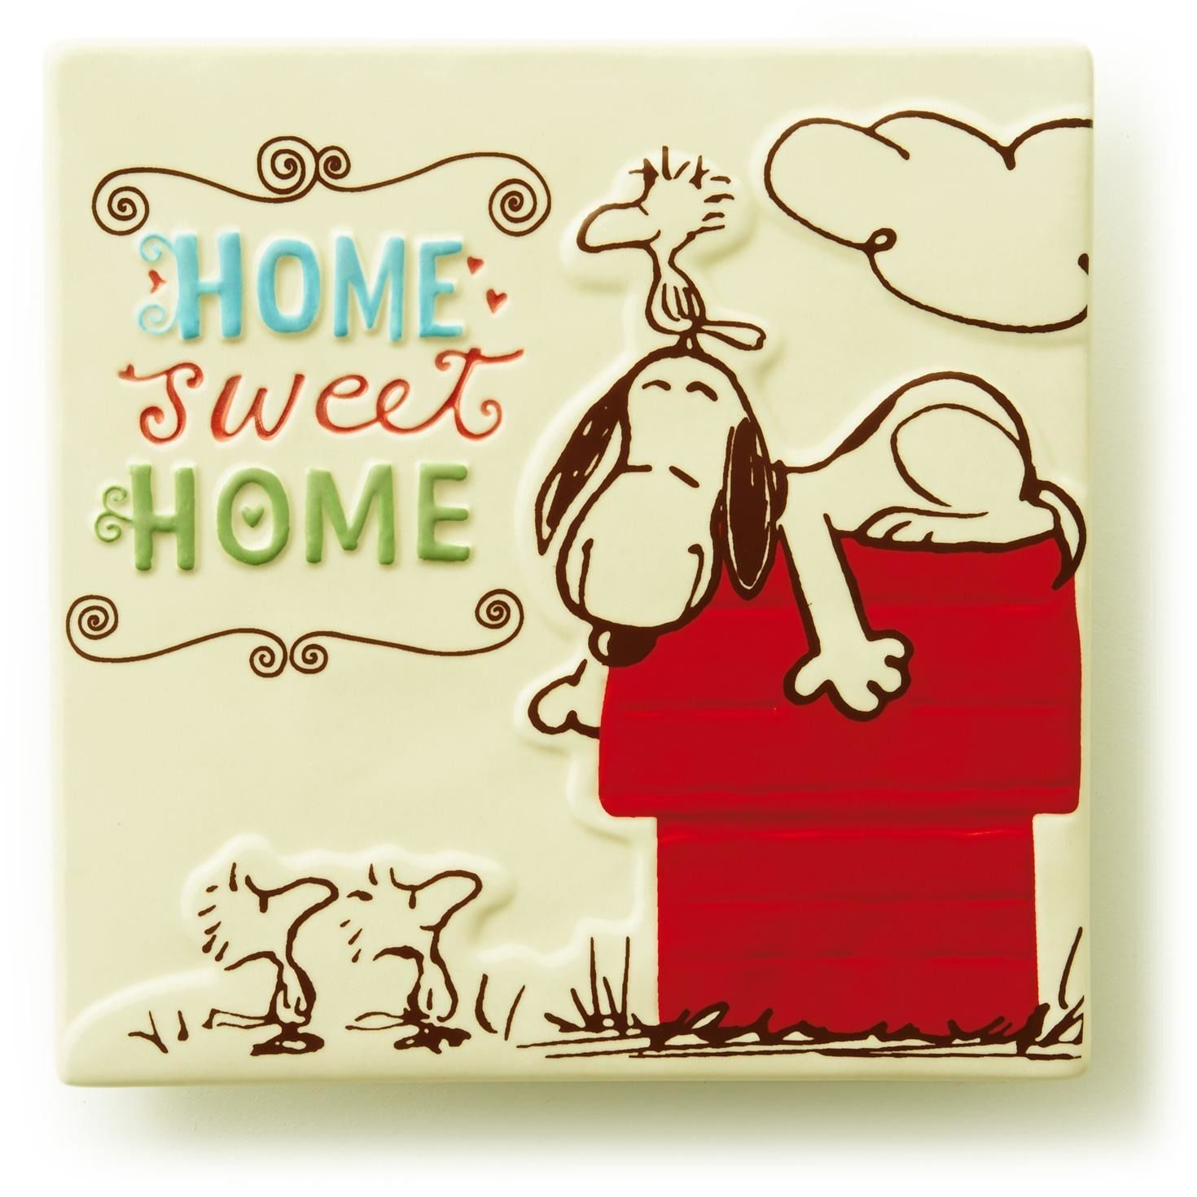
Looking for a place where I belong, belong, wow~

Slide 4
Maybe I fall or maybe I drown again and love again, wow~

Slide 5
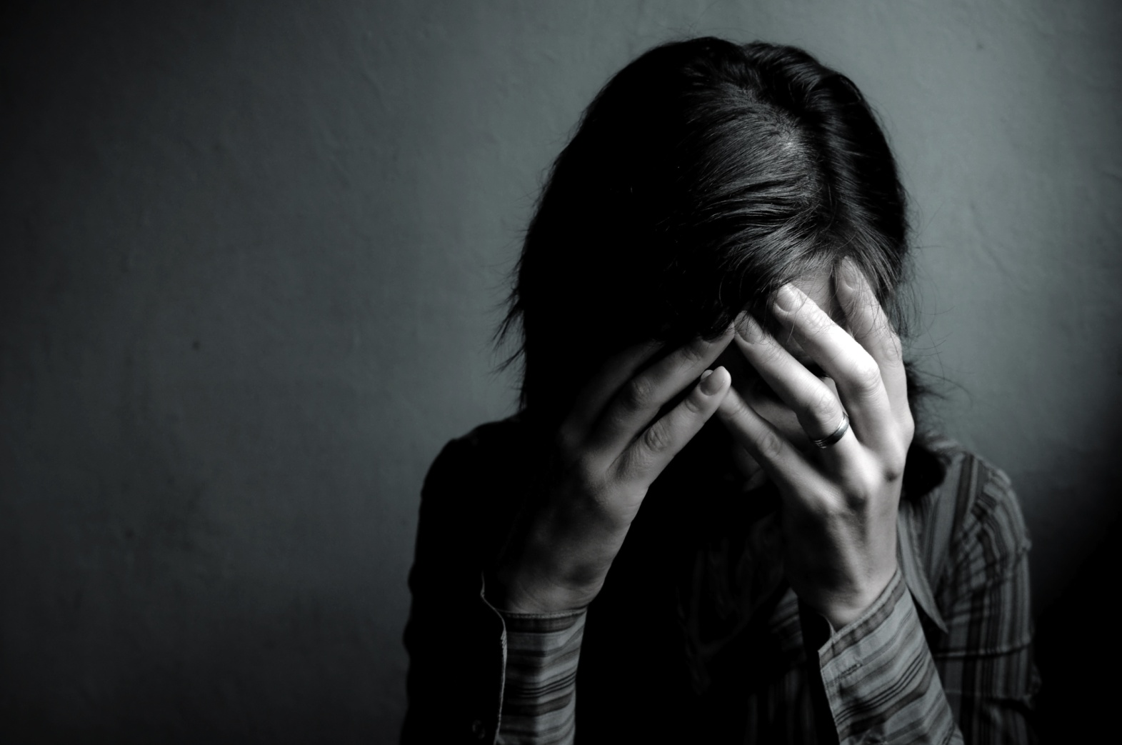
Maybe I fall or maybe I drown again and pain again, wow~

Slide 6
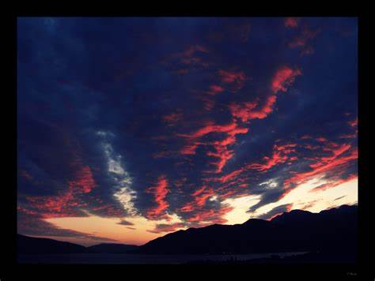
Even if the sky is falling down, falling down, I would search for you

Slide 7
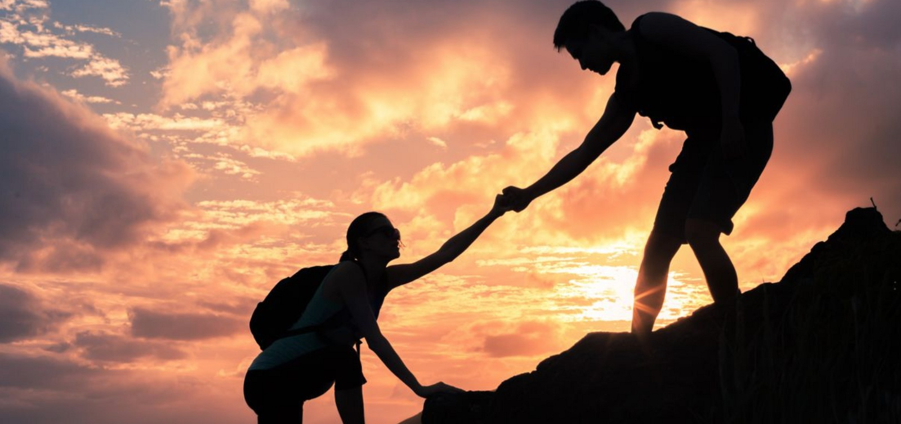
Even if the sky is falling down, falling down, I won’t give up on you

Slide 8
looking for a place that be myself, myself, wow~

Slide 9
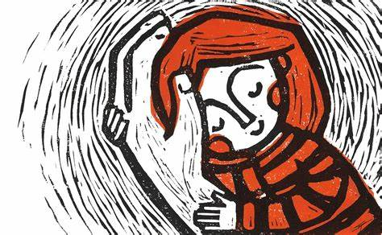
Looking for a place where I feel safe again, feel safe again, wow~

Slide 10
Maybe I fall or maybe I lose again, this faith again, wow~

Slide 11
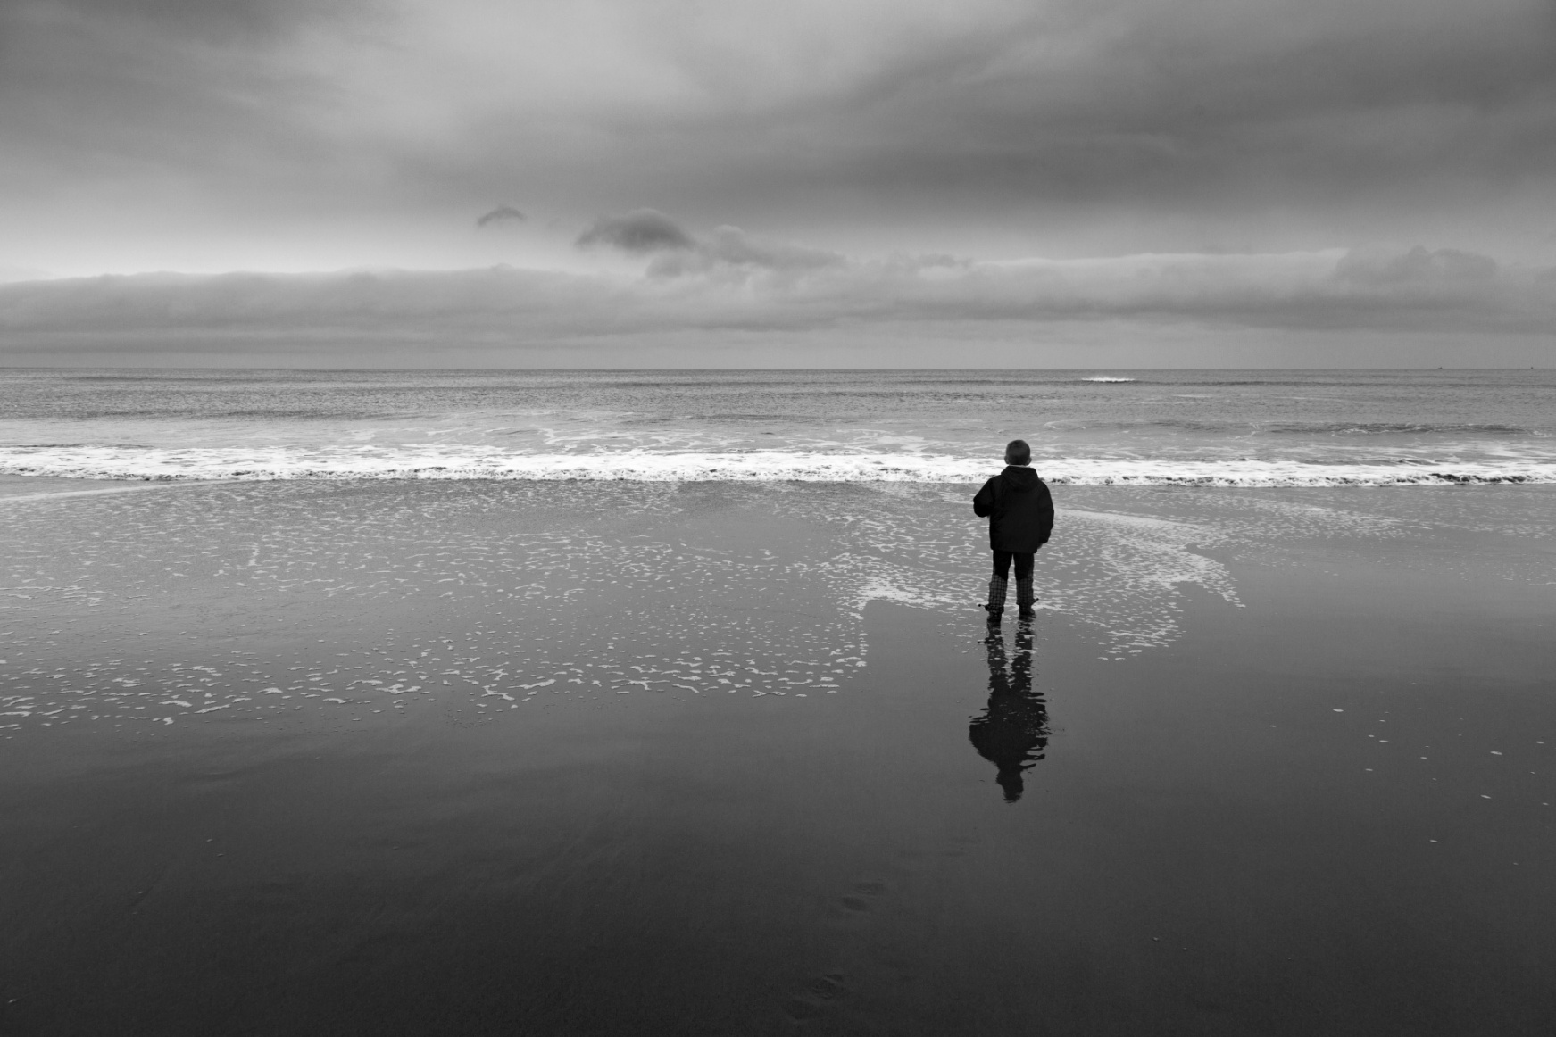
Maybe I fall or maybe I doubt again, alone again, wow~

Slide 12
Even if the sky is falling down, falling down, I would search for you

Slide 13
Even if the sky is falling down, falling down, I won’t give up on you

Slide 14
I won’t give up on you. I won’t give up on you.

