Slide 1
HOLD ON
——
Phrases about on
华南师范大学外国语言文化学院 王滢
广东省河源市和平县阳明镇新社学校 朱惠芳

Slide 2
I just assumed I'd play the part
I just assumed I'd play the part

Slide 3
Of keeping you in the right direction

Slide 4
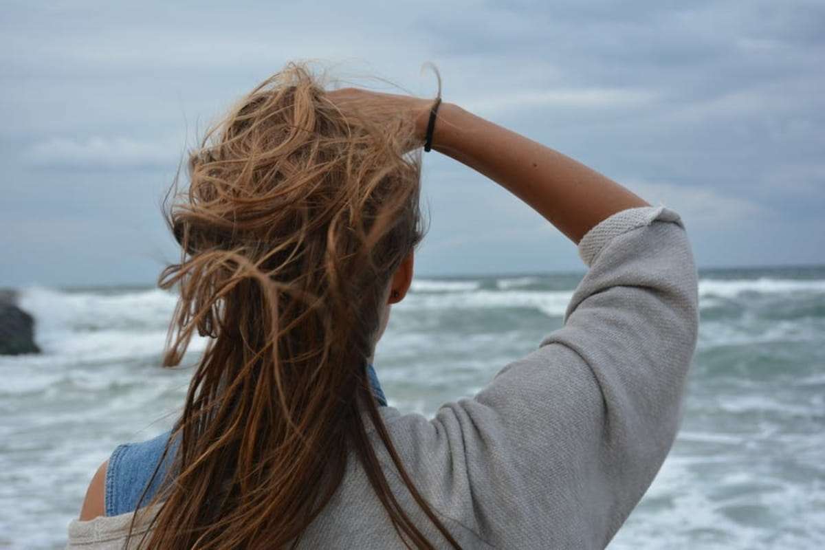
No matter how your confidence may fall

Slide 5
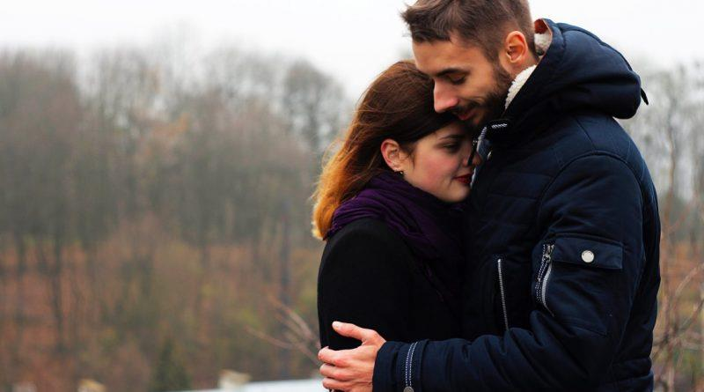
I'll be here as your foundation

Slide 6
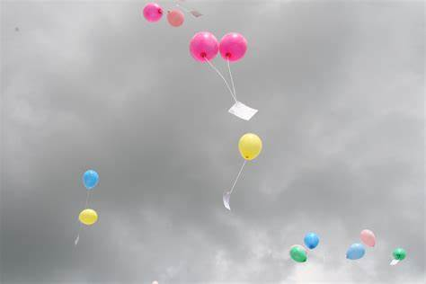
just let it go your struggles won't remain
And I said, Hey oh,

Slide 7
And I said, Hey oh,
we're holding hope in wake of yesterday

Slide 8
So hold on to me

Slide 9
hold on to me

Slide 10
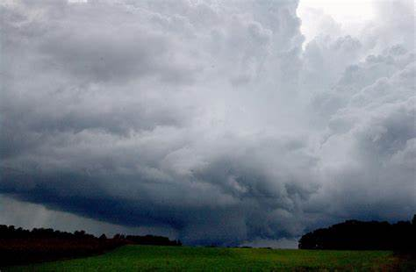
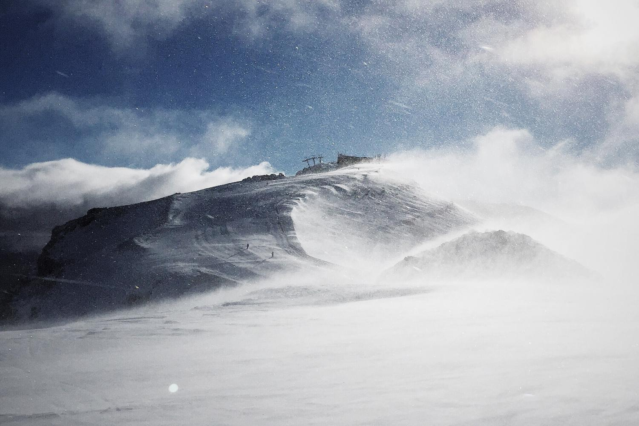
Hold on, hold on to me

Slide 11
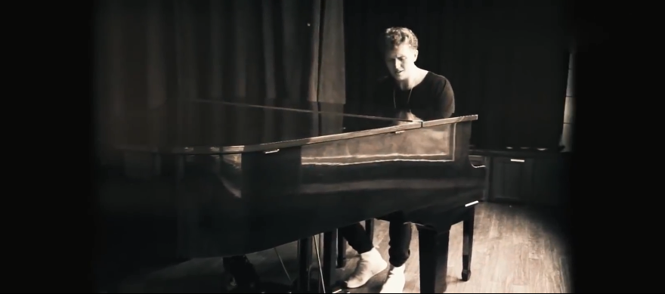
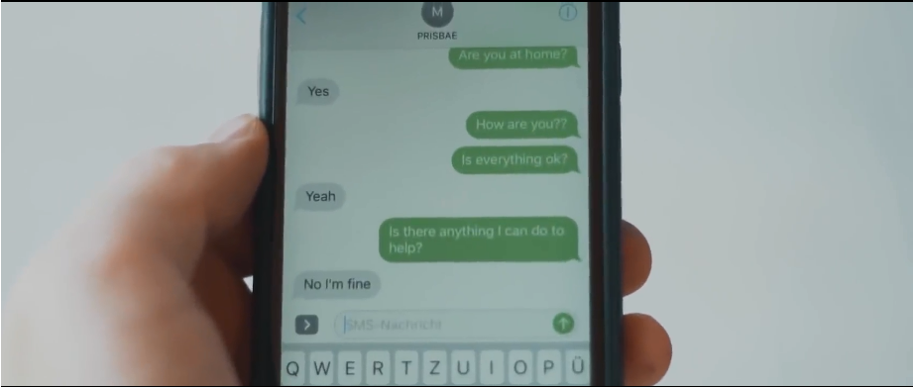
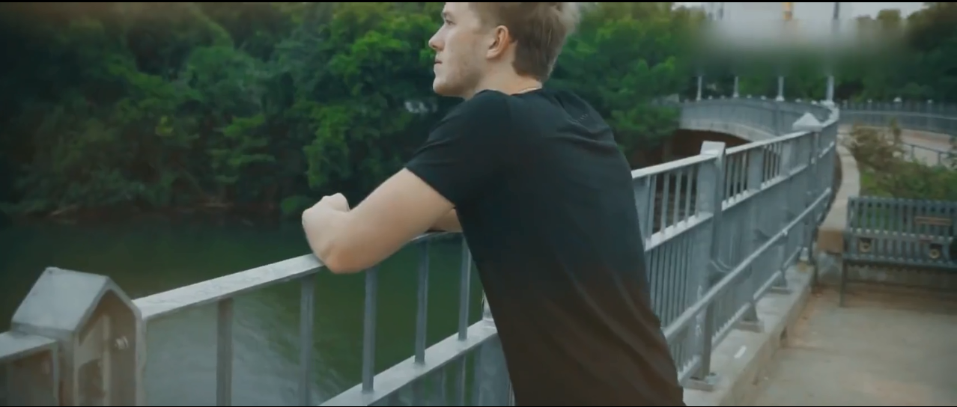
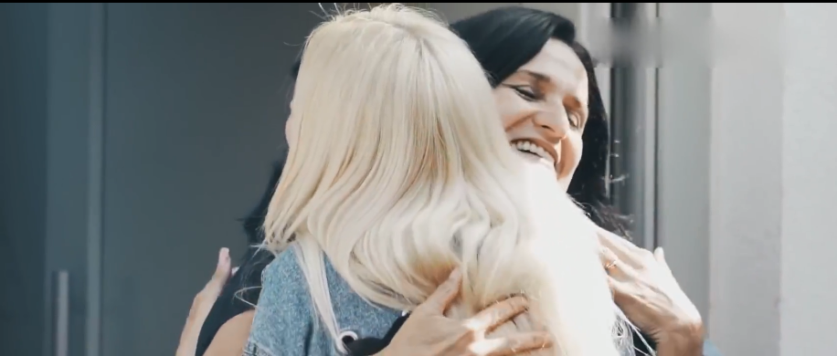
Hold on, hold on to me

Slide 12
Hold on, hold on to me

Slide 13
Hold on, hold on to me

Slide 14
Hold on, hold on to me

Slide 15
Hold on, hold on to me

Slide 16
Hold on, hold on to me

Slide 17
Please don't wait here until your faith is shaken

Slide 18
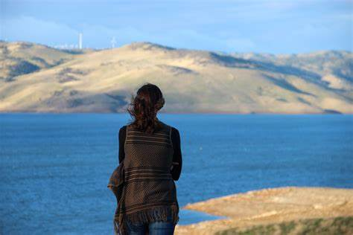
There's a whole lot of good on your mind

Slide 19
And on my mind

Slide 20
And I know that right now
I'd like to play the part

Slide 21
To rebuild you one more time

Slide 22
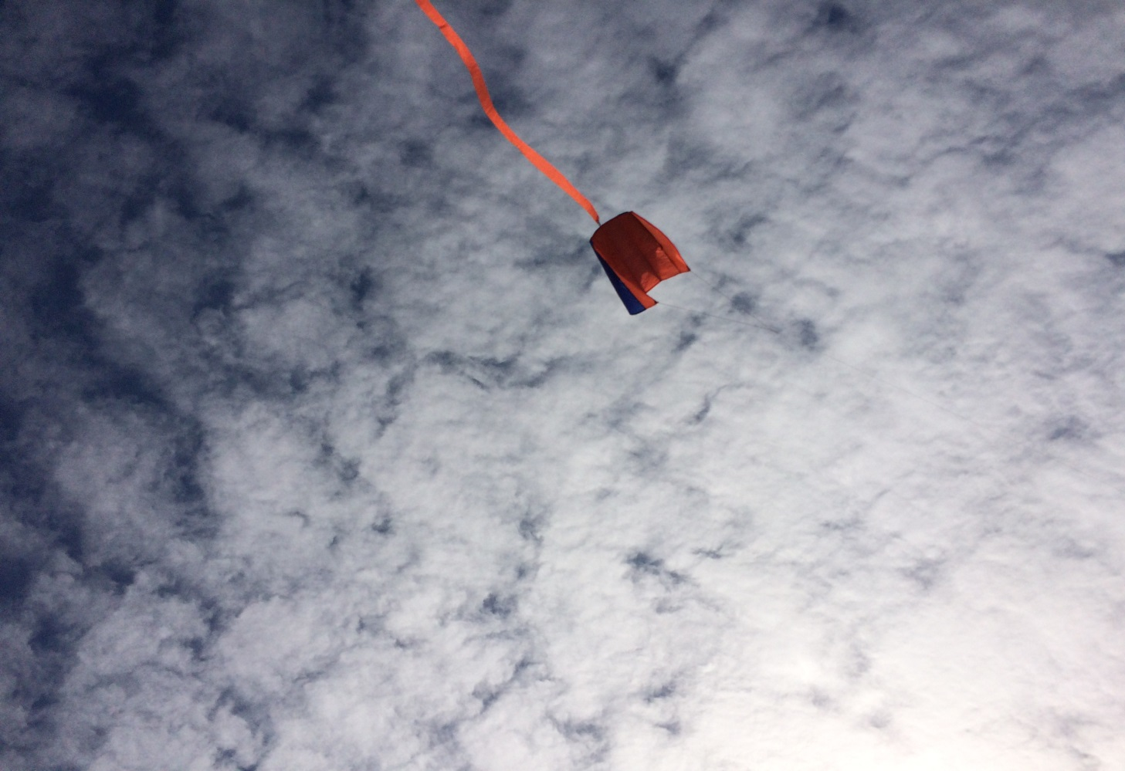
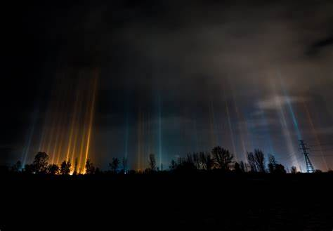
just let it go your struggles won't remain
And I said, Hey oh,

Slide 23
And I said, Hey oh,
we're holding hope in wake of yesterday

Slide 24
So hold on to me

Slide 25
hold on to me

Slide 26
Hold on, hold on to me

Slide 27
Hold on, hold on to me

Slide 28
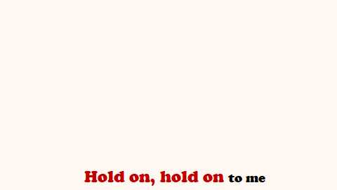
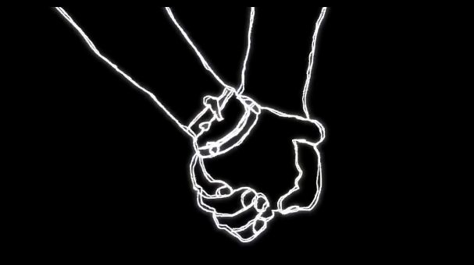
Please don't wait here until your faith is shaken
There's a whole lot of good on your mind
And on my mind
And I know that right now
I'd like to play the part
To rebuild you one more time
And I said, Hey oh
just let it go your struggles won't remain
And I said,
Hey oh we're holding hope in wake of yesterday
So hold on to me
Hold on to me
Hold on, hold on to me
Hold on, hold on to me

