Slide 1


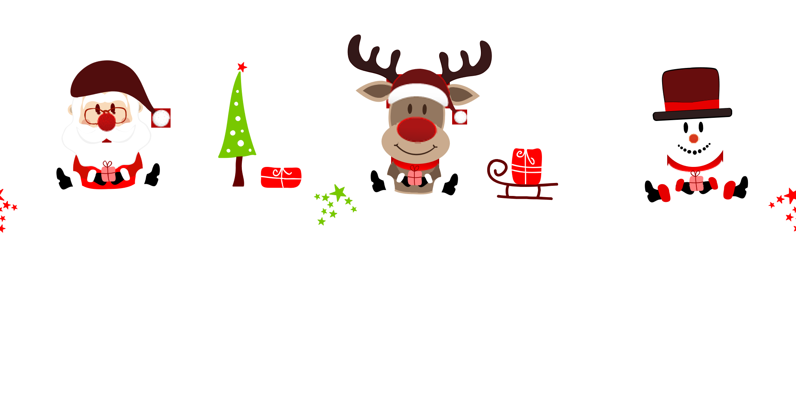

—— together with
华南师范大学外国语言文化学院 梁丽琪
广东省河源市和平县四联中学 林灿烂

Slide 2

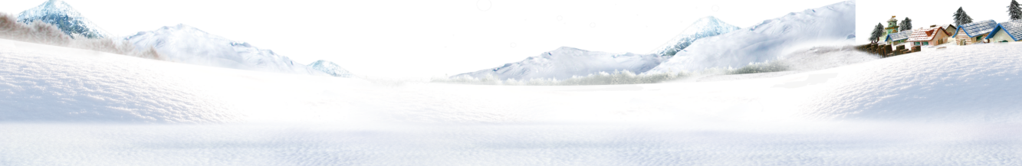

Just hear those
sleigh bells jingling
Ring ting tingling too
Notes:
1

Slide 3




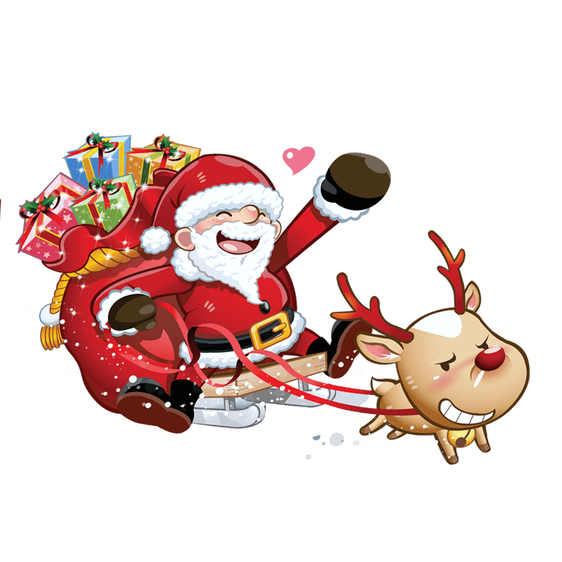
Come on, it's lovely weather
For a sleigh ride together with you
Notes:
1

Slide 4

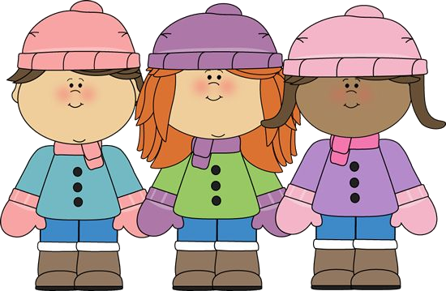
Outside the snow is falling
And friends are calling
Notes:
3 欠小朋友

Slide 5



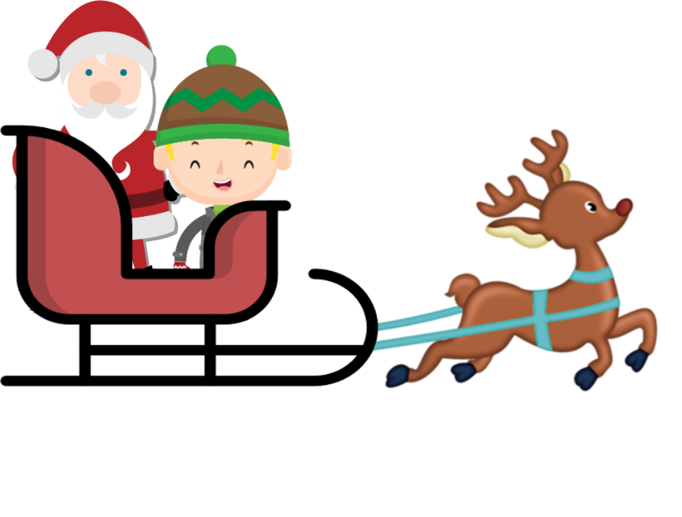
Come on, it's lovely weather
For a sleigh ride together with you

Slide 6
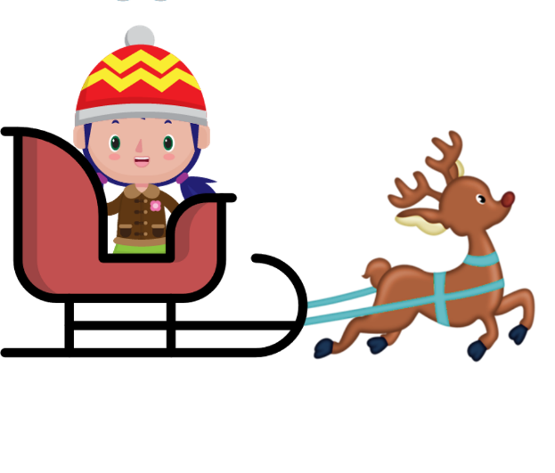


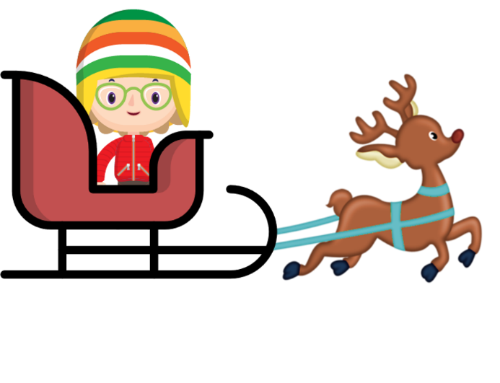
Let's go

Slide 7



Slide 8

We're riding in a wonderland of snow

Slide 9
It’s grand

Slide 10




Slide 11



We're gliding along with a song
Of a wintry fairy land

Slide 12
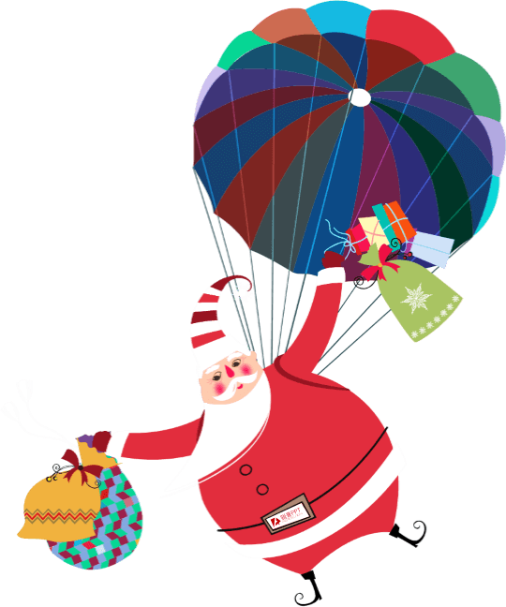

Our cheeks are nice and rosy
And comfy cozy are we

Slide 13

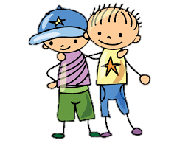
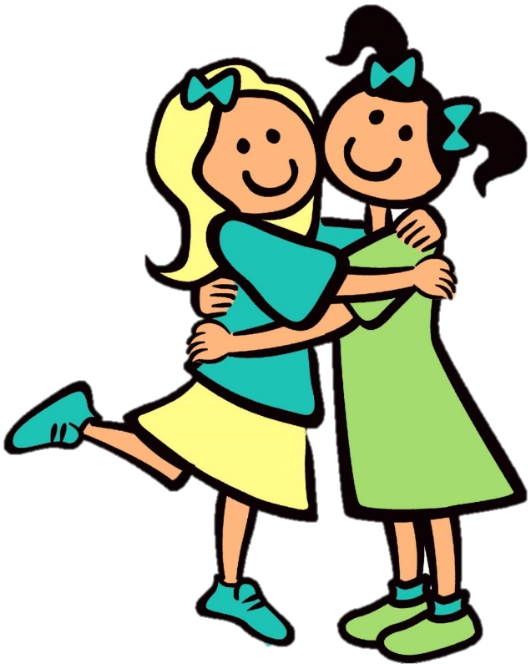
We're snuggled up together
Like two birds of a feather would be

Slide 14


Let's take that road before us
And sing a chorus or two

Slide 15
Come on, it's lovely weather
For a sleigh ride together with you

Slide 16


There's a birthday party
At the home of Farmer Gray

Slide 17





It'll be
the perfect ending
of a perfect day

Slide 18





We'll be singing the songs
We love to sing without a single stop

Slide 19


At the fireplace while we watch the chestnuts pop

Slide 20
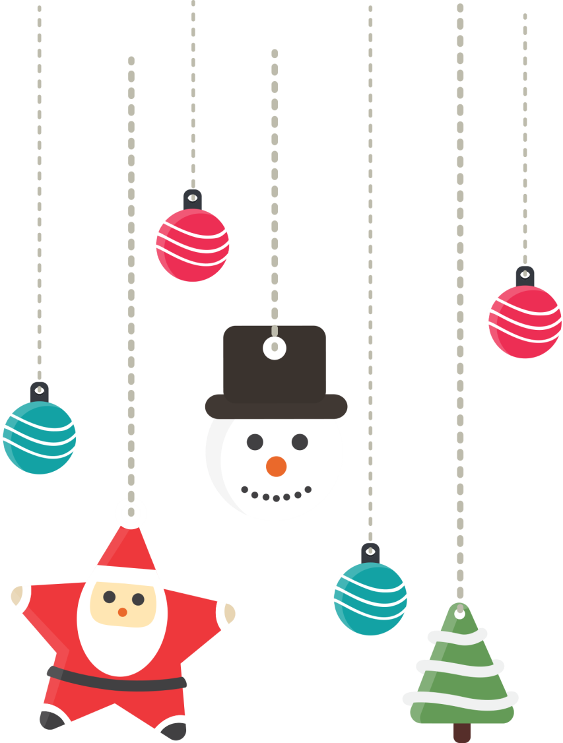
There's a happy feeling nothing in the world can buy

Slide 21




When they pass around
the coffee and the pumpkin pie

Slide 22
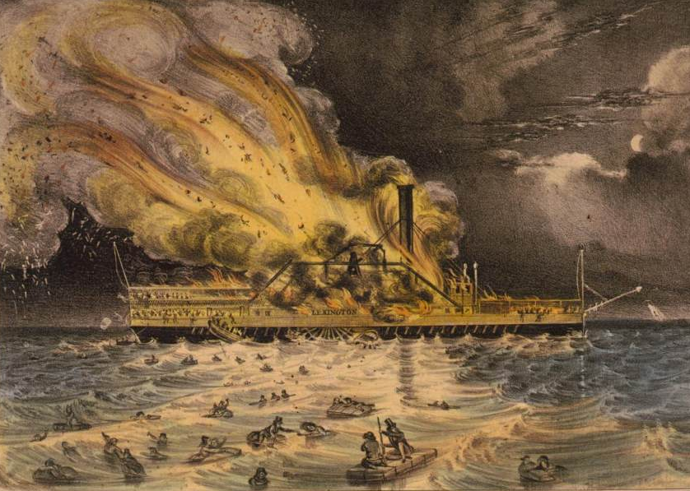

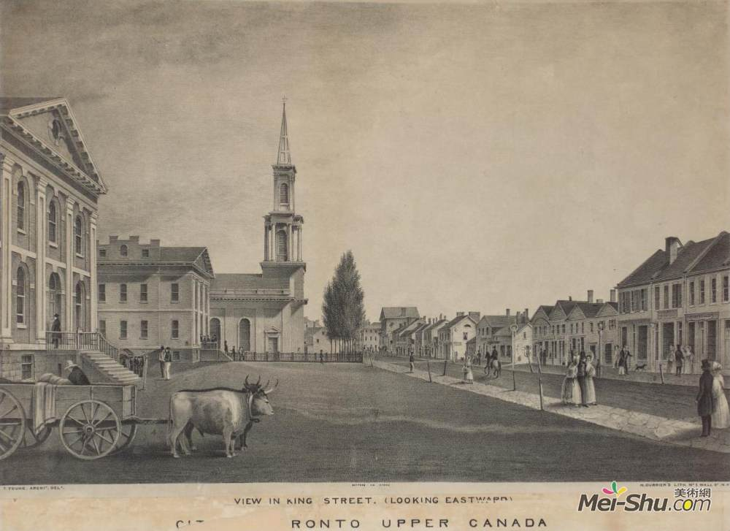
It'll nearly be like a picture print
By Currier and Ives

Slide 23




These wonderful things are the things
We remember all through our lives!

Slide 24
Just hear those
sleigh bells jingling
Ring ting tingling too
Notes:
1

Slide 25
Come on, it's lovely weather
For a sleigh ride together with you
Notes:
1

Slide 26
Outside the snow is falling
And friends are calling
Notes:
3 欠小朋友

Slide 27
Come on, it's lovely weather
For a sleigh ride together with you

Slide 28

Merry
Christmas

