Slide 1
When I grow up
——与 up 有关的短语
设计制作：华南师范大学外国语言文化学院 庄一飞
广东省河源市和平县阳明镇龙湖学校 陈丽丹
指导老师：陈丽丹、刘晓斌

Slide 2
When I grow up

Slide 3
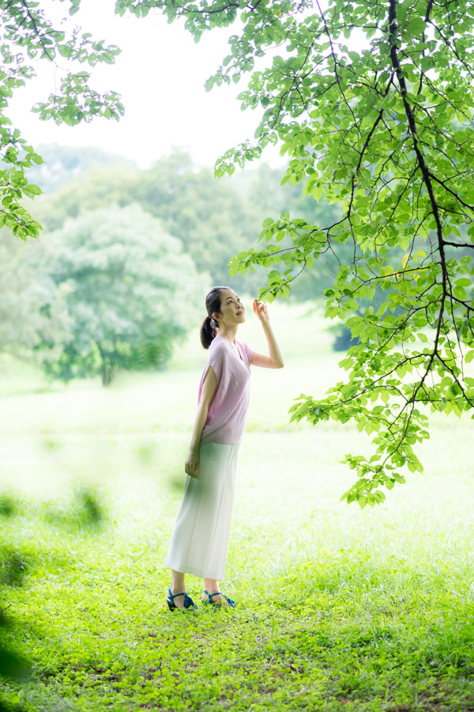
I will be tall enough to reach the branches

Slide 4
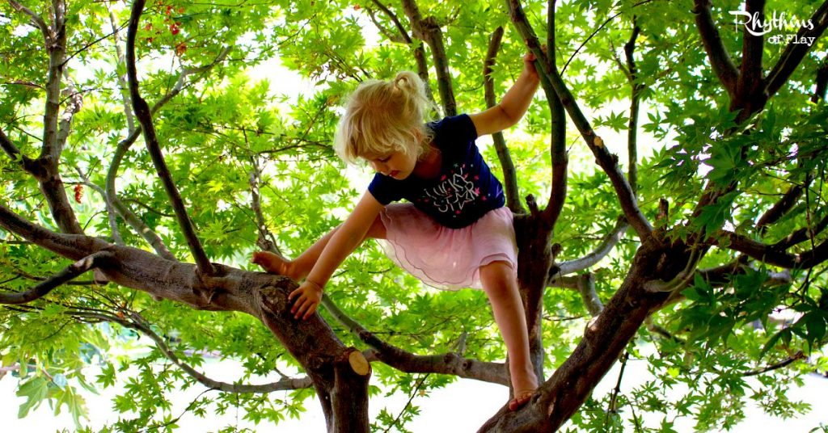
That I need to reach to climb the tree

Slide 5
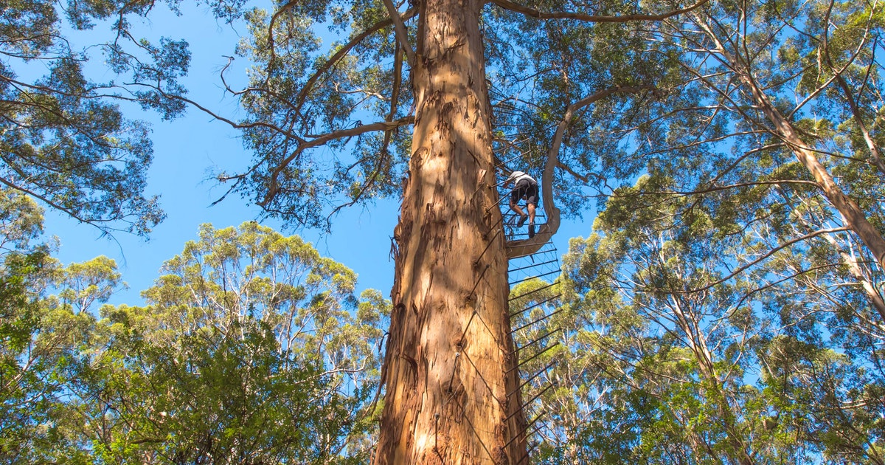
You get to climb when you're grown up

Slide 6
And when I grow up

Slide 7
I will be smart enough
to answer all
The questions
that you need to know

Slide 8
The answers to before you're grown up

Slide 9
And when I grow up

Slide 10
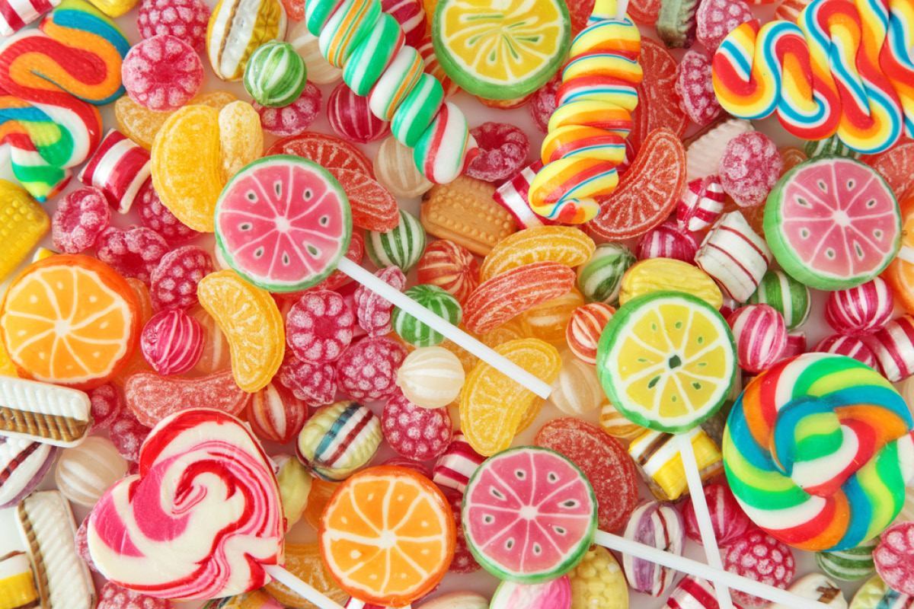
I will eat sweets
every day

Slide 11
On the way to work, and I will
go to bed late every night

Slide 12
And I will wake up when the sun comes up

Slide 13
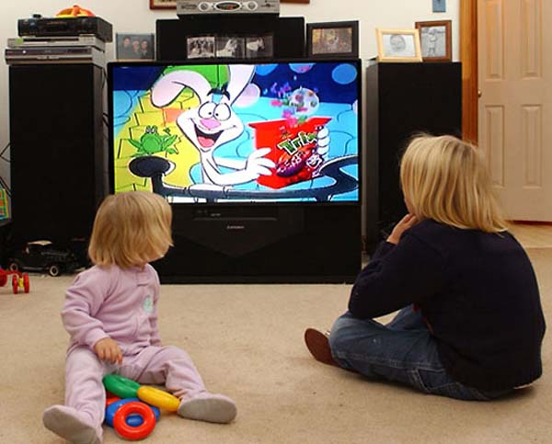
And I will watch cartoons until my eyes go square

Slide 14
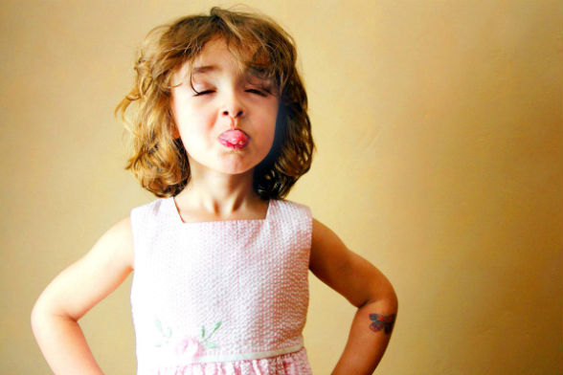
And I won't care cause I'll be all grown up

Slide 15
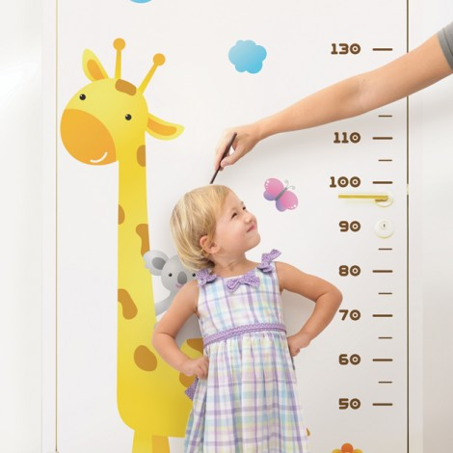
When I grow up

Slide 16
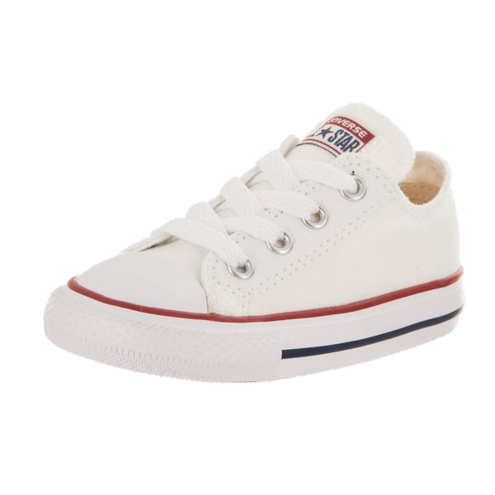
When I grow up

Slide 17
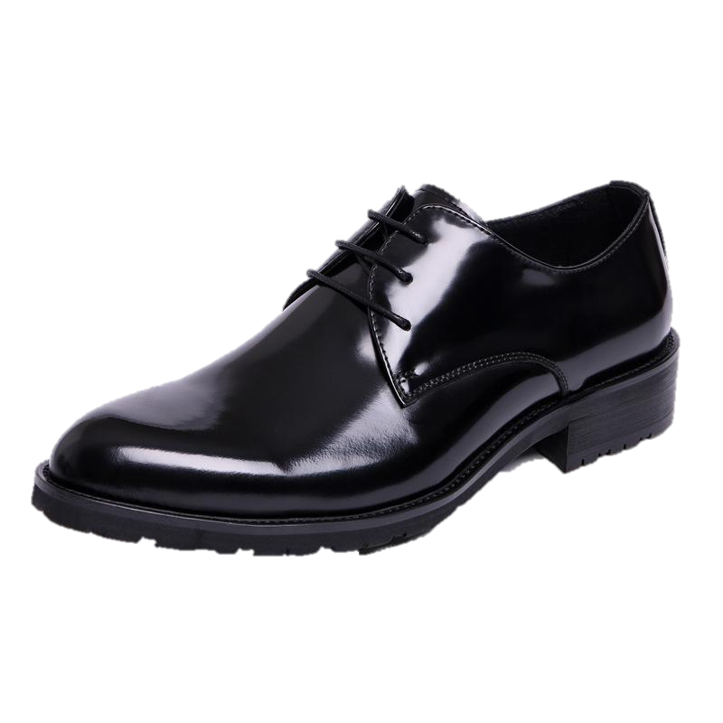
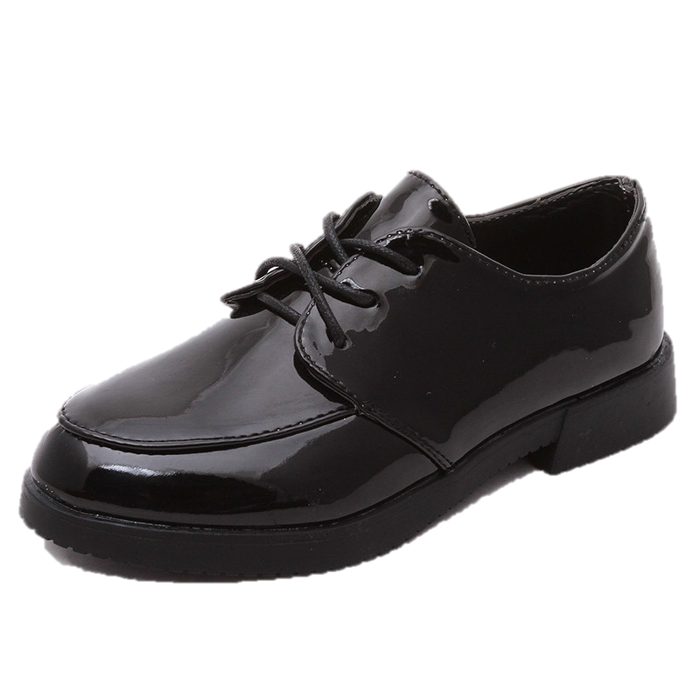
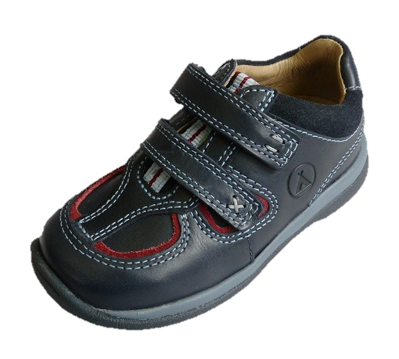
When I grow up

Slide 18
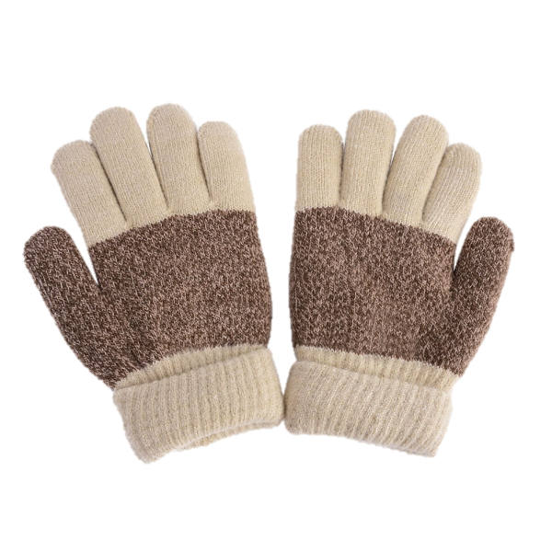
When I grow up

Slide 19
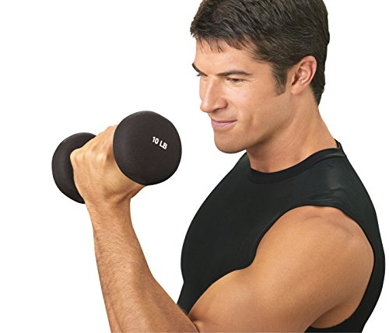
I will be strong enough to carry all

Slide 20
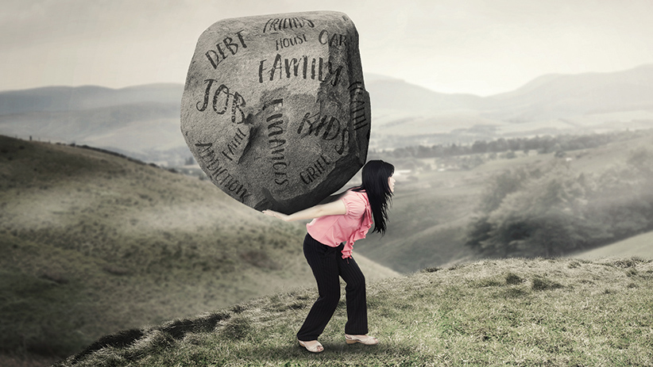
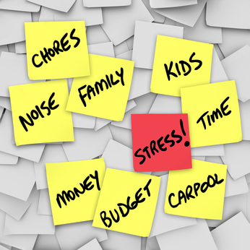
The heavy things you have to haul
around with you when you're a grown up

Slide 21
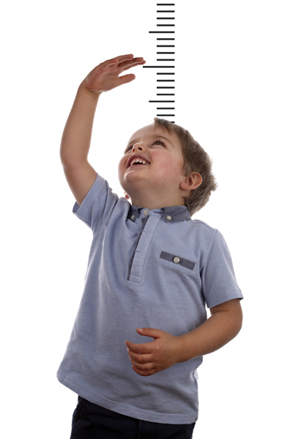
And when I grow up

Slide 22
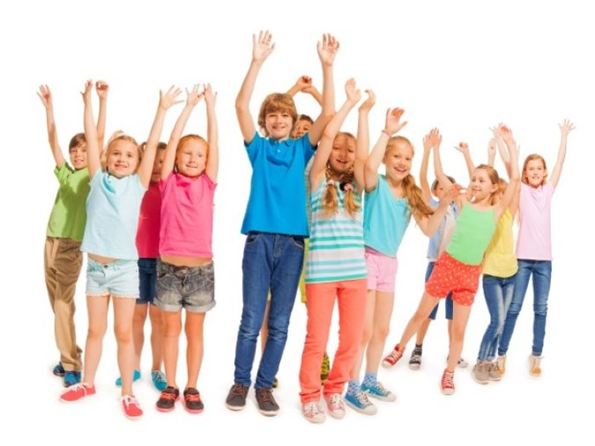
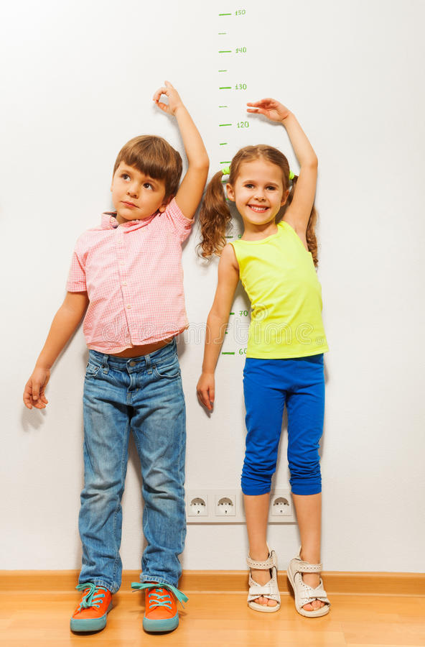
When I grow up
When I grow up

Slide 23
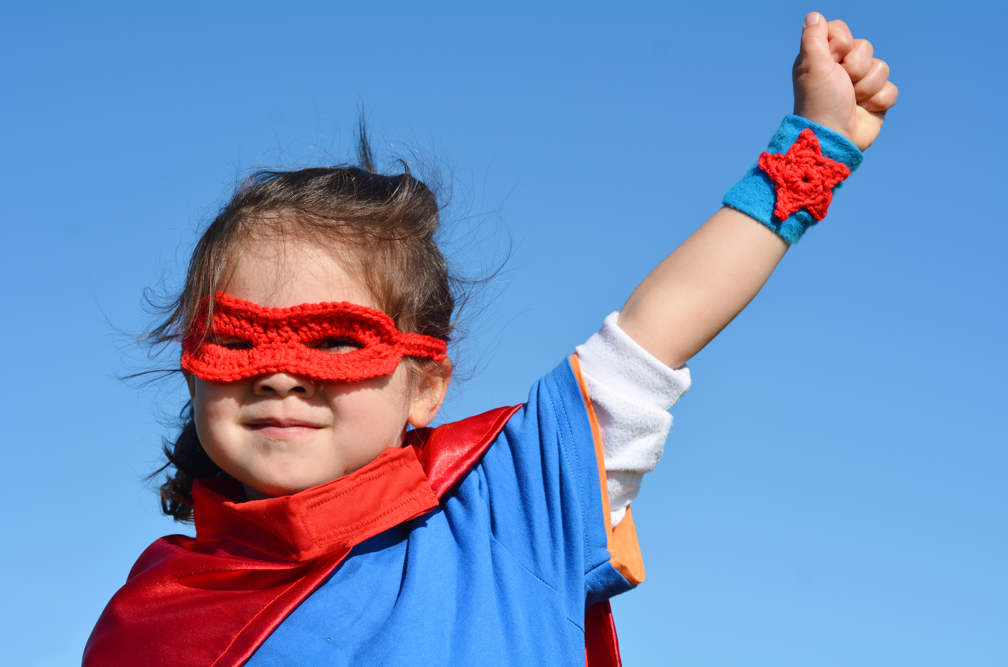
I will be brave enough to fight the creatures

Slide 24
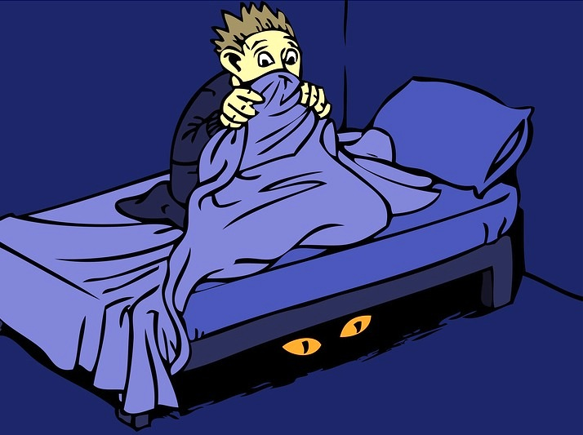
That you have to fight beneath the bed
each night to be a grown up

Slide 25
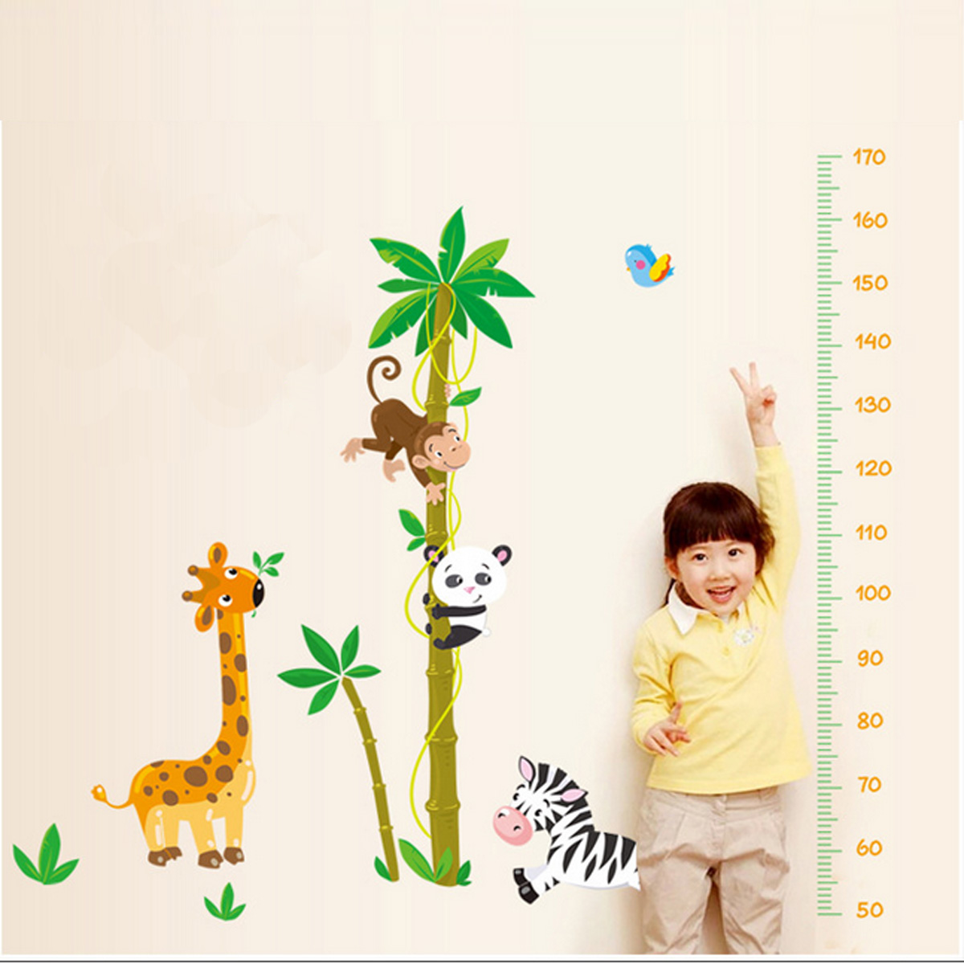
And when I grow up
And when I grow up

Slide 26
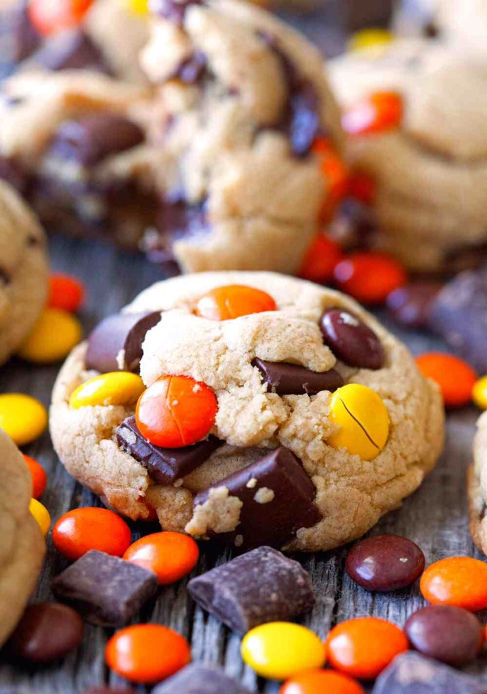
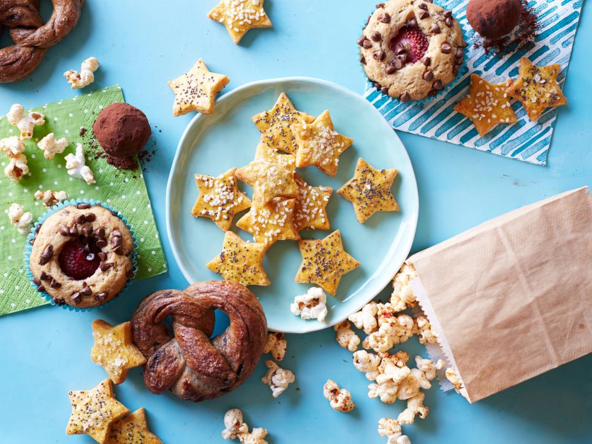
I will have treats every day

Slide 27
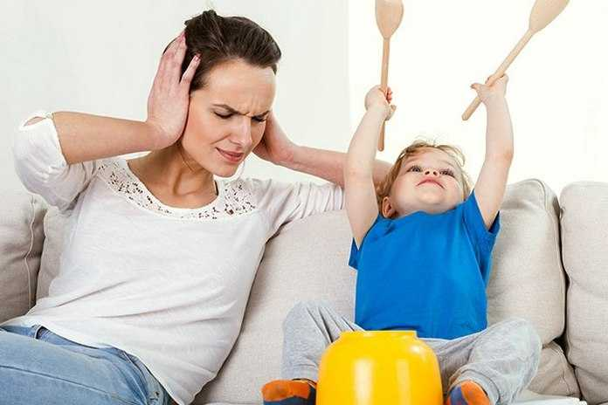
And I'll play with things that mum pretends
that mums don't think are fun

Slide 28
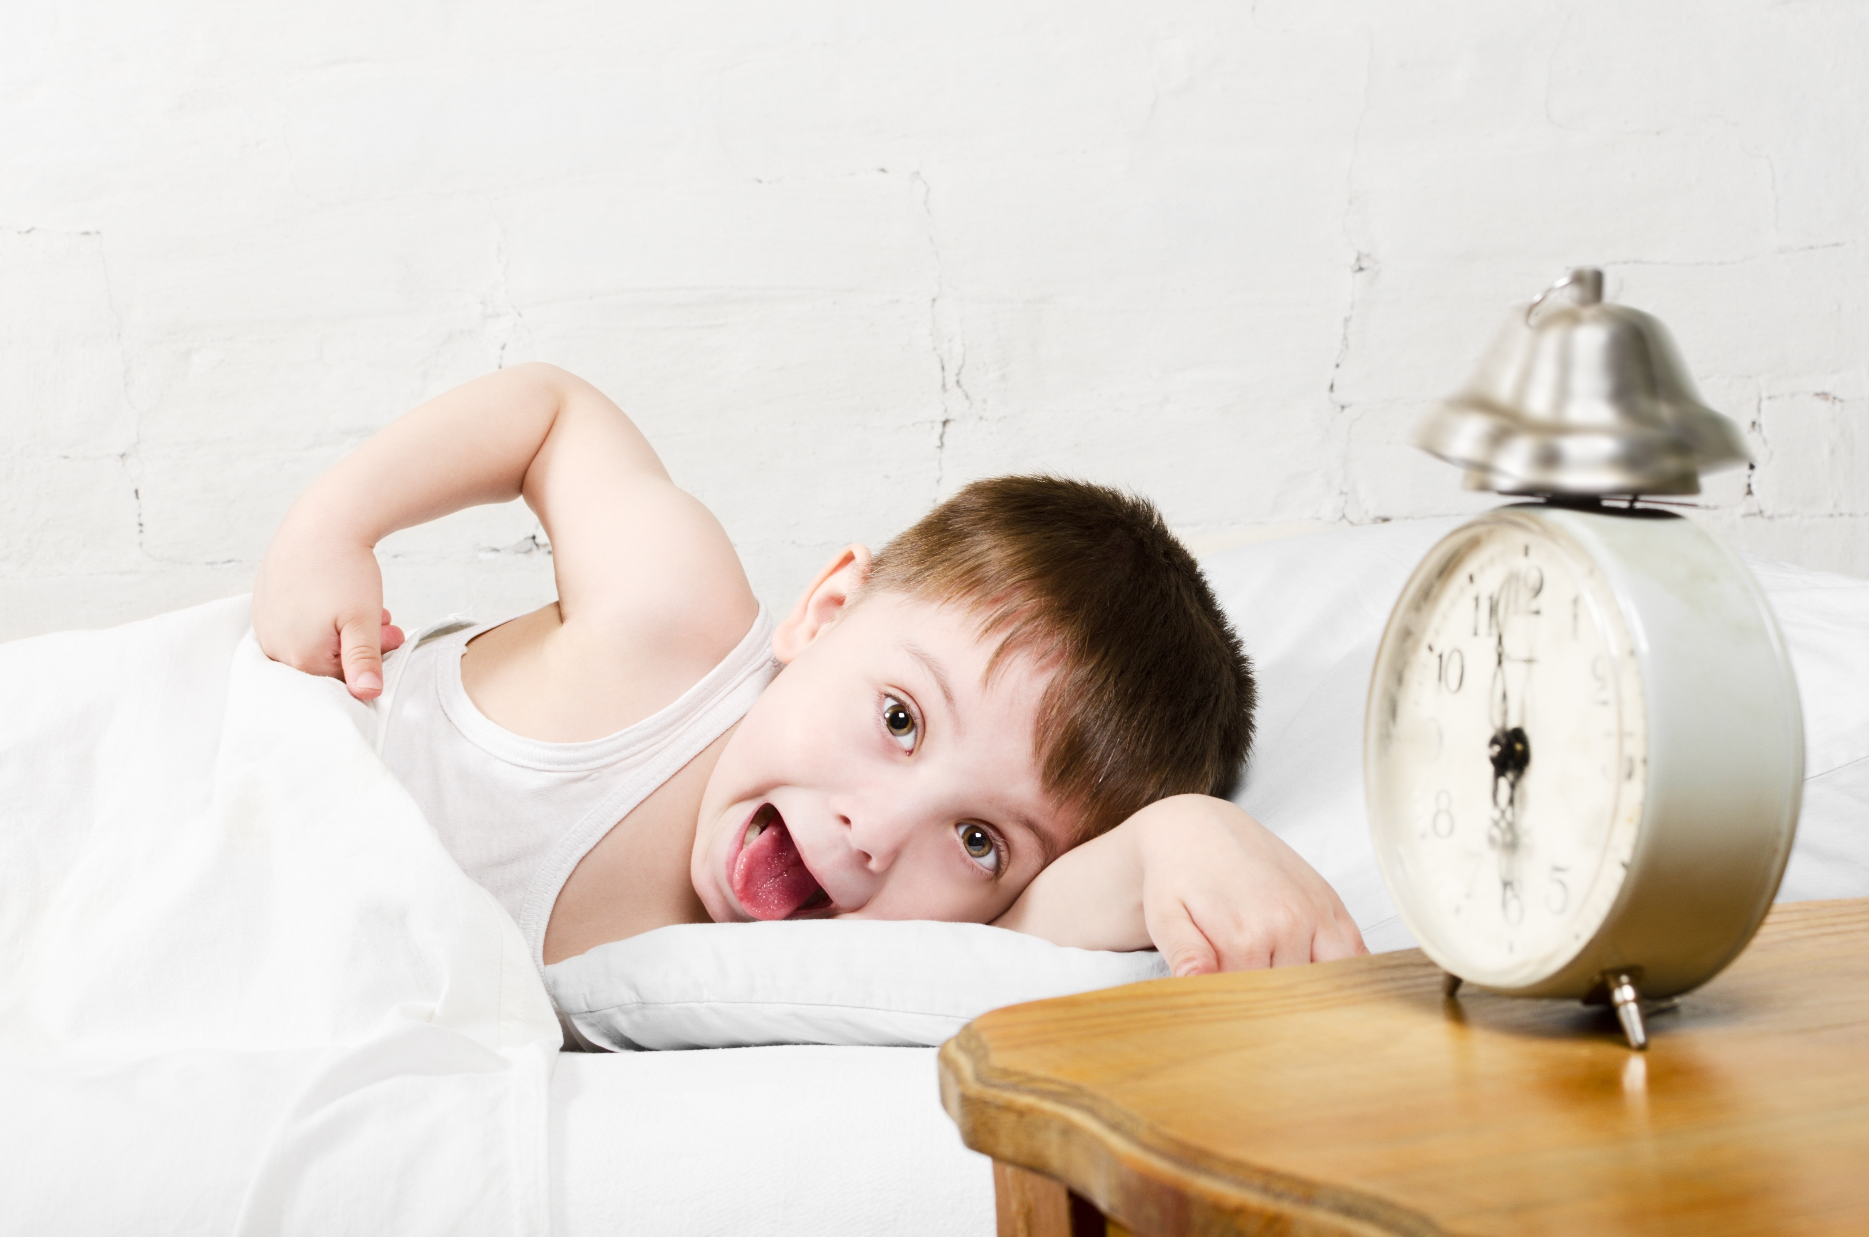
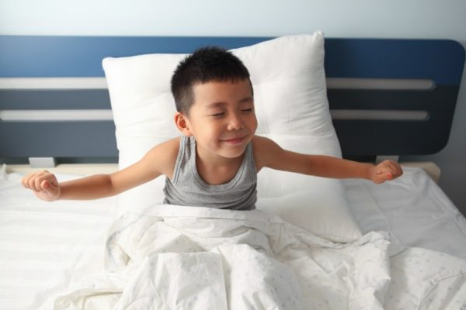
And I will wake up
And I will wake up

Slide 29
When the sun comes up

Slide 30
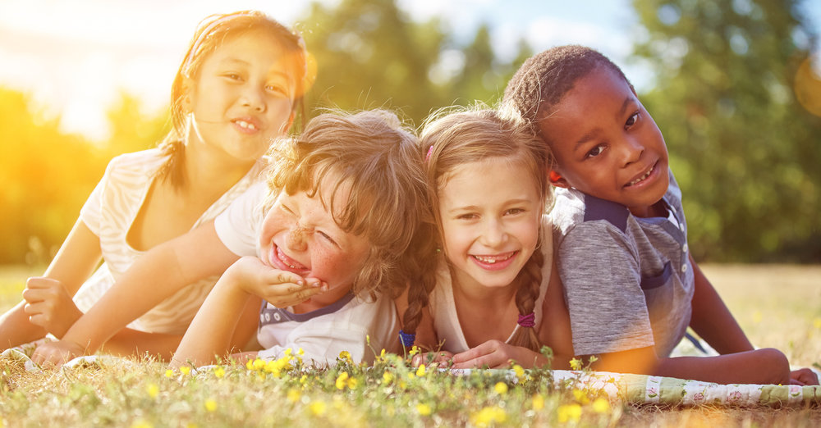
and I will spend all day just lying in the sun

Slide 31
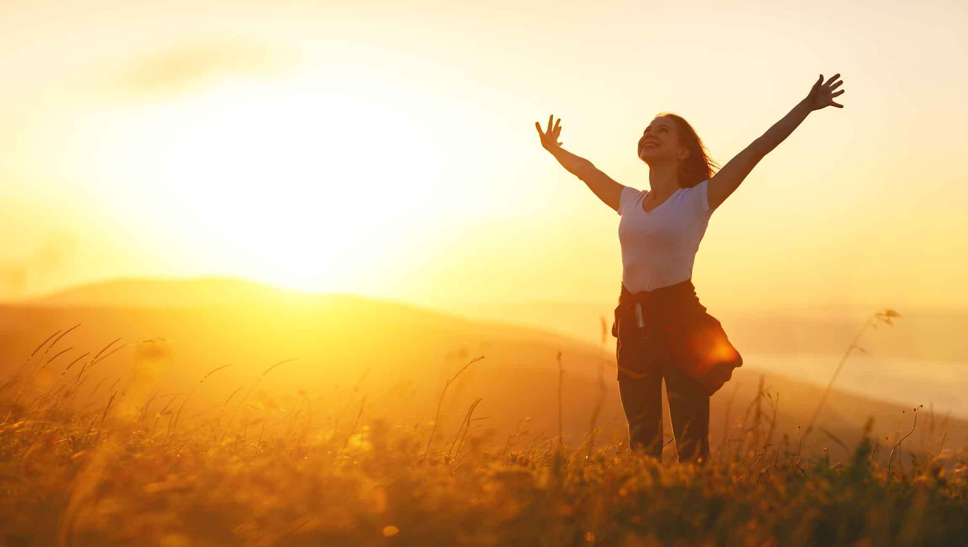
And I won't burn cause I'll be all grown up

Slide 32
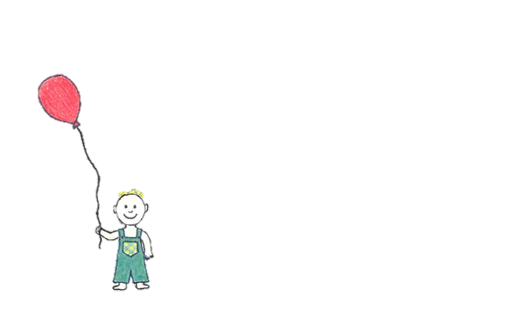
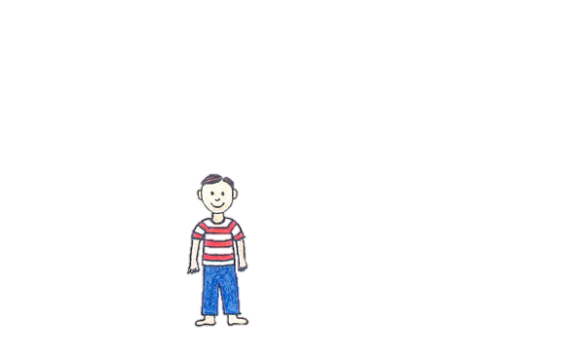
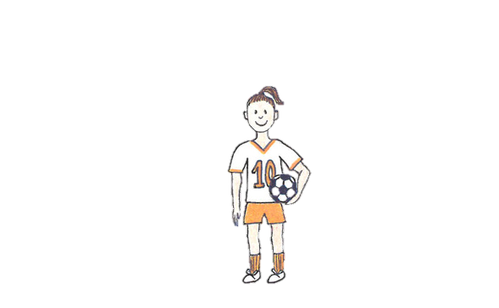
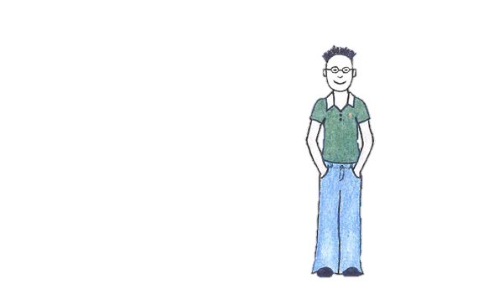
When I grow up

