Slide 1
Don’t turn off the lights
主题 | off相关词汇
蒋耀萱 | 华南师范大学外国语言文化学院
朱秀琼 | 广东省河源市和平县阳明镇龙湖学校

Slide 2
I don’t have to tell you
我不用全部告诉你

Slide 3
What this is all about
我心里在想什么

Slide 4
Cause baby half the fun is
因为这其中的乐趣就在于

Slide 5
in us figuring it all out
我们彼此能心有灵犀

Slide 6
So why you gotta ask me, 所以你为什么要问我，
What I’m doing now?
现在我在做什么？

Slide 7
'Cause I don't like to question,
因为我不喜欢别人问我

Slide 8
What I still haven't found
我还不确定的事情

Slide 9
So don't turn off the lights
所以不要关灯

Slide 10
I don't wanna be in the dark tonight
今晚我不想在黑暗中度过

Slide 11
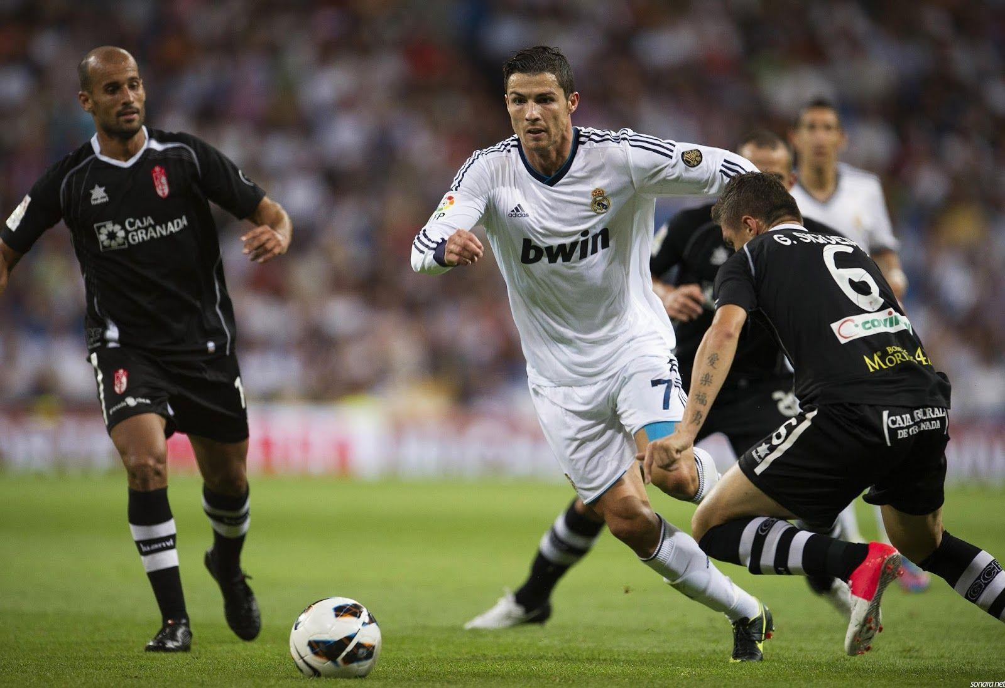
'Cause I can't read your mind
因为我无法知道你在想什么

Slide 12
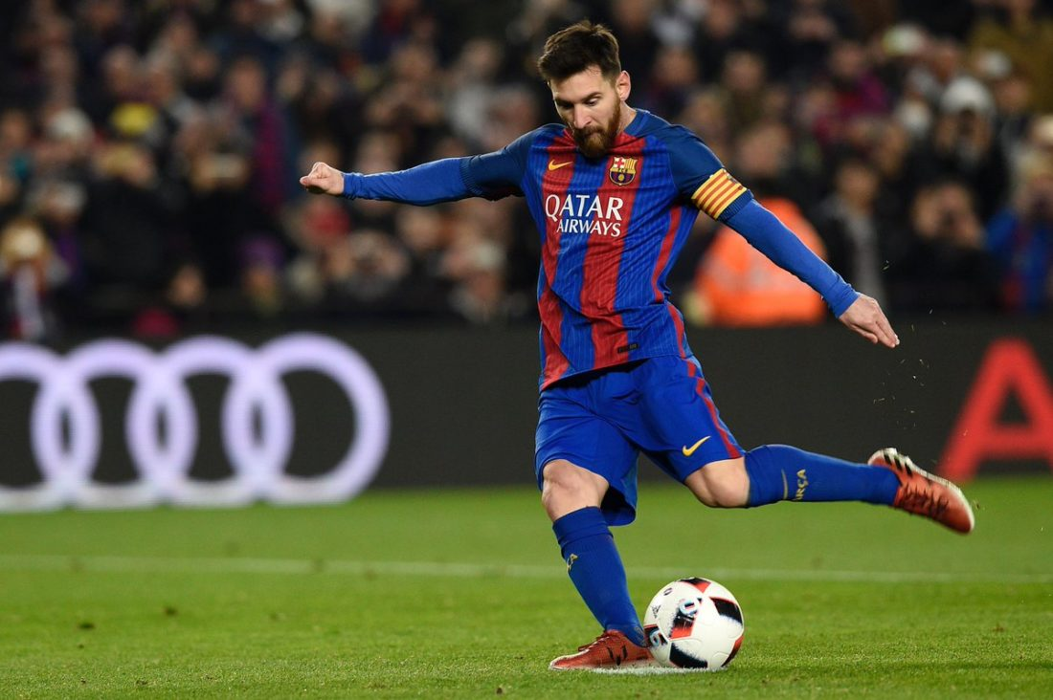
I need to know if What I'm doing is right
我不知道这样做对不对

Slide 13
So don't turn off the lights
所以请不要关灯

Slide 14
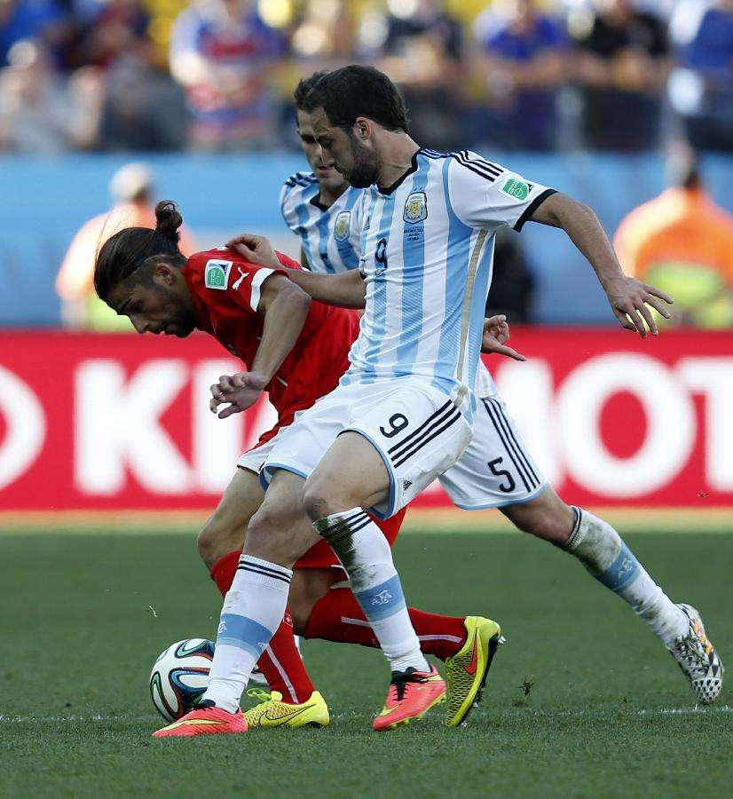
So don't turn off the lights
所以请不要关灯

Slide 15
So tell me how we're gonna get there
告诉我我们怎样才能长相厮守

Slide 16
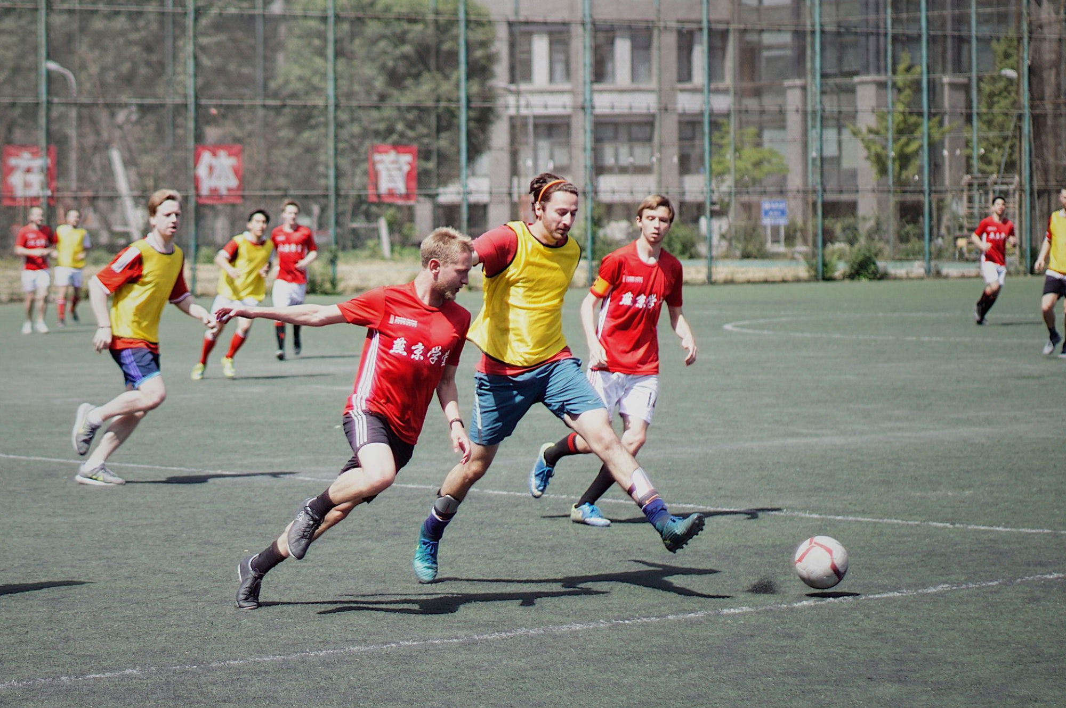
It's hard to even try
这很困难

Slide 17
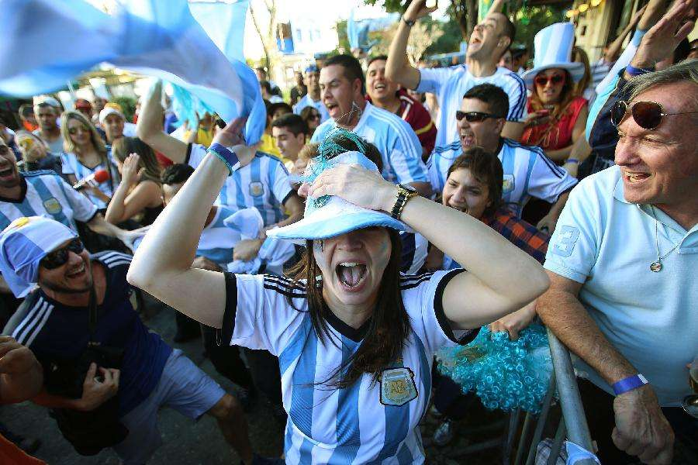
But if we move together
但是如果我们不离不弃

Slide 18
We'll end up on the same side
我们就不会再分离

Slide 19
So don't turn off the lights
所以请不要关灯

Slide 20
I don't wanna be in the dark tonight
今晚我不想在黑暗中度过

Slide 21
'Cause I can't read your mind
因为我无法知道你在想什么

Slide 22
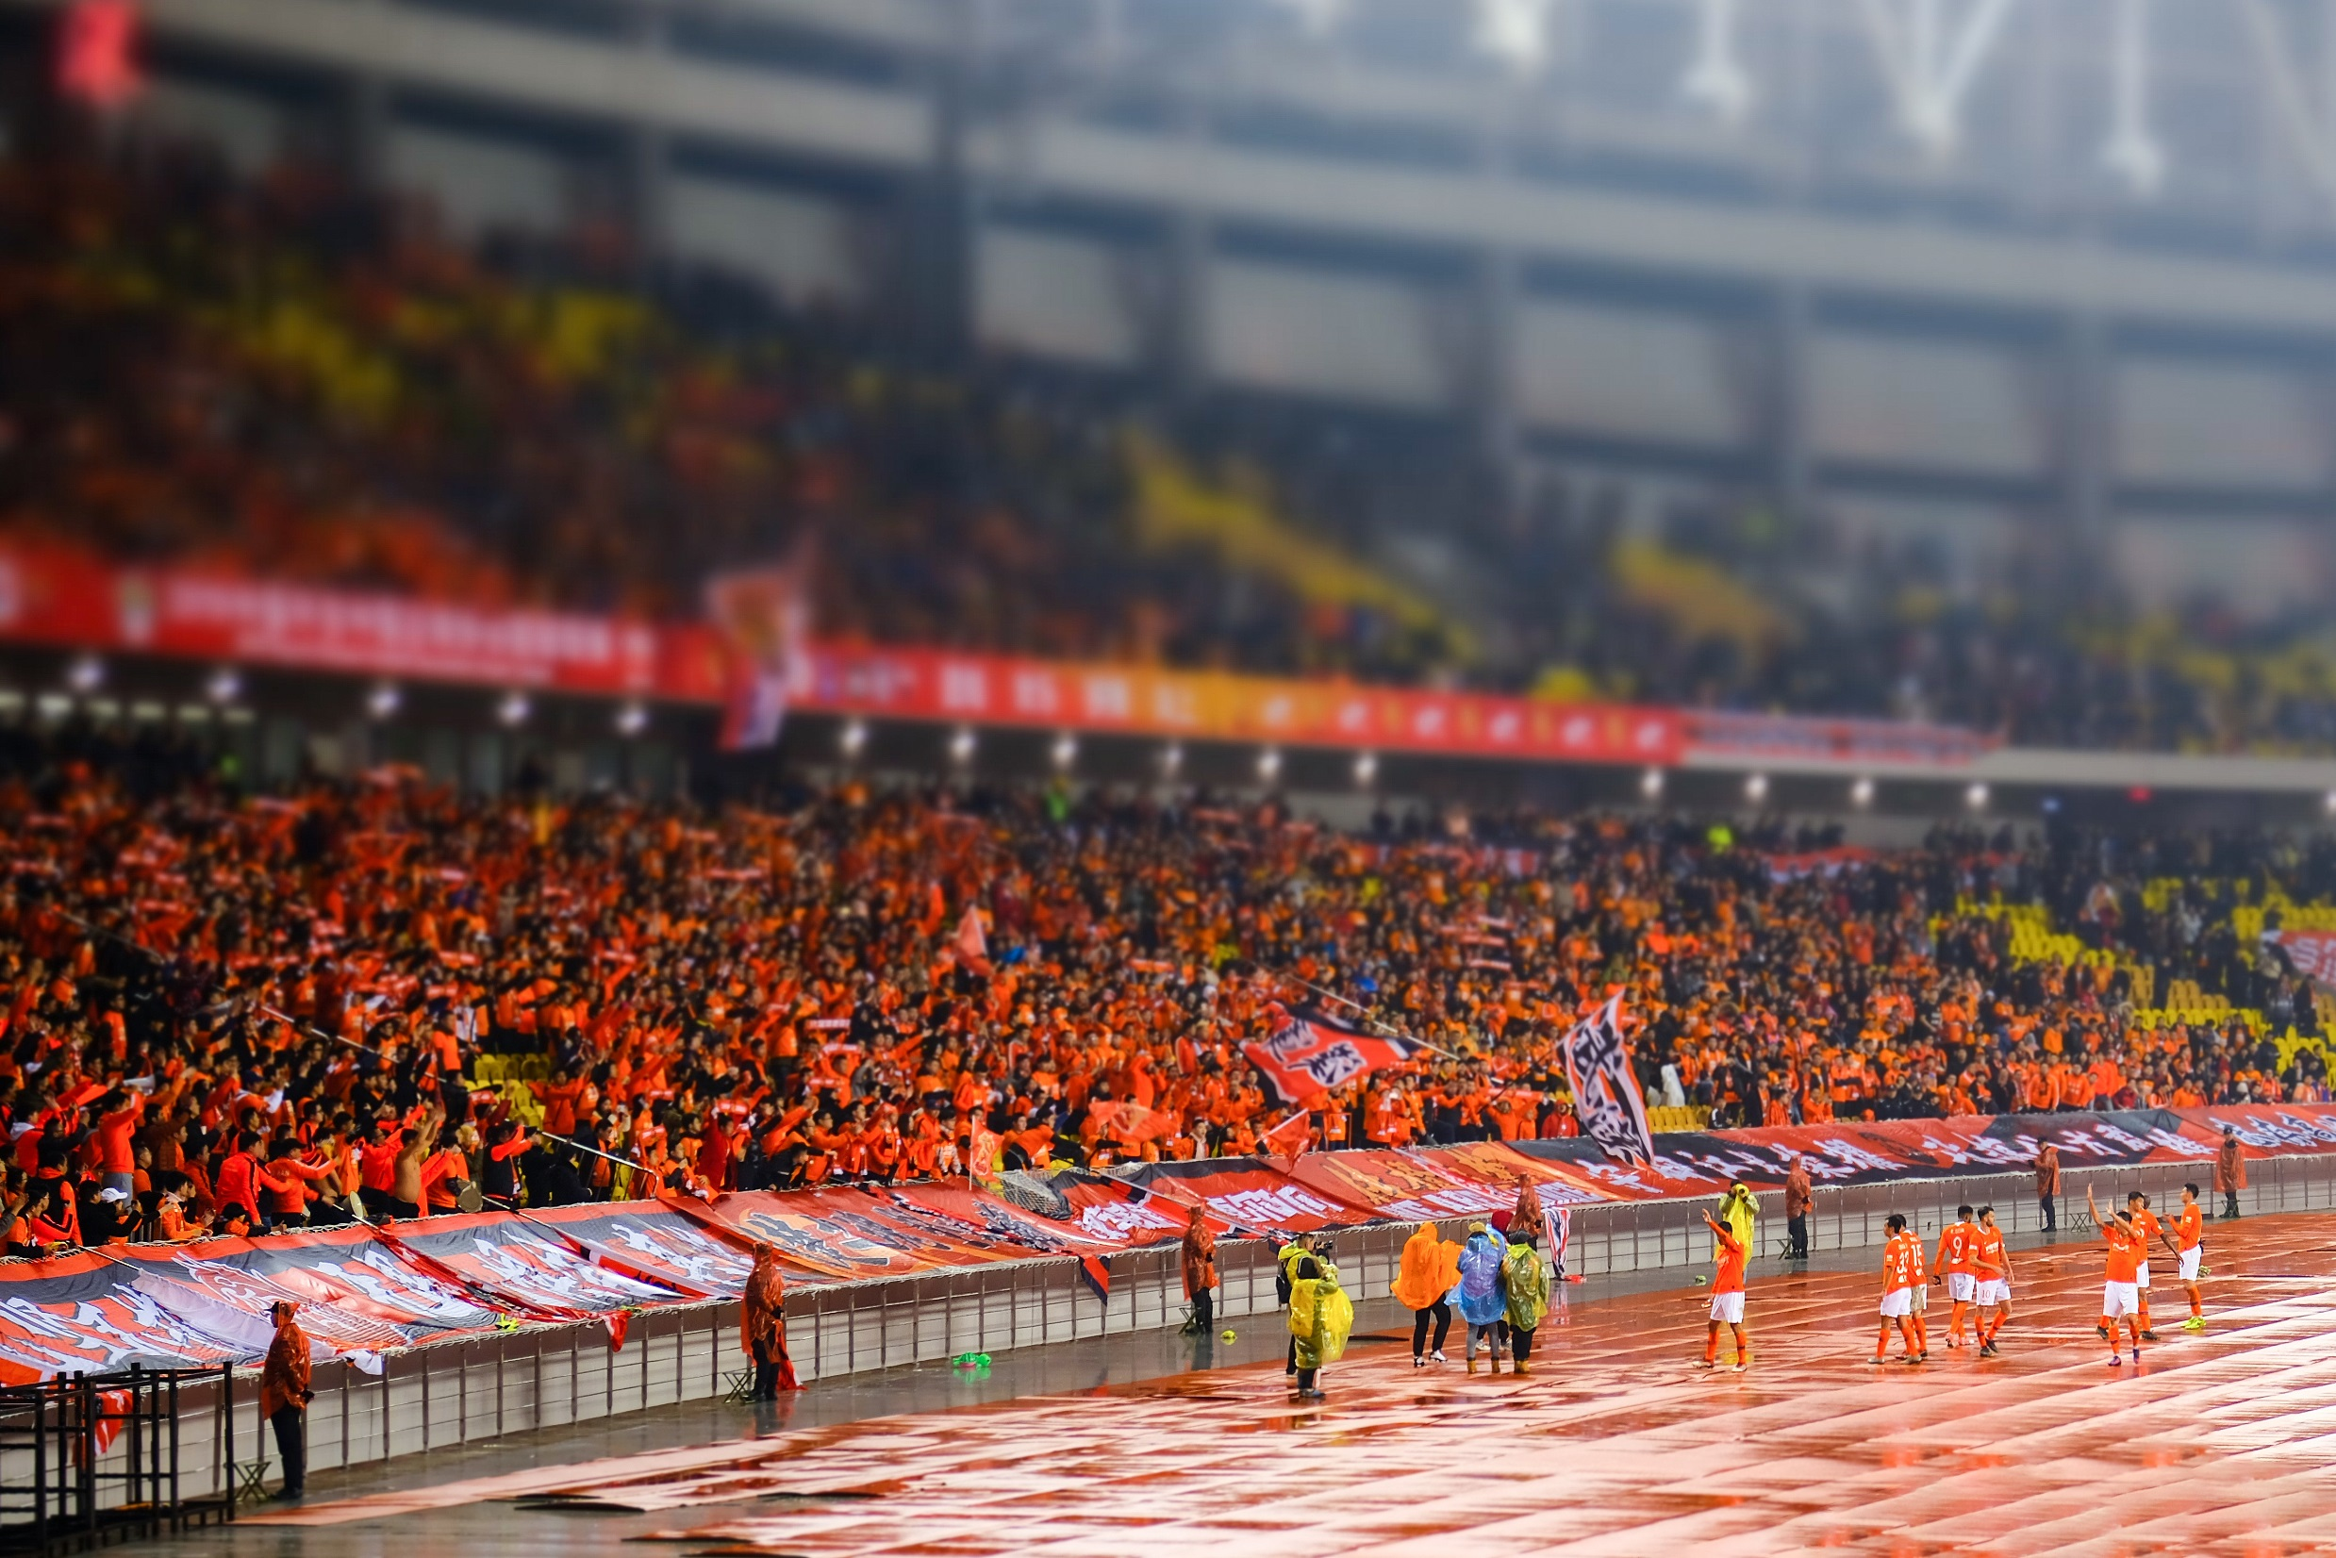
I need to know if
What I'm doing is right
我不知道这样做对不对

Slide 23
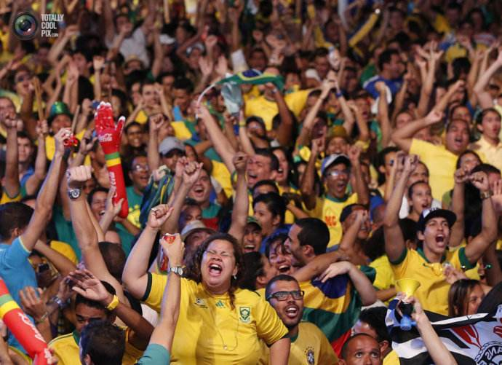
So don't turn off the lights
所以请不要关灯

Slide 24
So don't turn off the lights
所以请不要关灯

Slide 25
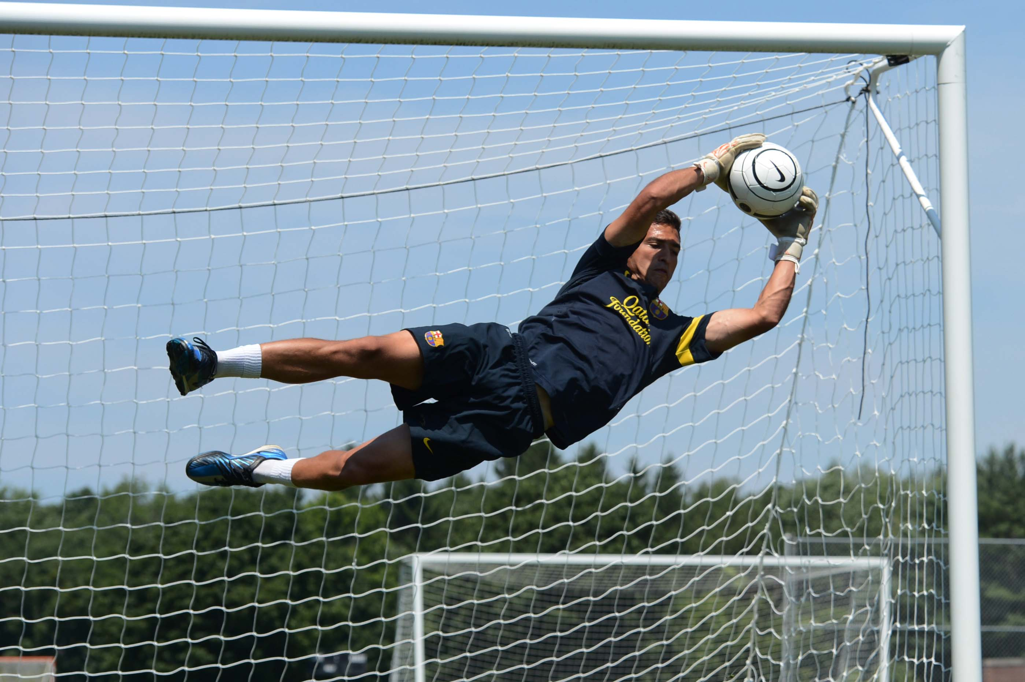
If you could know What I'm feeling
如果你知道我的感受

Slide 26
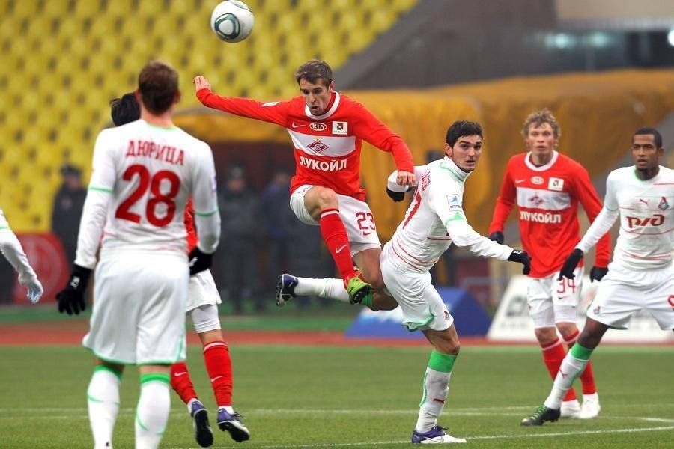
Would you run and Where would you go
你会跑开吗？你会去哪里？

Slide 27
If you want to know What I'm thinking
如果你想知道我在想什么

Slide 28
Then just turn on the lights and you'll know
只要打开灯你就会知道

Slide 29
So don't turn off the lights
所以请不要关灯

Slide 30
I don't wanna be in the dark tonight
今晚我不想在黑暗中度过

Slide 31
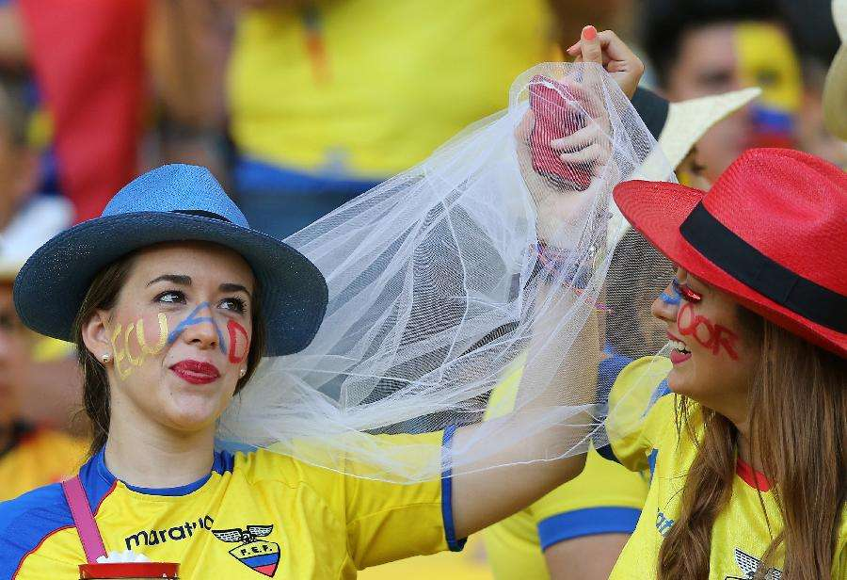
'Cause I can't read your mind
因为我无法知道你在想什么

Slide 32
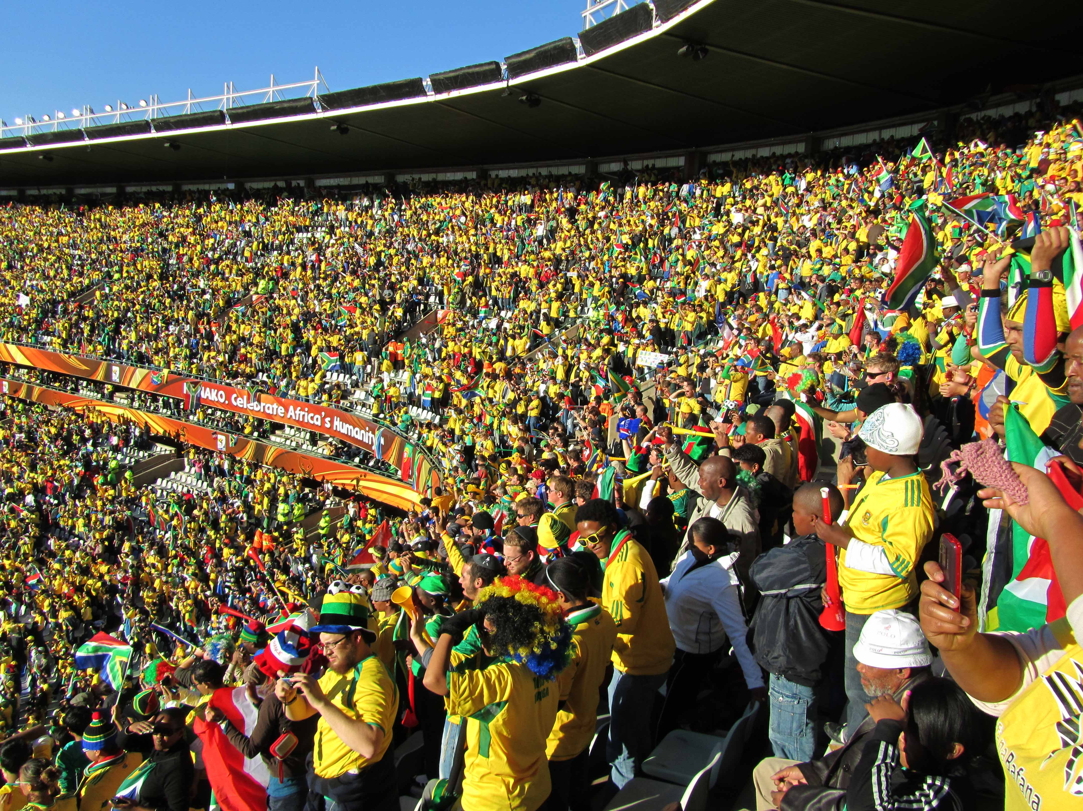
I need to know if
What I'm doing
is right
我不知道这样做对不对

Slide 33
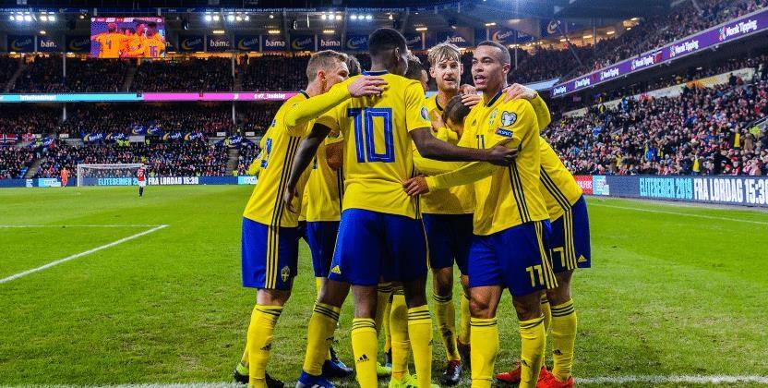
So don't turn off the lights
所以请不要关灯

Slide 34
So don't turn off the lights
所以请不要关灯

Slide 35
I don't wanna be in the dark tonight
今晚我不想在黑暗中度过

Slide 36
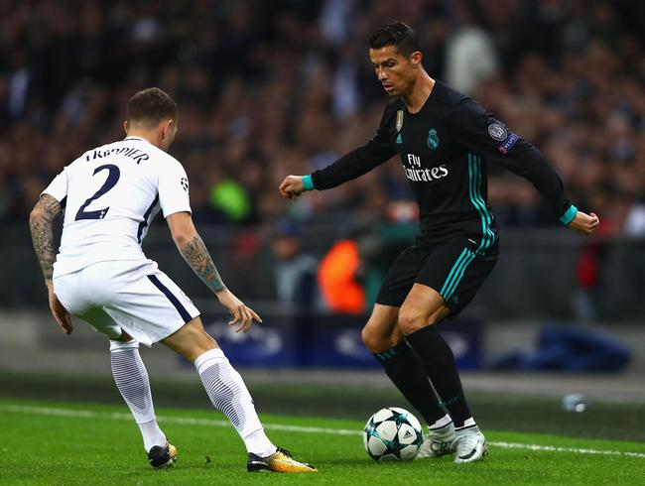
'Cause I can't read your mind
因为我无法知道你在想什么

Slide 37
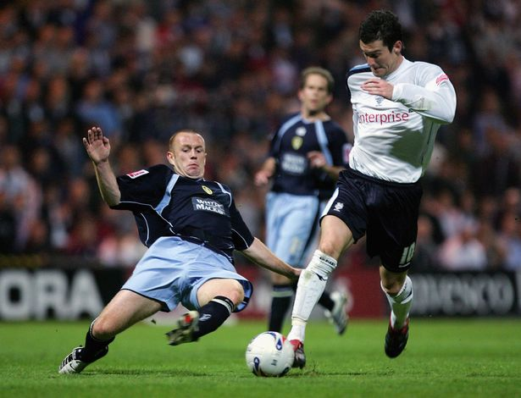
I need to know if What I’ m doing
is right
我不知道这样做对不对

Slide 38
So don't turn off the lights
所以请不要关灯

Slide 39
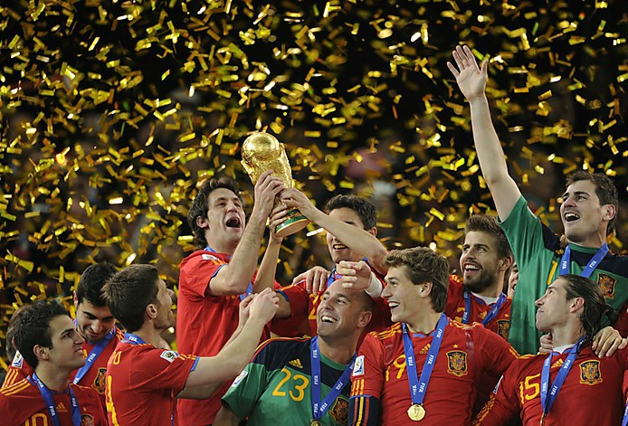
So don't turn off the lights
所以请不要关灯

Slide 40
So don't turn off the lights
所以请不要关灯

Slide 41
So don't turn off the lights
所以请不要关灯

