Slide 1
歌曲： What are you waiting for
知识点：与for相关的短语
作者： 华南师范大学外国语言文化学院 陈颖琪
广东省河源市和平县龙湖学校 朱莉丹

Slide 2

What are you waiting for？

Slide 3
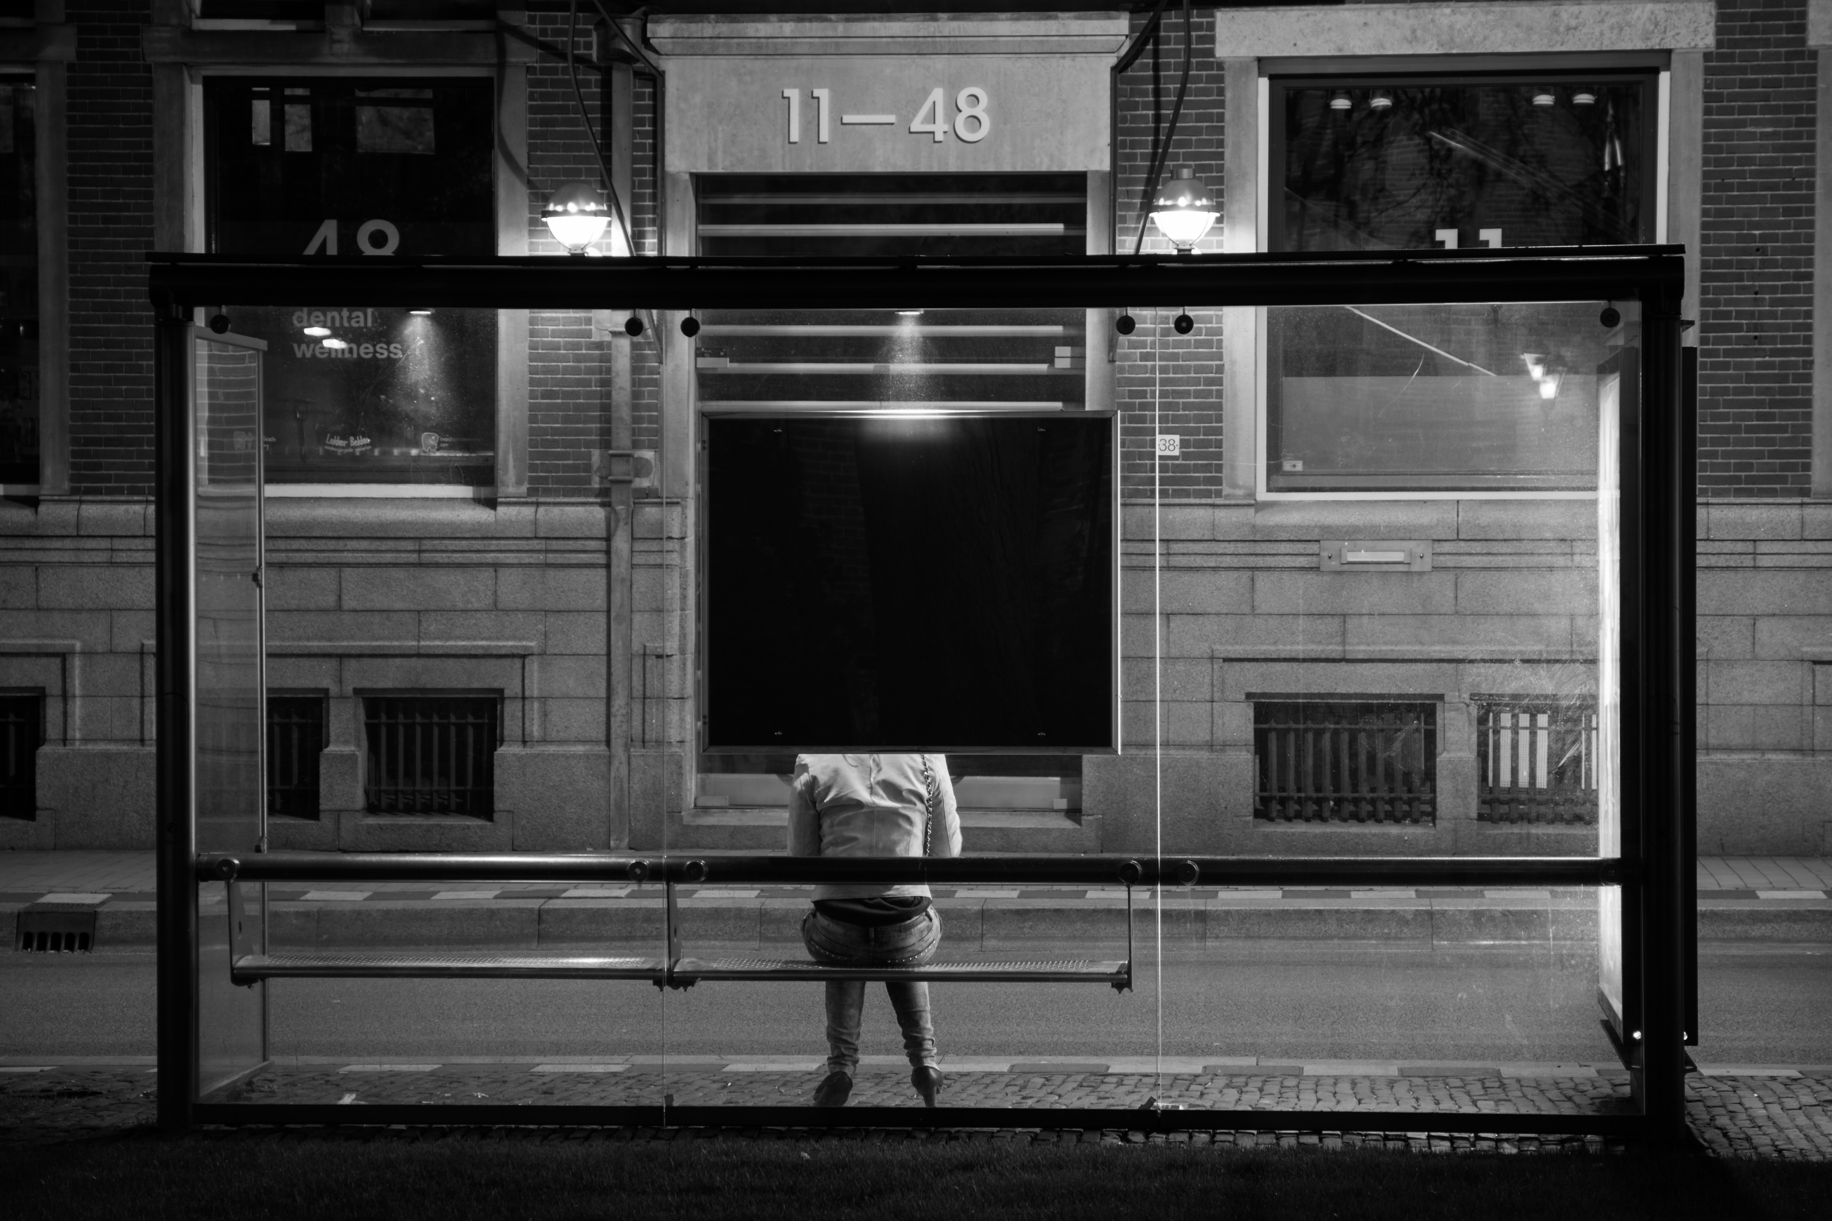
What are you waiting for？

Slide 4

Are you waiting on the
lightning strike

Slide 5

Are you waiting for the
perfect night

Slide 6

Are you waiting
till the
time
is right

Slide 7

︖
What are you
waiting for

Slide 8
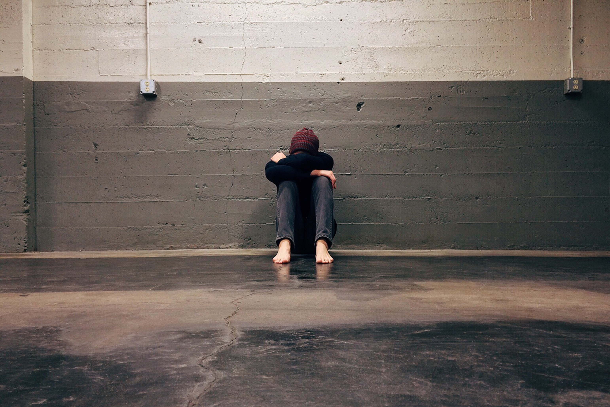
Don't you wanna
learn to
deal with
fear
fear

Slide 9

Don't you wanna
take the wheel and steer

Slide 10

Don't you wait another minute here?

Slide 11
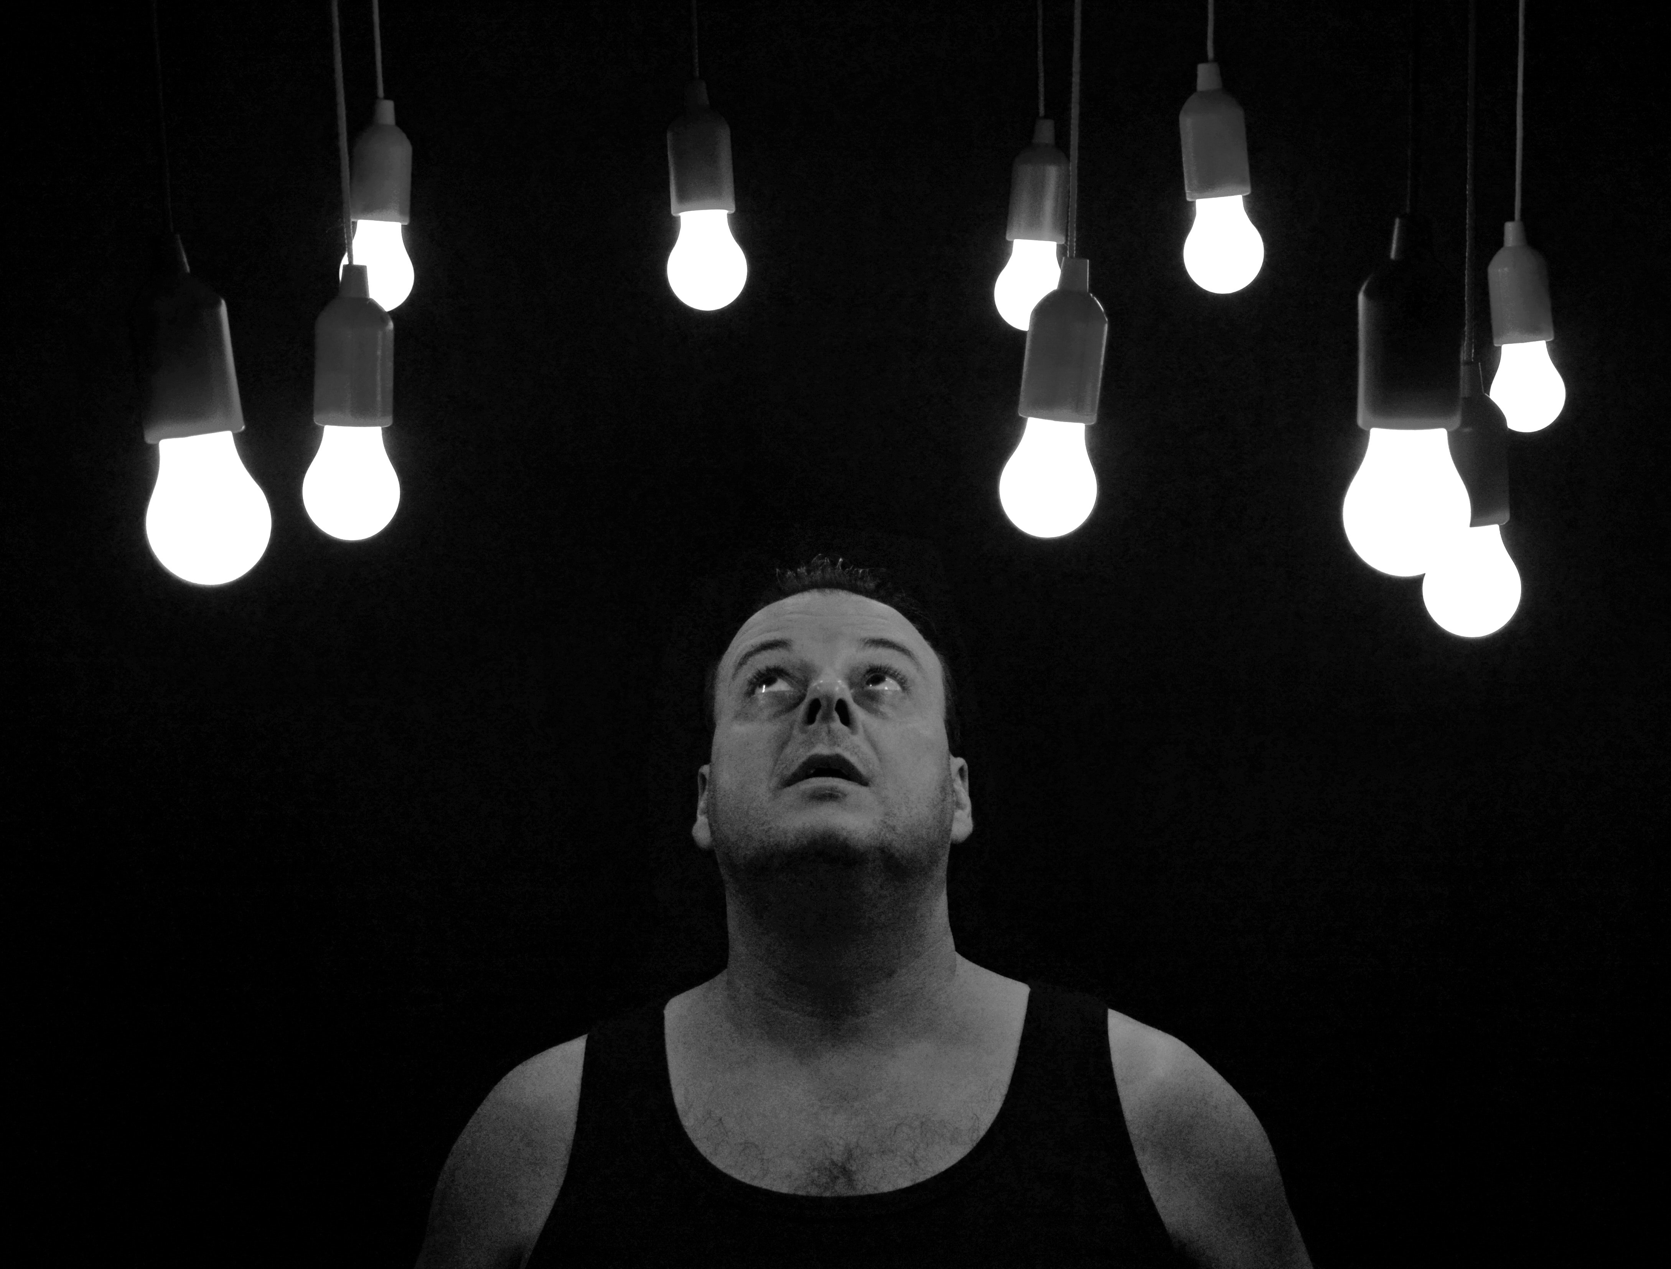
What are you waiting for?

Slide 12

You gotta go and reach for the top

Slide 13

Believe in every dream that you got

Slide 14

You only live once
so tell me

Slide 15

What are you,
What are you waiting for?

Slide 16

You know you
gotta
give it your all

Slide 17

And don't be
afraid
if you fall

Slide 18

You only living once
so tell me?
What are you ,
What are you
waiting for?

Slide 19


Are you waiting for
a sign to choose ?
Are you waiting for
the right excuse ?

Slide 20

While your waiting it's the time you lose
What are you waiting for?

Slide 21

Don't you wanna
spread your wings and fly?
Don't you really wanna live your life?
Don't you wanna love before you die?

Slide 22

What are you waiting for?
What are you waiting for?

Slide 23


You gotta go and reach for the top
You only living once
so tell me
Believe in every dream that you got
What are you,
what are you waiting for?

Slide 24

You know you gotta give it your all
And don't you be afraid if you fall
You only living once so tell me
What are you
What are you waiting for

Slide 25

Tell me what you are waiting for
Show me what you are aiming for
What you gonna save it for
So what you really waiting for

Slide 26

Tell me what you are waiting for
Show me what you are aiming for
What you gonna save it for
So what you really waiting for

Slide 27

Everybody's gonna make mistakes
But everybody's got a choice to make
What are you waiting for?
Everybody needs a leap of faith
When are you taking yours?

Slide 28

You gotta go and reach for the top
Believe in every dream that you got
You only living once so tell me
What are you, what are you waiting for ?

Slide 29
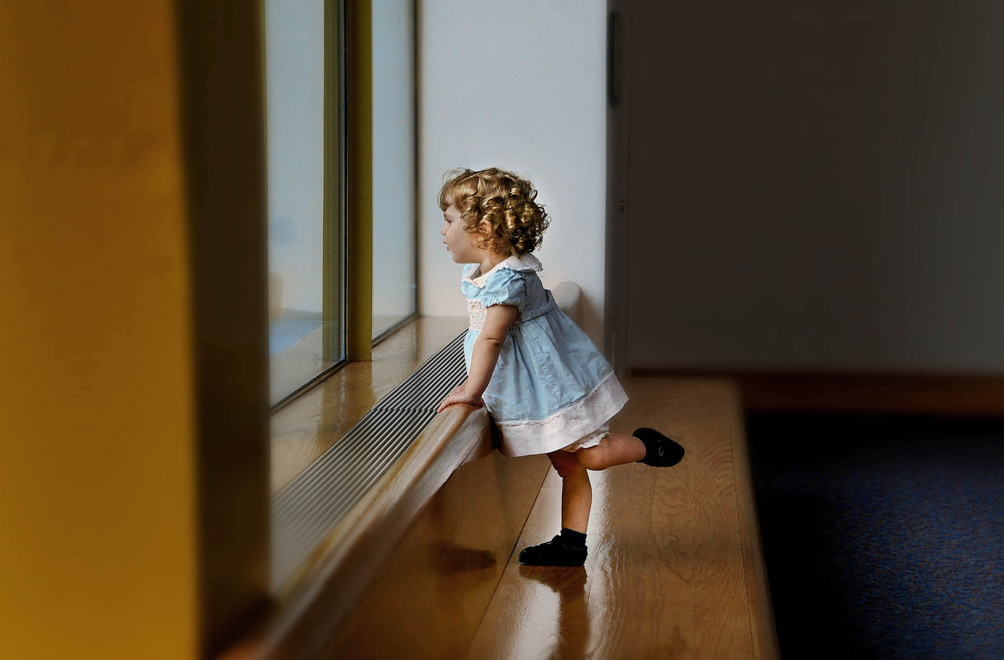
You know you gotta give it your all
And don't you be afraid if you fall
You only living once so tell me
What are you, what are you waiting for?

Slide 30








You gotta go and reach for the top
You know you gotta give it your all
What are you, what are you waiting for
What are you, what are you waiting for
Believe in every dream that you got
You only living once so tell me
What are you, what are you waiting for
What are you, what are you waiting for

Slide 31

What are you, what are you
What are you, what are you waiting for?

Slide 32

What are you, what are you
What are you, what are you waiting for?

