Slide 1
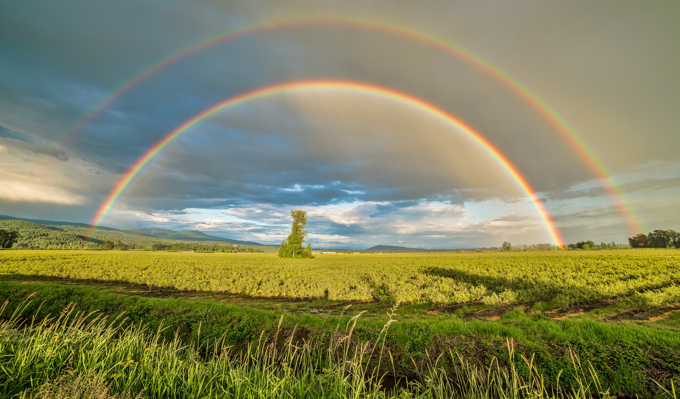
The End
“At” Phrases
Editor: 华南师范大学外国语言文化学院 许婉诗
广东省河源市华强中学 彭芳芳
Notes:
“At” Phrases
The End
Singer: Earl Grant
Editor: 许婉诗 20160221131
单位：华南师范大学

Slide 2
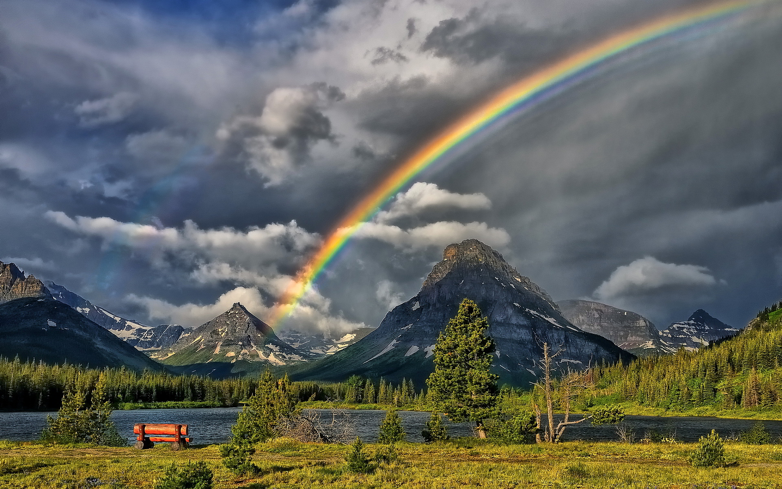
At the end of a rainbow

Slide 3
you'll find a pot of gold

Slide 4
At the end of a story
you'll find it's all been told

Slide 5
But our love has a treasure
our hearts can always spend

Slide 6
And it has a story
without any end

Slide 7
At the end of a river
the water stops its flow

Slide 8
At the end of a highway
there's no place you can go

Slide 9
But just tell me you love me
and you are only mine

Slide 10
And our love will go on
'til the end of time

Slide 11
At the end of a river
the water stops its flow

Slide 12
At the end of a highway
there's no place you can go

Slide 13
But just tell me you love me
and you are only mine

Slide 14
And our love will go on
'til the end of time

Slide 15
'til the end of time

