Slide 1
Champagne Supernova
——过去进行时
华南师范大学外国语言文化学院 陈诗琪
广东省河源市东源县黄村中学 黄海妮

Slide 2
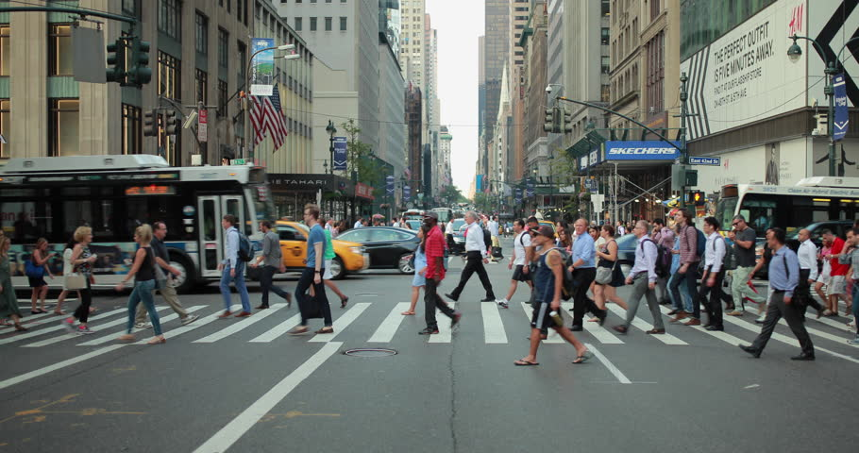
How many special people change?

Slide 3
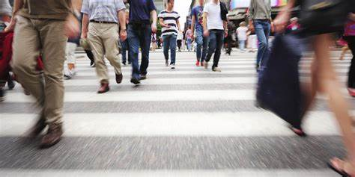
How many lives are living strange?

Slide 4
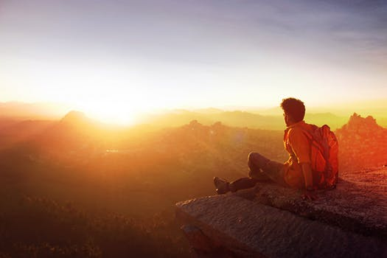
Where were you
when we were getting high?

Slide 5
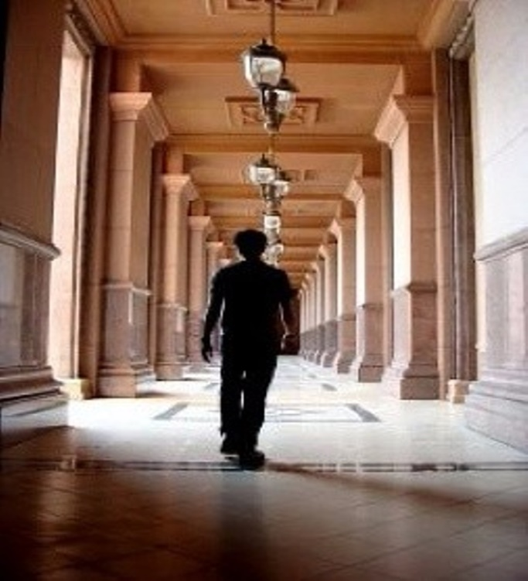
Slowly walking down the hall

Slide 6
Faster than a cannonball

Slide 7
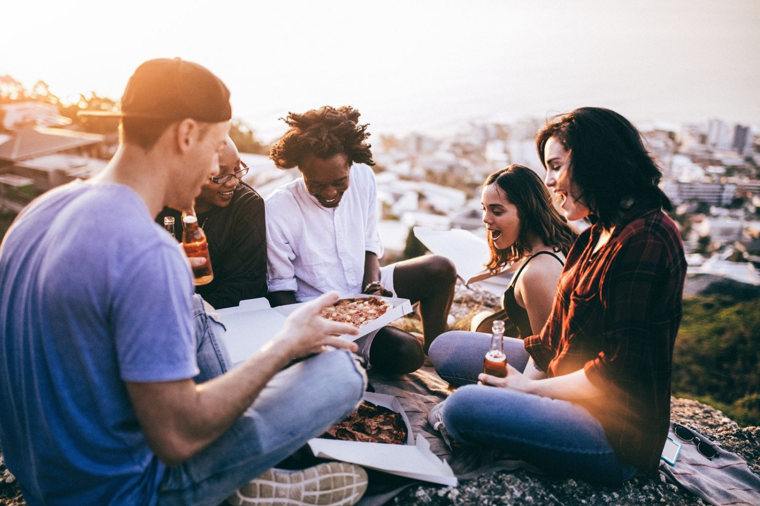
Where were you
when we were getting high?

Slide 8
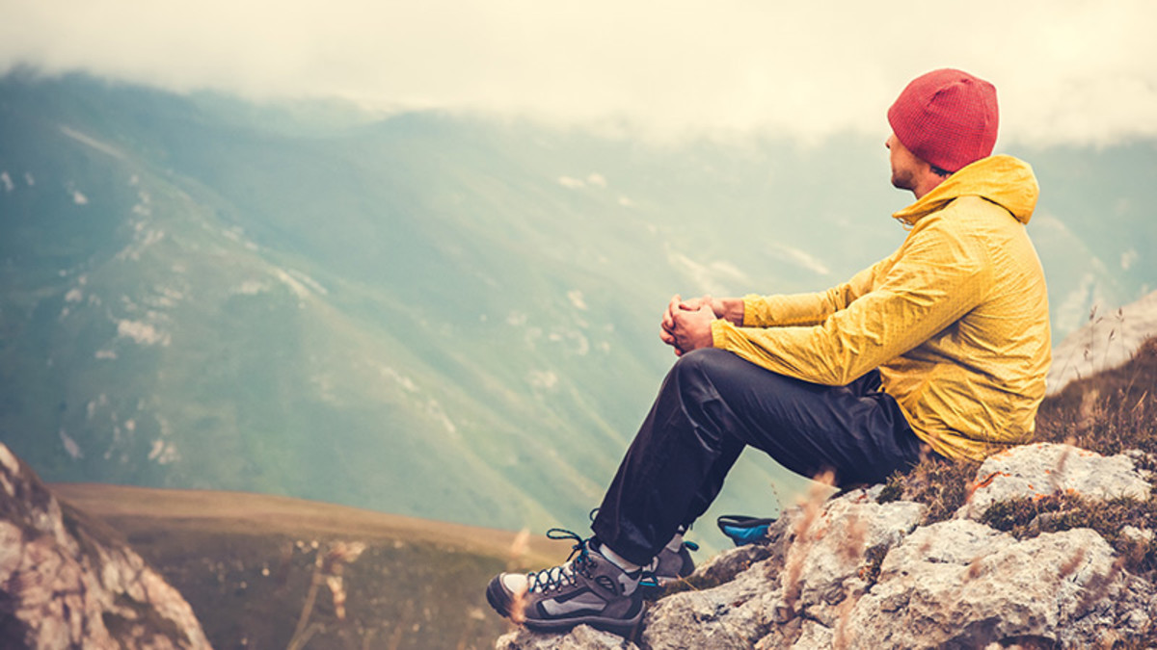
Someday you will find me

Slide 9
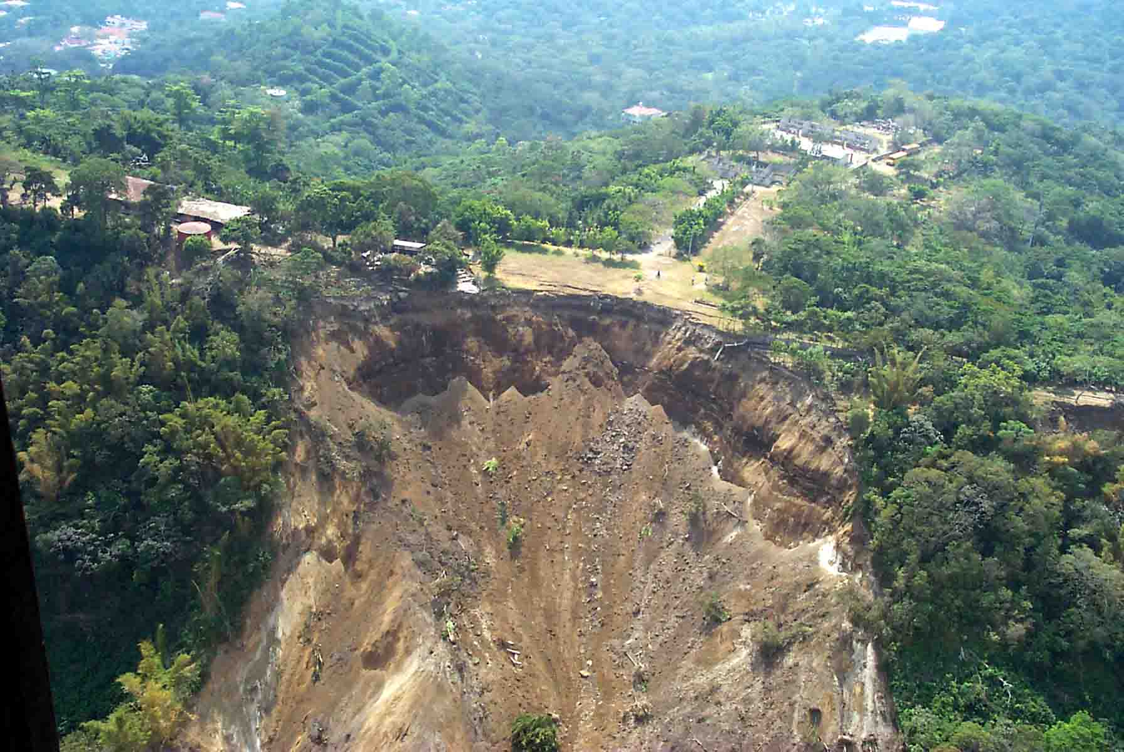
Caught beneath the landslide

Slide 10
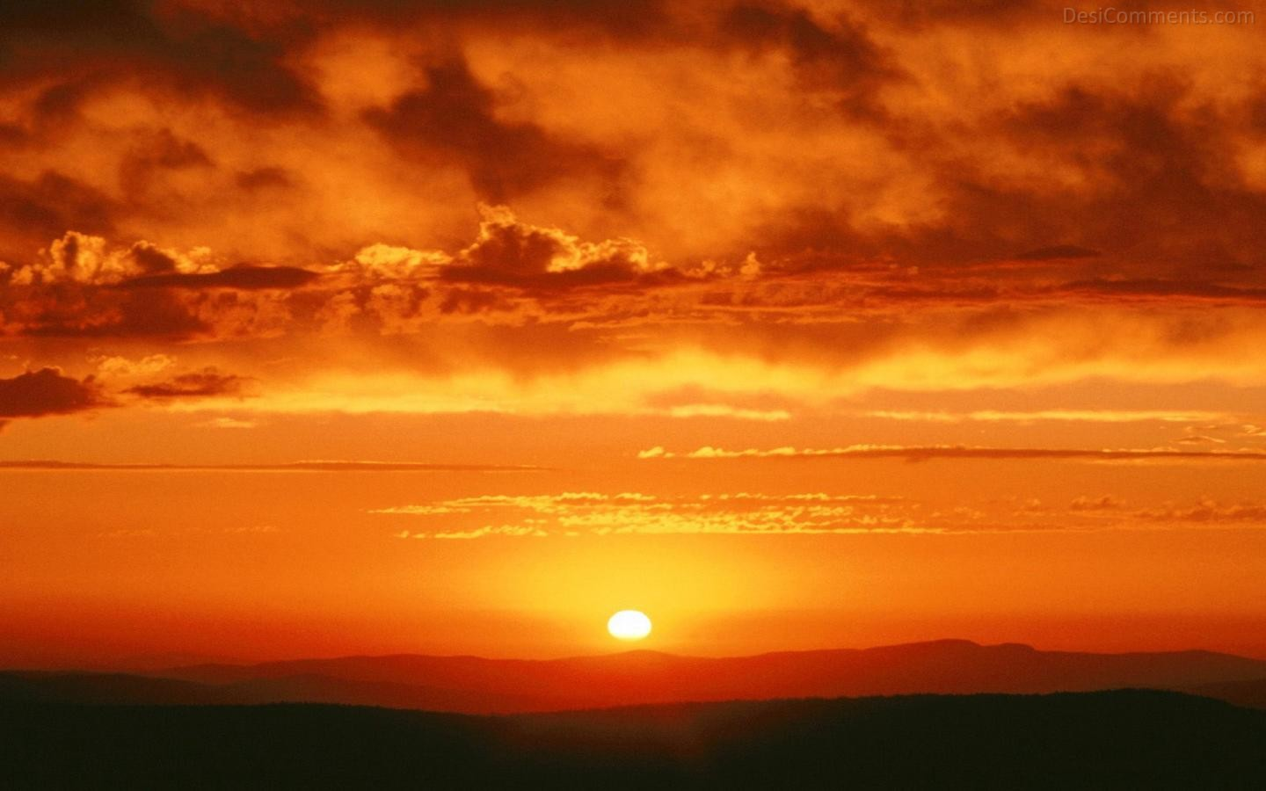
In a champagne supernova in the sky

Slide 11
Someday you will find me

Slide 12
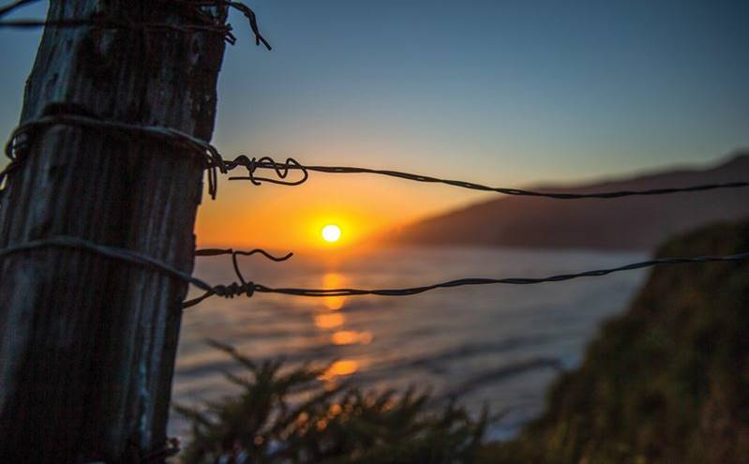
Caught beneath the landslide

Slide 13
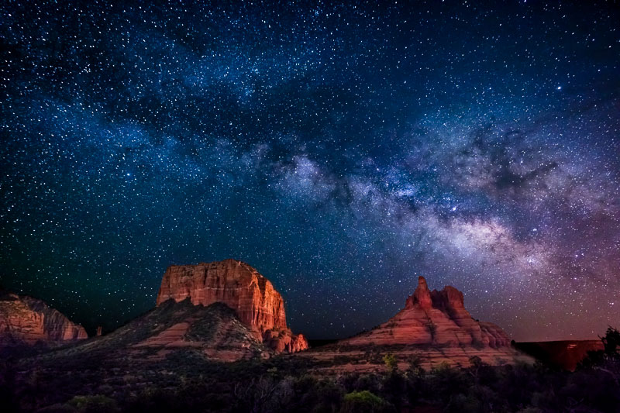
In a champagne supernova

Slide 14
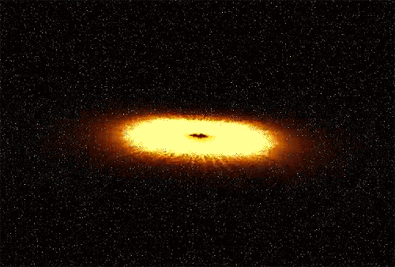
A champagne supernova in the sky

Slide 16
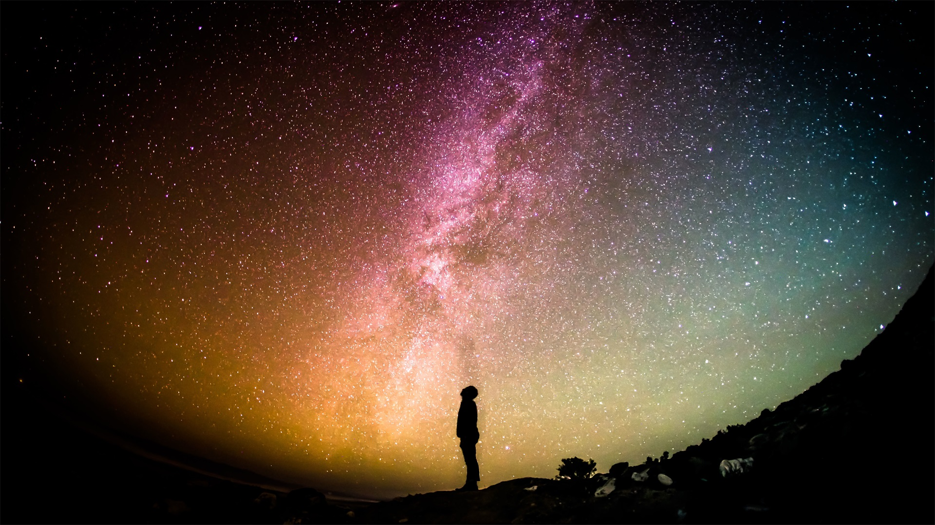

Slide 17
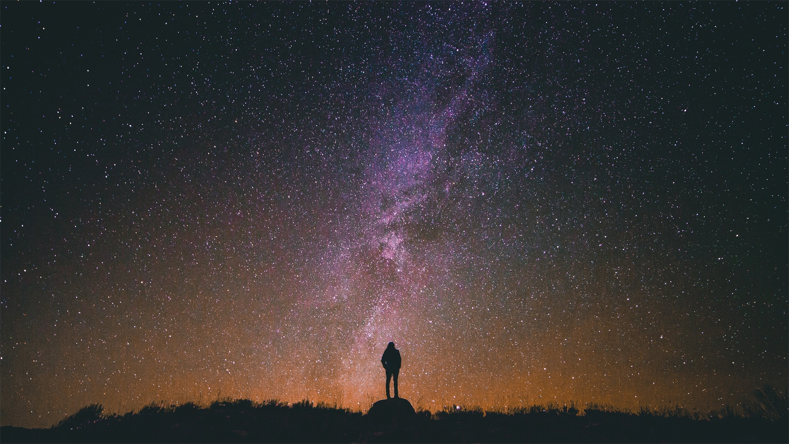

Slide 18
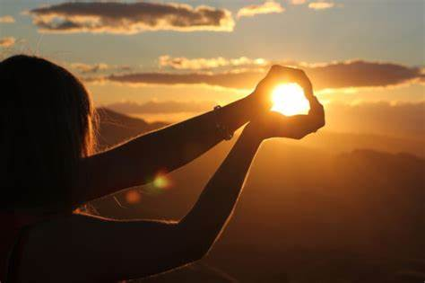
Wake up the dawn and ask her why

Slide 19
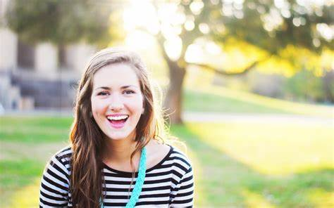
I dream a dream she never dies

Slide 20
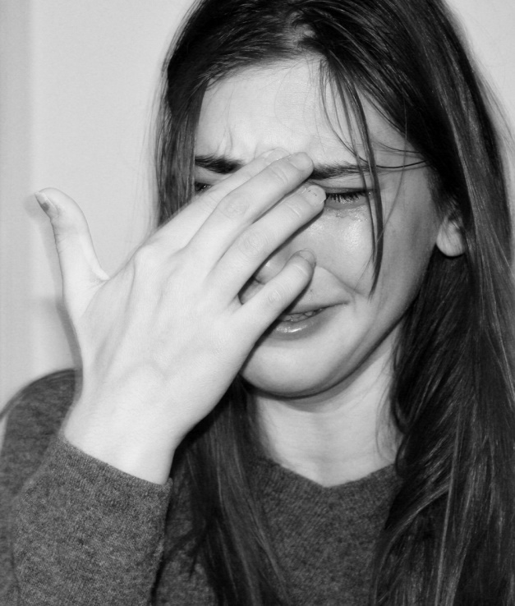
Wipe that tear away
now from your eye

Slide 21
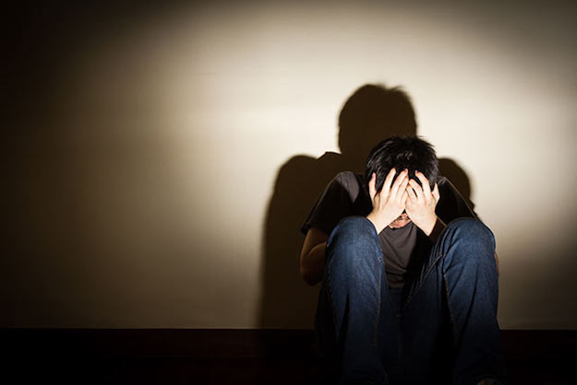
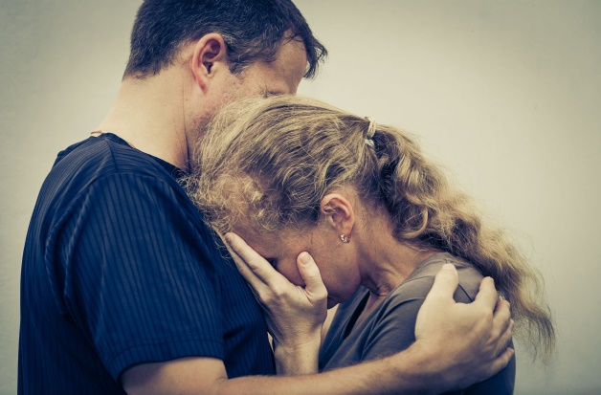
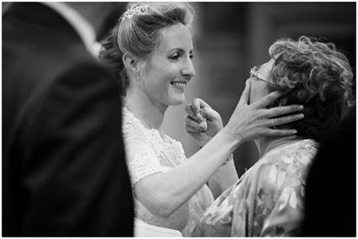
Wipe that tear away now from your eye
Notes:
使用方法： 【更改文字】：将标题框及正文框中的文字可直接改为您所需文字 【更改图片】：点中图片》绘图工具》格式》填充》图片》选择您需要展示的图片 【增加减少图片】：直接复制粘贴图片来增加图片数，复制后更改方法见【更改图片】 【更改图片色彩】：点中图片》图片工具》格式》色彩（重新着色）》选择您喜欢的色彩 下载更多模板、视频教程：http://www.mysoeasy.com

Slide 22
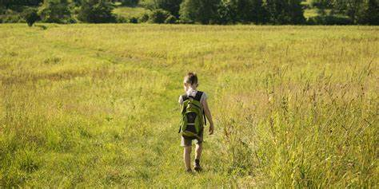
Slowly walking down the hall

Slide 23
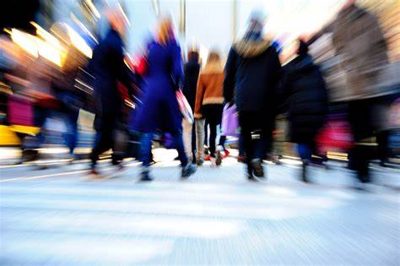
Faster than a cannonball

Slide 24
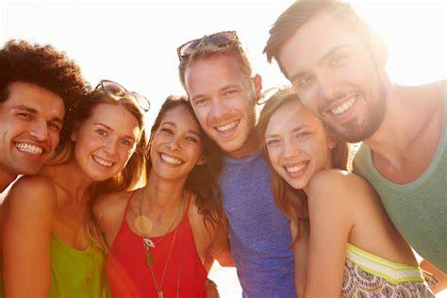
Where were you
while we were getting high?

Slide 25
Someday you will find me

Slide 26
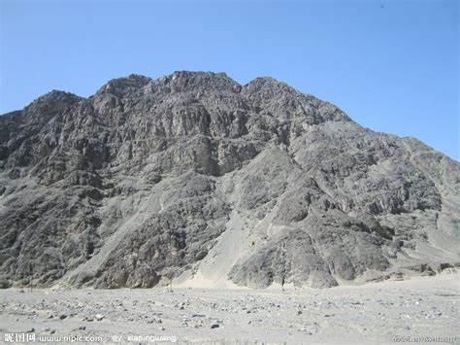
Caught beneath the landslide

Slide 27
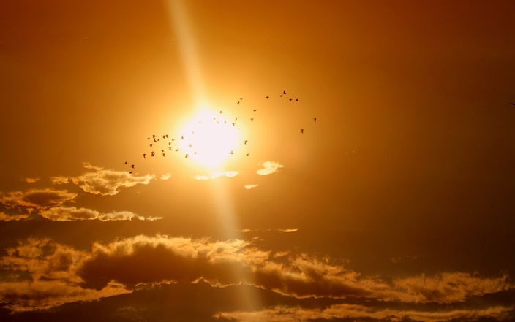
In a champagne supernova in the sky

Slide 28
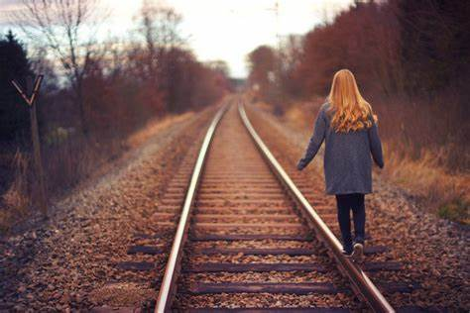
Someday you will find me

Slide 29
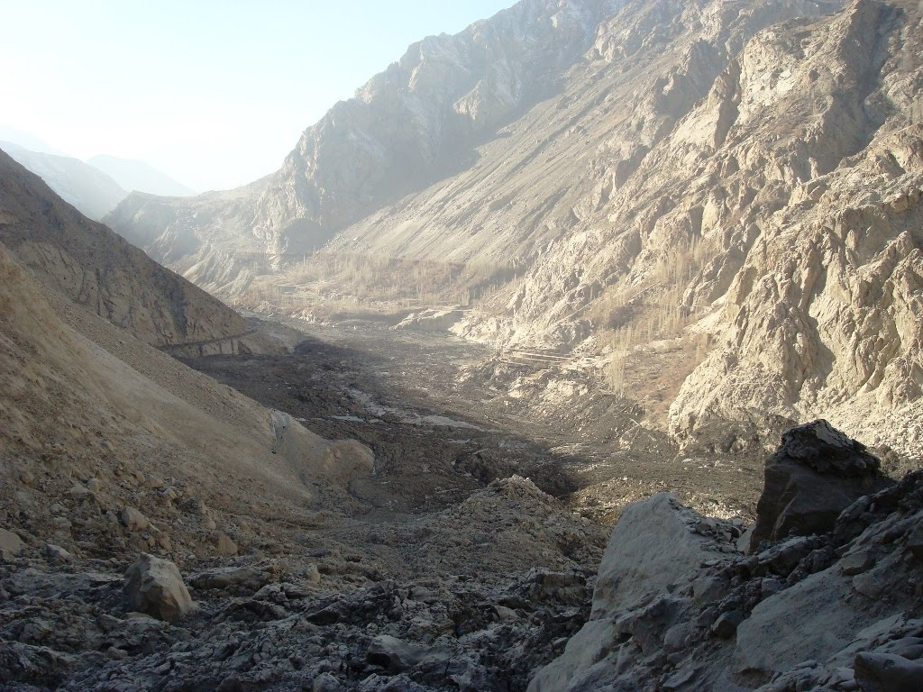
Caught beneath the landslide

Slide 30
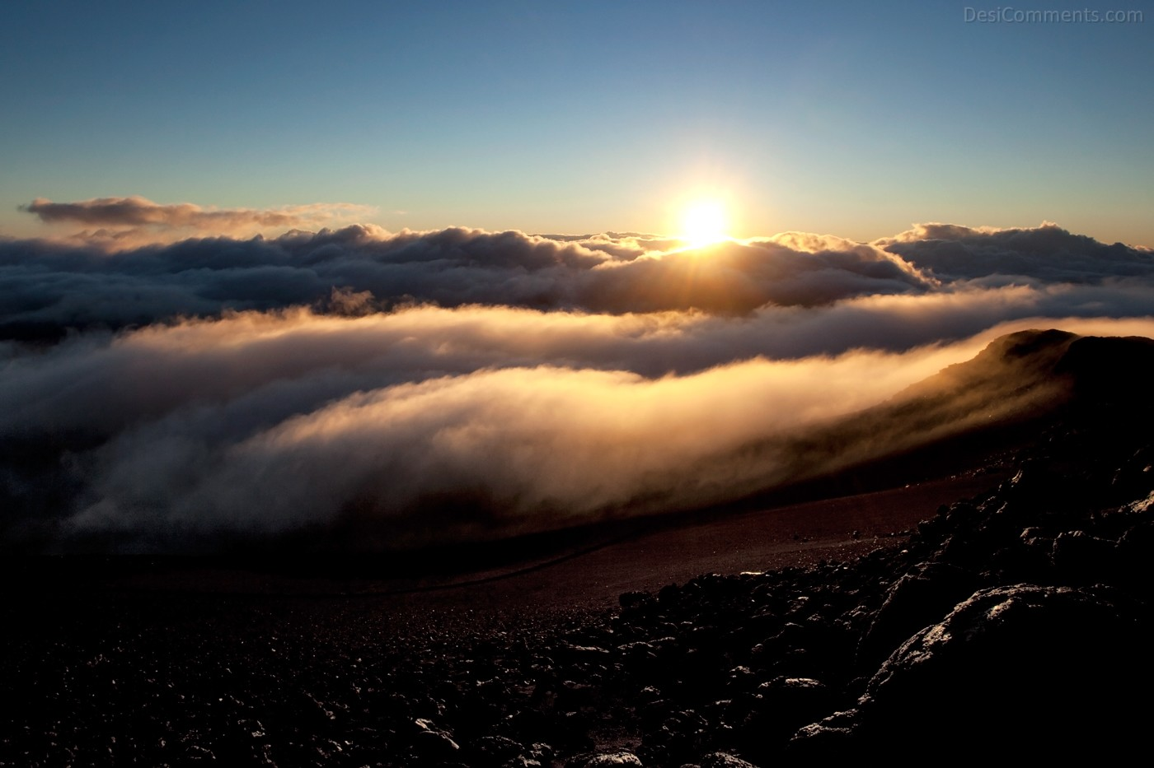
In a champagne supernova

Slide 31
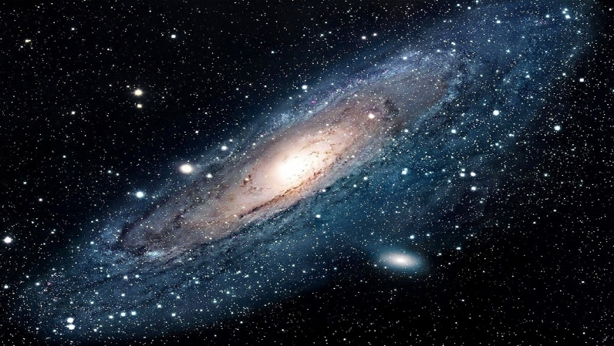
A champagne supernova

Slide 32
'Cuz we don't believe

Slide 33
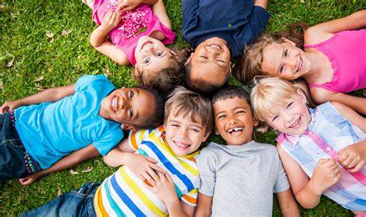
That they're gonna get away from the summer

Slide 34
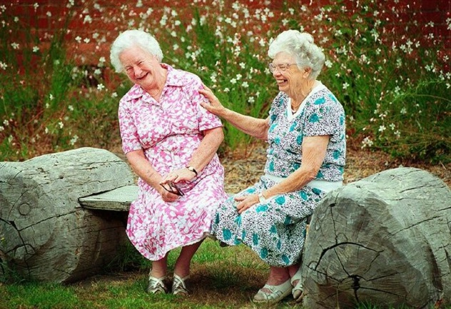

Slide 35
But you and I will never die

Slide 36
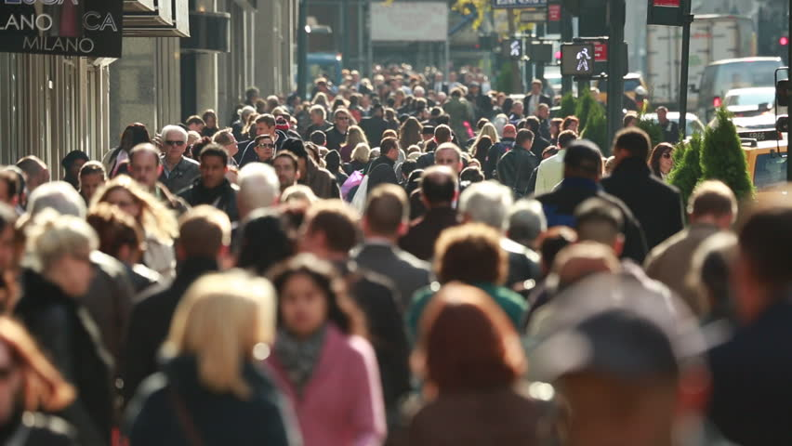
The world's still spinning around
we don't know why

Slide 37
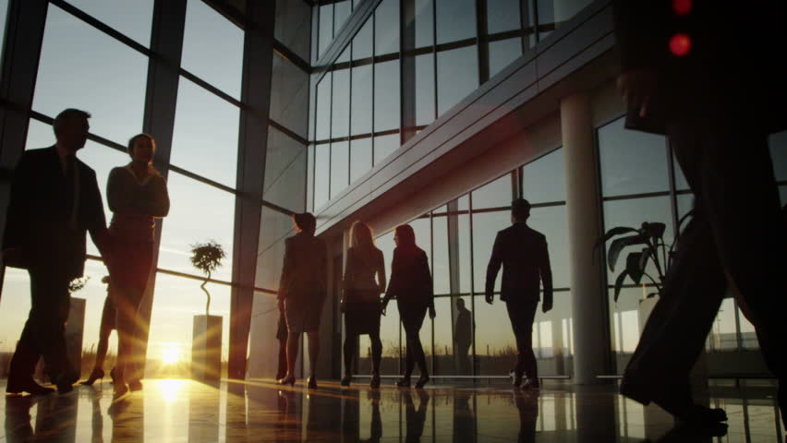
Why-why-why-why-i-i

Slide 38
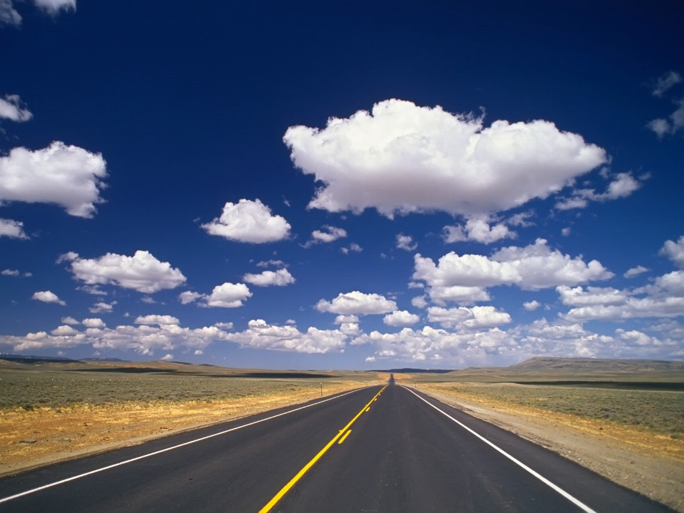

Slide 41
How many special people change?

Slide 42
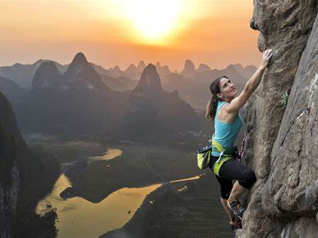
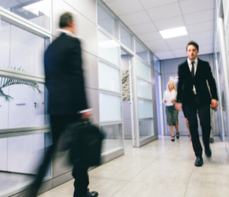
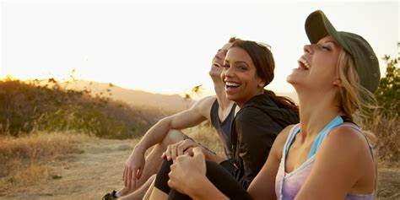
How many lives are living strange?

Slide 43
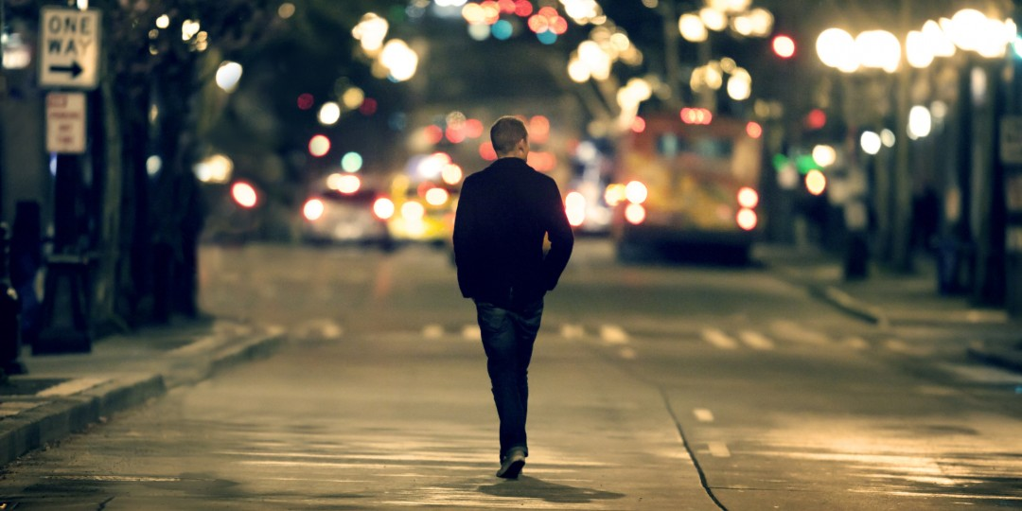
Where were you
while we were getting high?

Slide 44
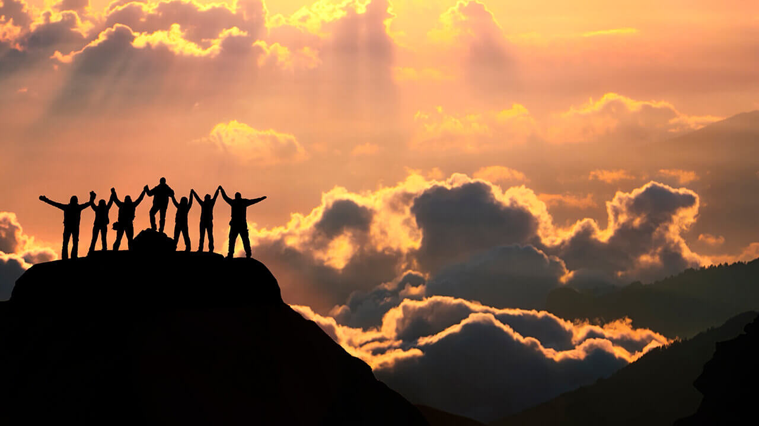
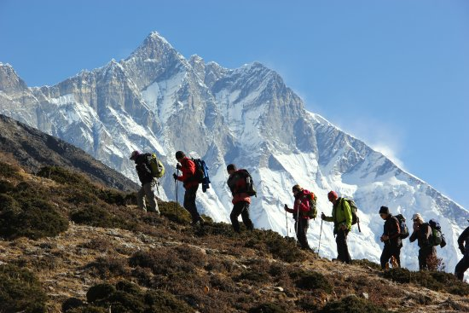
We were getting high

Slide 45
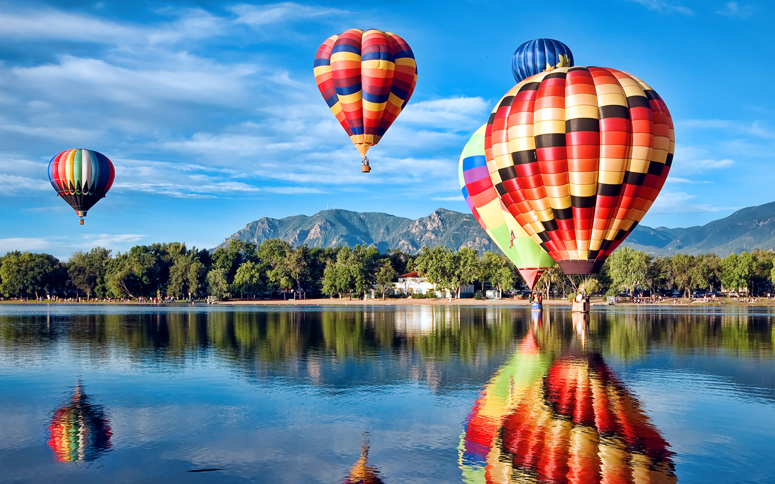

Slide 46
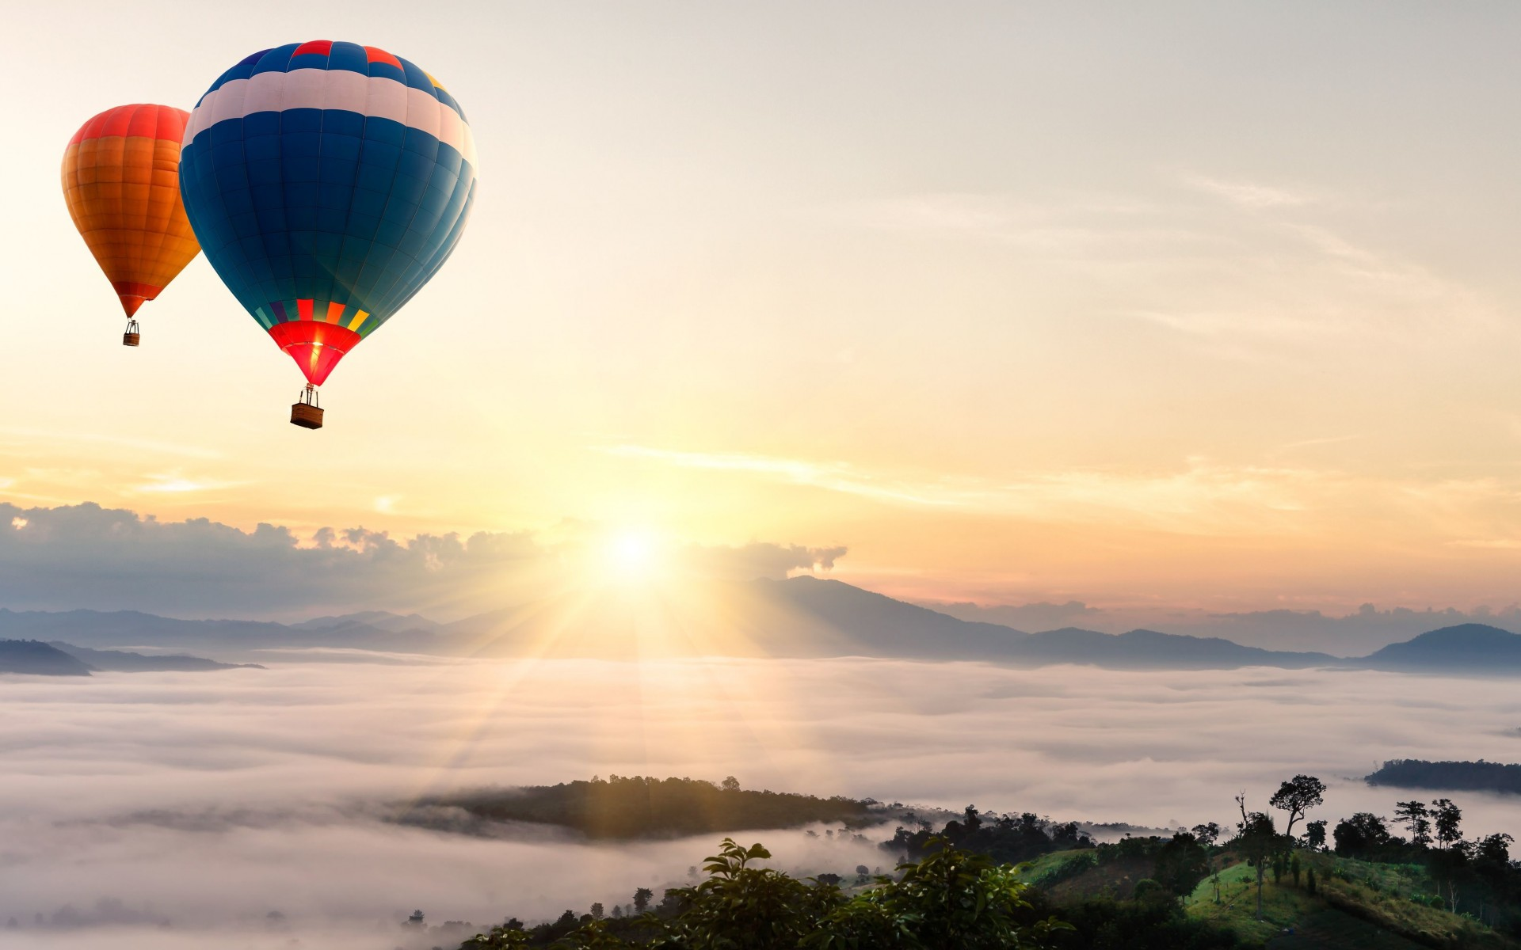

Slide 48
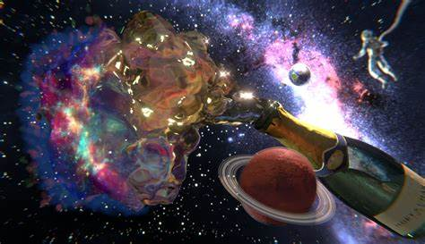
Champagne Supernova
——Oasis
Thank you！

