Slide 1
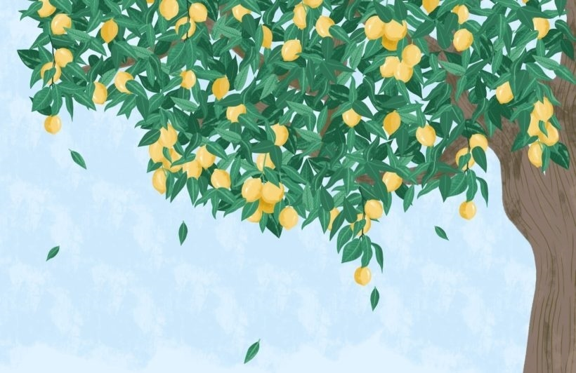
Lemon Tree
语法点：现在进行时
华南师范大学外国语言文化学院 李颖欣
广东省河源市东源县崇文学校 丘晓瑜

Slide 2
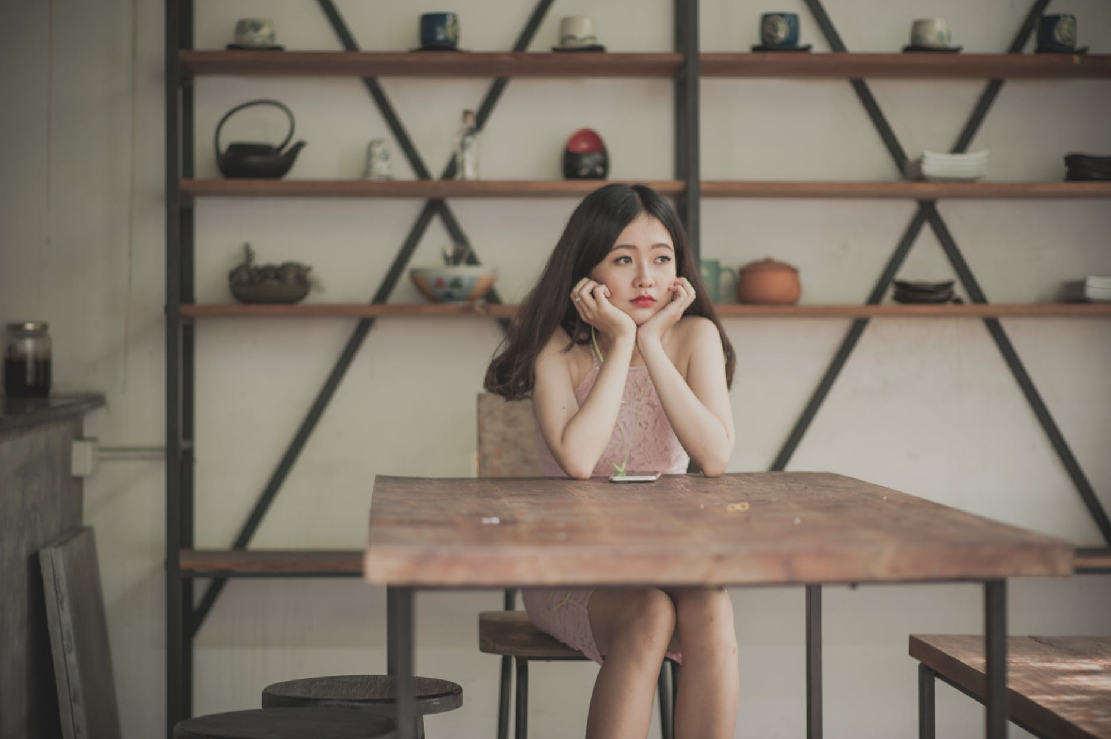
I’m sitting here in a boring room

Slide 3
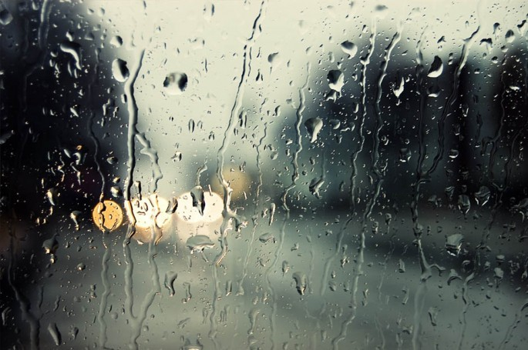
It's just another rainy Sunday afternoon

Slide 4
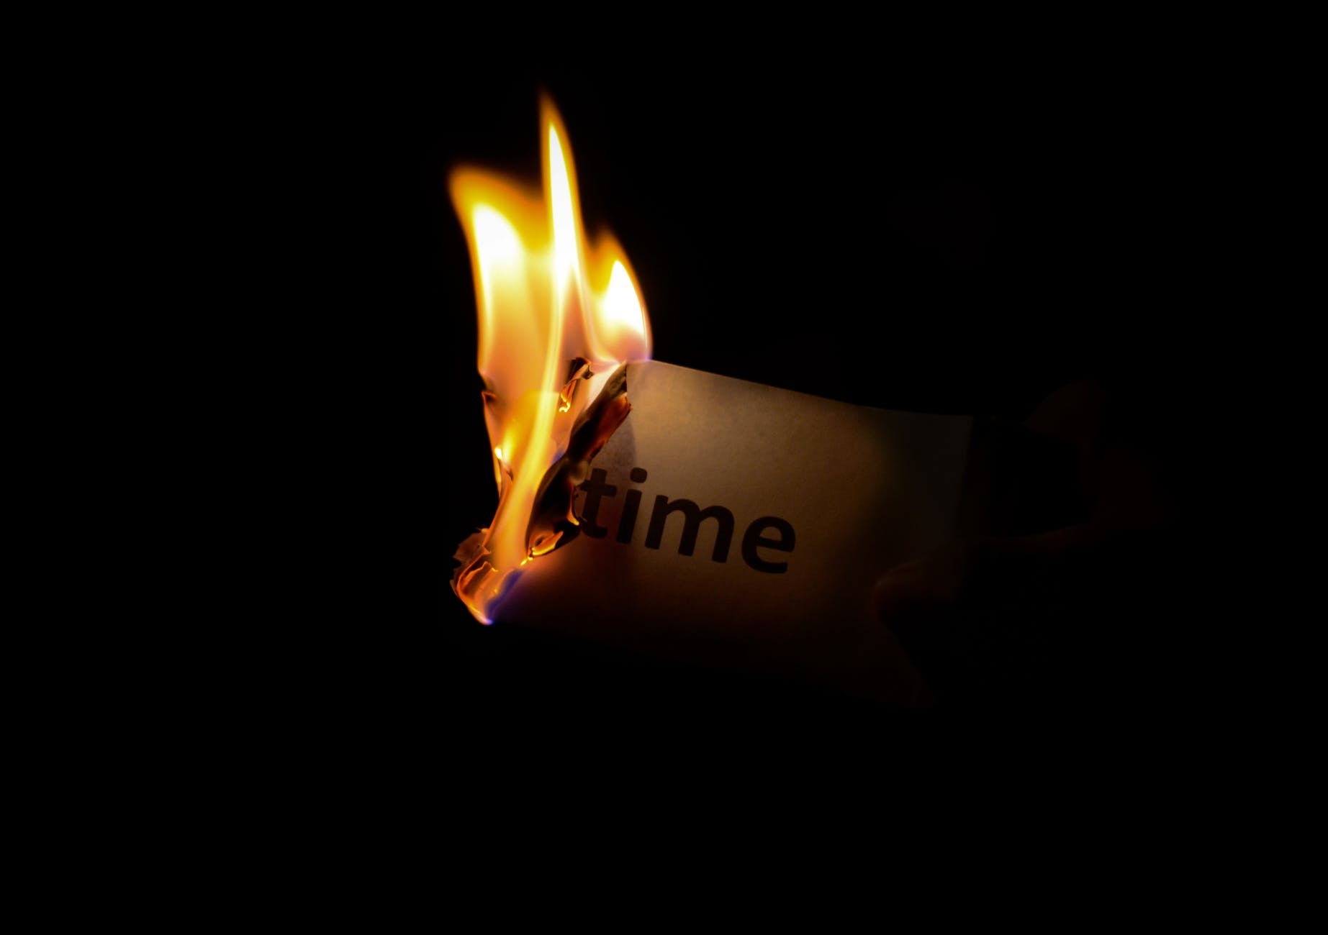
I'm wasting my time

Slide 5
I got nothing to do

Slide 6
I'm hanging around

Slide 7
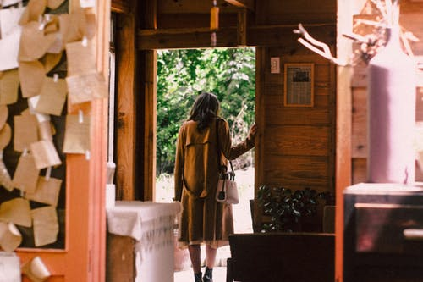
I'm waiting for you

Slide 8
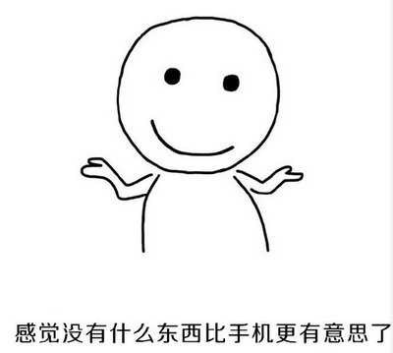
But nothing ever happens
And I wonder

Slide 9
I'm driving around in my car

Slide 10
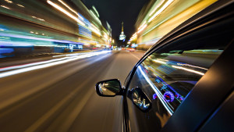
I'm driving too fast
I’m driving too far

Slide 11
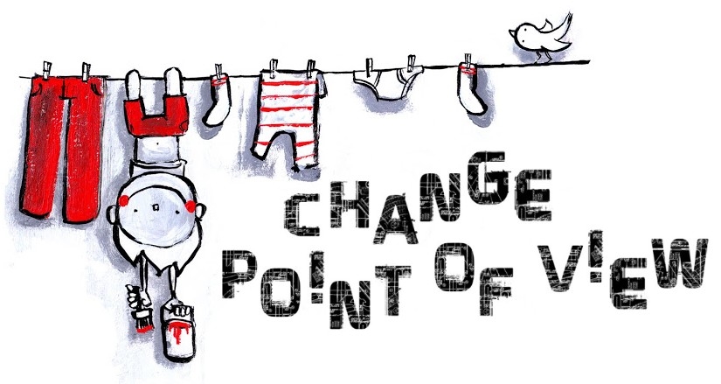
I'd like to change my point of view

Slide 12
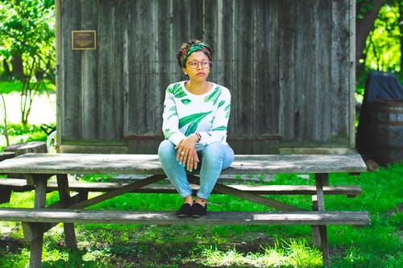
I feel so lonely
I'm waiting for you

Slide 13
But nothing ever happens
And I wonder

Slide 14
How
I wonder how

Slide 15
Why
I wonder why

Slide 16
Yesterday you told me about
the blue blue sky

Slide 17
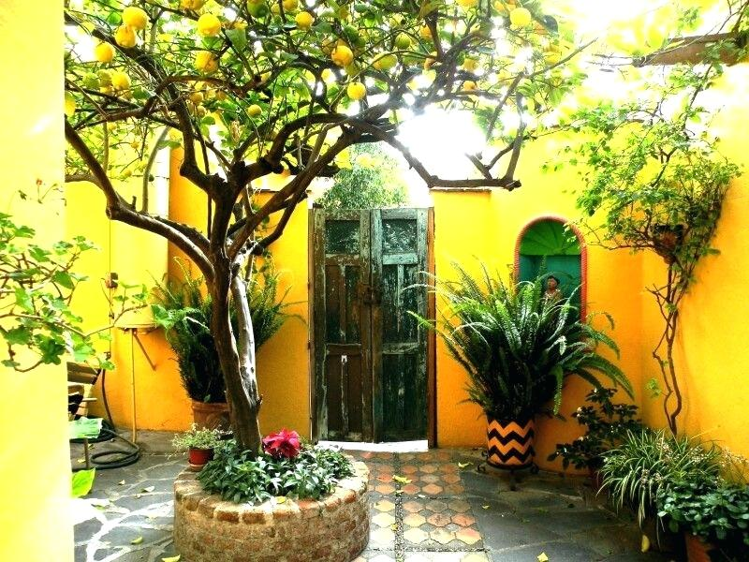
And all that I can see is just a yellow lemon tree

Slide 18
I'm turning my head up and down

Slide 19
I'm turning turning turning turning turning around

Slide 20
And all that I can see is just another lemon tree

Slide 21
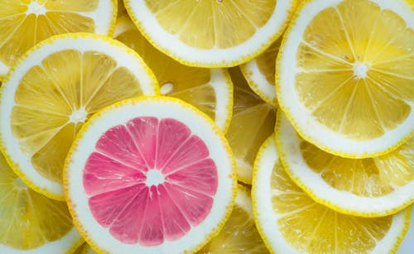
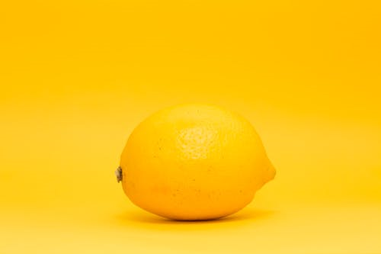
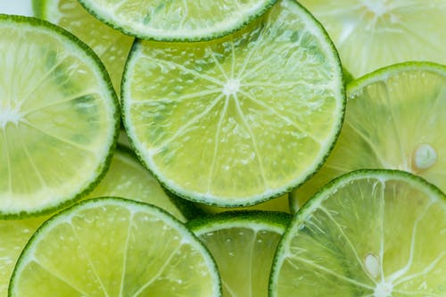
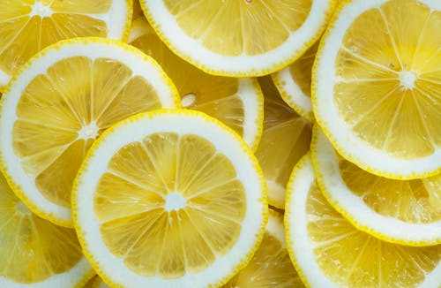
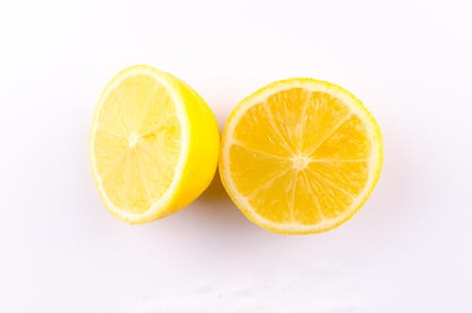
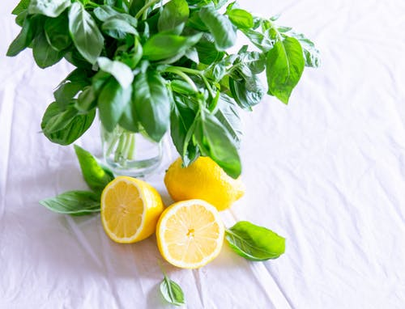
Sing

Slide 23
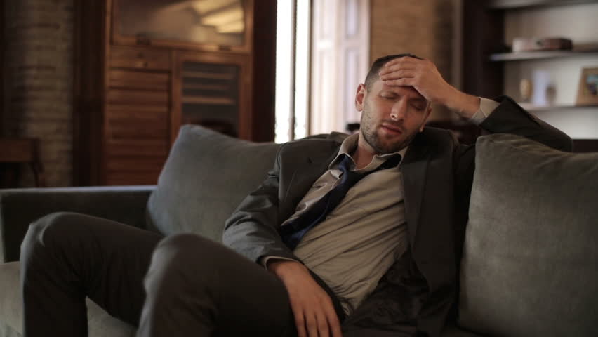
I'm sitting here
I miss the power

Slide 24
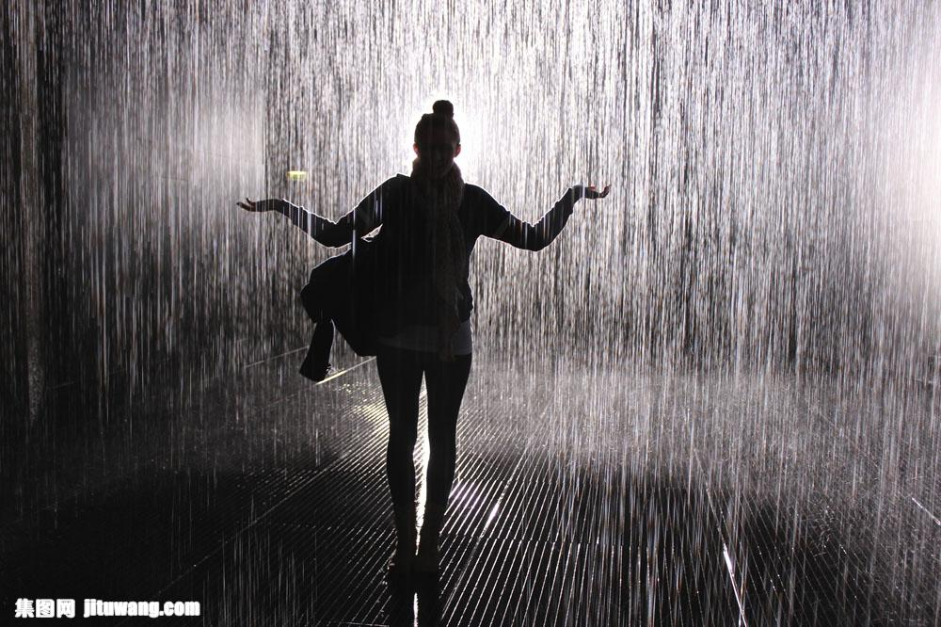
I'd like to go out taking a shower

Slide 25
But there's a heavy cloud inside my head

Slide 26
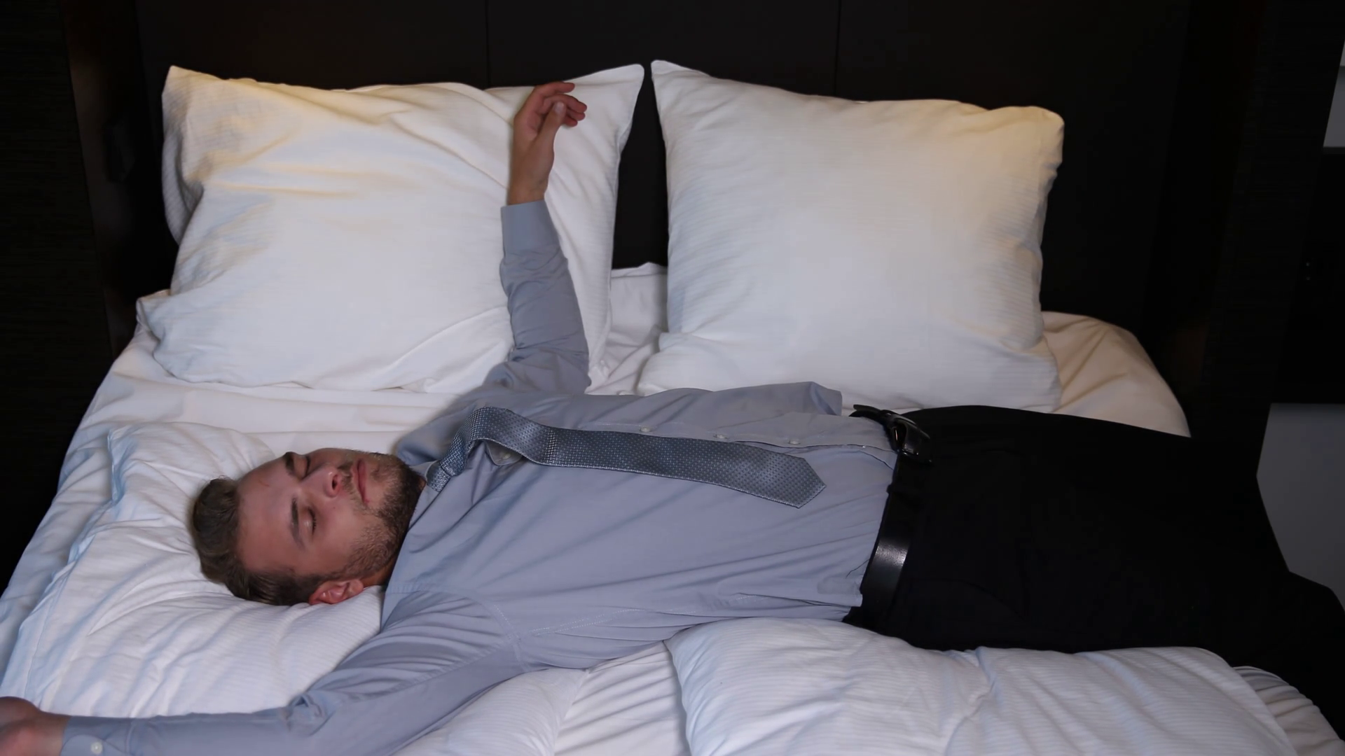
I feel so tired I put myself into bed

Slide 27
Well,
nothing ever happens
And I wonder

Slide 28
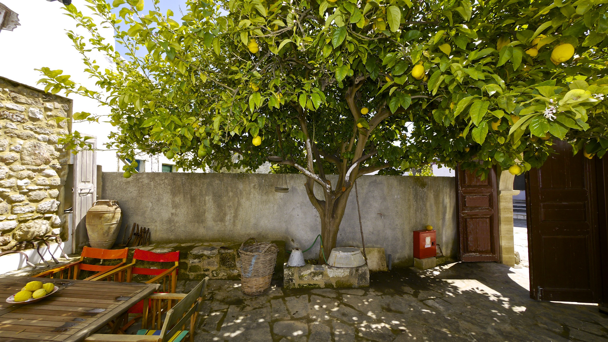
Isolation is not good for me
Isolation, I don't want to sit on a lemon tree

Slide 29
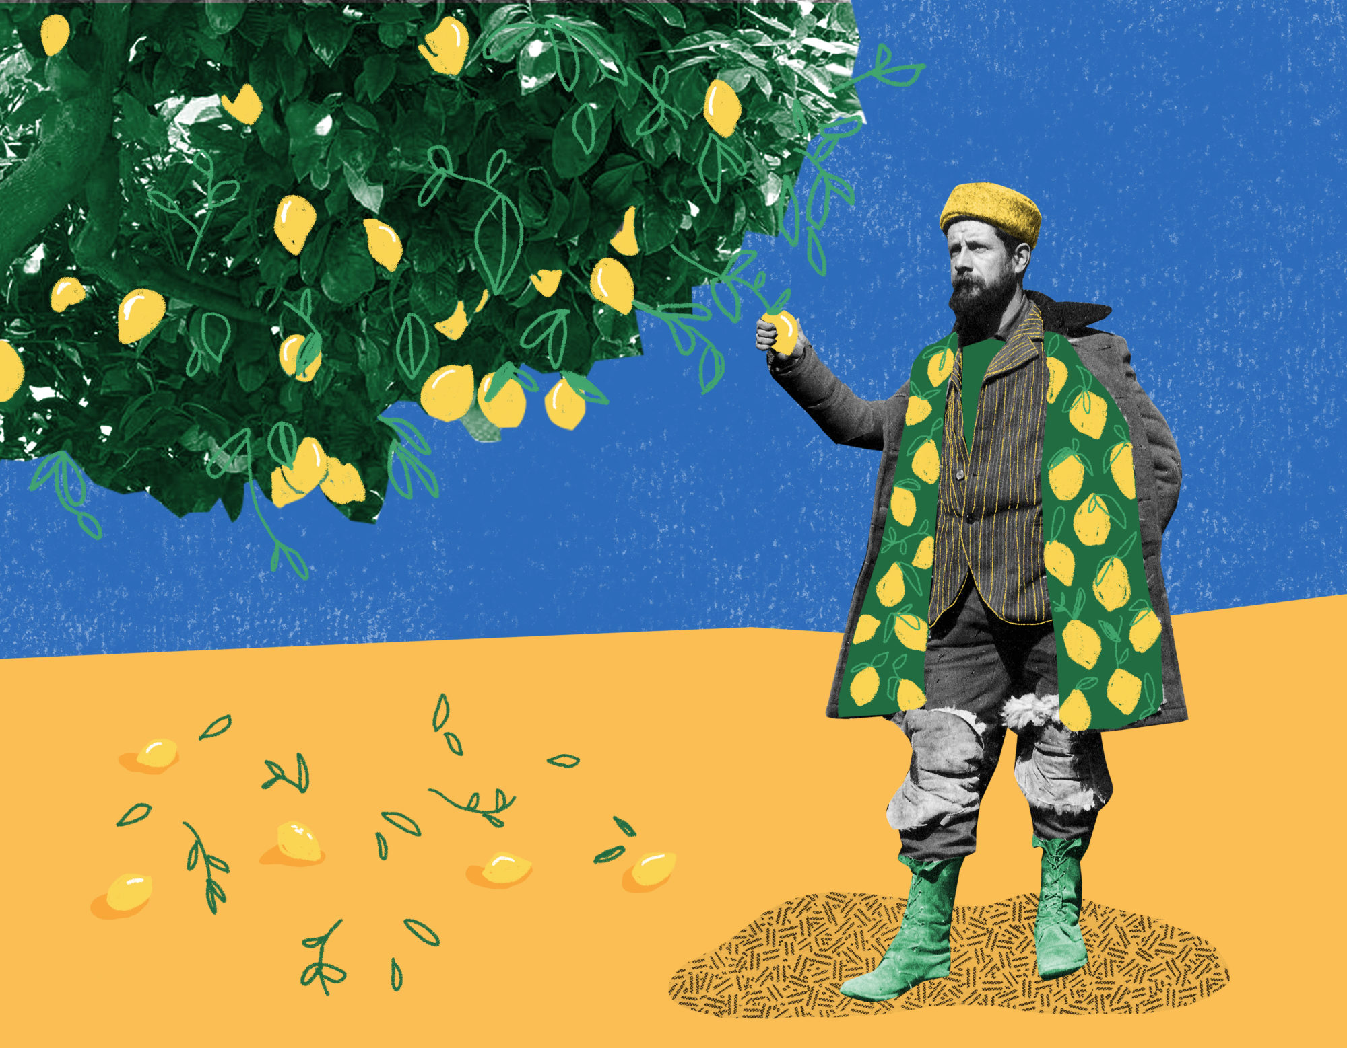
I'm stepping around in the desert of joy
Baby anyhow I'll get another toy

Slide 30
And everything will happen
And you’ll wonder

Slide 31
How
I wonder how

Slide 32
Why
I wonder why

Slide 33
Yesterday you told me about
the blue blue sky

Slide 34
And all that I can see is just another lemon tree

Slide 35
I'm turning my head up and down

Slide 36
I'm turning turning turning turning turning around

Slide 37
And all that I can see is just a yellow lemon tree

Slide 38
And I wonder wonder

Slide 39
How
I wonder how

Slide 40
Why
I wonder why

Slide 41
Yesterday you told me about
the blue blue sky

Slide 42
And all that I can see
And all that I can see
And all that I can see
Is just a yellow lemon tree

