Slide 1
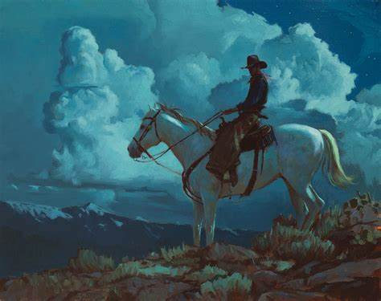
I am going to the west
作者：华南师范大学外国语言文化学院范超洁
授课老师：河源市东源县黄村崇伊中学吴雪莹

Slide 2
In this fair land I'll stay no more
labor 劳动
in vain 无效
here labor is in vain

Slide 3
I'll seek the mountains far away

Slide 4
and leave the fertile plain
fertile肥沃的

Slide 5
where waves of grass and oceans roam into infinity
infinity 无穷

Slide 6
I stand ready on the shore
shore海岸

Slide 7
to cross the inland sea

Slide 8
I am going to the west

Slide 9
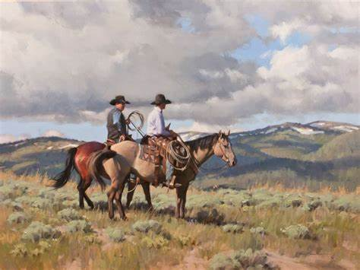
you say you will not go with me

Slide 10
you turn your eyes away

Slide 11
you say you will not follow me

Slide 12
no matter what I say

Slide 13
I am going to the west

Slide 14
I will journey to the place

Slide 15
that was shaped by heaven's hand
heaven天堂

Slide 16
I will build for me a bow

Slide 17
where angel's footprints mark the land
footprints足迹

Slide 18
where castle rocks and towers high

Slide 19
kneel to valleys wide and green
kneel跪
valley山谷

Slide 20
all my thoughts are turned to you

Slide 21
my waking hope, my sleeping dream

Slide 22
I am going to the west

Slide 23
you say you will not go with me

Slide 24
you turn your eyes away

Slide 25
you say you will not follow me

Slide 26
no matter what I say

Slide 27
I am going to the west

Slide 28
And when sun gives way to the moon

Slide 29
and silver starlight fills the sky
silver银色的

Slide 30
in the arms of these last hills

Slide 31
is where I'm bound to lie

Slide 32
wind my blanket earth my bed
blanket 毛毯

Slide 33
my canopy a tree
canopy华盖

Slide 34
willows by the riverside
willow柳树

Slide 35
will whisper me to sleep

Slide 36
I am going to the west

Slide 37
you say you will not go with me

Slide 38
you turn your eyes away

Slide 39
you say you will not follow me

Slide 40
no matter what I say

Slide 41
I am going to the west

