Slide 1
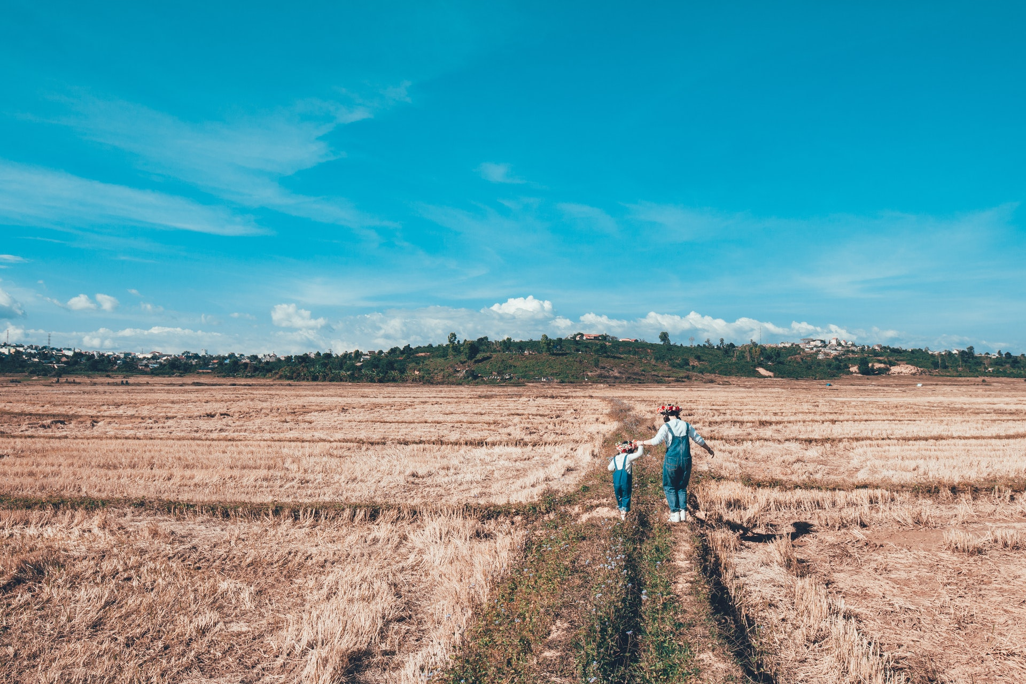
We are the world
Modal verbs
设计制作：华南师范大学外国语言文化学院 黄宝莹
广东省河源市啸仙中学 吴淑芬
指导教师：吴淑芬、刘晓斌

Slide 2
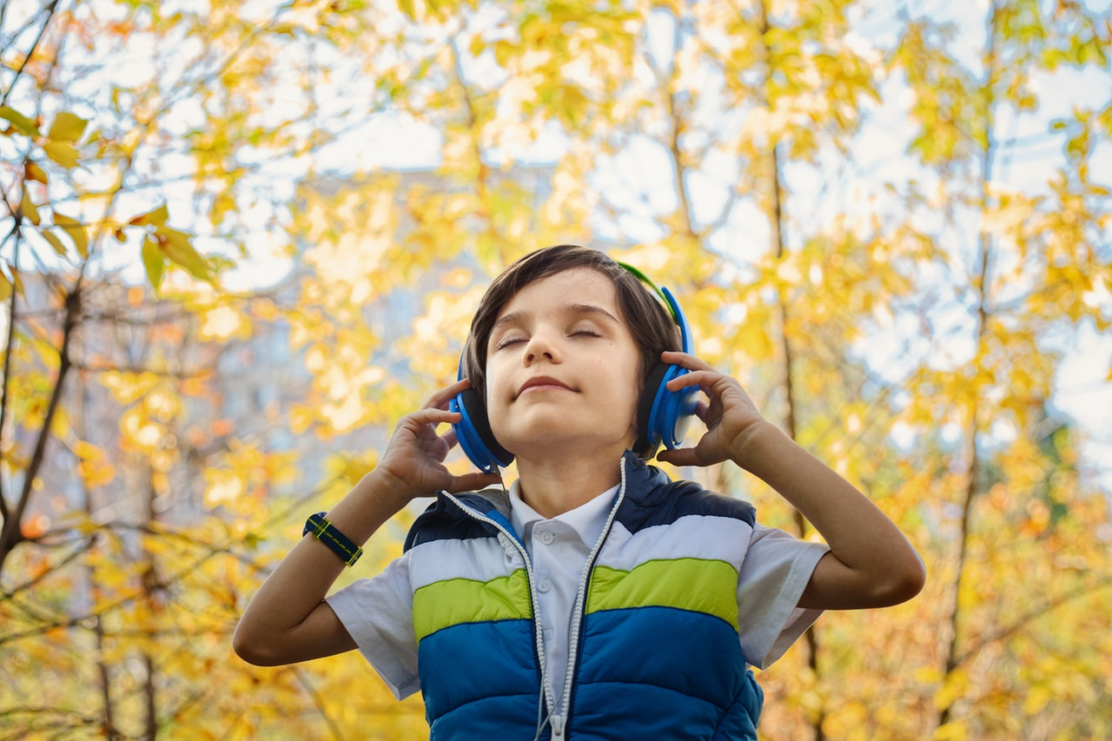
There is a time
when we should hear the certain calls.

Slide 3
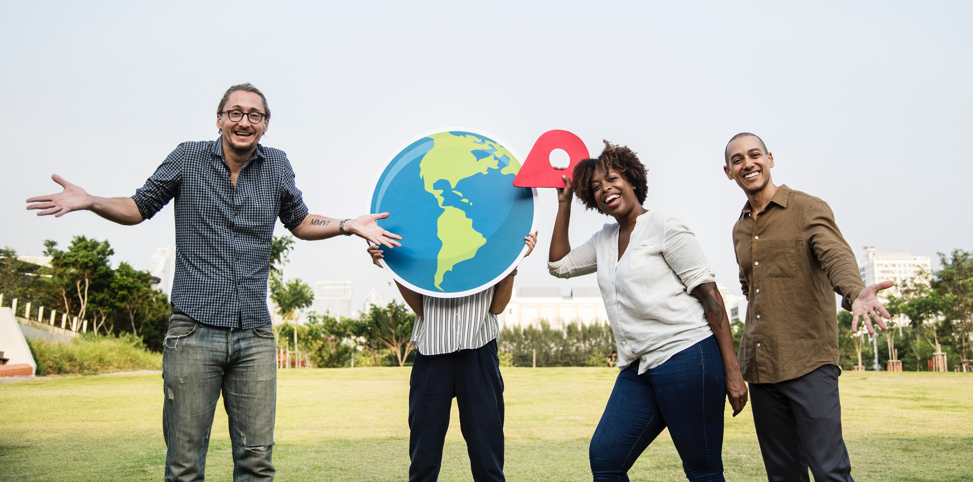
Cause the world it seems it's right in this line.

Slide 4
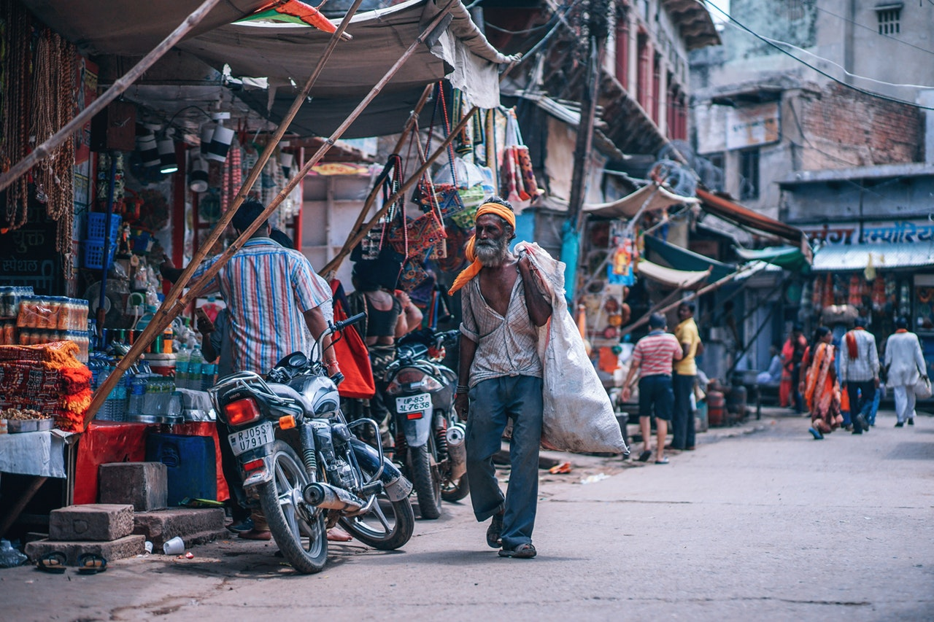
Cause there's a chance for taking in needing our own lives

Slide 5
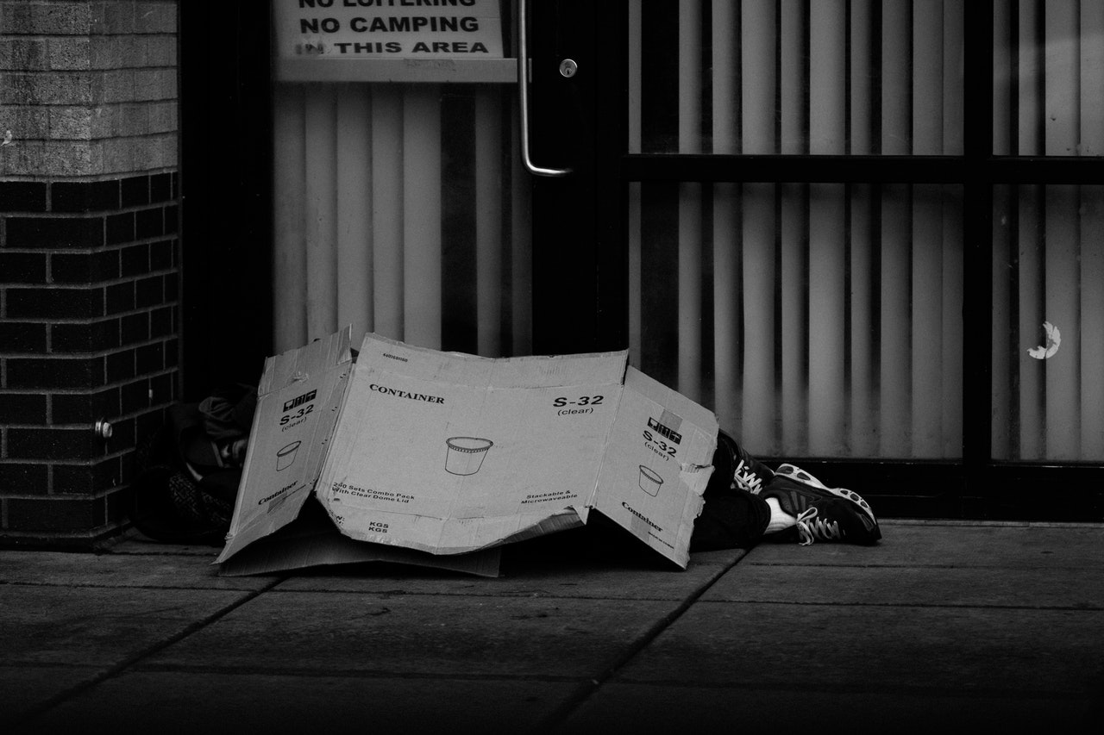
It seems we need nothing at all.

Slide 6
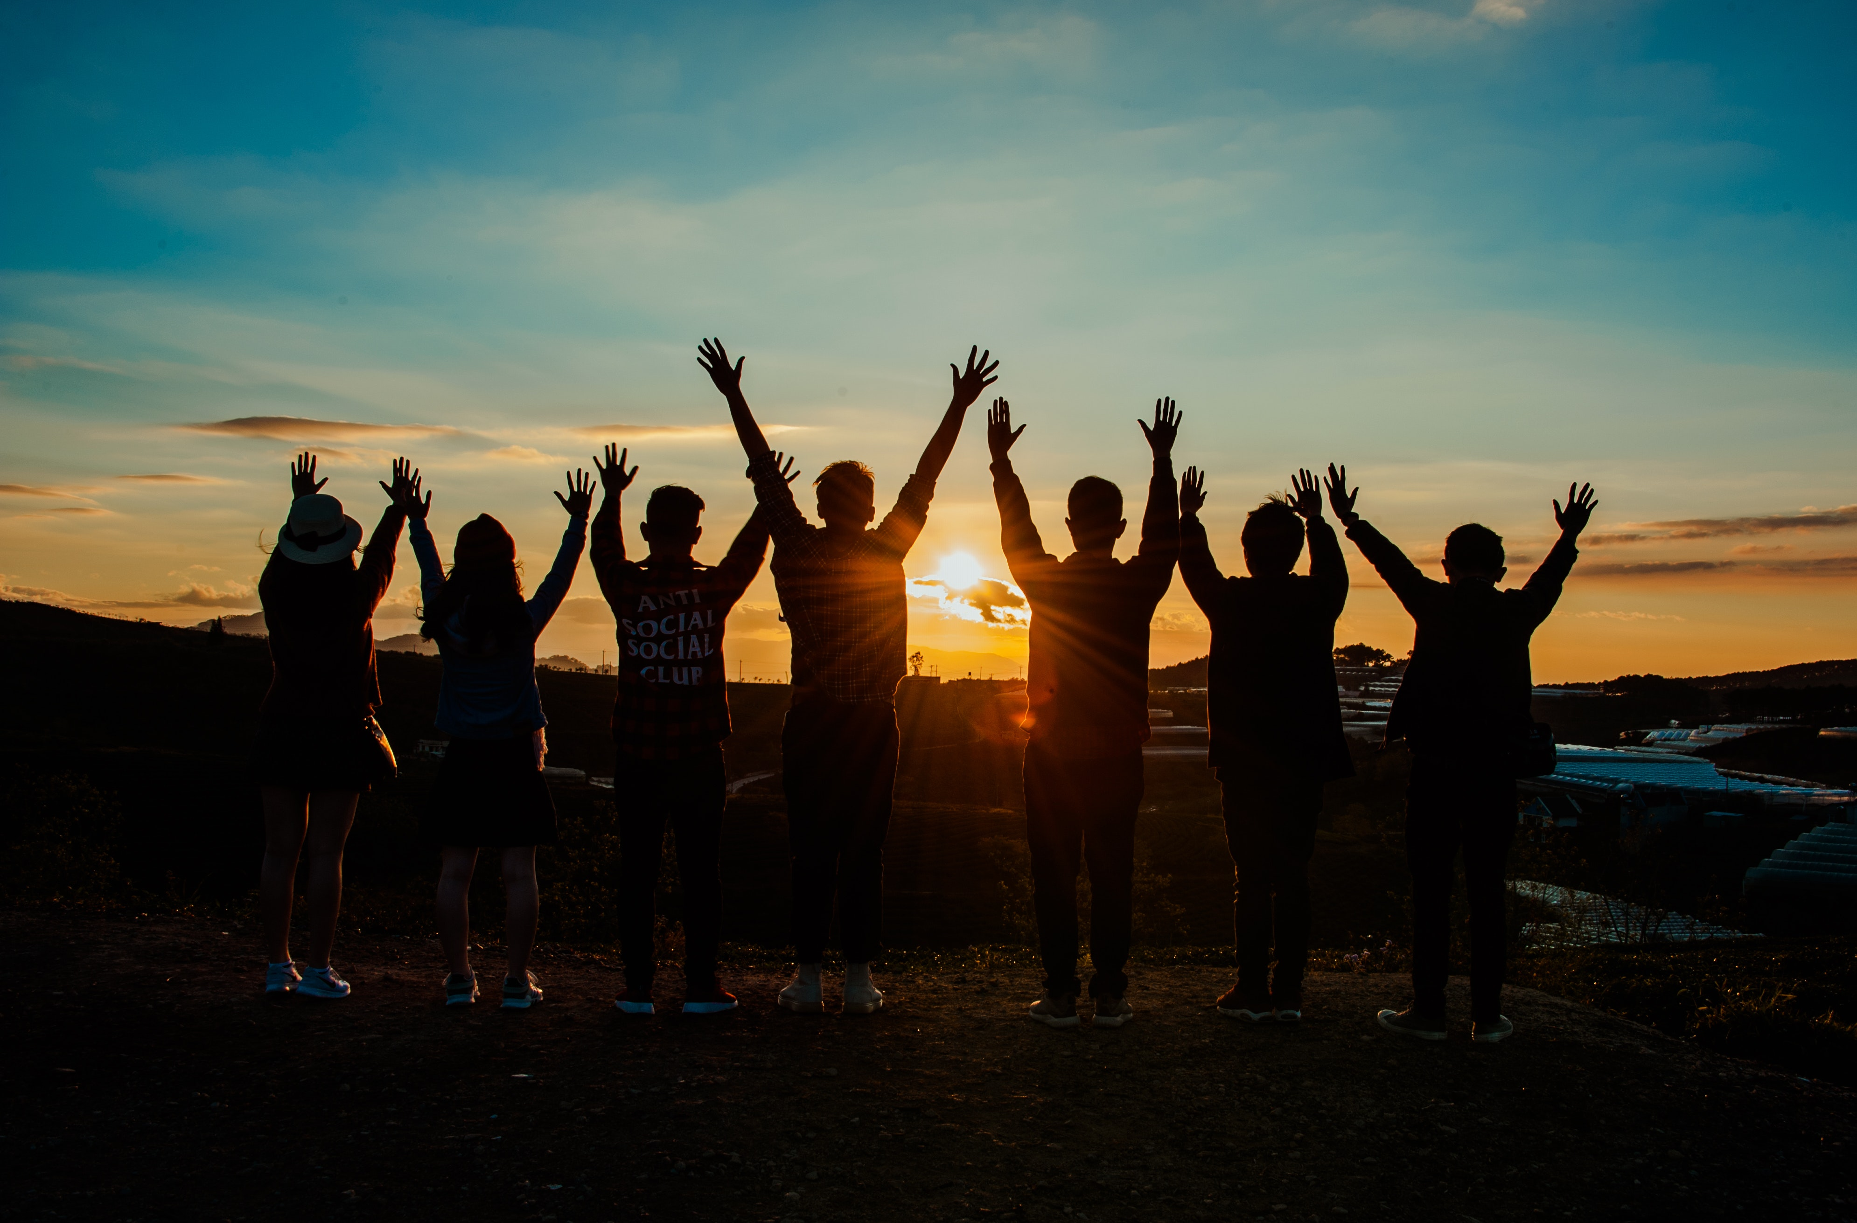
I used to feel that I should give away my heart.

Slide 7
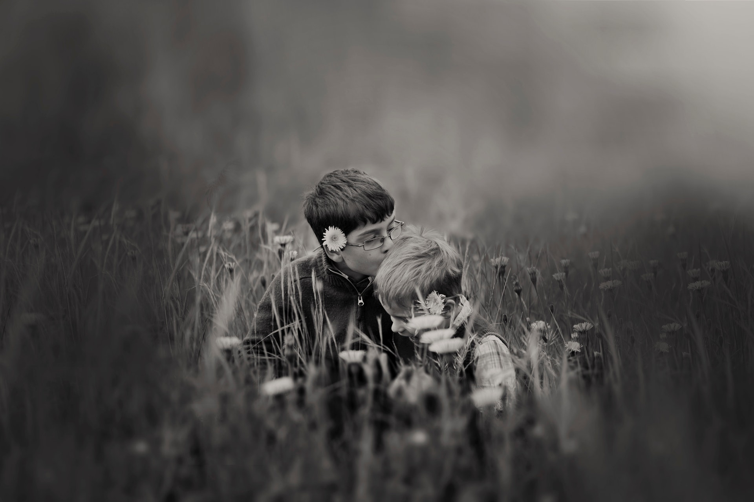
And it shows that fear of needing them.

Slide 8
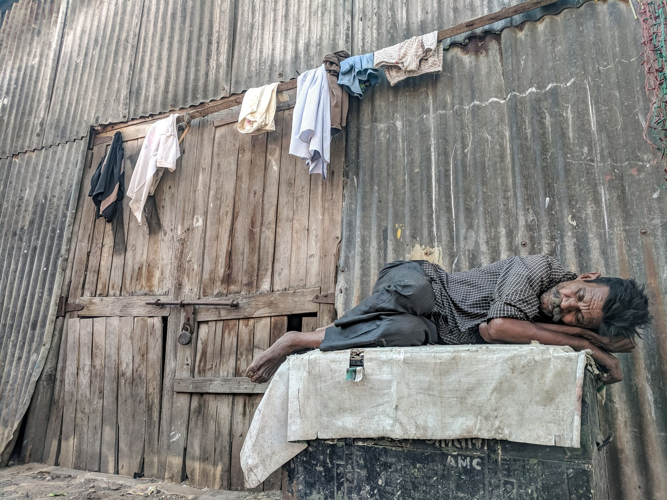
Then I read the headlines
and it said they're dying there.

Slide 9
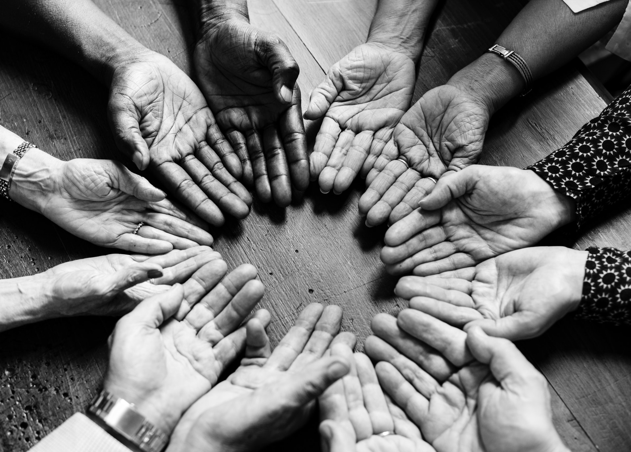
And it shows that we must heed instead.

Slide 10
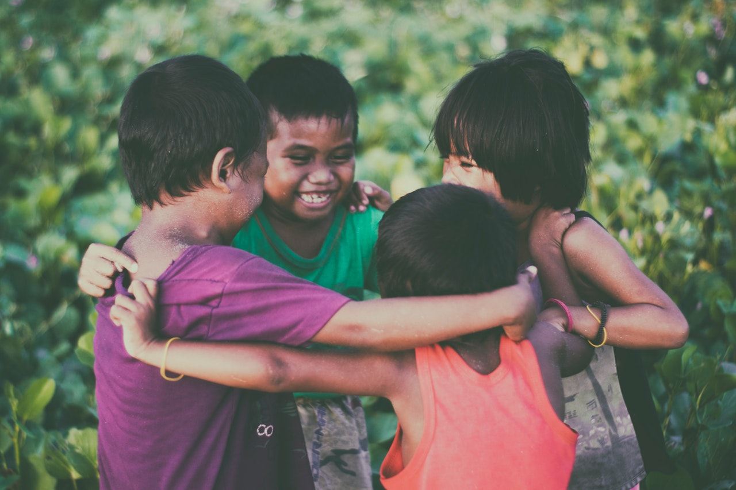
We are the world.
We are the children.

Slide 11
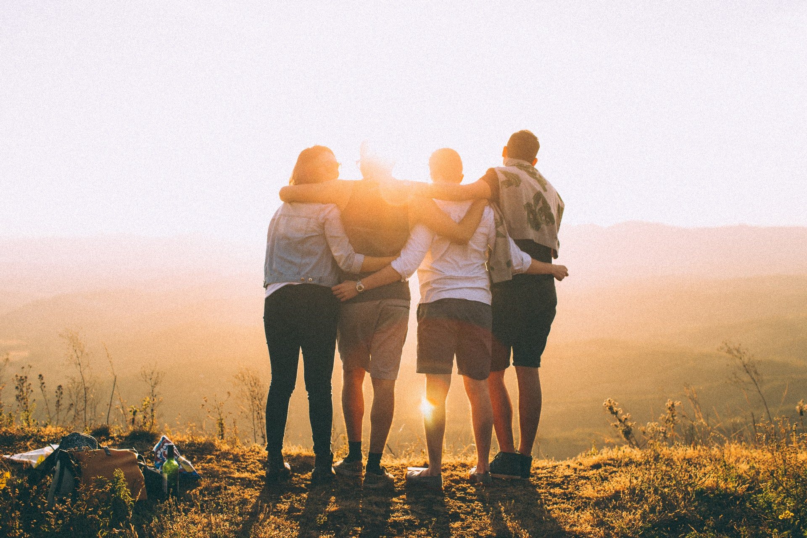
We are the ones who make a brighter day.
So let's start giving.

Slide 12
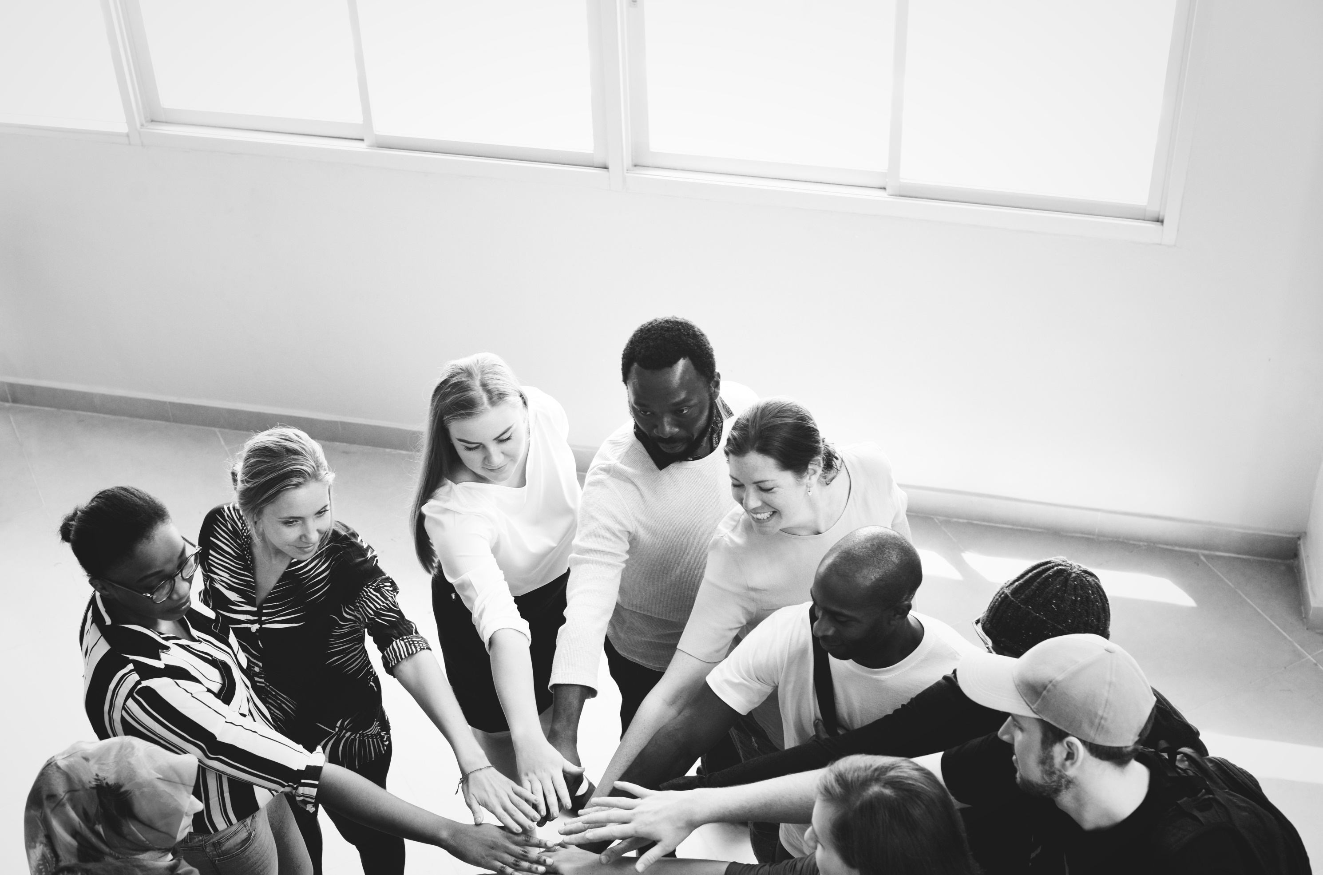
But there's a chance we're taking.
We're taking our own lives.

Slide 13
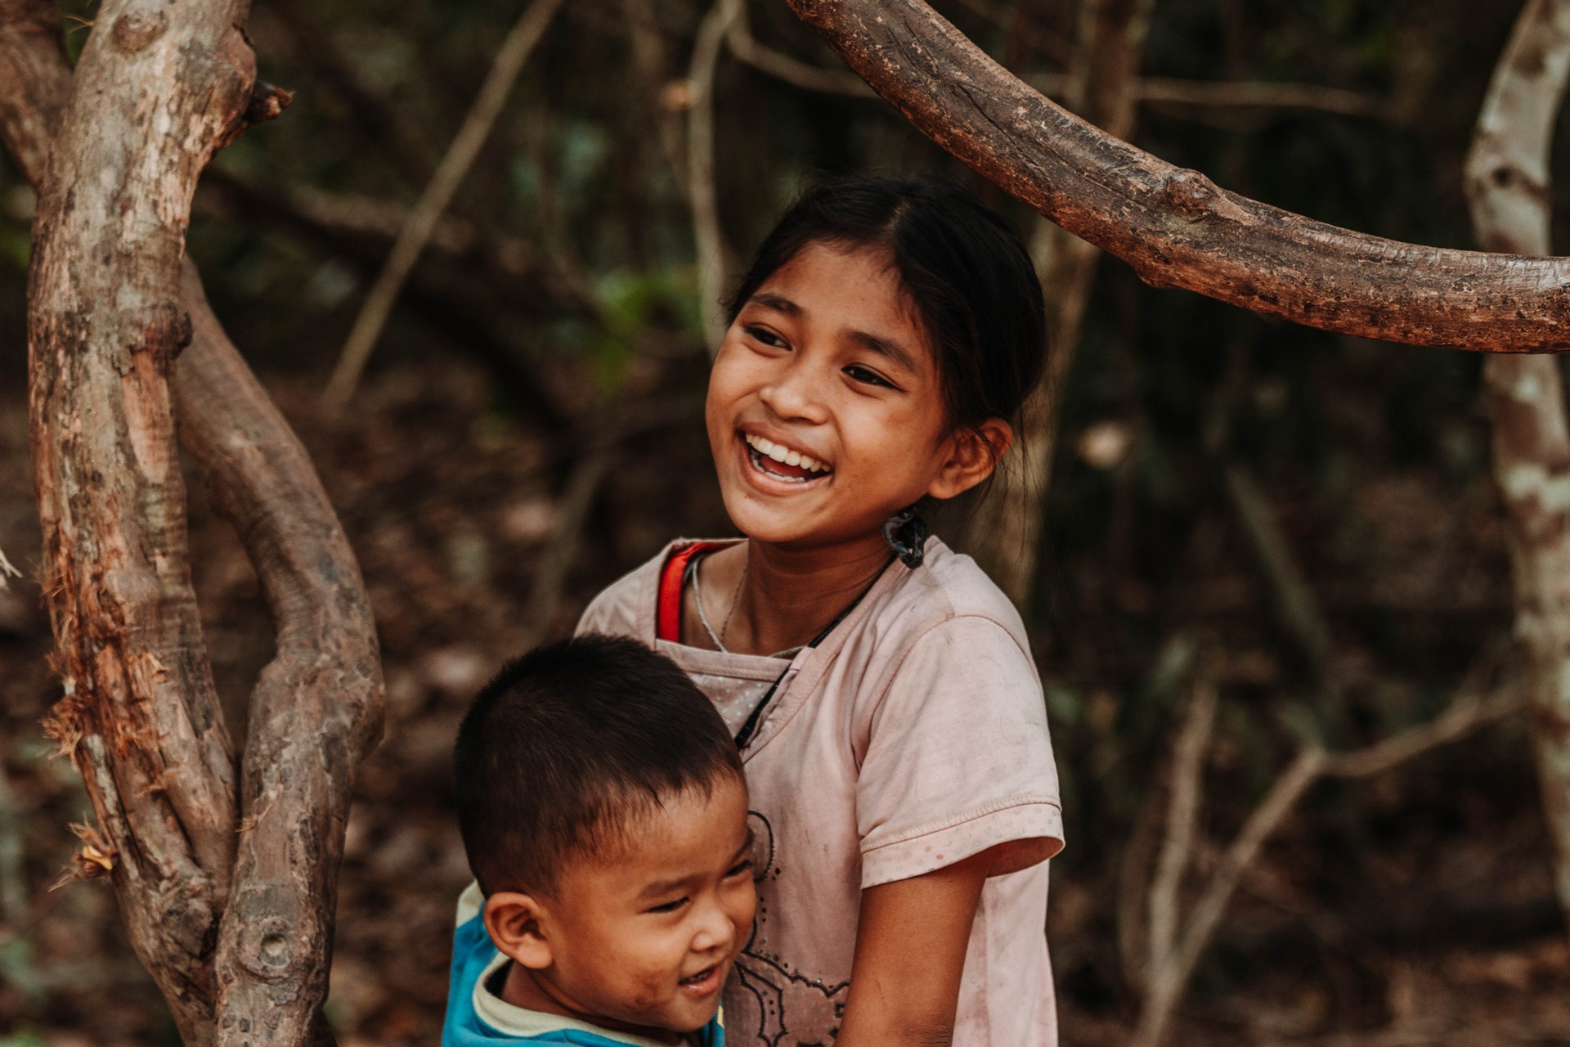
It's true we'll make a brighter day just you and me.

Slide 14
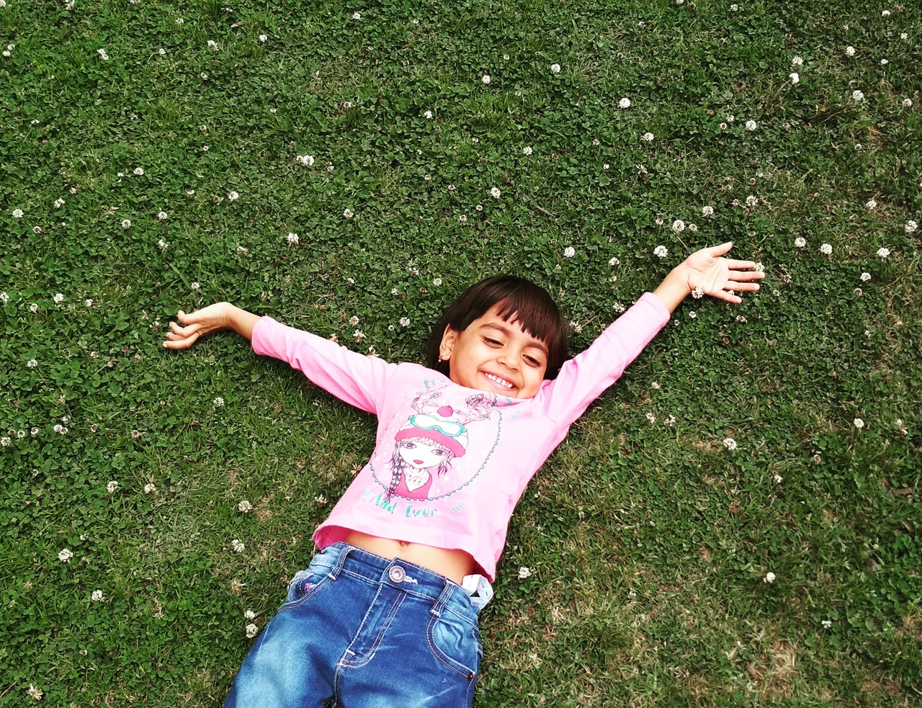
Give in your heart and you will see that someone cares.

Slide 15
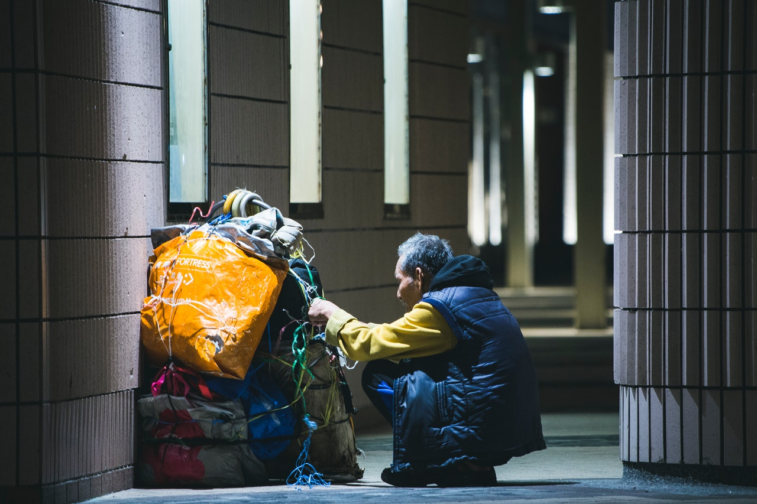
Cause you know that they can feed them all.

Slide 16
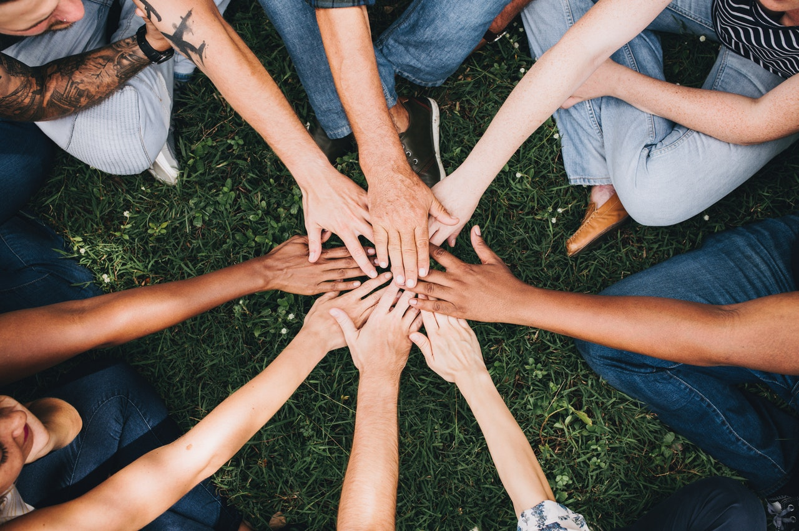
Then I read the paper
and it said that you've been denied.
And it shows the second we will call.

Slide 17
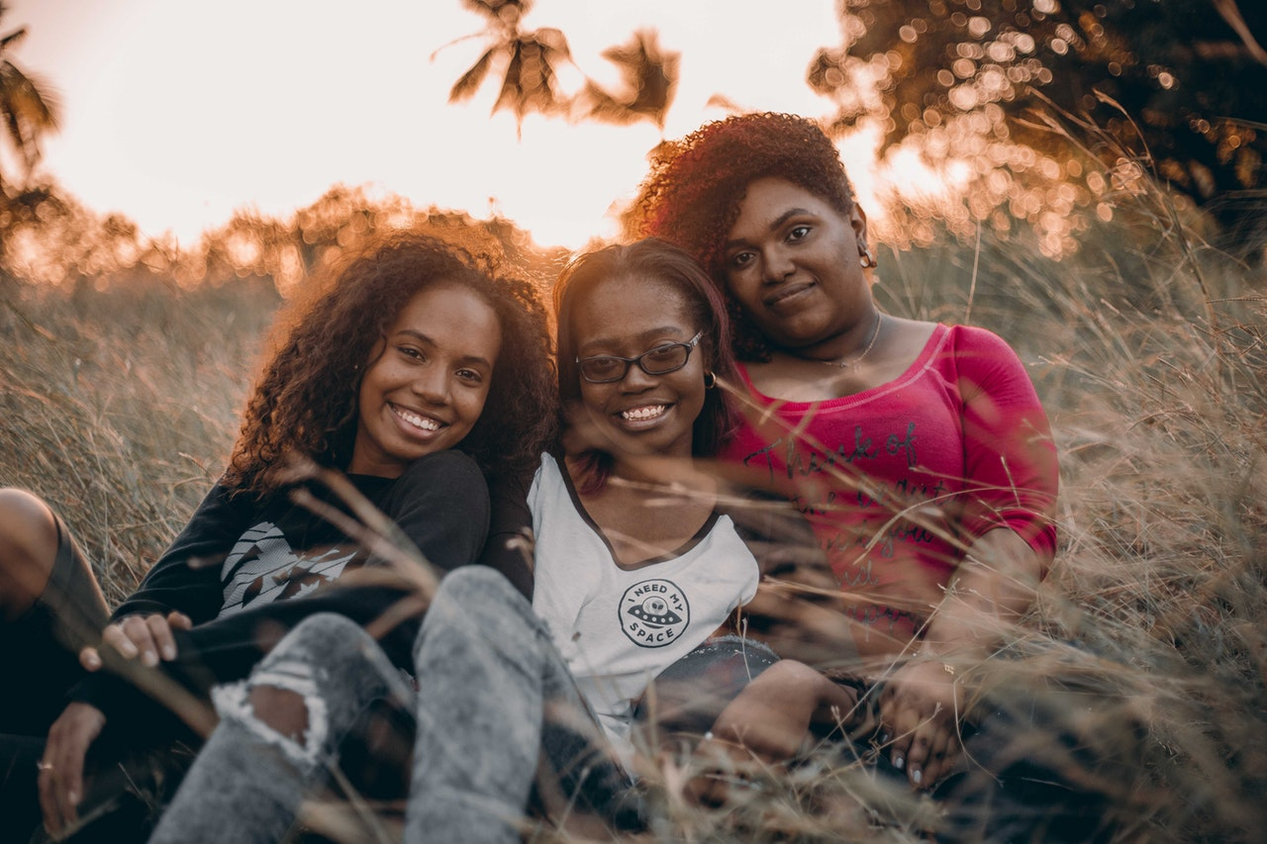
We are the world.
We are the children.

Slide 18
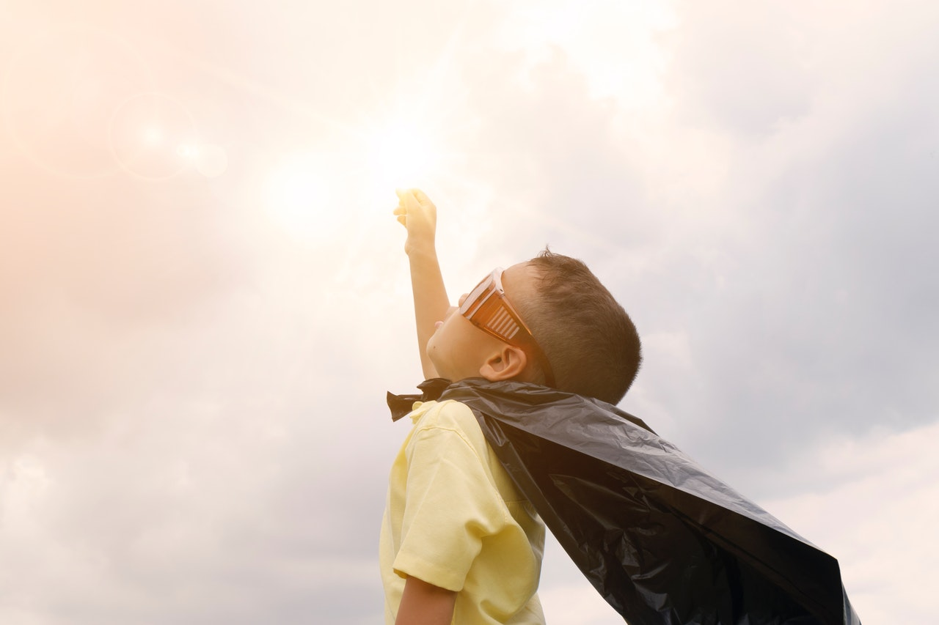
We are the ones who make a brighter day.
So let's start giving.

Slide 19
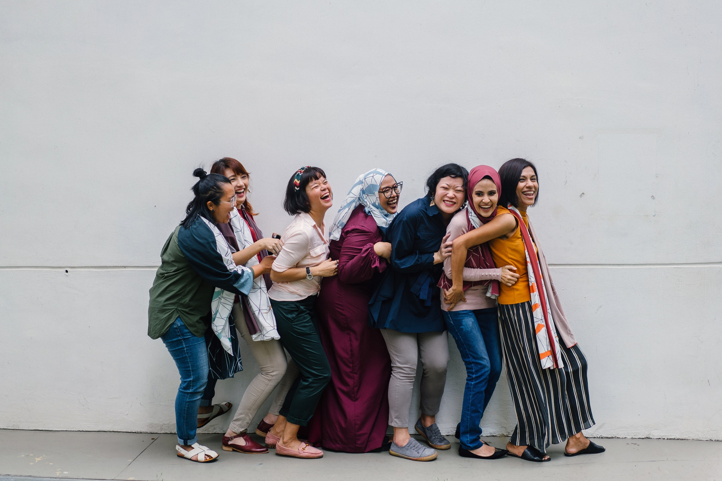
But there's a chance we're taking.
We're taking our own lives.

Slide 20
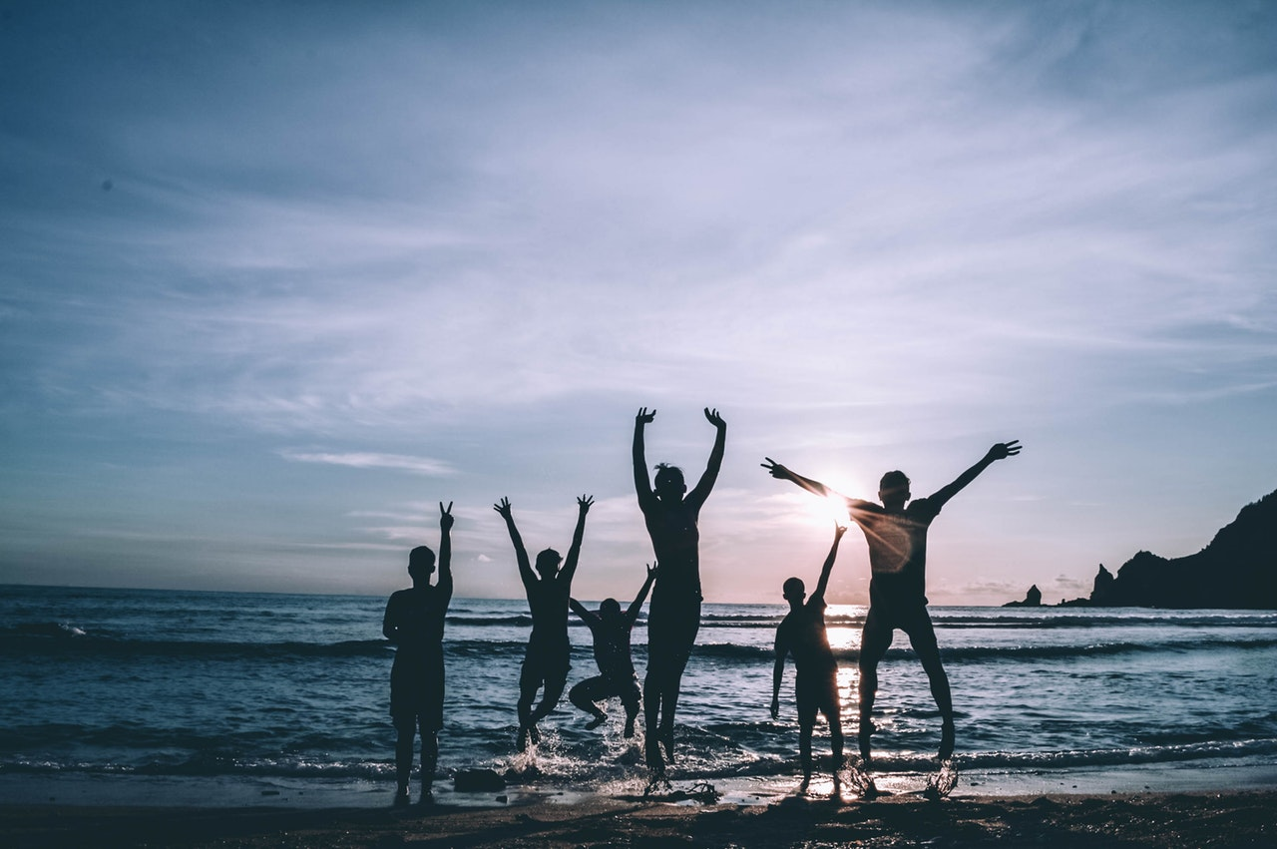
It's true we'll make a brighter day just you and me.

Slide 21
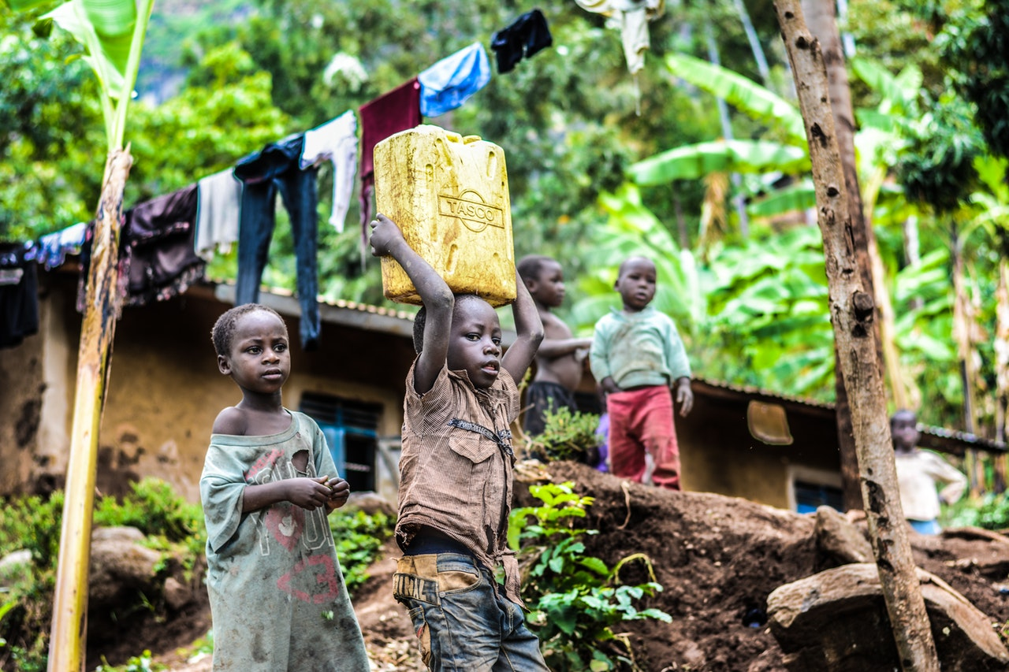
No there's a time when we must love them all.

Slide 22
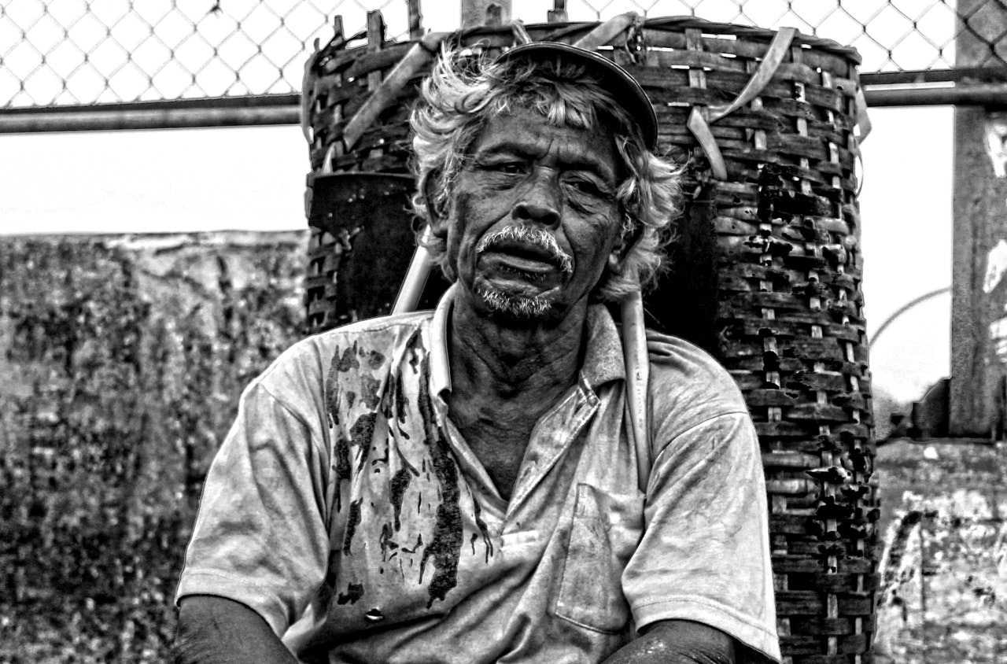
And it seems that life it don't make love at all.

Slide 23
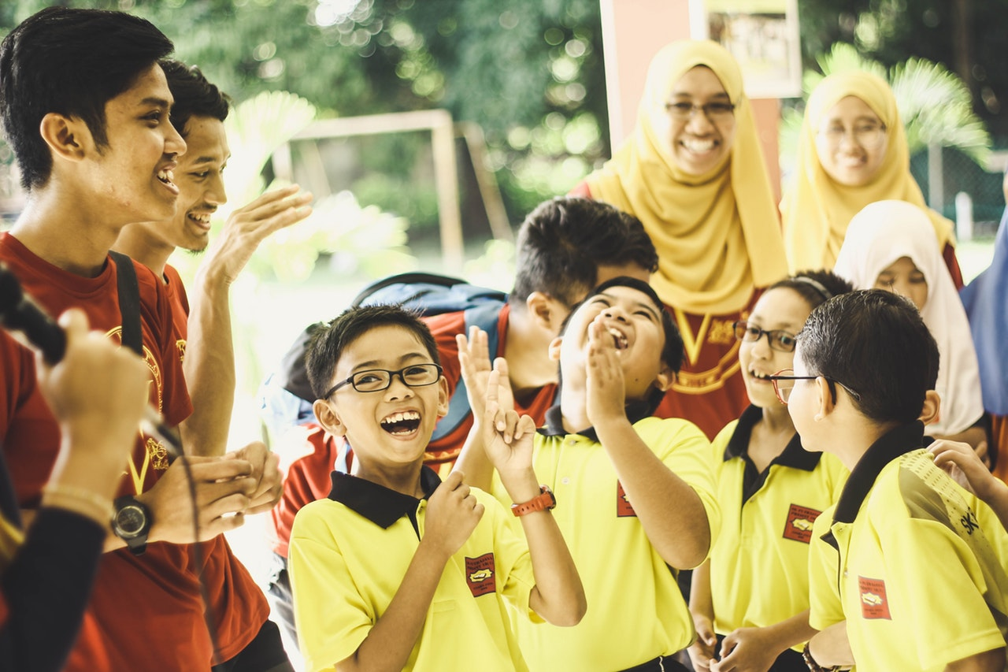
But if you'd be there and I'll love you more and more.

Slide 24
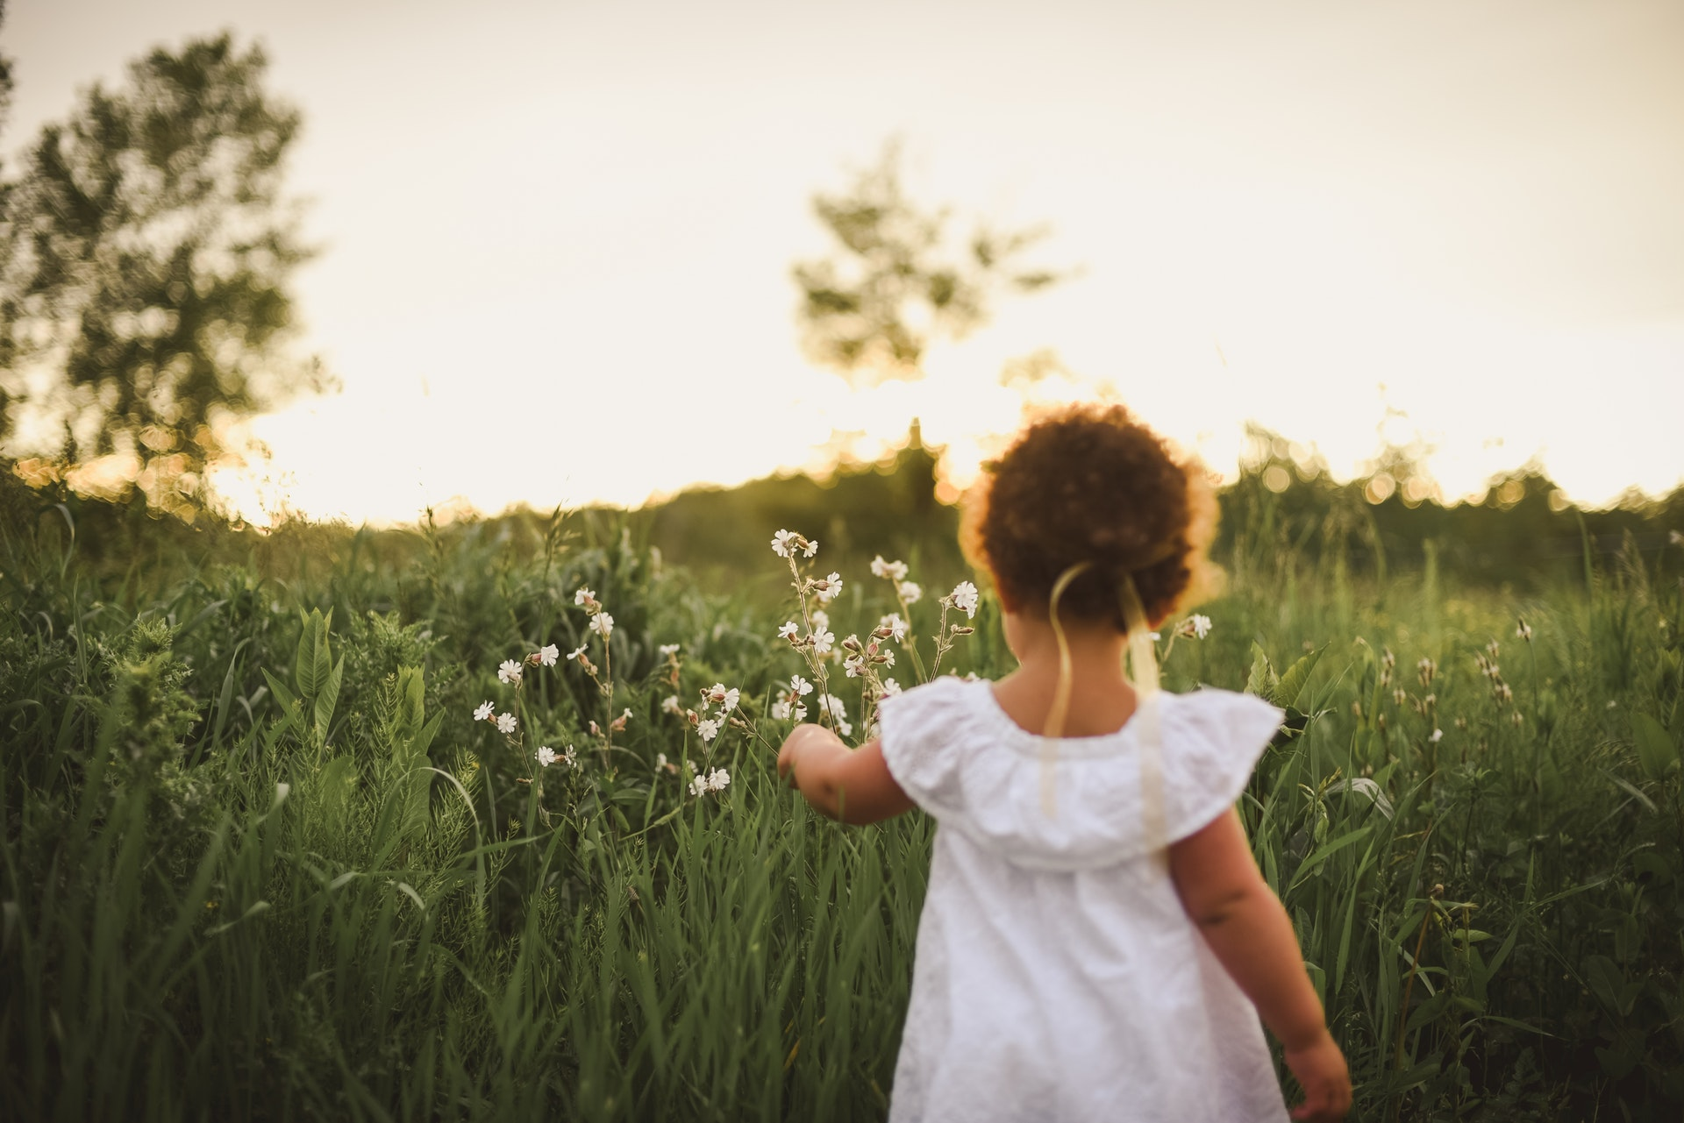
It seems in life I didn't do that.

Slide 25
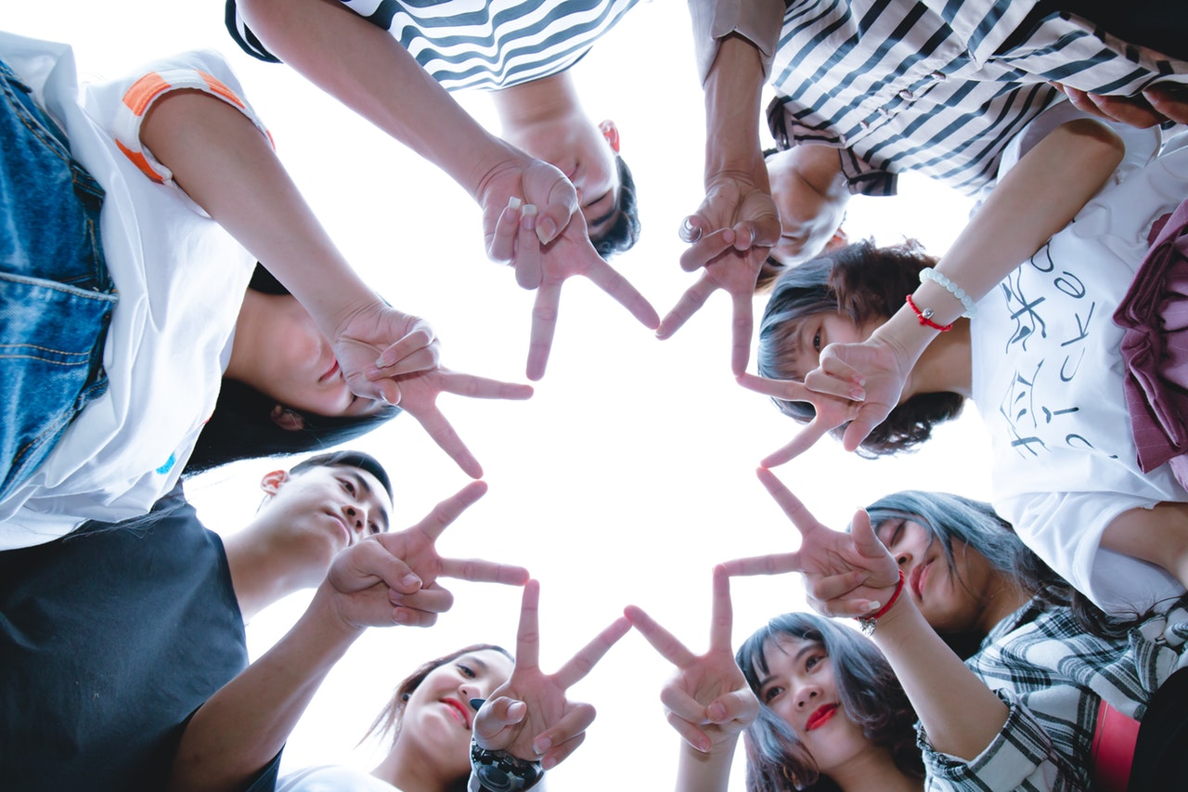
We are the world.
We are the children.

Slide 26
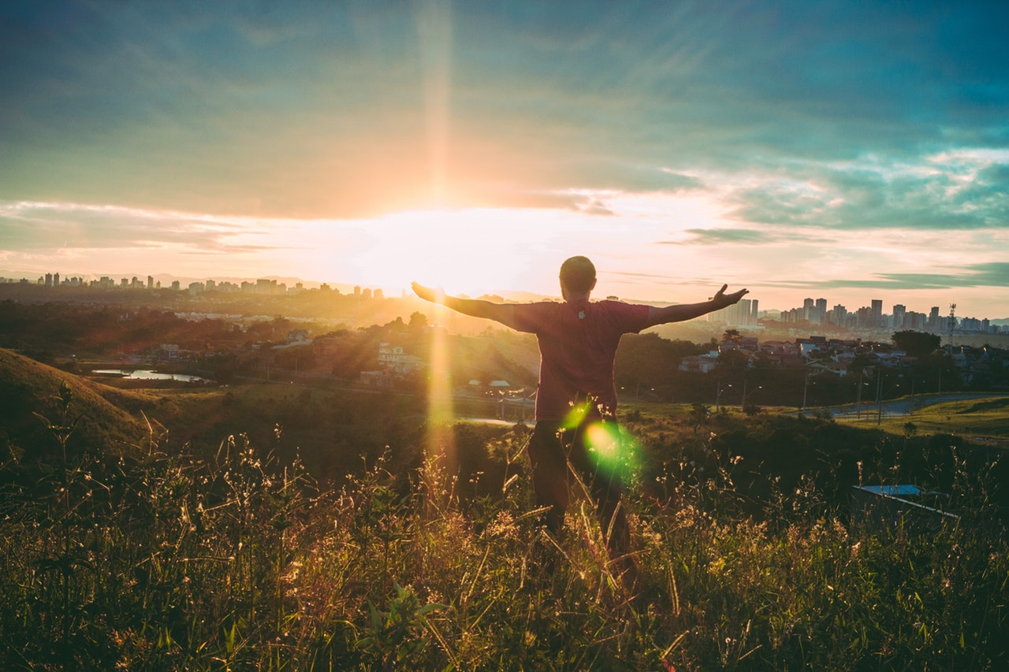
We are the ones who make a brighter day.
So let's start giving.

Slide 27
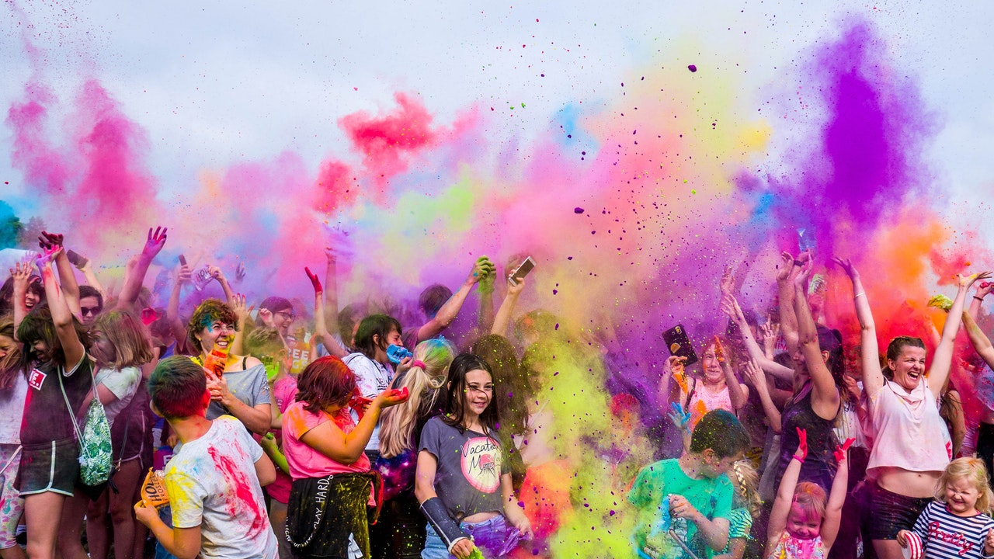
But there's a chance we're taking.
We're taking our own lives.

Slide 28
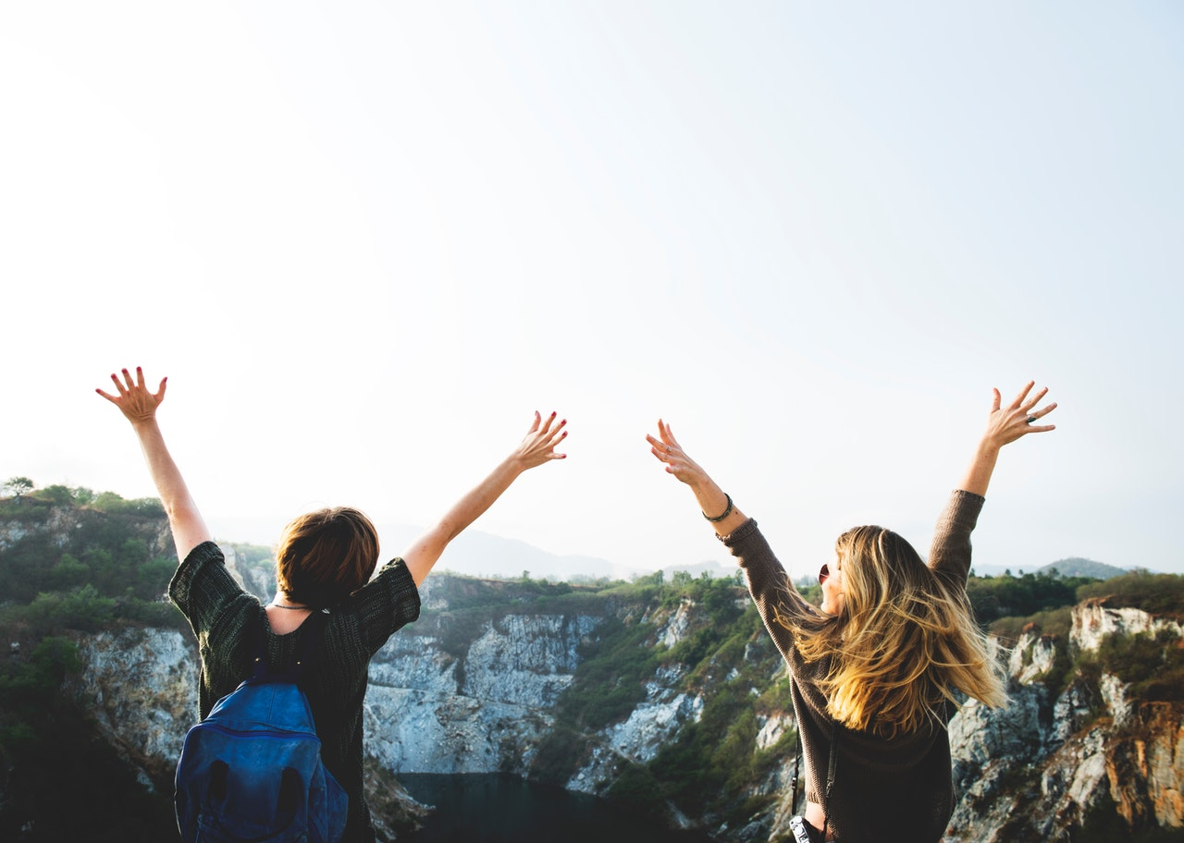
It's true we'll make a brighter day just you and me.

Slide 29
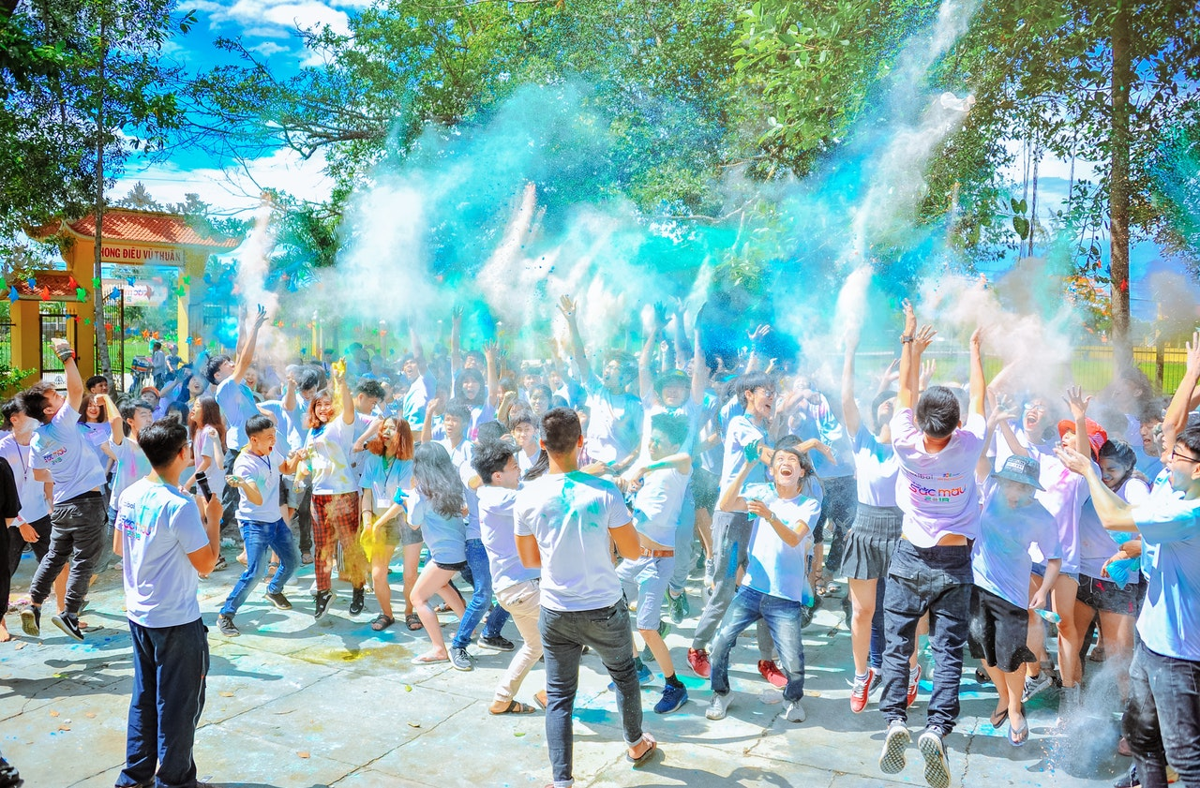
We are the world.
We are the children.

Slide 30
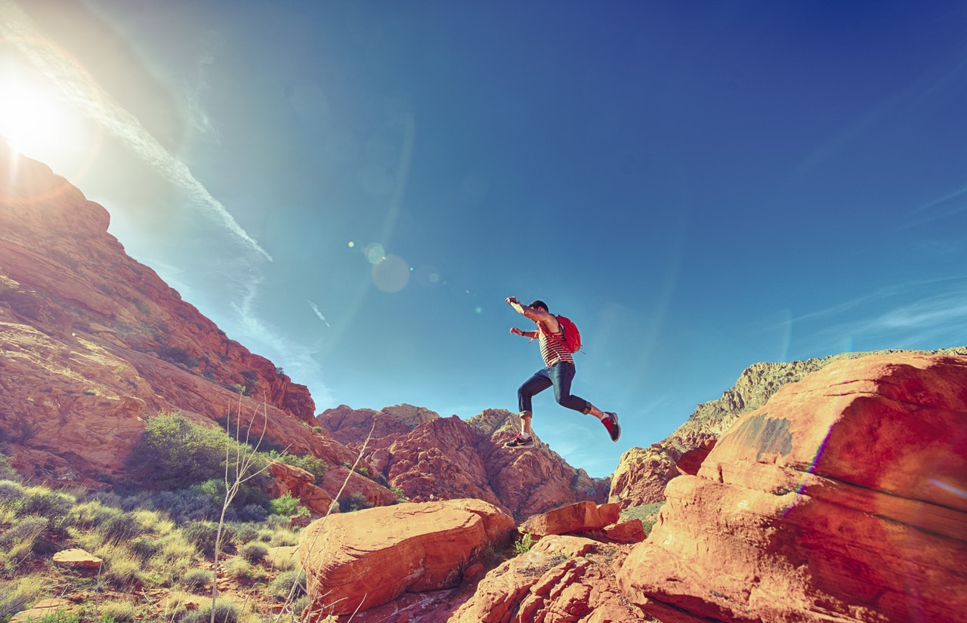
We are the ones who make a brighter day.
So let's start giving.

Slide 31
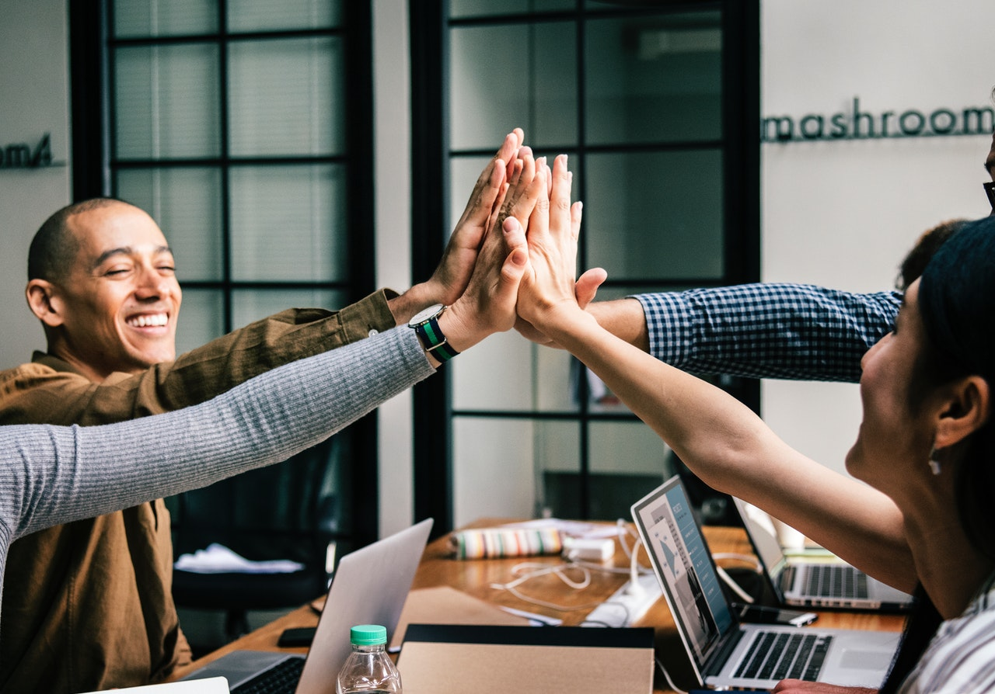
But there's a chance we're taking.
We're taking our own lives.

Slide 32
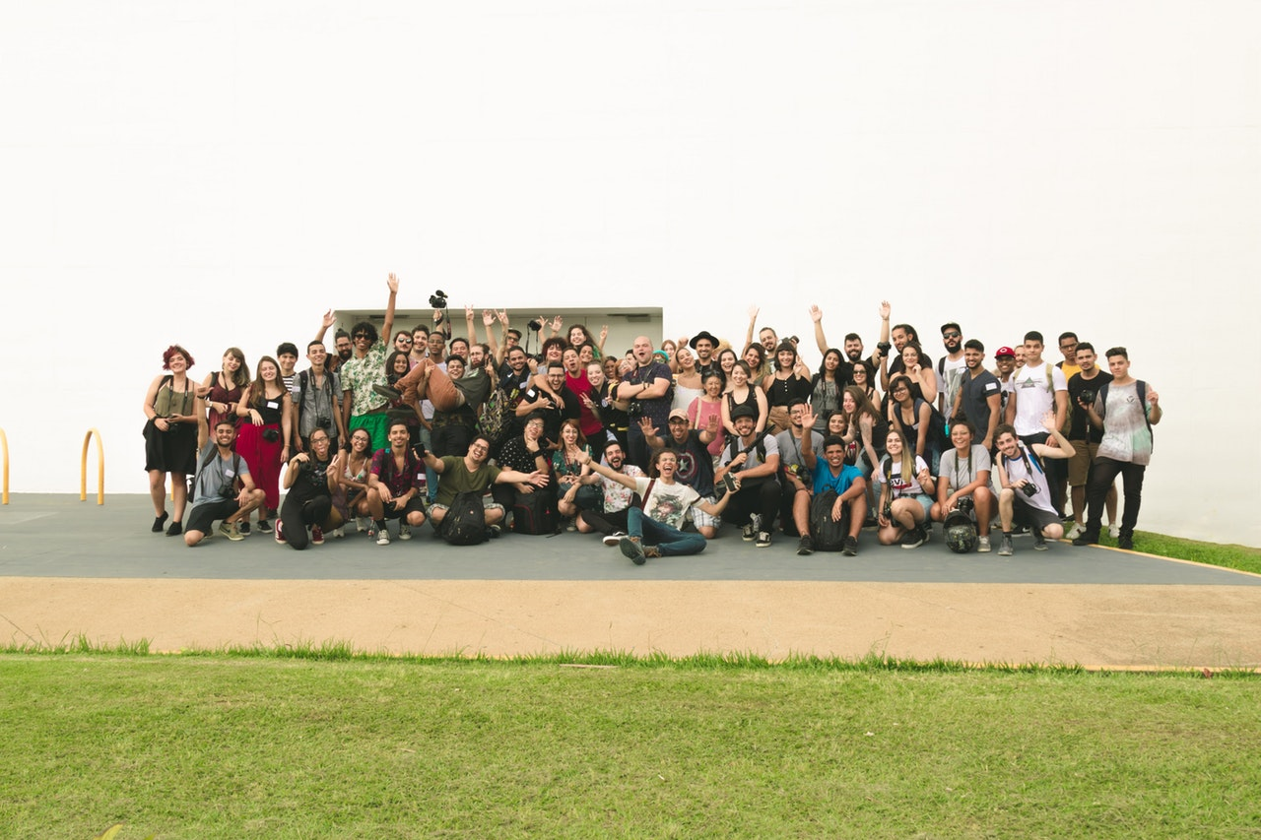
It's true we'll make a brighter day just you and me.

