Slide 1
Some of it
because
when
so
and
or
for
华南师范大学外国语言文化学院 萧伟杰
广东省河源市源城区新江路学校 刘琳
、
but
as
conj.
if
till

Slide 2
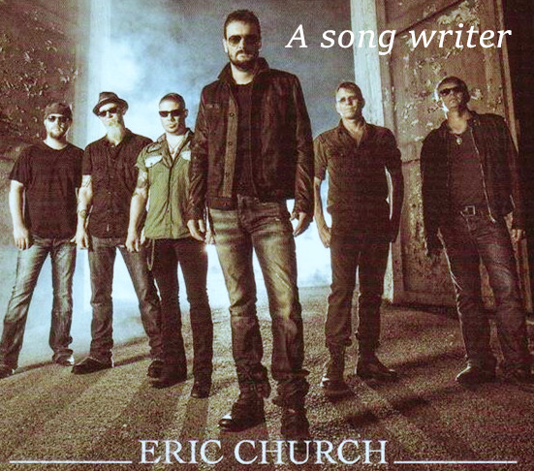

Slide 3
Beer don't keep
Love's not cheap

Slide 4
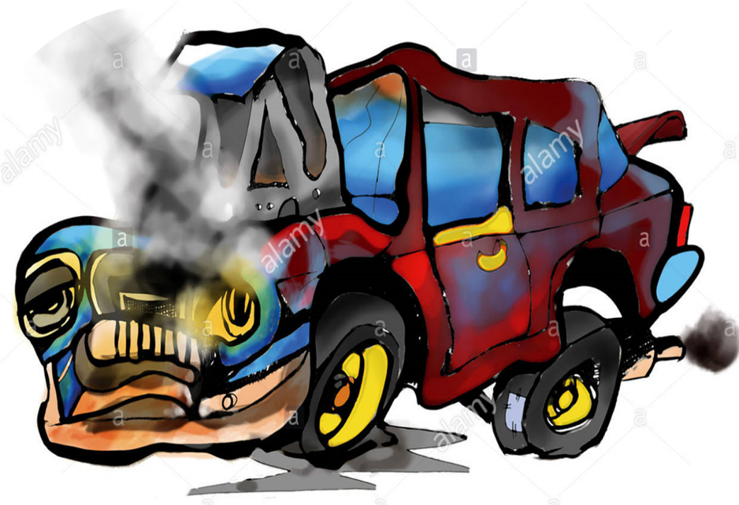
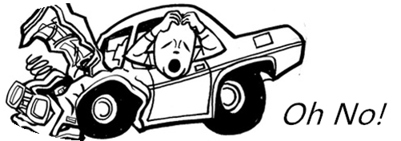
And trucks don't wreck themselves

Slide 5
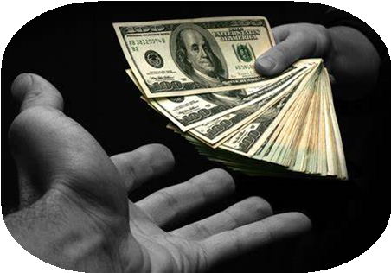
Mama ain't a shrink
Daddy ain't a bank

Slide 6
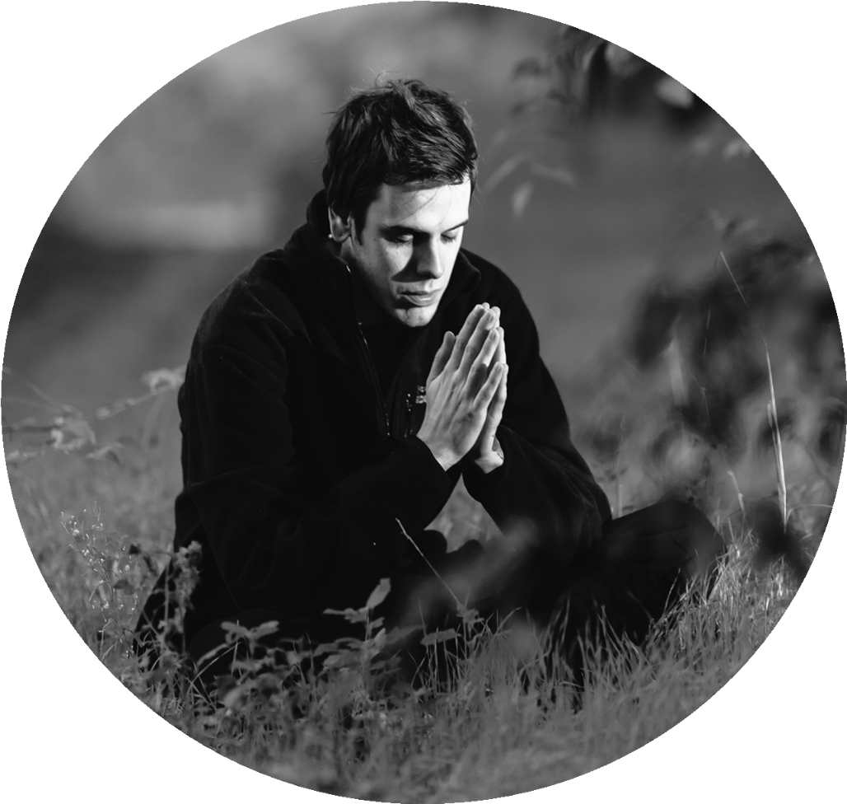
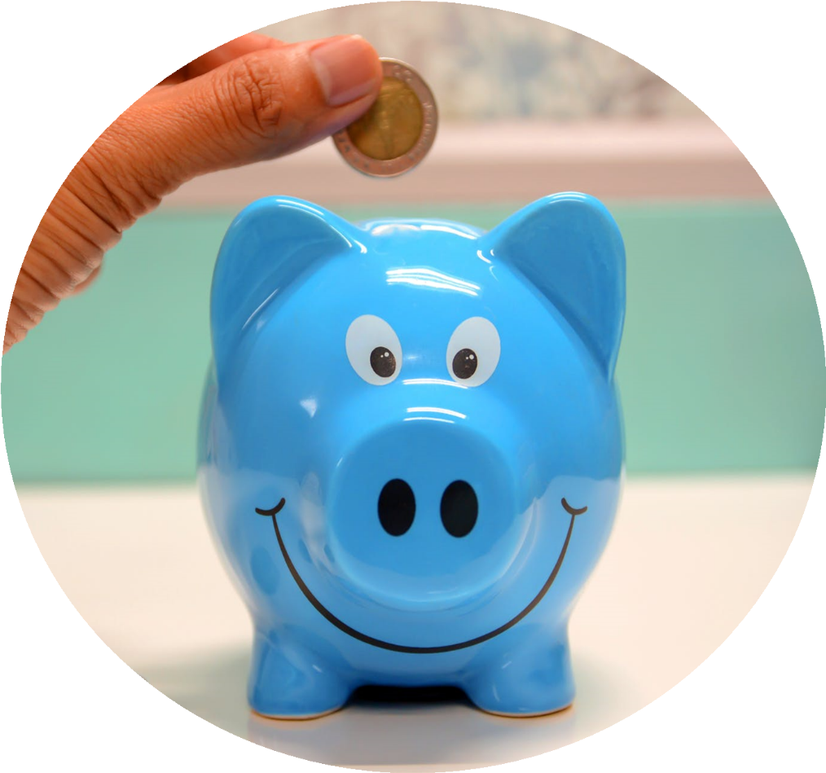
And God ain't wishin' well
Money ain't rich

Slide 7
Everybody sins
And nobody wins in a fight
Notes:
4S

Slide 8
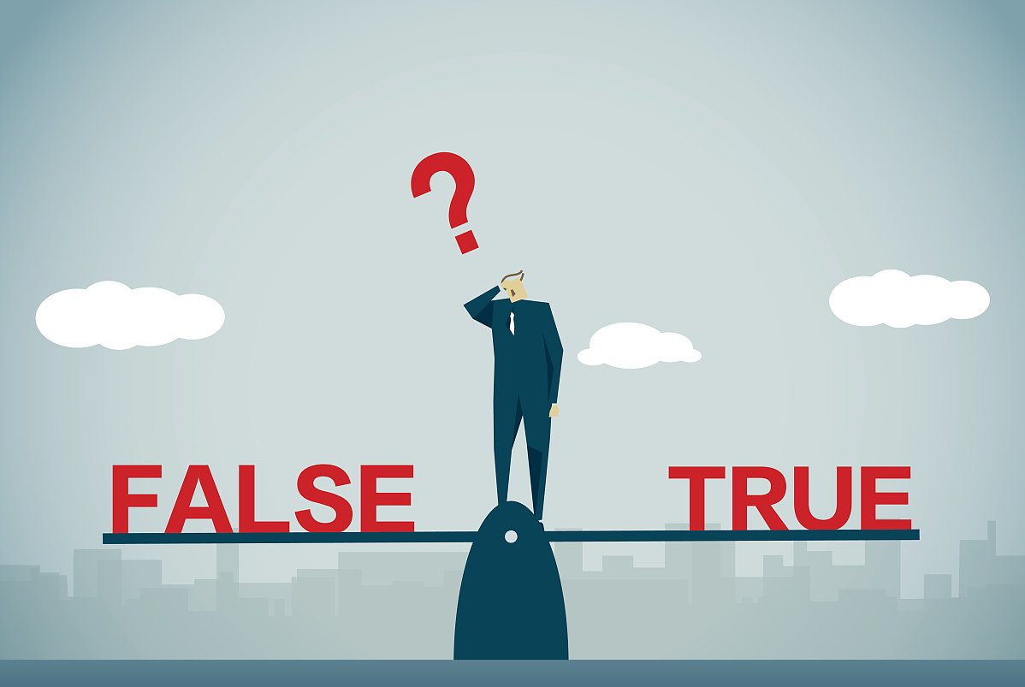
And sometimes wrong is right

Slide 9
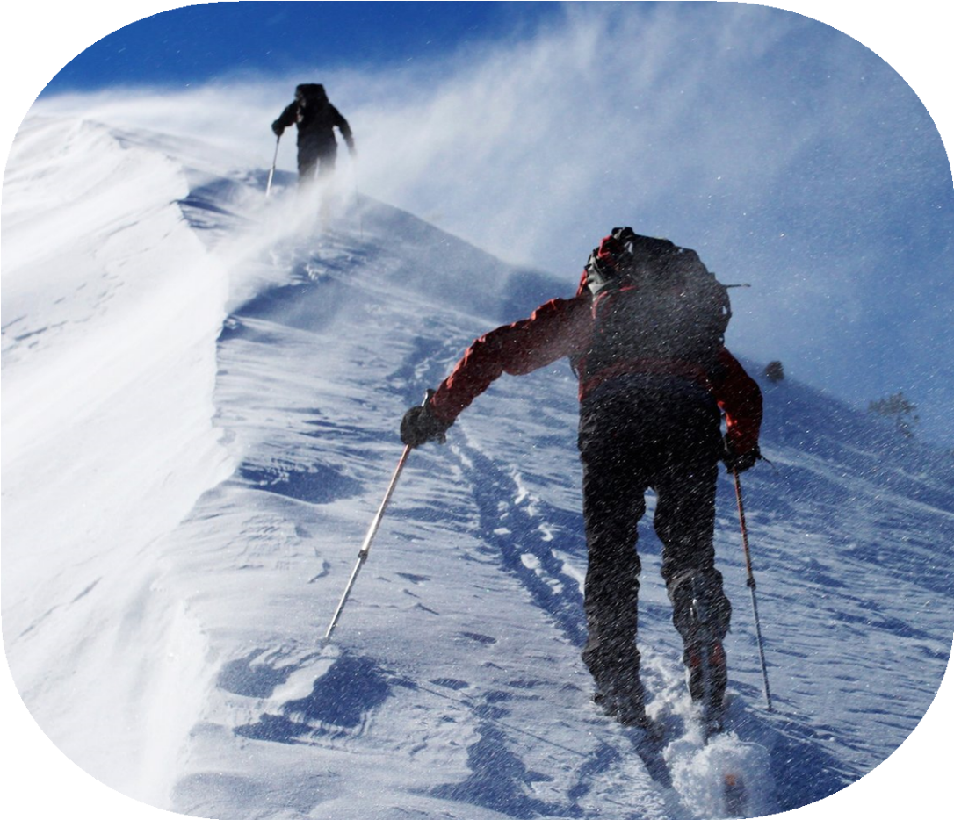
Some of it you learn the hard way
Some of it you read on a page
Some of it
comes from heartbreak
Notes:
32-44

Slide 10
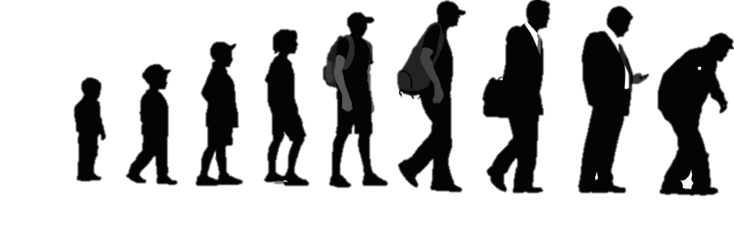
Most of it
comes with age

Slide 11
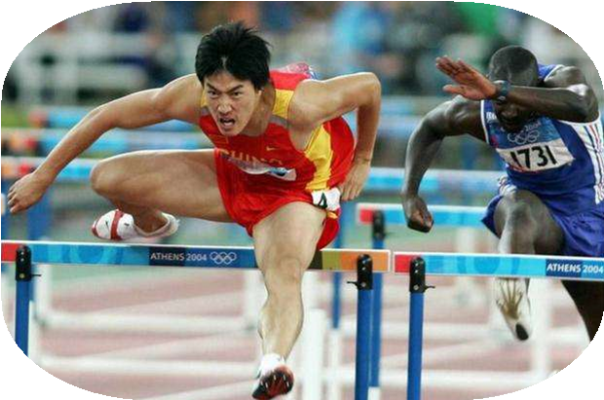
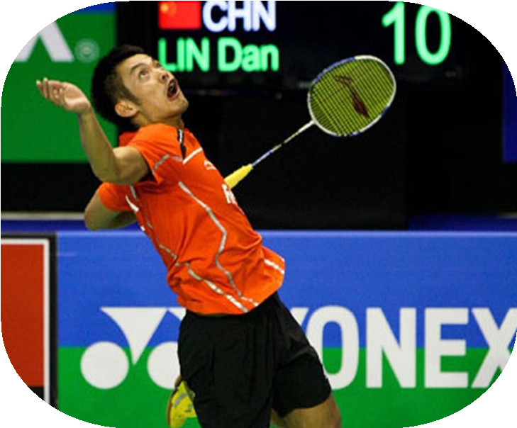
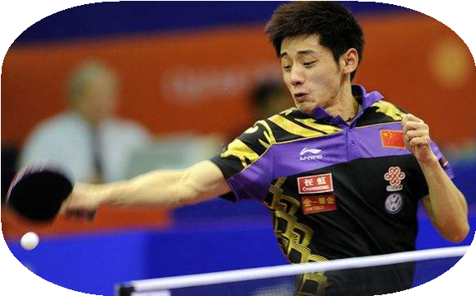
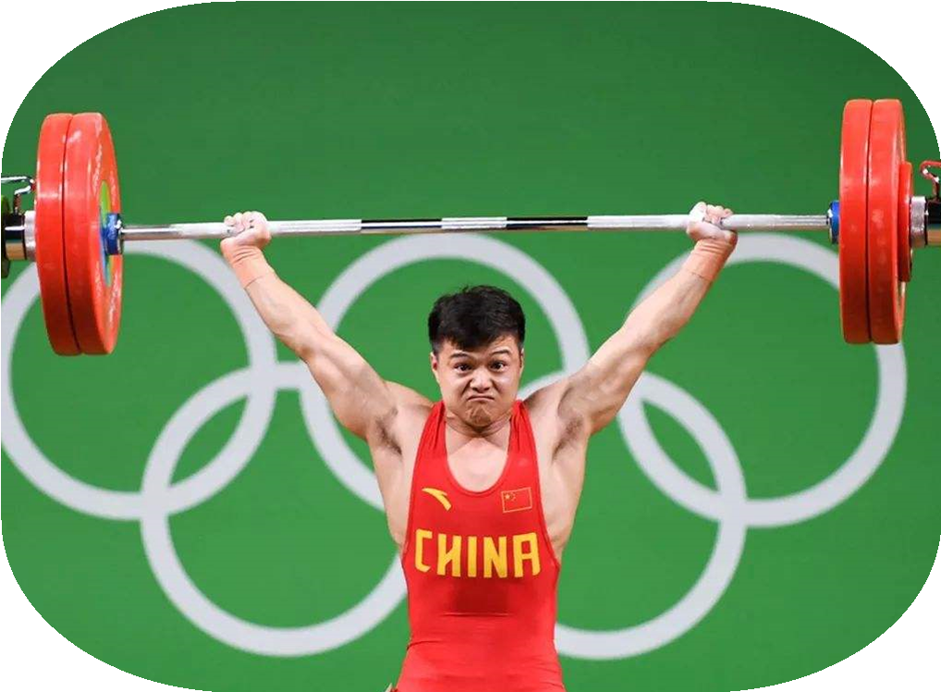
And none of it ever comes easy
A bunch of it you maybe can't use

Slide 12
I know I don't probably know
what think I do
But there’s something to
some of it

Slide 13
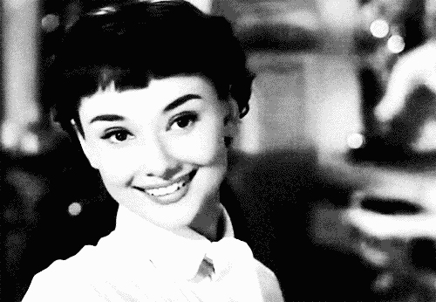
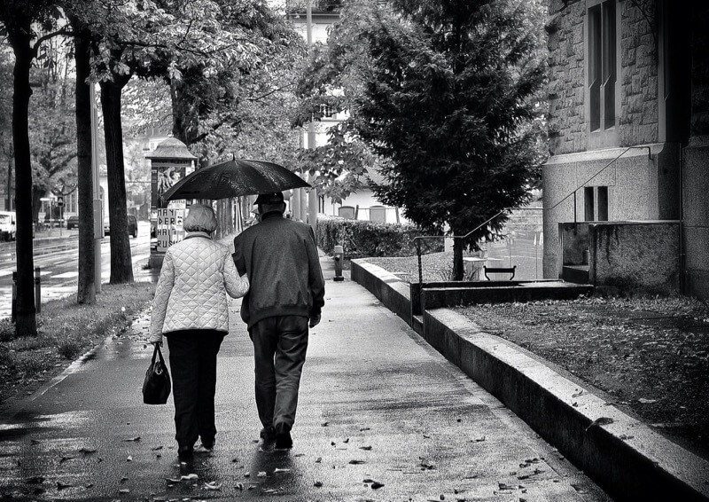
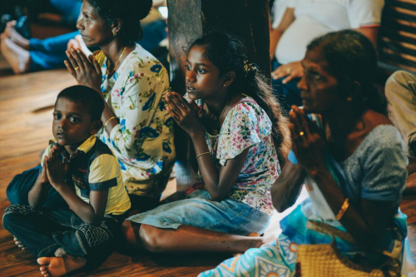

Slide 14
Girls like to laugh
Tears don't last

Slide 15
And scared's what prayings for
If it's close swing the bat

Slide 16
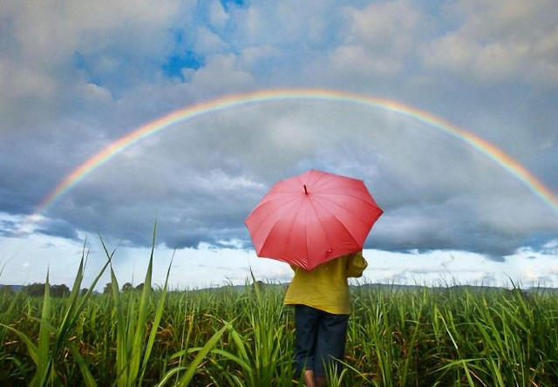
Everybody's gotta pass
And love's worth living for

Slide 17
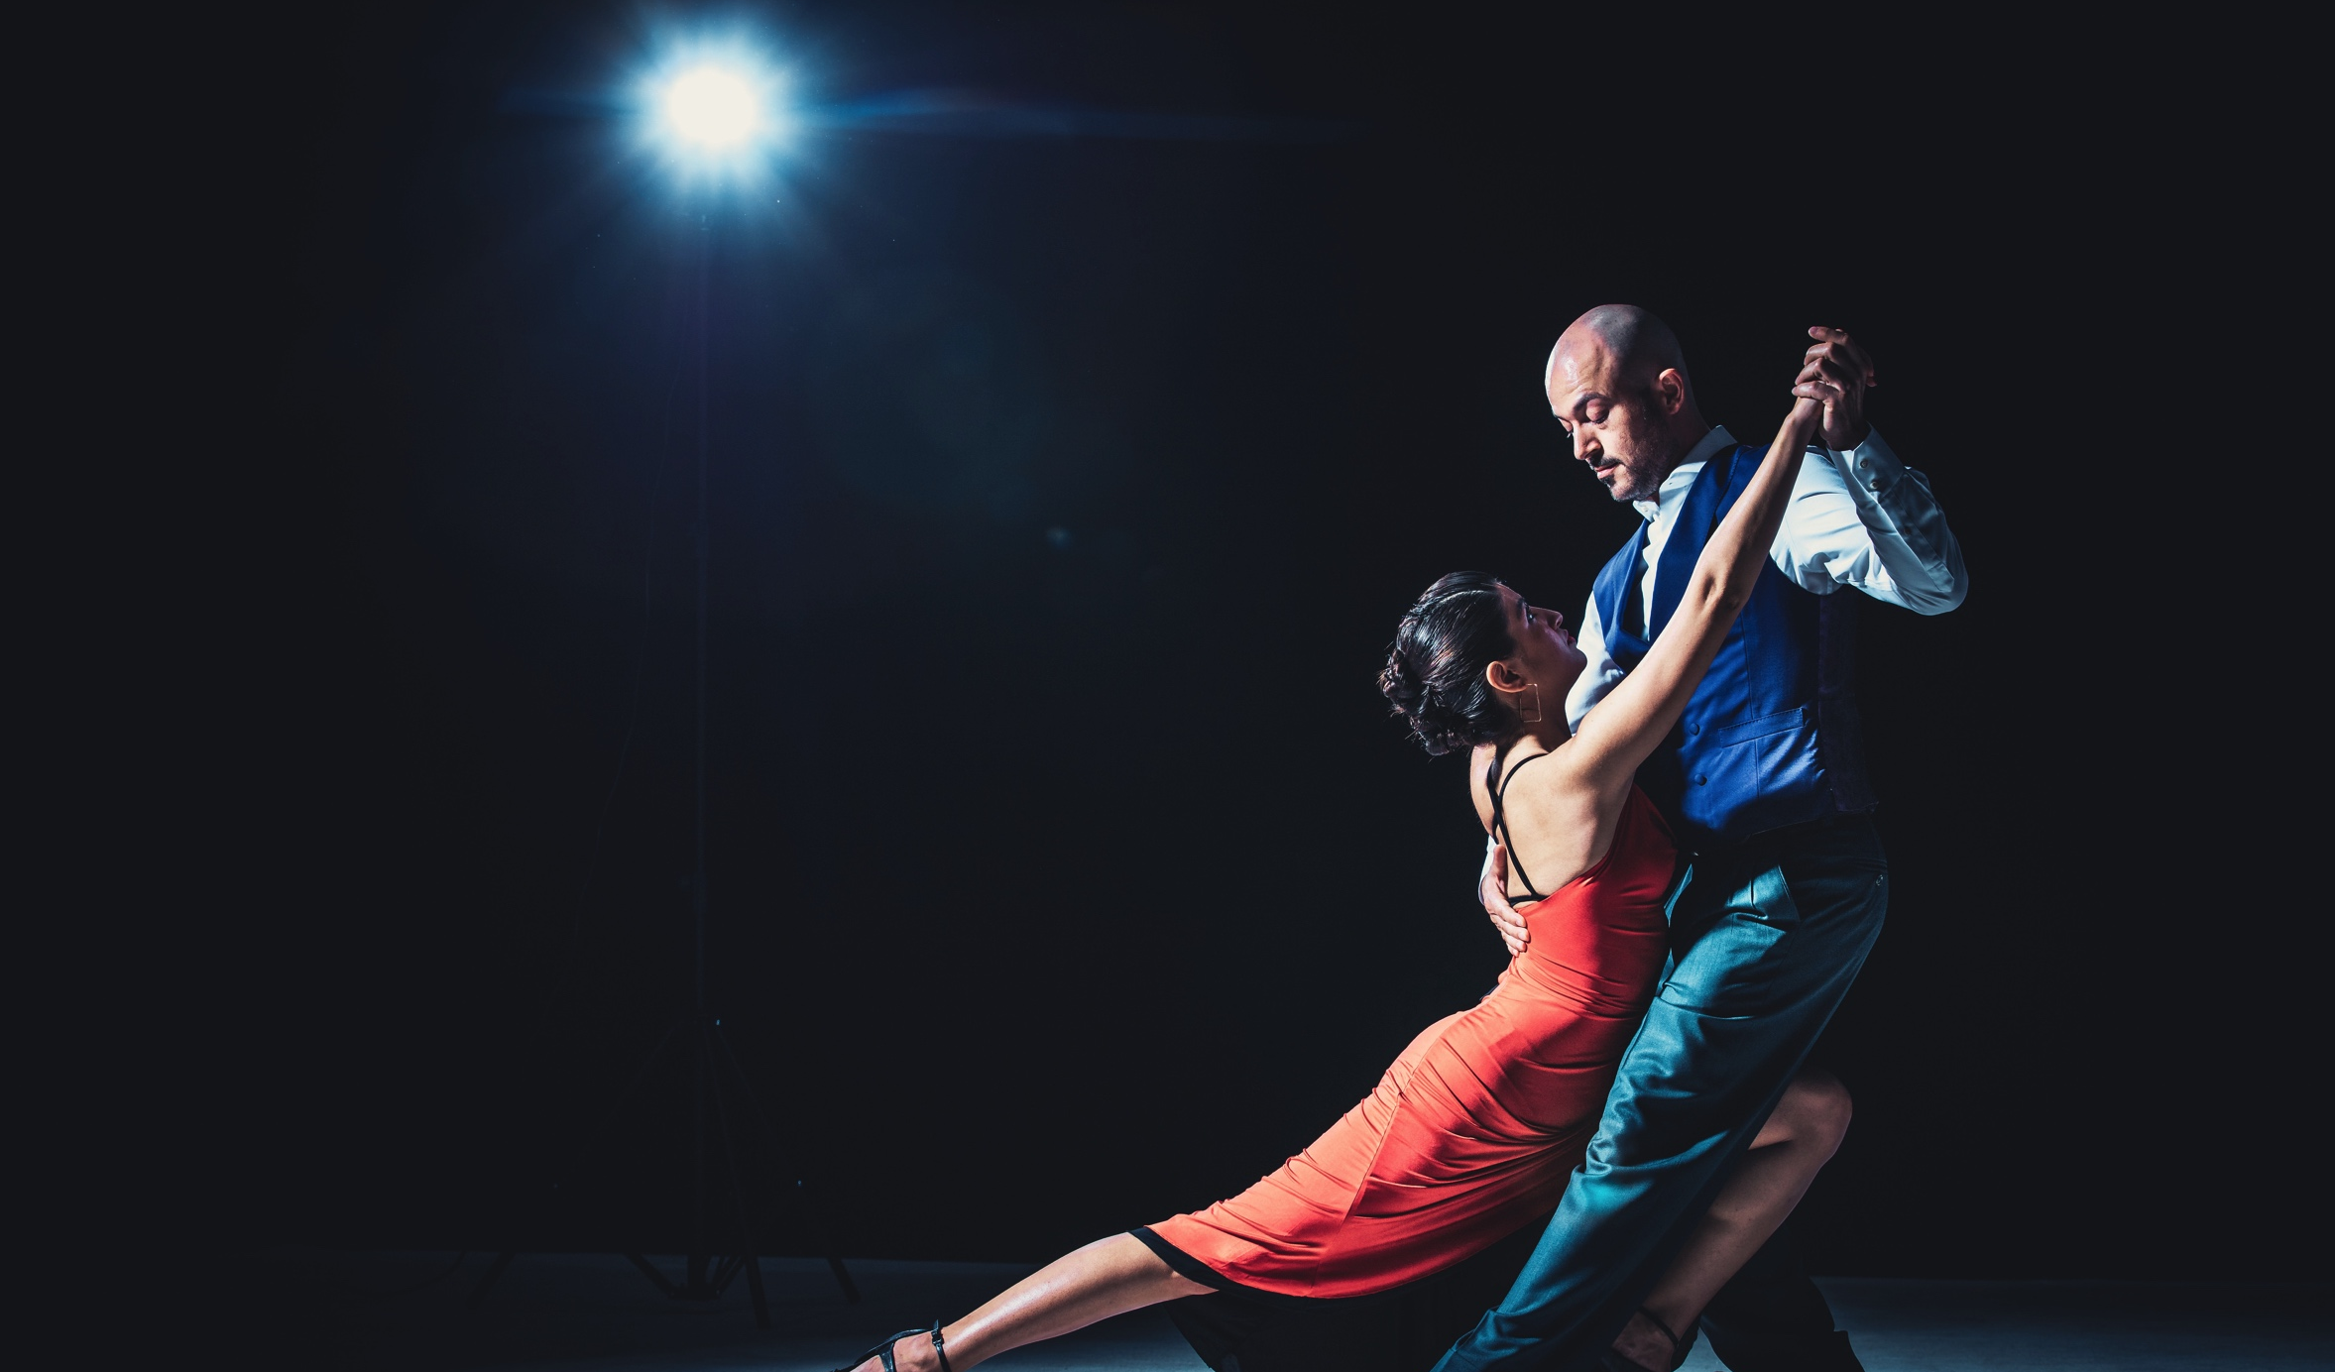
When you dance hold her close
Tell the brakes go for broke
Be the first to reach for her hand

Slide 18
No you don't get to do some things again

Slide 19
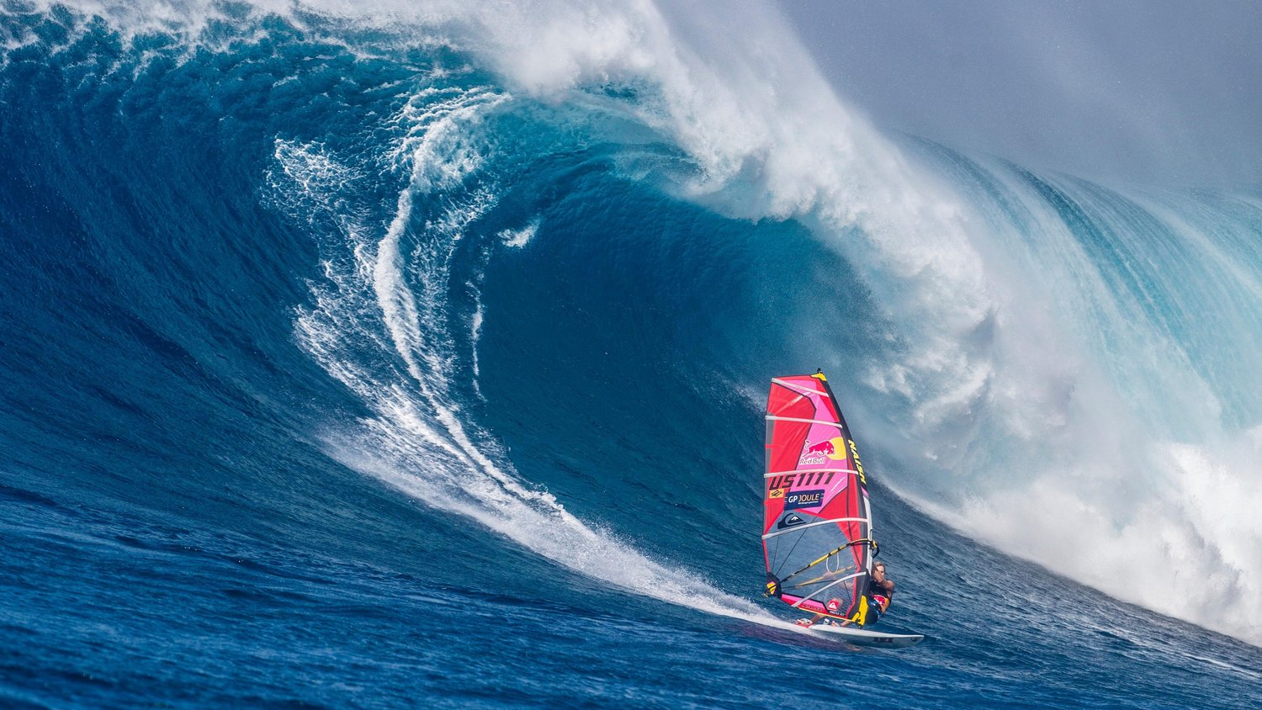
Some of it you learn the hard way
Some of it you read on a page
Some of it comes from heartbreak

Slide 20
Most of it
comes with age

Slide 21
And none of it ever comes easy
A bunch of it you maybe can't use

Slide 22
I know I don't probably know
what think I do

Slide 23
But there's something' to
Some of it

Slide 25
When you can’t take it slow
Cause time sure won’t

Slide 26
What really makes you a man
Is being true to her Til your glass runs out of the same

Slide 27
Some of it you learn the hard way
Some of it you read on a page
Some of it
comes from heartbreak
Notes:
32-44

Slide 28
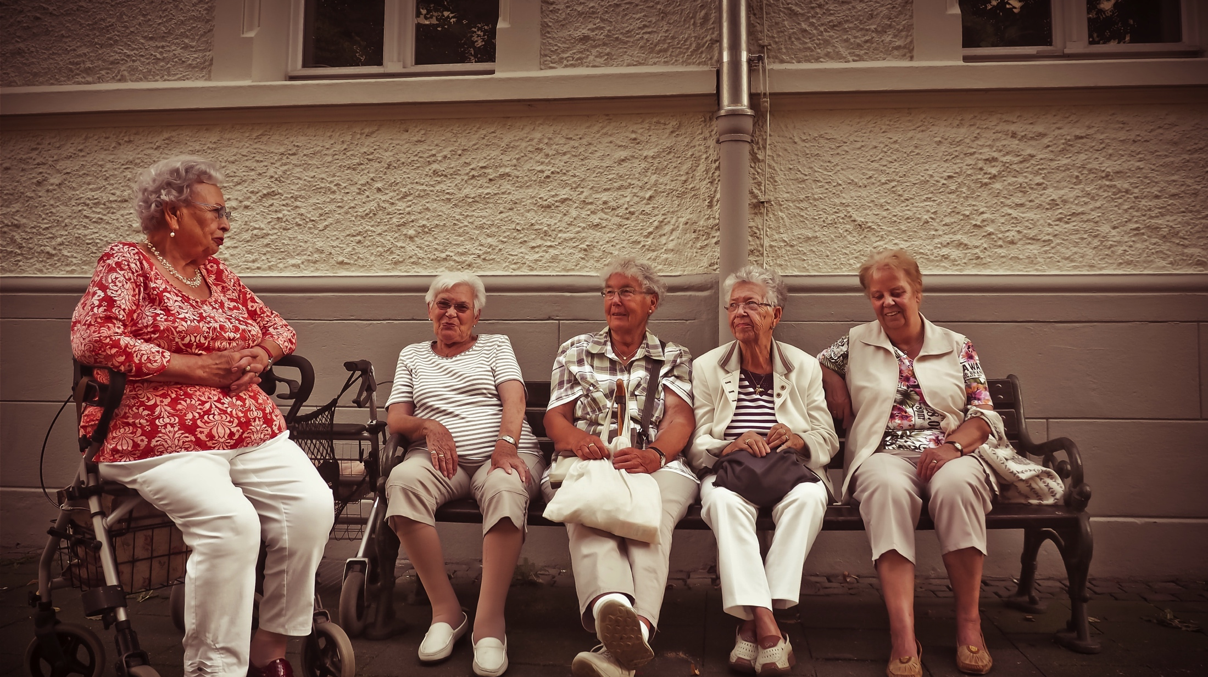
Most of it
comes with age

Slide 29
And none of it ever comes easy
A bunch of it you maybe can't use

Slide 30
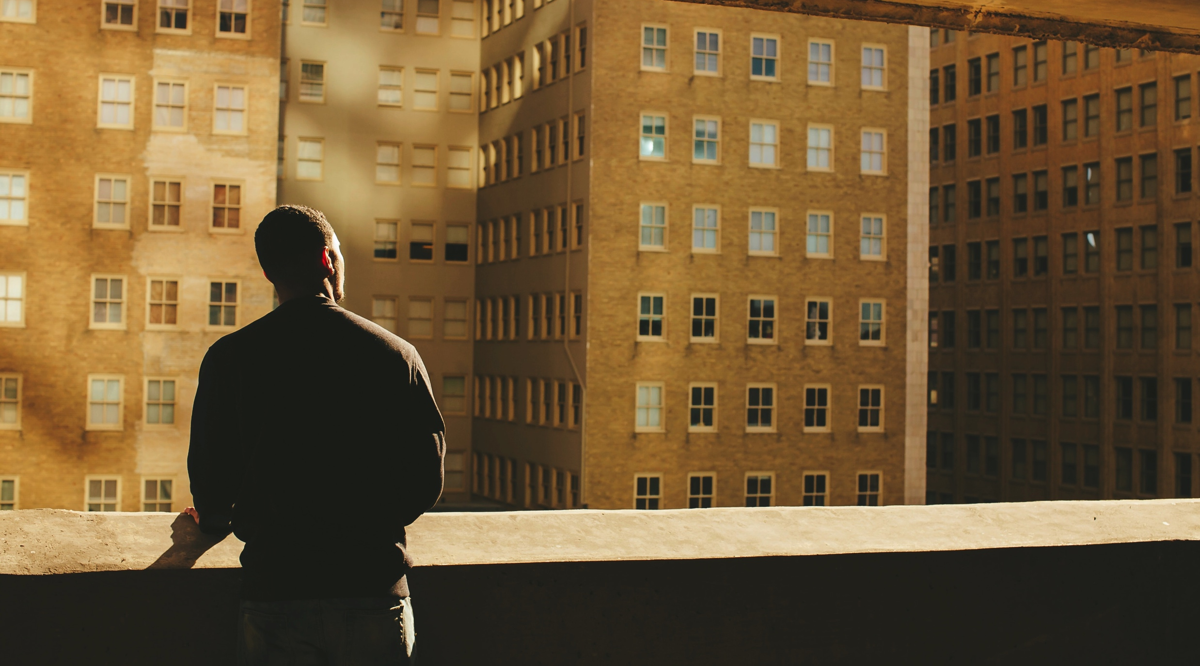
I know I don't probably know
what think I do

Slide 31
But there's something' to
Some of it

Slide 32
Some of it

