Slide 1
Song: Five Hundred Miles
Grammar: Numeral
华南师范大学外国语言文化学院 吴钰
广东省河源市雅居乐中学 吴美娟

Slide 2
Numeral

Slide 3
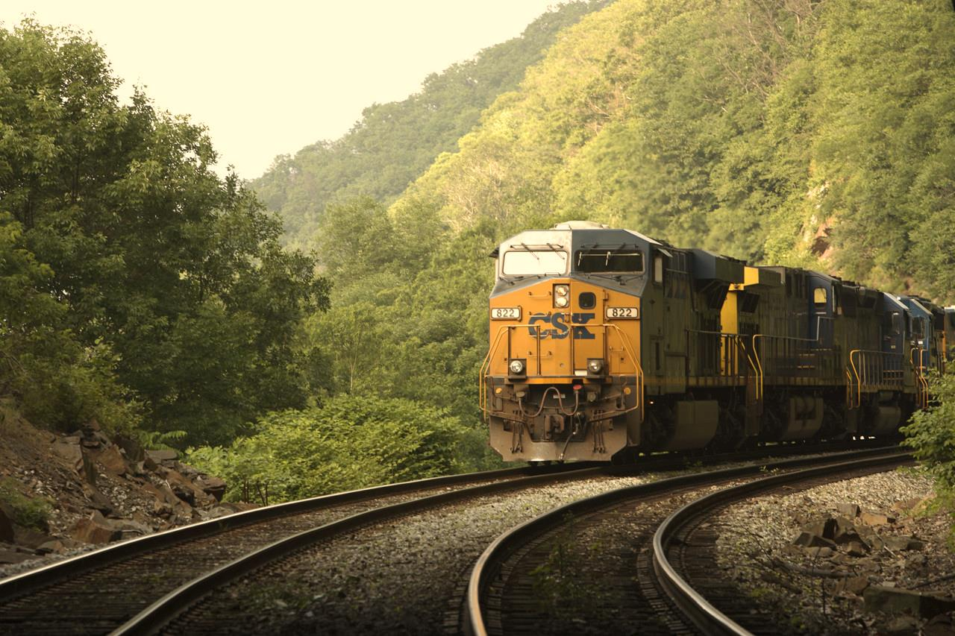
If you miss the train I’m on…

Slide 4
You will know that I am gone

Slide 5
You can hear the whistle blow miles
a hundred

Slide 6
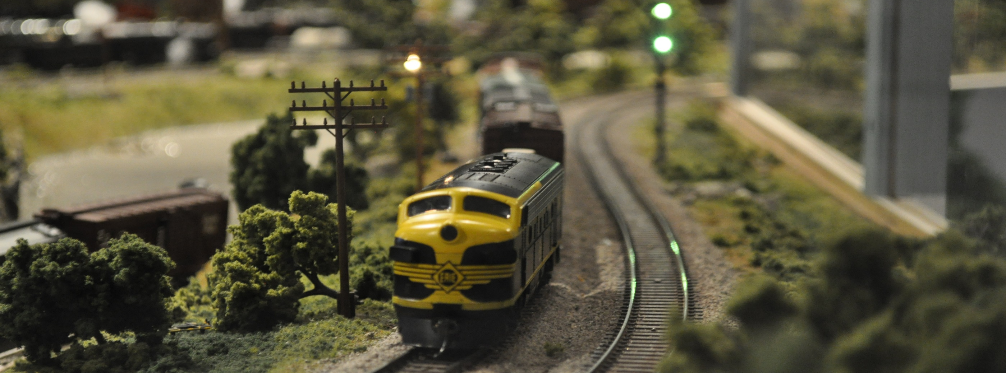
A hundred miles, A hundred miles
A hundred miles, A hundred miles

Slide 7
You can hear
the whistle blow
a hundred miles.

Slide 8
Lord, I’m four,
Lord, I’m one,
Lord, I’m two,
Lord, I’m three,

Slide 9
Lord, I’m miles away from home
five hundred

Slide 10
Away
from
home
Away
from
home
Away
from
home
Away
from
home

Slide 11
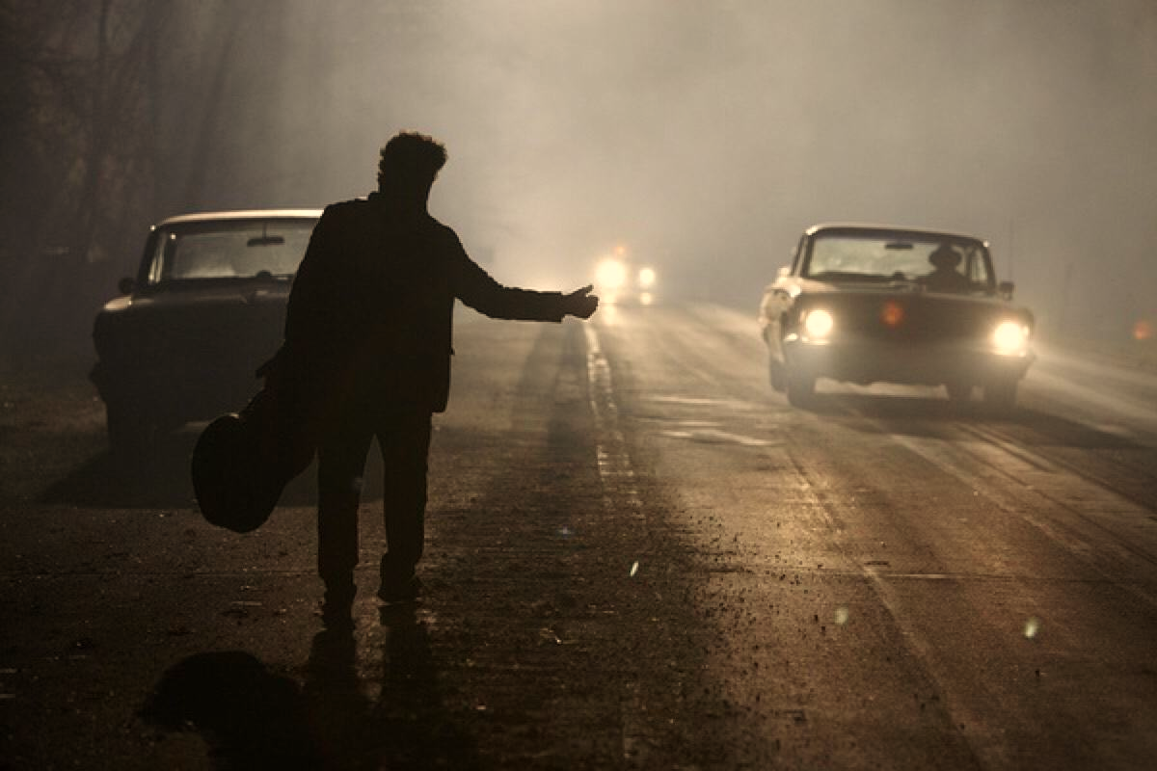
Lord, I’m five hundred miles away from home

Slide 12
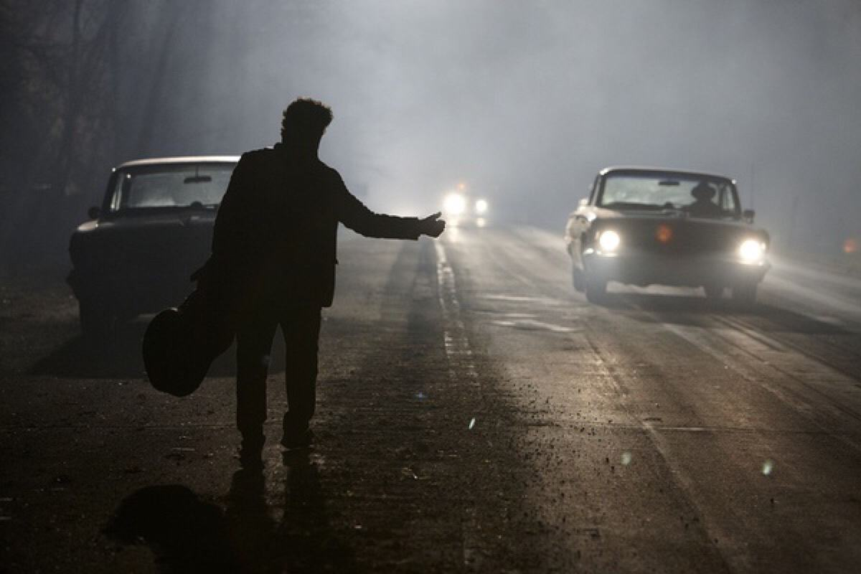
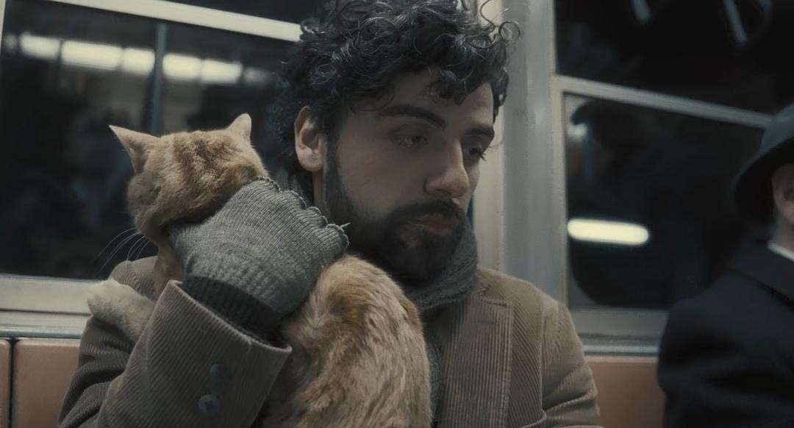

Slide 13
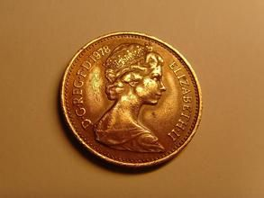
Not a shirt on my back,
not a penny to my name

Slide 14
Lord, I can’t go back home this-a way…

Slide 15
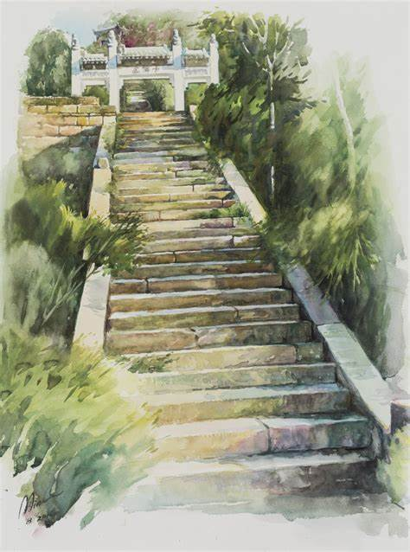
This-a way, this-a way
This-a way, this-a way

Slide 16
Lord, I can’t go back home this-a way

Slide 17
If you miss the train I'm on
You will know that I am gone

Slide 18
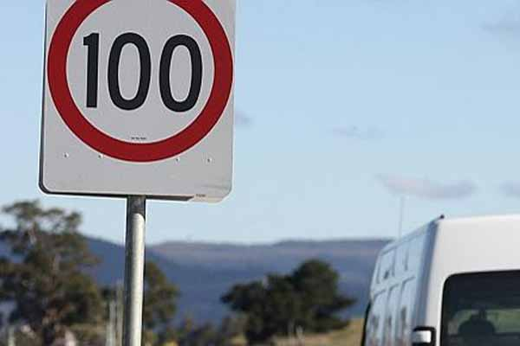
You can hear the whistle blow miles.
a hundred

Slide 19
A hundred miles
A hundred miles
A hundred miles
A hundred miles

Slide 20
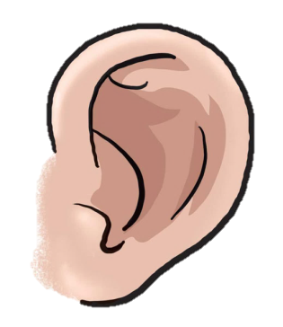
You can hear the whistle blow
a hundred miles

Slide 21
You can hear the whistle blow a hundred miles.
You can hear the whistle blow a hundred miles

Slide 22
You can hear the whistle blow miles…
a hundred

