Slide 1
Who we are
Personal pronouns
华南师范大学外国语言文化学院 钟佳玲
河源市光明双语学校 严锦玲

Slide 5
I don't know where the clouds are going.

Slide 6
They left but the sun is showing light beams on my skin.

Slide 7
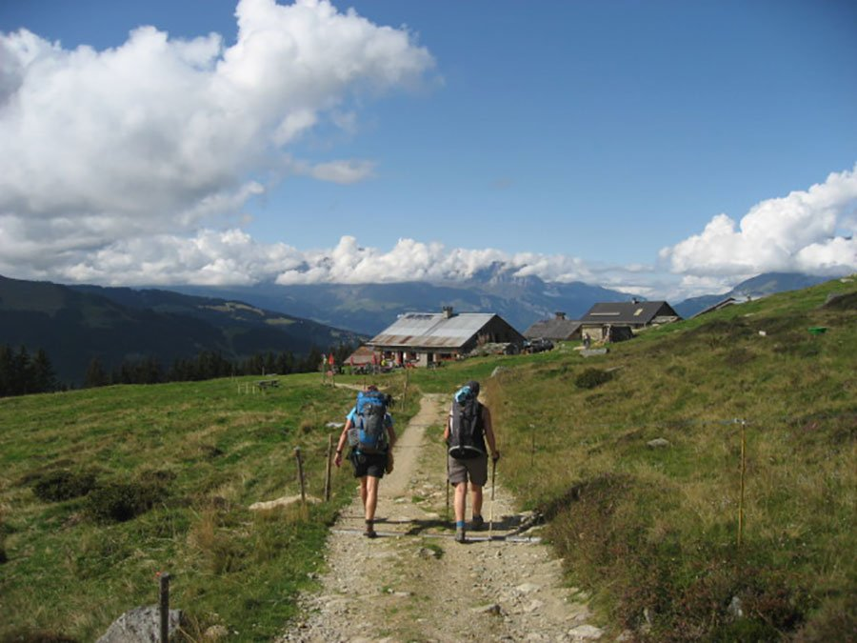
Let's(let us) keep moving on to the beat.

Slide 8
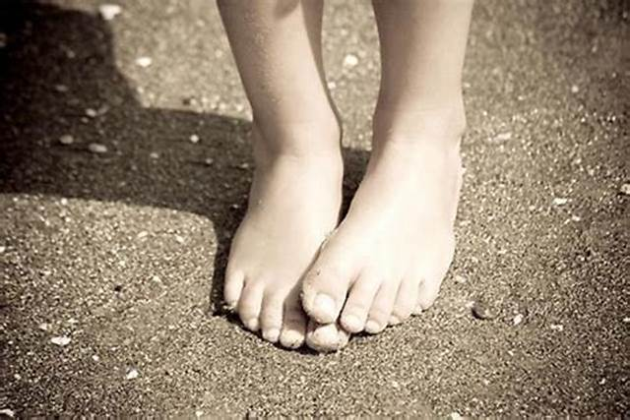
Open mind, dirty feet.

Slide 9
This is what we need.

Slide 10
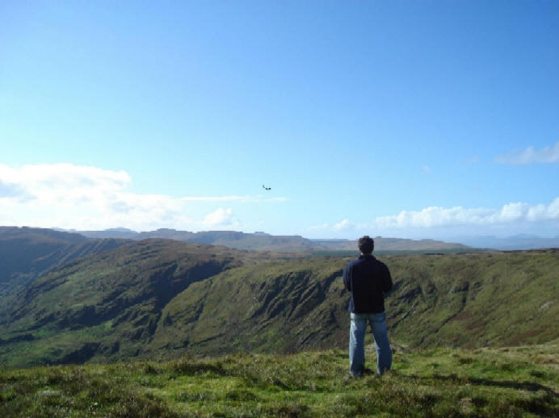
So let's(let us) stay, feel this way

Slide 11
for another perfect day.

Slide 12
A heart of gold within this stone

Slide 13
Let's take it out and make it whole.

Slide 14
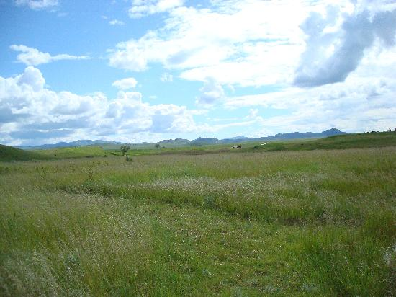
So even though, even though, even though, even though,

Slide 15
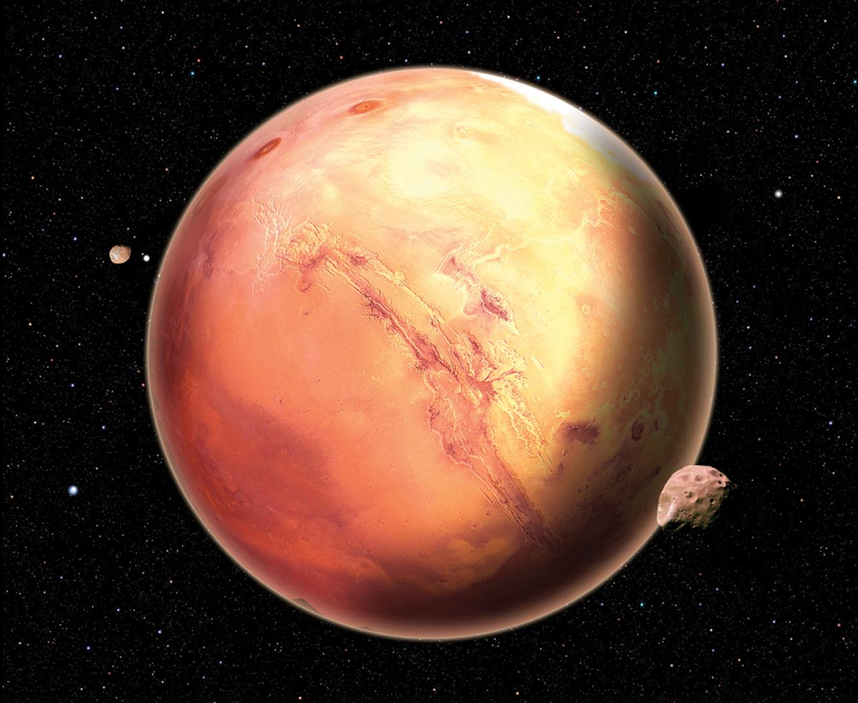
I wanna take you to Mars.

Slide 16
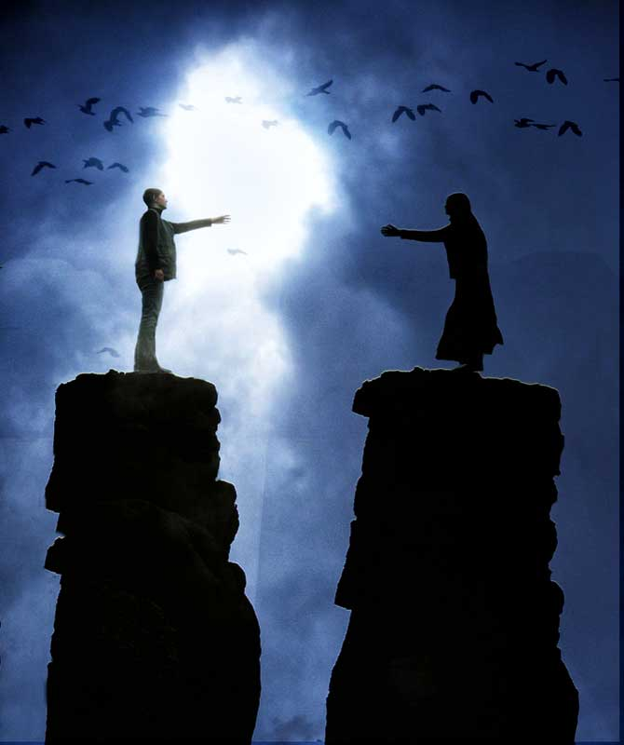
You gotta let it go, let it go, let it go, let it go.

Slide 17
We maybe take it too far but this is who we are.

Slide 18
We maybe take it too far but this is who we are.

Slide 19
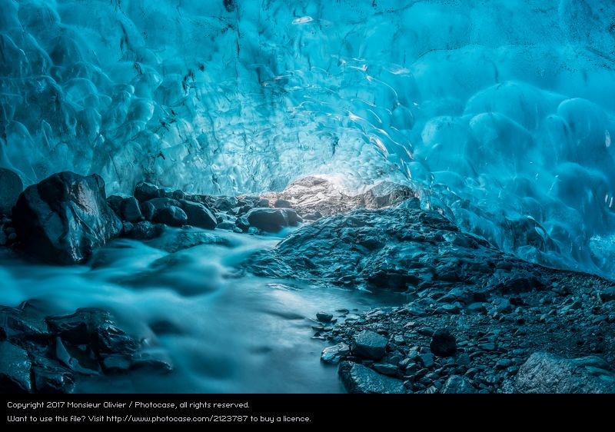
I know a secret place. It's out of time and space, defying gravity.

Slide 20
So let's(let us) keep moving on to the beat.

Slide 21
Open mind, dirty feet.

Slide 22
This is what we need.

Slide 23
I see your smile through the fire or for a perfect little while.

Slide 24
A heart of gold within this stone

Slide 25
Let's take it out and make it whole.

Slide 26
So even though, even though, even though, even though,

Slide 27
I wanna take you to Mars.

Slide 28
You gotta let it go, let it go, let it go, let it go.

Slide 29
We maybe take it too far but this is who we are.

Slide 30
We maybe take it too far but this is who we are.

Slide 31
This is who we are, but this is who we are.

Slide 32
So even though, even though, even though, even though,

Slide 33
I wanna take you to Mars.

Slide 34
You gotta let it go, let it go, let it go, let it go.

Slide 35
We maybe take it too far but this is who we are.

Slide 36
So even though, even though, even though, even though,

Slide 37
I wanna take you to Mars.

Slide 38
You gotta let it go, let it go, let it go, let it go.

Slide 39
We maybe take it too far but this is who we are.

Slide 40
But this is who we are, this is who we are.

