Slide 1
Hello Seattle
Knowledge point：Article
设计者：华南师范大学外国语言文化学院 何勤
广东省河源市源城区宝源中学 李丽青
指导老师：刘晓斌

Slide 2
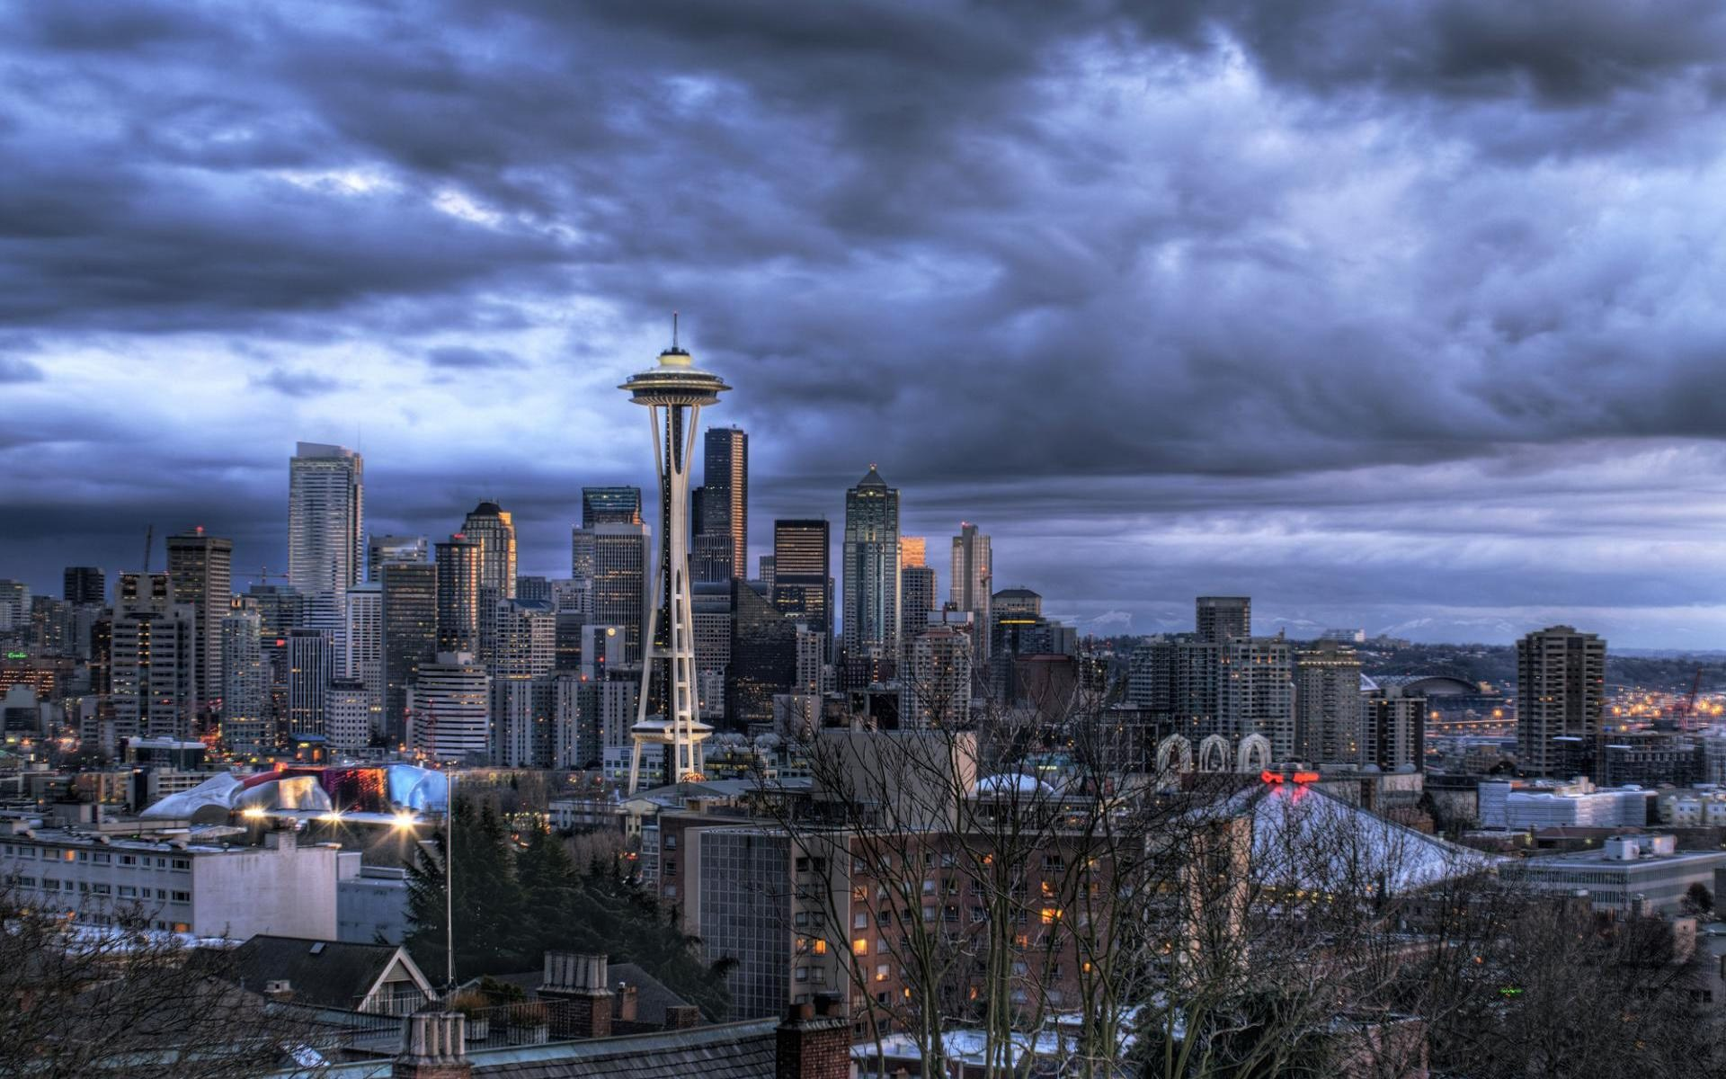
Hello Seattle

Slide 3
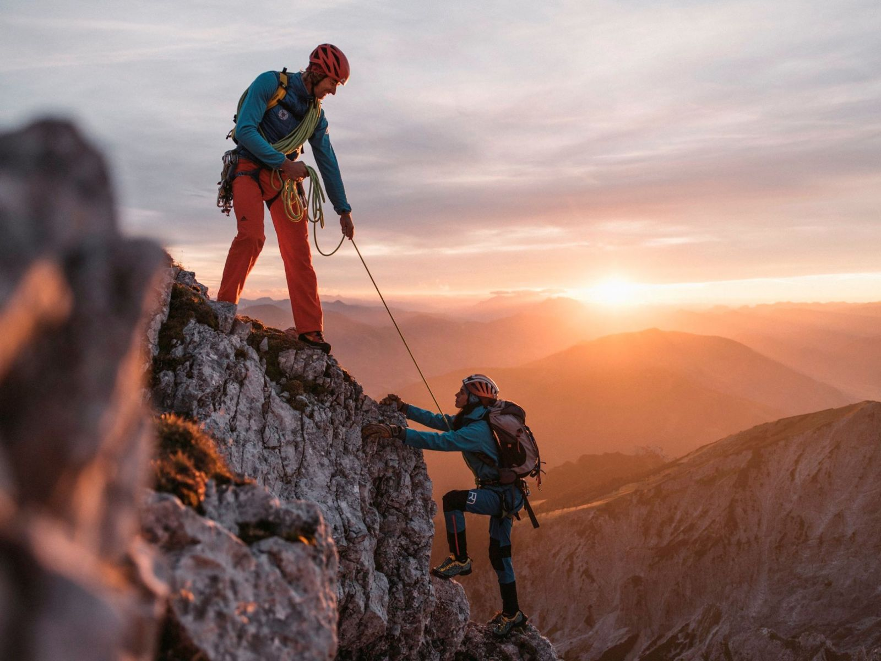
I am a mountaineer
In the hills and highlands

Slide 4
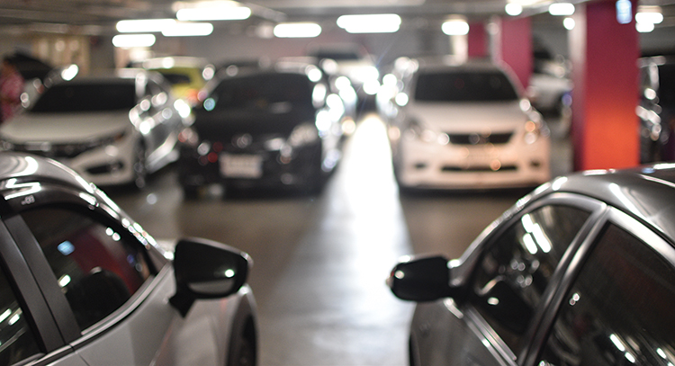
I fall asleep in hospital parking lots
And awake in your mouth

Slide 5
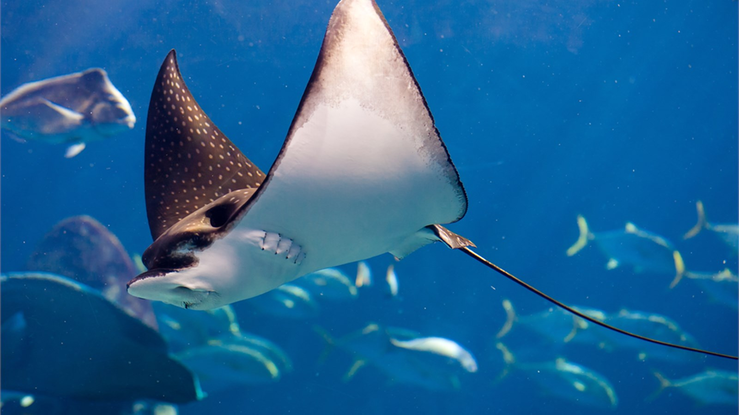
Hello Seattle
I am a manta ray

Slide 6
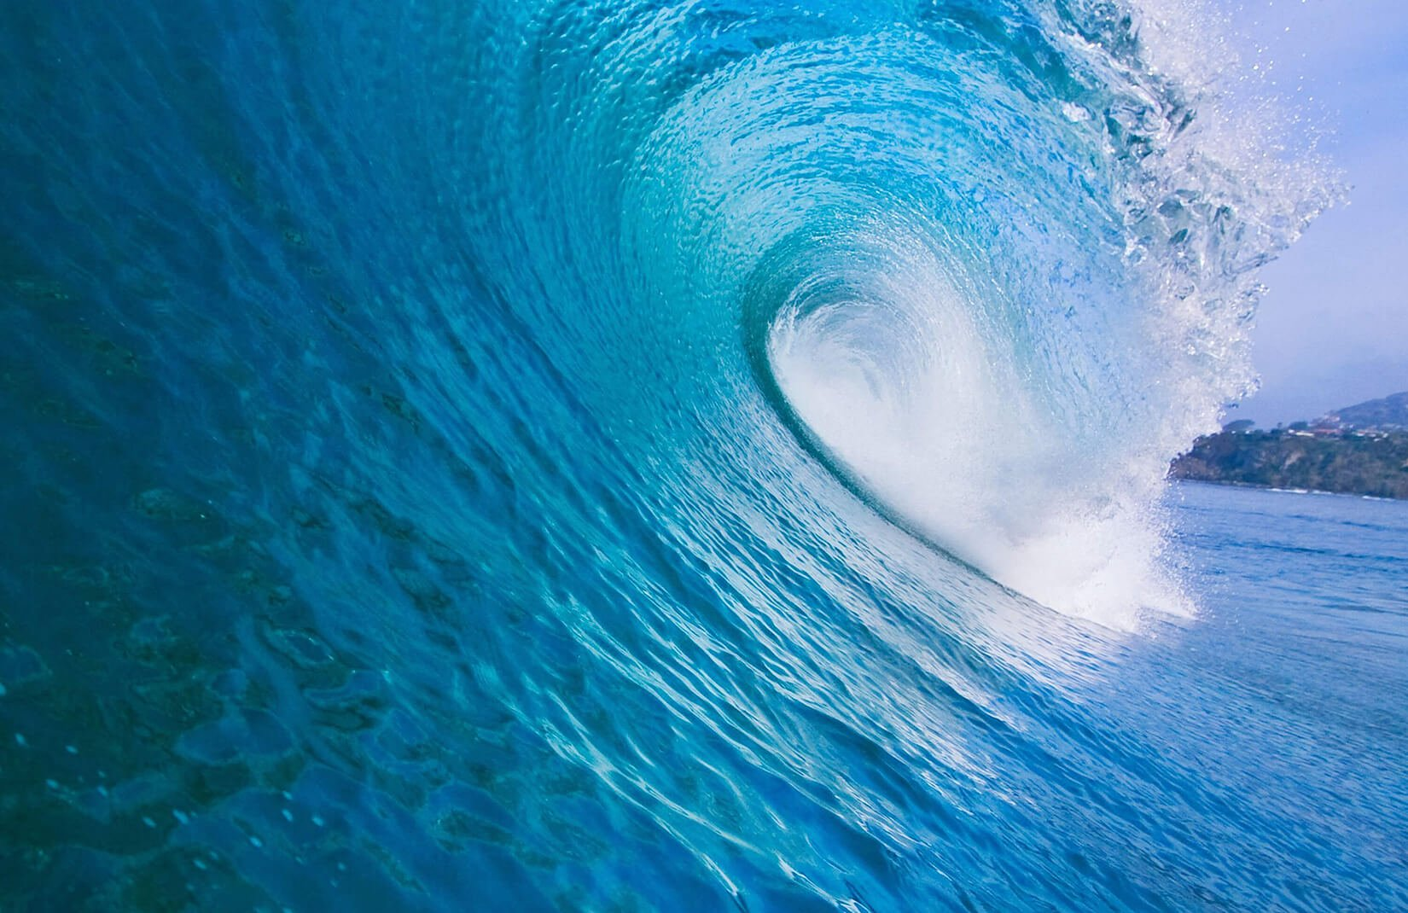
Deep beneath
the blue waves

Slide 7
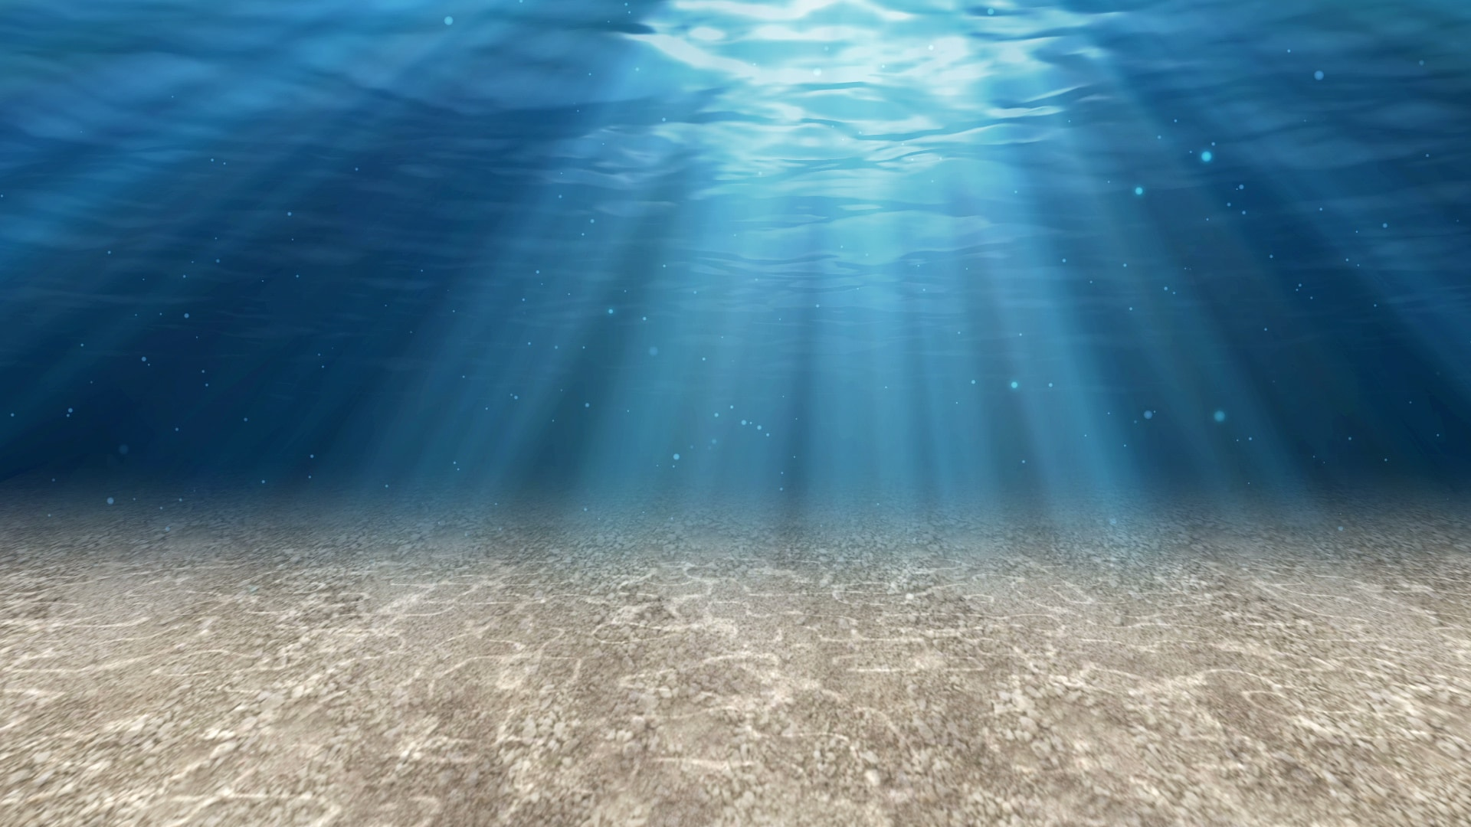
I'll crawl the sandy bottom of Puget Sound
And construct a summer home

Slide 8
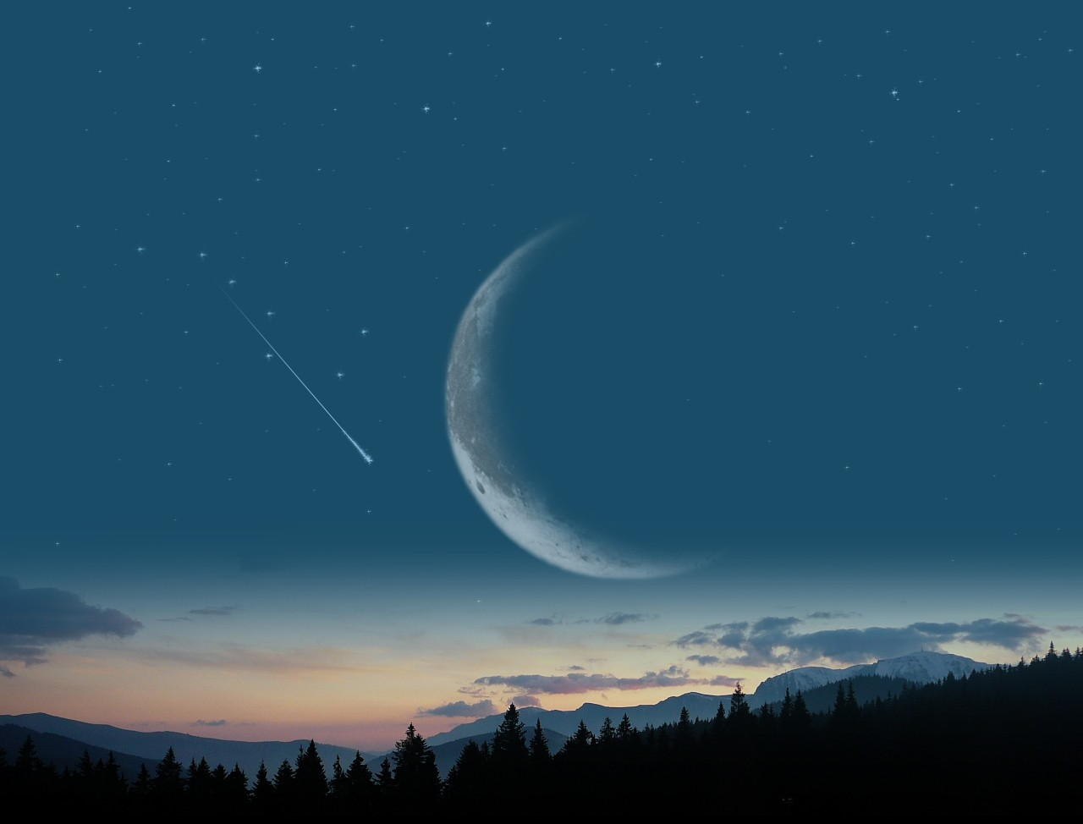
Hello Seattle
I am the crescent moon

Slide 9
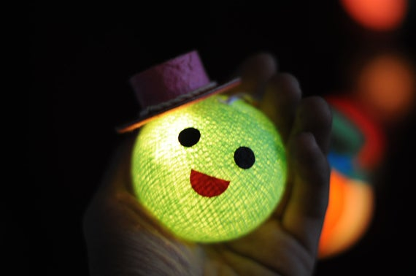
Shining down on your face
[pill

Slide 10
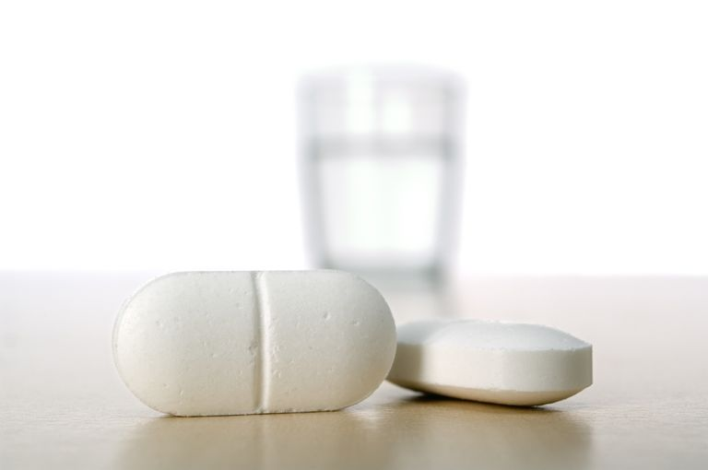
I will disguise myself as a sleeping pill
And construct a summer home

Slide 11
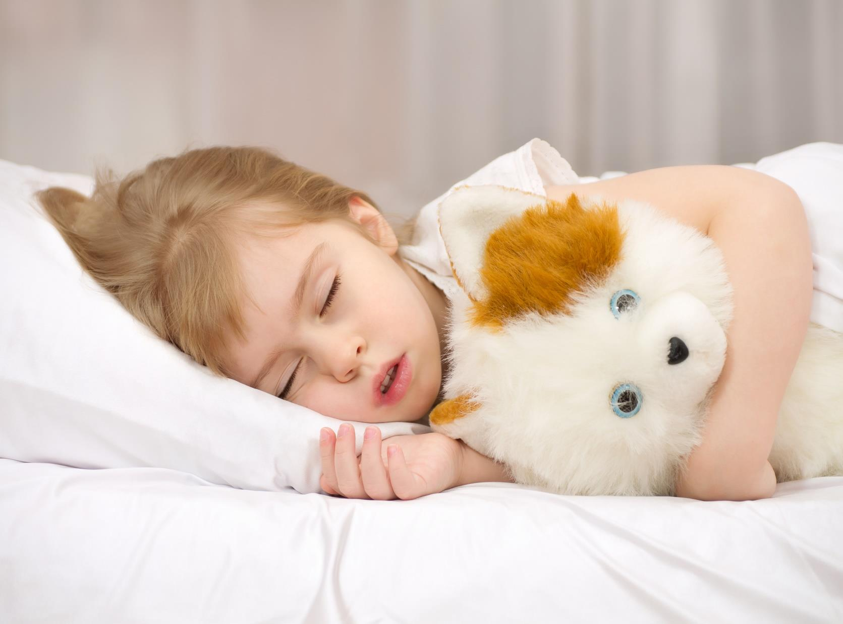
inside of you
And descend

Slide 12
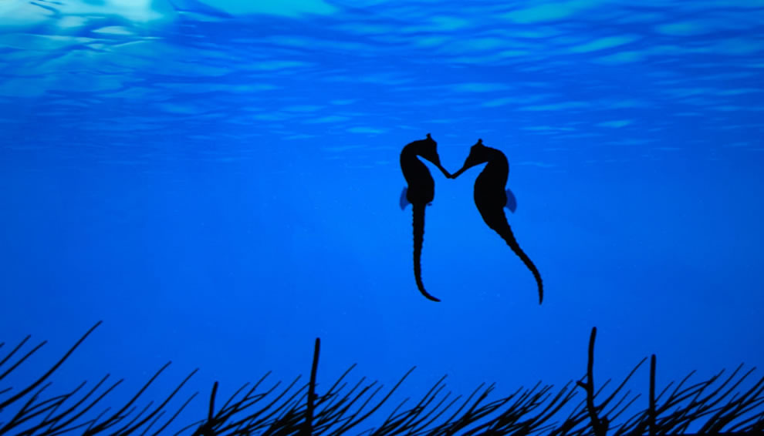
Hello Seattle
I am a cold sea horse

Slide 13
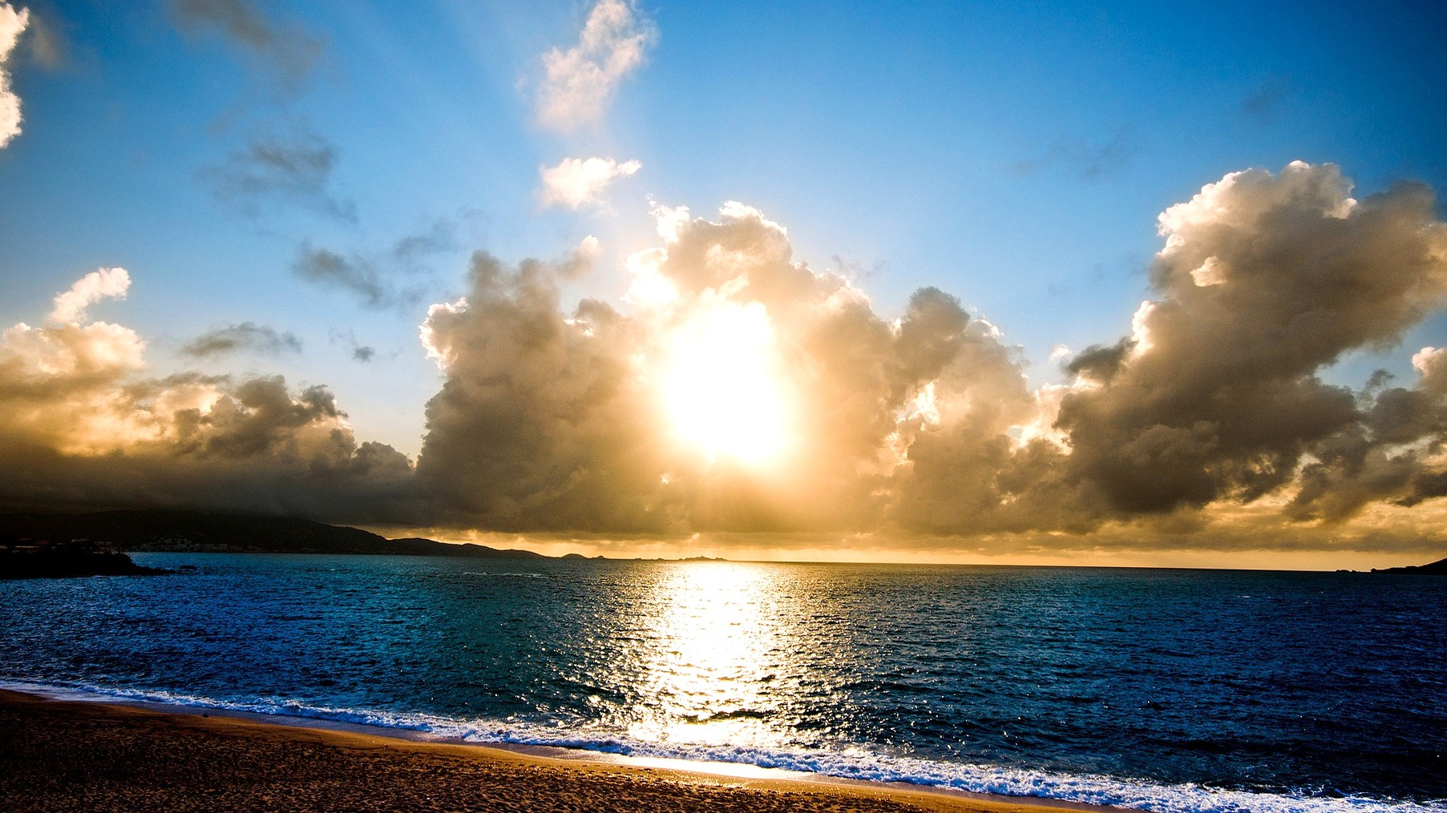
Feeling warm
in your sand

Slide 14
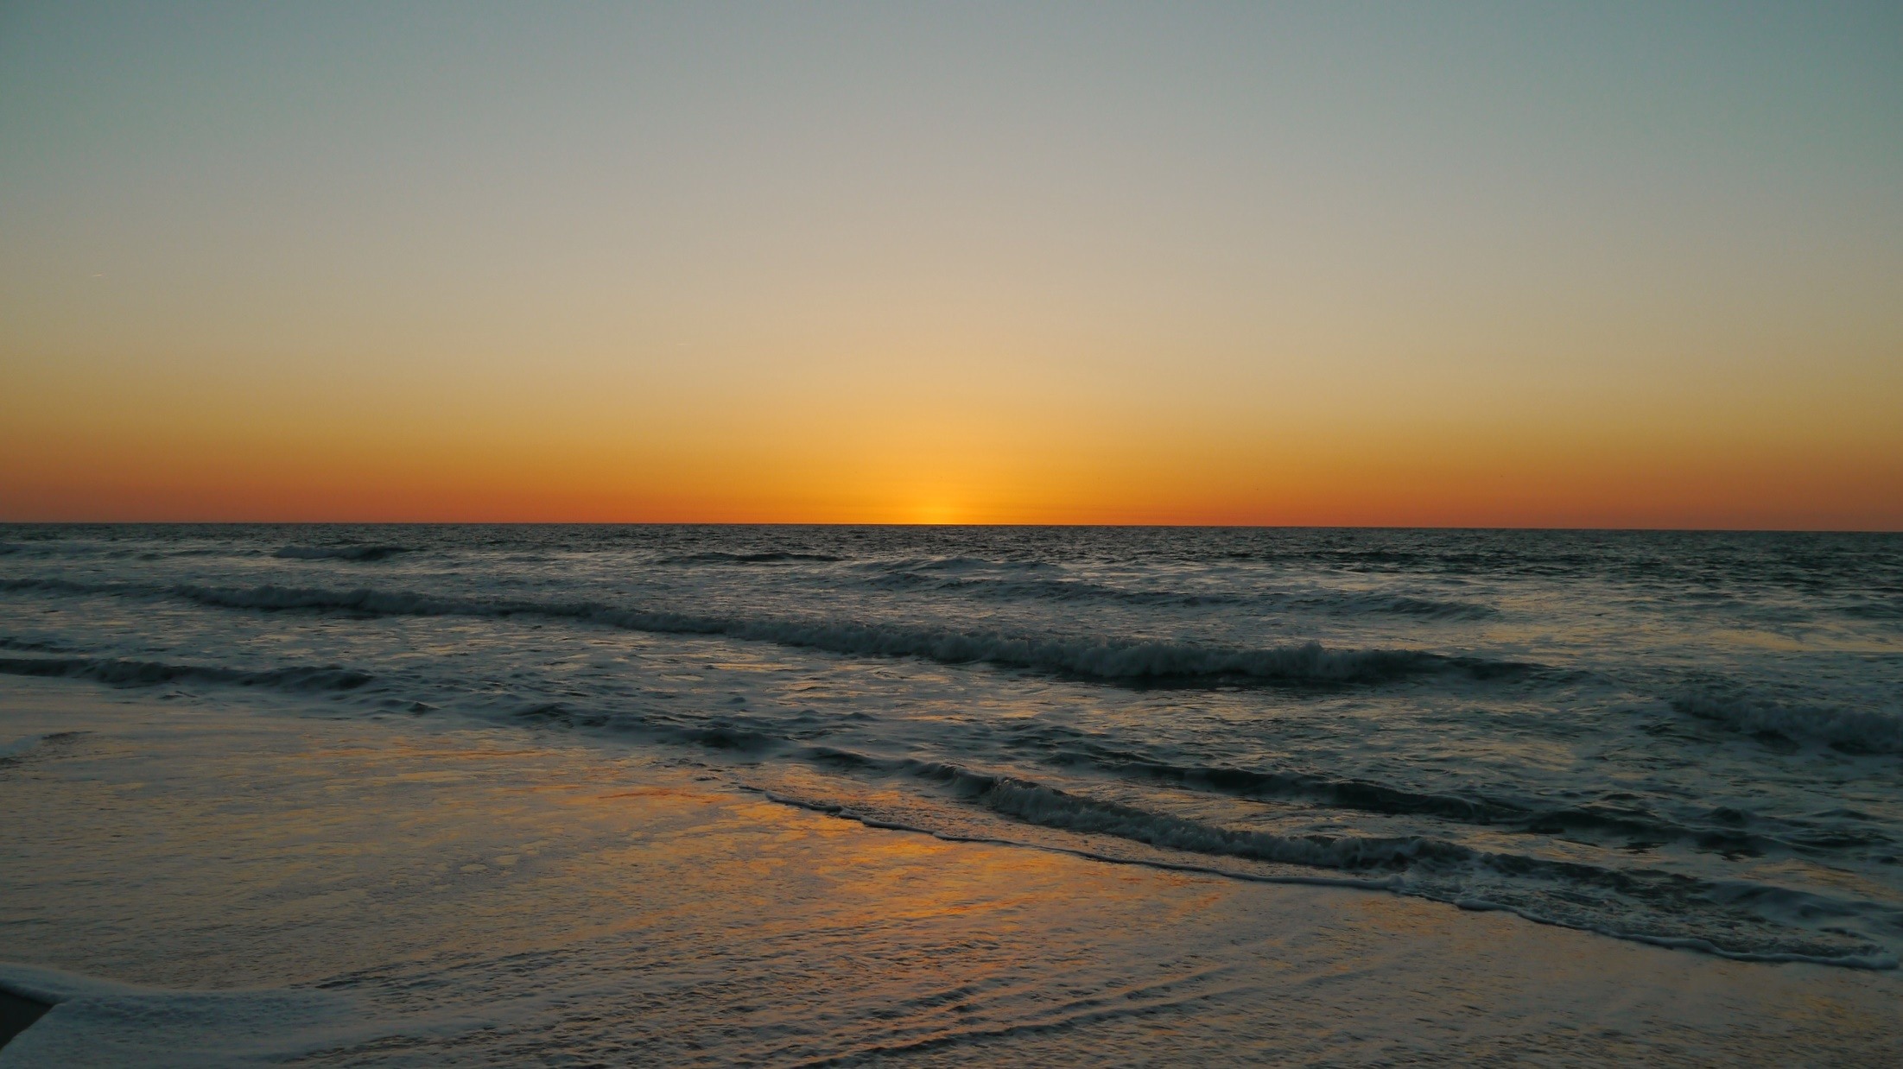
I sing about the tide
I'll crawl the sandy bottom of Puget Sound
and the ocean surf

Slide 15
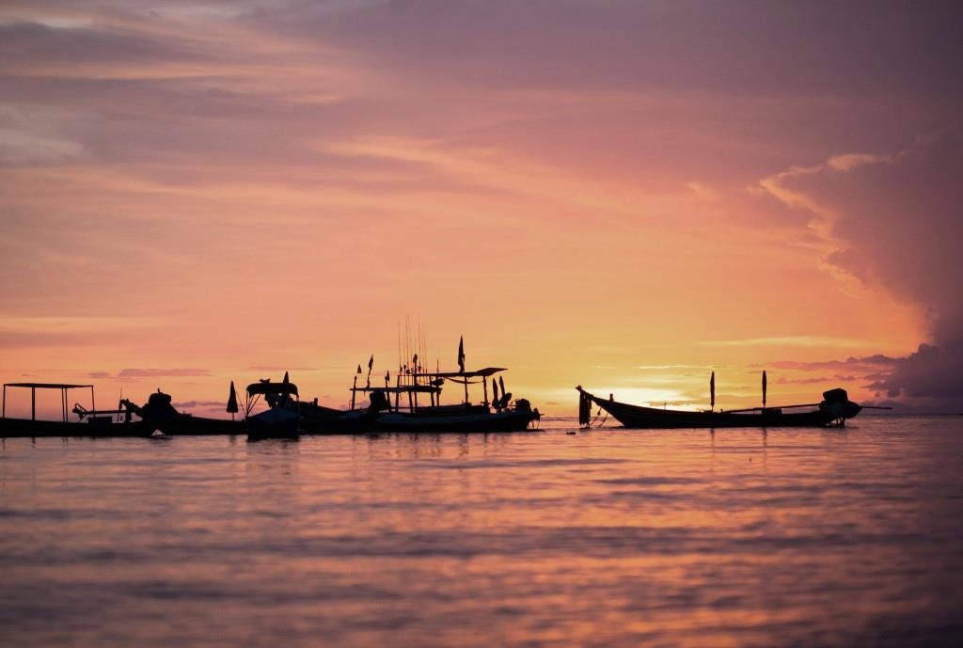
Rolling in
the evening breeze...

Slide 20
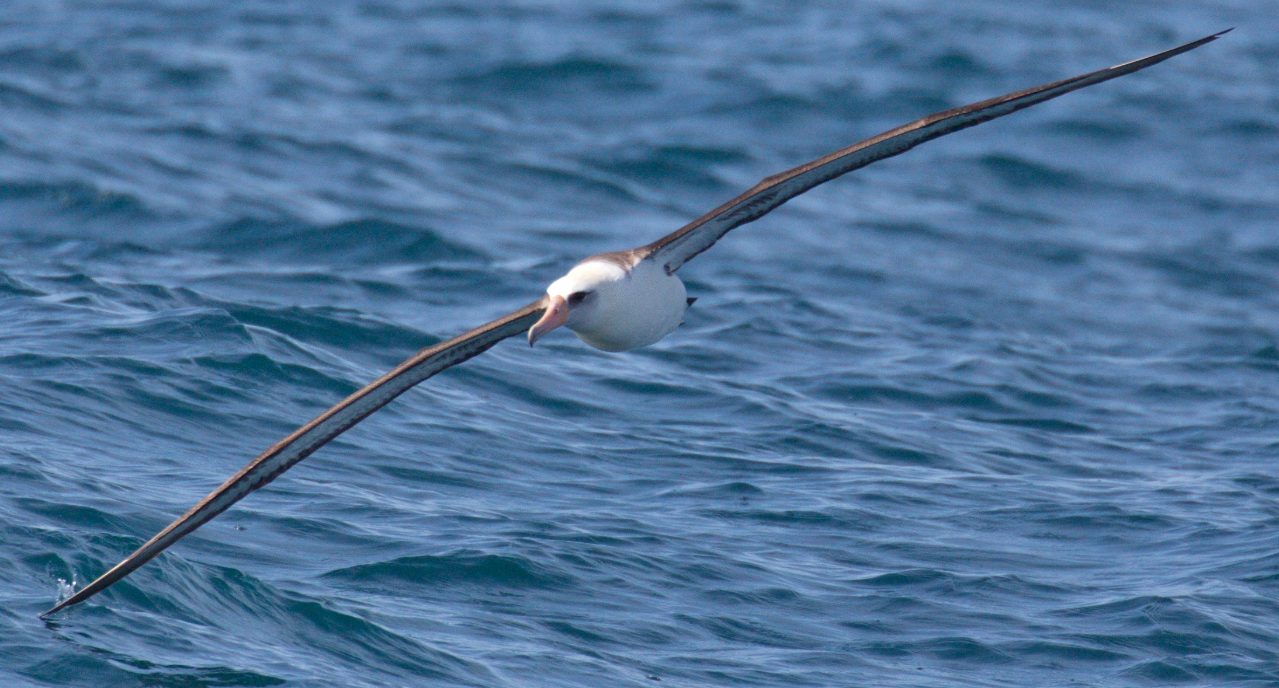
Hello Seattle
I am an albatross

Slide 21
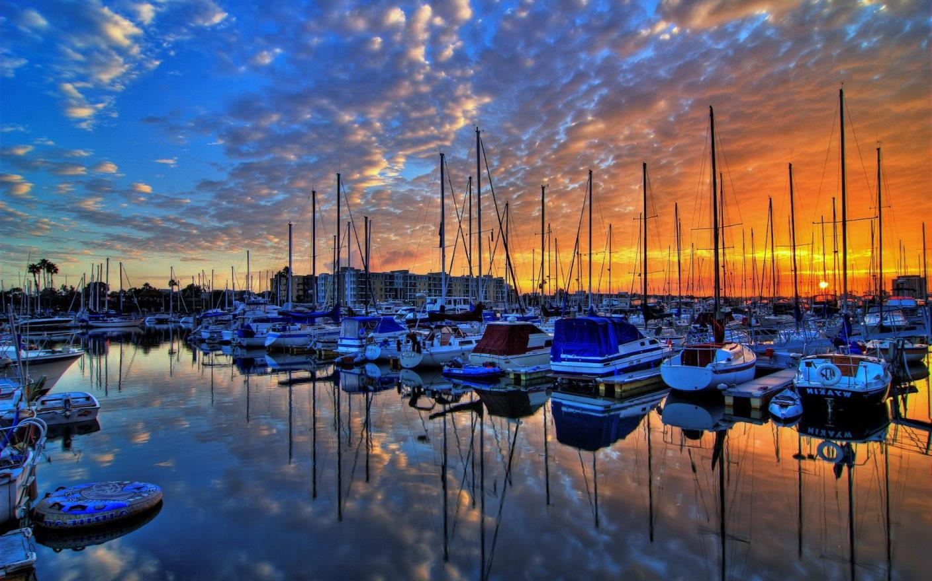
On the docks and moored boats

Slide 22
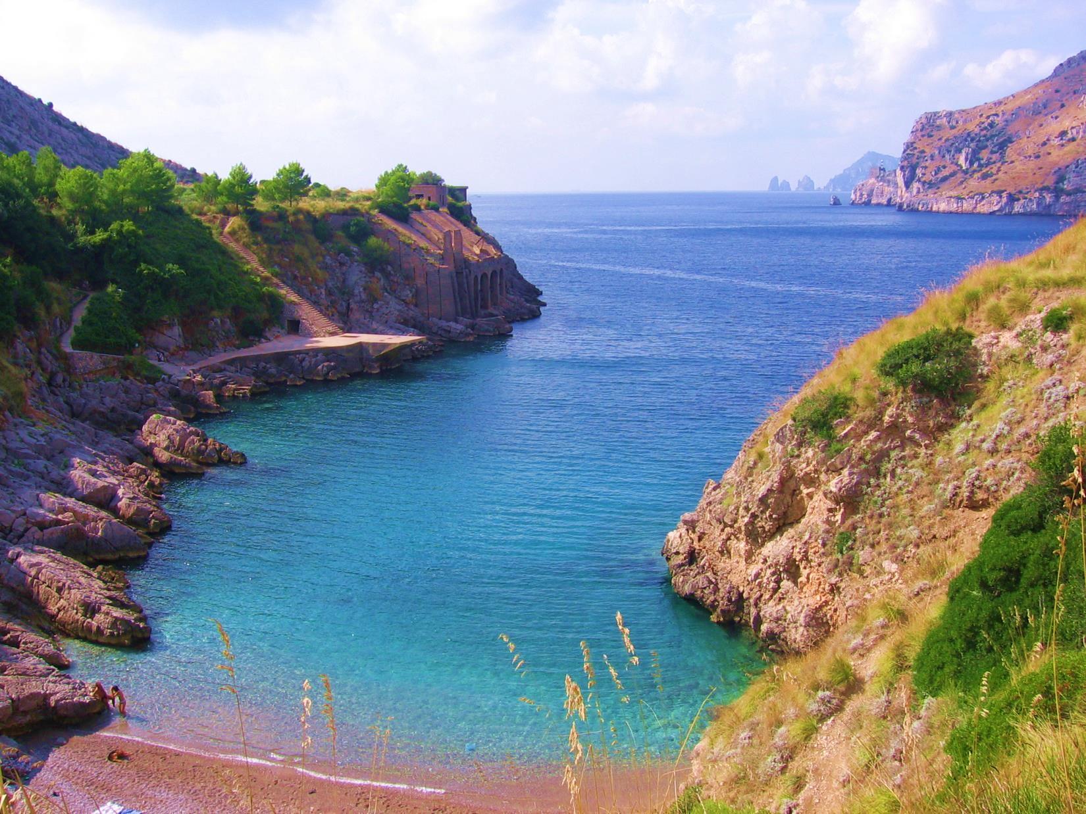
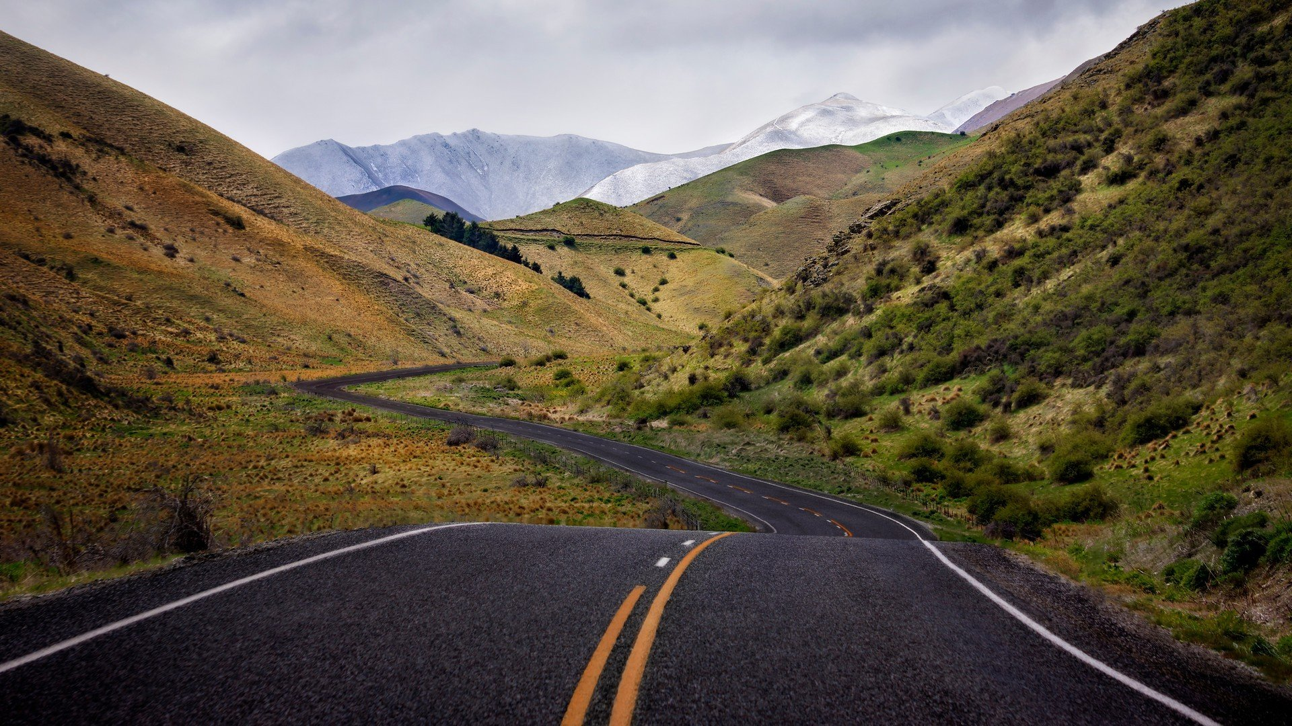
I sail above your inlets
and interstates

Slide 23
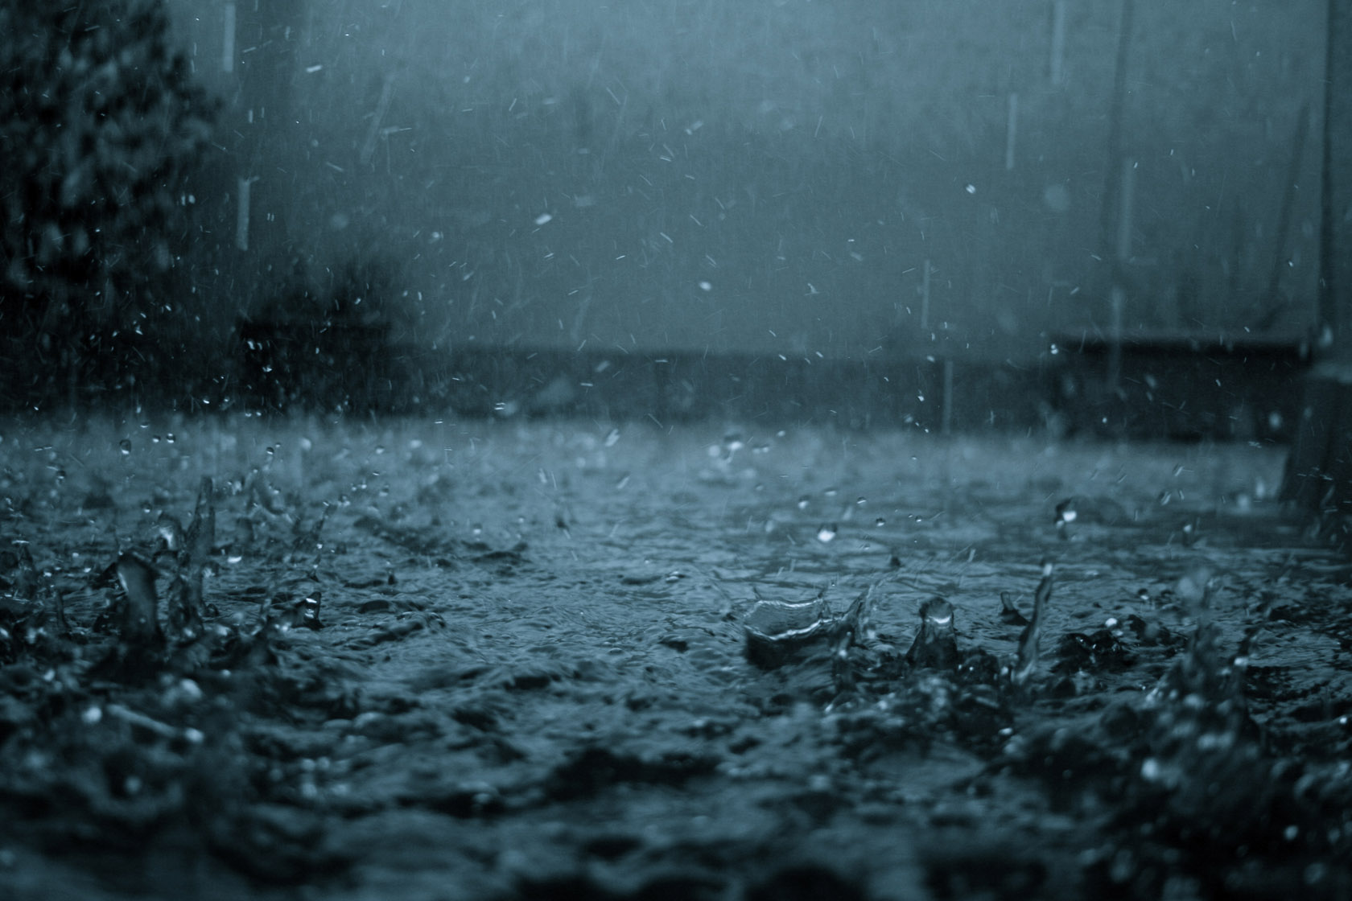
Through the rain
and open wind

Slide 24
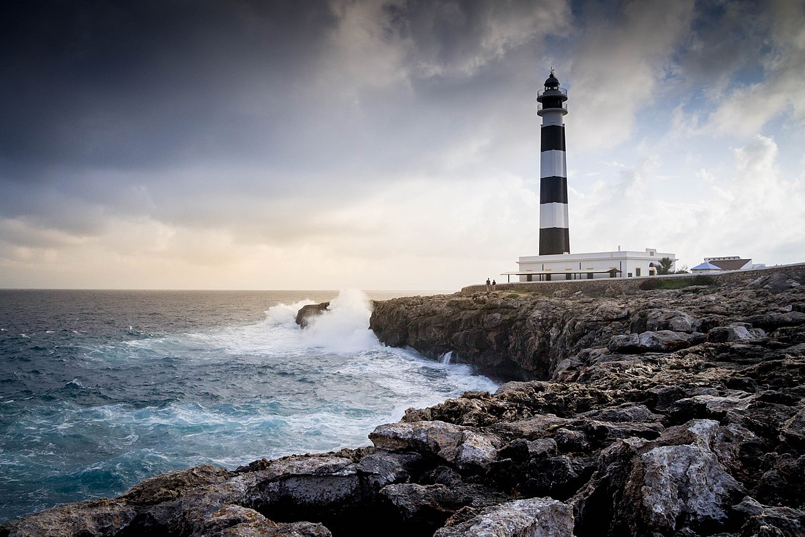
Hello Seattle
I am an old lighthouse

Slide 25
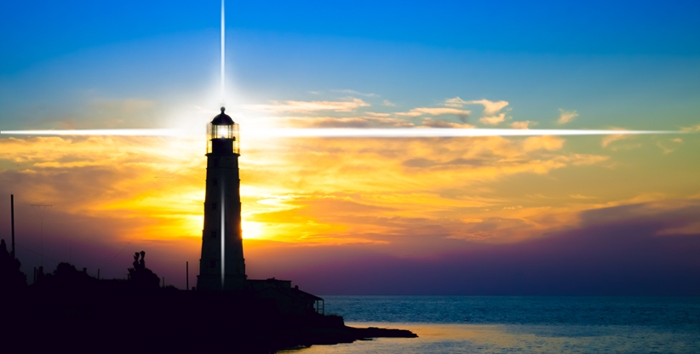
Throwing beams of bright light

Slide 26
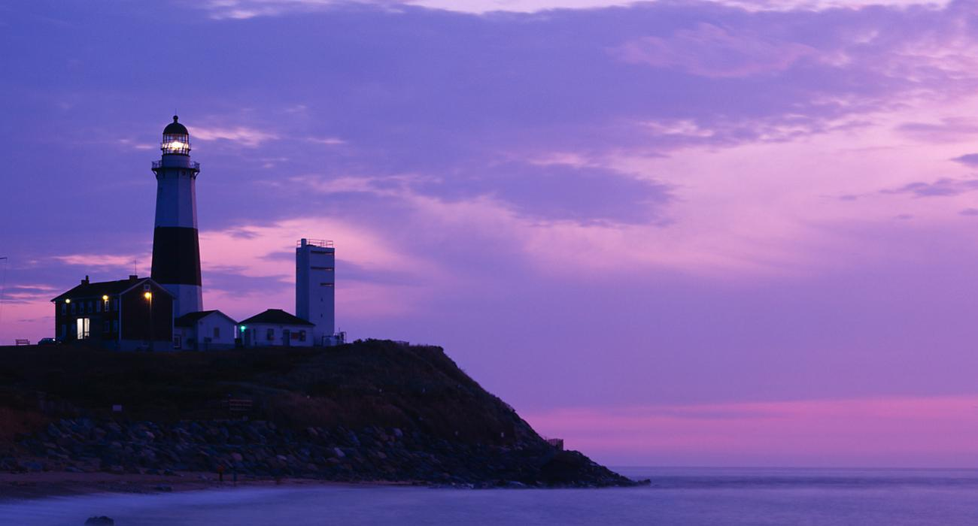
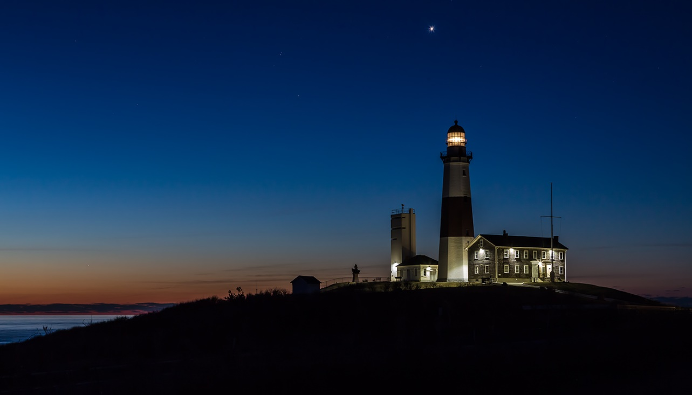
Red in the morning
Blue in the evening sun

Slide 27
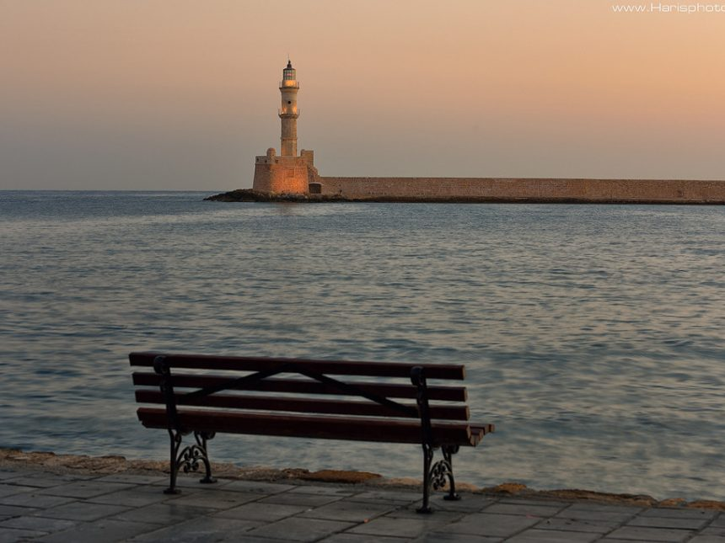
Taking heed
for everyone

Slide 28
Hello Seattle

Slide 29
I am a mountaineer
In the hills and highlands

Slide 30
I fall asleep
in hospital parking lots…

Slide 31
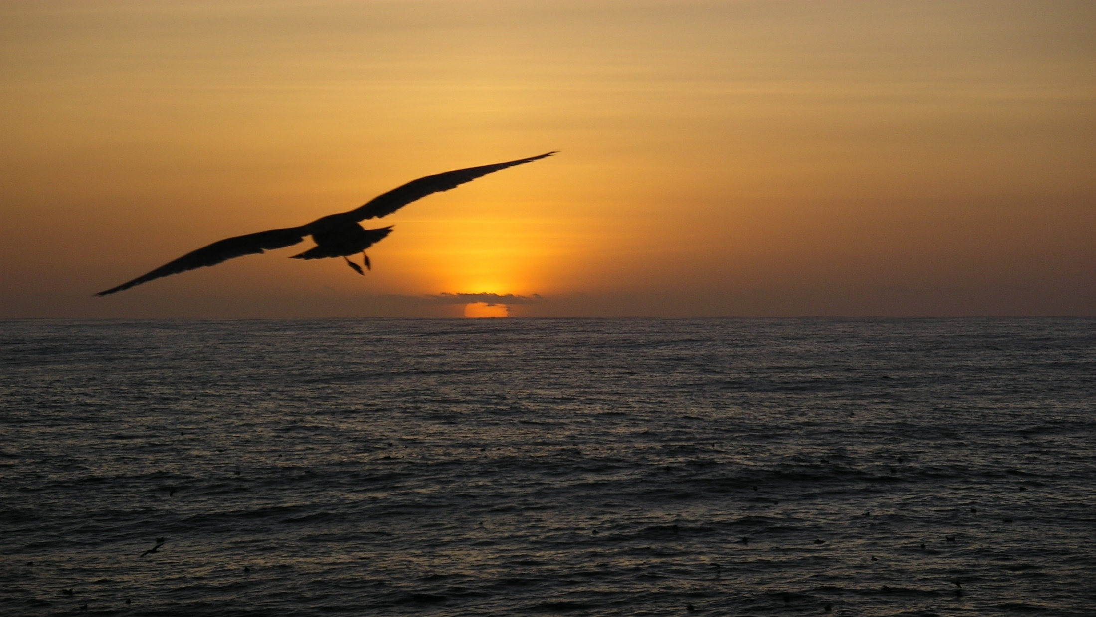
Take me above your light

Slide 32
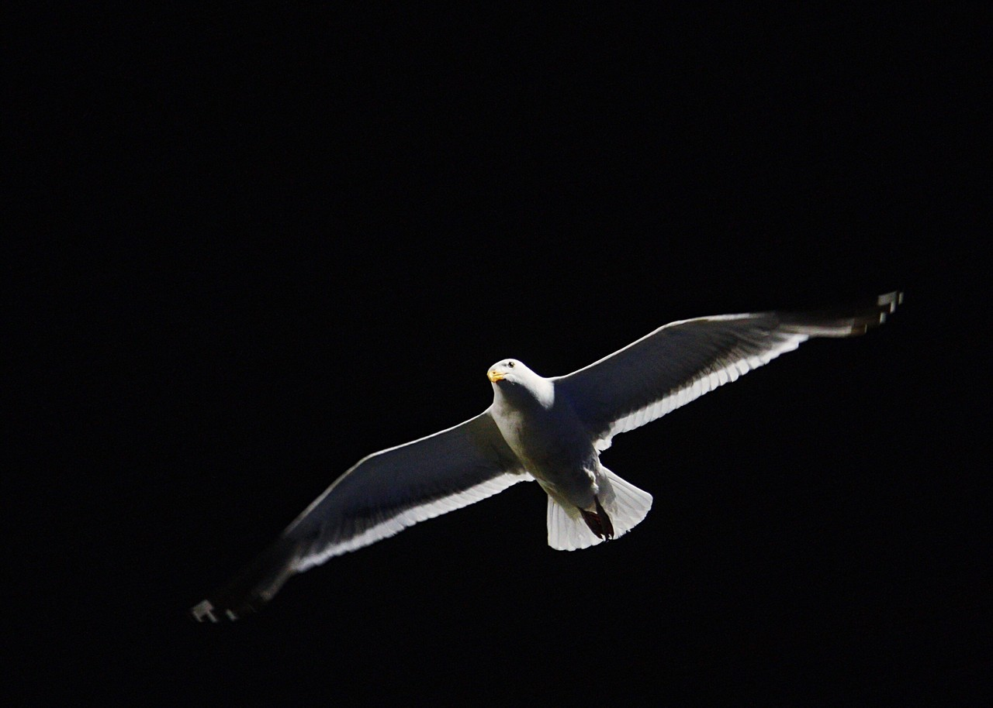
Carry me through the night

Slide 33
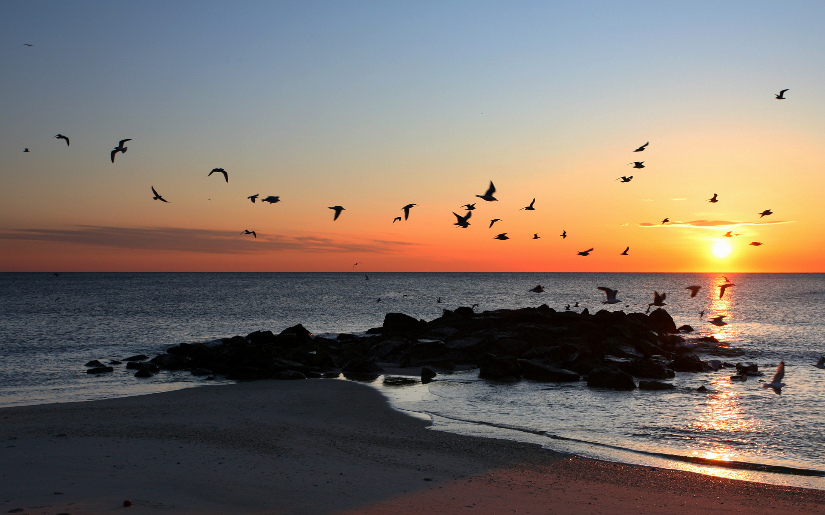
Hold me secure in flight

Slide 34
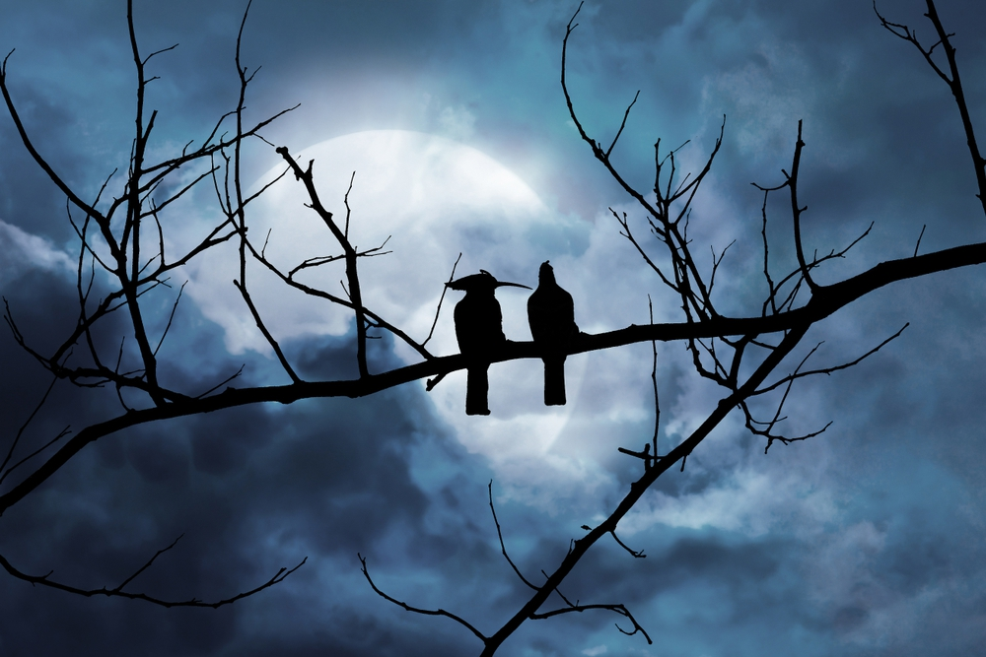
Sing me to sleep tonight

Slide 35
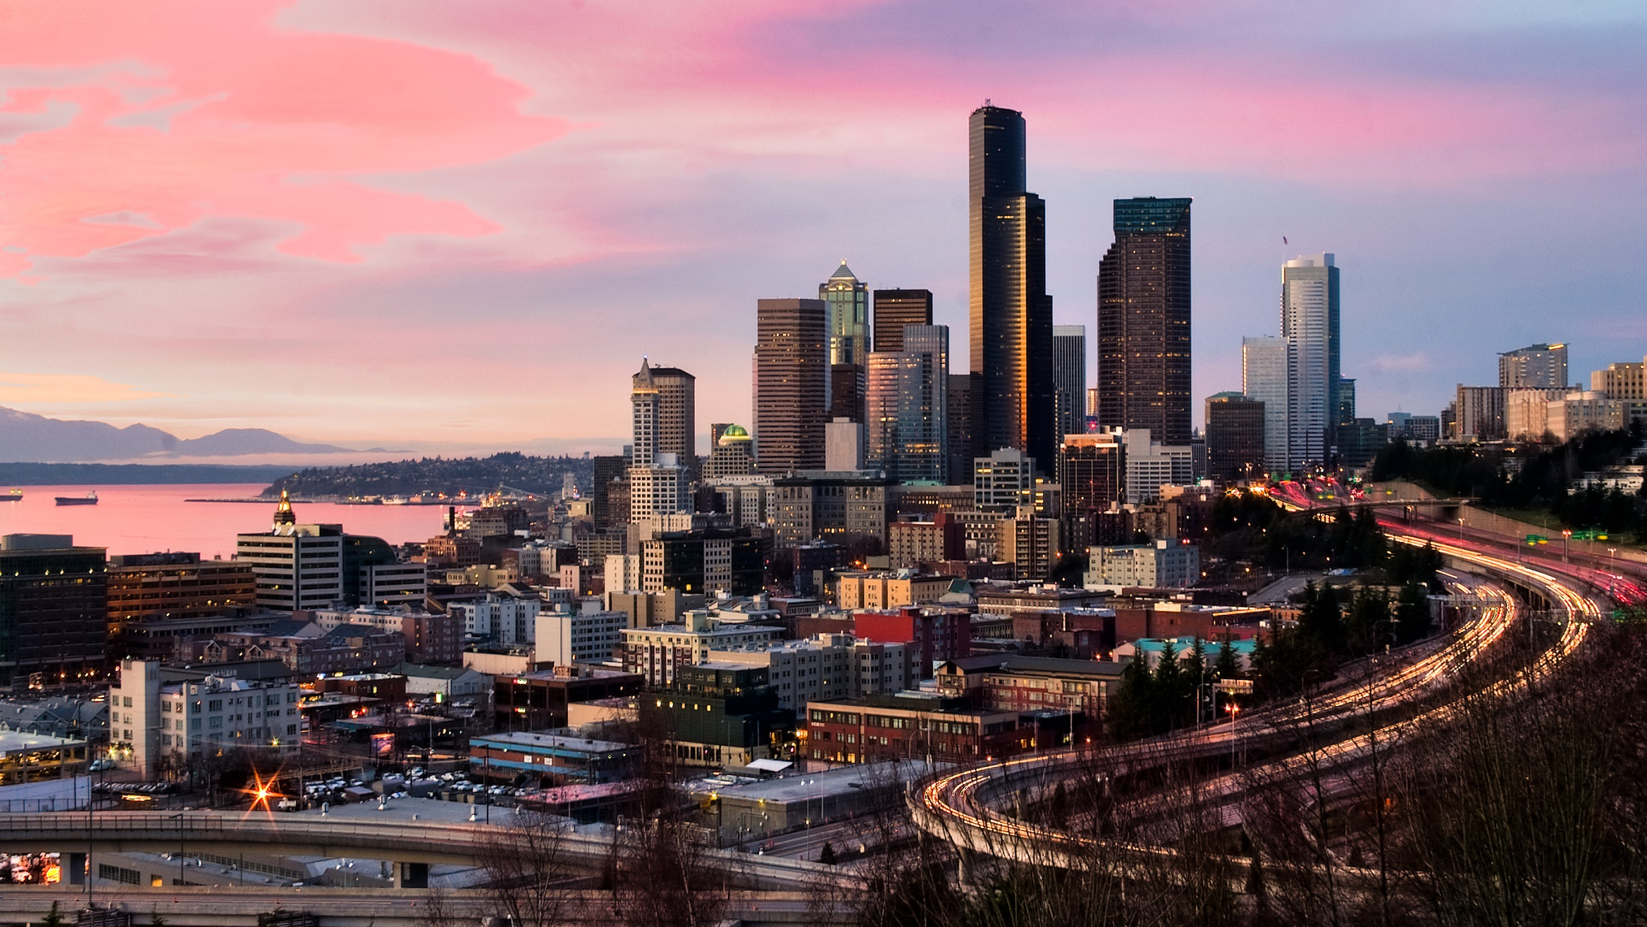
Take me above your light

Slide 36
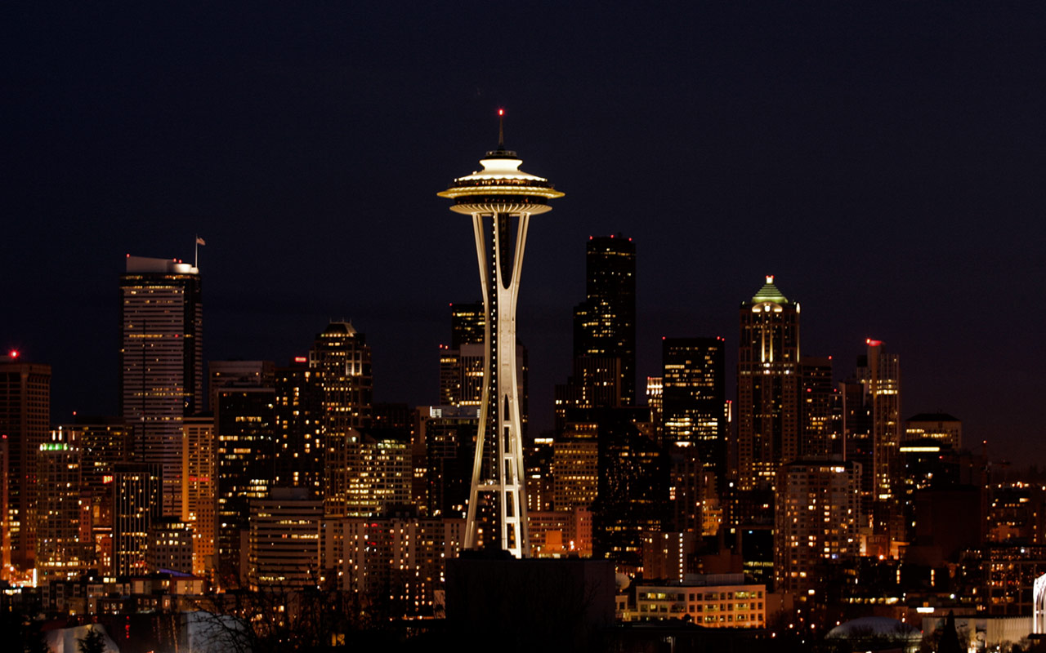
Carry me through the night

Slide 37
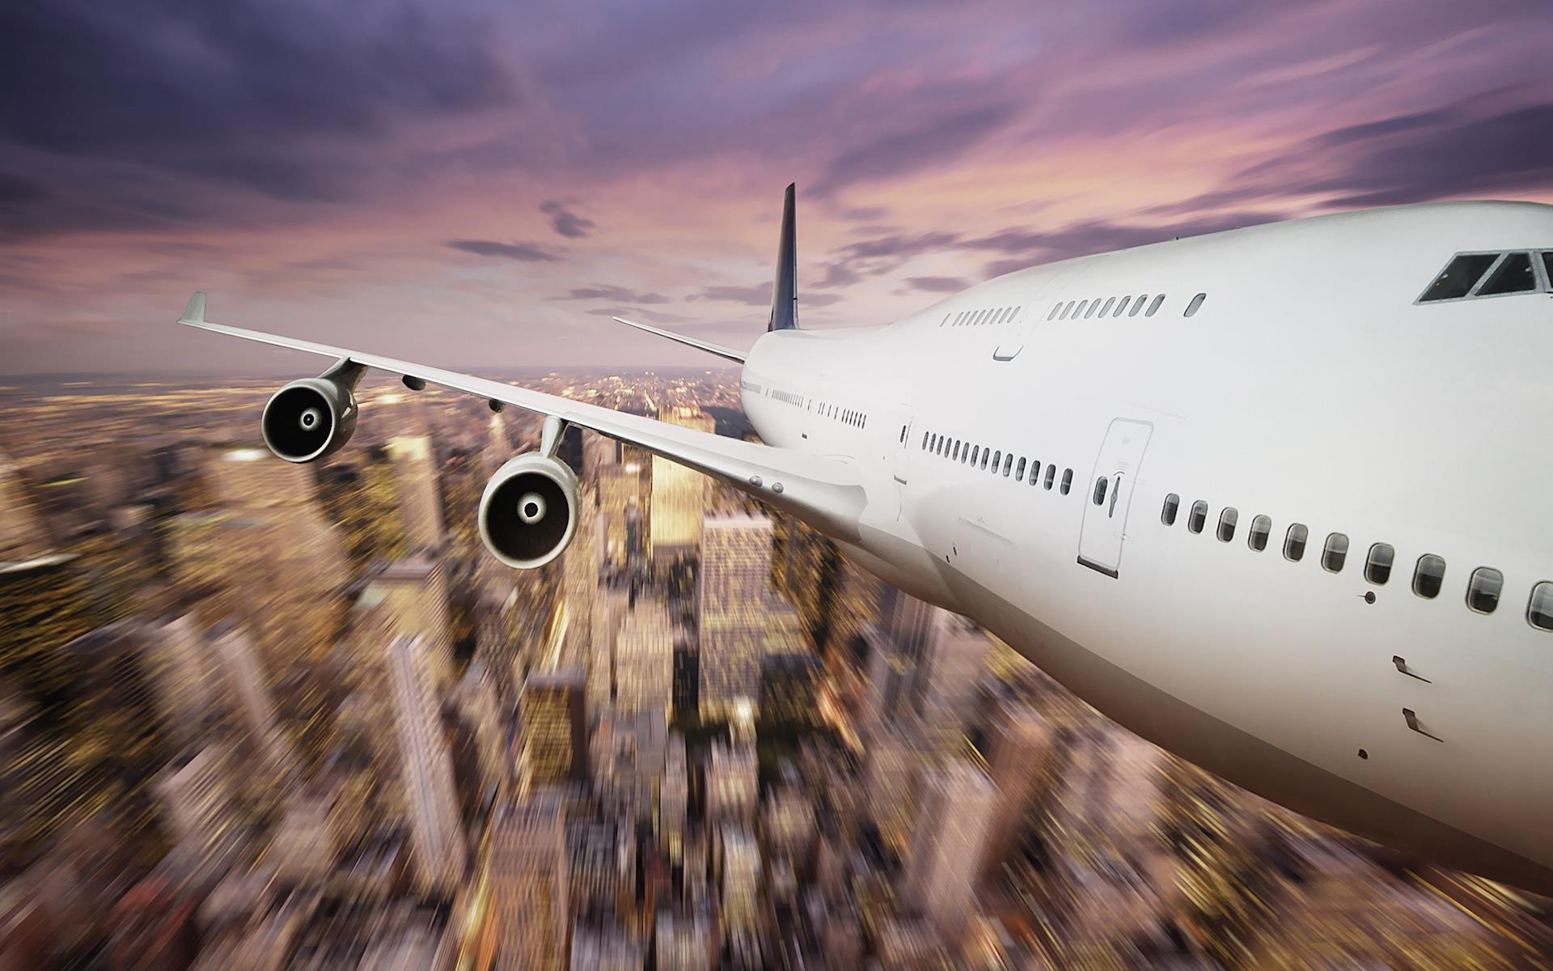
Hold me secure in flight

Slide 38
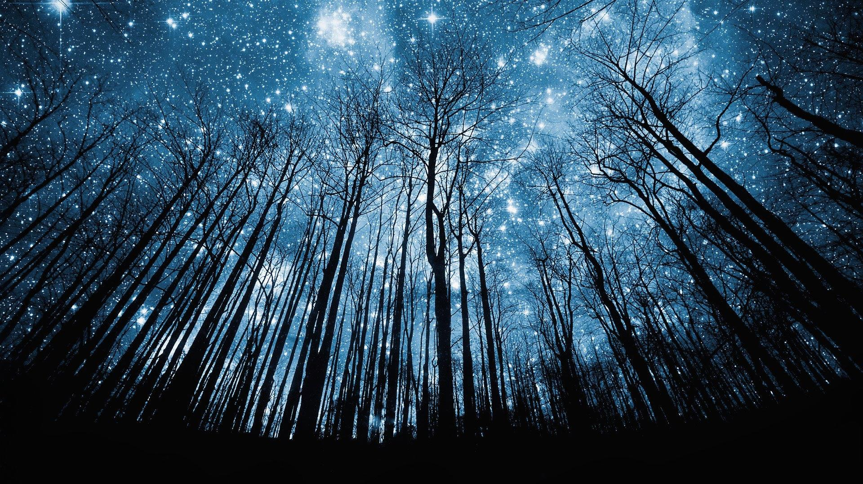
Sing me to sleep tonight

Slide 39
Thank you

