Slide 1
What A Wonderful World
感叹句用法
华南师范大学外国语言文化学院 潘梓珊
广东省东莞中学 陈小菲

Slide 2
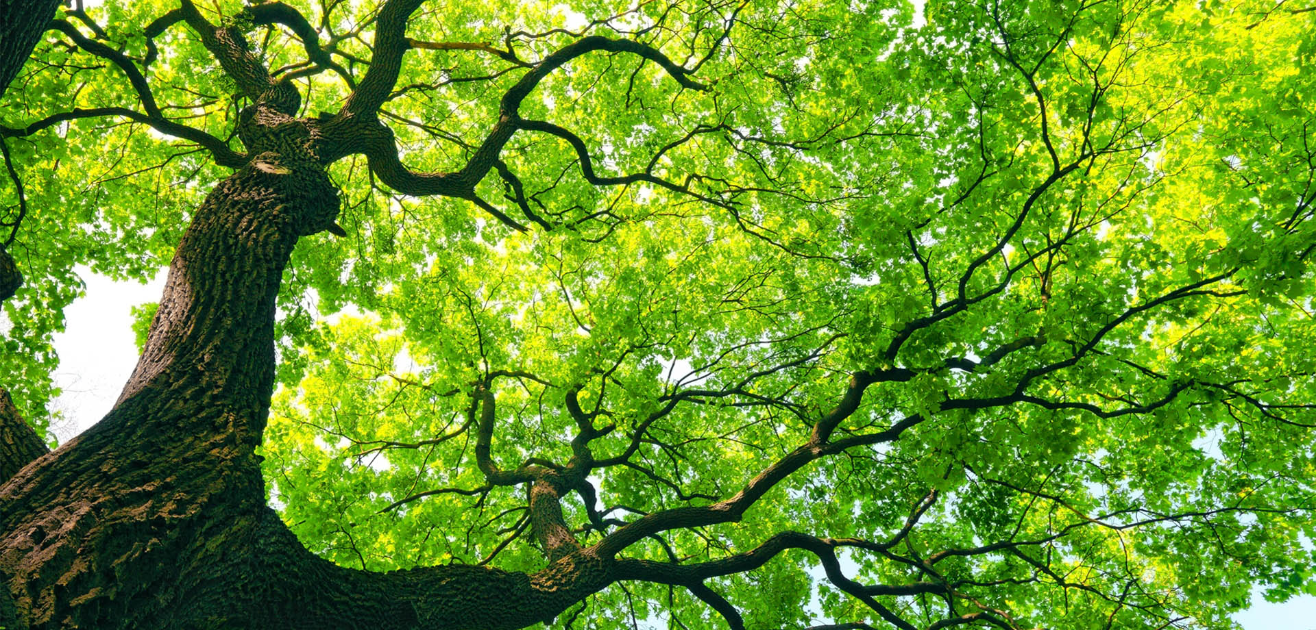
I see trees of green

Slide 3
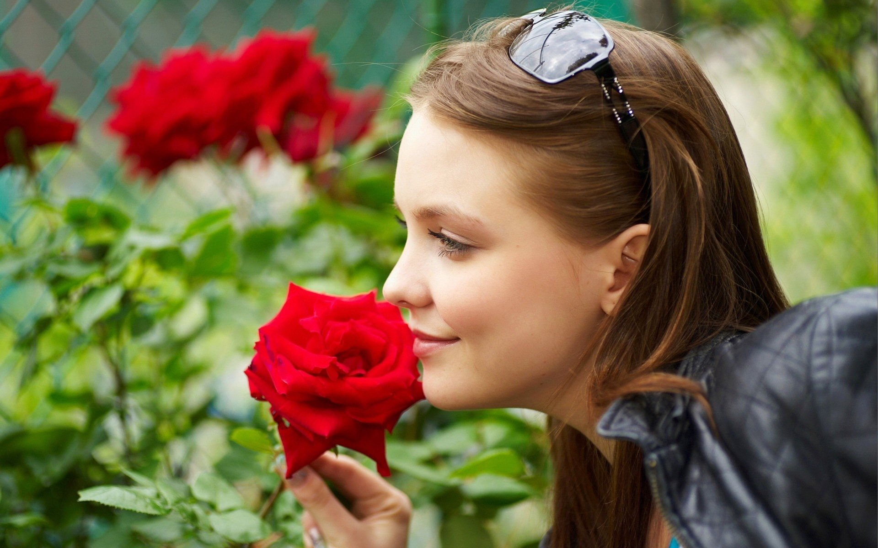
Red roses too

Slide 4
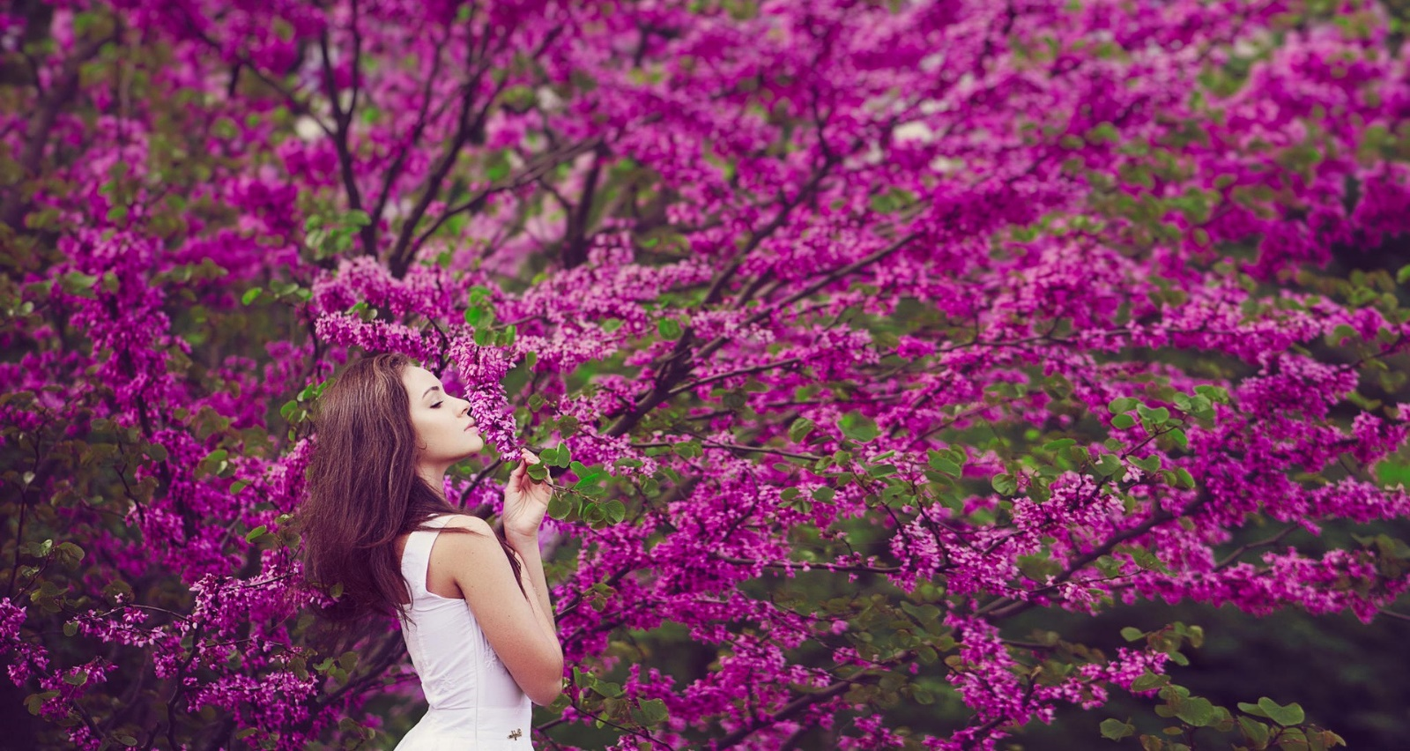
I see them bloom for me and you

Slide 5
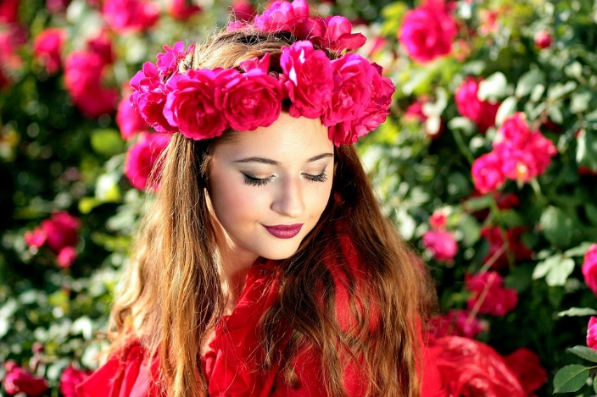
And I think to my self

Slide 6
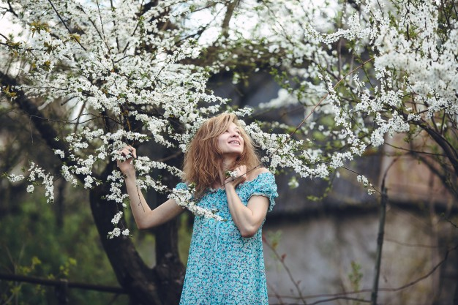
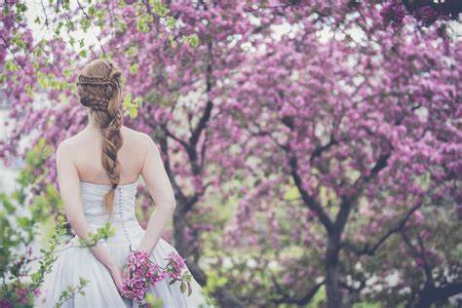
What a wonderful world

Slide 7
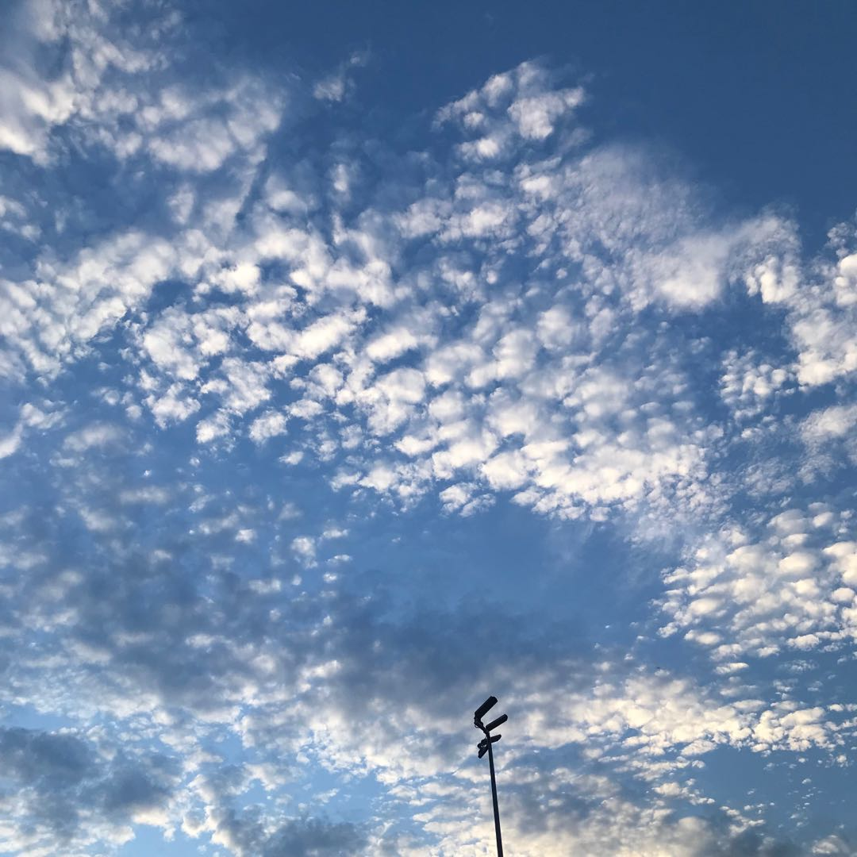
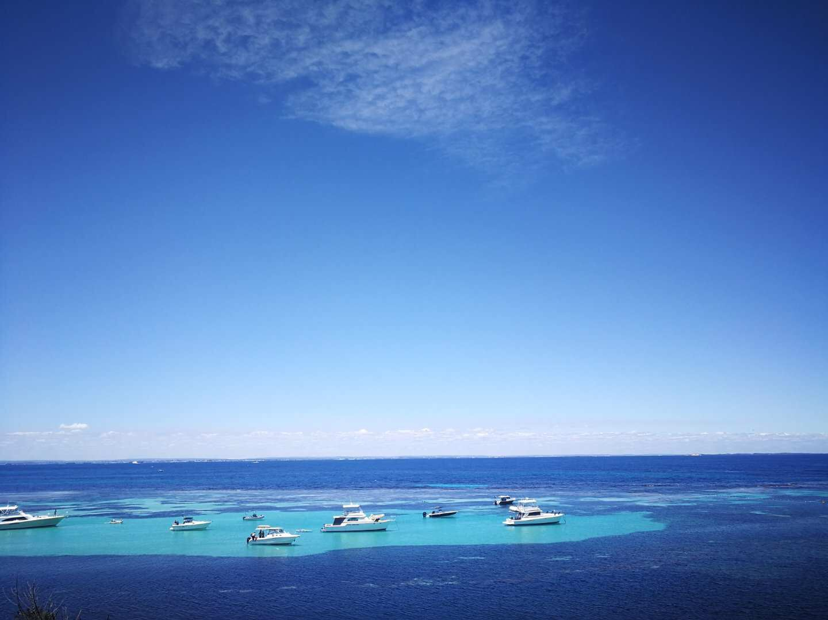
I see skies of blue
And clouds of white

Slide 8
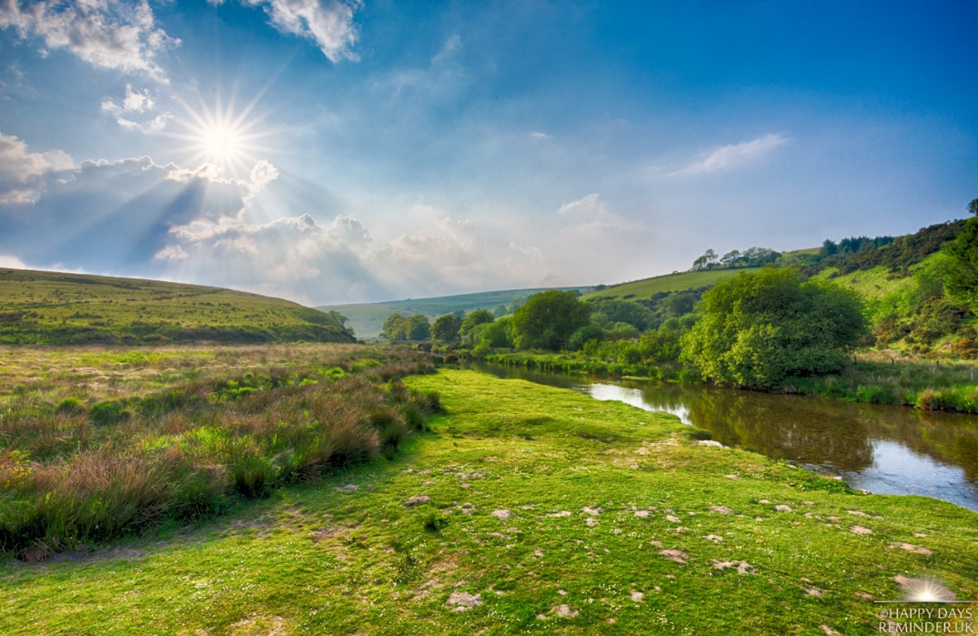
The bright blessed day

Slide 9
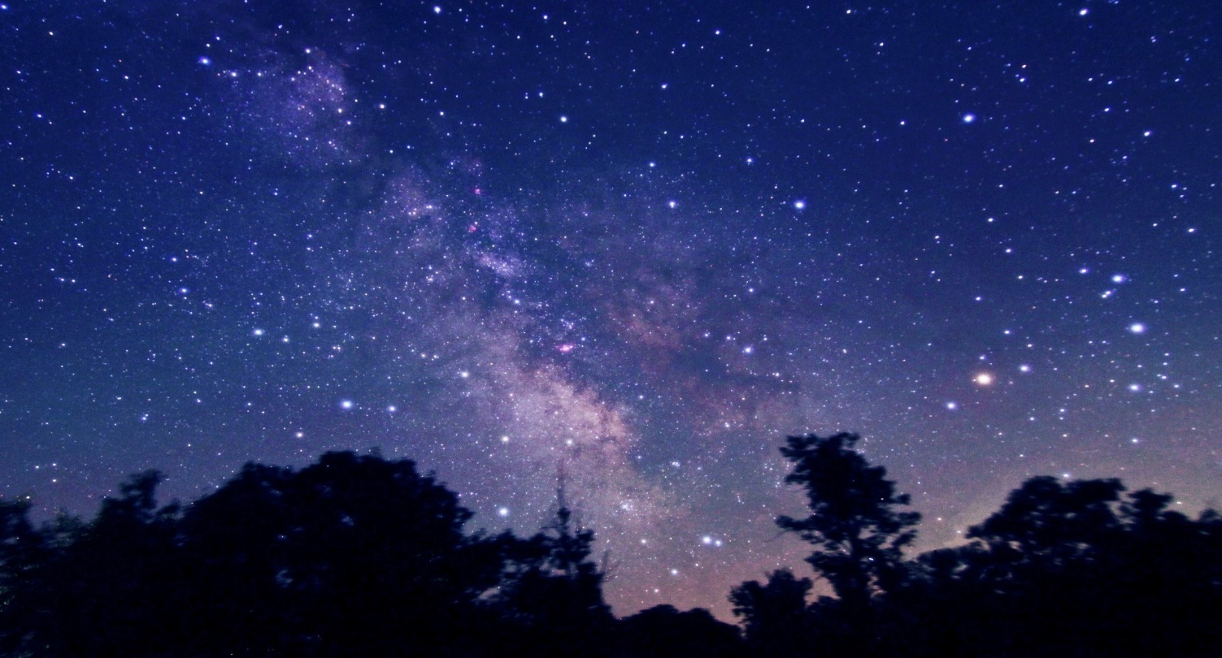
The dark sacred night

Slide 10
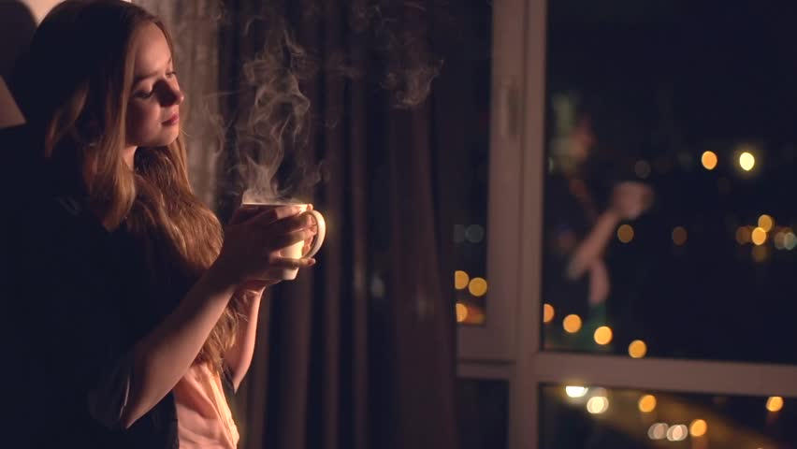
And I think to myself

Slide 11
What a wonderful world

Slide 12
Yes, I think to myself

Slide 13
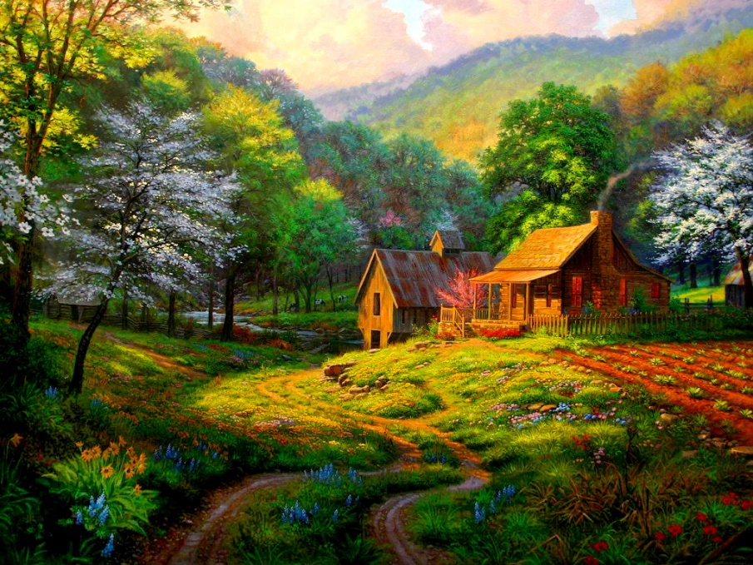
What a wonderful world

Slide 14
Thank you

