Slide 1
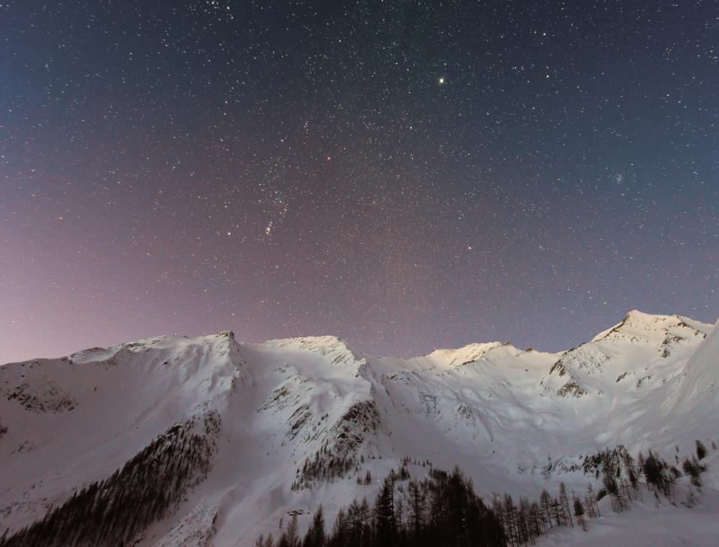
Let it go
句子种类：祈使句
By: 华南师范大学外国语言文化学院 姚小敏
广东省东莞市东莞中学初中部 陈小菲
指导老师：陈小菲、刘晓斌

Slide 2
The snow glows white on the mountain tonight

Slide 3
Not a footprint to be seen

Slide 4
A kingdom of isolation

Slide 5
And it looks like I’m the queen

Slide 6
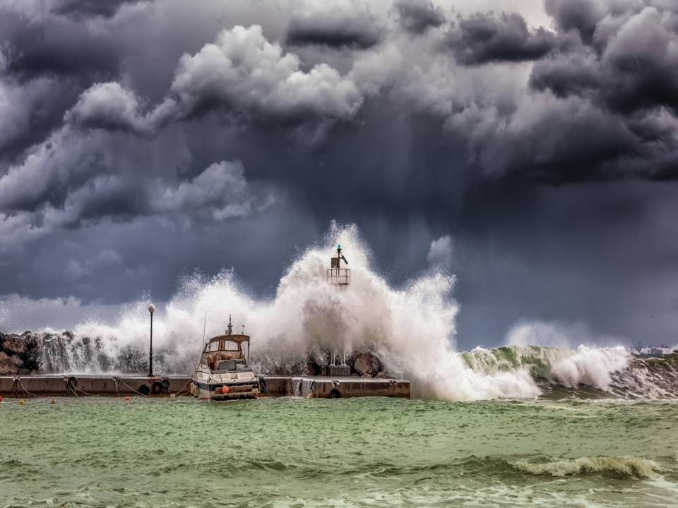
The wind is howling like this swirling storm inside

Slide 7
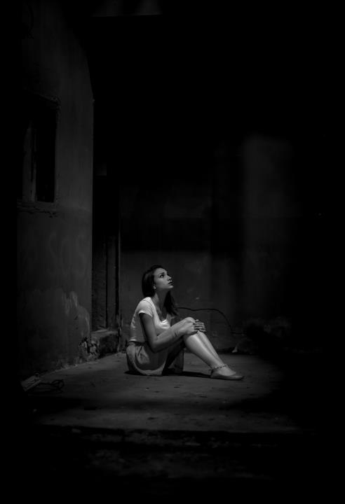
Couldn’t keep it in
Heaven knows I’ve tried

Slide 8
Don’t let them in

Slide 9
Don’t let them see

Slide 10
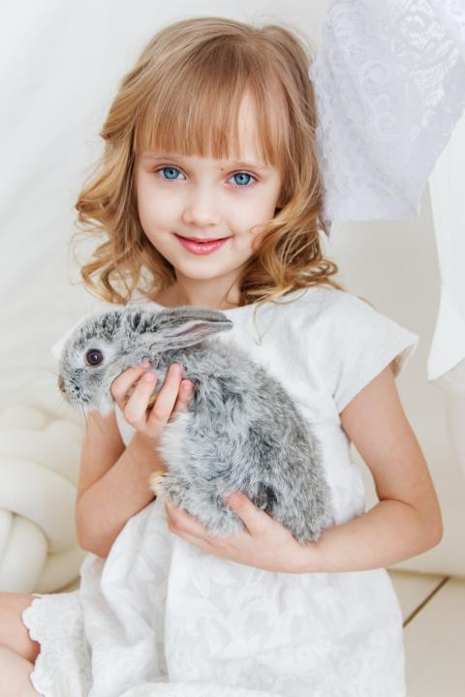
Be the good girl you always have to be

Slide 11
Conceal.
Don’t feel

Slide 12
Don't let them know

Slide 13
Well, now they know

Slide 14
Let it go. Let it go.

Slide 15
Can't hold it back anymore

Slide 16
Let it go. Let it go.

Slide 17
Turn away and slam the door

Slide 18
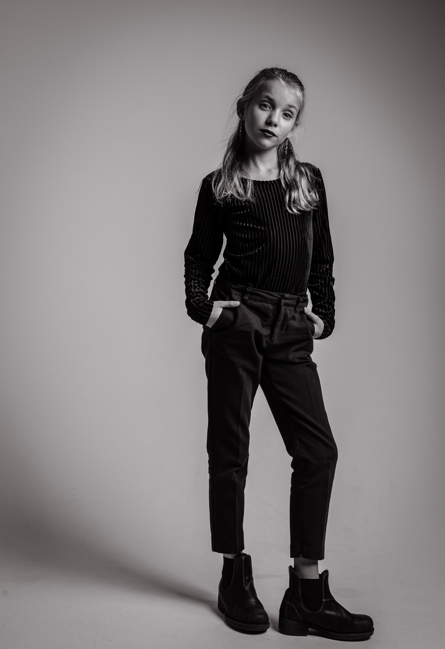
I don't care what they're going to say

Slide 19
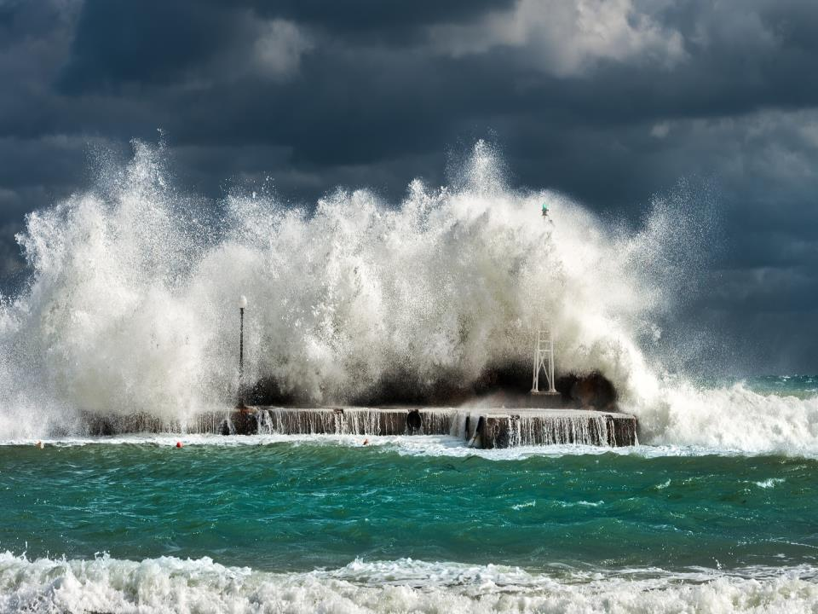
Let the storm rage on

Slide 20
The cold never bothered me anyway

Slide 21
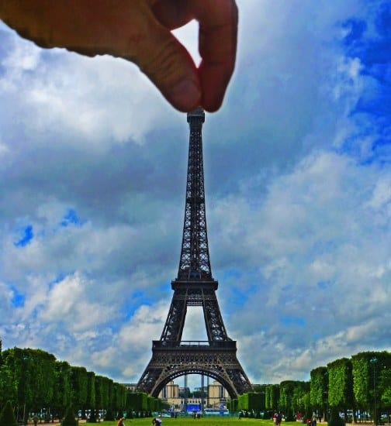
It's funny how some distance
makes everything seem small

Slide 22
And the fears that once controlled me
can't get to me at all

Slide 23
It's time to see what I can do

Slide 24
To test the limits and break through

Slide 25
No right no wrong no rules for me

Slide 26
I’m free

Slide 27
Let it go. Let it go

Slide 28
I am one with the wind and sky

Slide 29
Let it go. Let it go

Slide 30
You'll never see me cry

Slide 31
Here I stand and here I'll stay

Slide 32
Let the storm rage on

Slide 33
My power flurries through the air into the ground

Slide 34
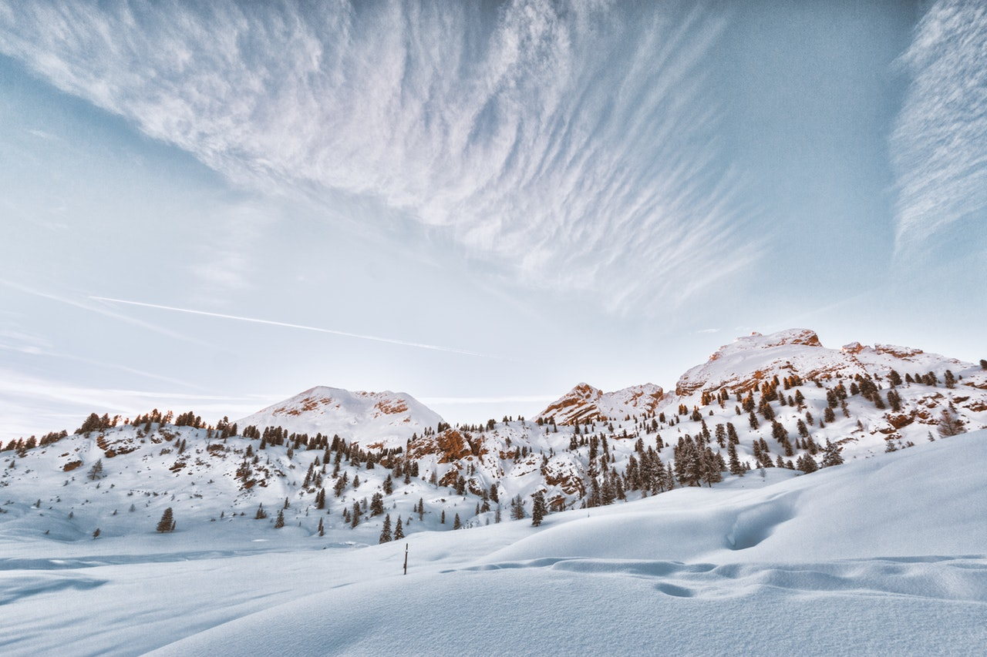
My soul is spiraling in frozen fractals all around

Slide 35
And one thought crystallizes like an icy blast

Slide 36
I'm never going back
The past is in the past

Slide 37
Let it go. Let it go.

Slide 38
And I'll rise like the break of dawn

Slide 39
Let it go. Let it go

Slide 40
That perfect girl is gone

Slide 41
Here I stand in the light of day

Slide 42
Let the storm rage on

Slide 43
The cold never bothered me anyway

