Slide 1
Hey Jude
-与身体部位有关的介词用法
设计制作：华南师范大学外国语言文化学院 莫敏琪
指导教师：广东省东莞市东莞中学初中部 陈小菲
刘晓斌

Slide 2
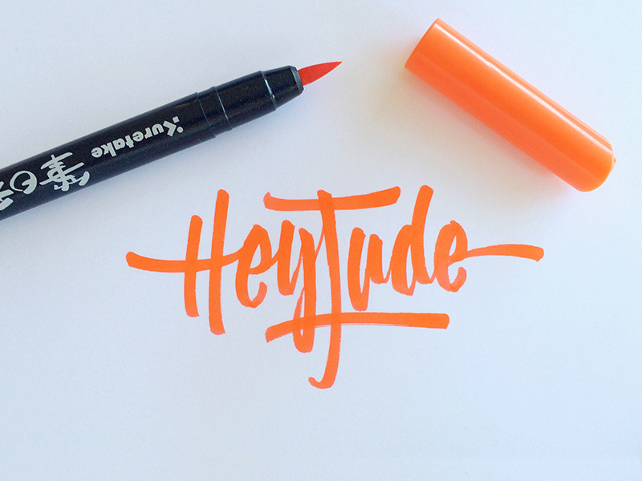
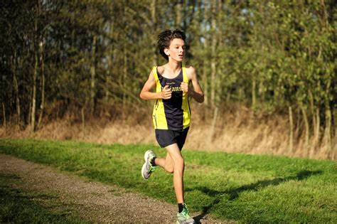
So let it out and let it in,
hey Jude, begin
You have found her
now go and get her
And don't you know that it's just you
hey Jude, you'll do
For well you know
that it's a fool who plays it cool
The movement you need is
on your shoulder
Na na na, na na na na,
na na na, hey Jude
Don't carry the world
upon your shoulders
You're waiting for
someone to perform with
Better better better
better better better, oh
Hey Jude, don't be afraid
By making his world a little colder
Remember to let her into your heart
Then you can start to make it better
Hey Jude, don't make it bad
The minute you let her under your skin
Then you‘ll begin to make it better
Then you can start to make it better
Take a sad song and make it better
You were made to go out and get her
Then you'll begin to make it
Hey Jude，don't make it bad
Hey Jude, don't let me down
Remember to let her into your heart
Hey Jude, refrain
And anytime you feel the pain
Remember to let her under your skin
Take a sad song and make it better

