Slide 1
T
i
c
-
T
o
c
基数词
华南师范大学外国语言文化学院 陈洁芯
广东省东莞中学初中部 叶玉芳

Slide 2
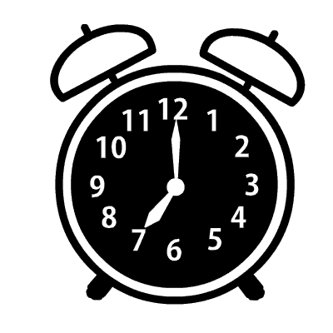
One o'clock, two o'clock
One o'clock, two o'clock
All the seconds passing by

Slide 3
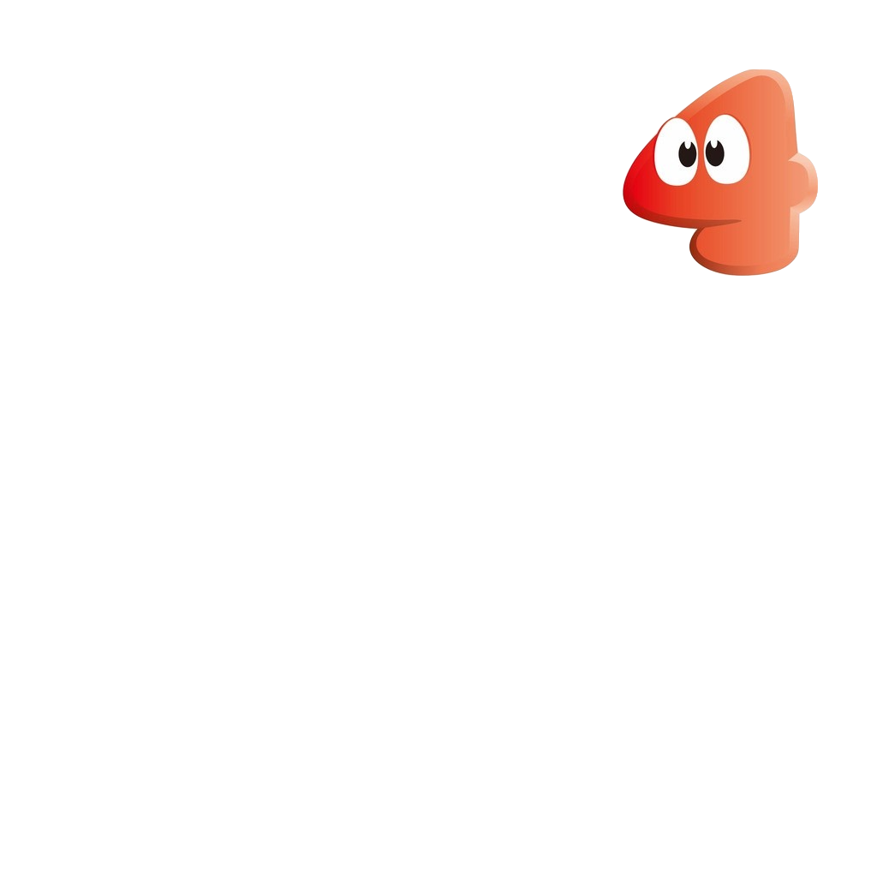
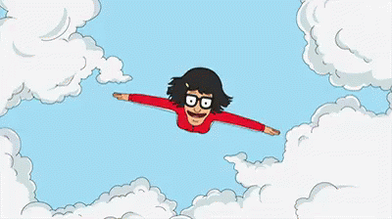
One o'clock, two o'clock
Three, four, five o'clock
Minutes gone up to the sky

Slide 4
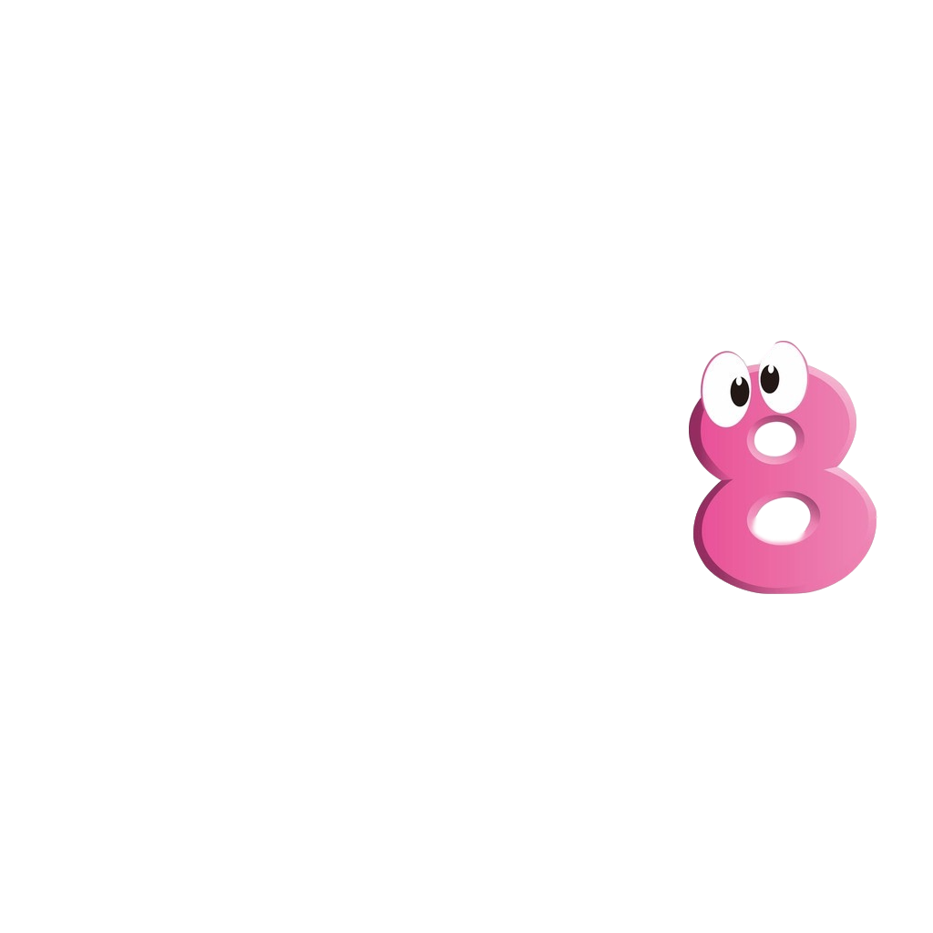
One o'clock, two o'clock
Six, seven, eight o'clock
To the hours say goodbye

Slide 5
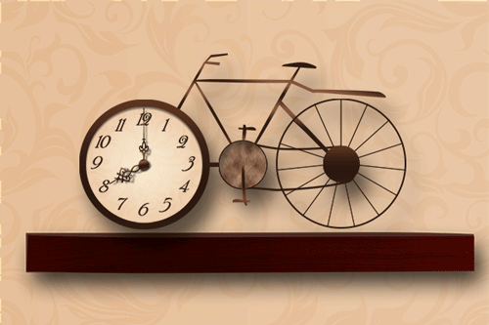
One o'clock, two o'clock
Nine and ten o'clock
When will it ever stop?

Slide 6
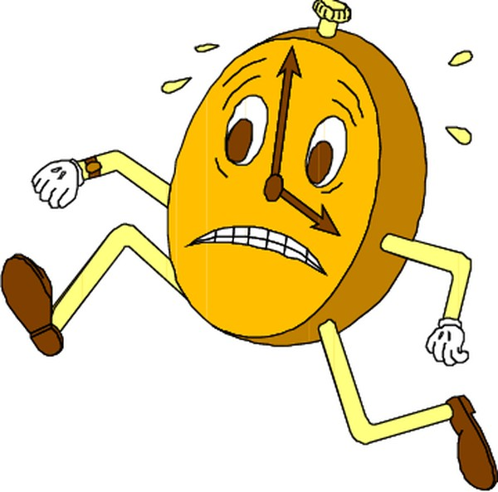
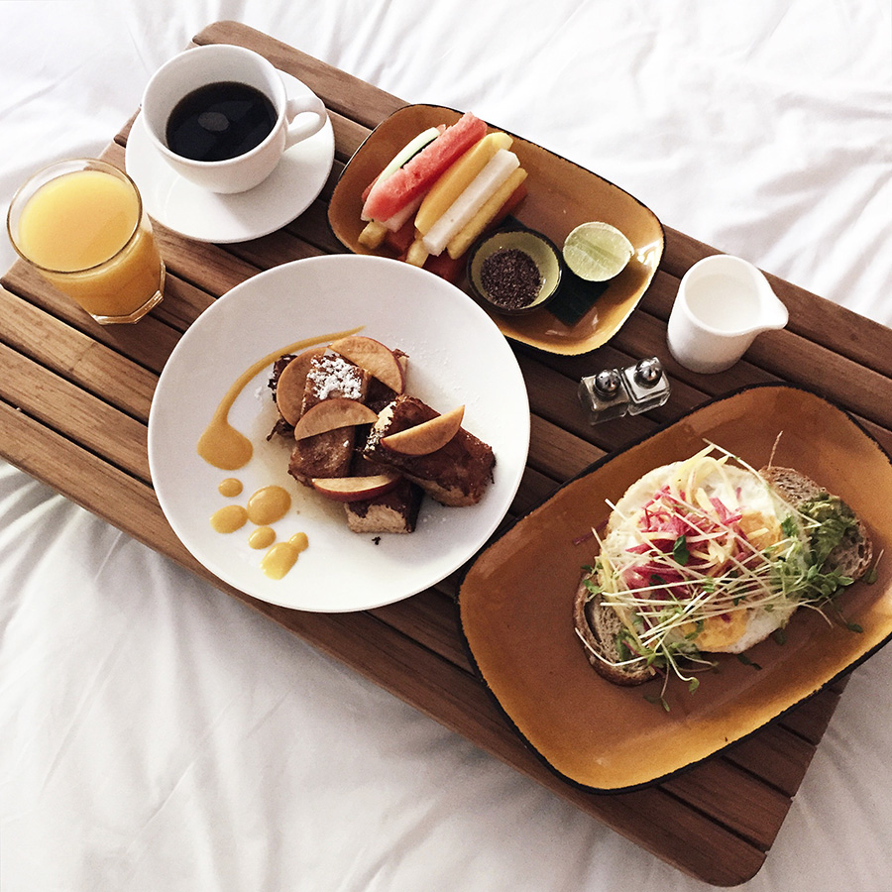
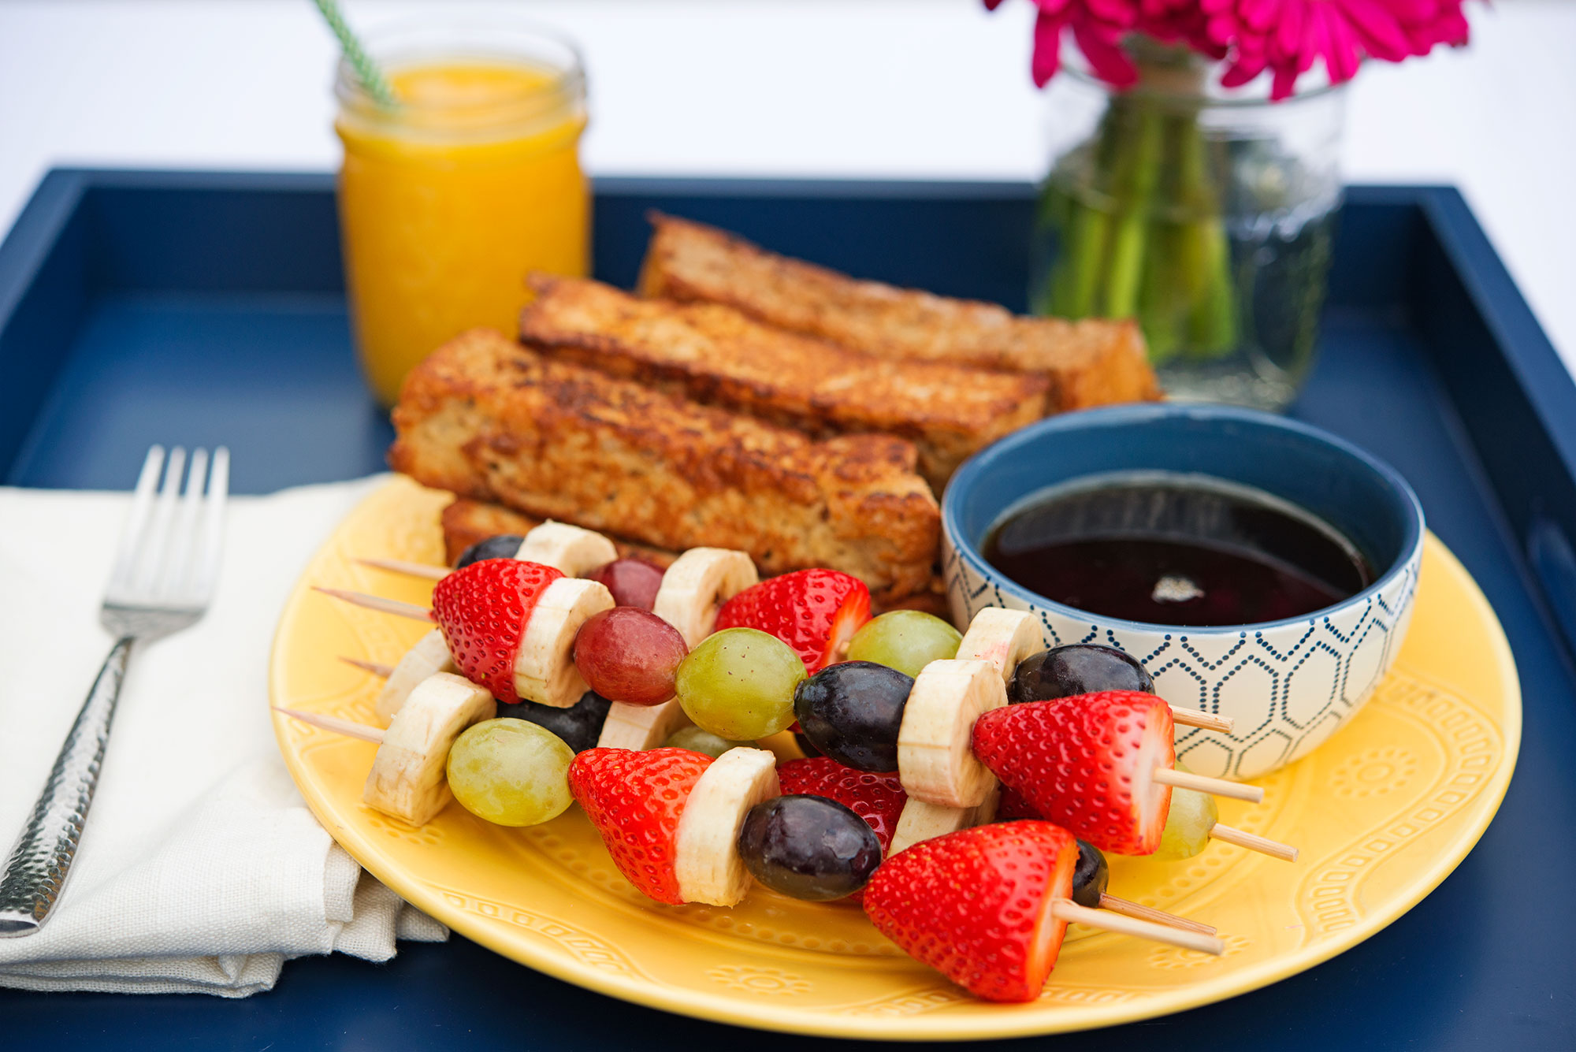
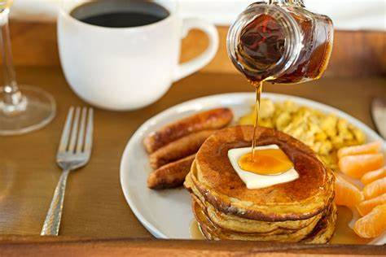
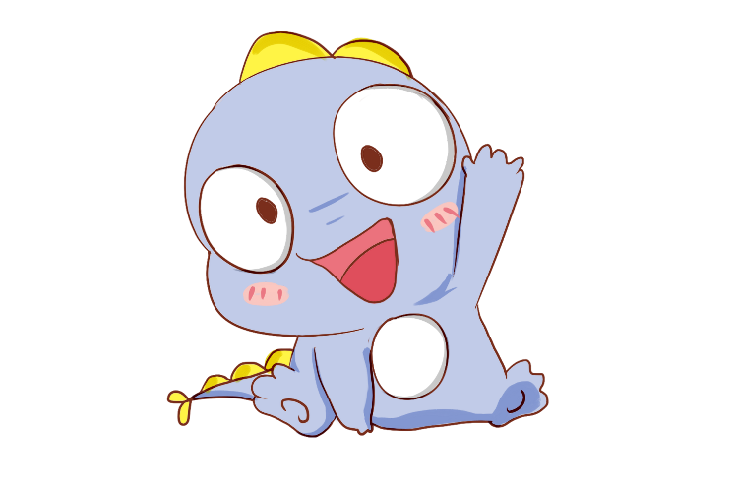
Got to hurry up
No time for breakfast in bed

Slide 7
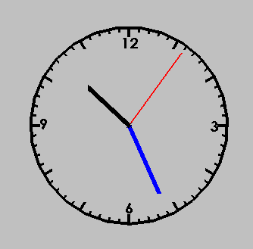
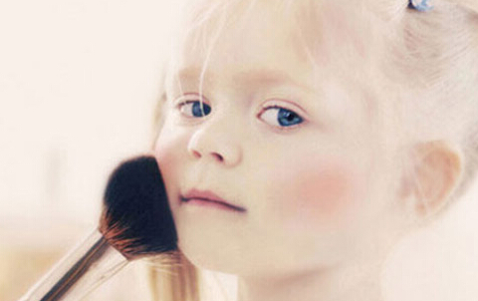
The clock goes tic-tac-tac
I'll fix my makeup instead

Slide 8
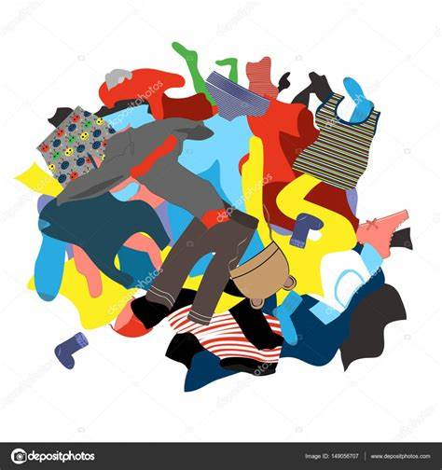
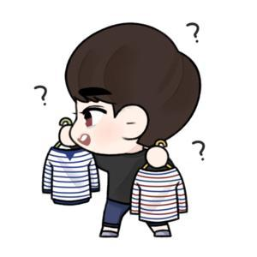
Clothes are all around
And I got nothing to wear

Slide 9
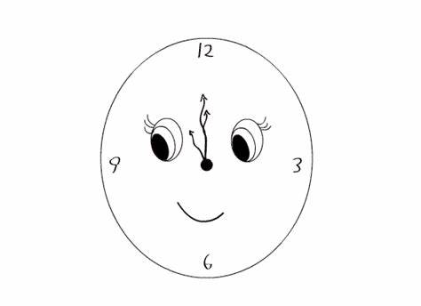
It's going tic-tac-tac
I have to do my hair

Slide 10
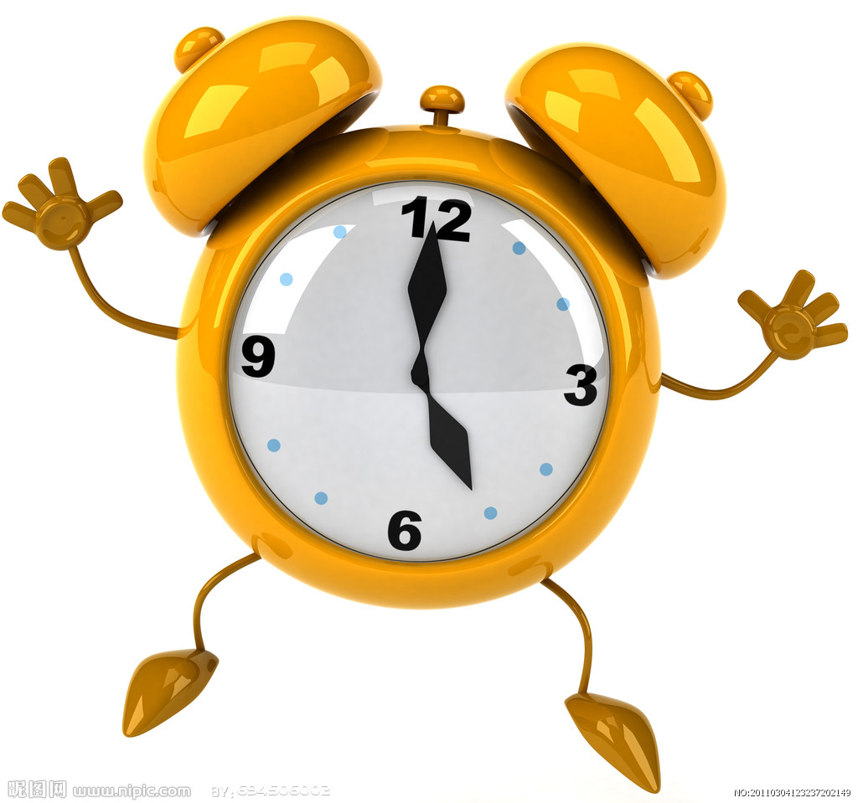
Oh I only wish I had a little time
I'm going crazy

Slide 11
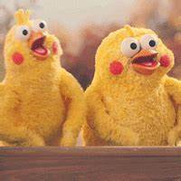
Shopping, talking on the phone,
my favorite line
Making me happy

Slide 12
One o'clock, two o'clock
One o'clock, two o'clock
All the seconds passing by

Slide 13
One o'clock, two o'clock
Three, four, five o'clock
Minutes gone up to the sky

Slide 14
One o'clock, two o'clock
Six, seven, eight o'clock
To the hours say goodbye

Slide 15
One o'clock, two o'clock
Nine and ten o'clock
When will it ever stop?

Slide 16
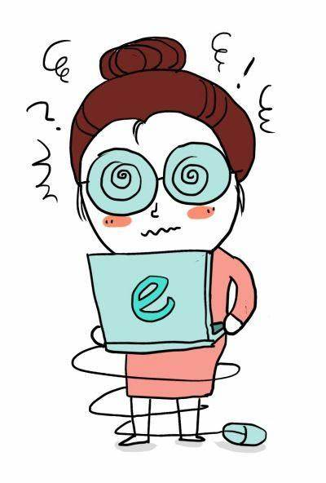
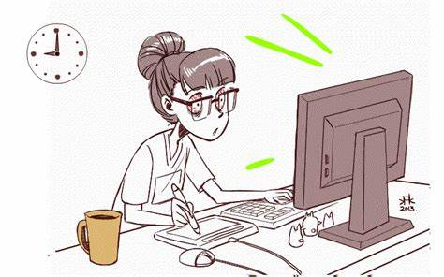
I'm so busy
Make me dizzy spinning around

Slide 17
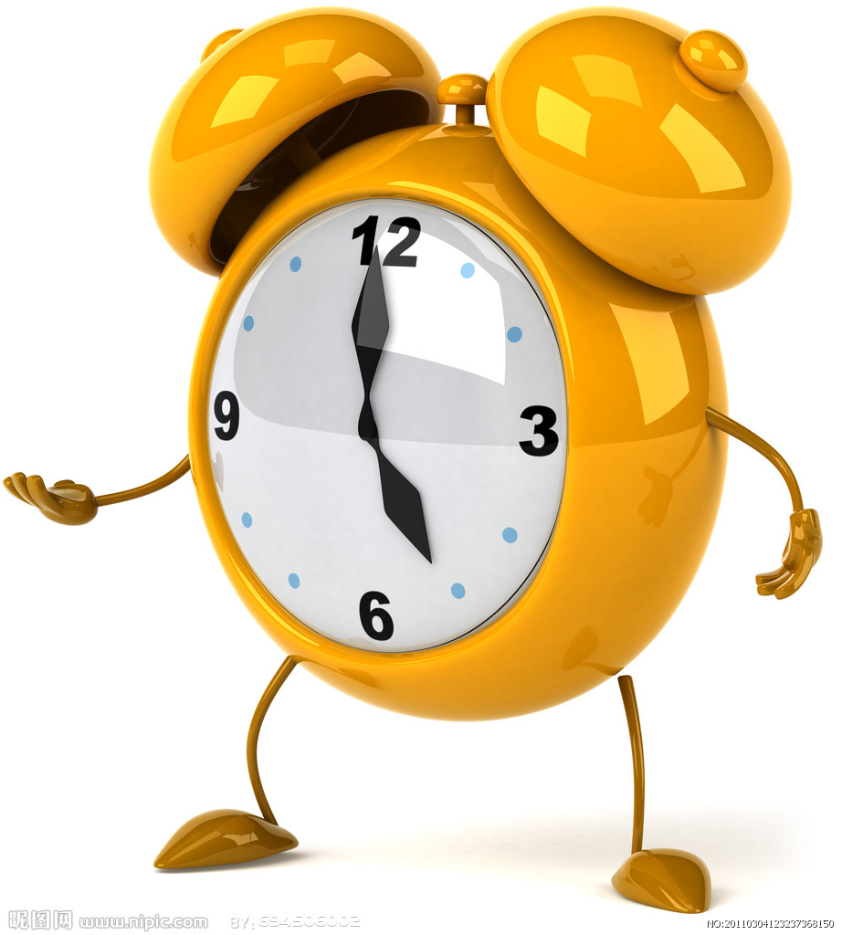
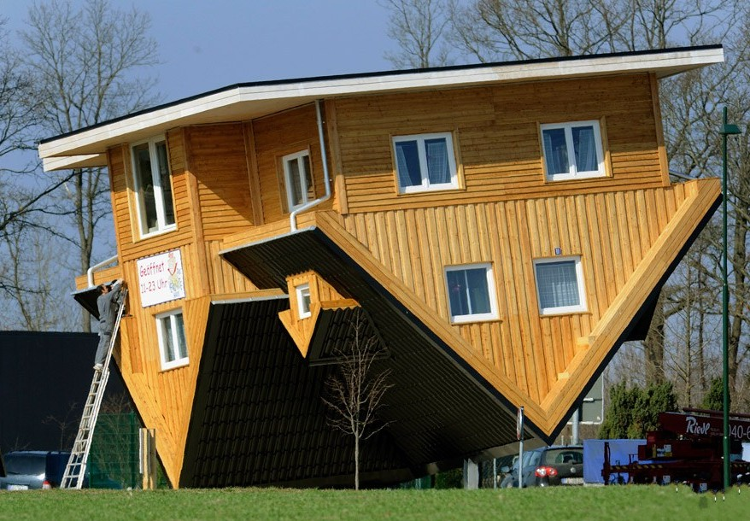
The clock goes tic-tac-tac
My world is upside down

Slide 18
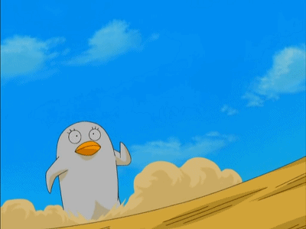
Running out the door
Oh dear, I'm already late

Slide 19
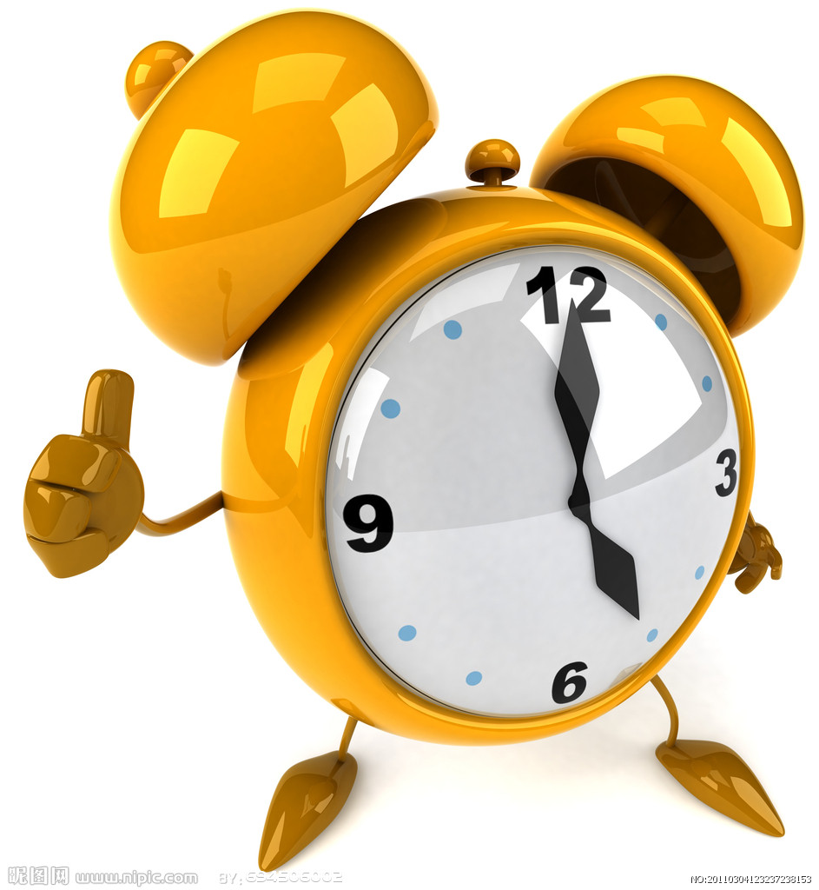
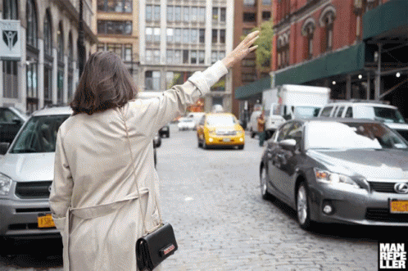
The clock goes tic-tac-tac
I'll get a cab on my way

Slide 20
Oh I only wish I had a little time
I'm going crazy

Slide 21
Shopping, talking on the phone,
my favorite line
Making me happy

Slide 22
One o'clock, two o'clock
One o'clock, two o'clock
All the seconds passing by

Slide 23
One o'clock, two o'clock
Three, four, five o'clock
Minutes gone up to the sky

Slide 24
One o'clock, two o'clock
Six, seven, eight o'clock
To the hours say goodbye

Slide 25
One o'clock, two o'clock
Nine and ten o'clock
When will it ever stop?

Slide 26
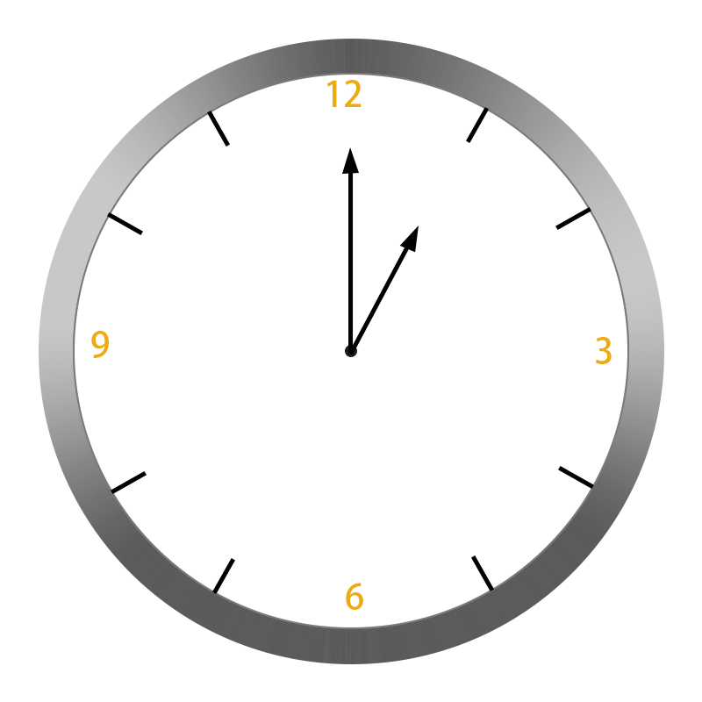
Tic-toc-tic-toc
O-woah-o-woah-o-woah

Slide 27
Tic-toc-tic-toc
Clock's ticking much too fast

Slide 28
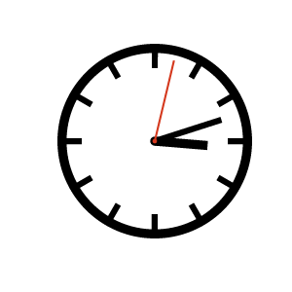
Tic-toc-tic-toc
O-woah-o-woah-o-woah

Slide 29
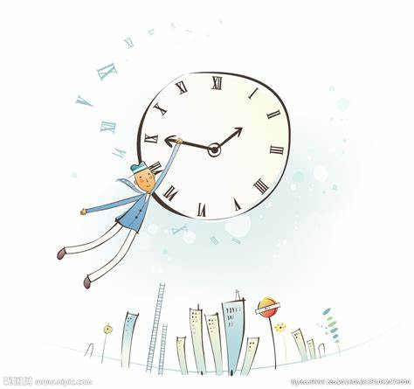
Tic-toc-tic-toc
Say how can I make it last

Slide 31
One o'clock, two o'clock
One o'clock, two o'clock
All the seconds passing by

Slide 32
One o'clock, two o'clock
Three, four, five o'clock
Minutes gone up to the sky

Slide 33
One o'clock, two o'clock
Six, seven, eight o'clock
To the hours say goodbye

Slide 34
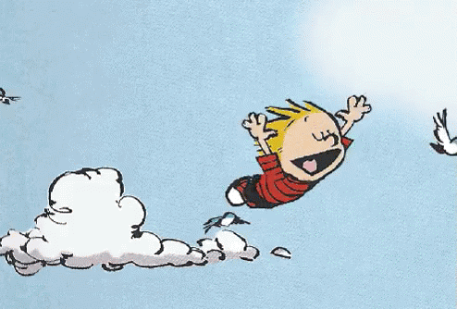
One o'clock, two o'clock
Nine and ten o'clock
Making me happy

Slide 35
One o'clock, two o'clock
One o'clock, two o'clock
All the seconds passing by

Slide 36
One o'clock, two o'clock
Three, four, five o'clock
Minutes gone up to the sky

Slide 37
One o'clock, two o'clock
Six, seven, eight o'clock
To the hours say goodbye

Slide 38
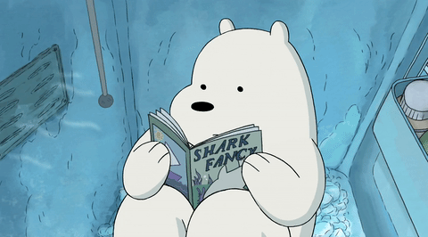
One o'clock, two o'clock
Nine and ten o'clock
When will it ever stop?

