Slide 1
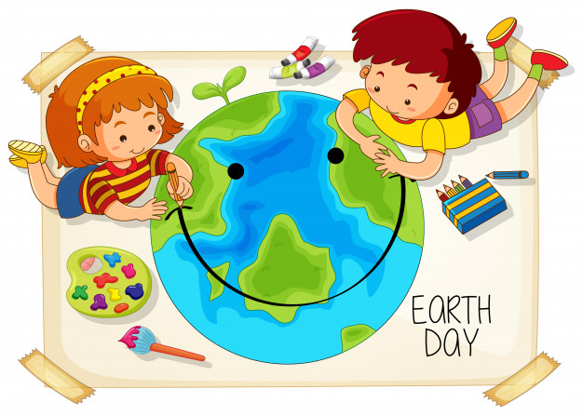
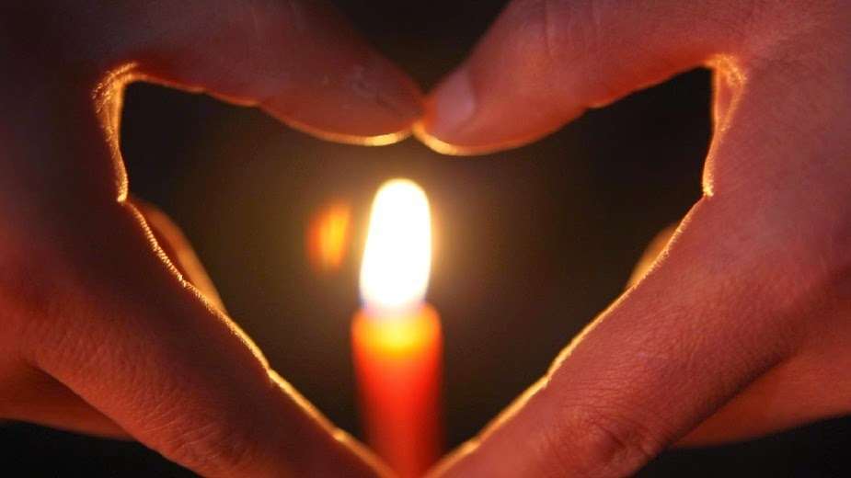
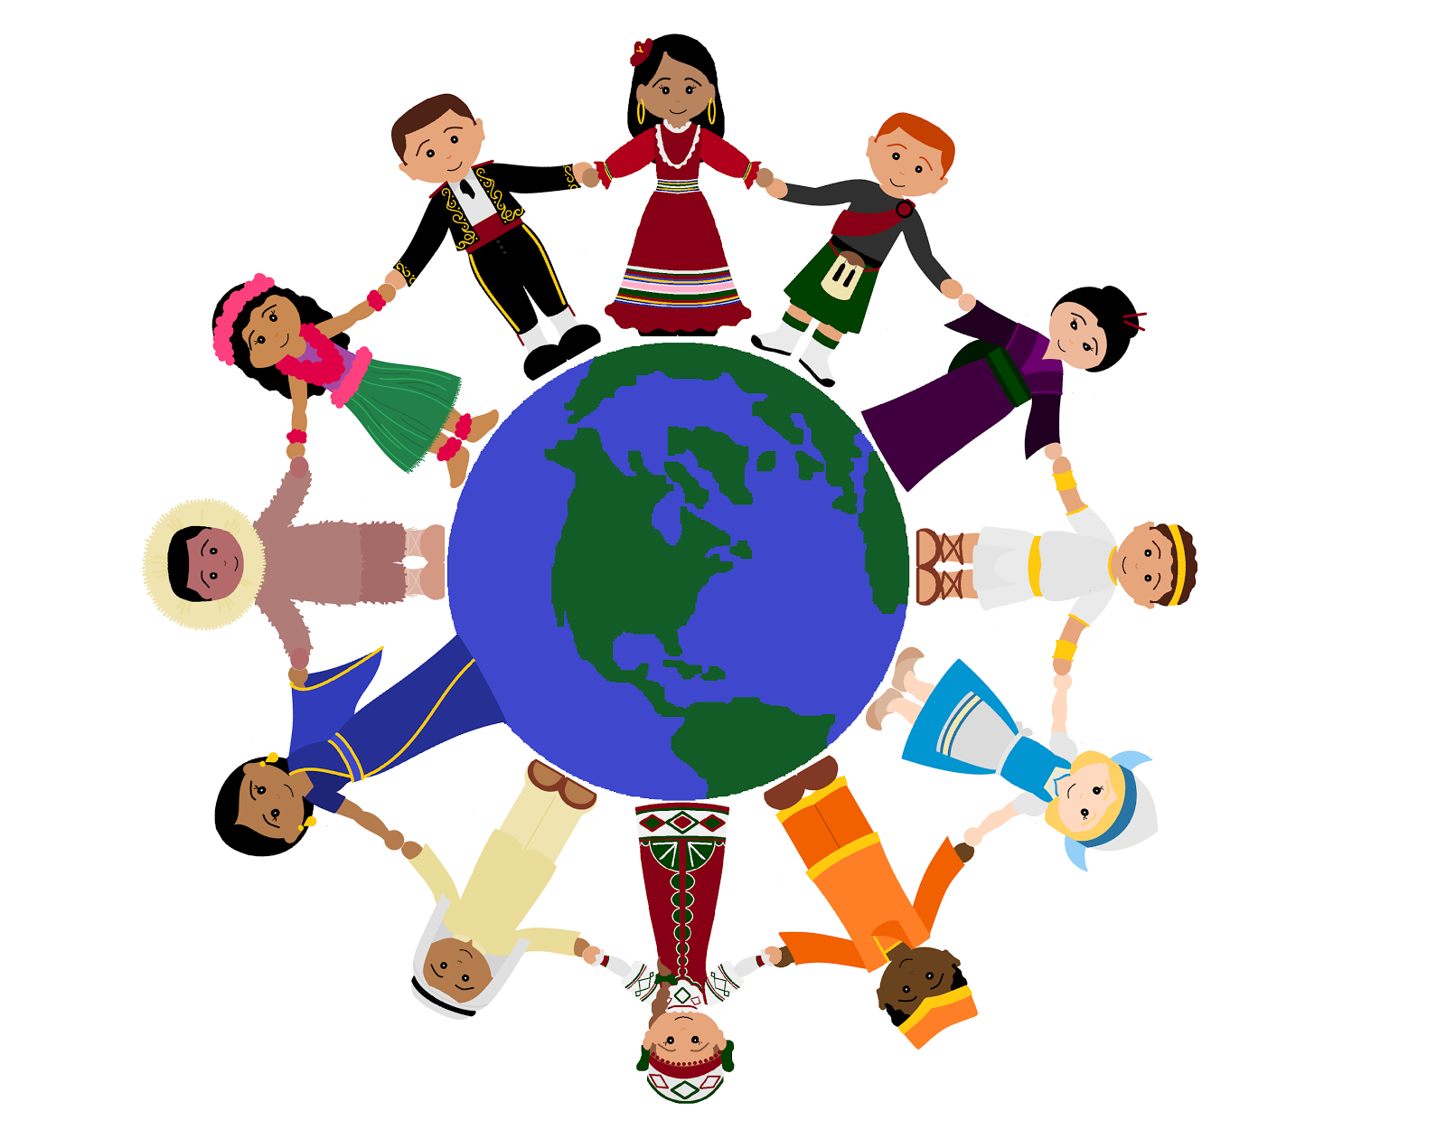
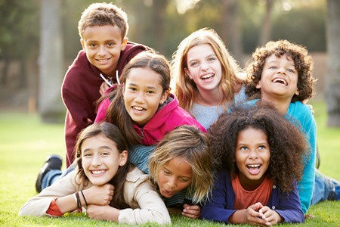
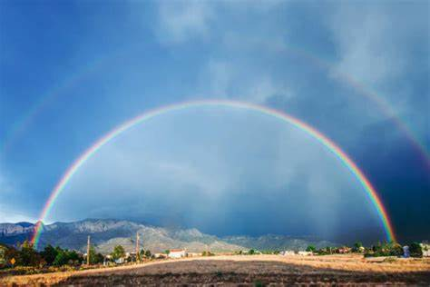
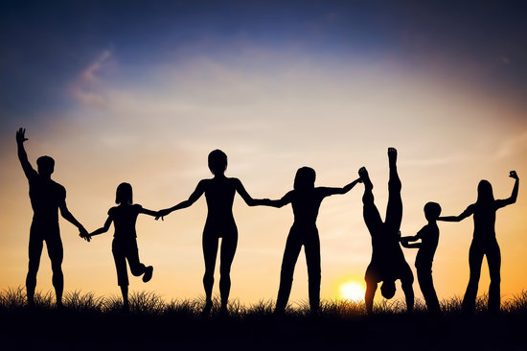
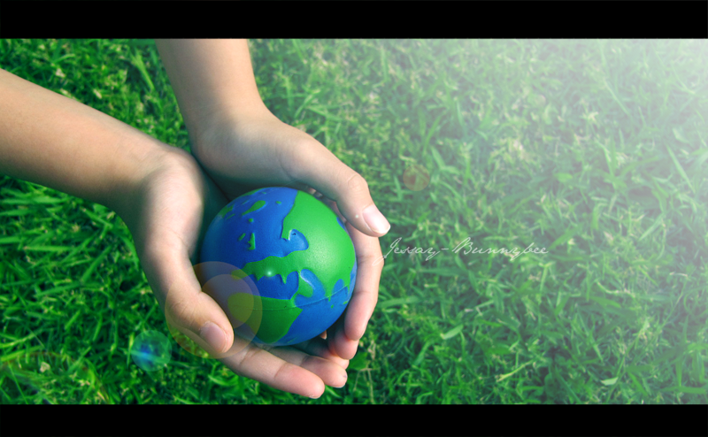
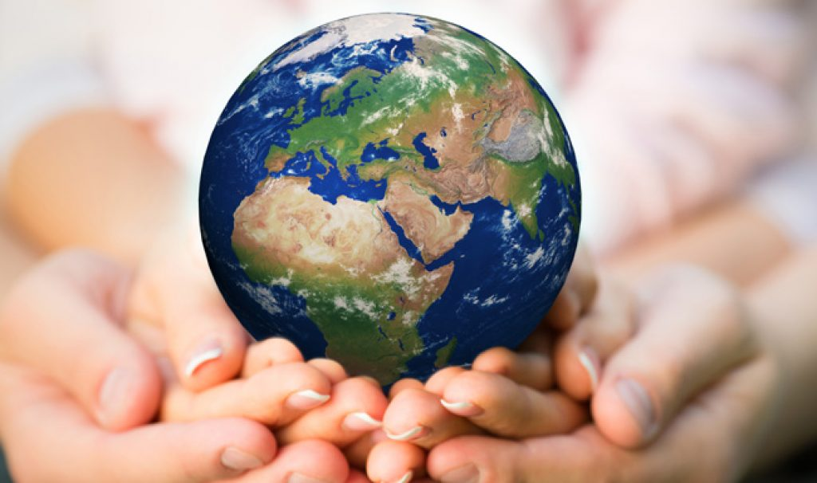
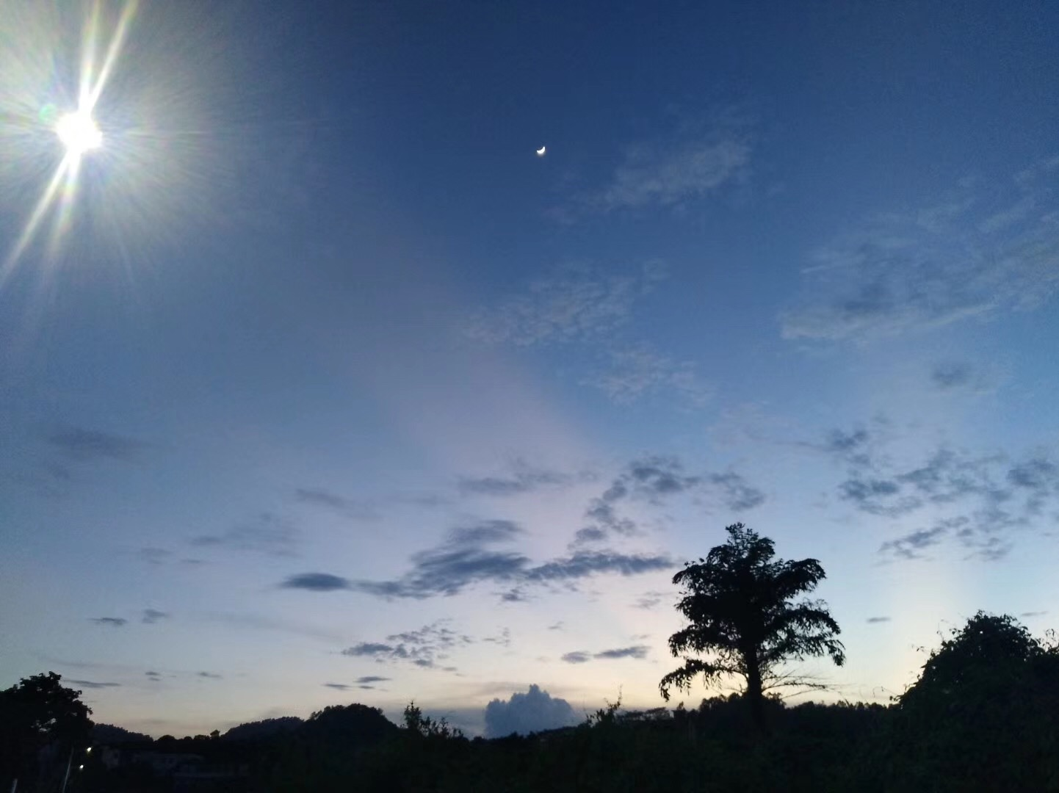
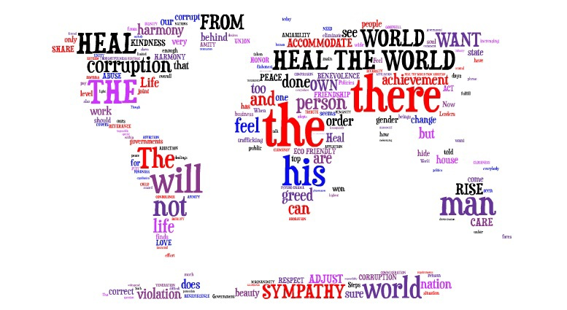
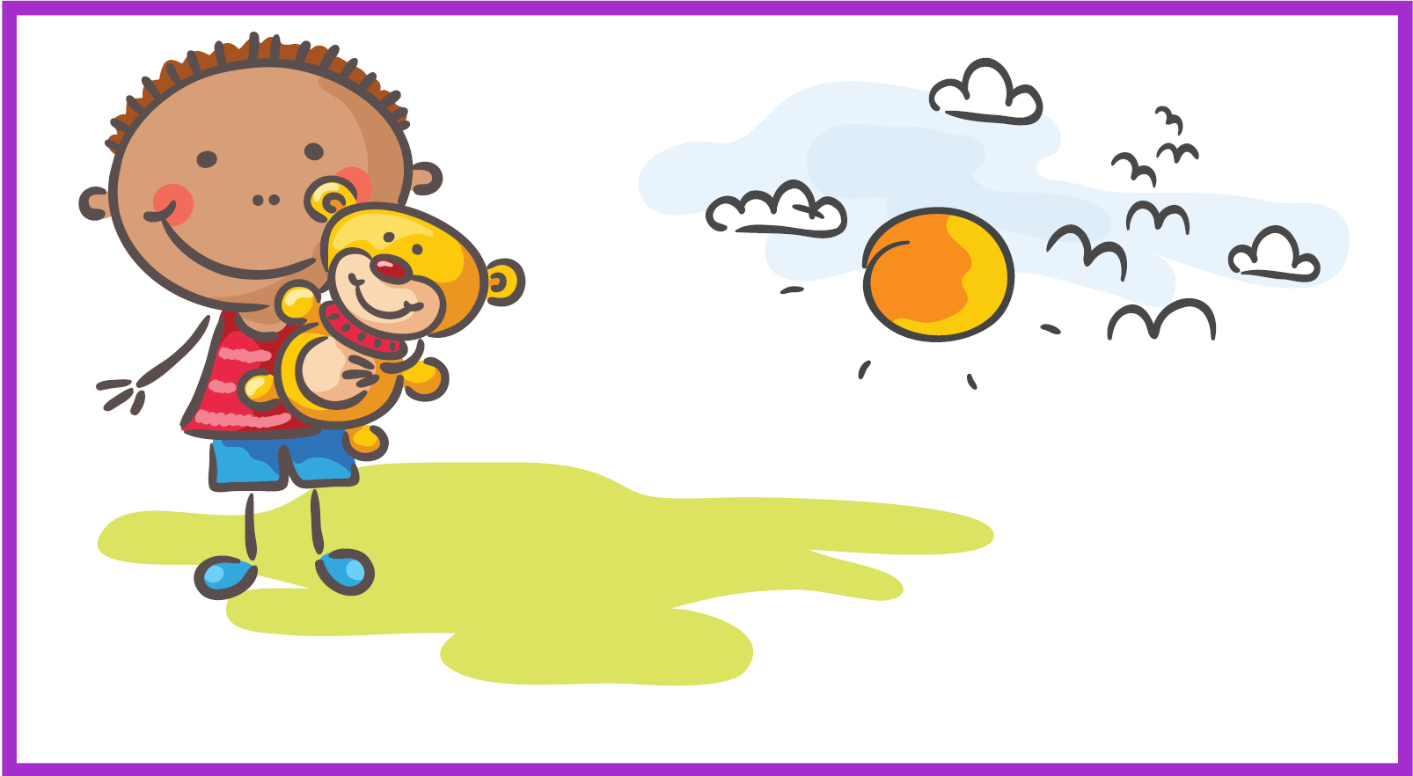
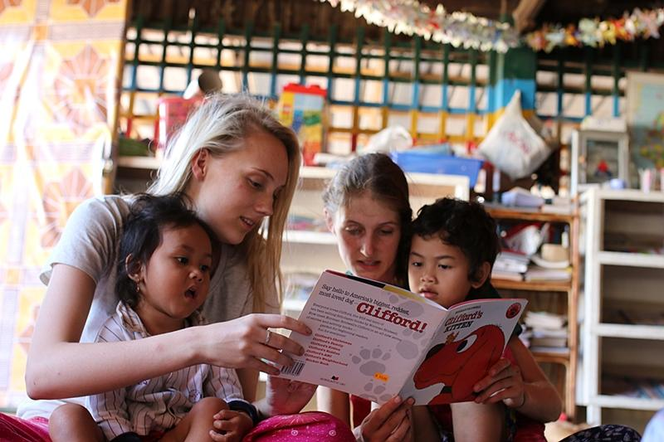
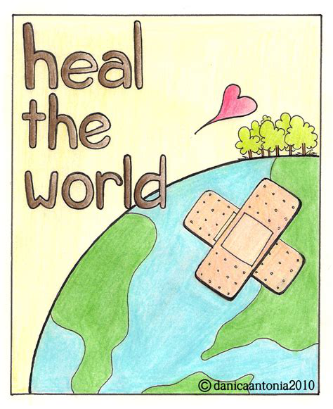
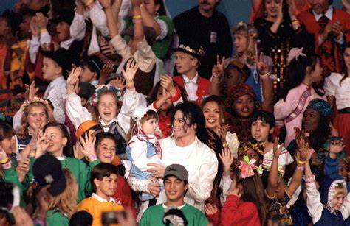
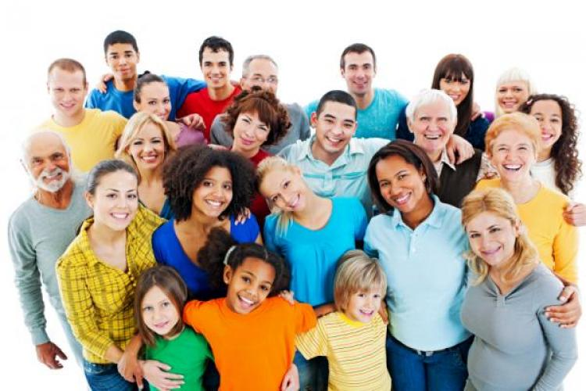
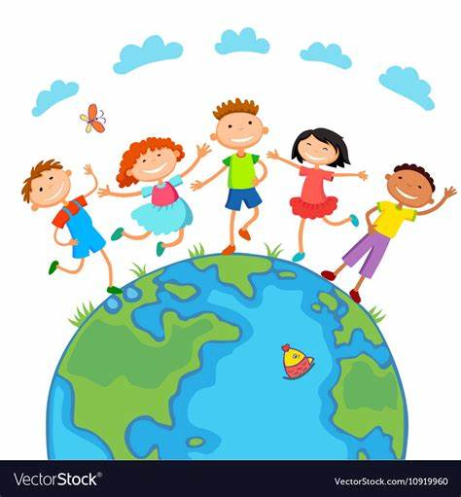
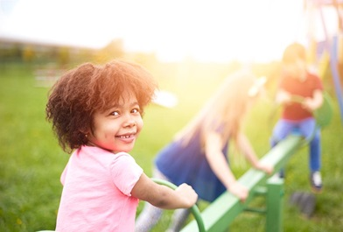
Heal the world
Make it a better place
For you and for me and the entire human race
If you care enough for the living
Heal the world Make it a better place
Make it a better place
There's a place in your heart
There are people dying If you care enough for the living
Make a better place
Make a little space
There are people dying If you care enough for the living
For you and for me and the entire human race
Heal the world
——There be句型
There are people dying
If you care enough for the living
Save it for our children
For you and for me and the entire human race
If we try We shall see
Heal the world
Make it a better place
Make a better place for you and for me
Make a better place for you and for me
Make a better place for you and for me
We stop existing And start living
Heal the world
And I know that it is love
And this place it was brighter than tomorrow
Save it for our children
Love’s enough for us growing
Heal the world we live in
Then it feels that always
Make a better place for you and for me
In this place you’ll feel there’s no hurt or sorrow
For you and for me and the entire human race
In this bliss We cannot feel fear or dread
There are ways to get there
if you care enough for the living
Love is strong
It only cares for joyful giving
you’ll find there’s no need to cry
And if you really try
There’s a love that cannot lie
Heal the world we live in
Save it for our children
Make a better world
If you want to know why
Make a better world
Heal the world we live in
Heal the world we live in
There are people dying
Save it for our children
作者: 华南师范大学外文学院 黄书凝
广东省东莞市东莞中学初中部 叶玉芳

