Slide 1
Count On Me
———— 一般现在时被动语态
设计制作：
华南师范大学外国语言文化学院 陈淑婷
广东省东莞市东莞中学初中部 莫洁文
指导教师：莫洁文、刘晓斌

Slide 2
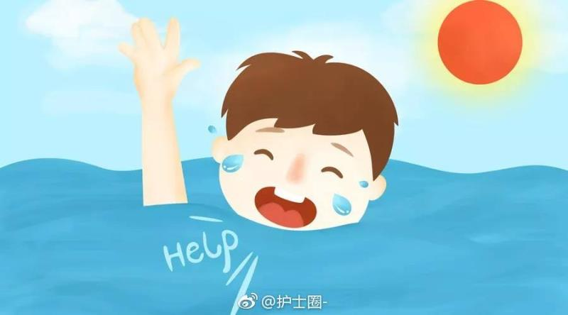
If you ever find yourself stuck in the middle of the sea,

Slide 3
I'll sail the world to find you

Slide 4
If you ever find yourself lost in the dark and you can't see

Slide 5
I'll be the light to guide you

Slide 6
Find out what we're made of

Slide 7
What we are called to help our friends in need

Slide 8
You can count on me like 1 2 3 I'll be there

Slide 9
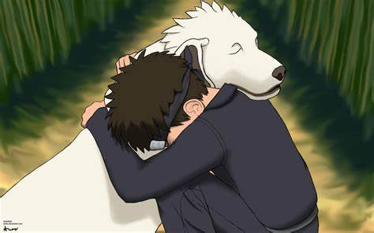
And I know when I need it I can count on you like 4 3 2

Slide 10
And you'll be there cause that's what friends are supposed to do, oh yeah

Slide 11
Wooooh, wooooh yeah yeah

Slide 12
If you toss and you turn and you just can't fall asleep

Slide 13
I'll sing a song beside you

Slide 14
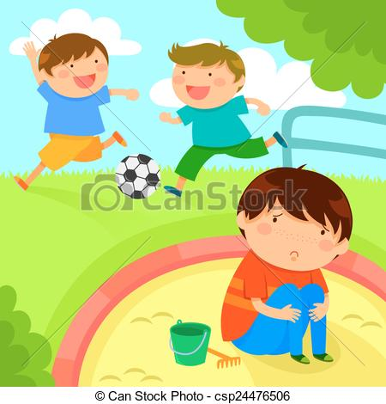
And if you ever forget how much you really mean to me

Slide 15
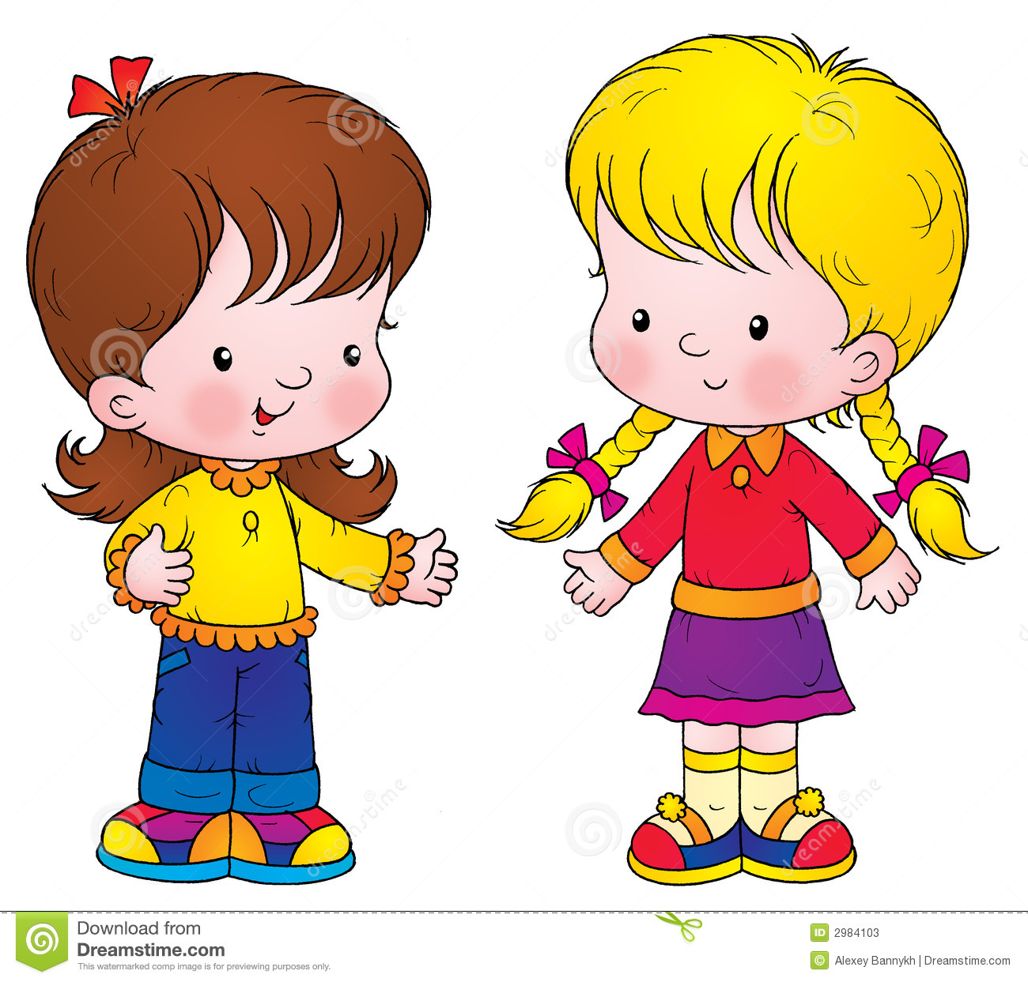
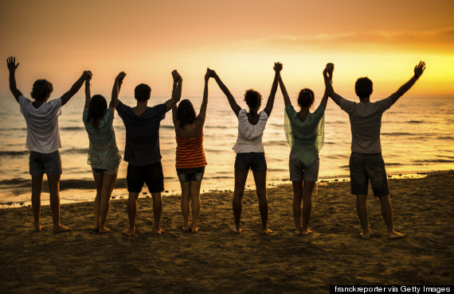
Everyday I will remind you ohh

Slide 16
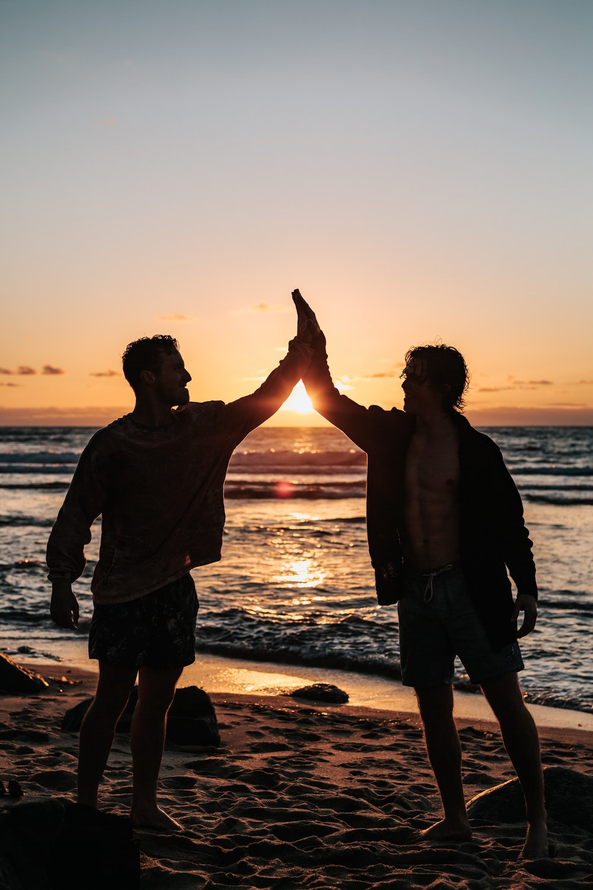
Find out what we're made of

Slide 17
What we are called to help our friends in need

Slide 18
You can count on me like 1 2 3 I'll be there

Slide 19
And I know when I need it I can count on you like 4 3 2； And you'll be there

Slide 20
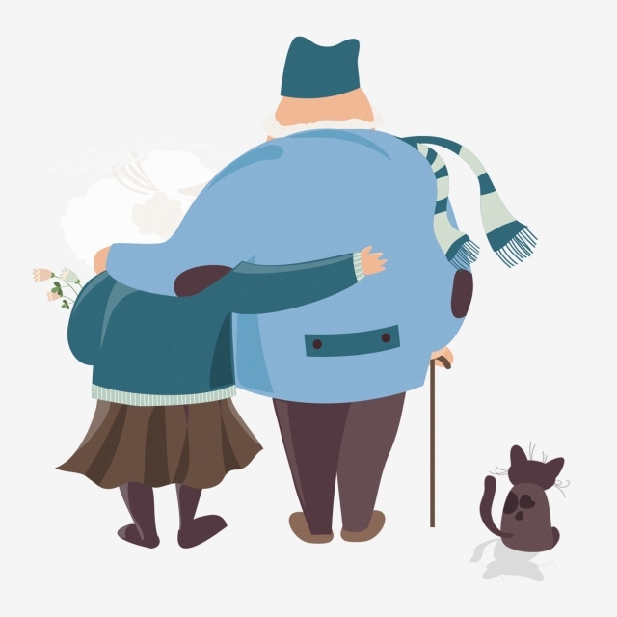
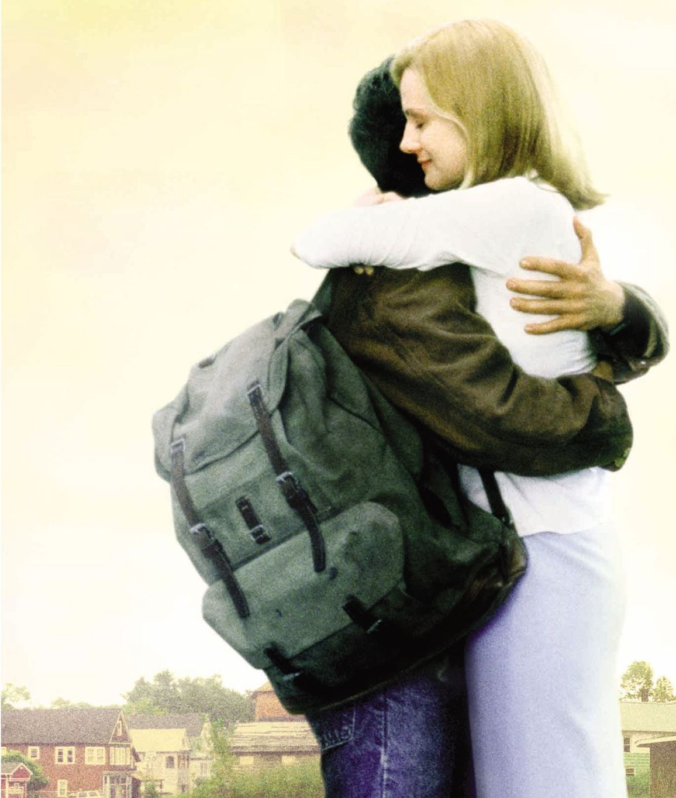
Cause that's what friends are supposed to do, oh yeah

Slide 21
Wooooh, wooooh yeah yeah

Slide 22
You'll always have my shoulder when you cry

Slide 23
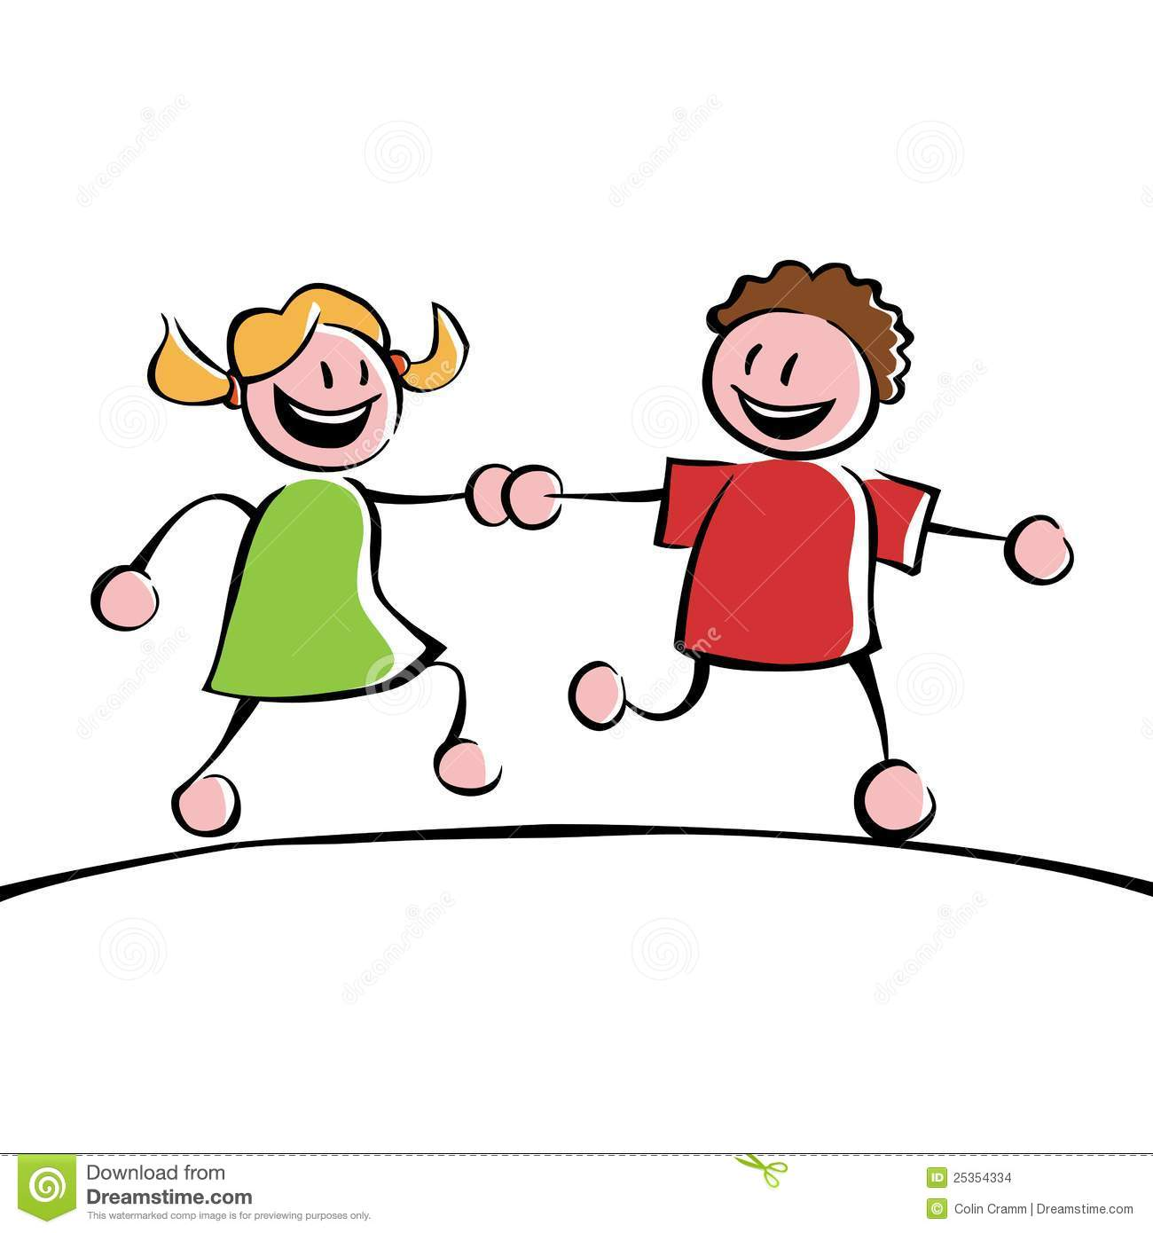
I'll never let go

Slide 24
Never say goodbye you know

Slide 25
You can count on me like 1 2 3 I'll be there

Slide 26
And I know when I need it I can count on you like 4 3 2 And you' ll be there

Slide 27
Cause that's what friends are supposed to do

Slide 28
You can count on me like 1 2 3 I'll be there

Slide 29
And I know when I need it I can count on you like 4 3 2； And you'll be there

Slide 30
Cause that's what friends are supposed to do, oh yeah

Slide 31
Wooooh, wooooh yeah yeah

Slide 32
You can count on me cos' I can count on you

