Slide 1
What Makes You Beautiful
---疑问代词&疑问副词
设计制作：
华南师范大学 陈雅琪
广东省东莞市东莞中学初中部 郑彩妍
指导教师：郑彩妍、刘晓斌

Slide 2
You're insecure Don't know what for

Slide 3
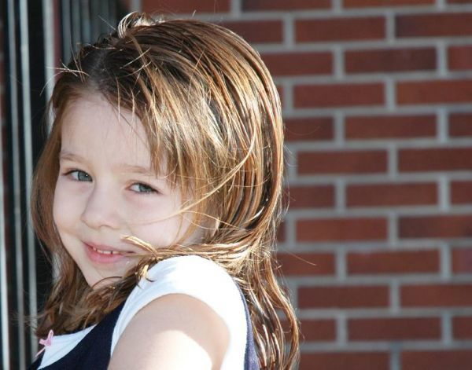
You're turning heads
When you walk through the door

Slide 4
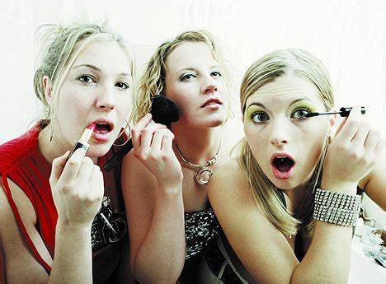
Don't need make up
To cover up

Slide 5
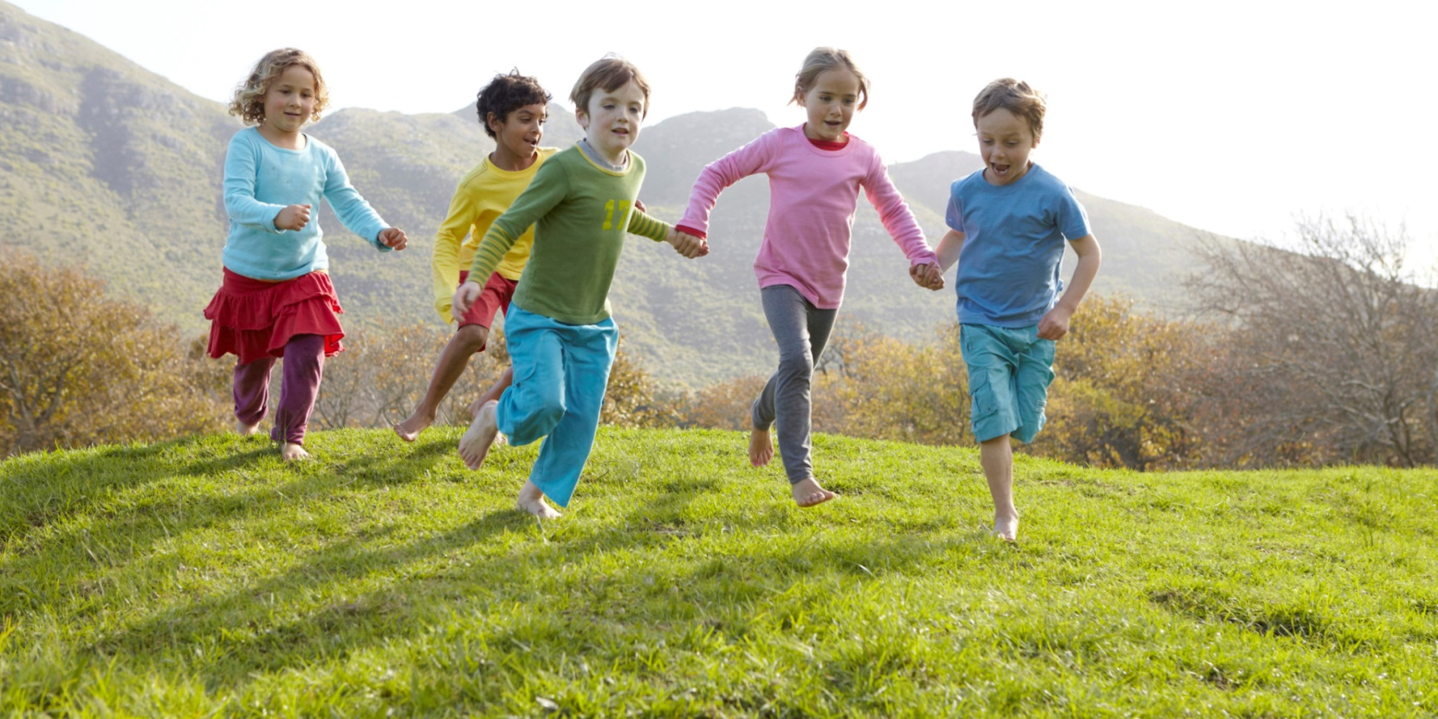
Being the way that you are is enough

Slide 6
Everyone else in the room can see it
Everyone else but you

Slide 7
Baby you light up my world like nobody else

Slide 8
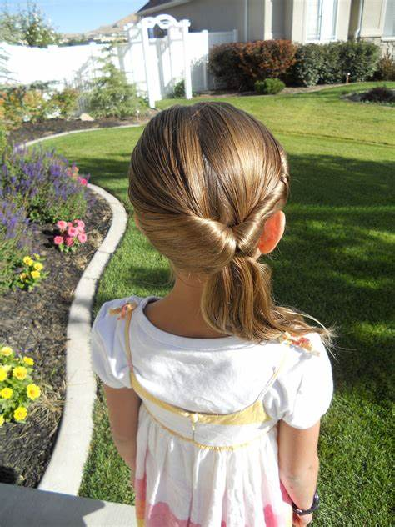
The way that you flip your hair gets me overwhelmed

Slide 9
But when you smile at the ground it ain't hard to tell
You don't know oh oh
You don't know you're beautiful

Slide 10
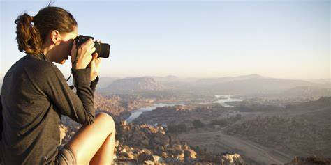
If only you saw what I can see

Slide 11
You'll understand why I want you so desperately

Slide 12
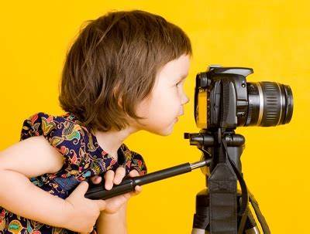
Right now I'm looking at you and I can't believe
You don't know oh oh

Slide 13
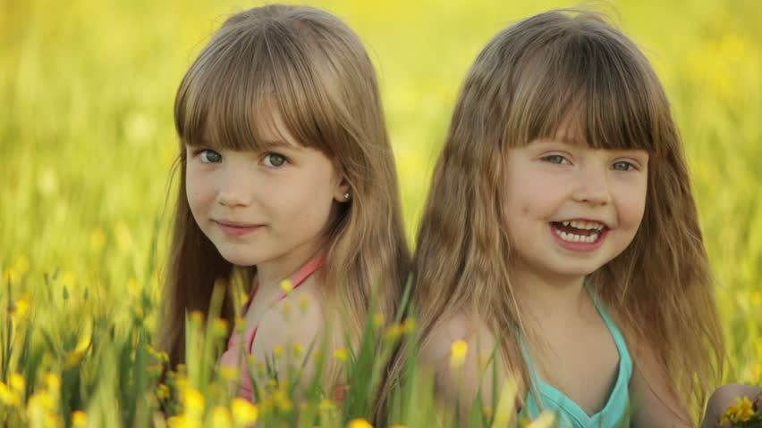
You don't know you're beautiful oh oh
That's what makes you beautiful

Slide 14
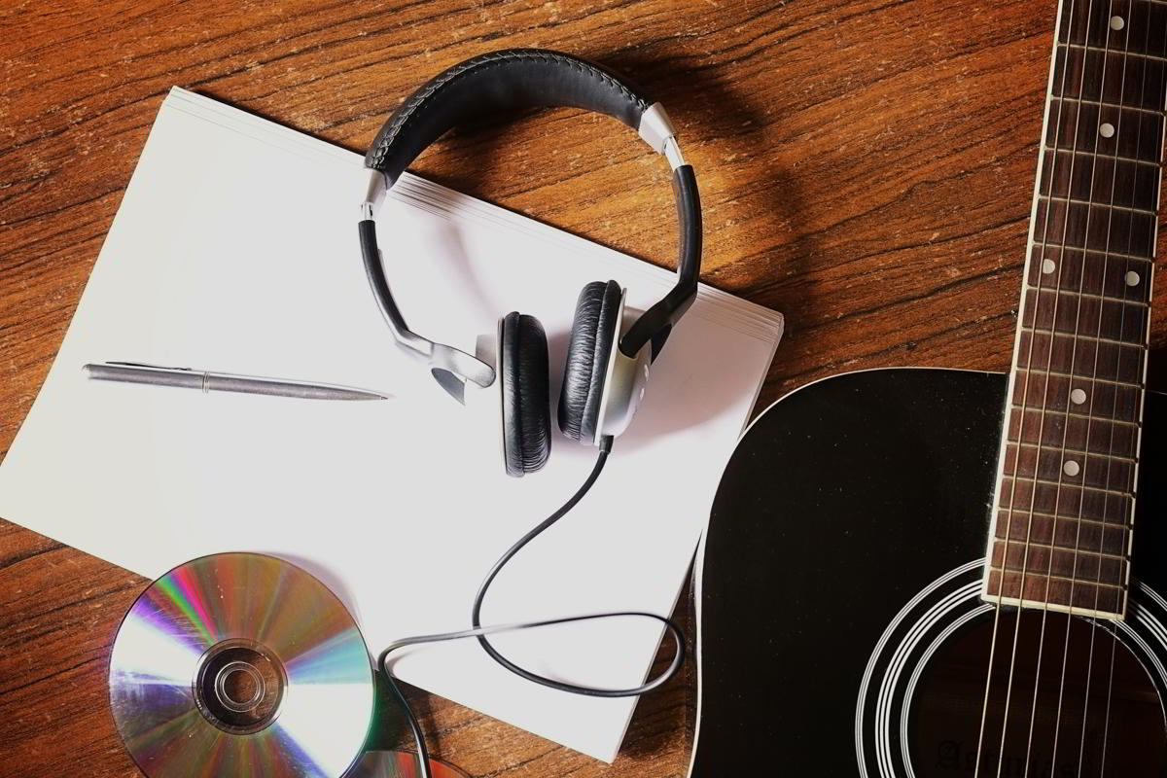
So c-come on
You got it wrong
To prove I'm right I put it in a song

Slide 15
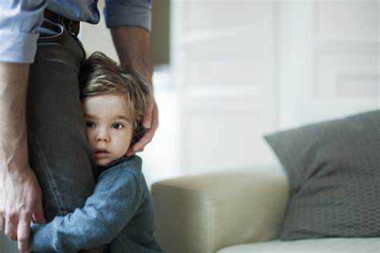
I don't know why
You're being shy

Slide 16
And turn away when I look into your eyes

Slide 17
Everyone else in the room can see it
Everyone else but you

Slide 18
Baby you light up my world like nobody else
The way that you flip your hair gets me overwhelmed

Slide 19
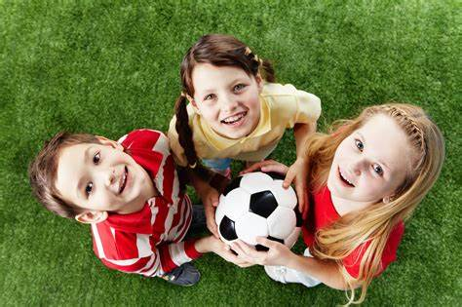
But when you smile at the ground it ain't hard to tell

Slide 20
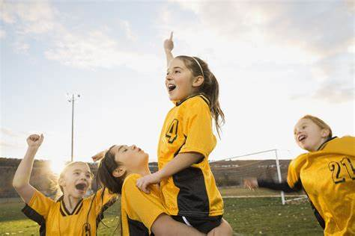
You don't know oh oh
You don't know you're beautiful

Slide 21
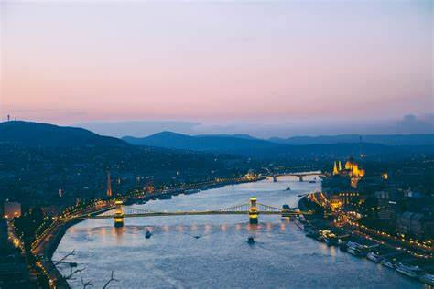
If only you saw what I can see

Slide 22
You'll understand why I want you so desperately

Slide 23
Right now I'm looking at you and I can't believe
You don't know oh oh
？

Slide 24
You don't know you're beautiful oh oh
That's what makes you beautiful

Slide 25
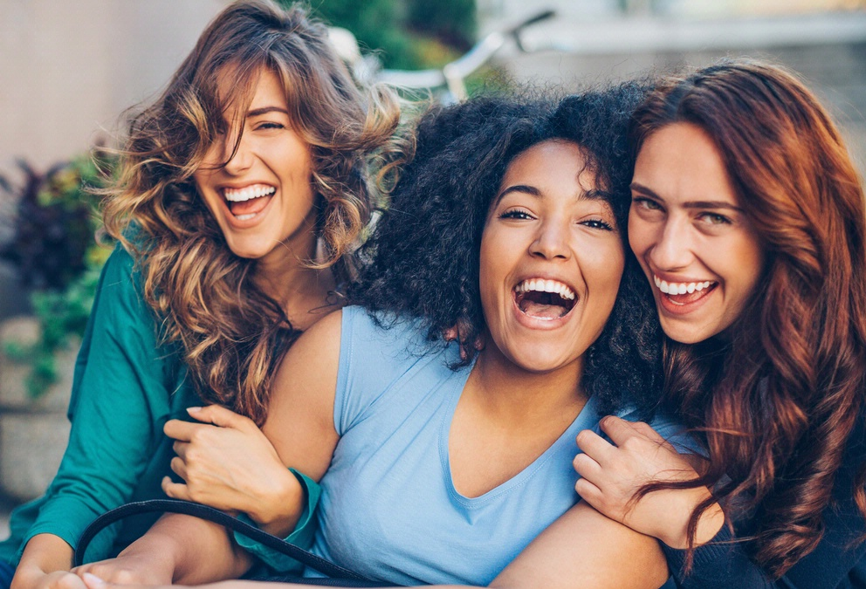
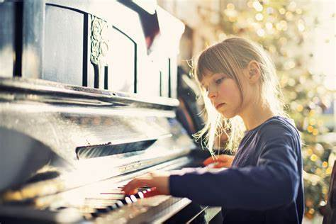
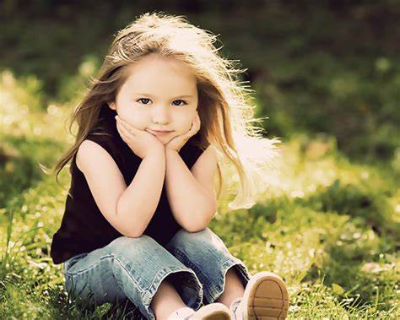
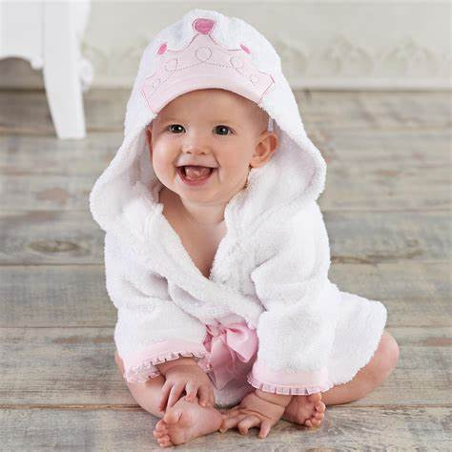

Slide 26
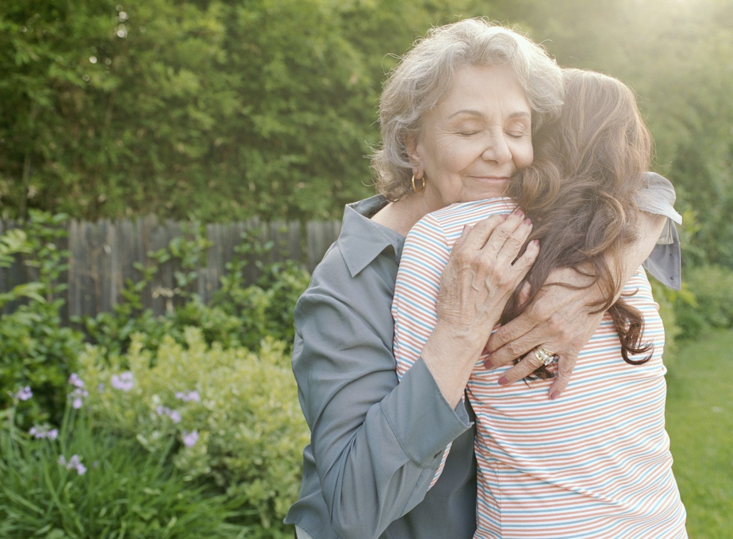

Slide 27
Baby you light up my world like nobody else
The way that you flip your hair gets me overwhelmed

Slide 28
But when you smile at the ground it ain't hard to tell

Slide 29
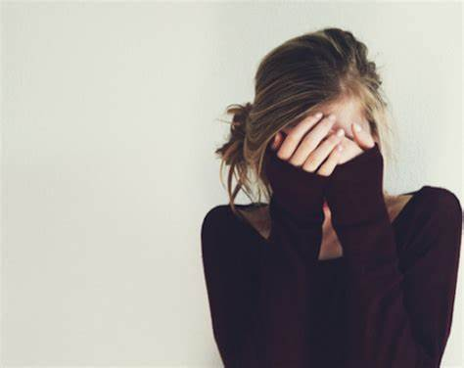
You don't know oh oh
You don't know you're beautiful

Slide 30
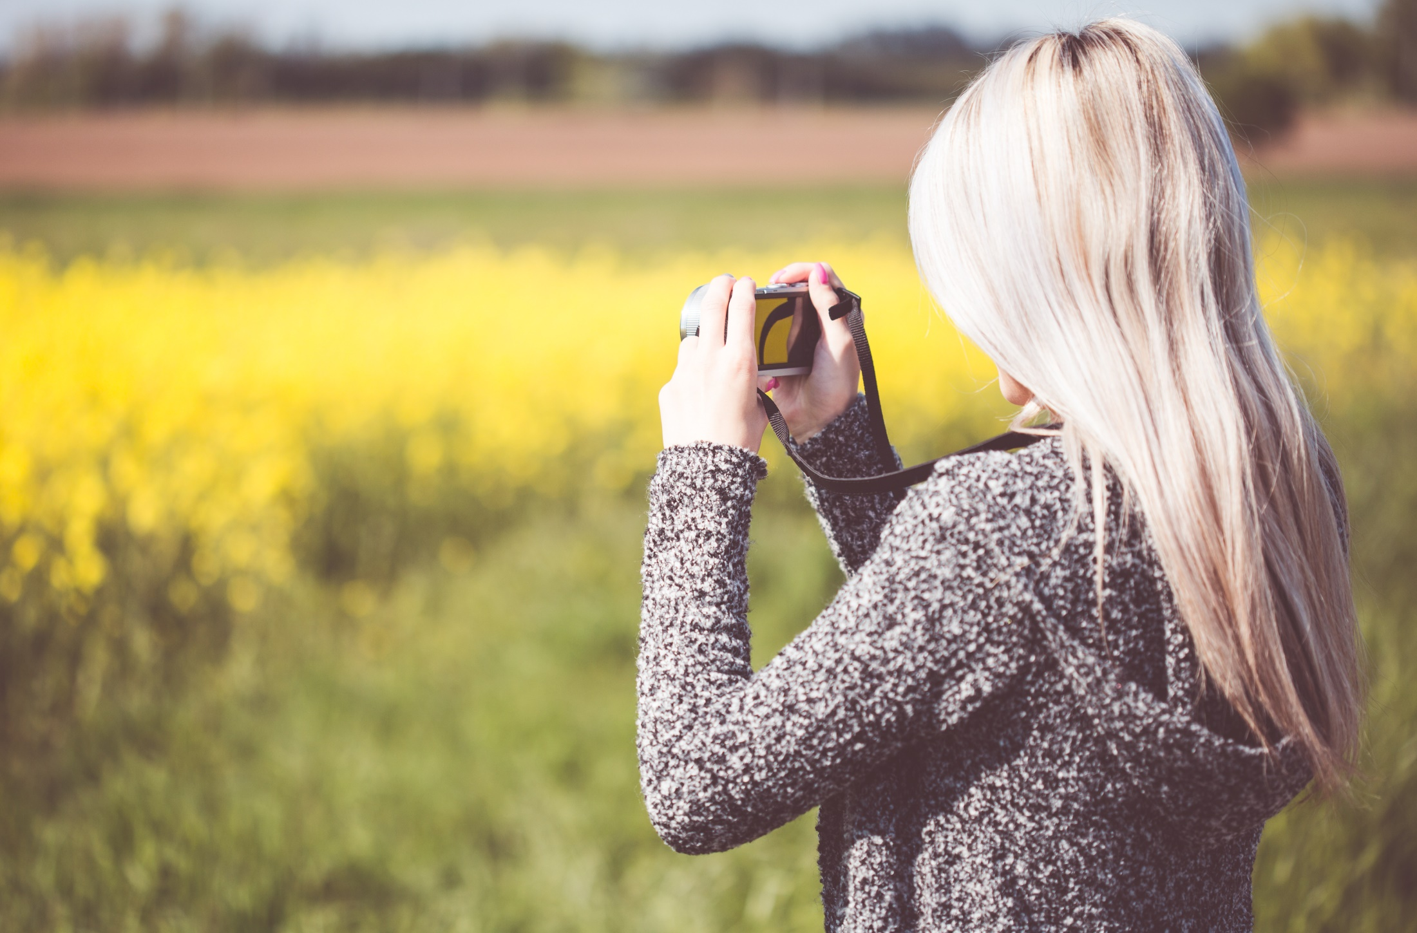
Baby you light up my world like nobody else
The way that you flip your hair gets me overwhelmed

Slide 31
But when you smile at the ground it ain't hard to tell
You don't know oh oh
You don't know you're beautiful

Slide 32
If only you saw what I can see

Slide 33
You'll understand why I want you so desperately

Slide 34
Right now I'm looking at you and I can't believe
You don't know oh oh

Slide 35
You don't know you're beautiful oh oh

Slide 36
That’s what makes you beautiful

