Slide 1

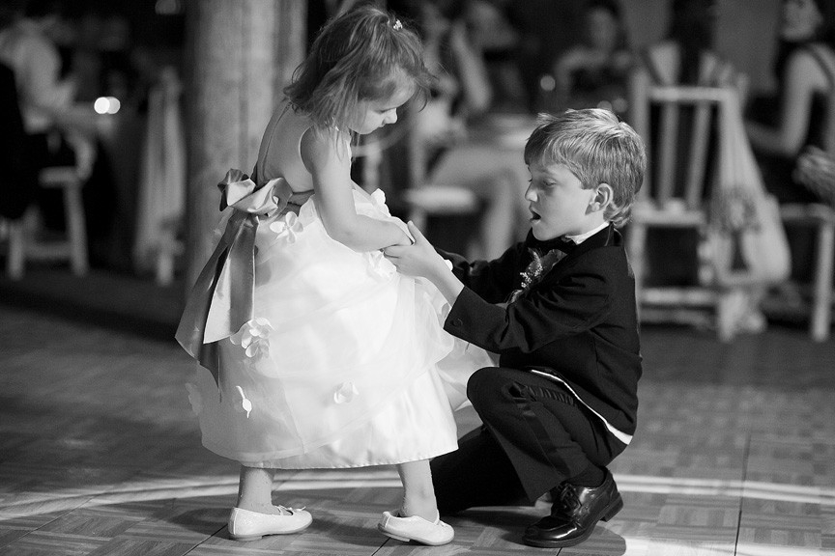















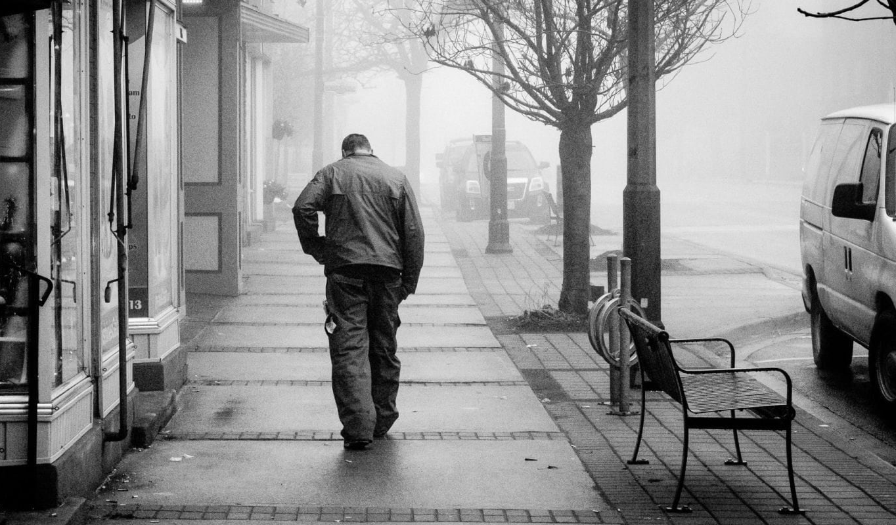
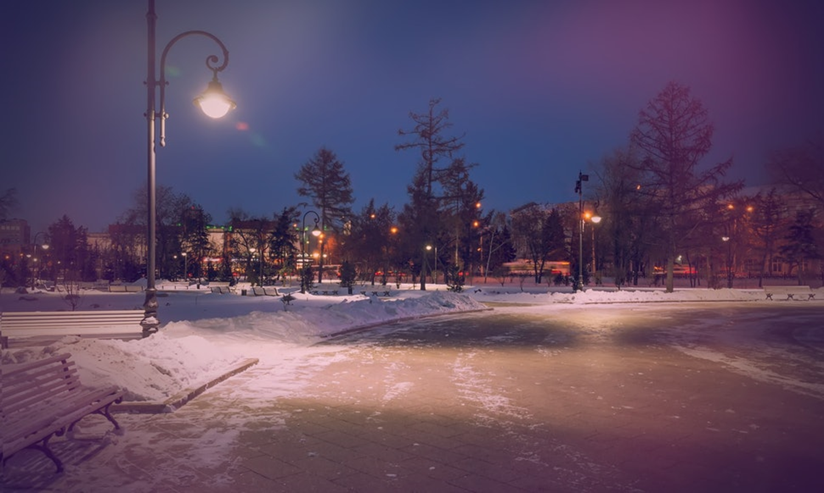
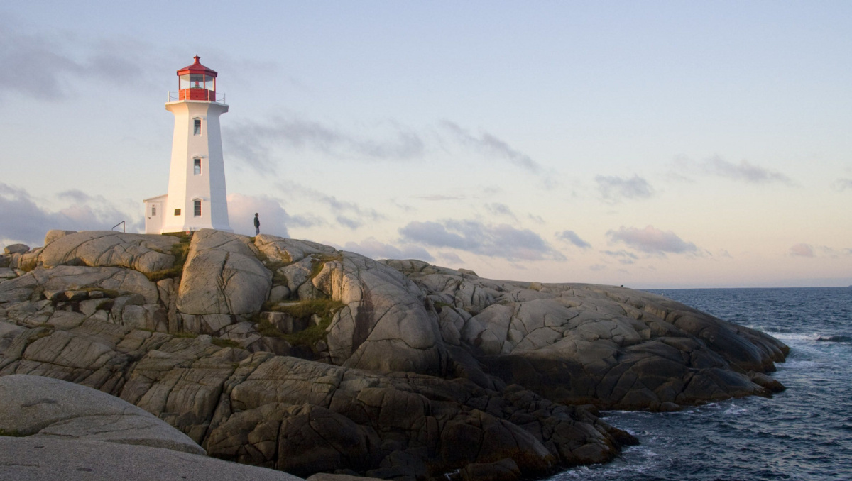



Take me away to where you are
带我去你那里
Everyday time is passing growing tired of all this traffic
每天时间在流逝，厌倦了这一切的交通
I wanna be holding your hand in the sand by the tire swing
我想在沙滩的轮胎秋千上牵着你的手
I traveled a thousand miles
我旅行了一千英里
I wanna be holding your hand in the sand by the tire swing
我想在沙滩的轮胎秋千上牵着你的手
I wanna be holding your hand in the sand by the tire swing
我想在沙滩的轮胎秋千上牵着你的手
I traveled a thousand miles
我旅行了一千英里
I wanna be holding your hand in the sand by the tire swing
我想在沙滩的轮胎秋千上牵着你的手
My skies seem a little bit darker
我的天空看起来有点阴暗
I traveled a thousand miles
我旅行了一千英里
Now that you're gone
现在你走了
I hate when you're gone
我恨你离开的时候
I traveled a thousand miles
我旅行了一千英里
My heart beats a little bit slower,
我的心跳有些慢，
these nights are a little bit colder
这些夜晚有点冷
Where we used to be baby you and me
像我们曾经那样
Where we used to be baby you and me
像我们曾经那样
Just so I can see you smile
只为了可以看见你的微笑
Where we used to be baby you and me
像我们曾经那样
Sweet dreams gonna a little bit harder
甜蜜的梦似乎有点困难
Where we used to be baby you and me
像我们曾经那样
If I could write another ending,
如果我能写下另一个结局
Just so I can see you smile
只为了可以看见你的微笑
Just so I can see you smile
只为了能看见你的微笑
Home is in your eyes
--------形容词比较级
设计制作：华南师范大学外国语言文化学院 谭诗逸
广东省东莞市东莞中学初中部 陈燕青
指导老师：陈燕青 刘晓斌
Just so I can see you smile
只为了能看见你的微笑
Your heart beats a little bit faster
你的心跳有些快
The end
this wouldn't even be our song
这也不会是我们的歌
Now that I'm gone
现在我走了
You hate that I'm gone
你恨我走了
I‘d find a way that we would never ever be apart
我想找到一种方法，我们将永远不分开
Feels so far away when you cry
当你哭泣时,感觉如此遥远
Feels so far away when you cry
当你哭泣时,感觉如此遥远
Feels so far away when you cry,
当你哭泣时,感觉如此遥远
Feels so far away when you cry,
当你哭泣时,感觉如此遥远
Things take just a little bit longer
事情需要一些时间
There's tears were there used to be laughter
曾经有泪水也有欢笑
You talk just a little bit softer
你的话语有些轻柔
right from the start
从一开始
Cause home is in your eyes
因为家就在你眼中
Cause home is in your eyes
因为家就在你眼中
Cause home is in your eyes
因为家就在你眼中
cause home is in Your eyes
因为家就在你眼中
Everyday time is passing, growing tired of all this traffic
每天时间在流逝 ，厌倦了所有的交通
Take me away to where you are
带我去你那里

