Slide 1
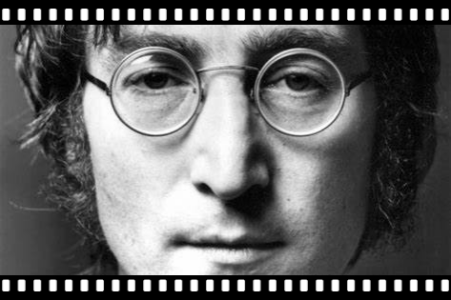
How
John Lennon
作者：
华南师范大学外国语言文化学院 方子欣
广东省东莞市东莞中学初中部 陈燕青

Slide 2
How can I go forward when I don't know which way I'm facing

Slide 3
How can I go forward when I don't know which way to turn

Slide 4
How can I go forward into
something I'm not sure of

Slide 5
Oh no, oh no

Slide 6
How can I have feeling
When I don’t know if it is a feeling

Slide 7
How can I feel something
if I just don't know how to feel

Slide 8
How can I have feelings
when my feelings have
always been denied

Slide 9
Oh no, oh no

Slide 10
You know life can be long And you got to be so strong

Slide 11
And the world is so tough
Sometimes I feel I've had enough

Slide 12
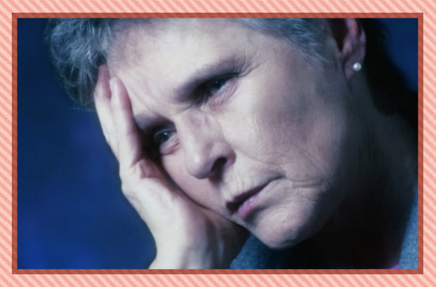
How can I give love
when I don't know what it is I'm giving

Slide 13
How can I give love
when I just don't know how to give

Slide 14
How can I give love
when love is something I ain't never had

Slide 15
Oh no, oh no

Slide 16
You know life can be long
And you’ve got to be so strong
Sometimes I feel I've had enough
And the world she is tough

Slide 17
How can we
go forward when we don't know which way
we're facing

Slide 18
How can we go forward
when we don't know
which way to turn

Slide 19
How can we go forward into something we're not sure of

Slide 20
Oh no
Oh no

Slide 21
John Lennon
How
Thank you for watching

