Slide 1
Anything You Can Do
副词的比较级与最高级
华南师范大学外国语言文化学院 王星玉
东莞中学初中部 陈燕青

Slide 2
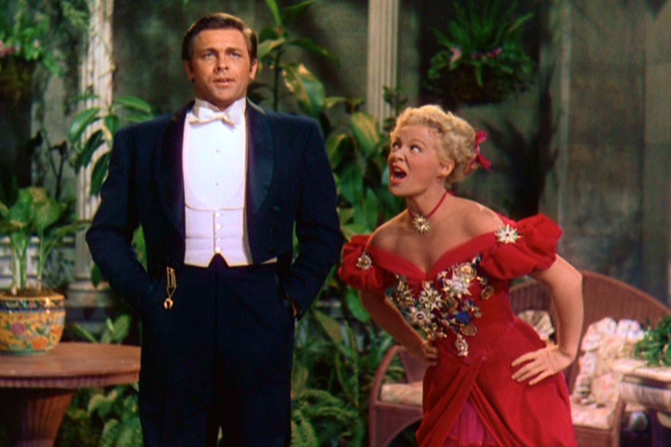
Anything you can do I can do better
I can do anything better than you

Slide 3
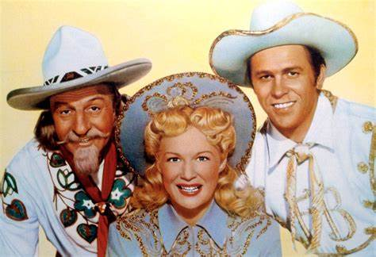
No， you can't
Yes， I can
No， you can't
Yes， I can~

Slide 4
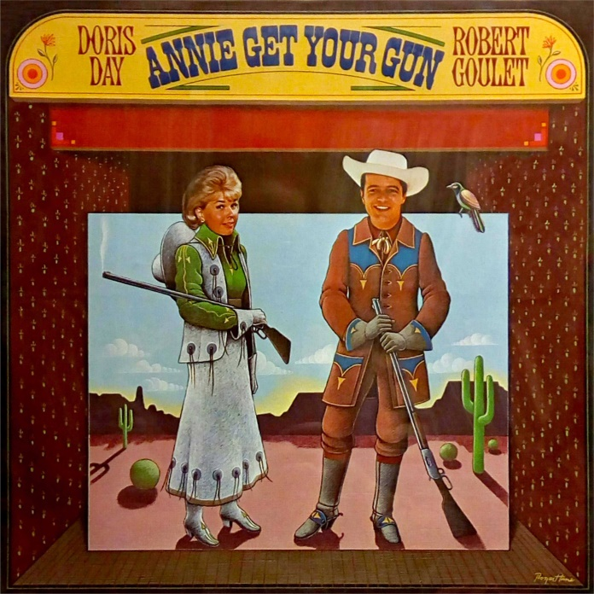
Anything you can be，I can be greater
Sooner or later，I'm greater than you

Slide 5
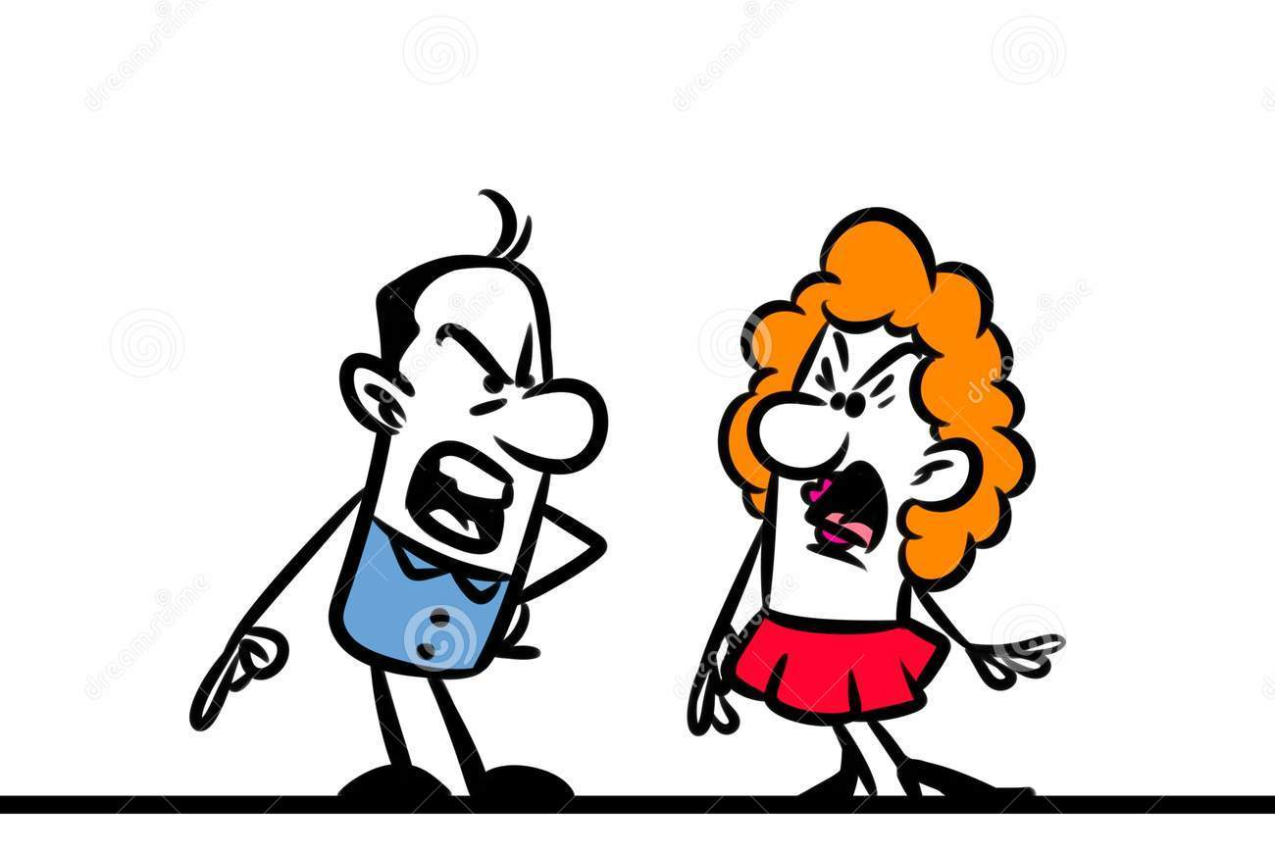
No, you‘re not
Yes. I am~

Slide 6
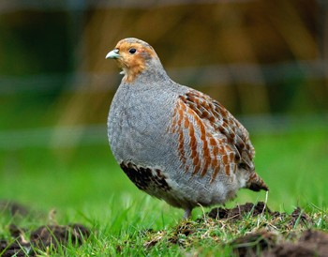
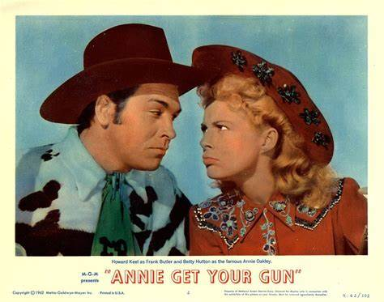
I can shoot a partridge
With a single cartridge

Slide 7
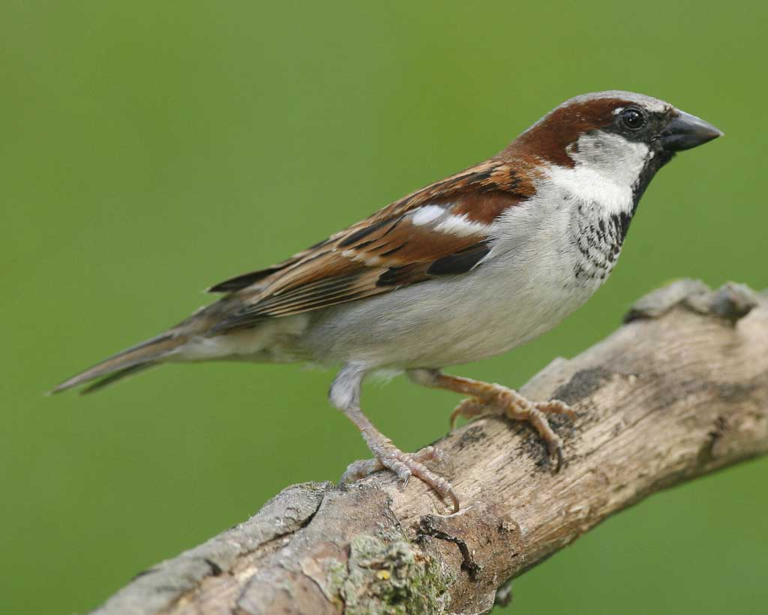
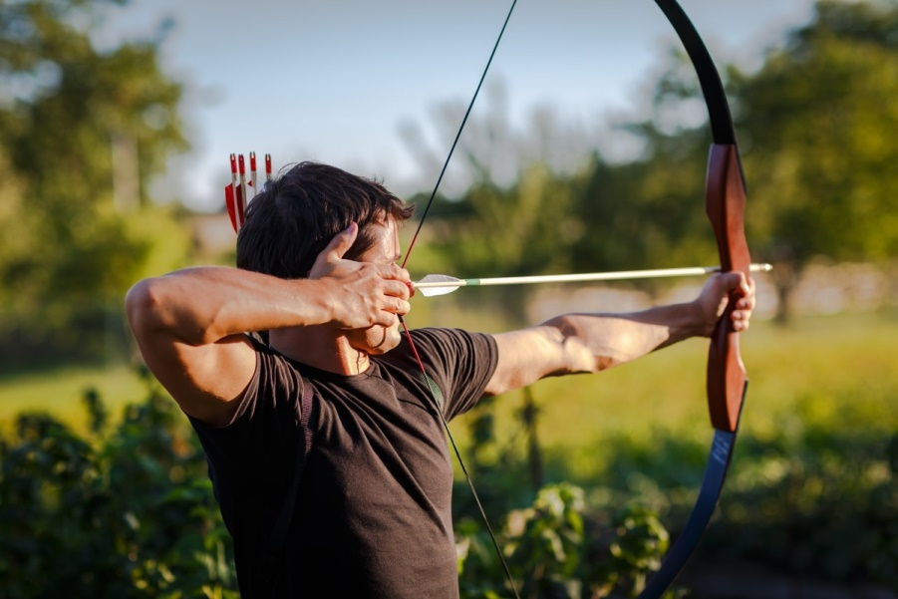
I can get a sparrow
With a bow and arrow

Slide 8
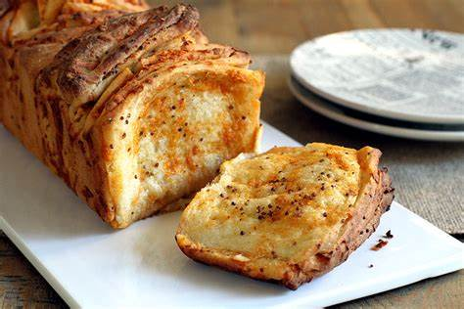
I can live on bread and cheese
And only on that, so can a rat

Slide 9
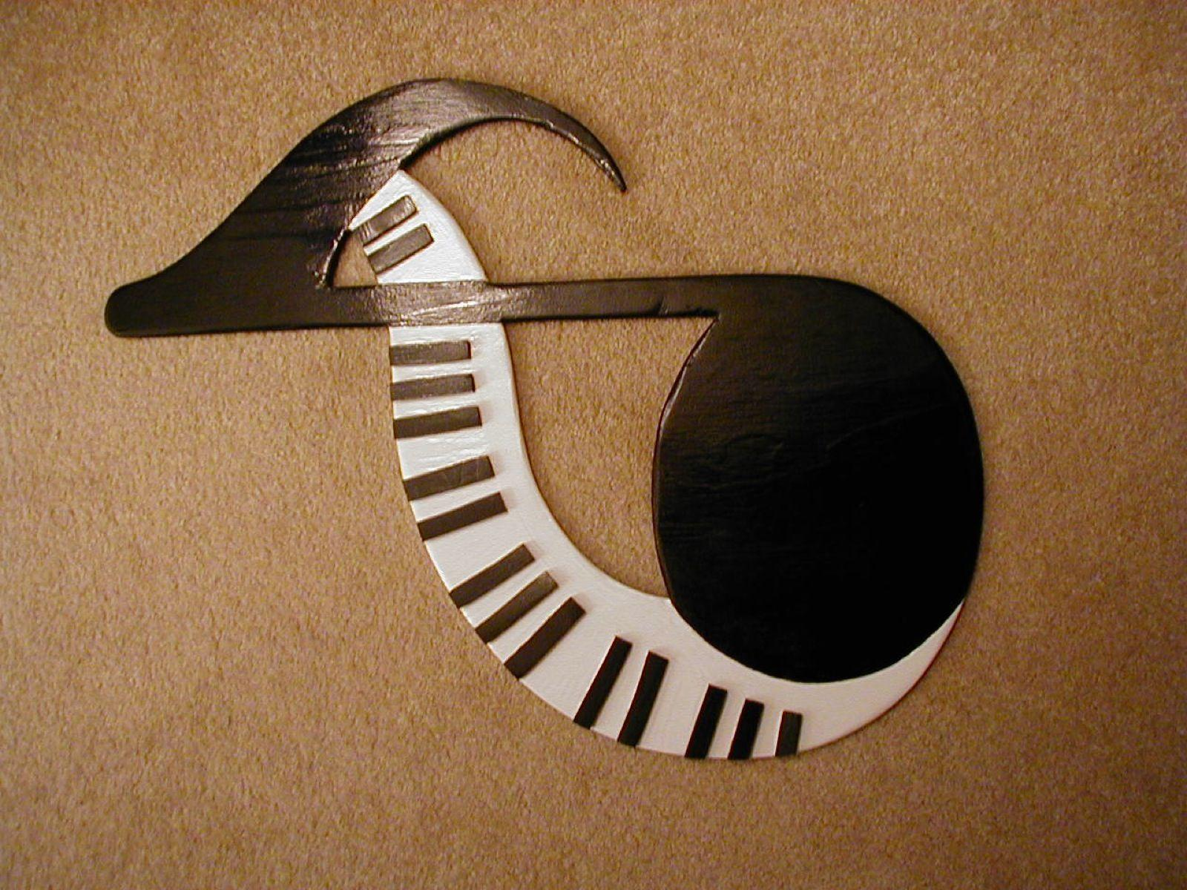
Any note you can reach, I can go higher
I can sing anything higher than you

Slide 10
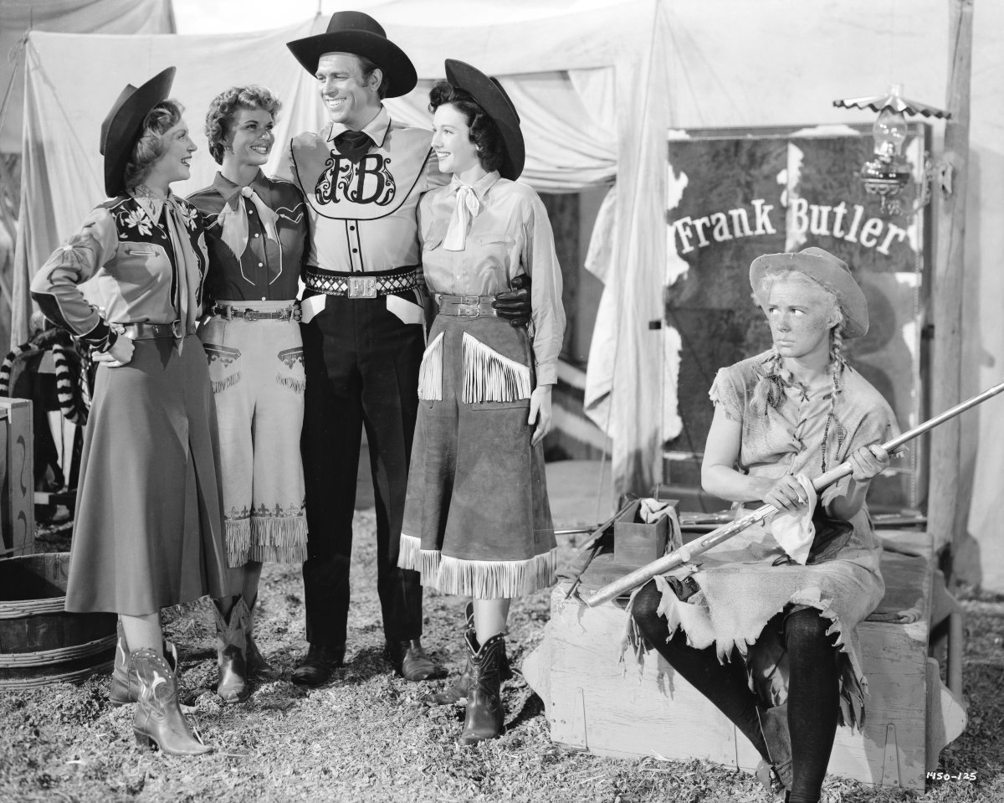
No, you can't
Yes, I can~

Slide 11
Anything you can buy
I can buy cheaper
I can buy anything
cheaper than you

Slide 12
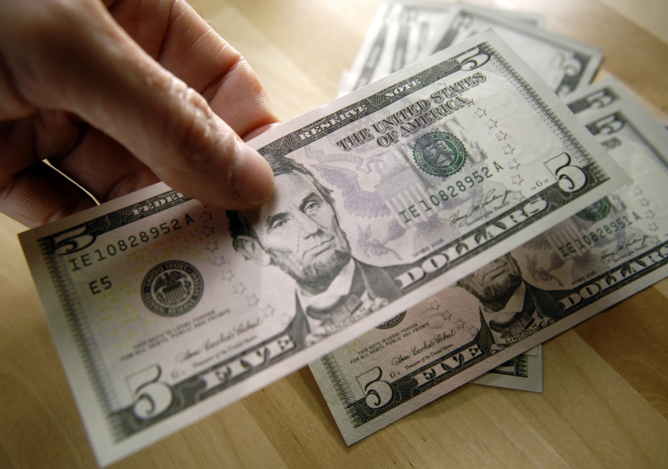
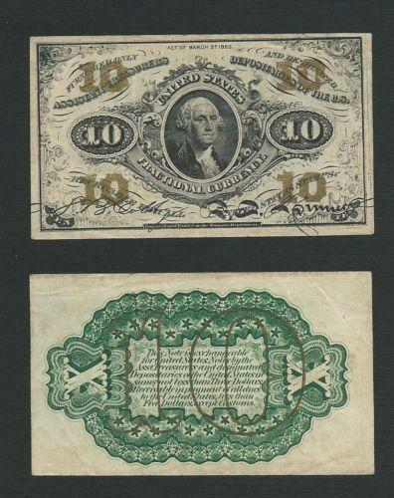
Forty cents Thirty cents Twenty cents
No, you can't Yes, I can

Slide 13
Anything you can say
I can say softer

Slide 14
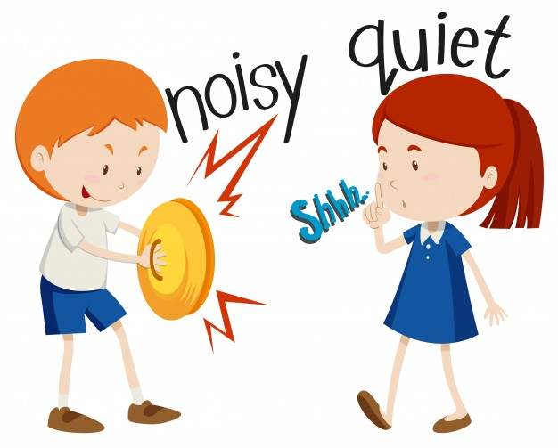
I can say anything
Softer than you

Slide 15
No, you can't
Yes, I can

Slide 16
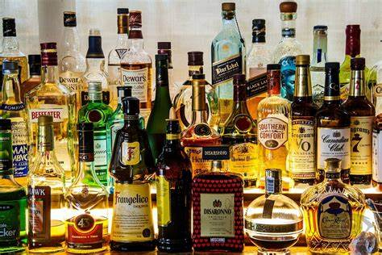
I can drink my liquor faster than a flicker
I can drink it quicker and get even sicker

Slide 17
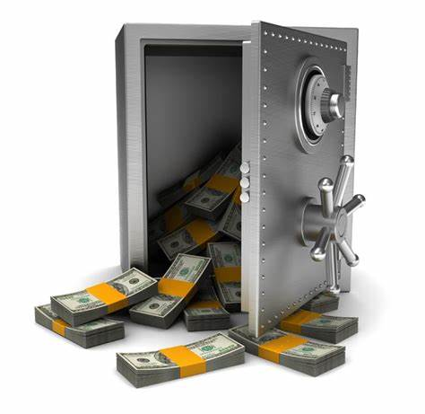
I can open any safe without being caught
Sure, that's what I thought

Slide 18
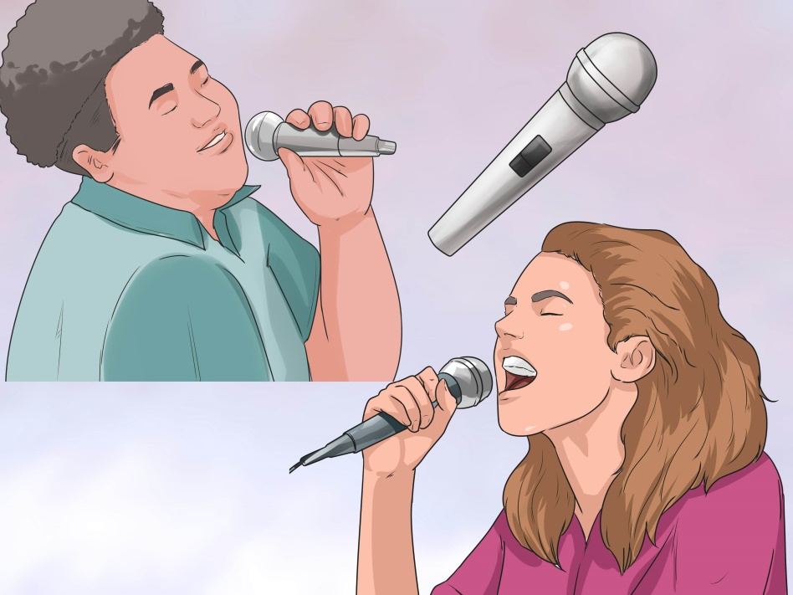
Any note you can hold
I can hold longer

Slide 19
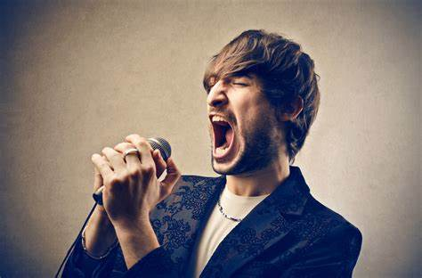
I can hold any note longer than you
No, you can't
Yes, you can
Yes, I can

Slide 20
Anything you can wear, I can wear better
In what you wear, I'd look better than you

Slide 21
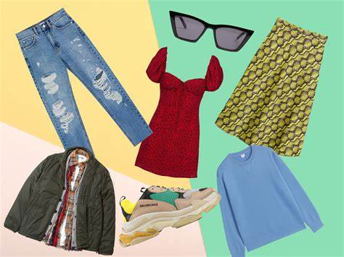
In my coat. In your vest.
In my shoes. In your hat.
No, you can't
Yes, I can

Slide 22
Anything you say, I can say faster
I can say anything, faster than you

Slide 23
No, you can't
Yes, I can

Slide 24
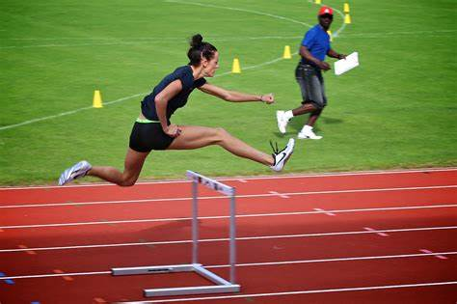
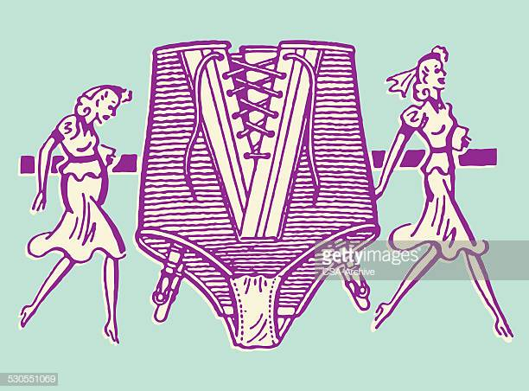
I can jump a hurdle
I can wear a girdle

Slide 25
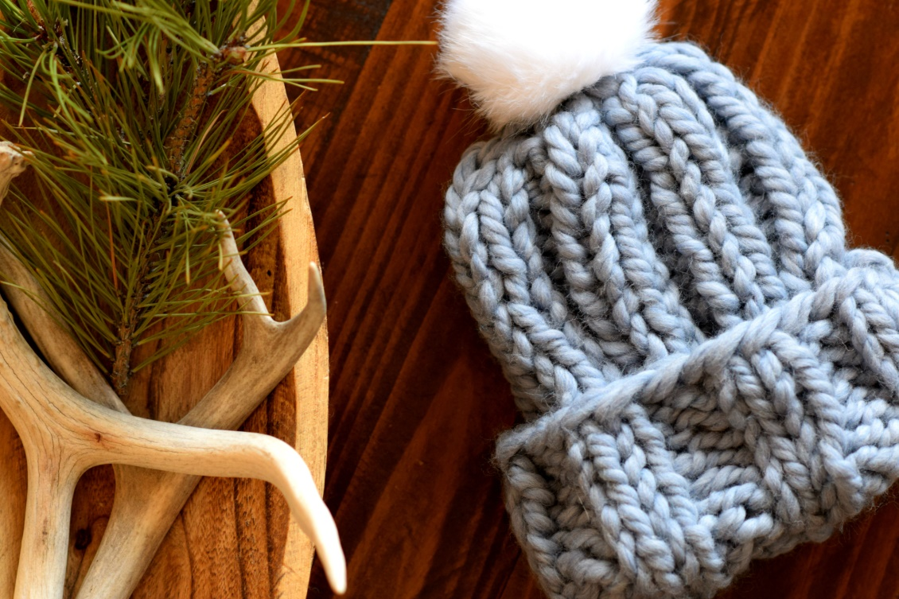
I can knit a sweater
I can fill it better
I can do most anything

Slide 26
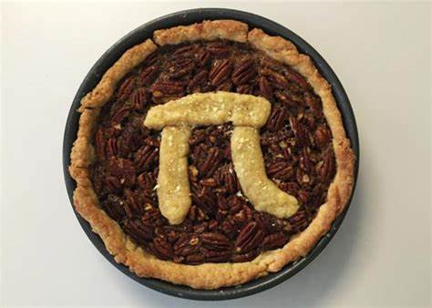
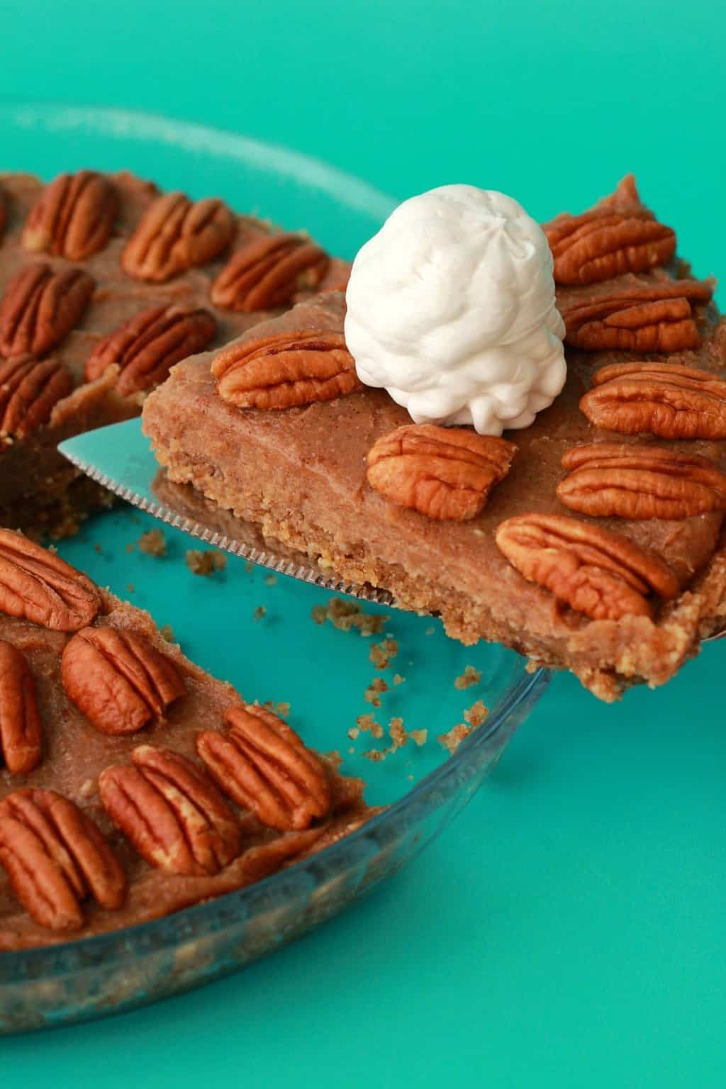
Can you bake a pie - No
Neither can I

Slide 27
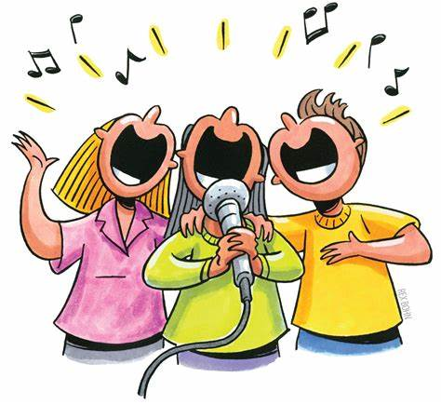
Anything you can sing, I can sing sweeter
I can sing anything, sweeter than you

Slide 28
No, you can't
Yes, I can
No, you can't ~

Slide 29
Thank you
华南师范大学外国语言文化学院 王星玉
东莞中学初中部 陈燕青

