Slide 1
Heartbeats
——形容词原级
设计制作：华南师范大学外国语言文化学院 陈洁盈
广东省东莞市东莞中学 初中部 陈燕青
指导教师：陈燕青、刘晓斌

Slide 3
I can’t figure out

Slide 4
THIS WAY
Is it meant to be this way

Slide 5
Easy words
Hard
Easy words so hard to say

Slide 6
I can’t live without
Know if this is real
Knowing how you feel

Slide 7
Tell me am I mistaken

Slide 8
Cause I don’t have another heart for breaking

Slide 9
Please don’t let me go I just wanna stay

Slide 10
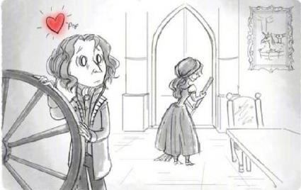
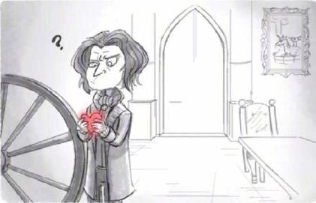
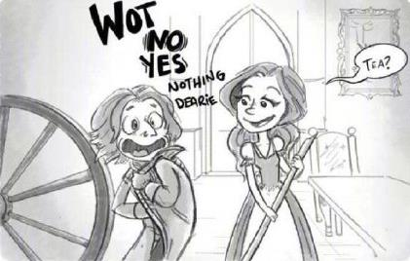
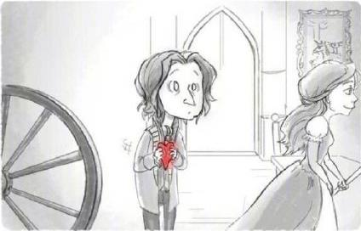
Can’t you feel my heartbeats giving me away

Slide 11
I just want to know if you too feel afraid

Slide 12
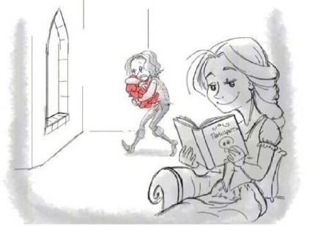
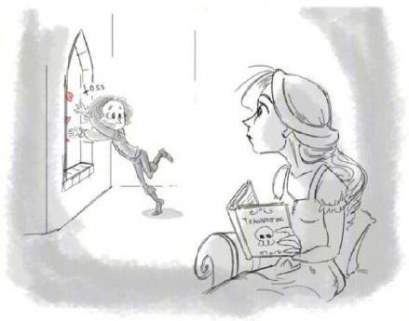
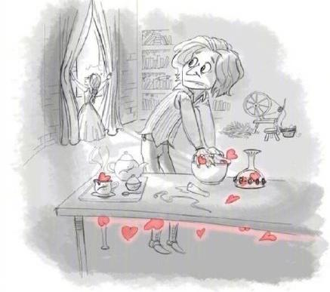
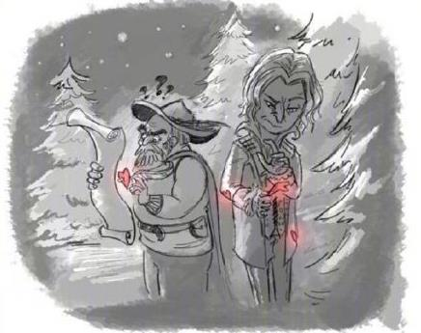
I can feel your heartbeats giving you away

Slide 13
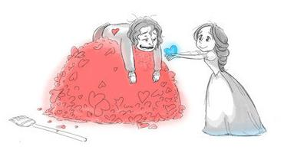
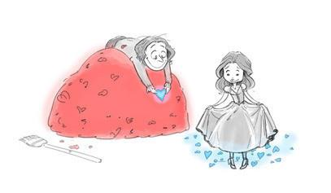
Giving us away

Slide 14
I can’t understand
How it’s making sense
That we put up such defense

Slide 15
When all you need to know

Slide 16
No matter what you do I’m just as scared as you

Slide 17
Tell me am I mistaken

Slide 18
Cause I don’t have another heart for breaking

Slide 19
Please don’t let me go I just wanna stay

Slide 20
Can’t you feel my heartbeats giving me away

Slide 21
I just want to know if you too feel afraid

Slide 22
I can feel your heartbeats giving you away

Slide 23
Giving us away

Slide 24
Please don’t let me go I just wanna stay

Slide 25
Can’t you feel my heartbeats giving me away

Slide 26
I just want to know if you too feel afraid

Slide 27
I can feel your heartbeats giving you away

Slide 28
Giving us away

Slide 29
The end

