Slide 1
Who 引导的定语从句
课件制作：华南师范大学外国语言文化学院 王志萍
广东省东莞市东莞中学初中部 徐秀媚
指导教师：徐秀媚、刘晓斌

Slide 2
I wanna move with the seasons

Slide 3
Go with the flow Take it easy
And let stuff go

Slide 4
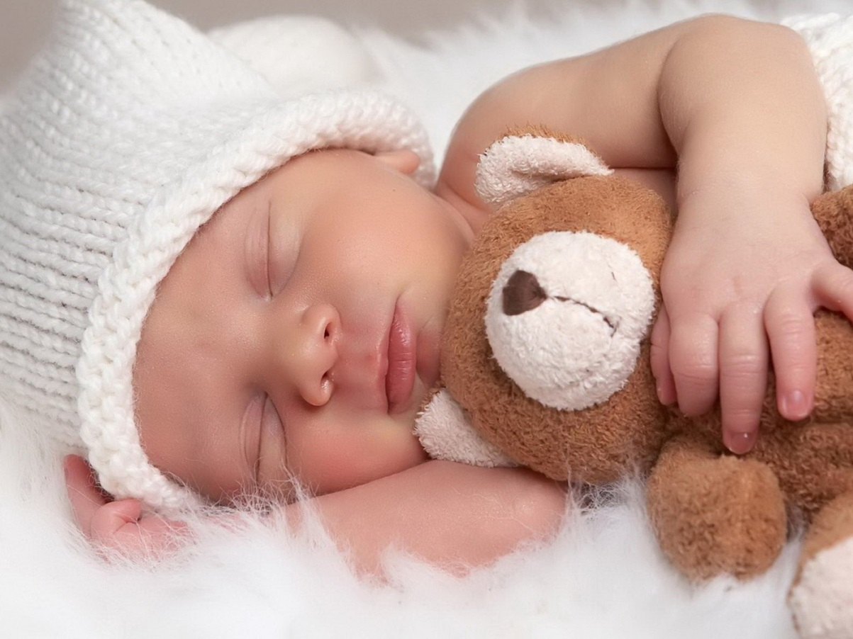
I wanna sleep like a baby

Slide 5
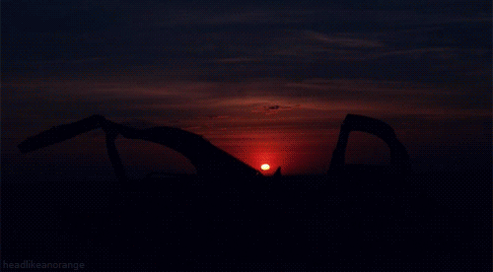
And rise with the sun
Kick it all back

Slide 6
And get nothing done

Slide 7
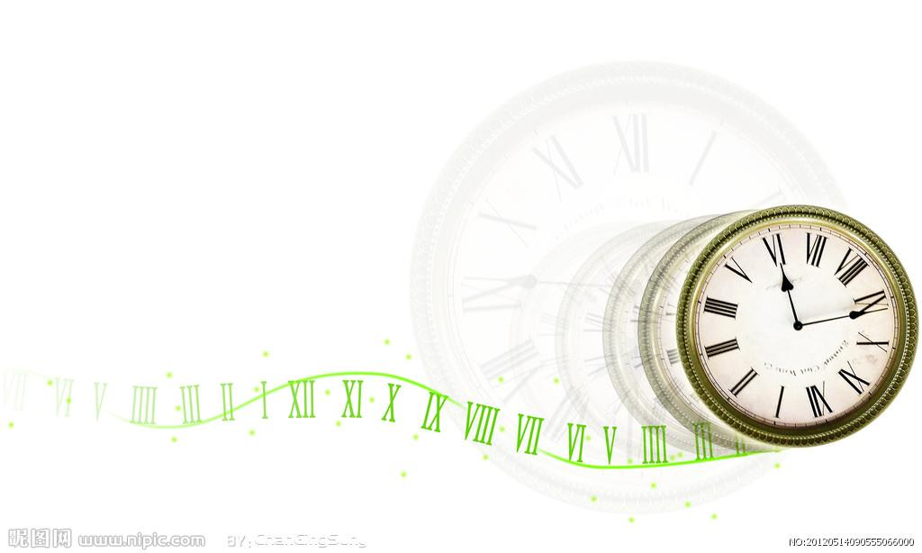
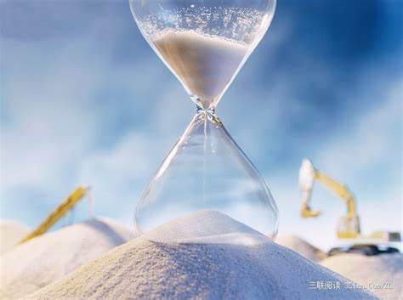
Wanna make this day
The longest day

Slide 8
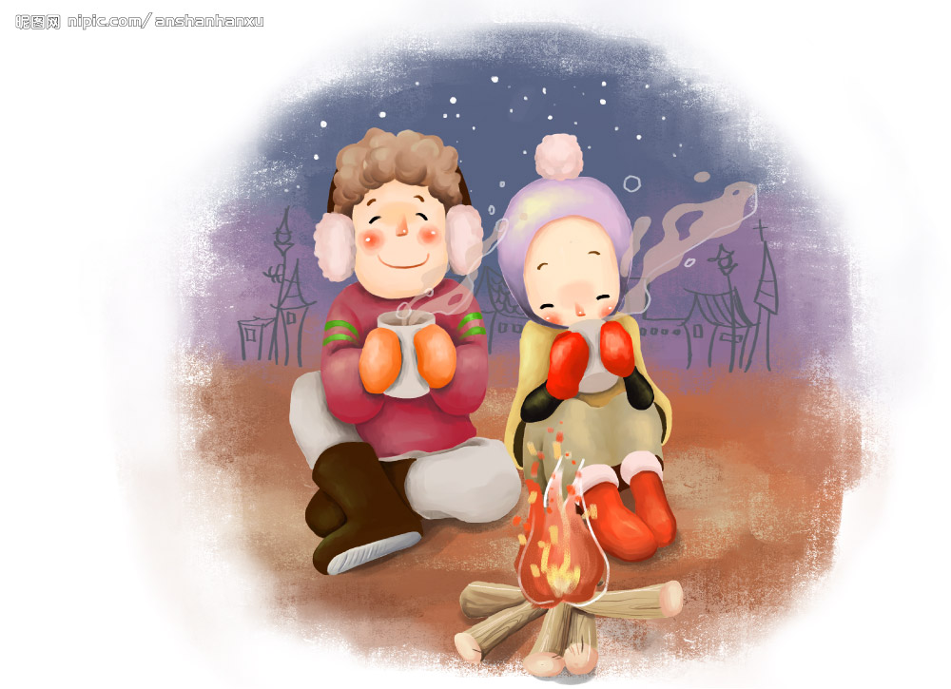
With a warmth that
Delivers happiness

Slide 9
If only for today
I wanna be
The girl who got away

Slide 10
(I wanna be)
The lover who really loved

Slide 11
(I wanna be)
The dancer who danced
To the last song

Slide 12
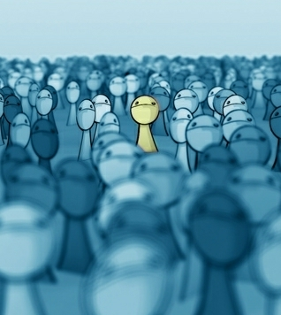
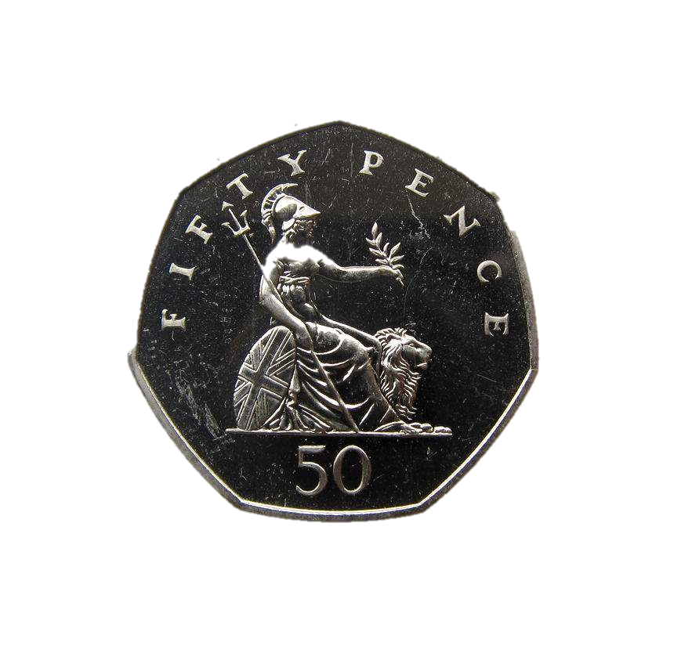
Don’t wanna make sense
Of pounds and pence
Don’t wanna take sides

Slide 13
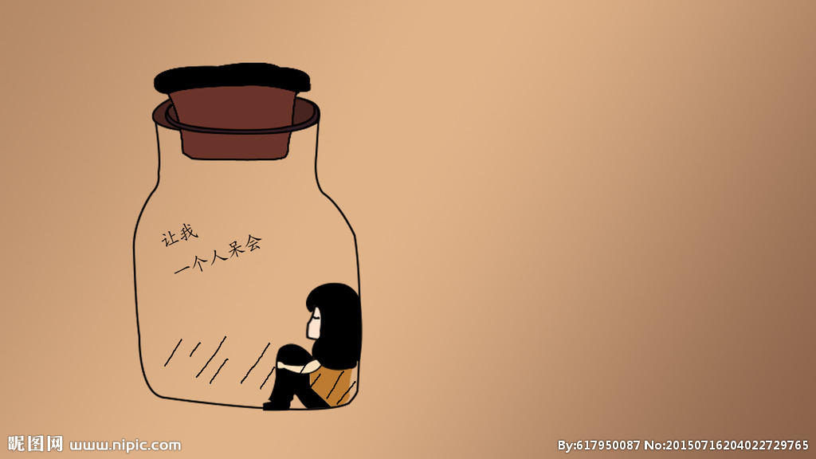
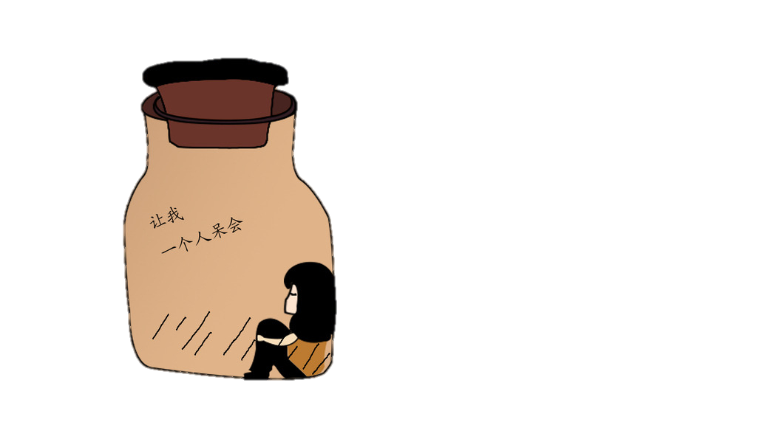
I want to be alone

Slide 14
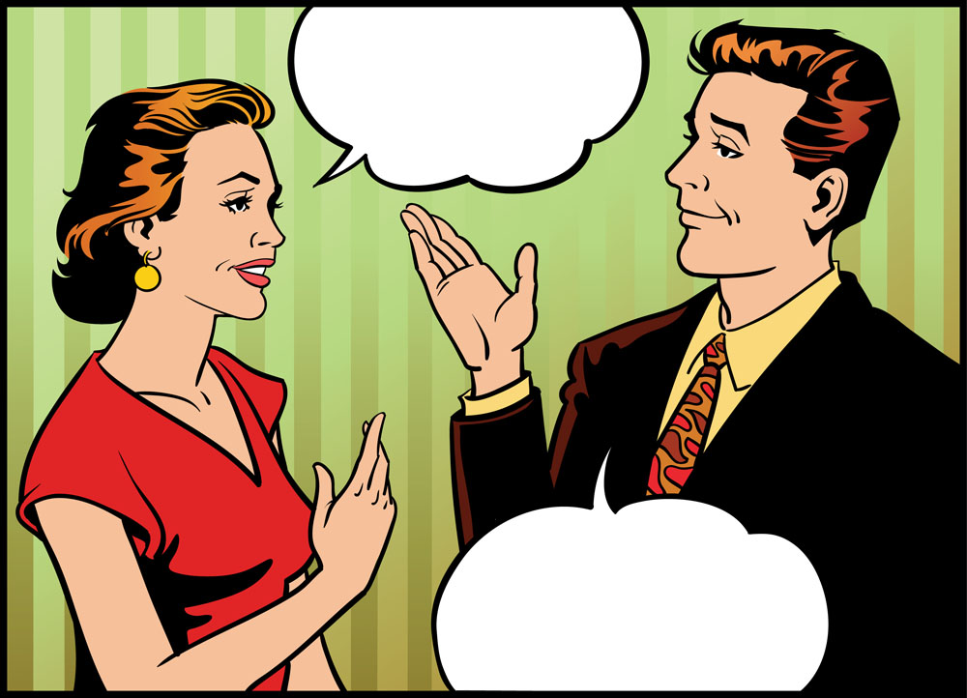
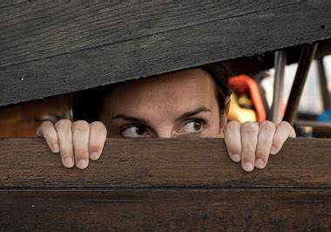
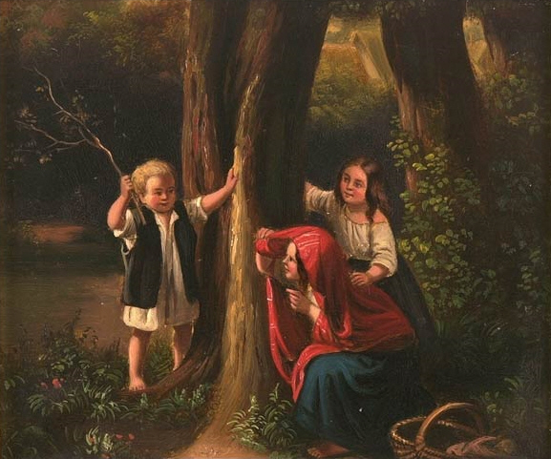
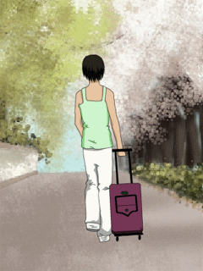
Don’t want hide
Don’t want to be talked over
Or walked upon

Slide 15
I want to think the heart is bigger than the head

Slide 16
Wanna follow you but not be led

Slide 17
If only for today
I wanna be
The girl who got away

Slide 18
(I wanna be)
The lover who really loved

Slide 19
(I wanna be)
The dancer who danced
To the last song

Slide 20
I know what it’s like
To be passed over
I know

Slide 21
To be clumsy get things wrong
To go unnoticed

Slide 22
I know what it’s like
To arrive too late

Slide 23
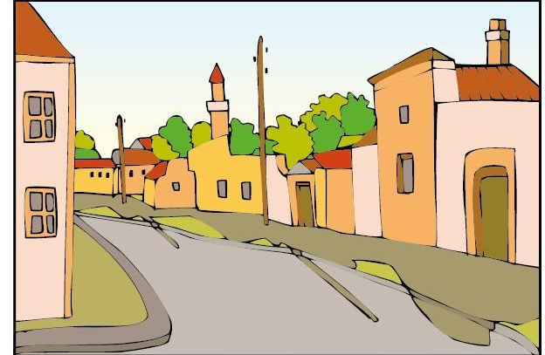
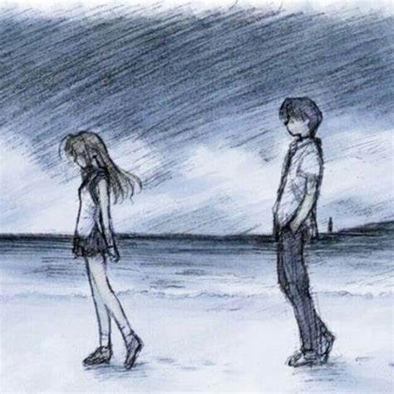
To be told to leave
To be walked upon

Slide 24
If only for today
I wanna be
The girl who got away

Slide 25
(I wanna be)
The lover who really loved

Slide 26
(I wanna be)
The dancer who danced
To the last song

Slide 27
If only for today
I wanna be
The girl who got away

Slide 28
(I wanna be)
The lover who really loved

Slide 29
(I wanna be)
The dancer who danced
To the last song

