Slide 1
Miserable
--------- 主从复合句：unless
设计制作：华南师范大学外文学院 曾晓铷
广东省东莞市东莞中学初中部 徐秀媚
指导老师：徐秀媚、刘晓斌

Slide 2
Your heart's as heavy as the stones you throw

Slide 3
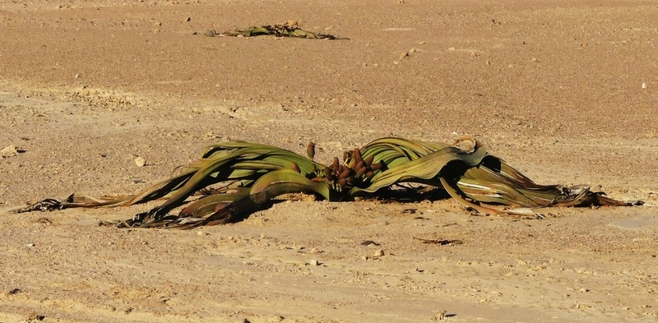
Can't see the flowers for the weeds you grow

Slide 4
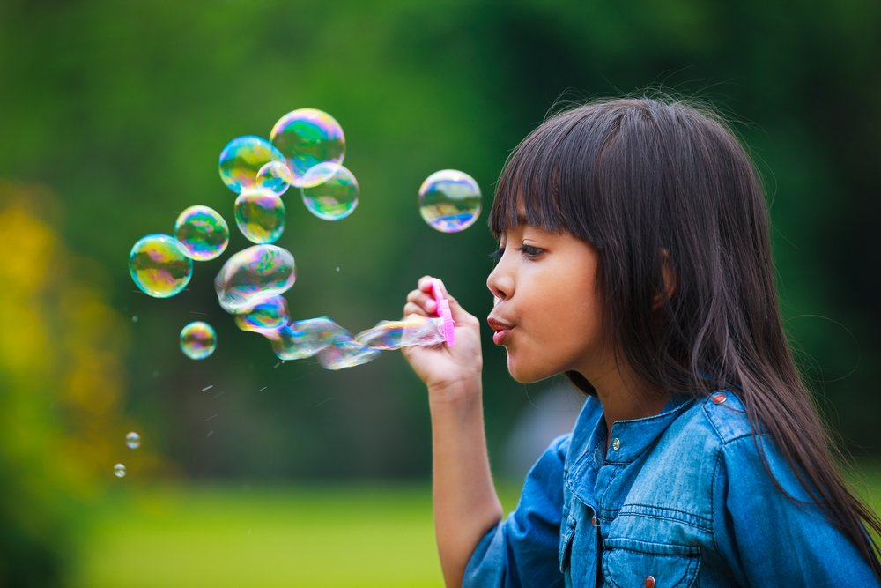
You blow your bubbles just to watch 'em burst

Slide 5
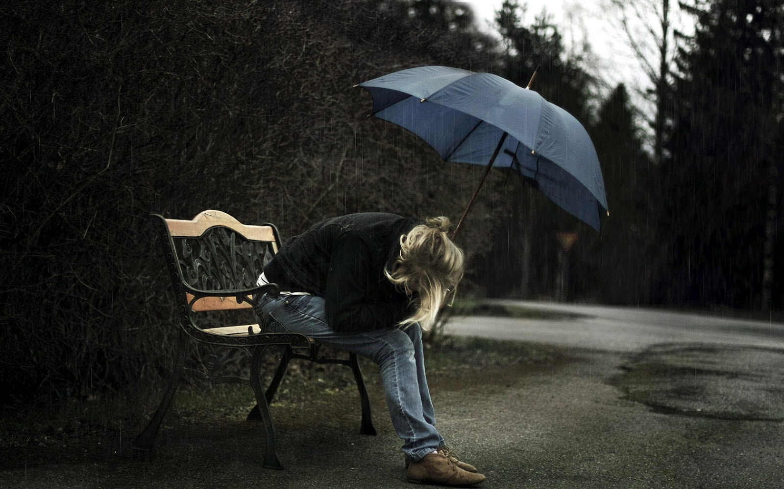
For you it's always bad to worse

Slide 6
And you...
can't win unless you lose

Slide 7
You try to tell me you want happiness

Slide 8
But you ain't happy unless
You're miserable

Slide 9
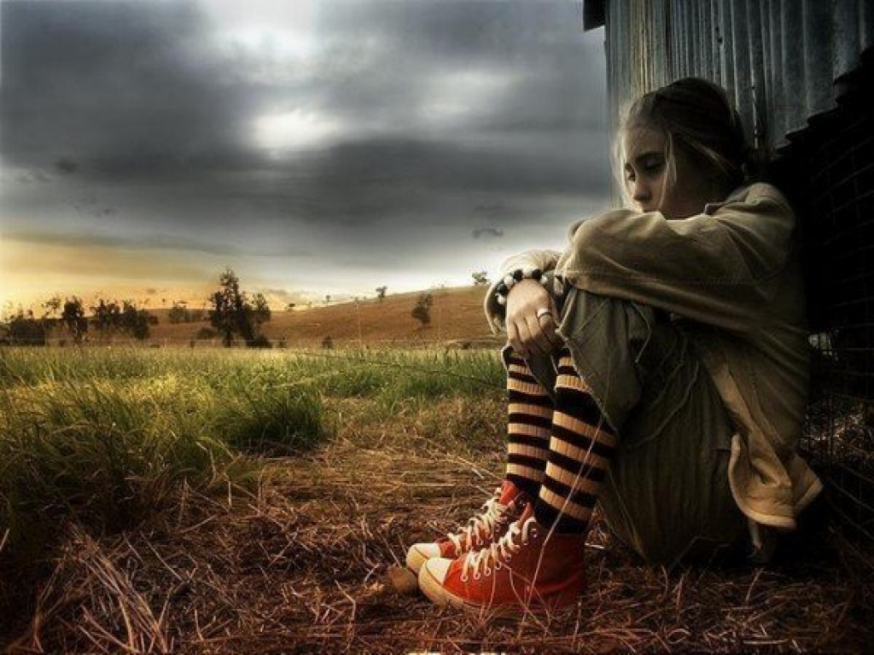
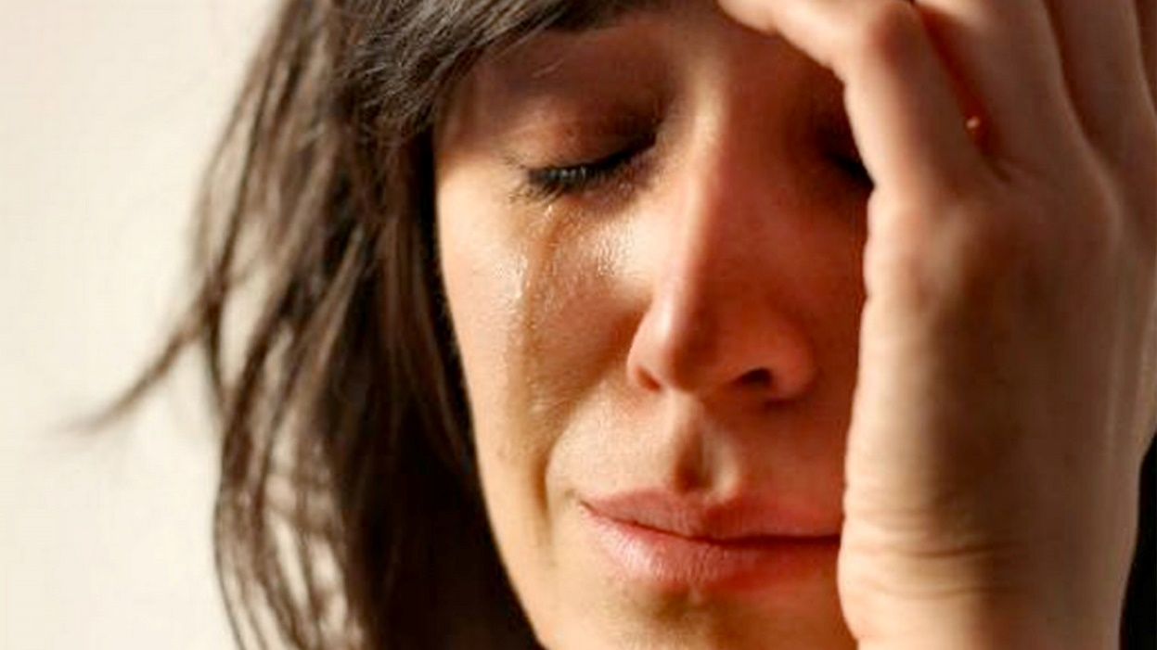

Slide 10
Your neighbor's dirty laundry's cleaner

Slide 11
And the wolf at your
door's always meaner

Slide 12
The sky's still grey when the sun's around

Slide 13
But you can't set sail
if your anchor's down

Slide 14
can't win unless you lose
And you...

Slide 15
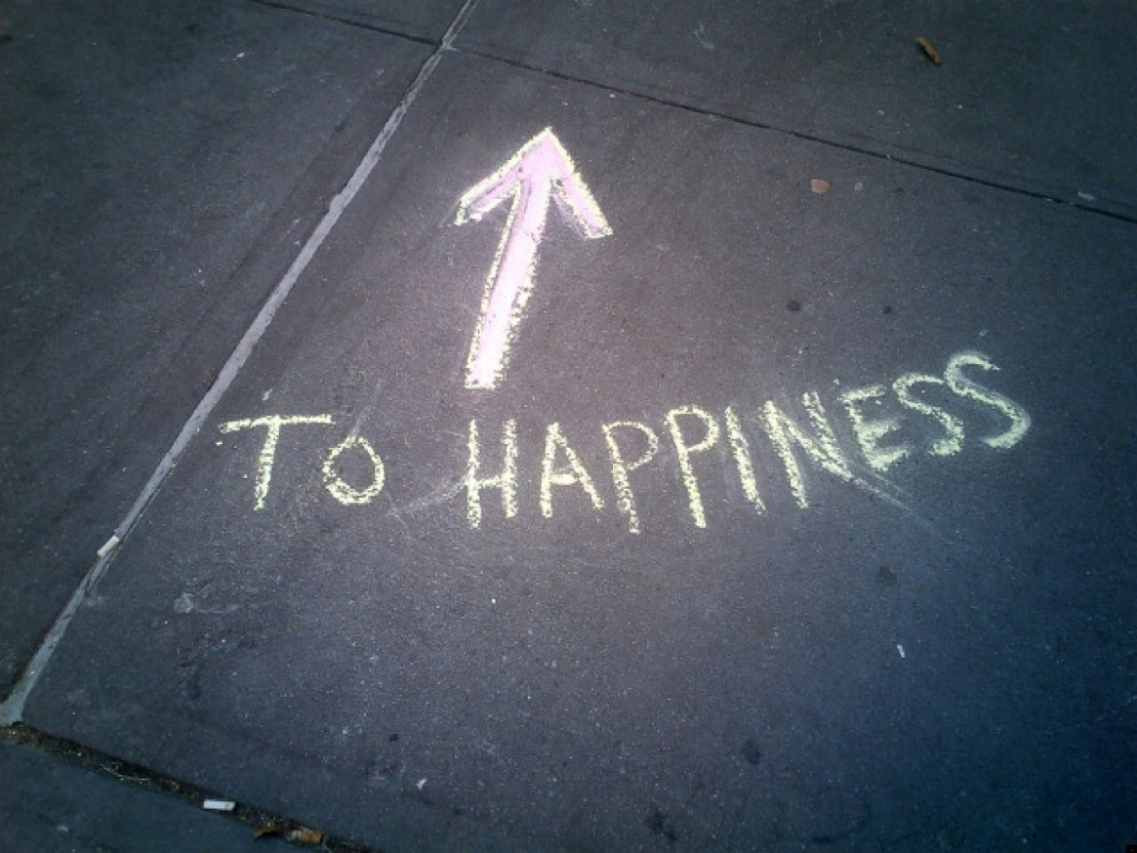
You try to tell me
you want happiness

Slide 16
But you ain't happy unless
You're miserable
I'm miserable

Slide 17
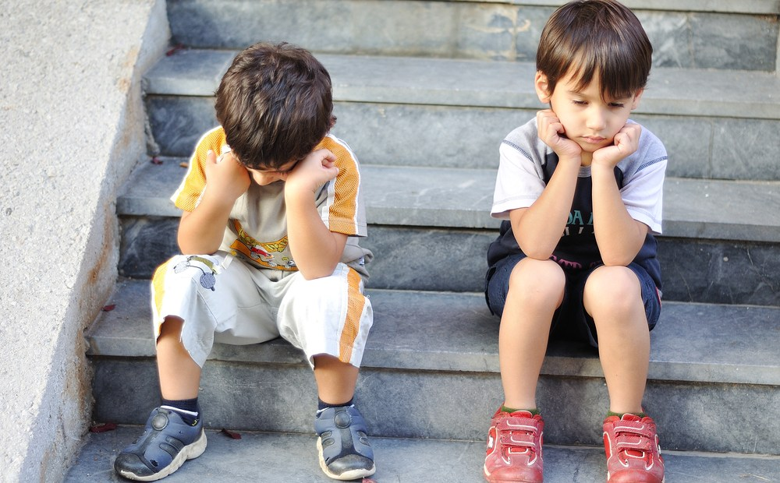
Can't liven up for the both of us

Slide 18
We have enough for the whole of us

Slide 19
If misery loves company

Slide 20
Then I can't keep you company no more

Slide 21
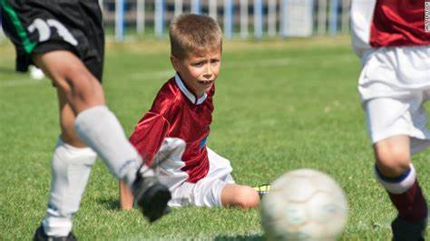
You

Slide 22
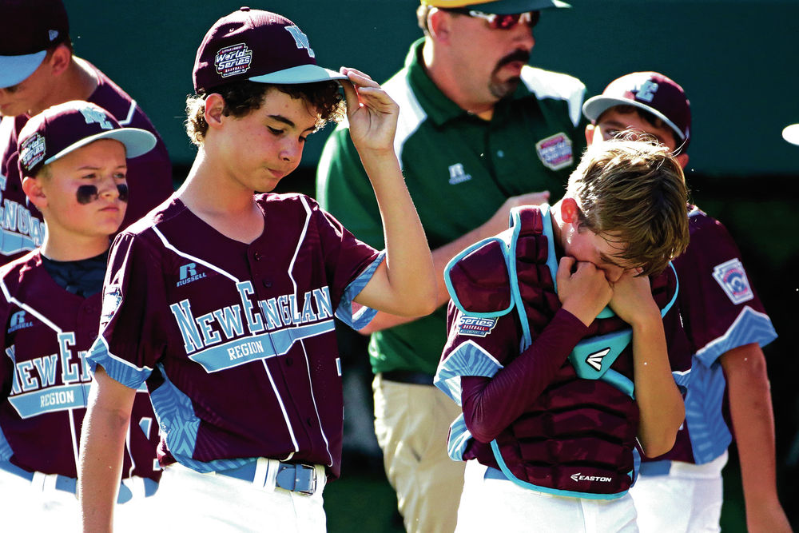
can't win unless you lose
You...

Slide 23
You try to tell me you want happiness

Slide 24
But you ain't happy unless
You're miserable

Slide 25
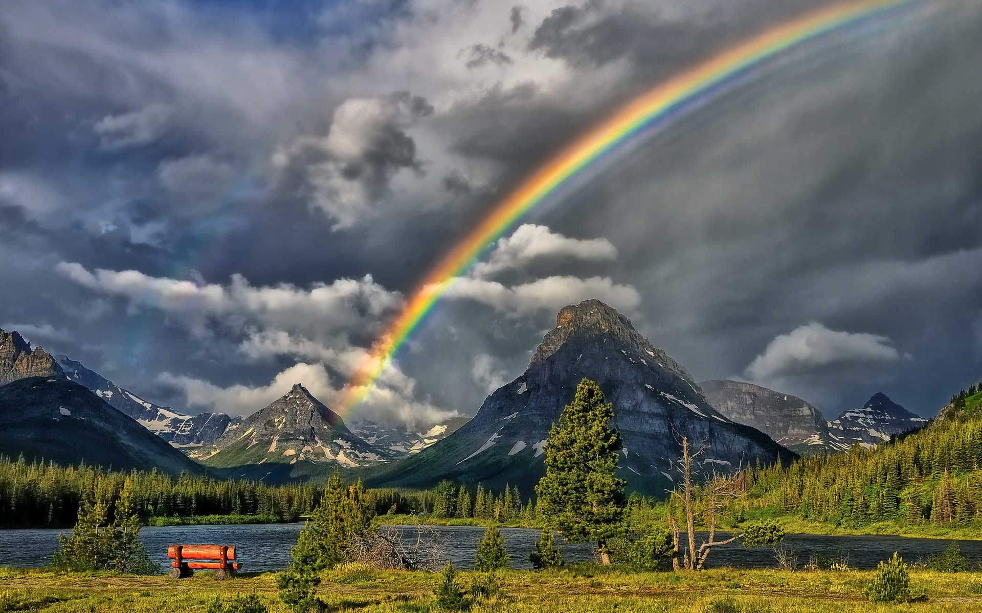
There always comes a rainbow after every storm.
When you’re miserable, please don’t give up.
The End

