Slide 1
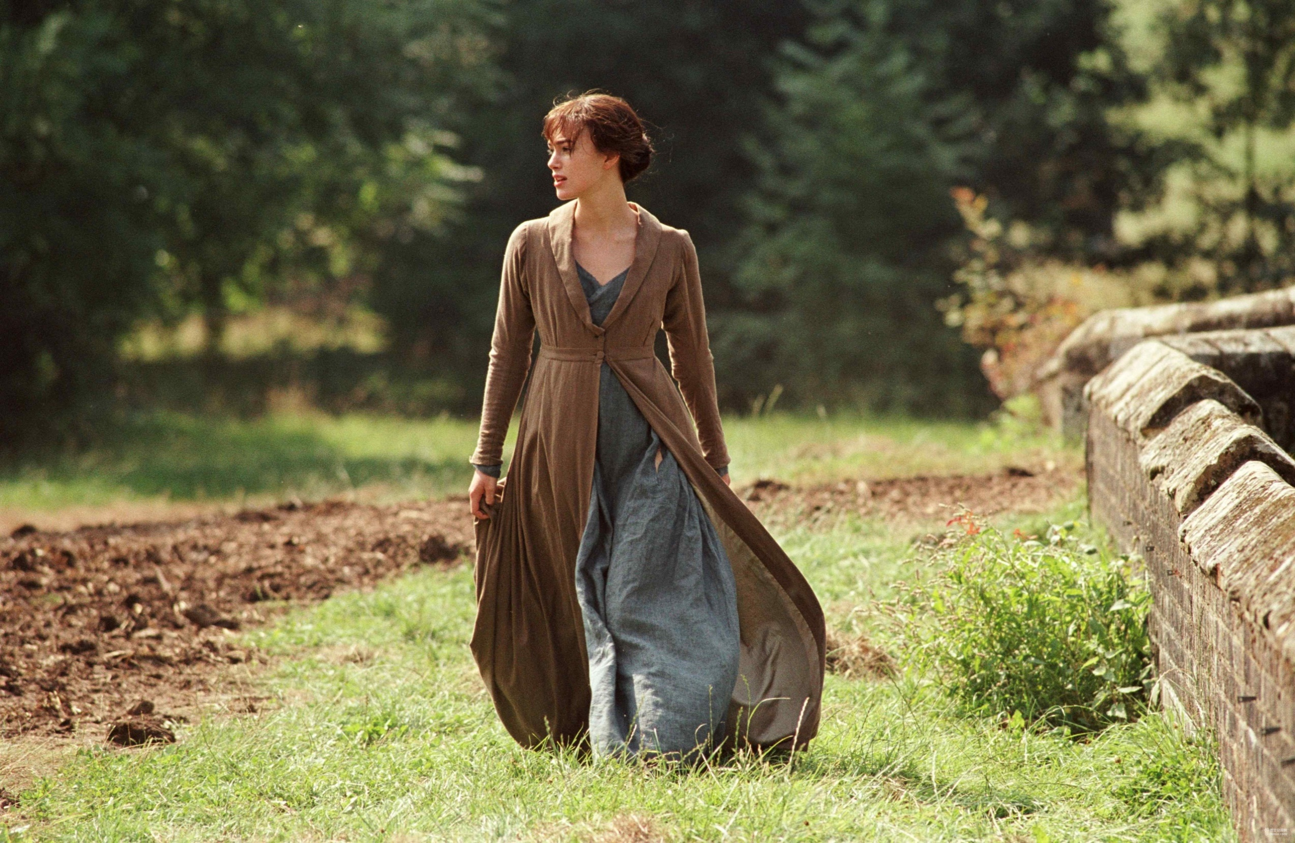
I Wonder
If引导的状语、定语从句
设计制作：华南师范大学外国语言文化学院 何慧雯
广东省东莞市东莞中学初中部 徐秀媚
指导教师：徐秀媚、刘晓斌

Slide 2
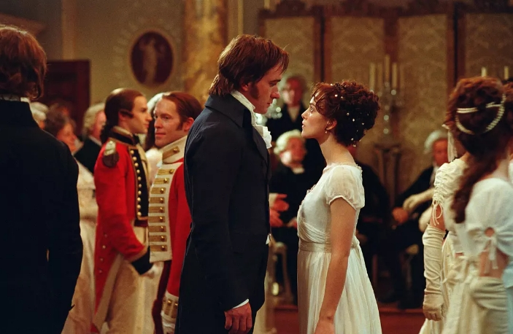
I was off by a nose, off by a hair

Slide 3
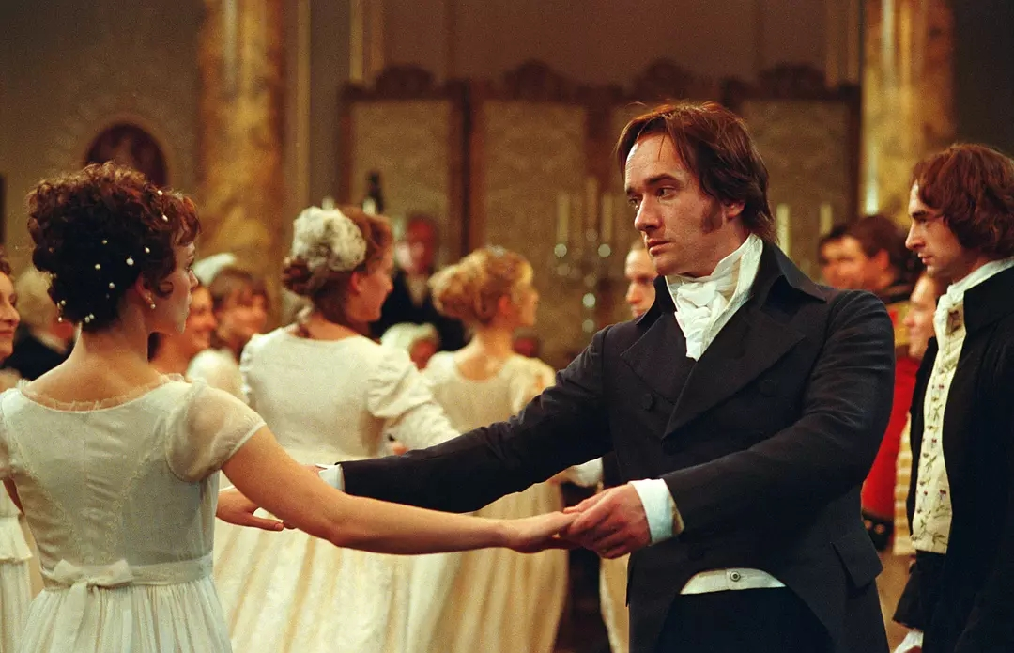
All the things you said didn’t get me anywhere

Slide 4
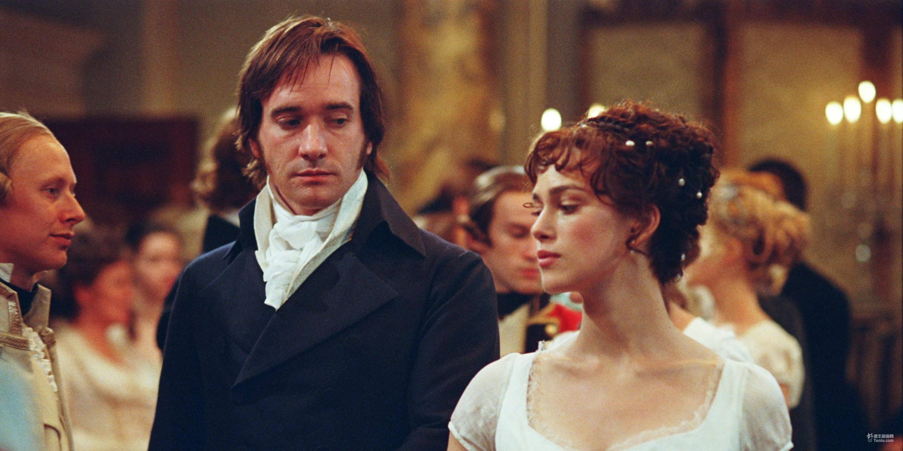
All I had was cake when you wanted bread

Slide 5
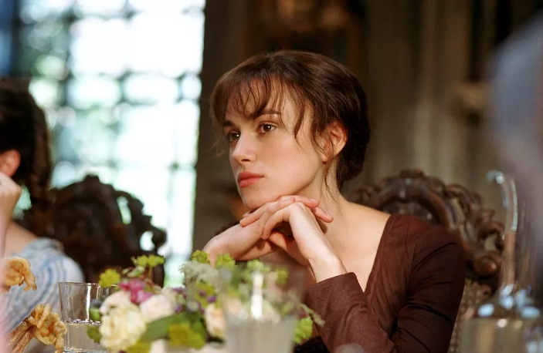
Such simple taste, it’s off with my head again

Slide 6
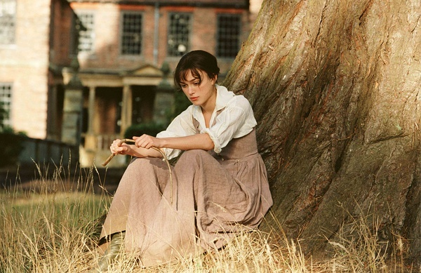
Maybe I can’t be all the things you need

Slide 7
If you can sit in the dirt for just a little while

Slide 8
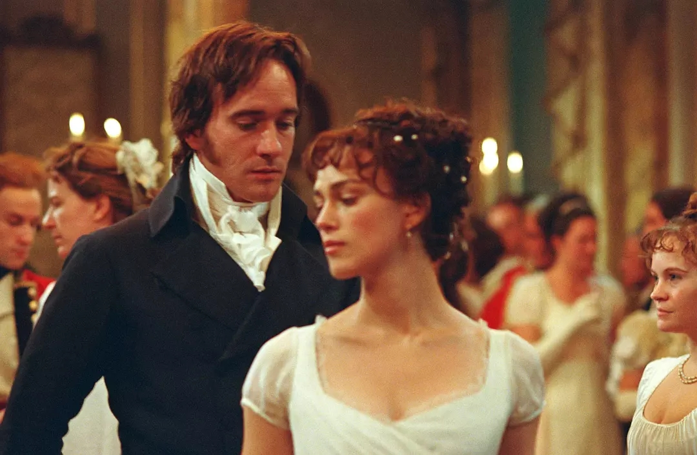
You’ll find the things I hid and buried over time

Slide 9
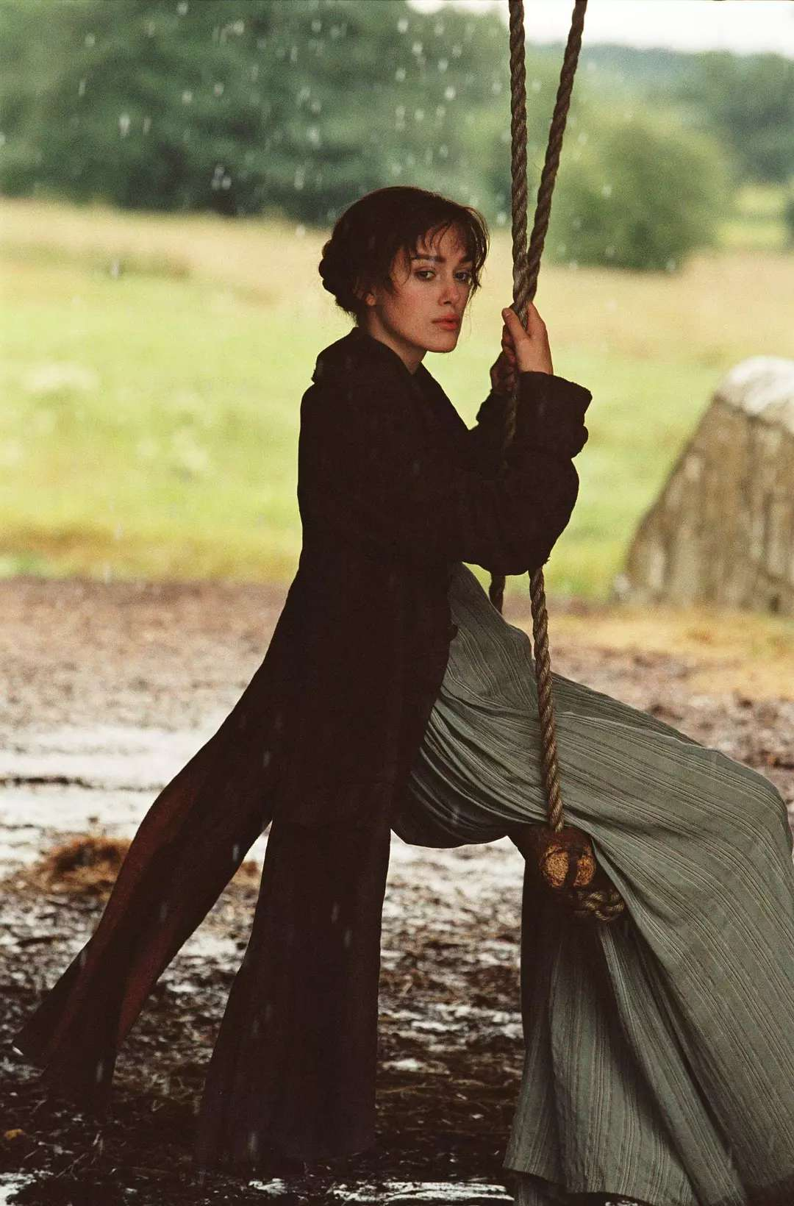
I made a slip and impasse

Slide 10
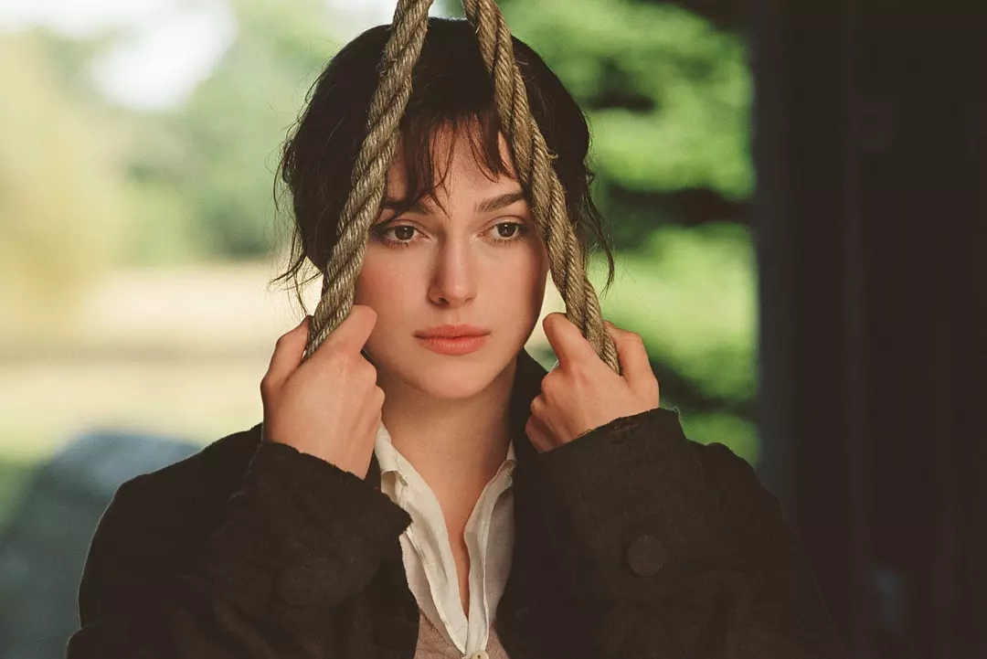
Oh me, oh my pardon my mistakes again

Slide 11
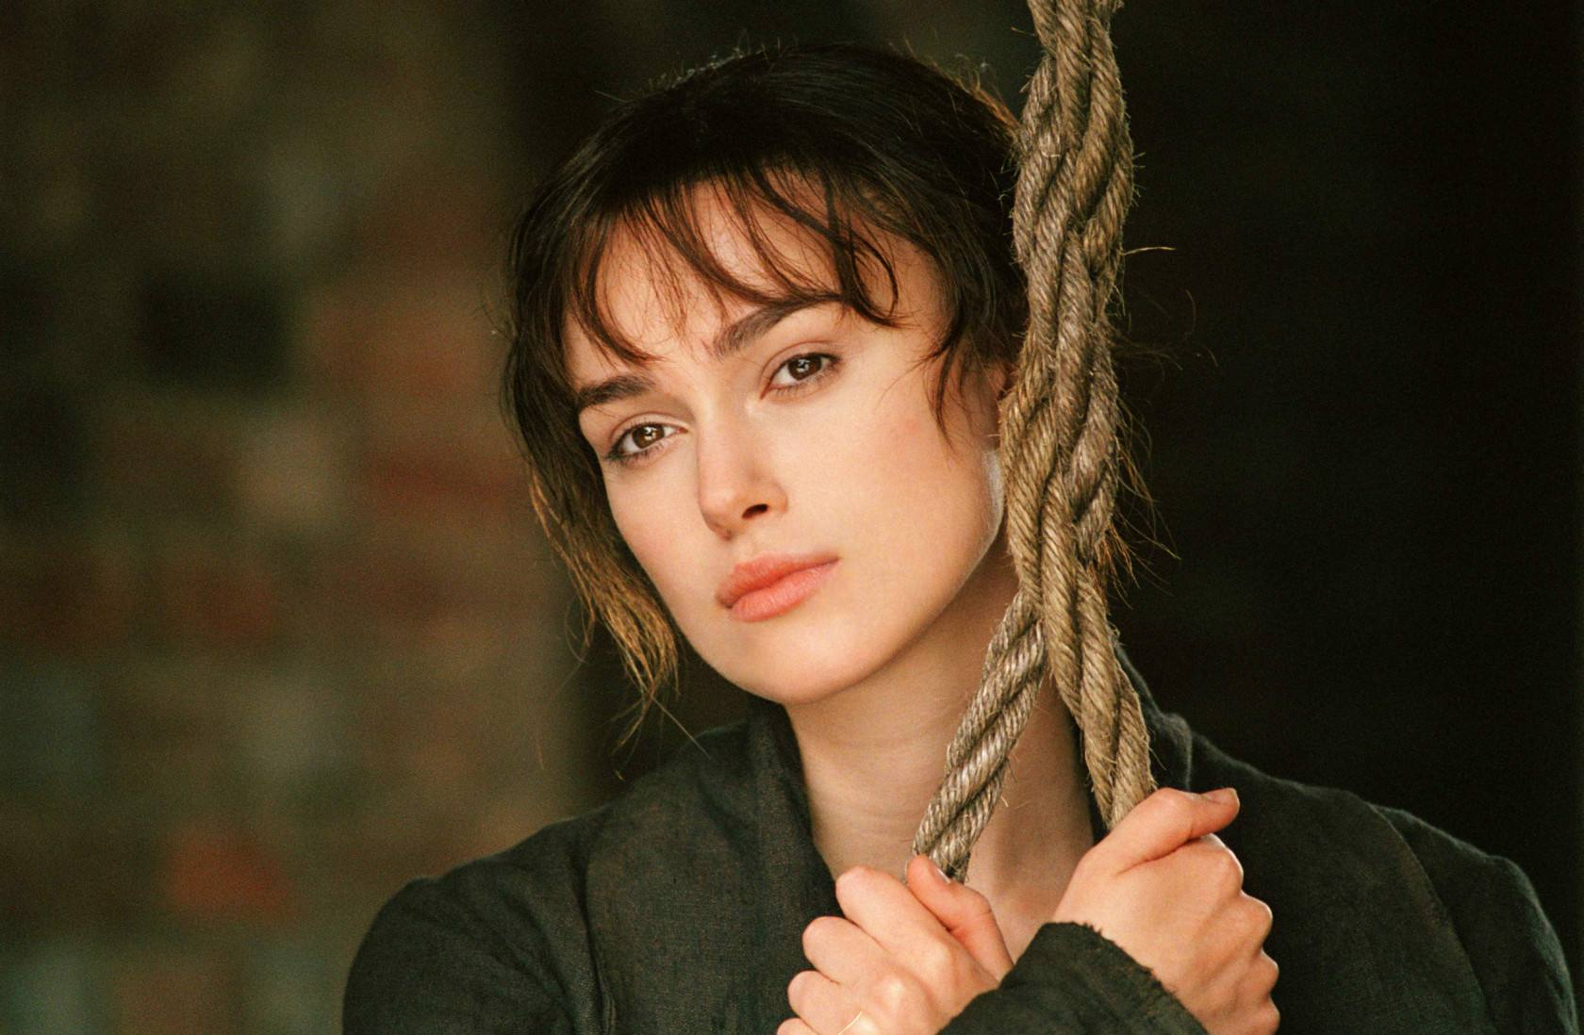
Cause maybe I can’t be everything

Slide 12
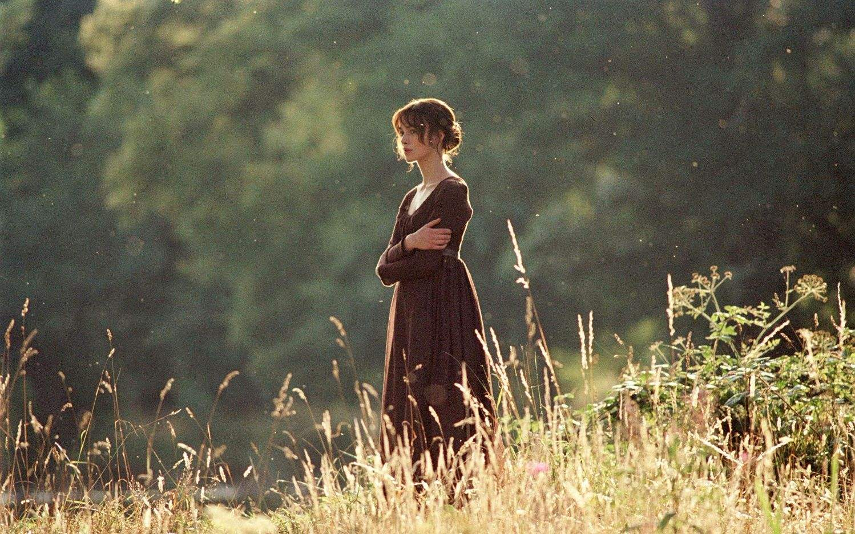
I wonder if I never complain

Slide 13
And promise you that someday I will change

Slide 14
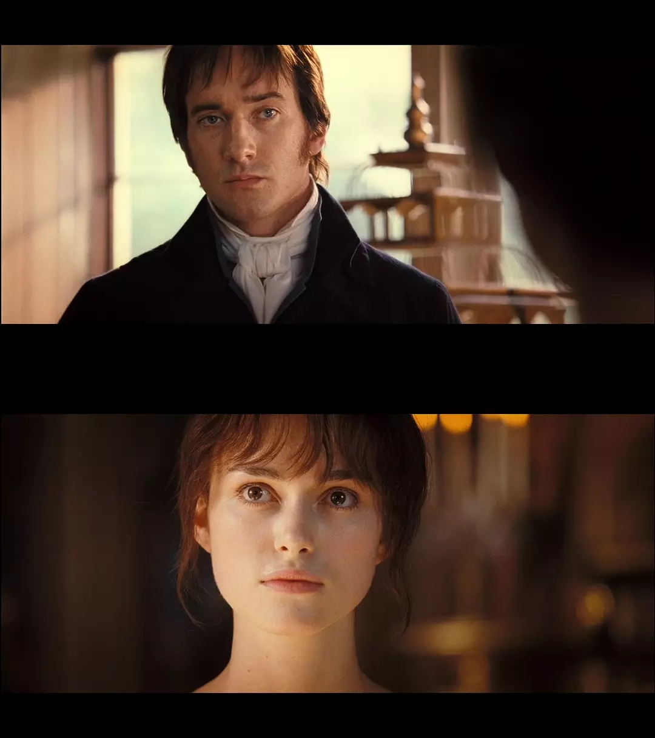
If I do everything you say, will you love me more?

Slide 15
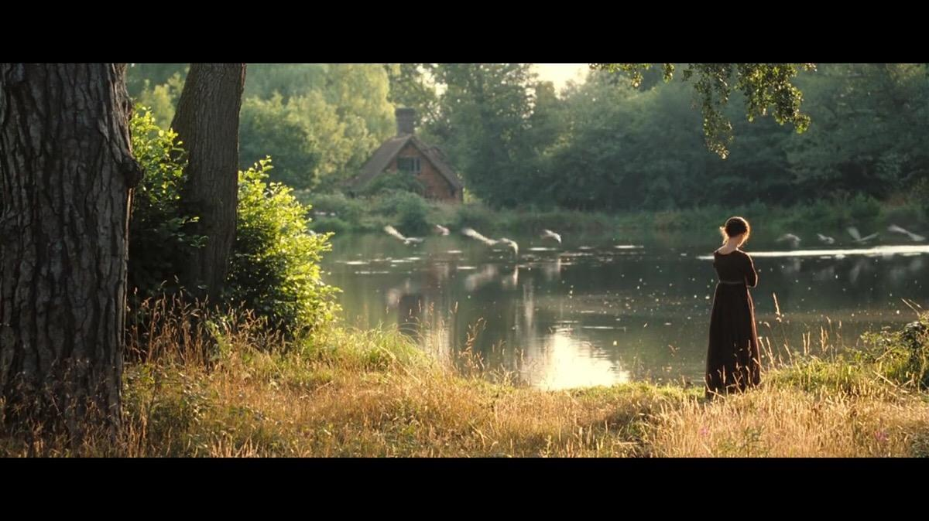
I give up my dreams to make you feel stronger

Slide 16
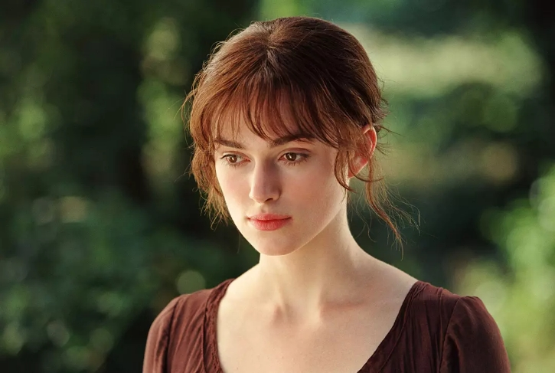
Never doubting you and never wonder

Slide 17
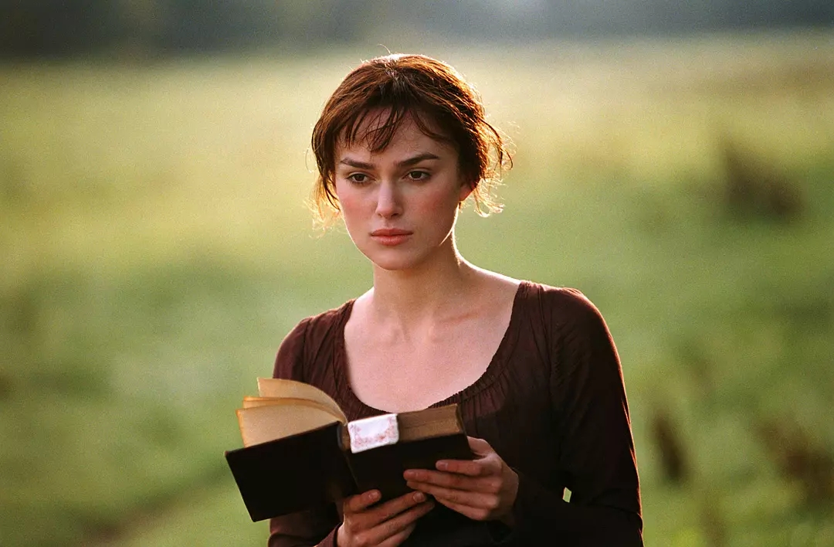
If a good girl should wonder at all

Slide 18
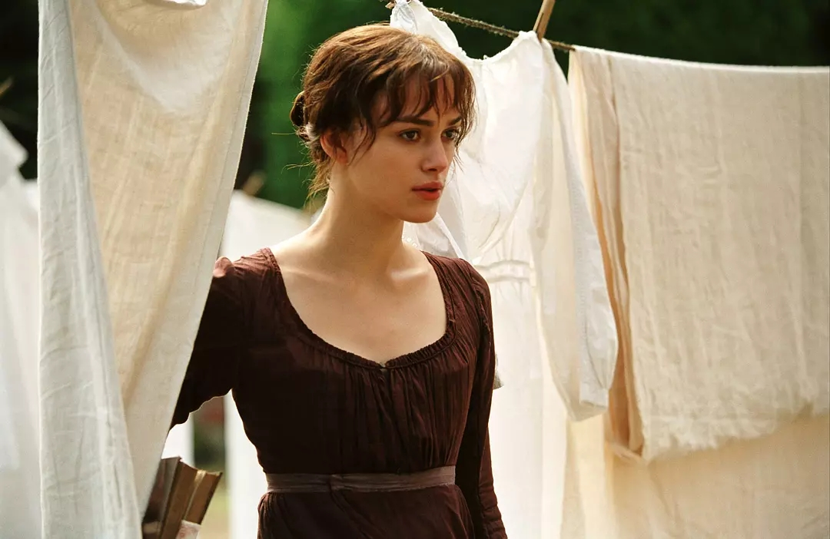
What’s behind those doors

Slide 19
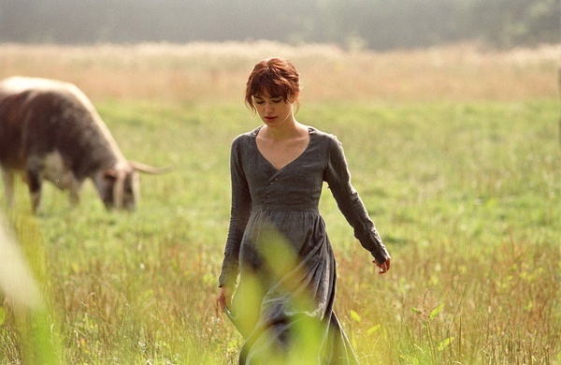
The hedges were tall over my head

Slide 20
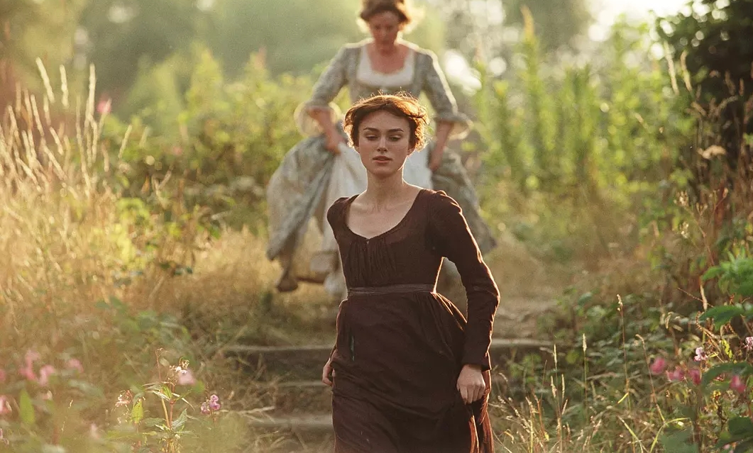
Running through this maze, the devil hasn’t got me yet

Slide 21
Shrubs in the garden hiding little bugs

Slide 22
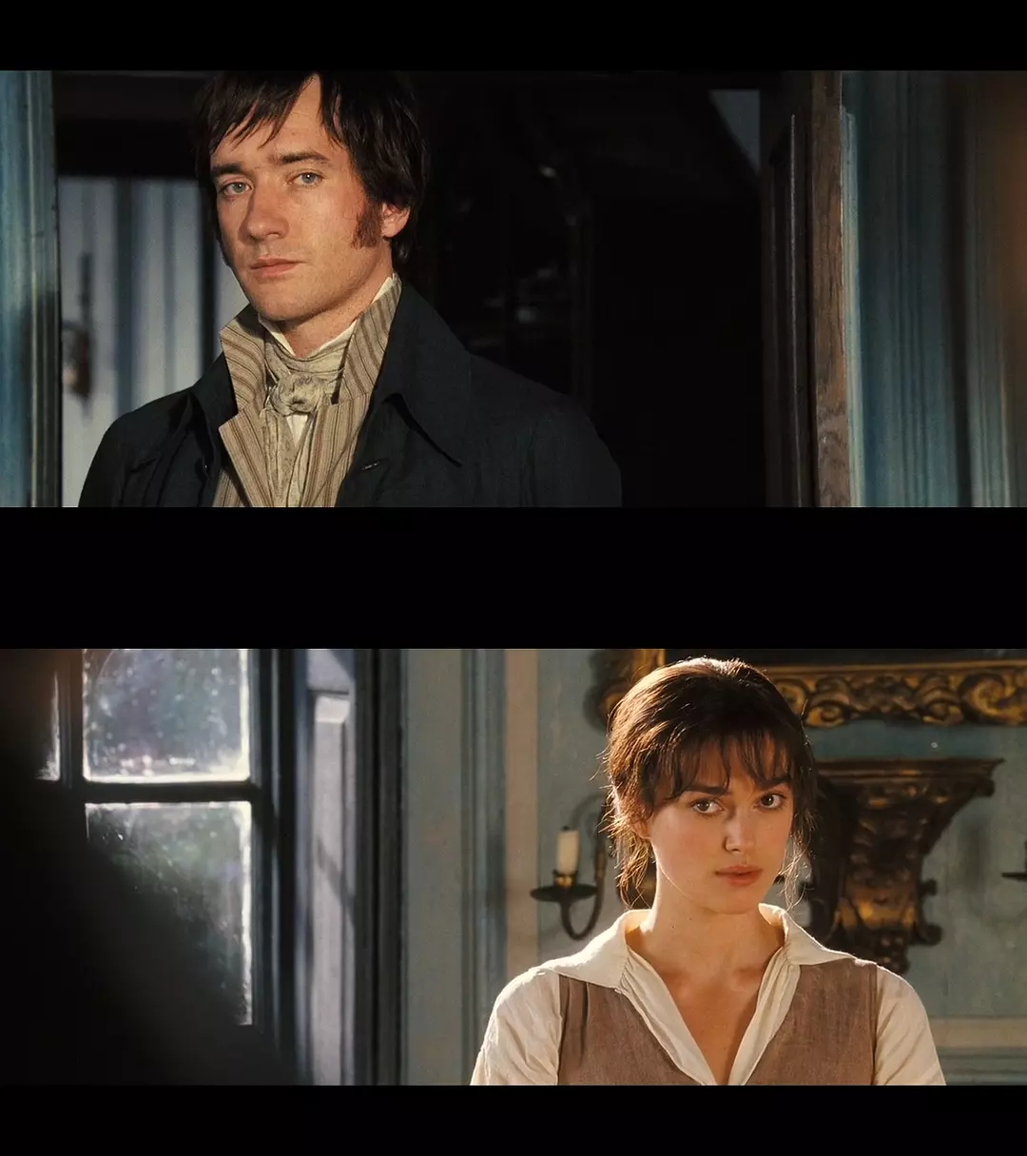
Standing in the courtyard,
won’t you please show yourself?

Slide 23
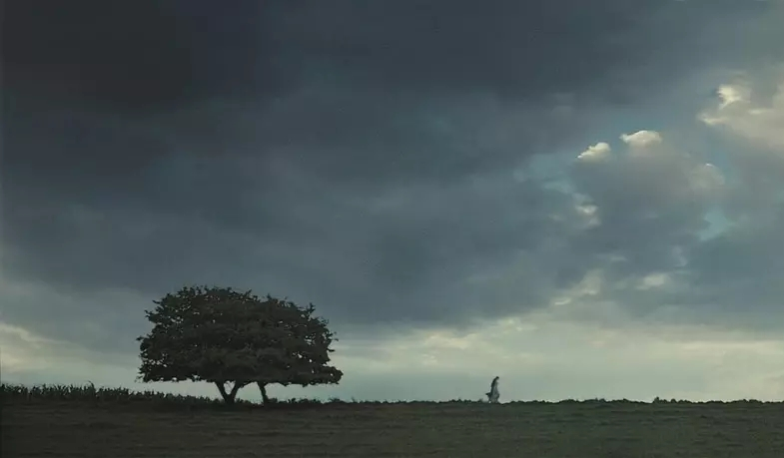
Cause maybe you can’t be anything

Slide 24
I wonder if I never complain

Slide 25
And promise you that someday I will change

Slide 26
If I do everything you say, will you love me more?

Slide 27
I give up my dreams to make you feel stronger

Slide 28
Never doubting you and never wonder

Slide 29
If a good girl should wonder at all

Slide 30
What’s behind those doors

Slide 31
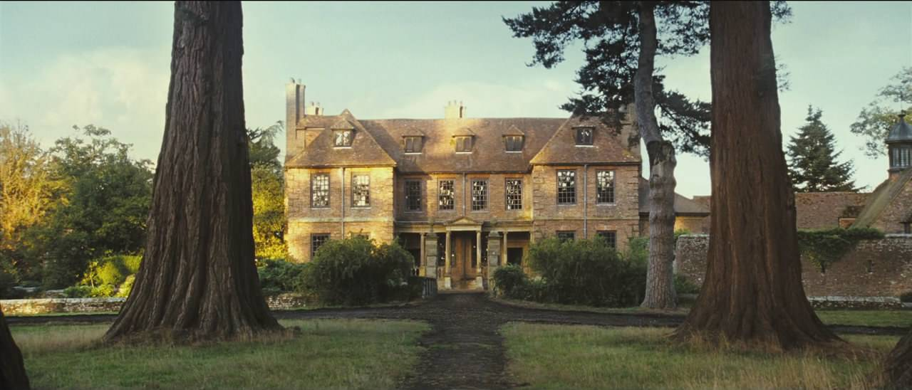
This grey wall of clay is slowly washing away

Slide 32
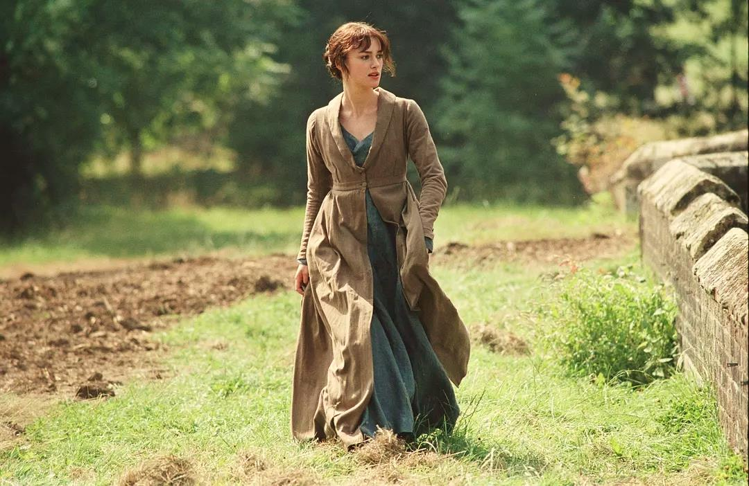
I look up and down while spinning around and around

Slide 33
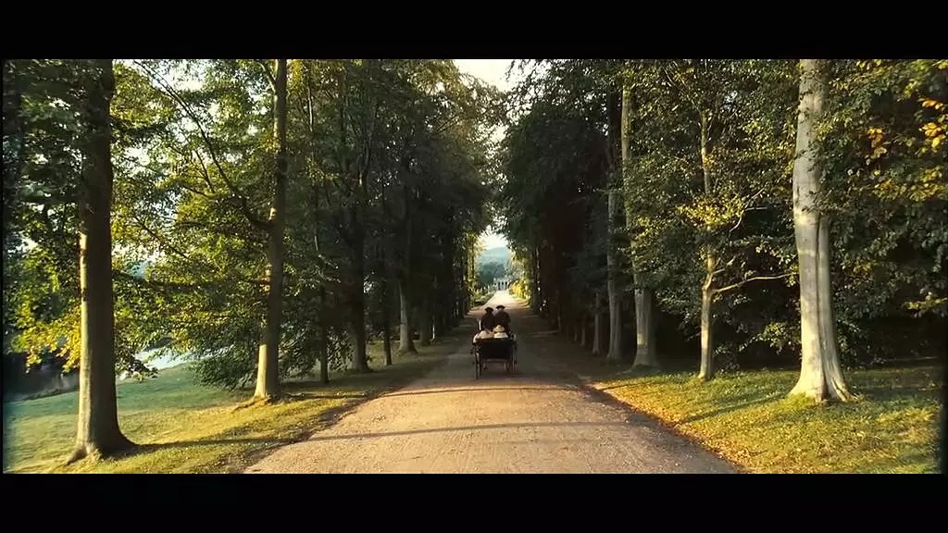
These crumbling stones won’t hold me back no more

Slide 34
I wonder why I never complained

Slide 35
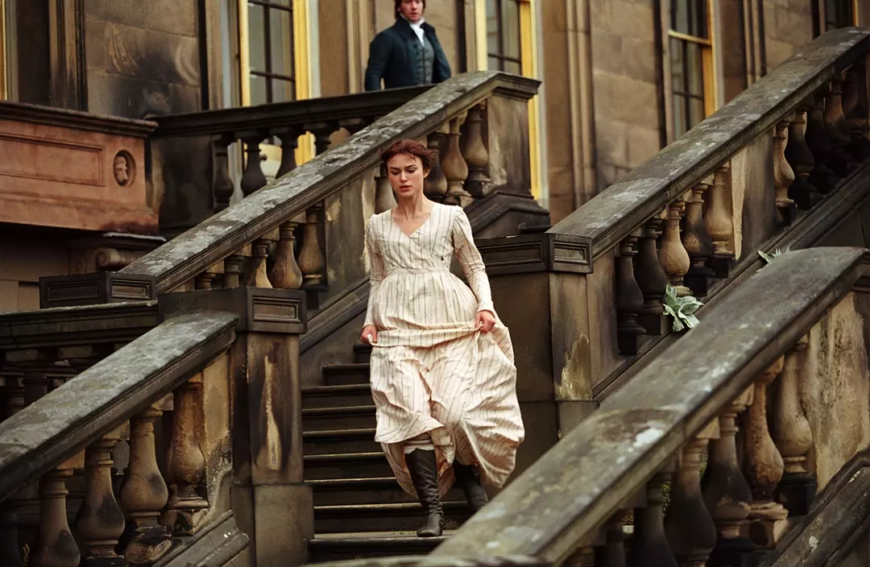
Why it took so long for me to escape

Slide 36
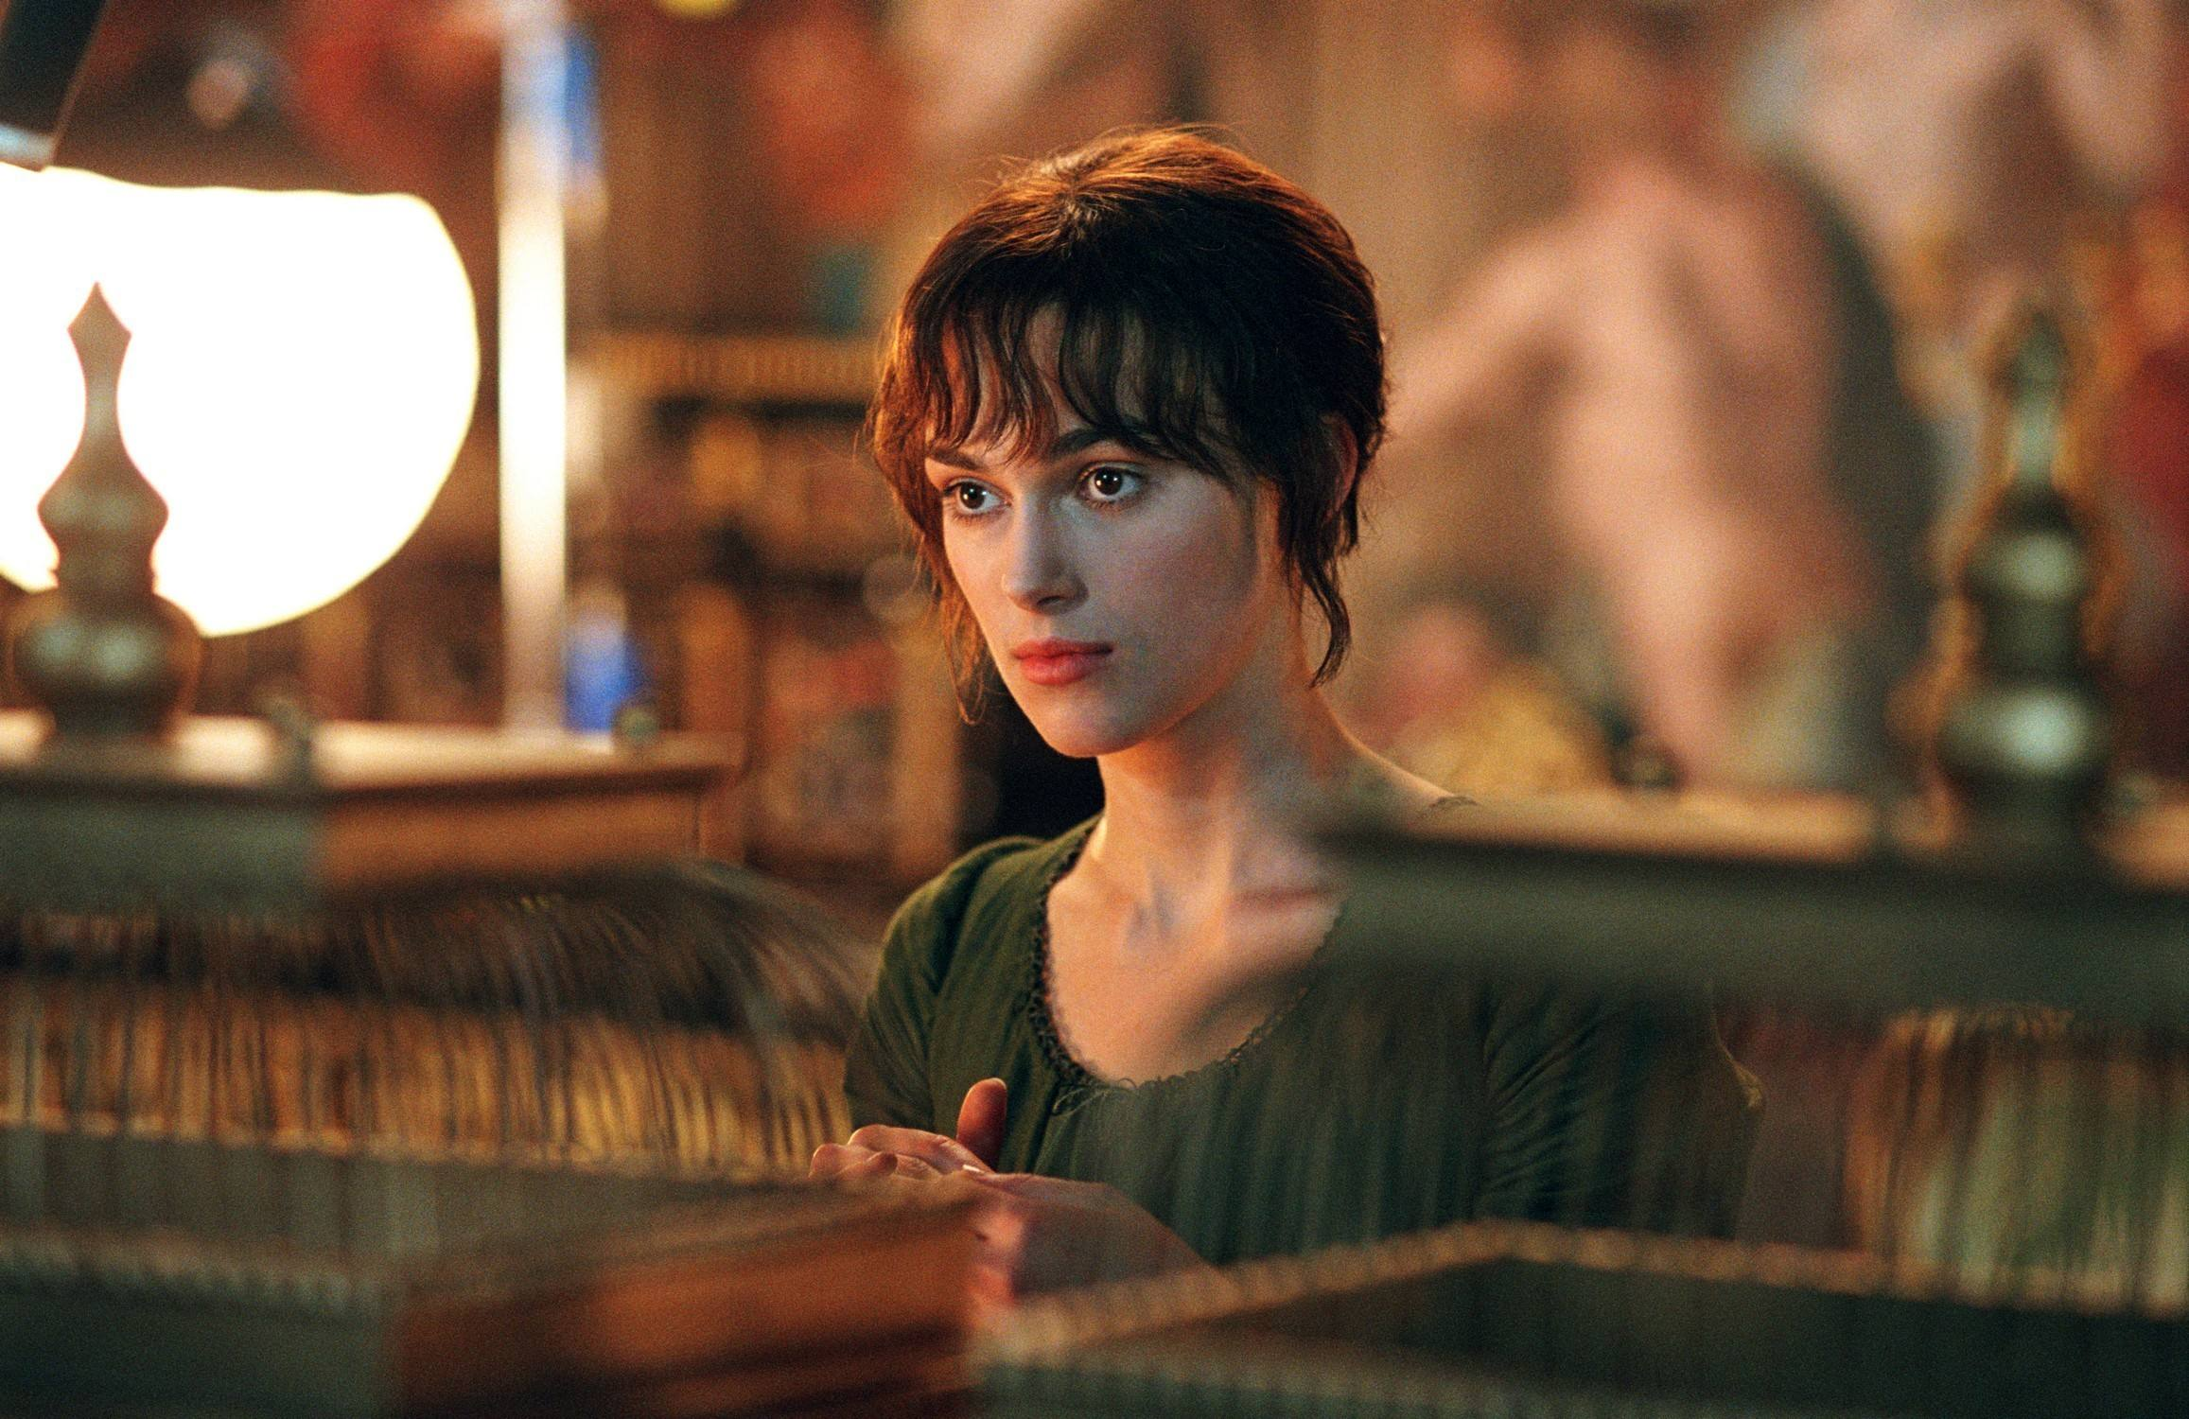
I gave my soul to you just so you could love me more

Slide 37
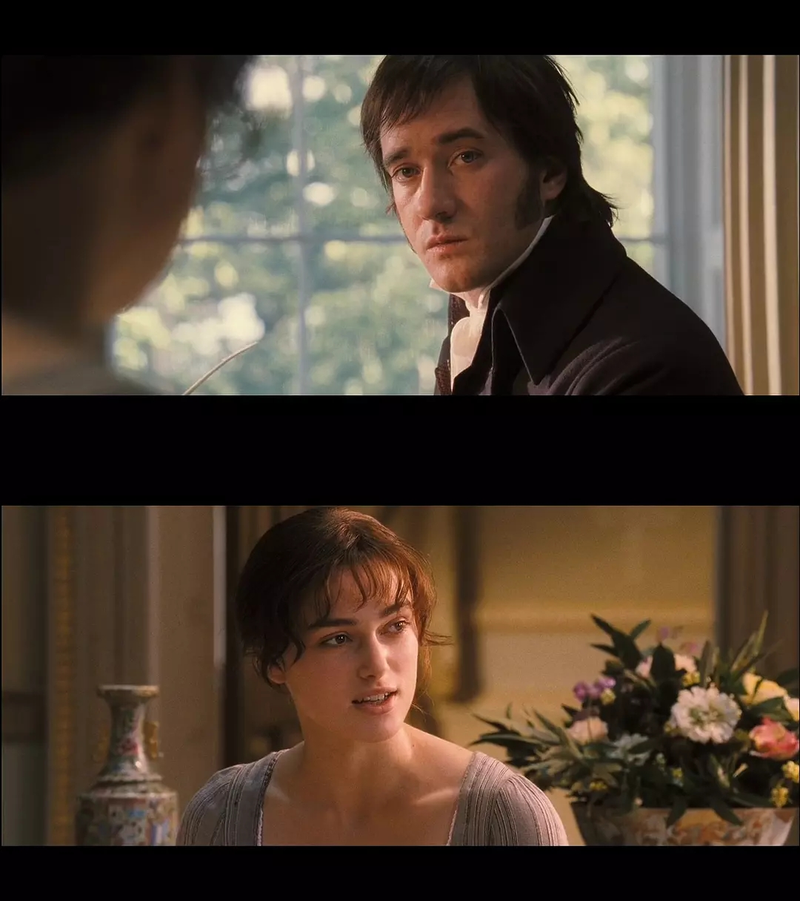
I’m still alive and you’re getting older

Slide 38
Maybe one day you’ll wake up and wonder

Slide 39
If it’s so wrong to wonder at all

Slide 40
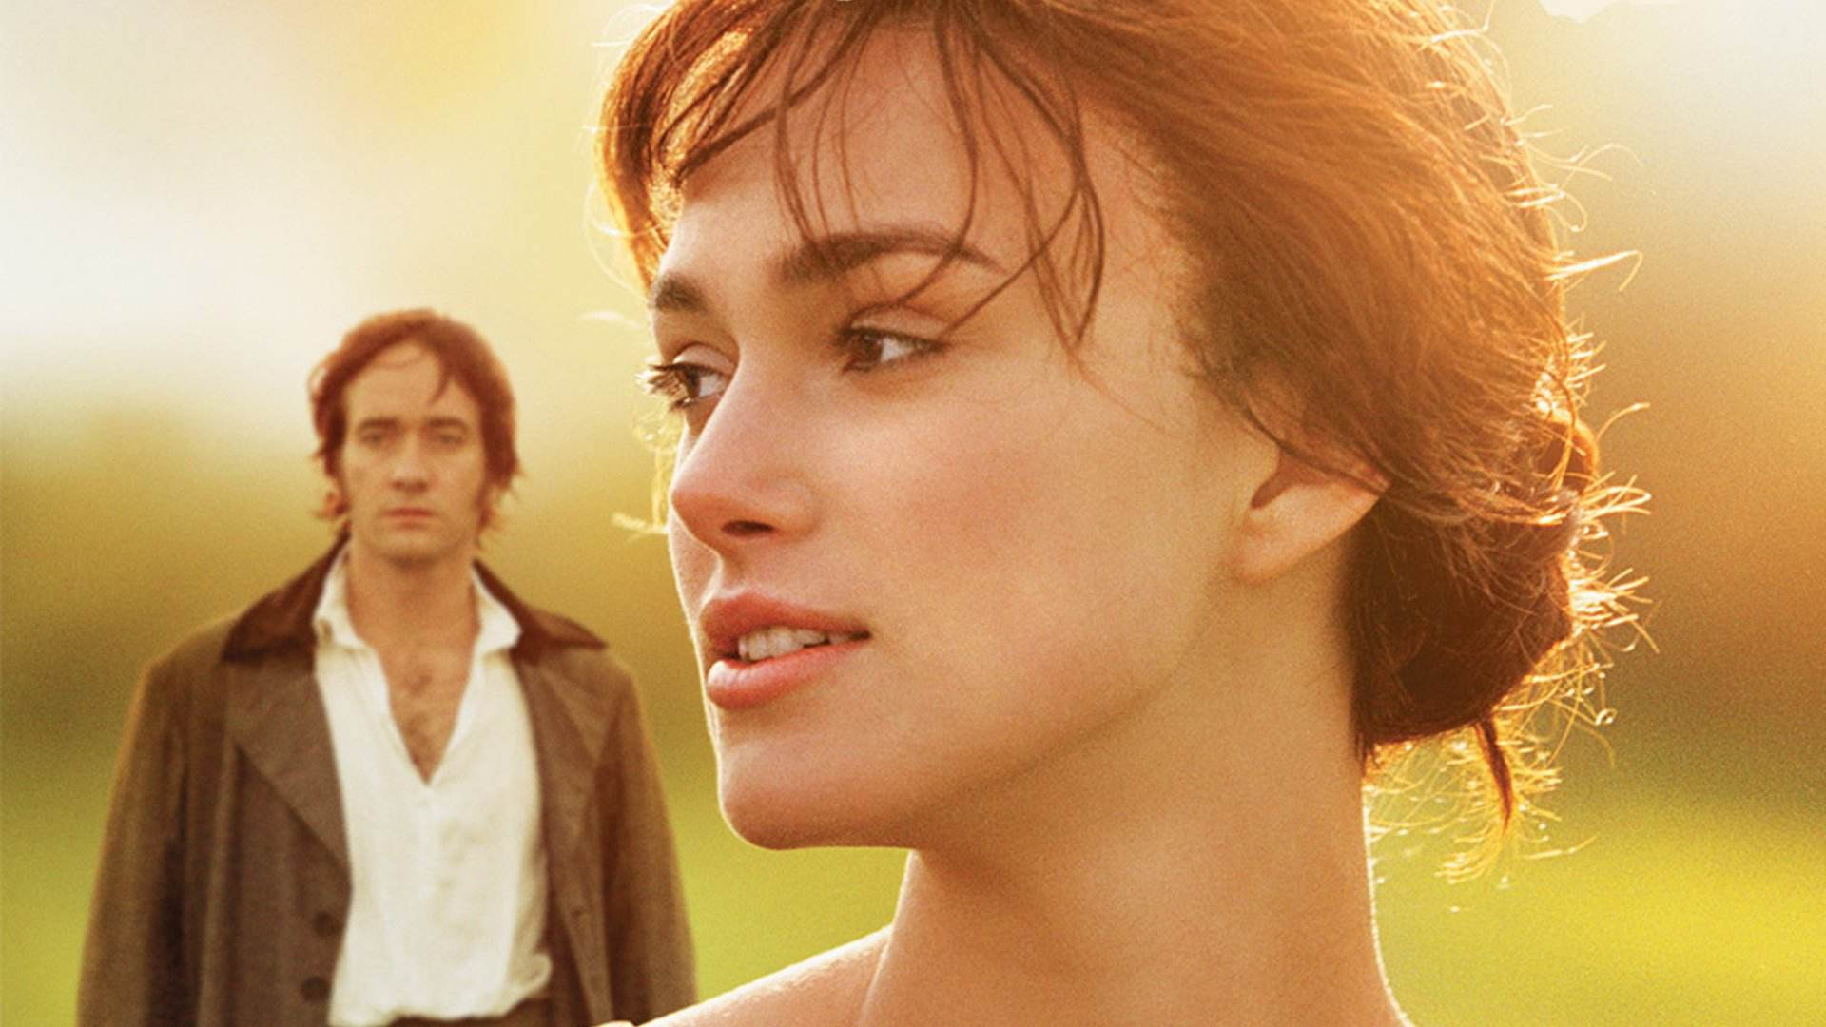
What’s behind those doors

Slide 41
What’s behind those doors

Slide 42
Thank you for listening.

