Slide 1
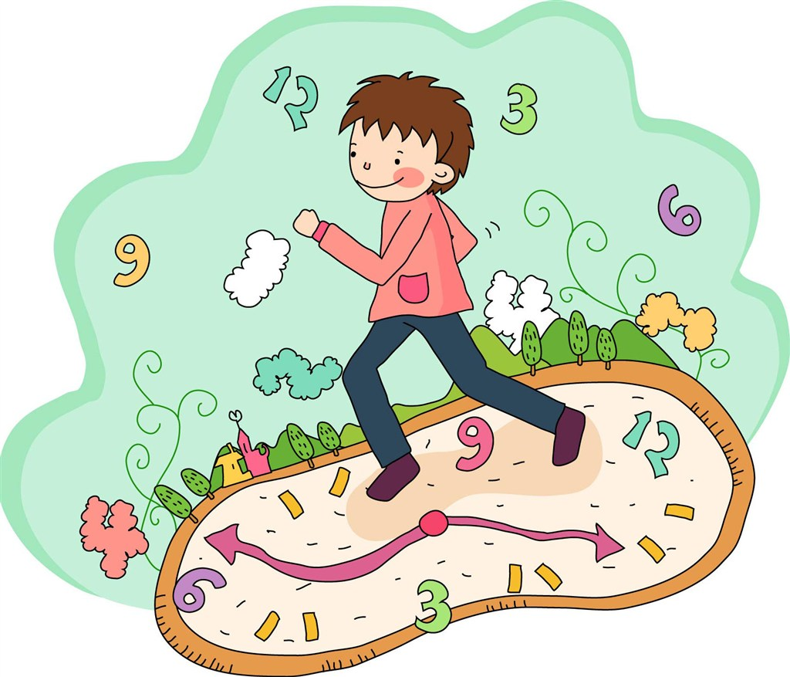
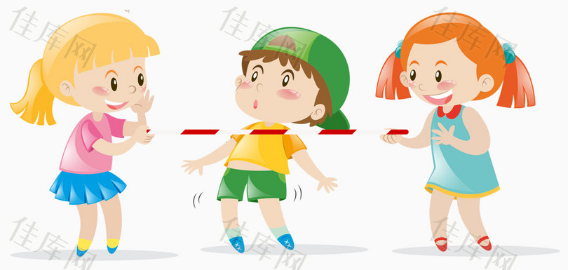
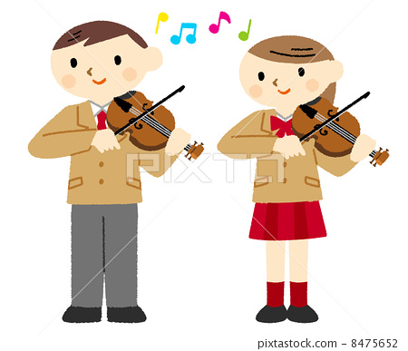
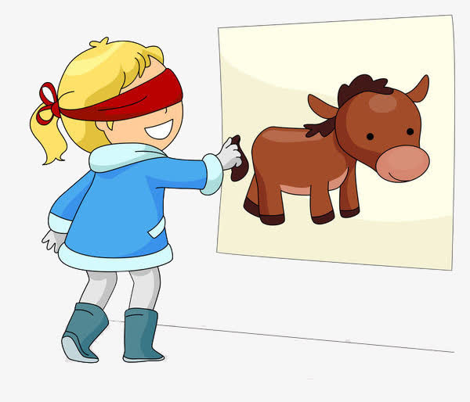
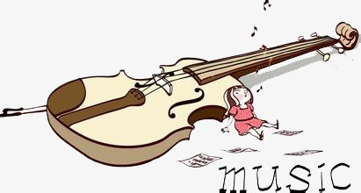
Drown into eyes
while they`re still blind
当while引导时间状语时、表当什么时，一般主句和从句的谓语都用做进行时.
同时, While引导的句子的谓语要是延续性动词.
而when所引导的句子的谓语可以是延续性的动词也可以是非延续性动词.这是它们两者的最大区别处.
例：
My mum was washing clothes , while my dad was watching TV .
When I reached there , he has left .
When I came here , he was writing a letter .
Young heart for love
Every thawing heart
plays your theme with care
Dark hair
for
catching
the wind
Hold another hand
Drown into eyes
while they`re still blind
The violin, the poet`s hand,
Hold another hand
Drown into eyes
while they`re still blind
While Your Lips Are Still Red
Hold another hand
While he`s still silent
Rest
While he`s still silent
Rest
While he`s still silent
Rest
A passionate
hour`s
never a
wasted one
Not to veil
the sight of
a cold world
First day of love
never comes back
Kiss while
your lips are still red
Kiss
while your lips are
still red
Not heartache
Kiss while
your lips are still red
-状语从句： while
while the hand`s still without a tool
while the hand`s still without a tool
while the hand`s still without a tool
while bosom is still untouched, unveiled
while bosom is still untouched, unveiled
while bosom is still
untouched, unveiled
设计制作：华南师范大学 陈惠娴
广东省东莞中学初中部 徐秀媚
指导老师：刘晓斌 徐秀媚
Sweet little words
made for silence
Love while the night still
hides the withering dawn
Not talk
Love while the night still
hides the withering dawn
Love while the night still
hides the withering dawn

