Slide 1
Just want you to know
—— That 的宾语从句
华南师范大学外国语言文化学院 施烁妮
广东省东莞市东莞中学 徐秀媚
Notes:
注意：本幻灯片文档背景歌曲为由Backstreet后街男孩于2006年发行歌曲 Just want you to know，幻灯片文档内图片来自NBC电视剧《老友记》(Friends)中有关照片。本幻灯片文档仅供教学使用！

Slide 2
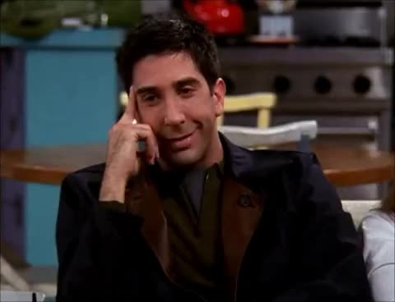
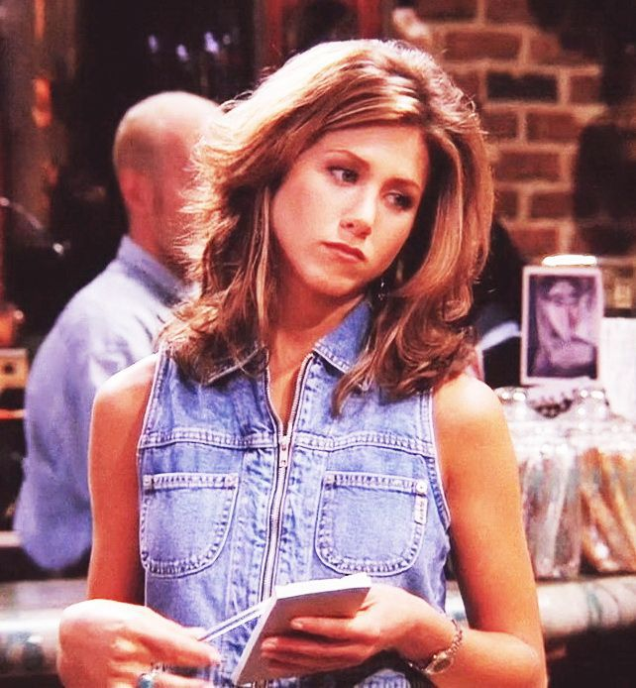
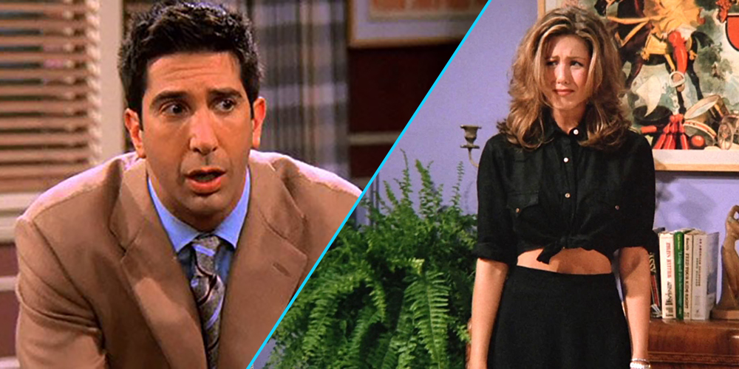

Slide 3
Looking at your picture from when we first met

Slide 4
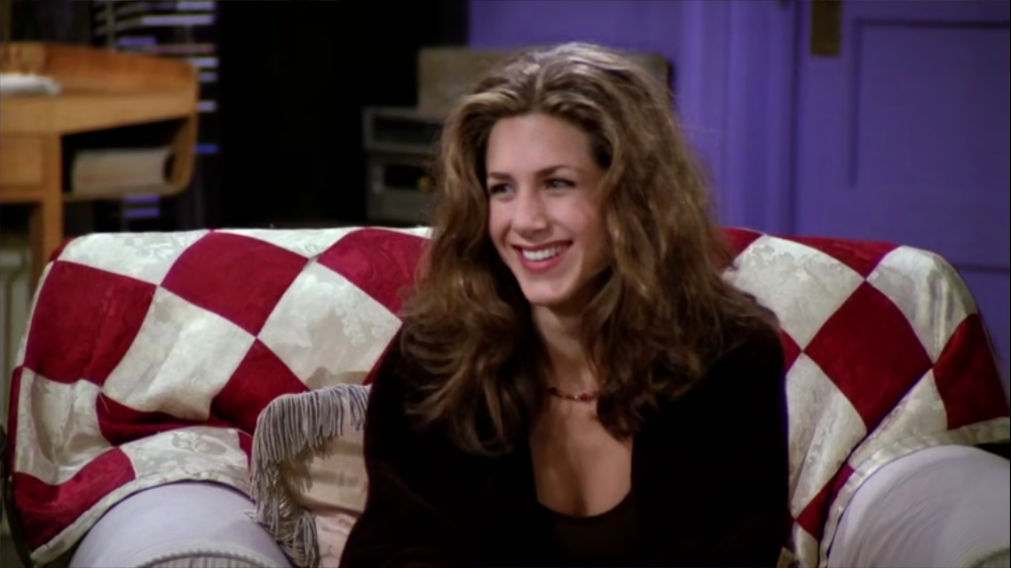
You gave me a smile that I could never forget

Slide 5
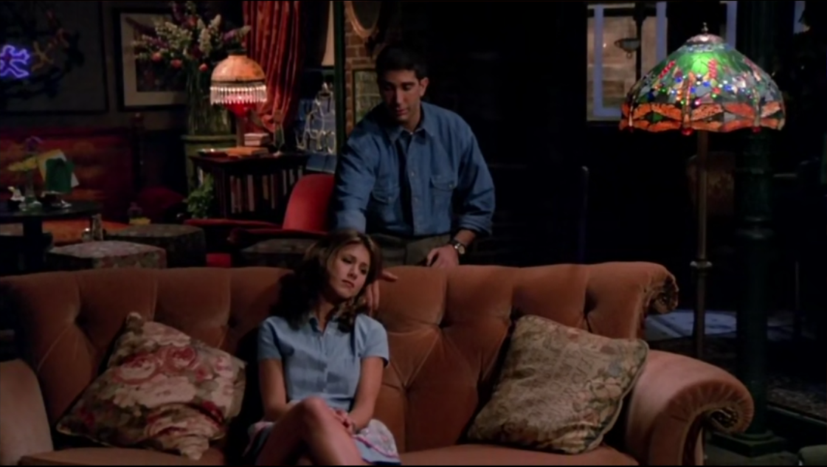
And nothing I could do could protect me from you that night

Slide 6
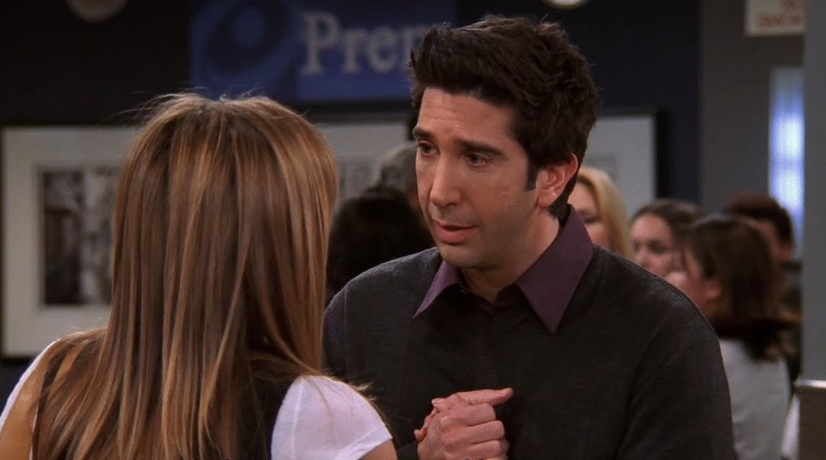
Wrapped around your finger, always in my mind

Slide 7
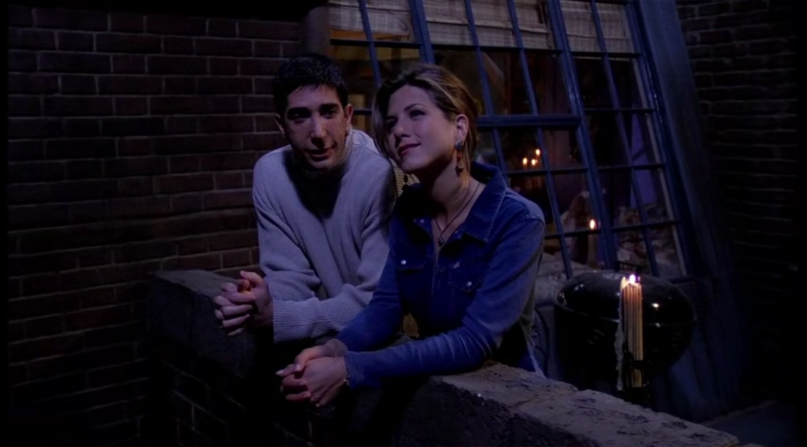
The days would blend cause we stayed up all night

Slide 8
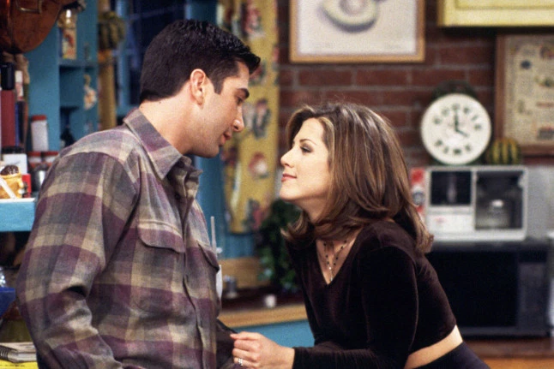
Yeah, you and I were everything, everything to me

Slide 9
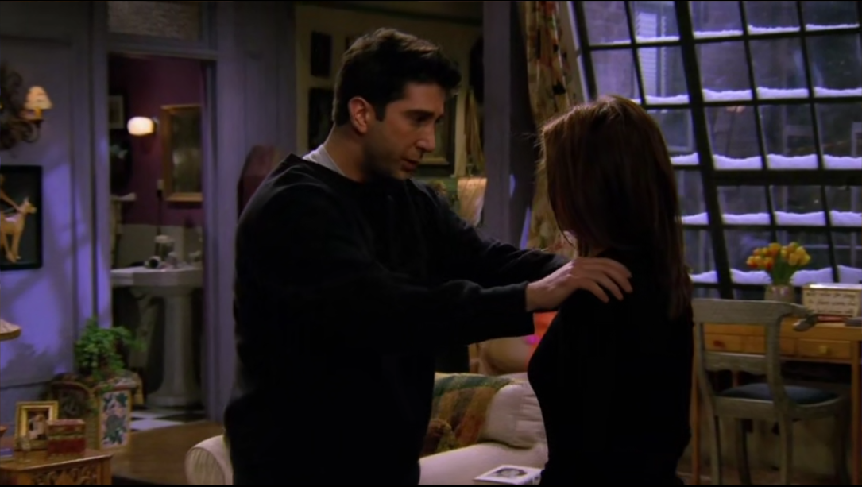
I just want you to know that I’ ve been fighting to let you go

Slide 10
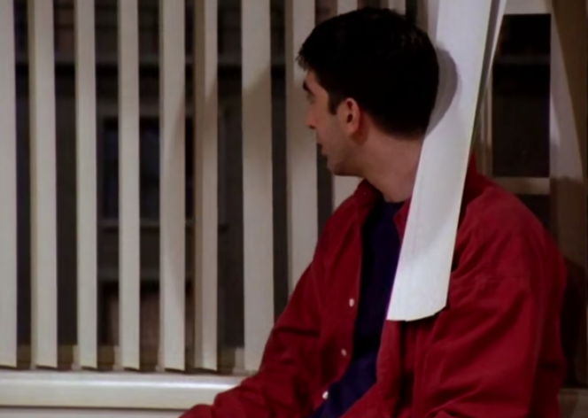
Some days I make it through
And then there’s nights that never end

Slide 11
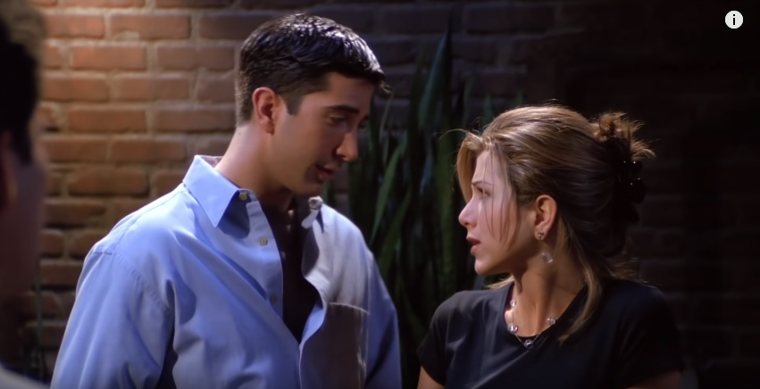
I wish that I could believe that there’s a day you’ll come back to me

Slide 12
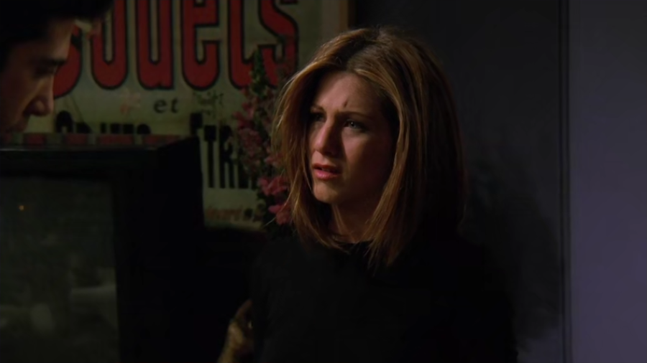
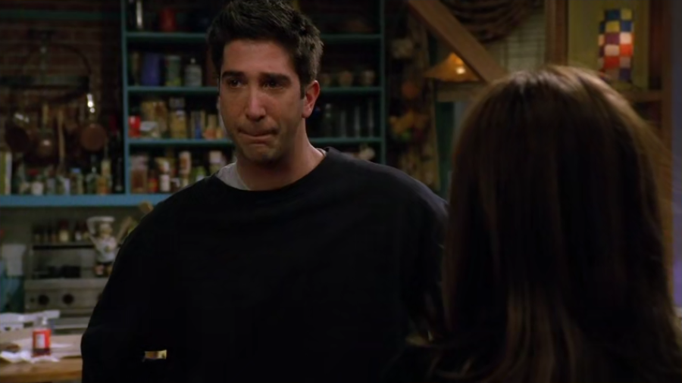
But still I have to say I would do it all again

Slide 13
Just want you to know

Slide 14
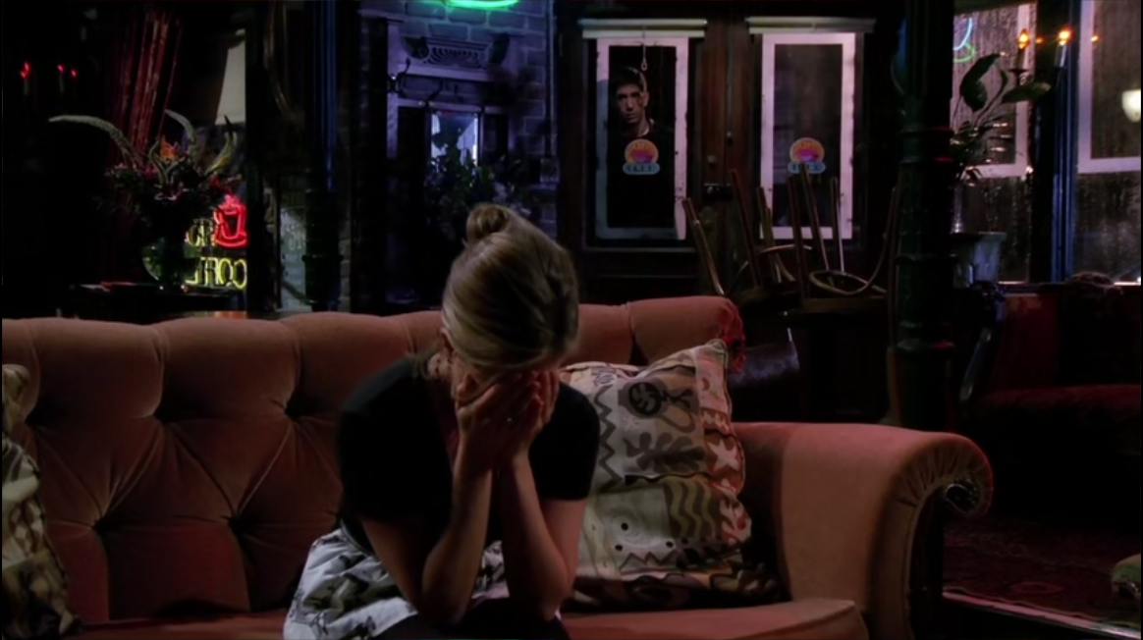
All the doors are closing I’m tryin’ to move ahead

Slide 15
And deep inside I wish (that) it’s me instead

Slide 16
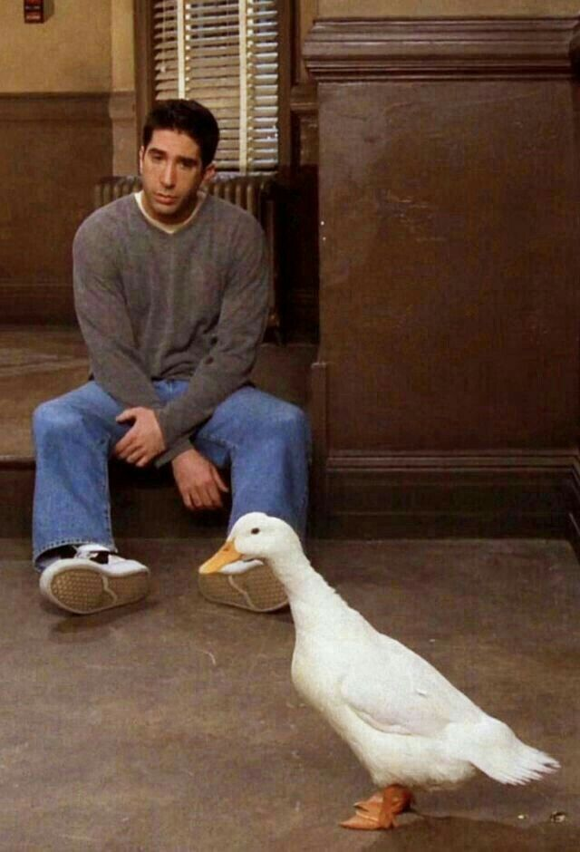
My dreams are empty from the day,
the day you slipped away

Slide 17
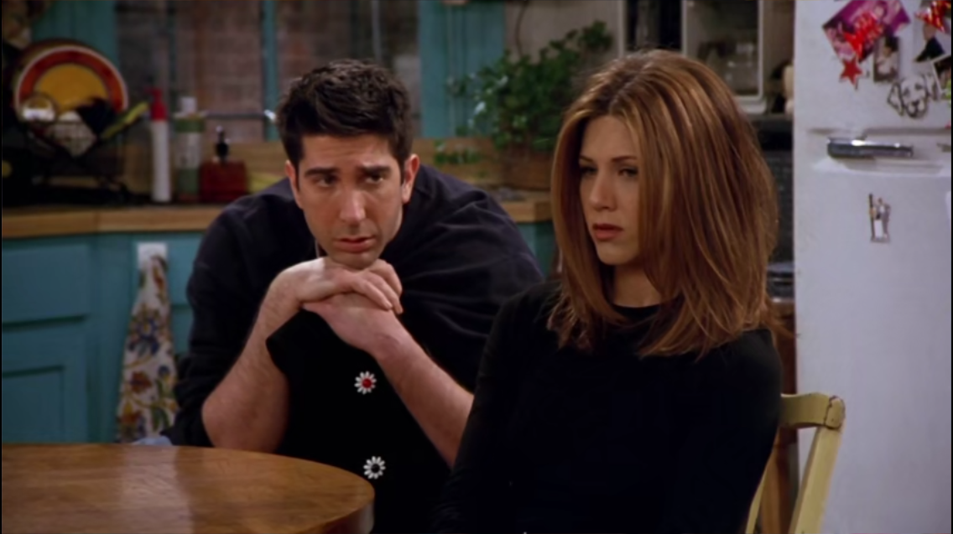
I just want you to know that I’ve been fighting to let you go

Slide 18
Some days I make it through
And then there’s nights that never end

Slide 19
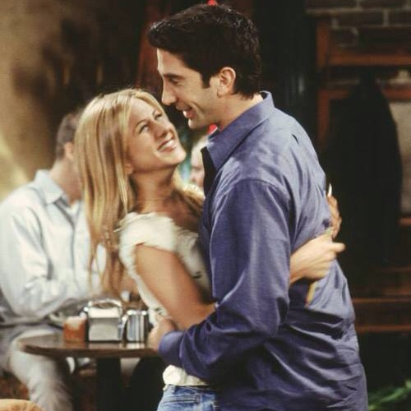
I wish that I could believe that there’s a day you’ll come back to me

Slide 20
But still I have to say (that) I would do it all again

Slide 21
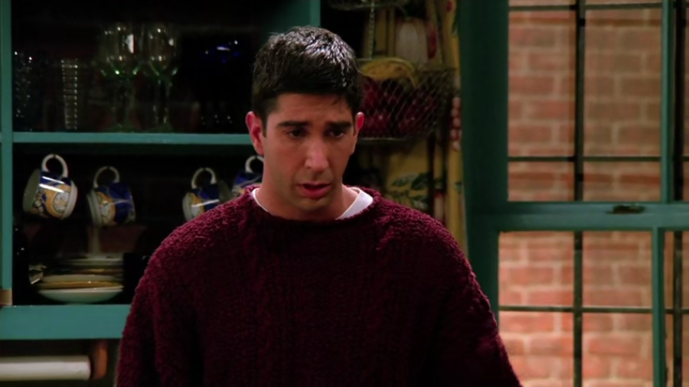
Just want you to know that since I lost you, I lost myself

Slide 22
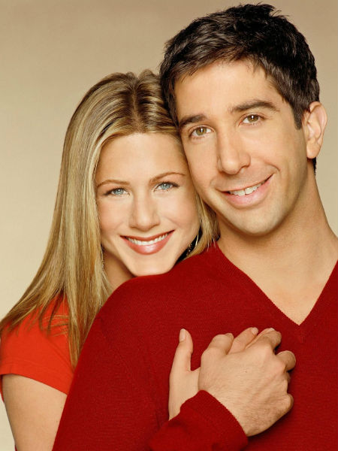
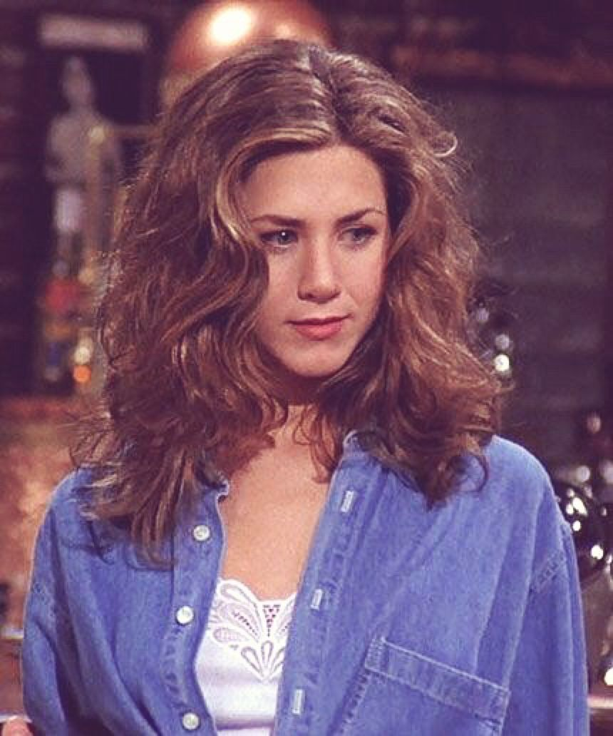
No I can’t fake it, there’s no one else

Slide 23
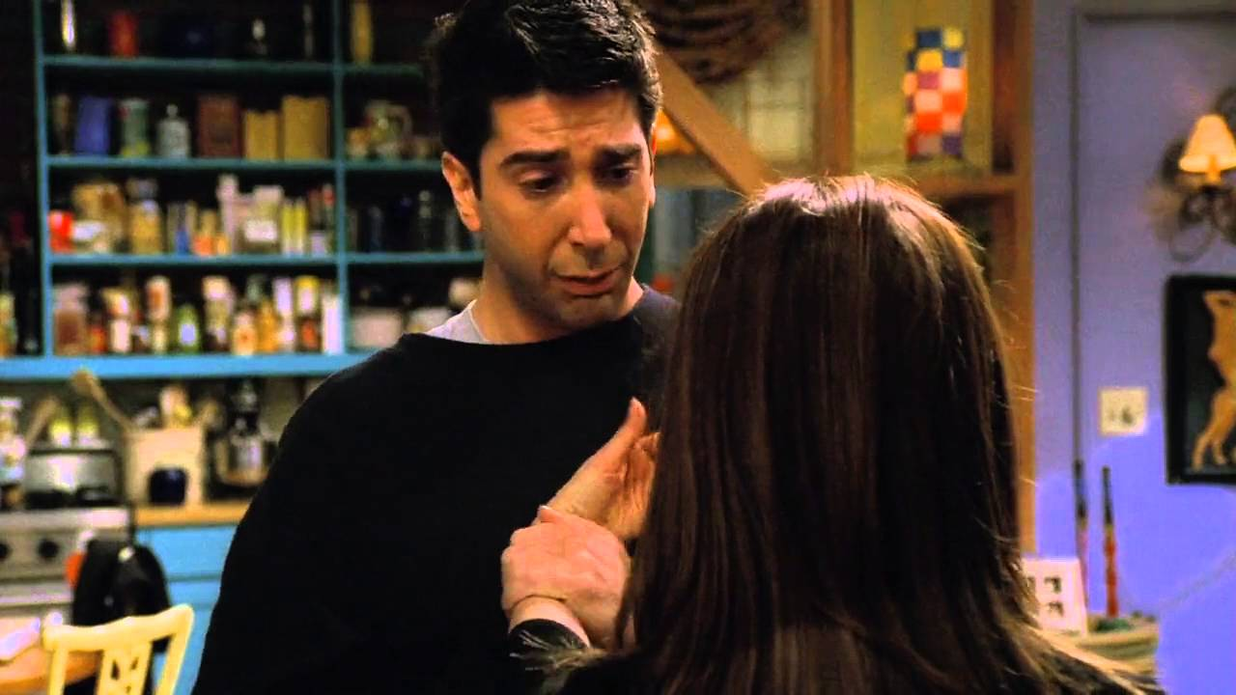
I just want you to know that I’ve been fighting to let you go

Slide 24
Some days I make it through
And then there’s nights that never end

Slide 25
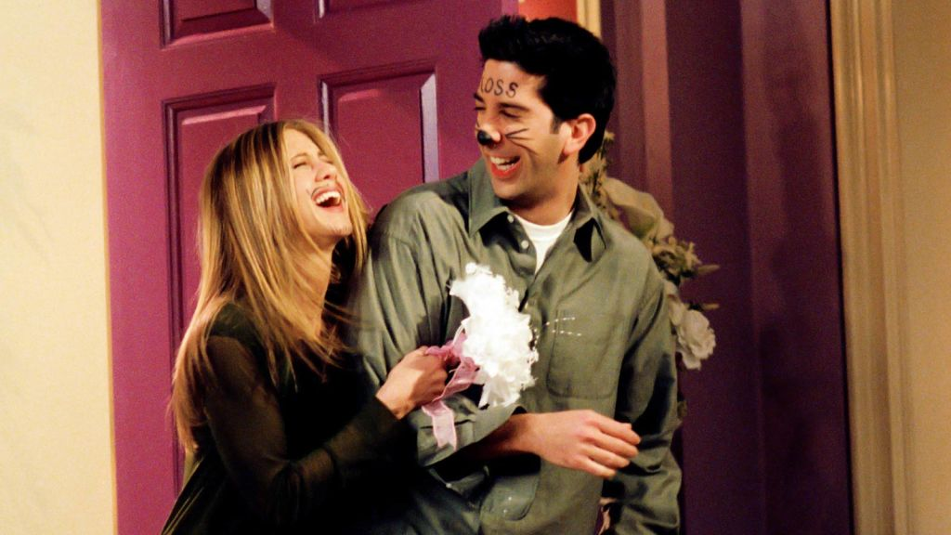
I wish that I could believe that there’s a day you’ll come back to me

Slide 26
But still I have to say I would do it all again

Slide 27
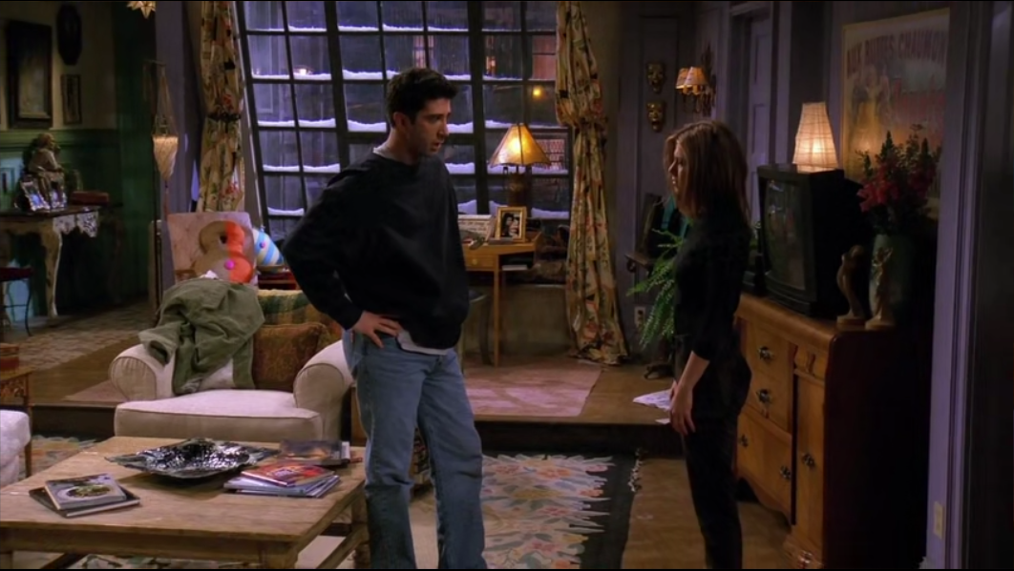
Just want you to know that I’ve been fighting to let you go

Slide 28
Some days I make it through
And then there’s nights that never end

Slide 29
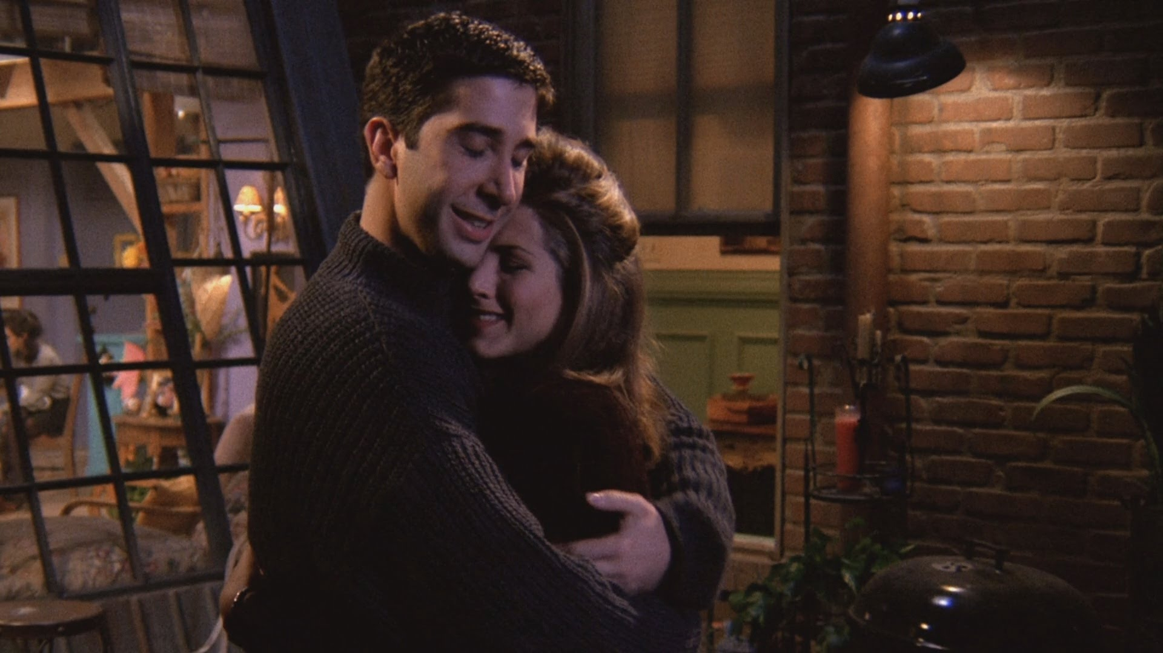
I wish that I could believe that there’s a day you’ll come back to me

Slide 30
But still I have to say (that) I would do it all again

Slide 31
Just want you to know

Slide 32
Thank you for watching!

