Slide 1
We Are The Champions
——现在完成时
设计制作：华南师范大学外文学院 苏靖慧
广东省东莞市东莞中学初中部 李丹丹
指导老师：李丹丹、刘晓斌

Slide 2
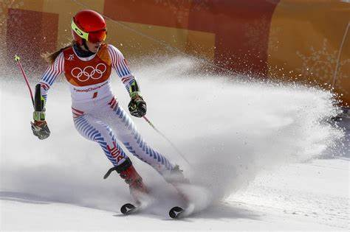
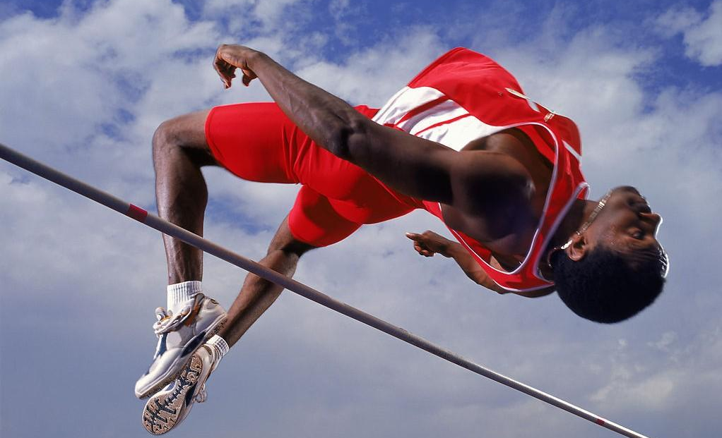
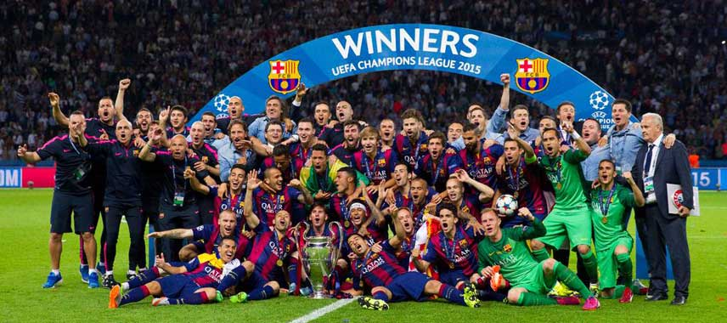
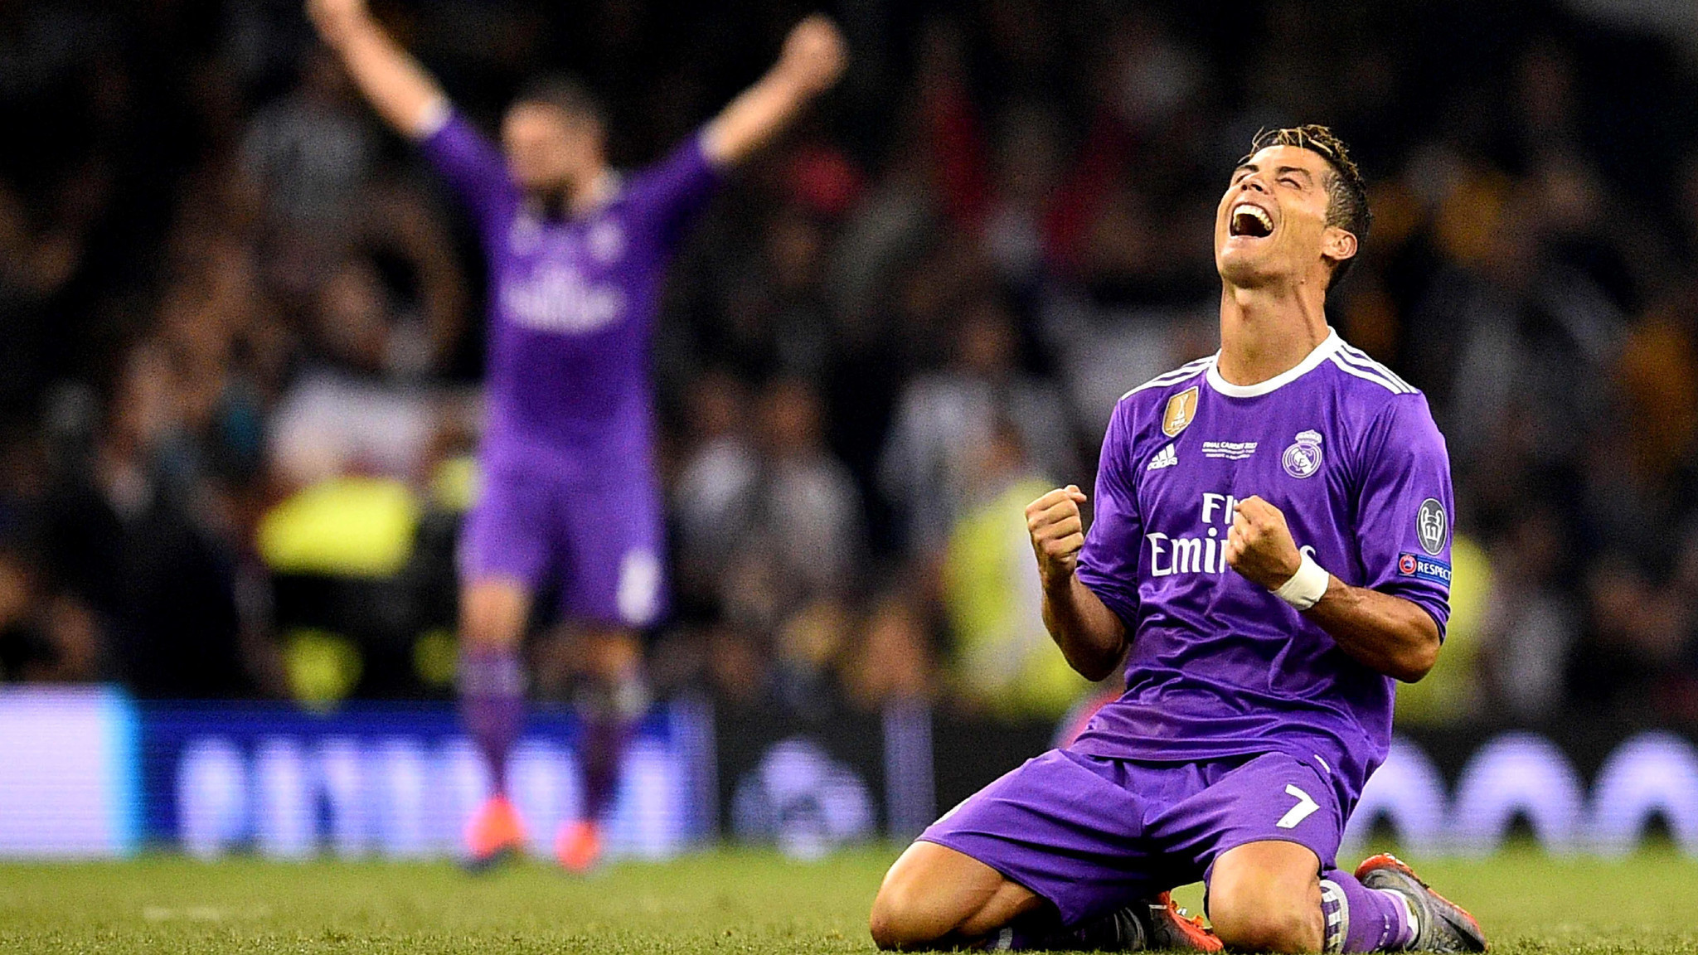
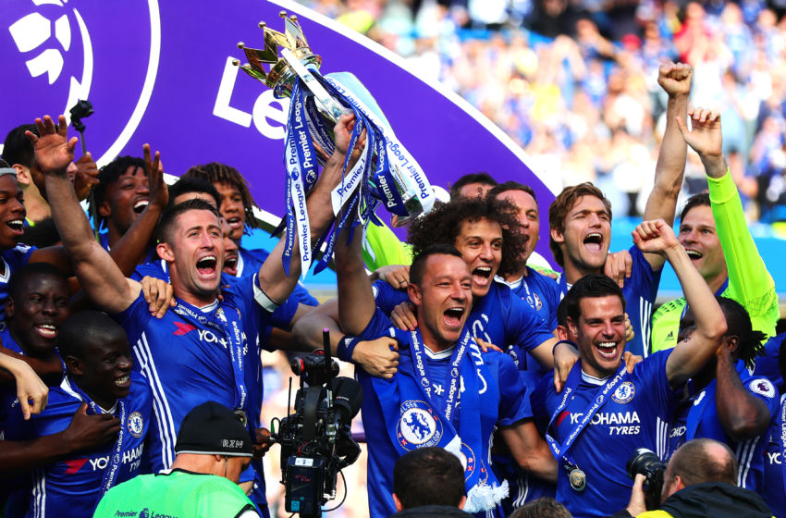
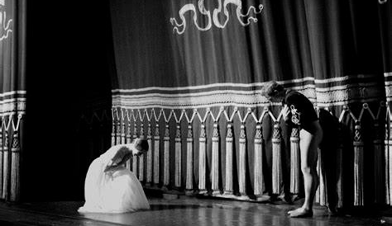
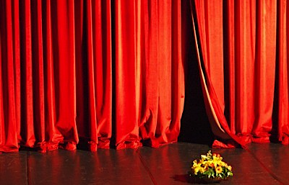
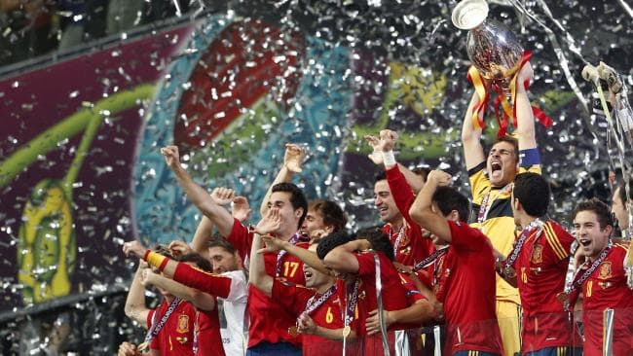
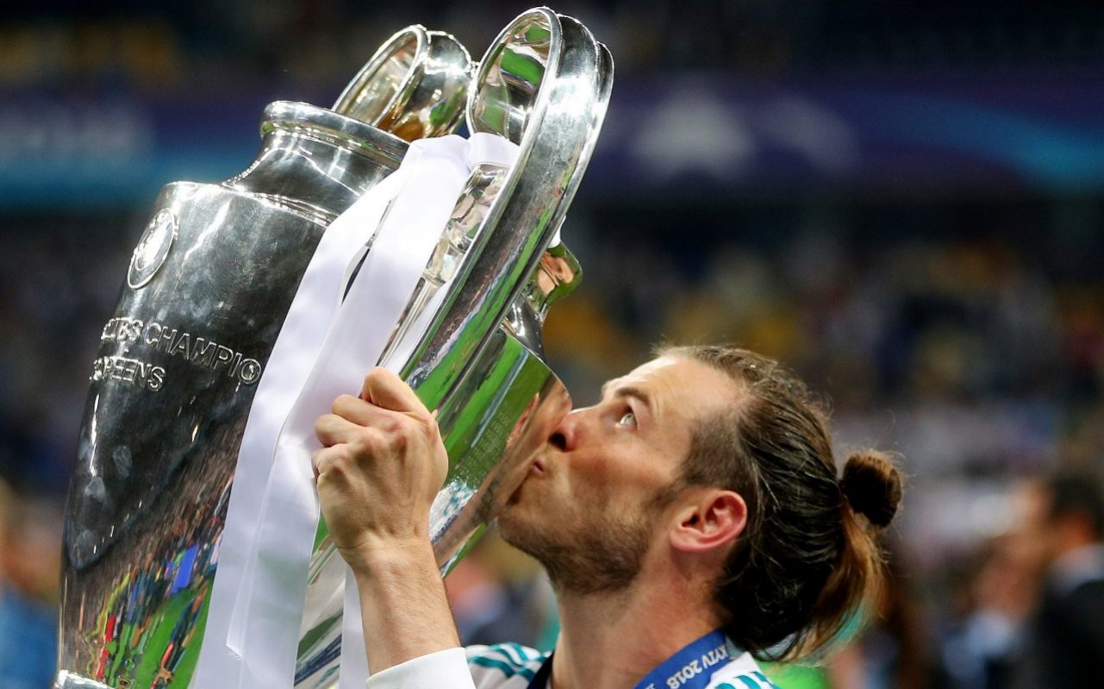
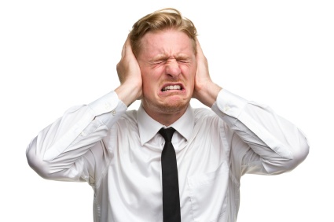
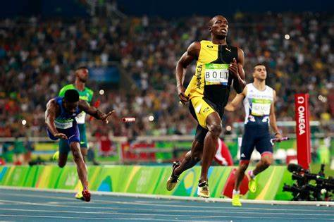
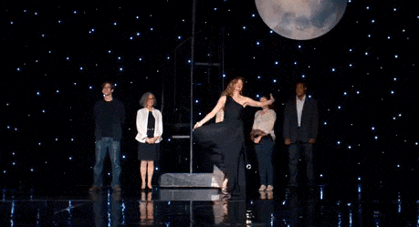
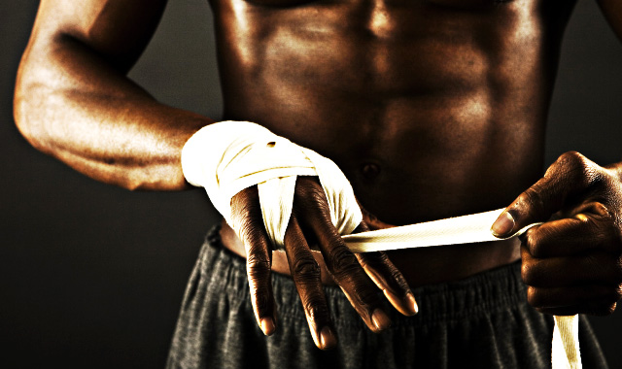
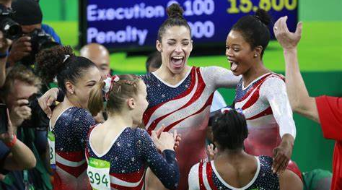
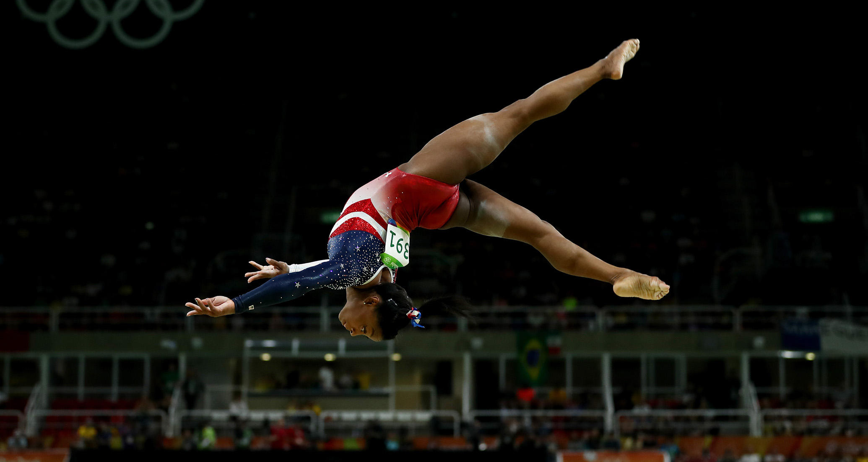
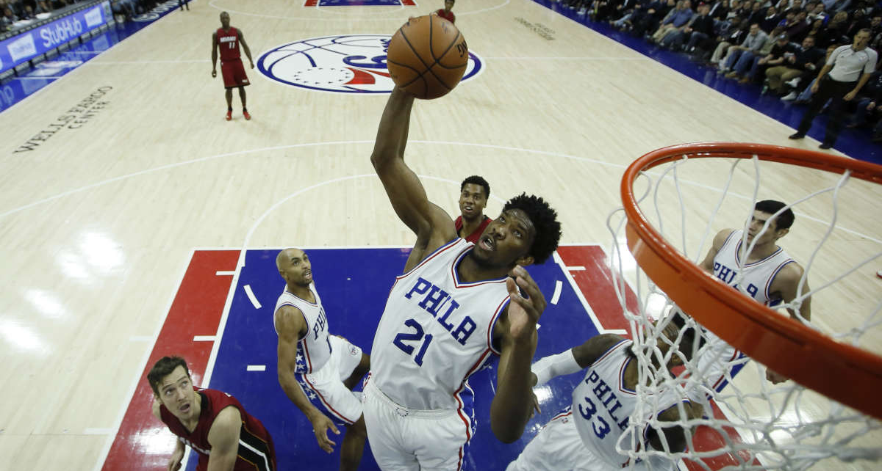
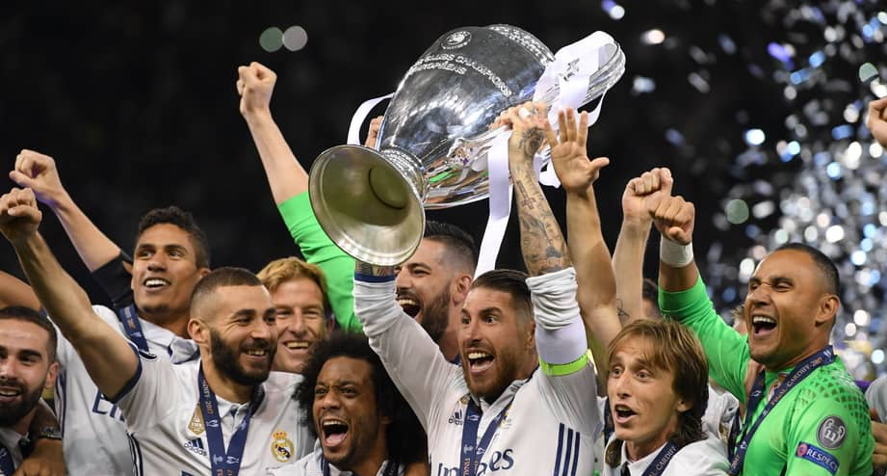
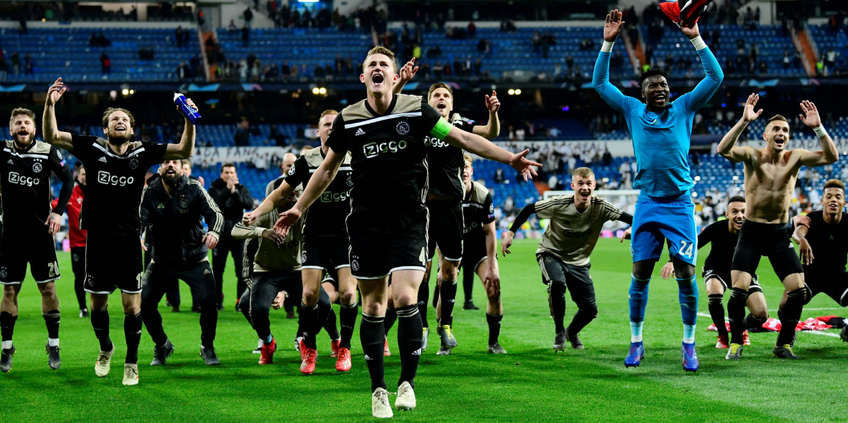
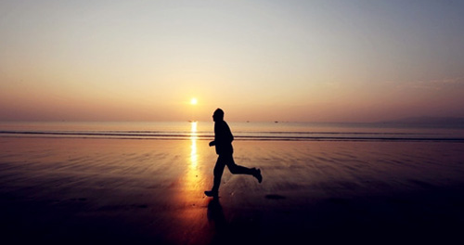
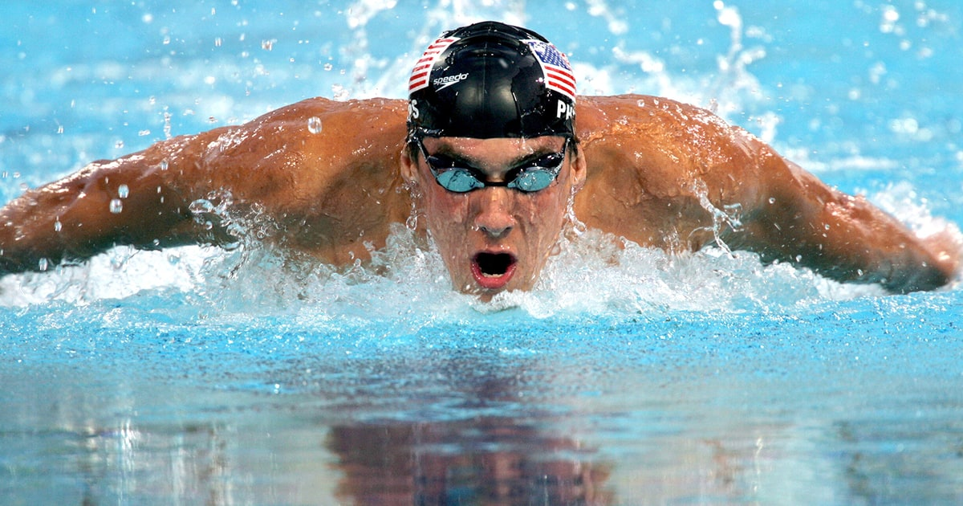
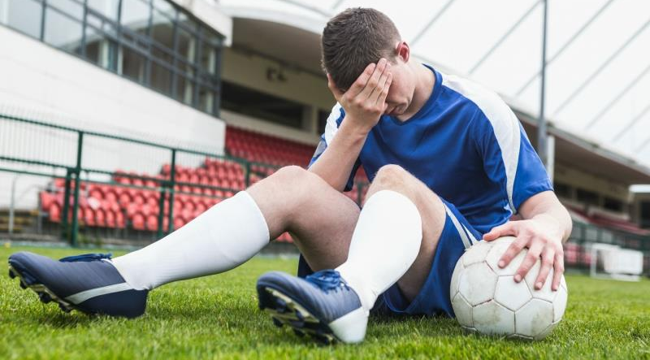
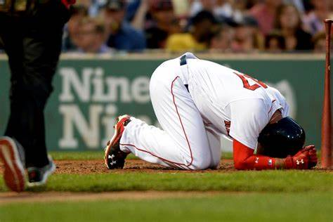
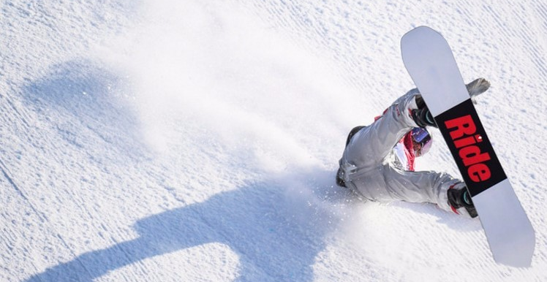
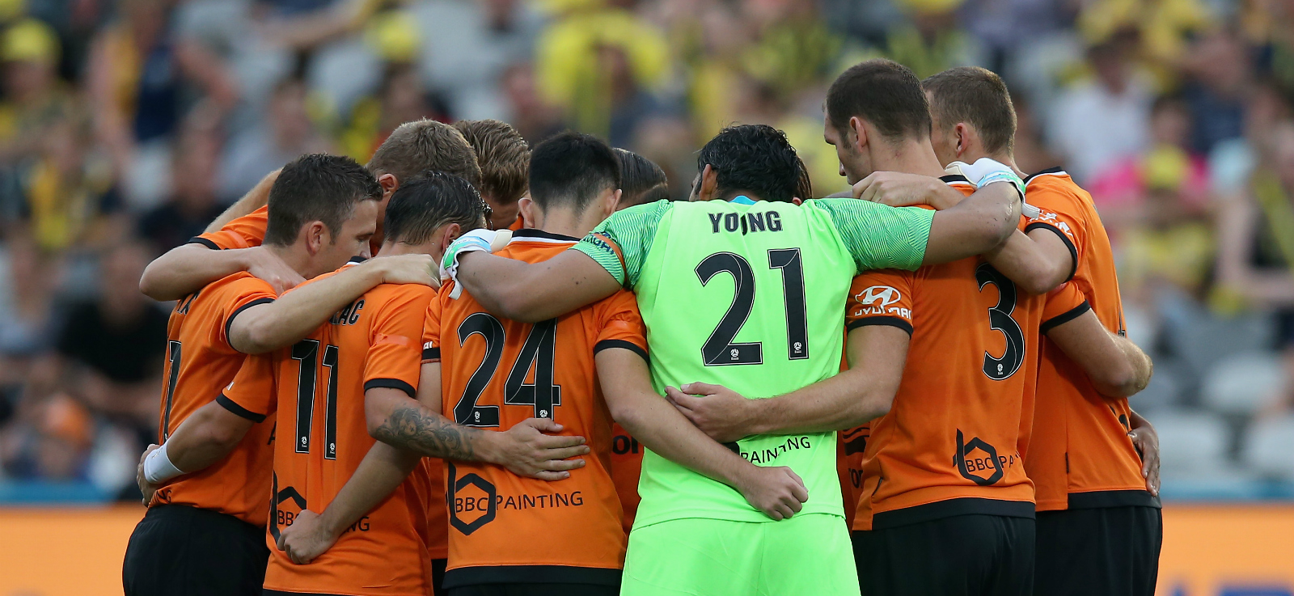
You’ve brought me fame and fortune
and everything that goes with it
I’ve paid my dues time after time
I consider it a challenge before the whole human race
No time for losers
But I’ve come through
Cause we are the champions of the world
And we’ll keep on fighting till the end
And I need to go on and on and on and on
I’ve had my share of sand, kicked in my face
I’ve taken my bows
No time for losers
But committed no crime
We are the champions
Cause we are the champions of the world
I’ve done my sentence
We are the champions my friends
And we’ll keep on fighting till the end
We are the champions
And we’ll keep on fighting till the end
We are the champions my friends
And bad mistakes I’ve made a few
And I need to go on and on and on and on
And my curtain calls
We are the champions my friends
I thank you all
Cause we are the champions
We are the champions
But it’s been no bed of roses no pleasure cruise
No time for losers
And I ain’t gonna lose

