Slide 1
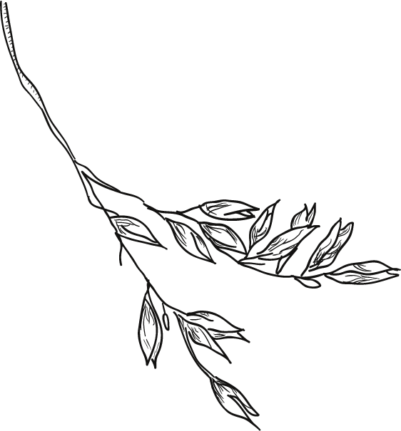
The Birds Were Singing of You
Past Continuous Tense
作者：华南师范大学外国语言文化学院 陈欣铃
广东省东莞市东莞中学初中部 李丹丹

Slide 2
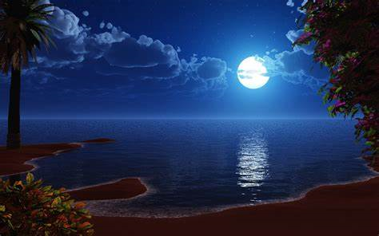
Last night the pale moon
was shining

Slide 3
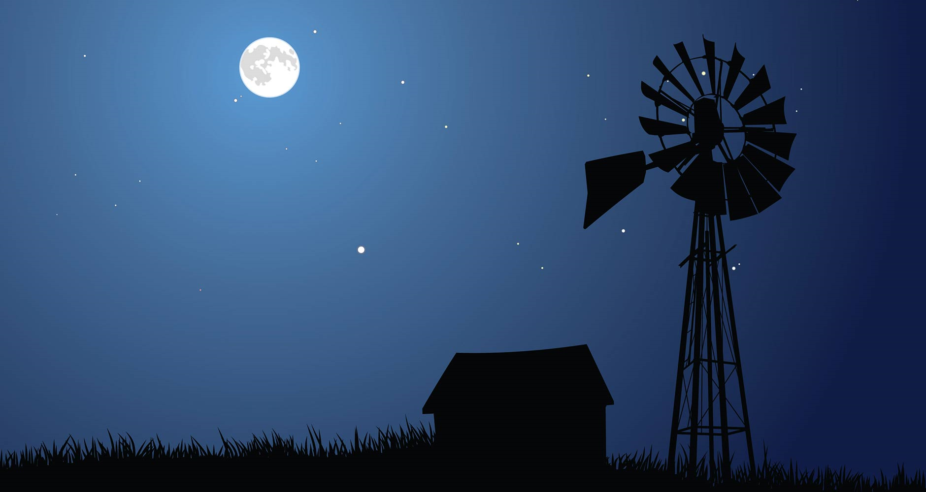
Last night when all was still

Slide 4
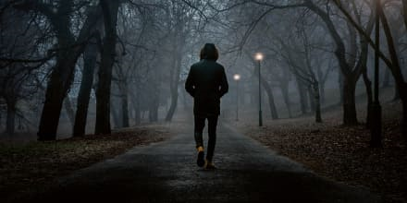
I alone in sadness
was wandering

Slide 5
Out among the woodland hills

Slide 6
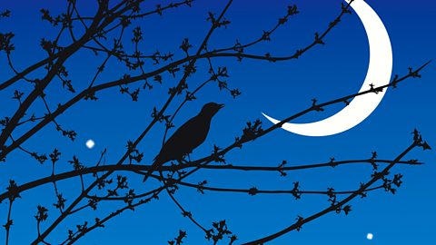
I heard
the
birds singing

Slide 7
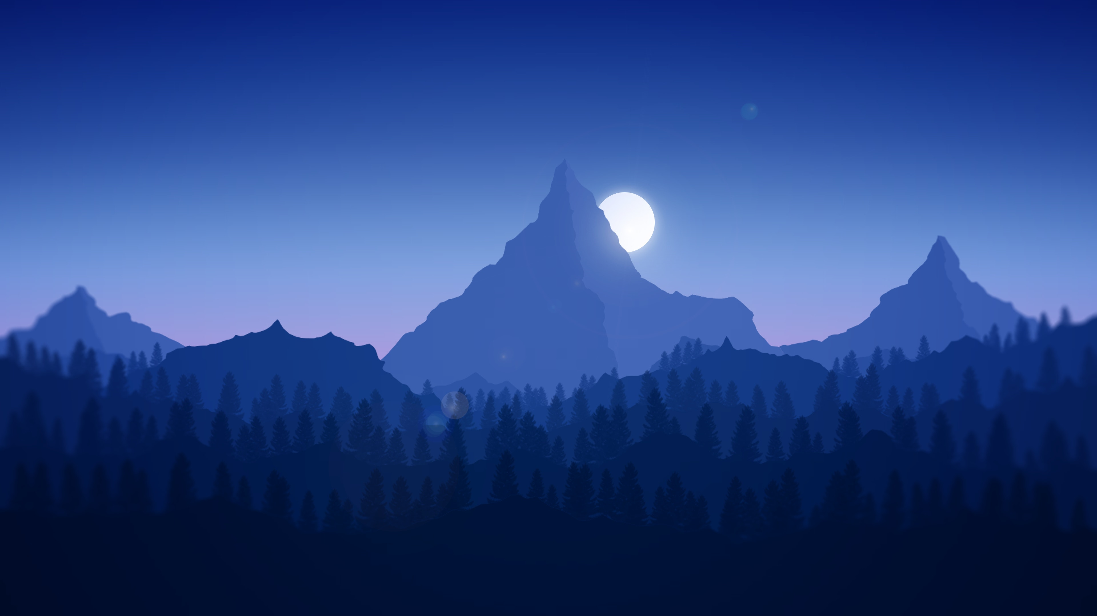
Out among
the trees and hills

Slide 8
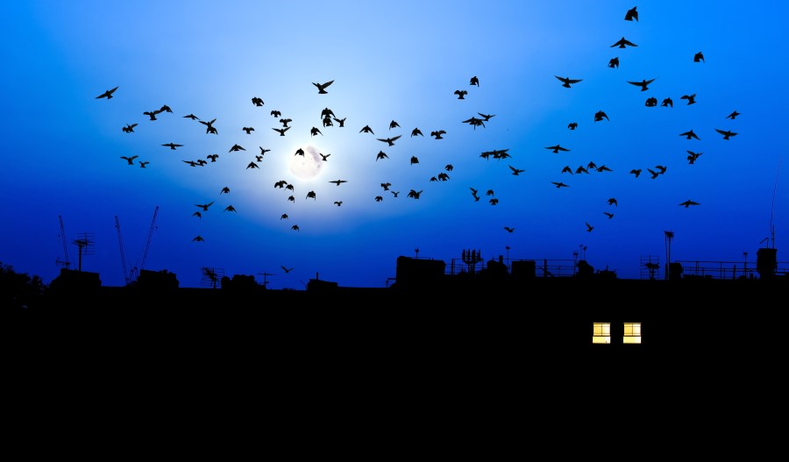
Were singing, were singing of you
And all the birds, my darling

Slide 9
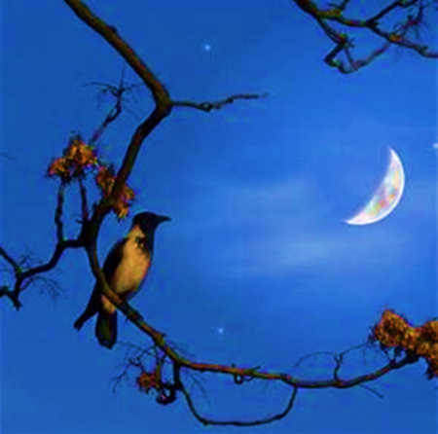
Were singing,
were singing
of you
Were singing, were singing
of you (my love)

Slide 10
And all the birds, my darling
Were singing, were singing of you

Slide 13
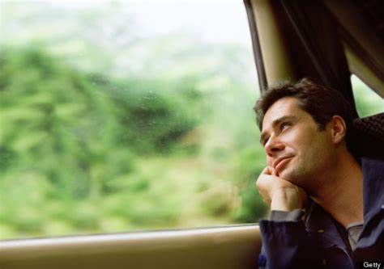
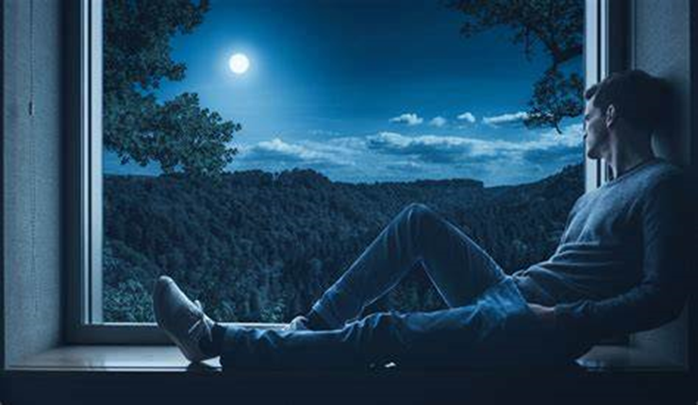
I think of you
in the daytime
I dream of you
by night

Slide 14
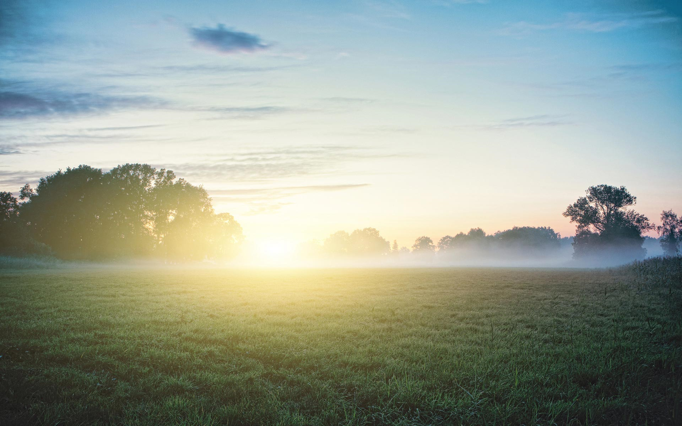
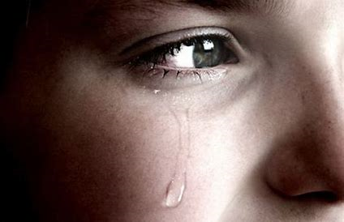
wish you was here
And tears are blinding my sight
I wake and wish you was here

Slide 15
The flowers that slumber so sweetly

Slide 16
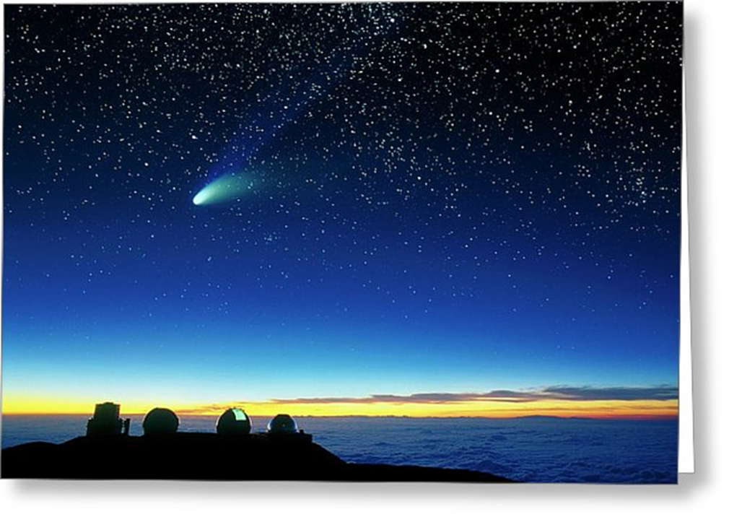
The stars are above the blue

Slide 17
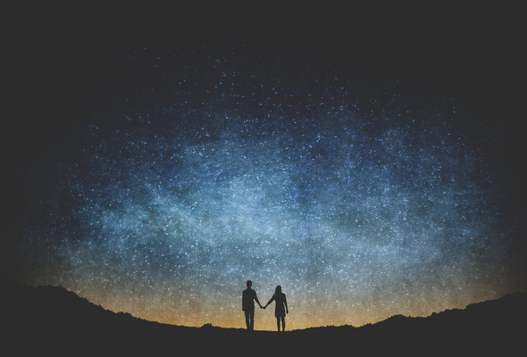
Oh, heaven itself, my darling
Is thinking, is thinking of you

Slide 18
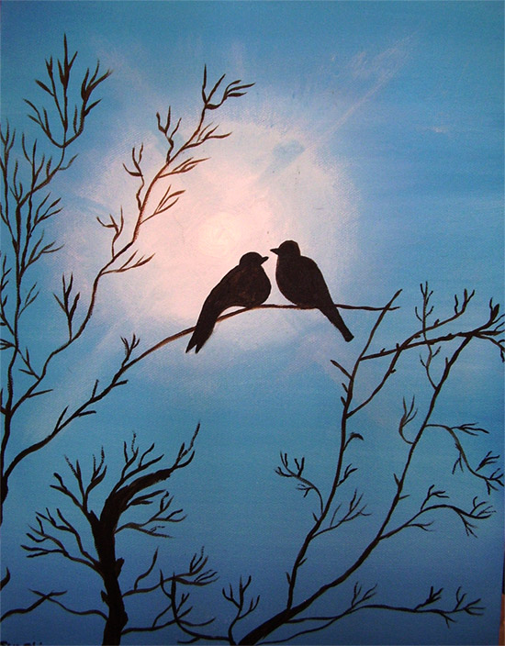
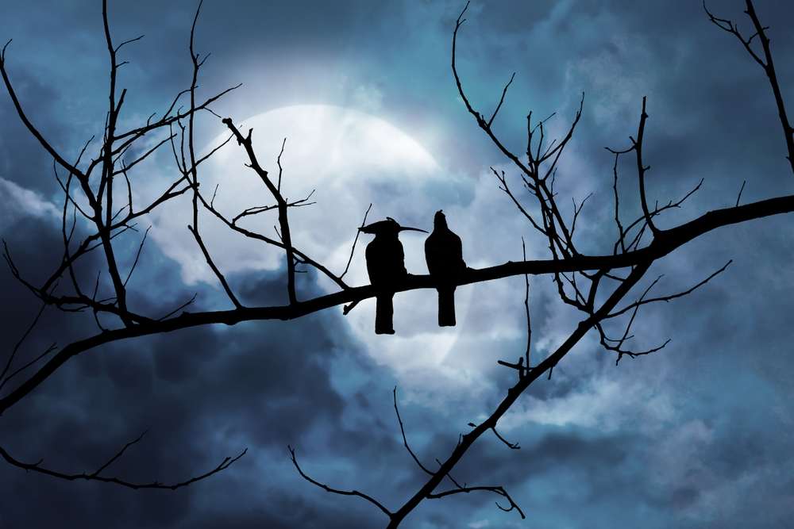
Is thinking,
thinking of you
(my love)
Is thinking, thinking of you

Slide 19
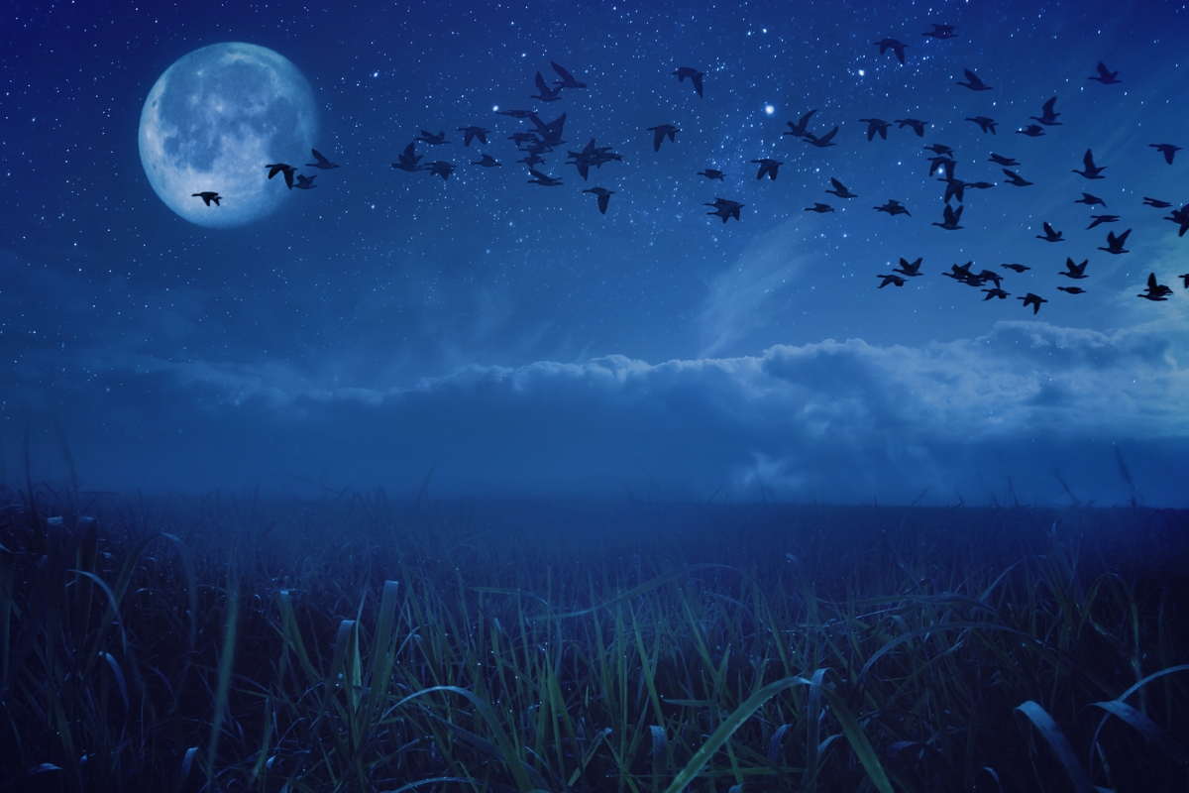
Is thinking, is thinking of you
Oh, heaven itself, my darling

Slide 20
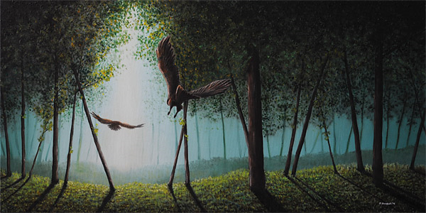
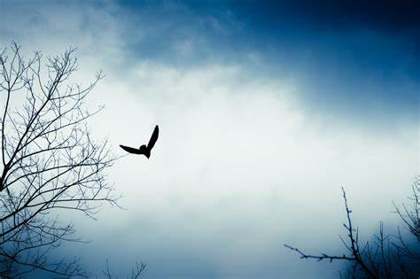

Slide 21
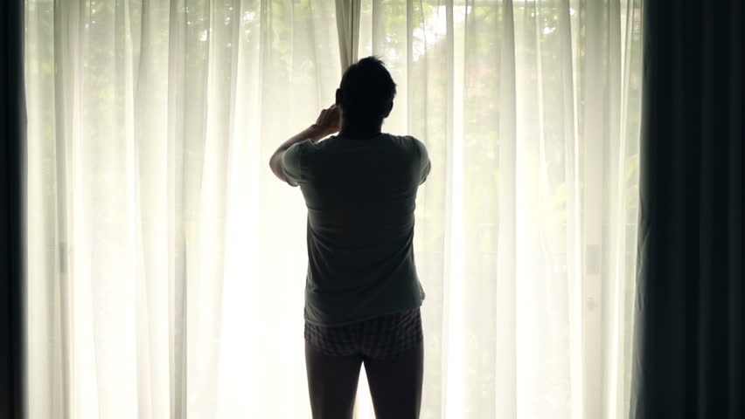
I opened my windows so gently

Slide 22
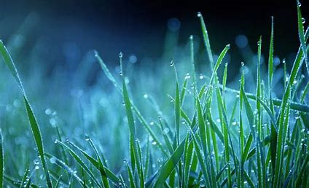
Look out on the dreaming dew

Slide 23
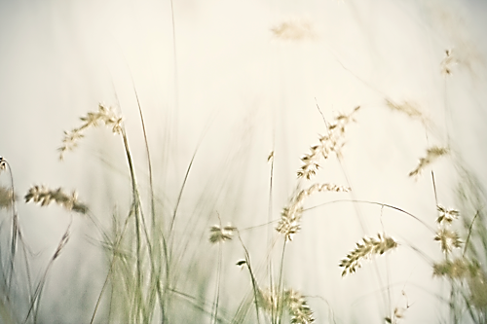
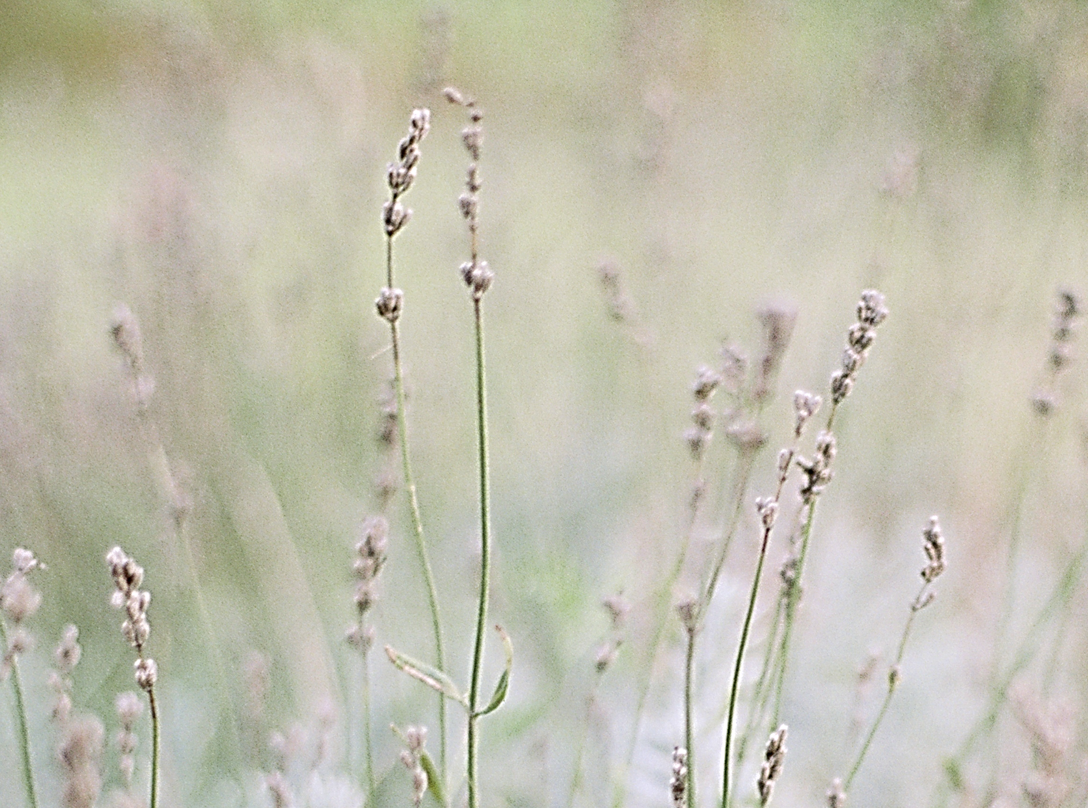
And all the world,
my darling
Was sighing,
was sighing for you

Slide 24
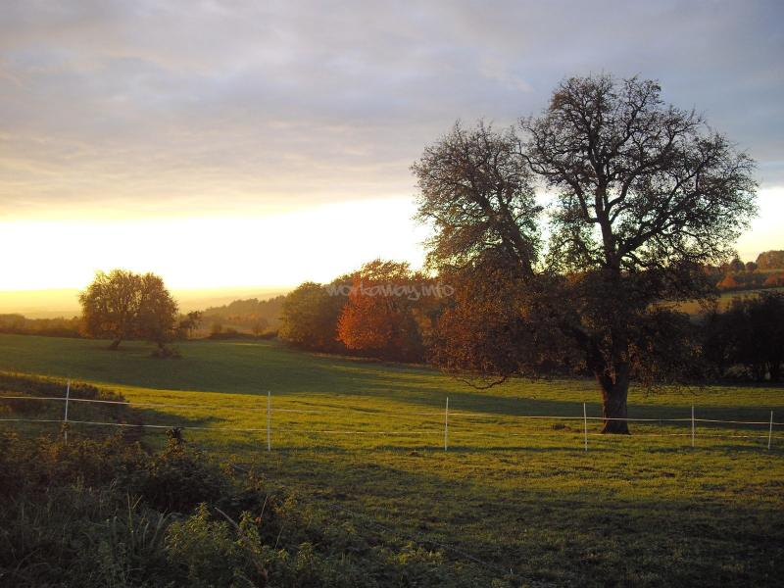
Was sighing,
sighing for you
(my love)
Was sighing,
sighing for you

Slide 25
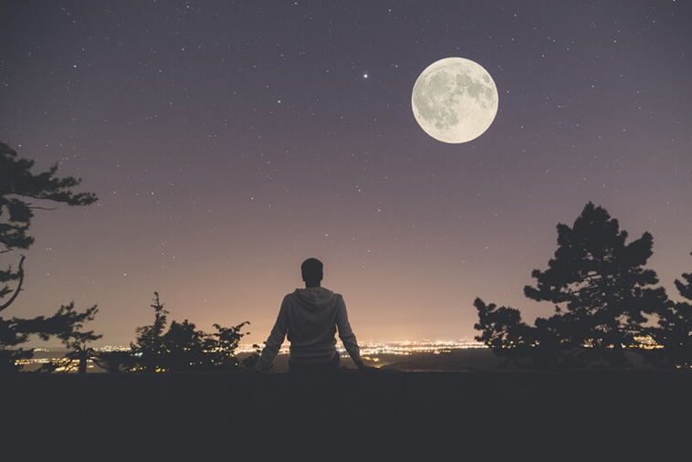
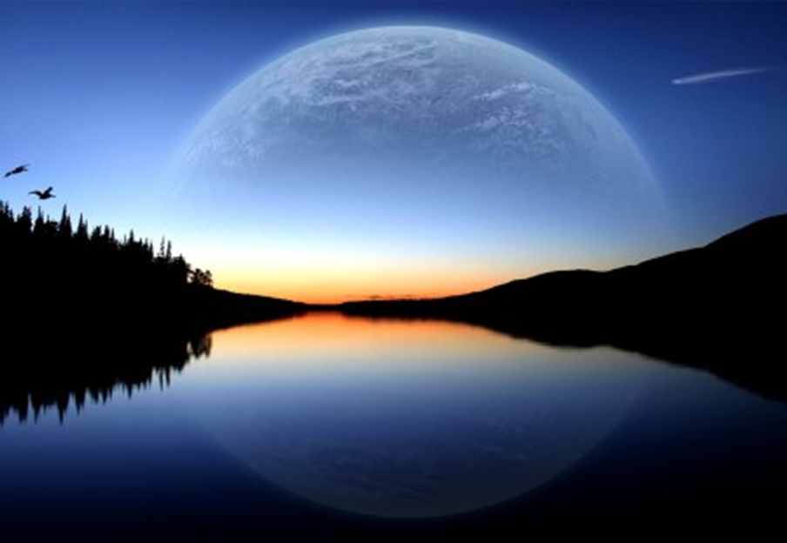
Was sighing, was sighing for you
And all the world, my darling

Slide 26
Was sighing,
sighing for you
(my love)
Was sighing,
sighing for you

Slide 27
And all the world, my darling
Was sighing, was sighing for you

