Slide 1
Touch the sky
——一般将来时
设计制作：华南师范大学外文学院 卢凯琪
广东省东莞市东莞中学初中部 李丹丹
指导教师：李丹丹、刘晓斌

Slide 3
When the cold wind’s a calling
当寒冷的风在呼啸

Slide 4
And the sky is clear and bright
而天空清澈明亮

Slide 5
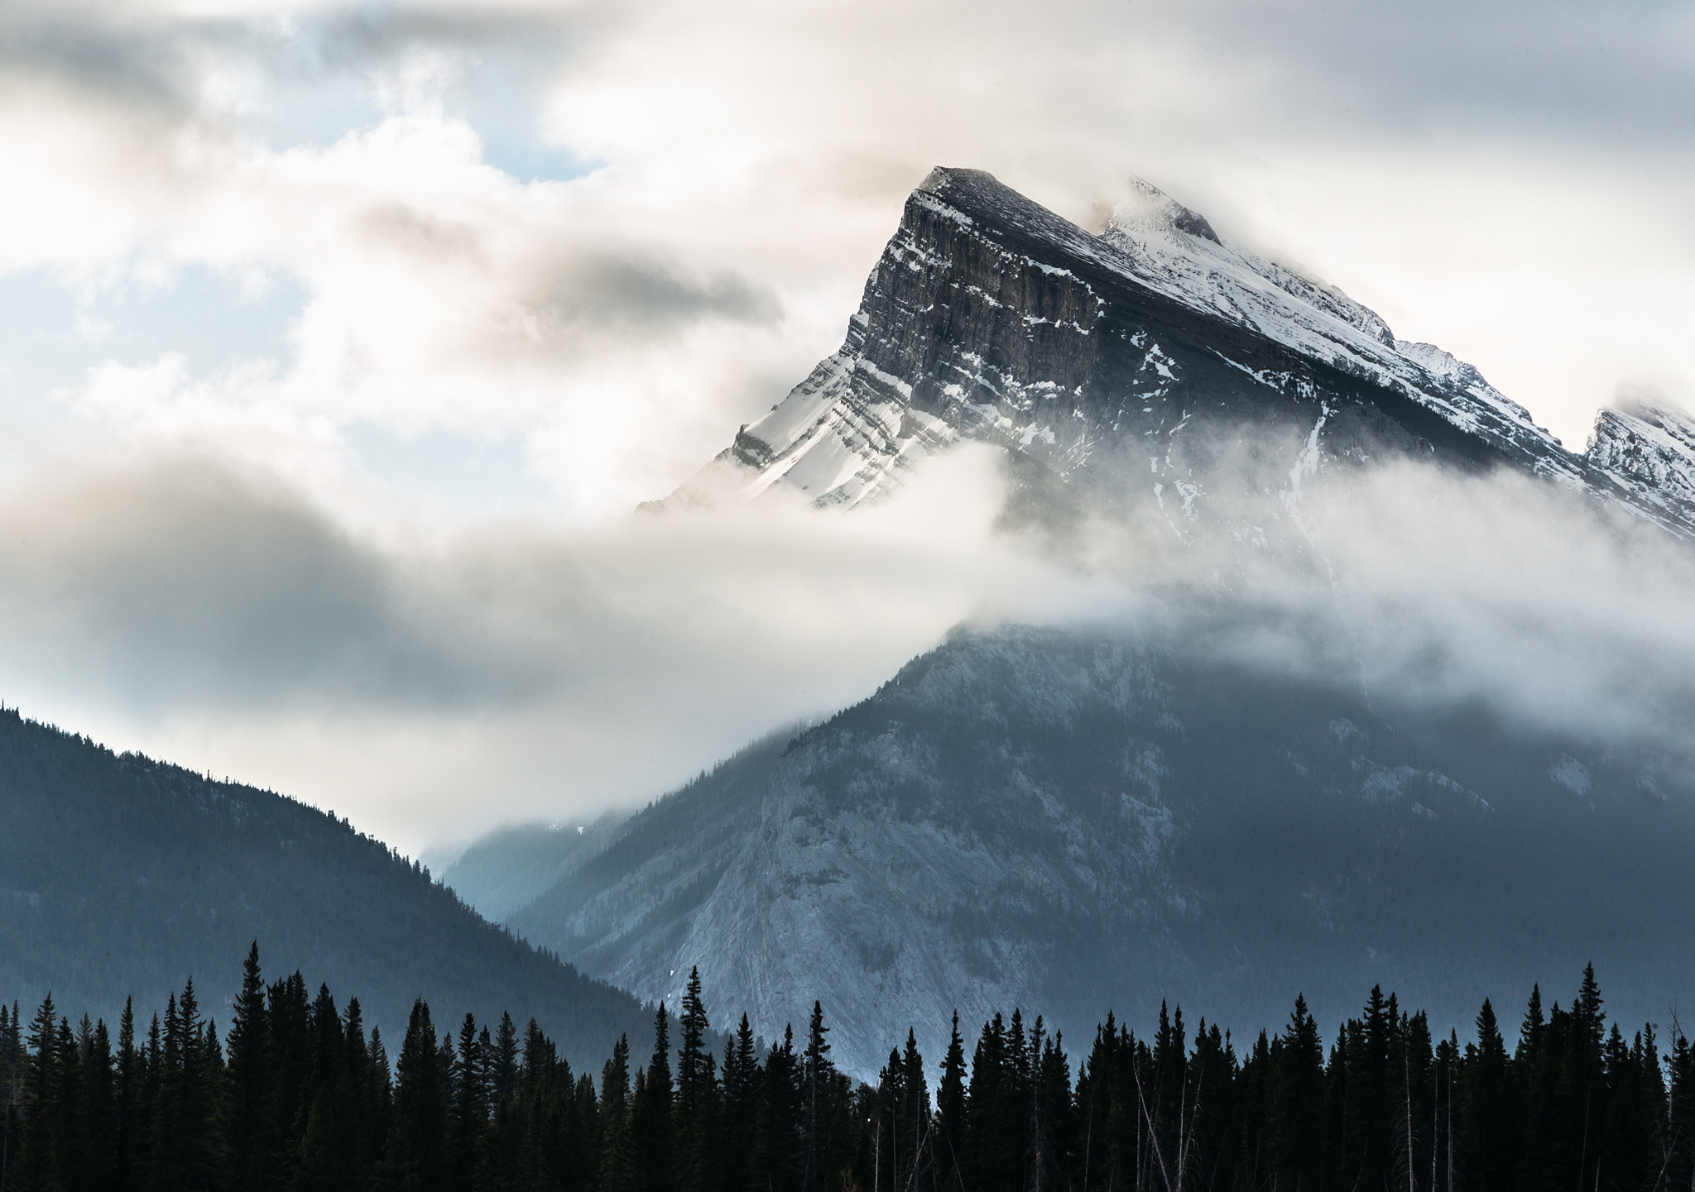
Misty mountains sing and beckon
雾茫茫的山岭歌唱 召唤

Slide 6
Lead me out into the light
带我到光明之中

Slide 7
I will ride. I will fly
我将驰骋 我将飞翔

Slide 8
Chase the wind and touch the sky
追逐清风 触碰天空

Slide 9
I will fly
我将飞翔

Slide 10
Chase the wind and touch the sky
追逐清风 触碰天空

Slide 11
Where dark woods hide secrets
当黑暗的树林藏匿着秘密

Slide 12
And mountains are fierce and bold
而山岭凶猛而陡峭

Slide 13
Deep waters hold reflections
深邃的潭水印存着倒影

Slide 14
Of times lost long ago
那是消逝已久的时光

Slide 15
I will heed every story
我将听从每一个故事

Slide 16
Take hold of my own dream
抓住自己的梦想

Slide 17
Be as strong as the seas are stormy
像海面的汹涌一样坚强

Slide 18
And proud as an eagle’s scream
像鹰啸一样骄傲

Slide 19
I will ride. I will fly
我将驰骋 我将飞翔

Slide 20
Chase the wind and touch the sky
追逐清风 触碰天空

Slide 21
I will fly
我将飞翔

Slide 22
Chase the wind and touch the sky
追逐清风 触碰天空

Slide 23
And touch the sky
触碰天空

Slide 24
Chase the wind
追逐清风
Chase the wind
追逐清风

Slide 25
Touch the sky
触碰天空

