Slide 1
Seven Years
Past Tense
作者：华南师范大学外国语言文化学院 杨心怡
广东省东莞市东莞中学初中部 李丹丹
指导老师：李丹丹、刘晓斌

Slide 2
Once I was seven years old my mama told me

Slide 3
Go make yourself some friends or you’ll be lonely

Slide 4
Once I was seven years old

Slide 5
It was a big big world,
but we thought we were bigger

Slide 6
Pushing each other to the limits, we were learning quicker.

Slide 7
By eleven smoking herb and drinking burning liquor

Slide 8
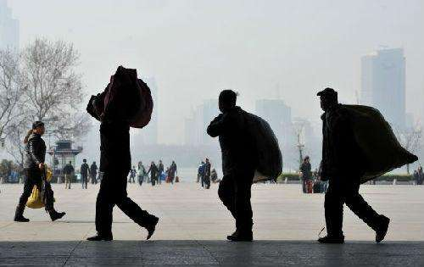
Never rich so we were out to make that steady figure

Slide 9
Once I was eleven years old my daddy told me

Slide 10
Go get yourself a wife or you’ll be lonely

Slide 11
Once I was eleven years old

Slide 12
I always had that dream like my daddy before me

Slide 13
So I started writing songs, I started writing stories

Slide 14
Something about the glory just always seemed to bore me

Slide 15
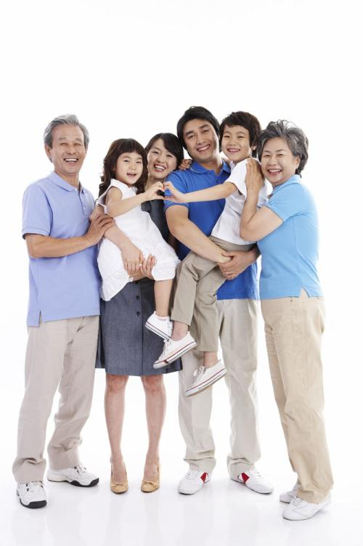
Cause only those I really love will ever really know me

Slide 16
Once I was 20 years old my story got told

Slide 17
Before the morning sun when life was lonely

Slide 18
Once I was 20 years old

Slide 19
I only see my goals I don't believe in failure

Slide 20
Cause I know the smallest voices they can make it major

Slide 21
I got my boys with me at least those in favor

Slide 22
And if we don't meet before I leave I hope I'll see you later

Slide 23
Once I was 20 years old my story got told

Slide 24
I was writing about everything I saw before me

Slide 25
Once I was 20 years old

Slide 26
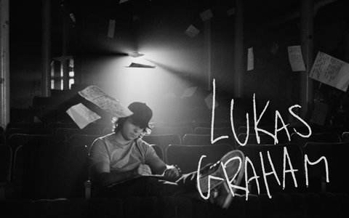
Soon we'll be 30 years old our songs have been sold

Slide 27
We've traveled around the world and we're still rolling

Slide 28
Soon we'll be 30 years old

Slide 29
I'm still learning about life

Slide 30
My woman brought children for me

Slide 31
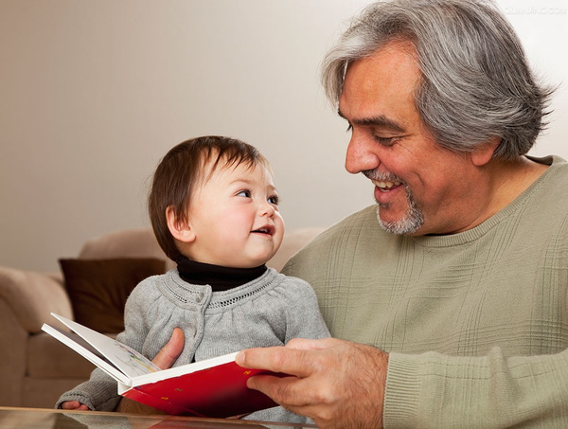
So I can sing them all my songs
And I can tell them stories

Slide 32
Most of my boys are with me
Some are still out seeking glory

Slide 33
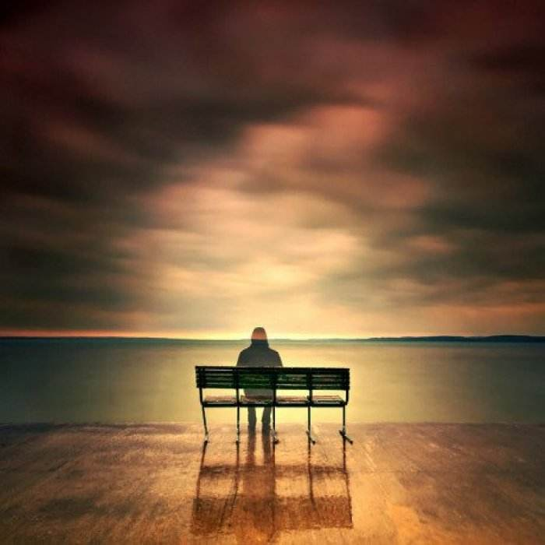
And some I had to leave behind
My brother I'm still sorry

Slide 34
Soon I'll be 60 years old my daddy got 61

Slide 35
Remember life and then your life becomes a better one

Slide 36
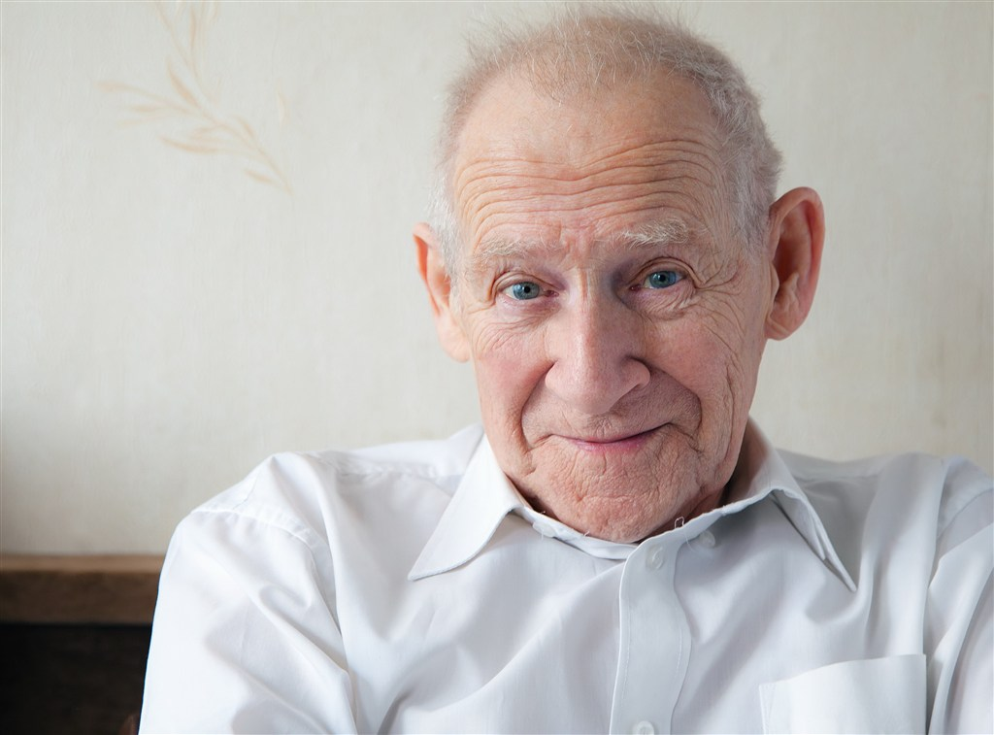
I made the man so happy when I wrote a letter once

Slide 37
I hope my children come and visit once or twice a month

Slide 38
Soon I'll be 60 years old will I think the world is cold

Slide 39
Or will I have a lot of children who can warm me

Slide 40
Soon I'll be 60 years old

Slide 41
Soon I'll be 60 years old will I think the world is cold

Slide 42
Or will I have a lot of children who can warm me

Slide 43
Soon I'll be 60 years old

Slide 44
Once I was seven years old my mama told me

Slide 45
Go make yourself some friends or you'll be lonely

Slide 46
Once I was seven years old
Once I was seven years old

