Slide 1


设计制作：华南师范大学外国语言文化学院 周玉祺
广东省东莞市东莞中学初中部 李丹丹
指导教师：李丹丹、刘晓斌

Slide 2

Woah-oh-oh-oh
It's always a good time

Slide 3

Woah-oh-oh-oh
It's always a good time

Slide 4

Woke up on the right side of the bed

Slide 5

What's up with this Prince song inside my head?

Slide 6

Hands up if you're down to get down tonight
Cuz it's always a good time.

Slide 7
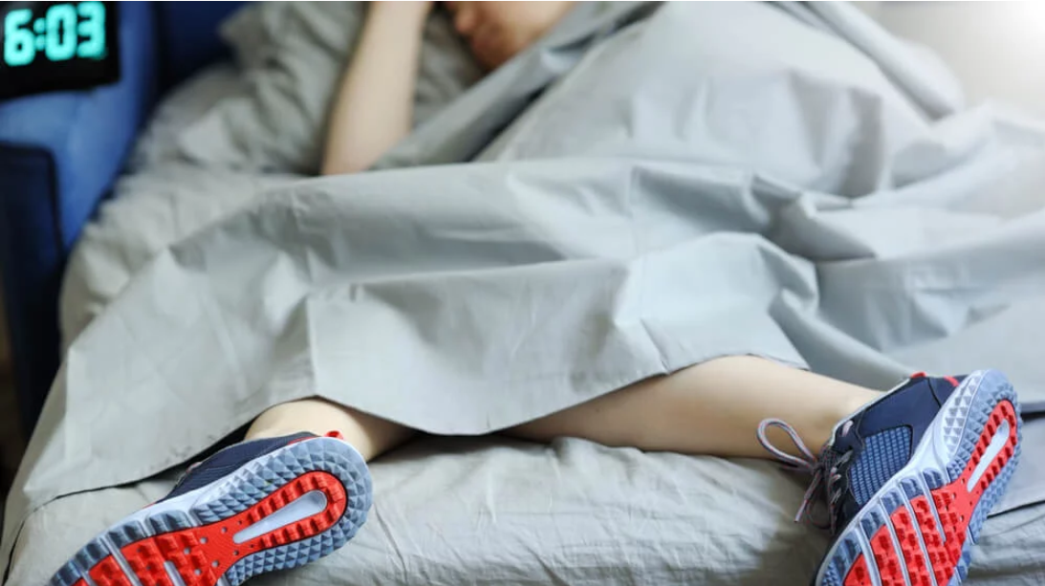
Slept in all my clothes like I didn't care

Slide 8
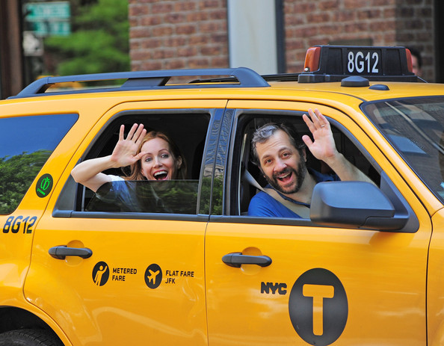
Hopped into a cab, take me anywhere

Slide 9

I'm in if you're down to get down tonight
Cuz it's always a good time

Slide 10

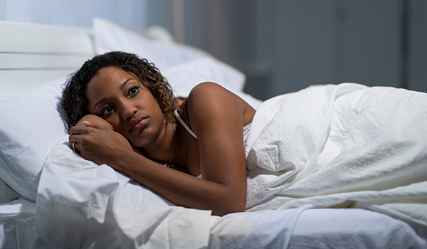
Good morning and good night
I wake up at twilight

Slide 11
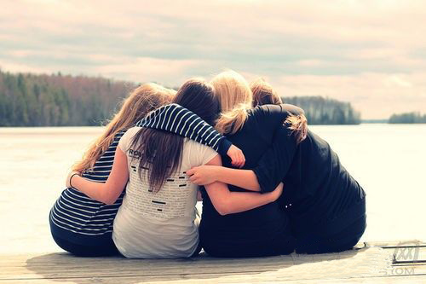
It's gonna be alright

Slide 12

We don't even have to try
It's always a good time

Slide 13

Woah-oh-oh-oh
Woah-oh-oh-oh
It's always a good time

Slide 14

We don't even have to try, it's always a good time
Woah-oh-oh-oh

Slide 15
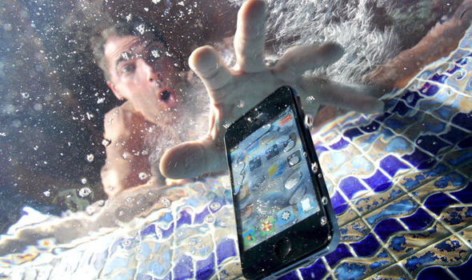
Feet down dropped my phone in the pool again

Slide 16
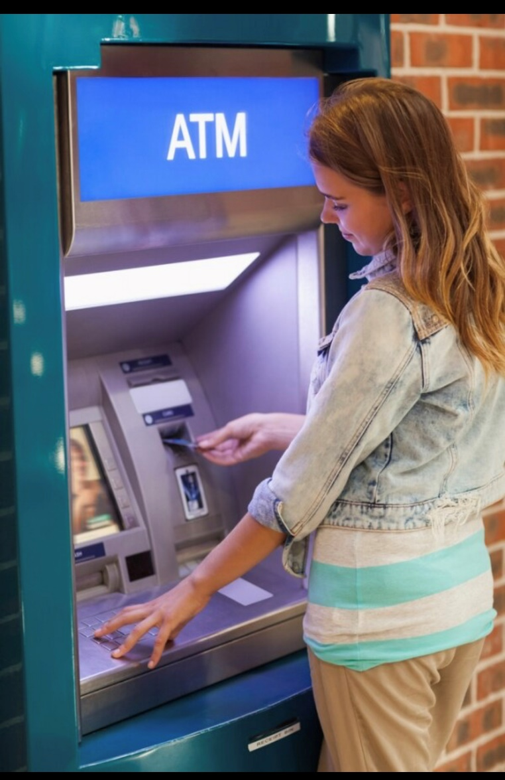
Checked out of my room hit the ATM

Slide 17

Let's hang out if you're down to get down tonight
Cuz it's always a good time

Slide 18

Good morning and good night
I wake up at twilight
It's gonna be alright

Slide 19

We don't even have to try
It's always a good time.

Slide 20

Woah-oh-oh-oh
Woah-oh-oh-oh
It's always a good time

Slide 21

Woah-oh-oh-oh
We don't even have to try, it's always a good time.

Slide 22

Woah-oh-oh-oh
Woah-oh-oh-oh
It's always a good time

Slide 23

Woah-oh-oh-oh
We don't even have to try, it's always a good time.

Slide 24

Doesn't matter when
It's always a good time then

Slide 25

Doesn't matter where
It's always a good time there

Slide 26
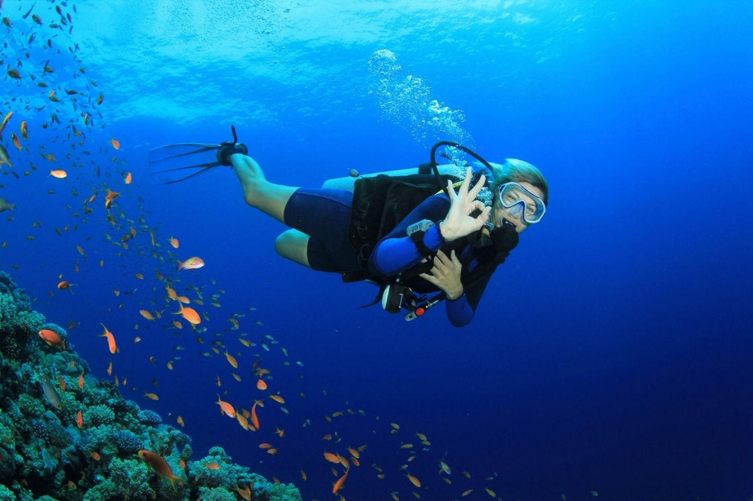
Doesn't matter when,
It's always a good time then
It's always a good time

Slide 27

Woah-oh-oh-oh
Woah-oh-oh-oh
It's always a good time

Slide 28

Woah-oh-oh-oh
We don't even have to try, it's always a good time

Slide 29
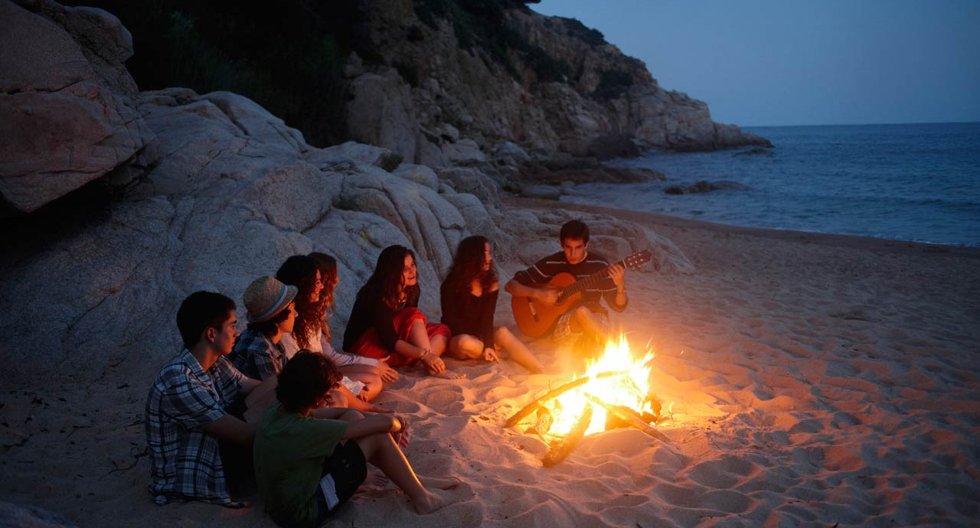
Woah-oh-oh-oh
Woah-oh-oh-oh
It's always a good time

Slide 30

Woah-oh-oh-oh
We don't even have to try, it's always a good time

